Slide 1
Damage Control Resuscitation
Niel Kang

Slide 3
Overview
Polytrauma resuscitation
Case Based Application of knowledge
NOTSS
Summary

Slide 4
Suicide Attempt

Slide 5
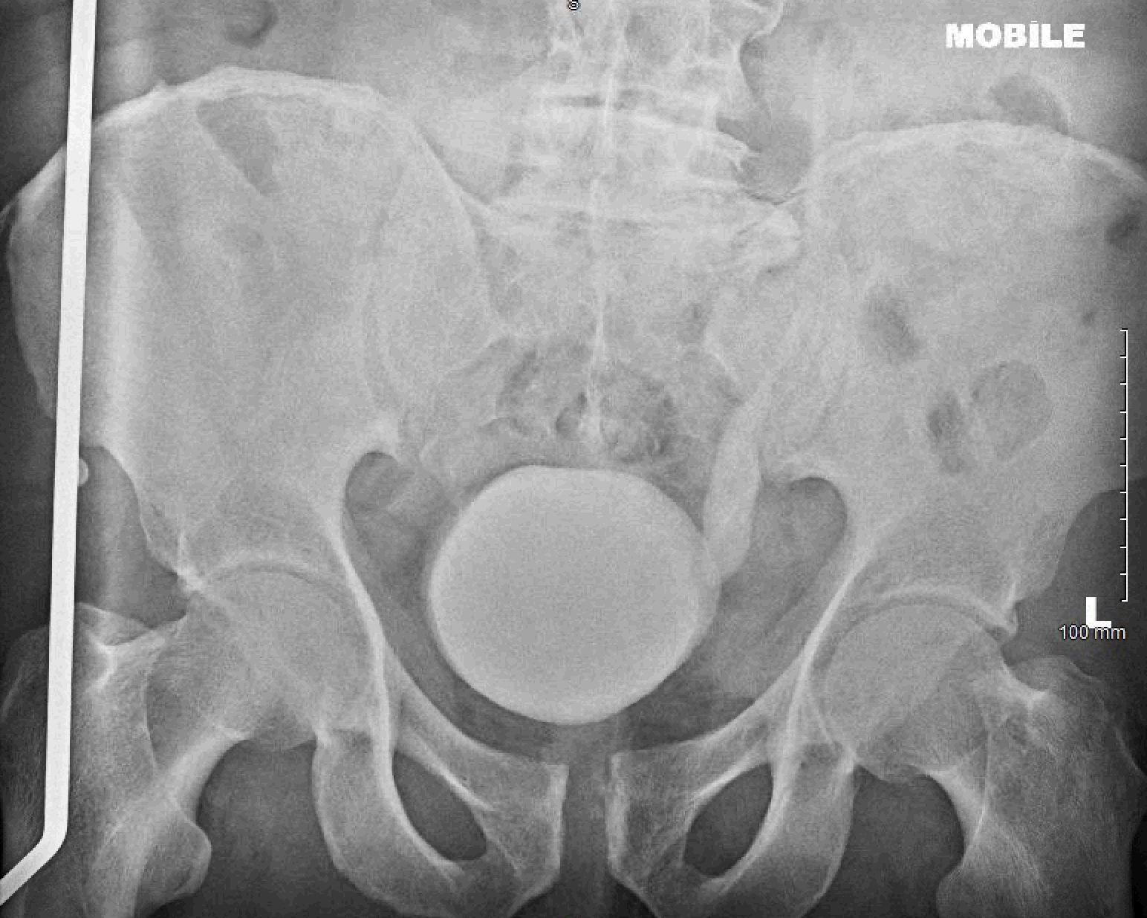

Slide 6
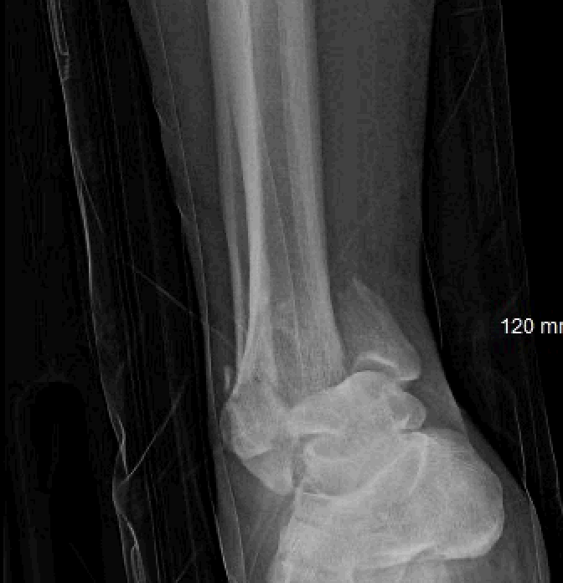

Slide 7
Pilon Fracture
Span
Scan
Plan

Slide 9
Example of a Blush on CT angio

Slide 11
Cognitive biases
Heuristics

Slide 12
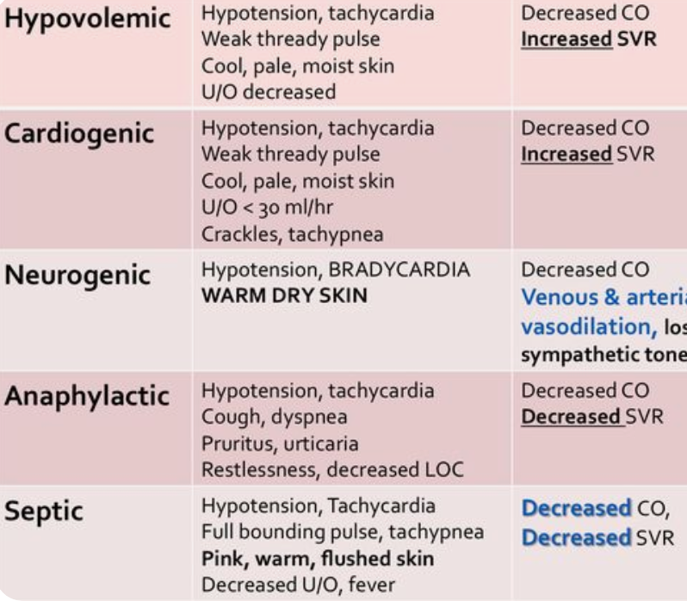
Types of Shock

Slide 14
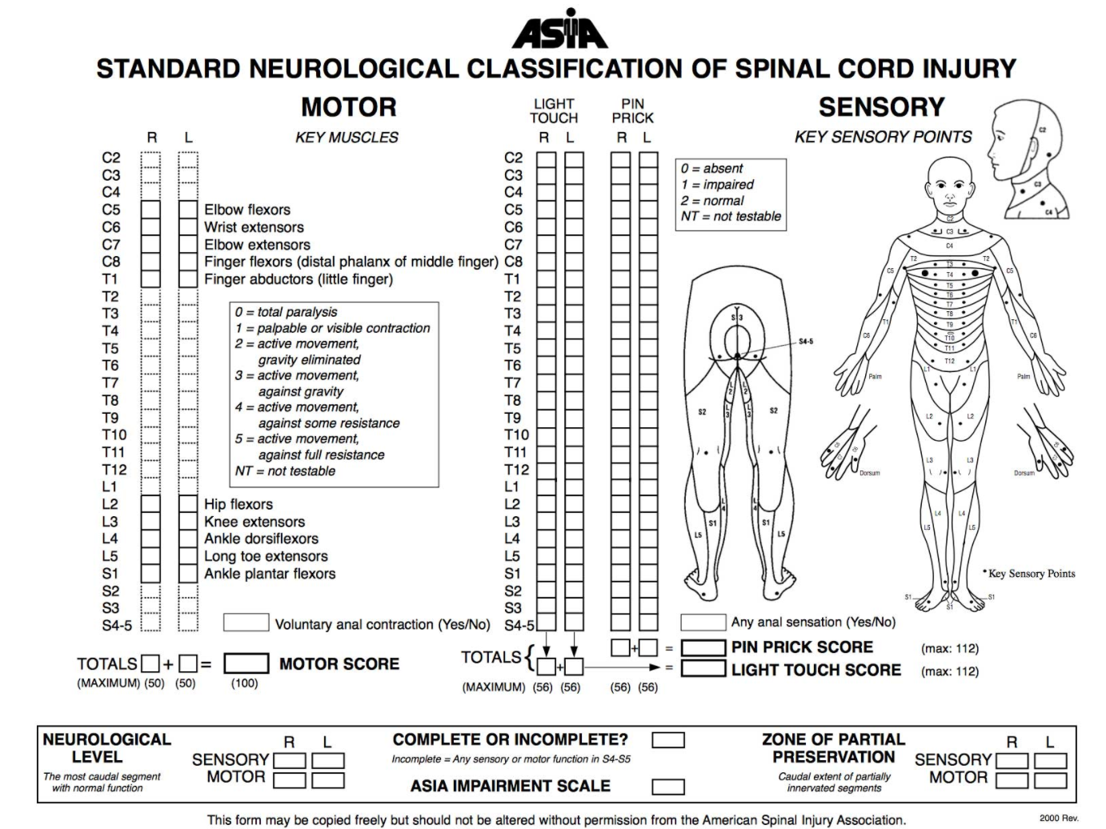

Slide 15
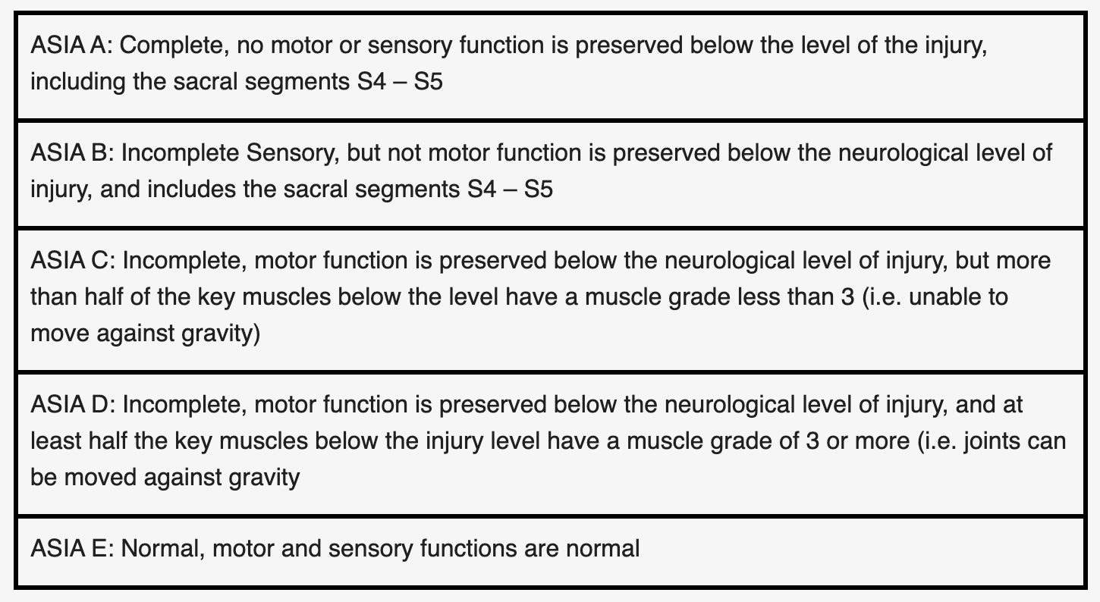

Slide 16
Bulbocavernosus Reflex

Slide 17
Radiology Findings
Fracture dislocation of right ankle
L1 burst fracture with spinal cord narrowing
Small haemothorax on right
Fracture-dislocation, coccyx closed
Presacral haematoma
Suspected pelvic fracture
Multiple rib fractures

Slide 19
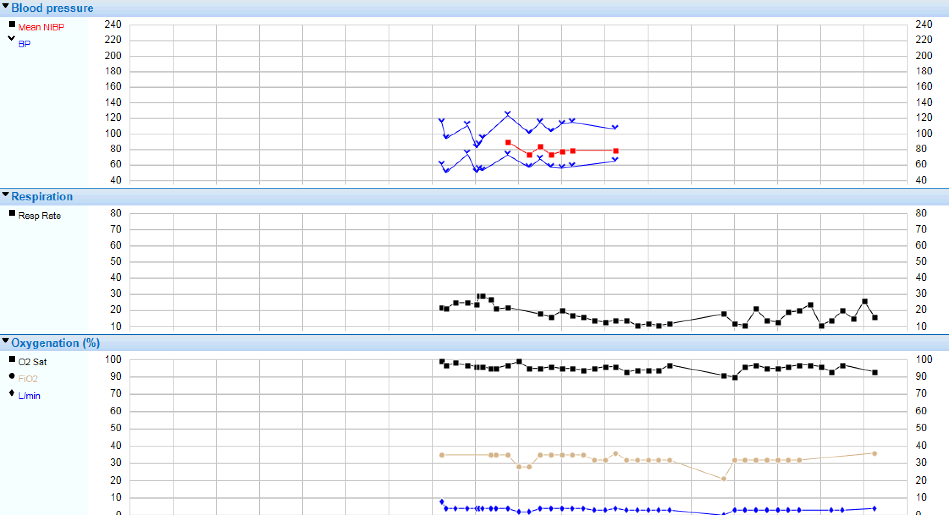

Slide 20
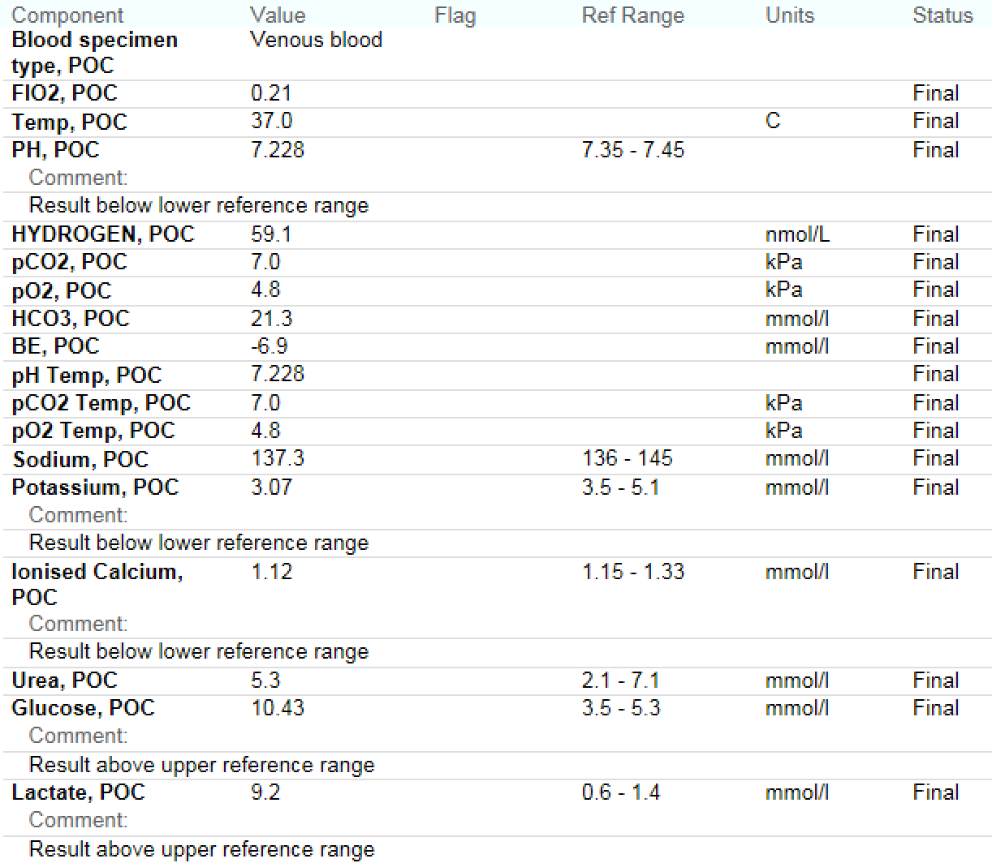

Slide 21
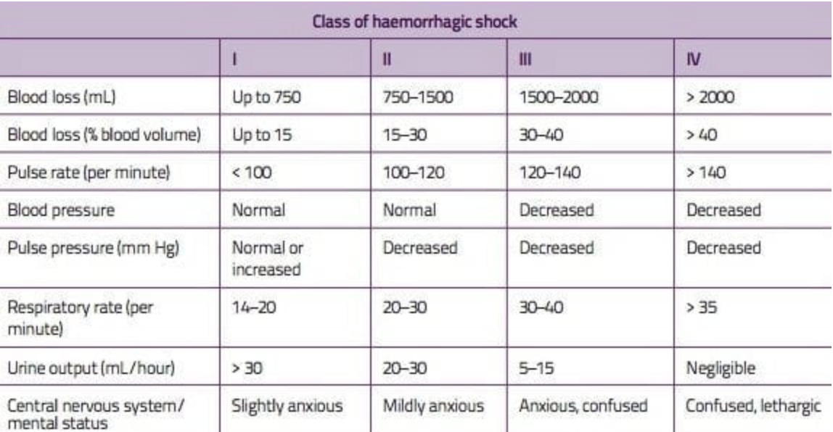

Slide 22
ATLS+
Differences in compensation for different types of injuries (e.g. blunt versus penetrating trauma)
Age (e.g. blunted physiological responses in the elderly)
Comorbidities
Medications (e.g. beta-blockade may conceal shock by preventing tachycardia)

Slide 23
Lethal Triad

Slide 24
Prevent and Treat Hypothermia
Aggressive resuscitation with blood products
Use warmed fluids (e.g. Level 1 Fluid Warmer)
Bair Hugger or warm blankets
Minimise exposure
Increase ambient temperature
Continuous temperature monitoring

Slide 25
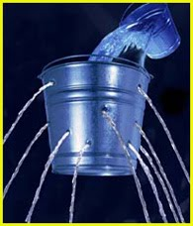
Damage Control Resuscitation
3 components:
permissive hypotension (aka minimal normotension)
early haemostatic resuscitation
damage control surgery
The underlying principles are to limit ongoing haemorrhage, identify and correct coagulopathy and restrict the use of crystalloids.

Slide 26
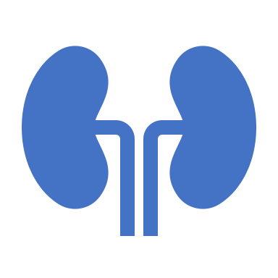
Permissive hypotension
Or minimal normotension, avoids excessive fluid administration
With associated problems of haemodilution, fluid overload and clot disruption.
Target SBP of 80 - 100 mmHg.
As perfusion is more important than blood pressure, an alternate strategy is to target a MAP >65 mmHg + good radial pulse + pulse oximetry waveform.
If BP too high, use titrated aliquots of fentanyl (e.g. 25 micrograms IV) to provide sympatholysis & analgesia.

Slide 27
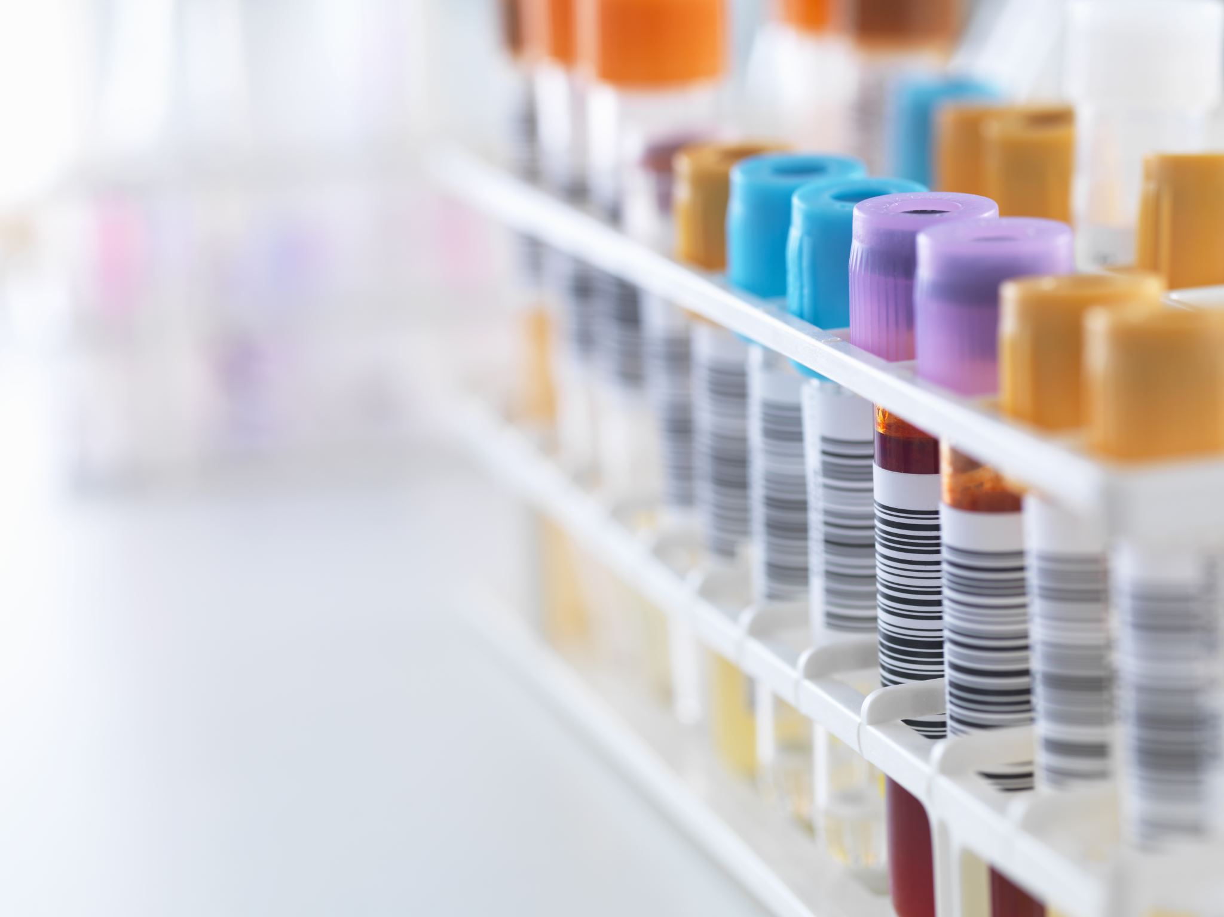
Downsides of Crystalloids
Dilutional coagulopathy
Impaired oxygen delivery due to dilutional anaemia
Hypothermia
Worsening metabolic acidosis (especially hyperchloremic non-anion gap metabolic acidosis from normal saline administration)
Clot dislodgement & haemorrhage from blood pressure elevation

Slide 28
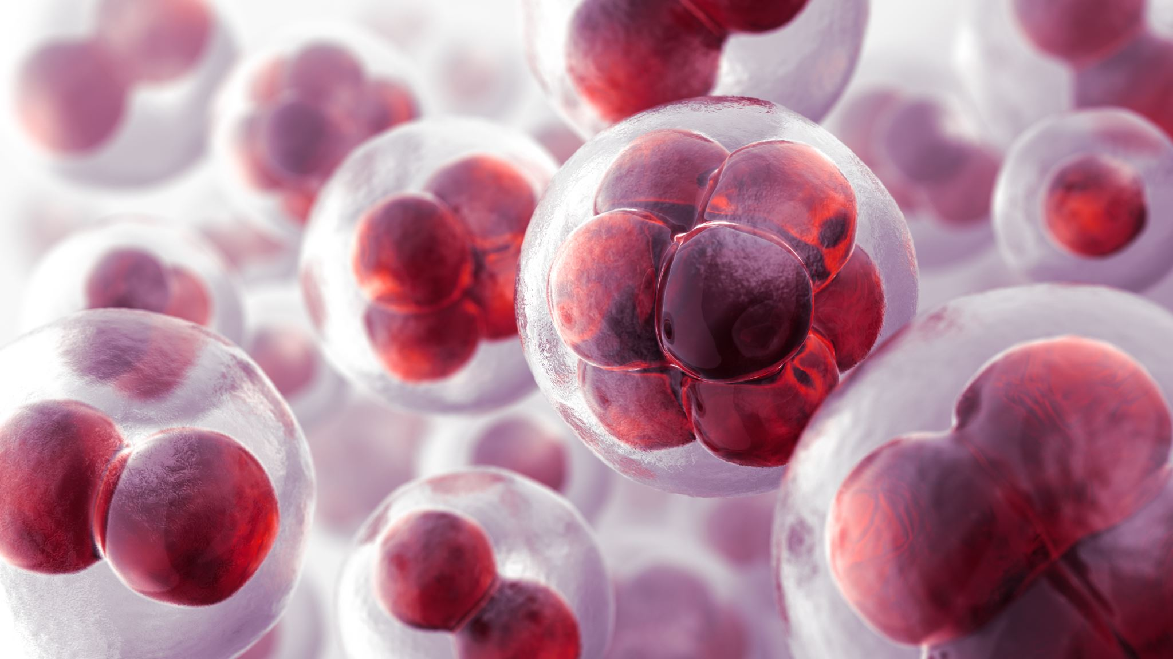
Major Blood loss
3 main goals:
Stop bleeding
Rapid and effective restoration of blood volume
Maintain functional blood composition to preserve blood function: — hemostasis, oxygen carrying capacity, oncotic pressure and biochemistry
Critical bleeding is major haemorrhage that is life threatening and may require massive transfusion.

Slide 29
Source
SCALPeR when finding the bleeding:
‘Street’: scalp and external sources (especially small children)
Chest
Abdomen
Long bones (especially femurs)
Pelvis
Retroperitoneum

Slide 30
Haemorrhage Control
Find the cause
Initial measures, such as: — Direct pressure and elevation, — Adrenaline soaked gauze, hemostatic dressings — Reduce and splint long bone and pelvic fractures — Tourniquets
Invasive measures, such as: — sutures — tamponade, by packing or foley catheter with balloon inflated — tie off vessels — cautery — interventional radiology — damage control surgery
Correct coagulopathy

Slide 31
Assessment of Blood Consumption (ABC) Score
ED SBP <90mmHg(0=no; 1=yes)
ED HR >120bpm
Penetrating mechanism
Positive fluid on FAST exam
Score of 3 predicts 45% need for massive transfusion; score of 4 predicts 100% need for massive transfusion

Slide 32
Trauma-Associated Severe Hemorrhage
SBP
Gender
Hb
Fluid on ultrasound
HR
Base excess
Extremity or pelvic fracture

Slide 33
McLaughlin score
HR > 105/min
SBP < 110 mmHg
pH < 7.25
Hct < 32%

Slide 34
Definition
10 unit transfusion in 24 h
transfusion of an entire blood volume in 24 h
replacement of 50% blood volume over 3 h
Up to 5% of civilian trauma patients require massive transfusion
of these 25% have trauma-associated coagulopathy in ED

Slide 35
Guide
Administer a 1:1:1 ratio of red cells, FFP and platelets
ratio of blood products emulates the composition of whole blood
The target is to achieve 1:1:1 ratio over 6 hours

Slide 36
Theory
Note that 1 adult bag of platelets is equivalent to 4 units PRBCs for the purposes of maintaining the 1:1 ratio.
Note that the 1:1:1 concept makes sense pathophysiologically and by retrospective and observational studies.
No RCT.
concerns that perceived benefit of haemostatic resuscitation and the ‘1:1:1’ ratio is due to survivor bias.
Cliff Reid states this eloquently:

Slide 40
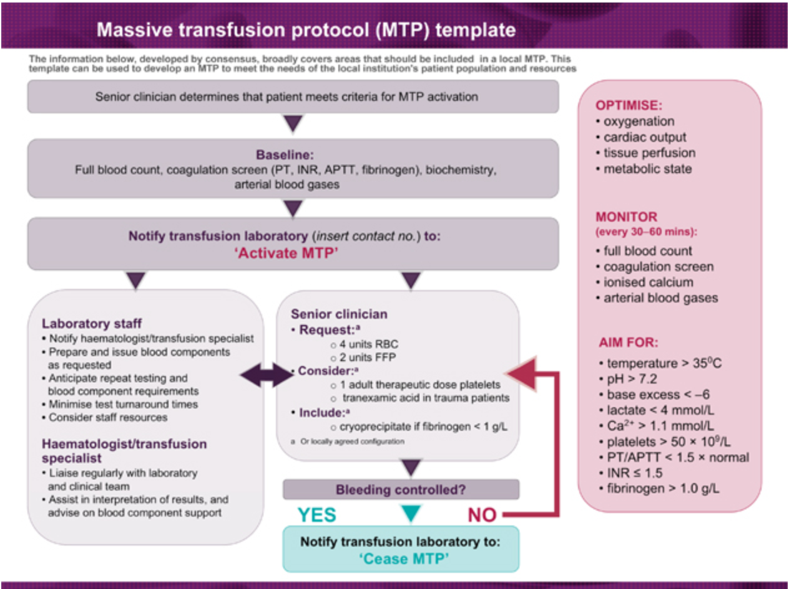

Slide 41
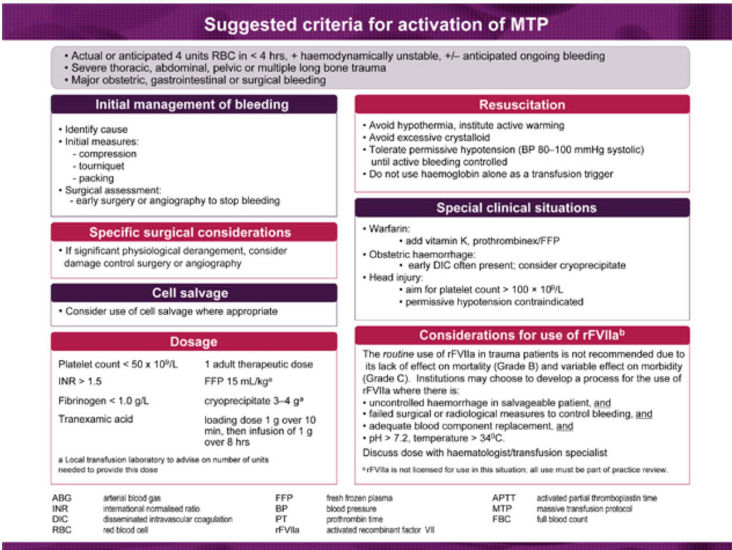

Slide 43
Tranexamic acid
Antifibrinolytic
competitively inhibits activation of plasminogen to plasmin .
plasmin is responsible for degradation of fibrin.
Cheap
proven mortality benefit (NNT = 67)
few adverse effects
Tranexamic acid
1g IV loading dose followed by
1g over 8 hours.
Tranexamic acid should be given early,
within 3 hours of the time of injury

Slide 44
https://www.thelancet.com/pdfs/journals/lancet/PIIS0140-6736(10)60835-5.pdf

Slide 46
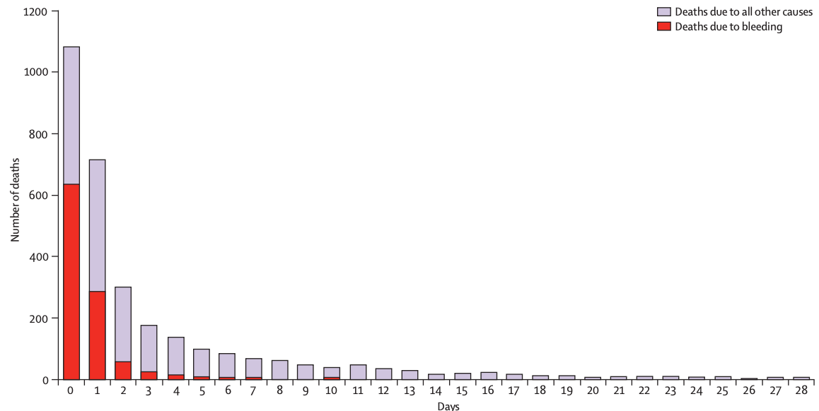

Slide 47
Summary of DCR

