Slide 1
Blowing up a balloon with co2
By Mia Van Rensburg

Slide 2
Test 1: blowing up a balloon with ……
For this test I tried to blow up a balloon with :
Oil and bicarbonate of soda
Water and bicarbonate of soda
Vinegar and bicarbonate of soda
The vinegar and bicarbonate of soda will blow up the balloon the biggest.
Hypothesis:

Slide 3
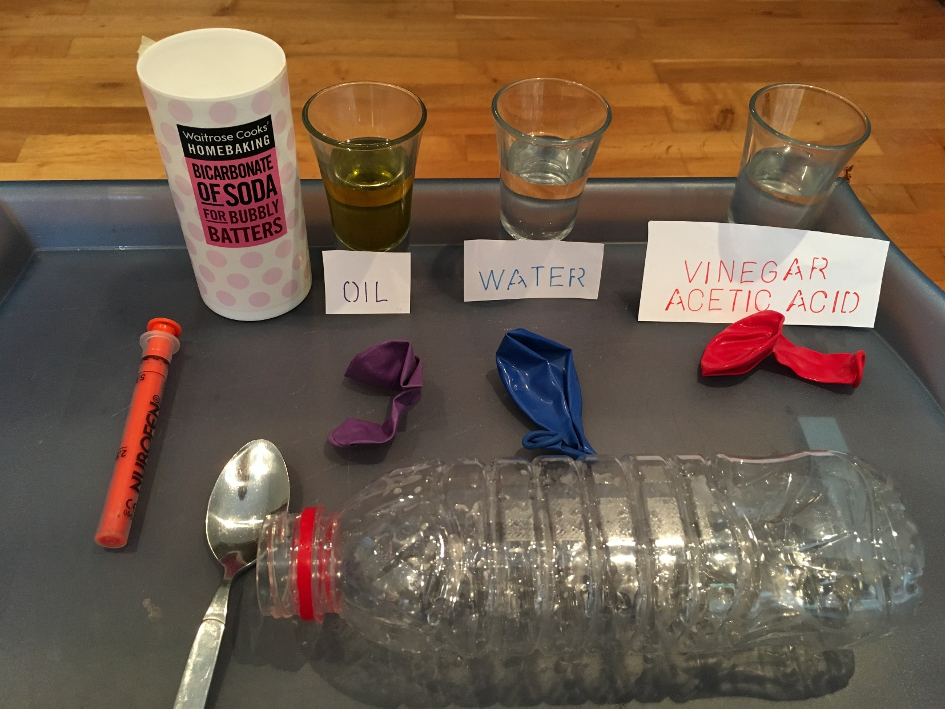
Ingredients
20mls

Slide 4
Method
I put 20ml of each liquid in to a plastic bottle.
I filled each balloon with half a teaspoon of
bicarbonate of soda and attached each balloon to a plastic bottle.
Then I lifted up the balloon to let the Bicarbonate of soda mix and react with the liquid.

Slide 5
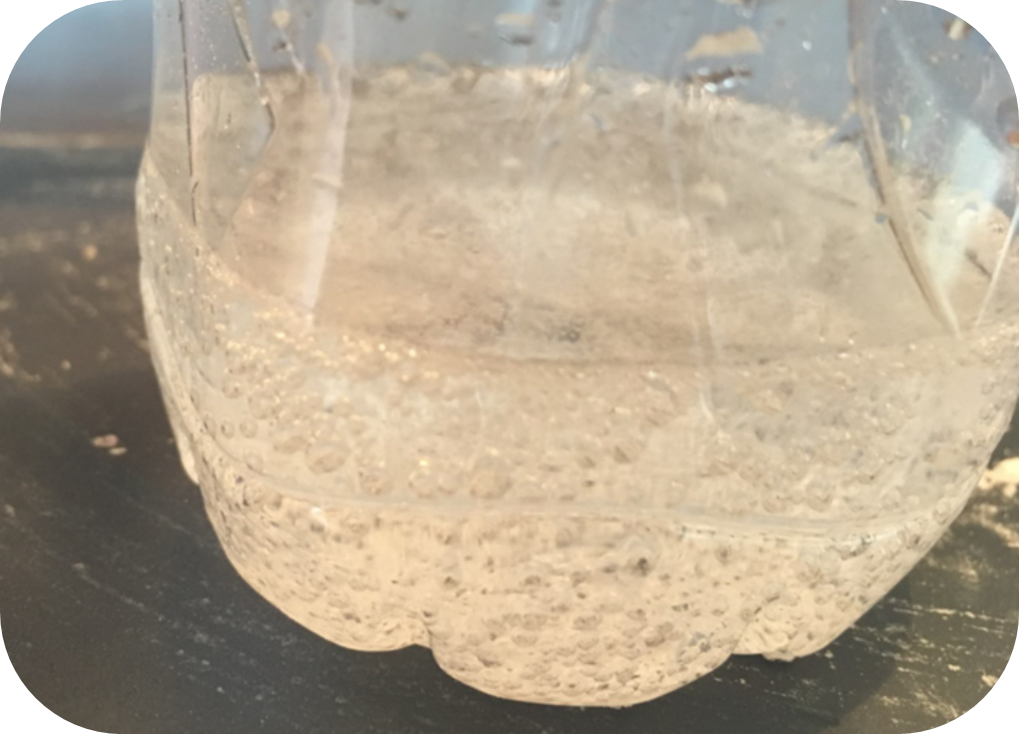
Test 1: Results
The bicarbonate of soda did not react with the water
or the oil but it did with the vinegar.
When the bicarbonate of soda mixed with the vinegar
It created a gas which inflated the balloon.

Slide 6
Conclusion: The chemical reaction
Bicarbonate of Soda + Vinegar (Acetic acid) = Sodium acetate + Water + Carbon Dioxide
NaHCO3 + HC2H3O2 → NaC2H3O2 + H2O + CO2
Carbon dioxide is a gas that fills up the balloon

Slide 7
Fire extinguisher
With CO₂

Slide 8
Ingredients
To show the gas is Carbon dioxide, I made a Carbon Dioxide
Fire extinguisher.
I used a lit candle, a plastic bottle
Vinegar, bicarbonate of soda, balloons and plastic tubing.

Slide 9
Method
I put the bicarbonate of soda in the second
channel and twisted the balloon between the vinegar
and bicarbonate of soda to stop it reacting till I lit the
candle.
Then I untwisted the balloon to let the bicarbonate of
soda through to the vinegar to create the co2.
I then placed the tubing near the flame to let the co2
Extinguish the flame.

Slide 10
Combustion triangle

Slide 12
Not just blowing it out

Slide 13
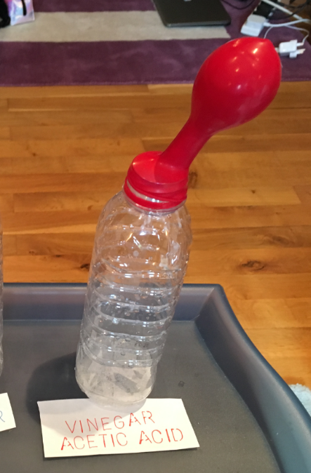
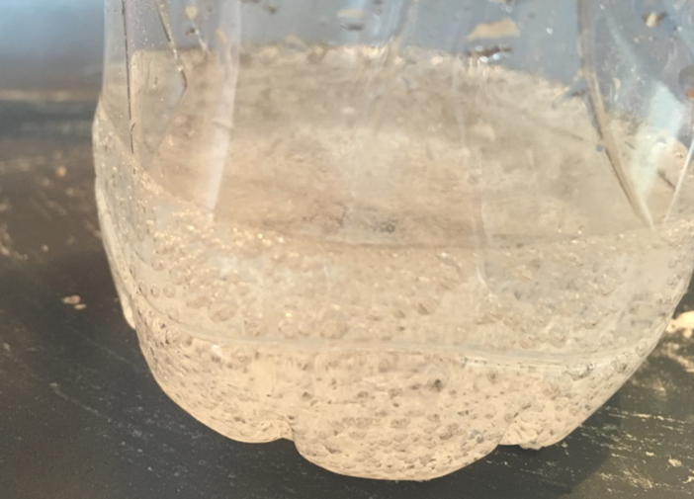
Conclusion
Bicarbonate of soda and Vinegar creates a gas - Carbon dioxide.

Slide 14
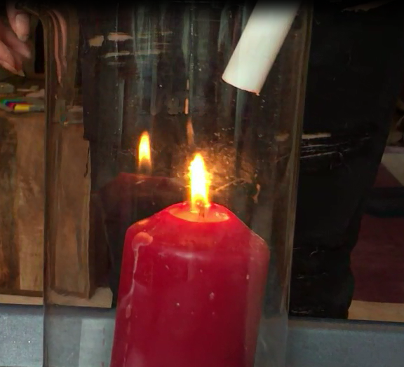
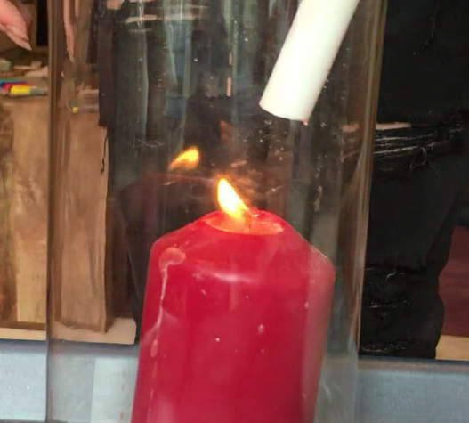
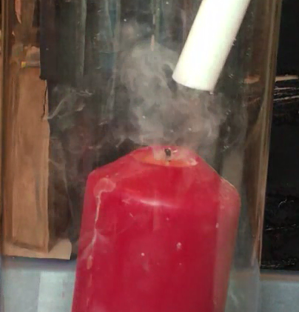
Conclusion
Bicarbonate of soda and Vinegar creates a gas Carbon dioxide.
This gas can blow out a flame.

Slide 15
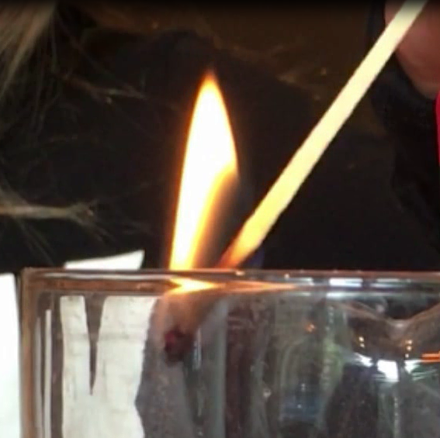
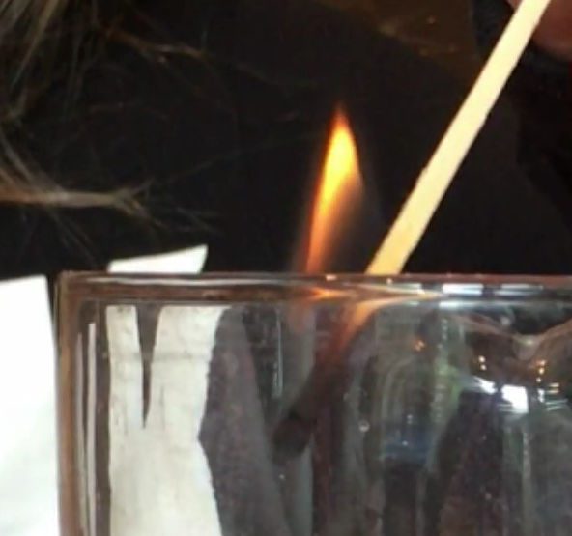
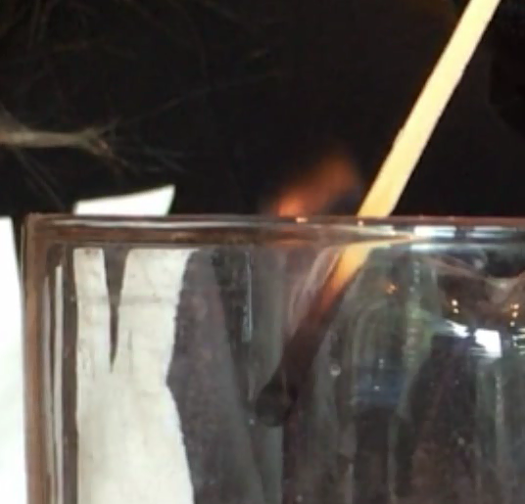
Conclusion
Bicarbonate of soda and Vinegar creates a gas Carbon dioxide.
This gas can blow out a flame.
The effect of the gas is more than just blowing out the flame.
Carbon dioxide removes Oxygen from the combustion triangle, putting out the flame.

