Slide 1
Scapular Fractures
Mostafa Mahmoud, MD
Cairo University
AOTrauma Course
Cairo, May 2016

Slide 2
Introduction
Traditionally treated nonoperatively with acceptable results
Operative treatment more recently prescribed, surgery safe and effective
Deficient literature

Slide 3
Objectives
Anatomic considerations
Incidence
Types
Surgical
Indications
Approach
Fixation methods

Slide 4
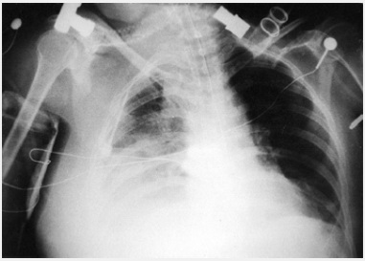
# Scapula
Forget about the Scapula
90% Associated injuries → Mortality

Slide 5
Associated fractures
Associated fractures | % of patients
Ribs | 44%
Clavicle | 26%
Skull | 24%
Humerus | 12%
Tibia/fibula | 11%
Face | 9%
L spine | 7%
C spine | 6%
Hand/wrist | 6%
Foot/ankle | 5%
Pelvis | 5%
Femur | 4%
Radius/ulna | 4%
A-C separation | 3%
T spine | 3%
Patella | 2%
Notes:
Scapular fractures result from high-energy trauma and have a very high rate of associated injuries, as would be expected.
Associated fractures with the highest rates are those around the shoulder girdle, ribs, clavicle, skull, and humerus.

Slide 6
Associated injuries
Associated injuries | % of patients
Cerebral contusion/hematoma | 20%
Neurological injuries | 13%
Pneumo/hemothorax | 9%
Pulmonary contusion | 8%
Ruptured spleen | 8%
Renal contusion | 7%
Subdural injuries | 3%
Arterial injuries | 3%
Death | 2%
Other injuries | 5%

Slide 7
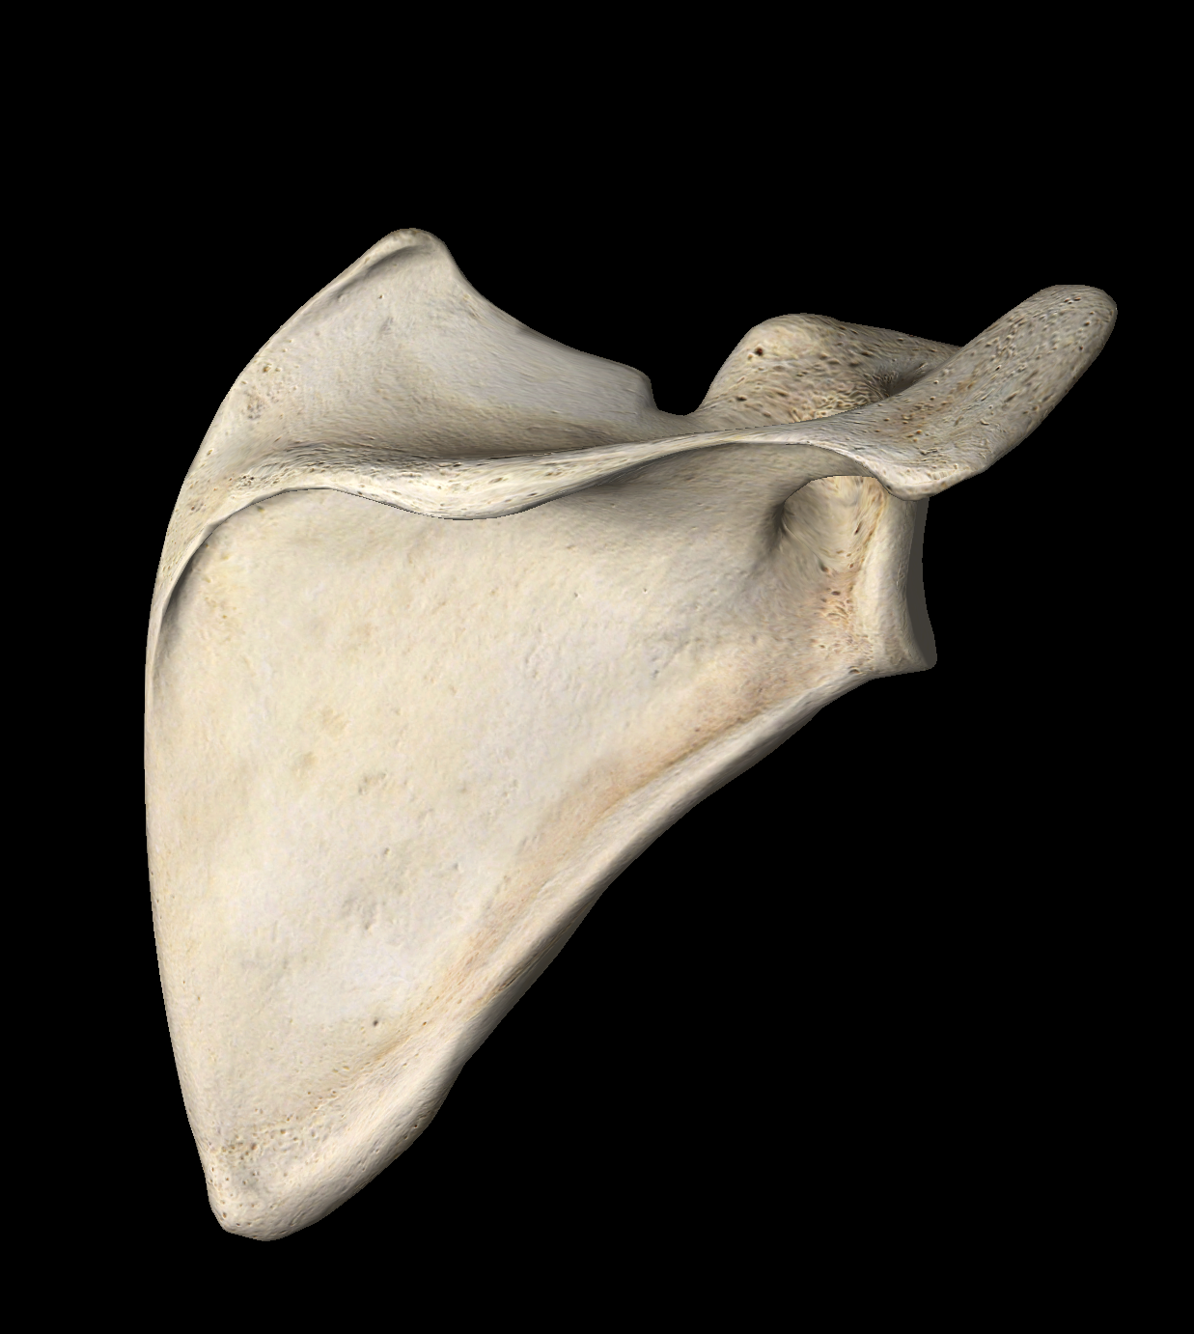
Incidence
15% Co & Ac
3–5% of shoulder girdle
< 1% of all broken bones
10%
IAG
50% Body
25% Neck

Slide 8
Age and Sex
25-40 M
60-70 F
High Energy
High Energy
Body

Slide 9
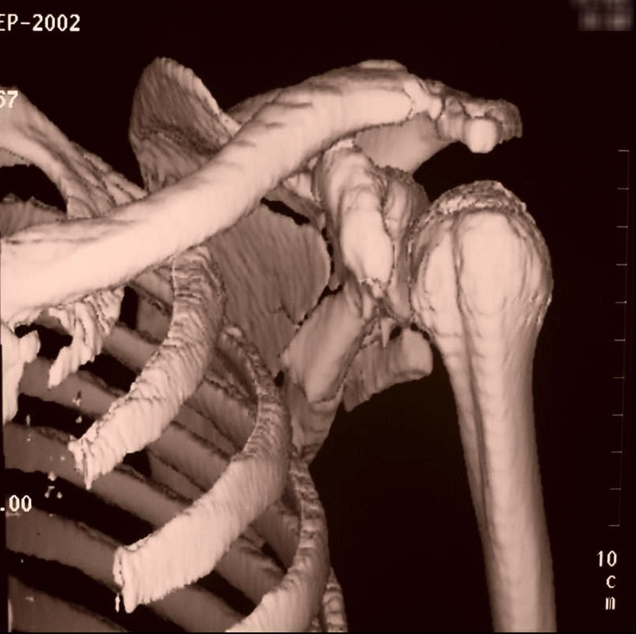
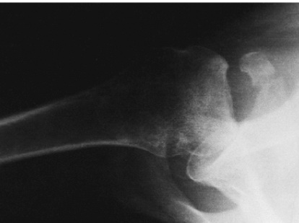
Mechanism
Direct blow
Humeral head
Avulsion
Stress

Slide 10
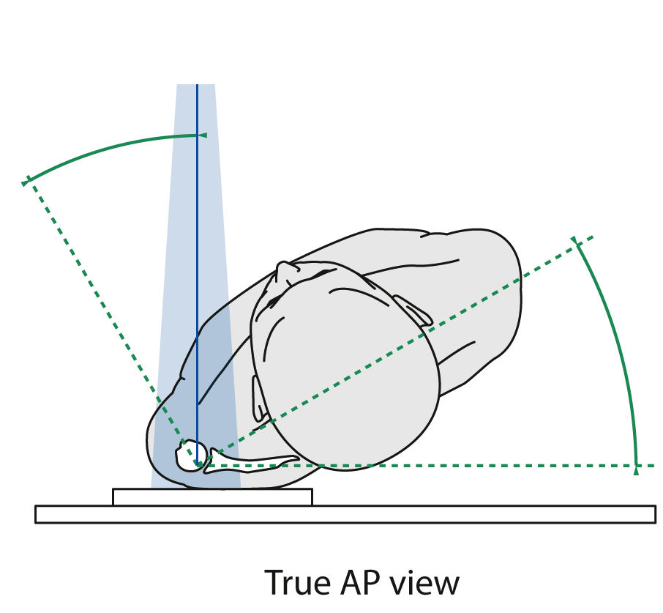
Trauma Series

Slide 11
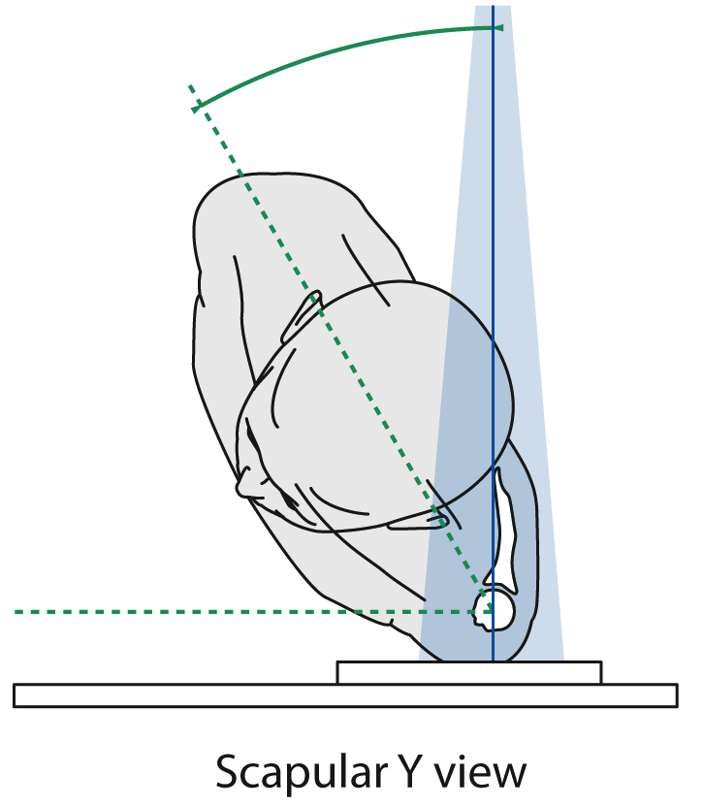

Slide 12
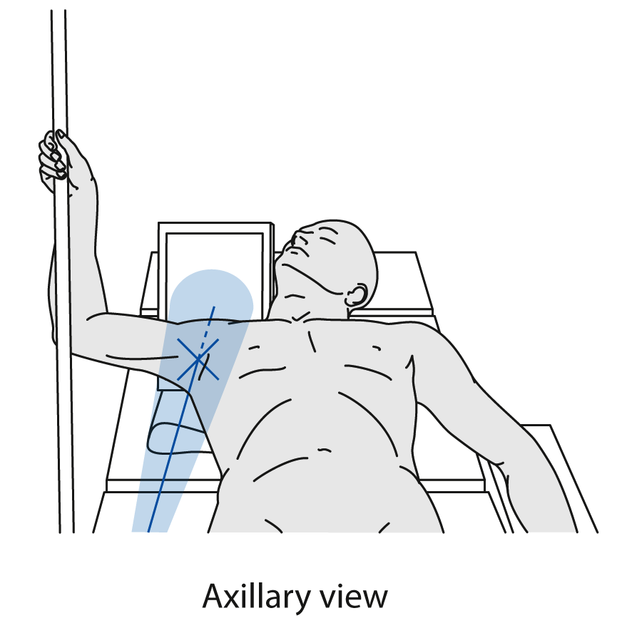

Slide 13
Sequence
What happens when not treated
SSSC
Types of fractures
Most common surgical indications
The most widely used approaches
Classic case example
Notes:
References:
Ada JR, Miller ME. Scapular fractures. Clin Orthop Relat Res. 1991;269: 174–180.
Egol KA, Connor PM, Karunakar MA, et al. The floating shoulder: clinical and functional results. J Bone Joint Surg Am. 2001;83:1188–1194.

Slide 14
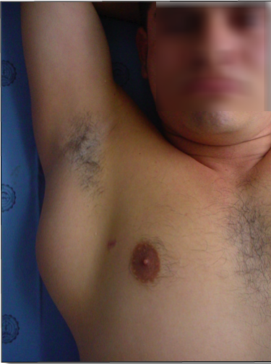
Problems can develop after displaced fracture of the scapula
Altered shoulder girdle function
Malalignment
Dysfunction of the rotator cuff ➔ Impingement- type pain
Scapulothoracic dyskinesis ➔ disturbed rhythm
Arthrosis
Notes:
References:
Ada JR, Miller ME. Scapular fractures. Clin Orthop Relat Res. 1991;269: 174–180.
Egol KA, Connor PM, Karunakar MA, et al. The floating shoulder: clinical and functional results. J Bone Joint Surg Am. 2001;83:1188–1194.

Slide 15
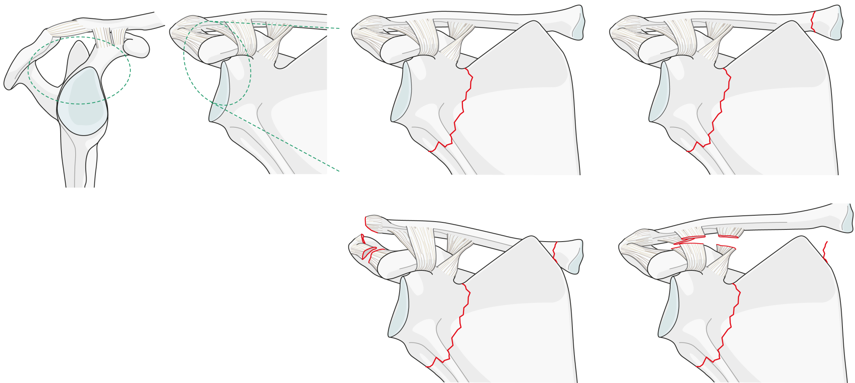
Superior Suspensory Shoulder Complex
Double disruption ➔ altered mechanics
Notes:
The floating shoulder injury or double disruption of the superior suspensory shoulder complex is characterized as a clavicular fracture or an acromioclavicular separation injury in combination with an ipsilateral scapular neck fracture.

Slide 16
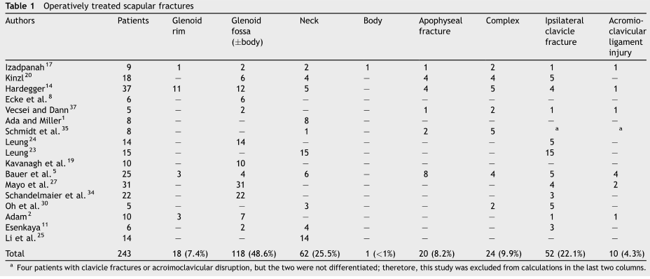
Which types of scapular fractures are treated surgically?
IA Glenoid fractures
Neck fractures
Ipsilateral clavicular fractures
Notes:
In published series of factures treated with surgery, there is a preponderance of glenoid fossa and glenoid neck fractures. Many of them had ipsilateral clavicular fractures.

Slide 17
Body fractures
90% may be treated CONSERVATIVE
Sling for comfort, up to 10–14 days
Pendulum and passive/AAROM for 4–6 weeks
AROM at 6–12 weeks
Strengthening for more than 8–12 weeks
Improvement in strength and ROM for up to 1 year

Slide 18
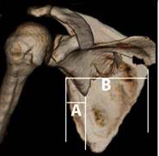
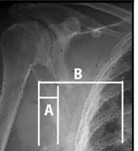
Body fractures
Medialization
+ 10–20 mm
Notes:
Some have suggested operation based on a medialization of the glenoid fossa. If looked at on a chest x-ray, it may be that the medial fragment is lateralized, and not that the joint is medialized.
References:
Romero J, Schai P, Imhoff AB. Scapular neck fracture – the influence of permanent malalignment of the glenoid neck on clinical outcome. Arch Orthop Trauma Surg. 2001 June, 12(16); 313–316.

Slide 19
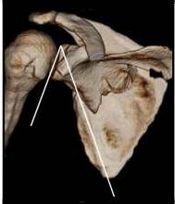
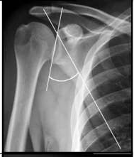
Body fractures
Glenopolar angle
>20° difference
.
Notes:
Change in the glenopolar angle by 20 degrees or more (compared to opposite shoulder) has also been suggested as operative indication.
References:
Kim KC, Rhee KJ, Shin HD, et al. Can the glenopolar angle be used to predict outcome and treatment of the floating shoulder? J Trauma. 2008 Jan;64(1):174–178.

Slide 20
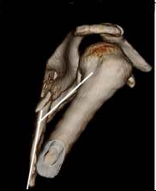
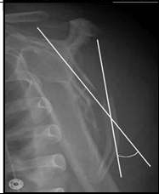
Body fractures
Angulation
> 30°
Notes:
Angulation measured on the scapular Y-view of more than 30 degrees has been suggested as operative indication.
References:
Romero J, Schai P, Imhoff AB. Scapular neck fracture the influence of permanent malalignment of the glenoid neck on clinical outcome. Arch Orthop Trauma Surg 2001;121:313–316.

Slide 21
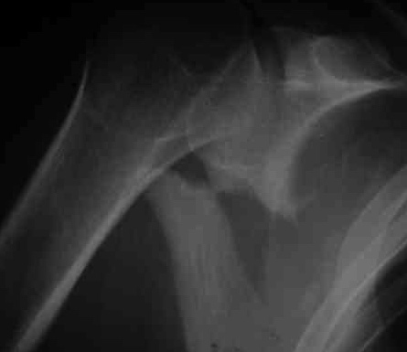
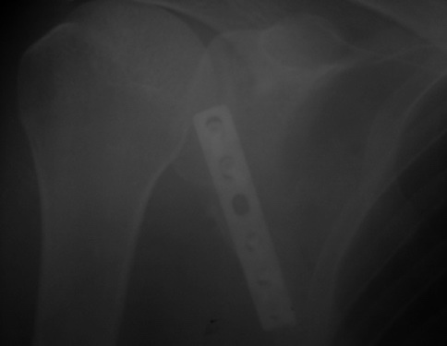
Body fractures
Notes:
Two months after injury, this displaced fracture was operated. Callus was taken down to realign the bone.

Slide 22
Apophyseal fractures

Slide 23
Apophyseal fractures

Slide 24
Acromial non-union

Slide 25
Acromial non-union

Slide 26
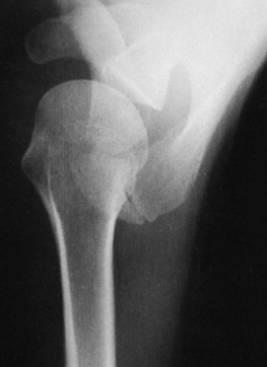
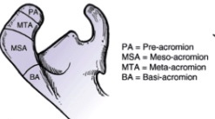
DD [Os Acromial]

Slide 27
Co & Ac
Body
Neck

Slide 28
Neck fractures
Share common surgical indications as body fractures

Slide 29
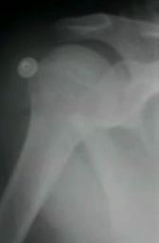
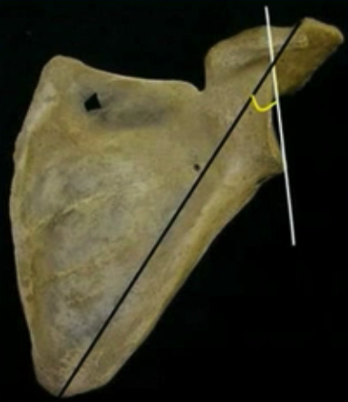
Neck fractures
>10mm
Gleno-Polar angle <20

Slide 30
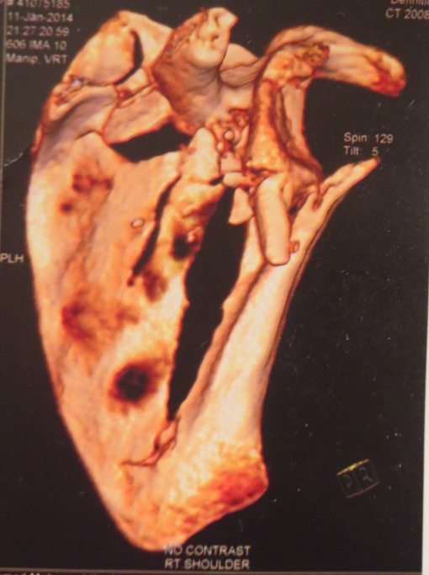
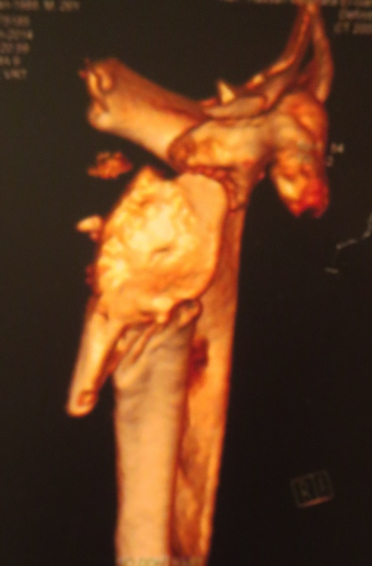
Neck fractures
Angulation > 30
Floating Shoulder
Discussed in the case example

Slide 31
Co & Ac
Glenoid
Body
Neck

Slide 32
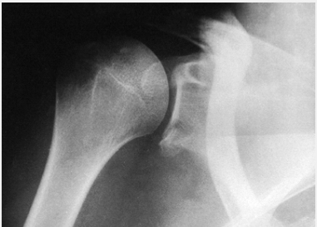
Intra-articular Glenoid fractures
Bony labral fractures
25%
5mm
Subluxation

Slide 33
Intra-articular Glenoid fractures
Transverse glenoid fractures
Gap >5mm
Step-off >2mm

Slide 34
Intra-articular Glenoid fractures
Exit
Superior
Medial
Inferior

Slide 35
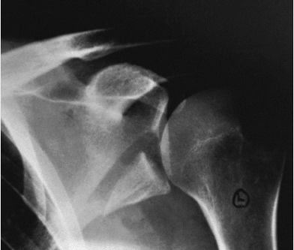
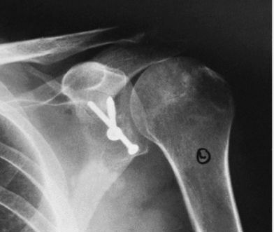
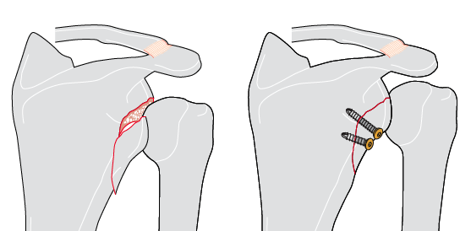
Intra-articular Glenoid fractures
Inferior exit
➔ Subluxation

Slide 36
Intra-articular Glenoid fractures
Superior exit
Flexed coracoid
Narrow outlet

Slide 37
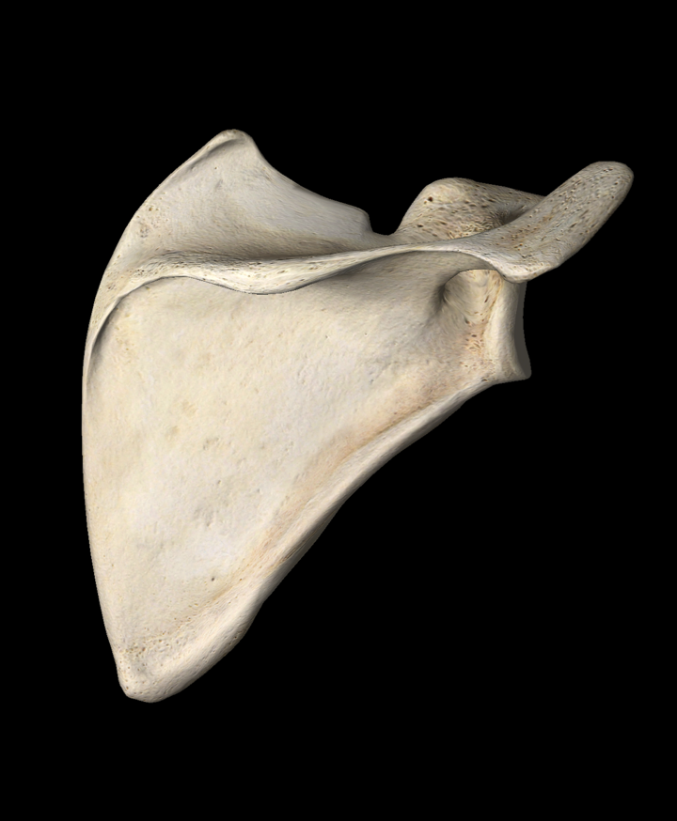
Intra-articular Glenoid fractures
Screws direction
Coracoid osteotomy

Slide 38
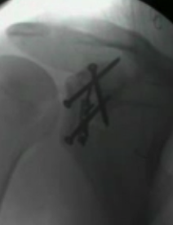
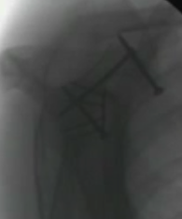
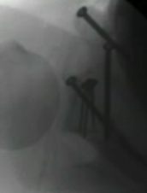

Slide 39
Intra-articular Glenoid fractures
Medial exits

Slide 40
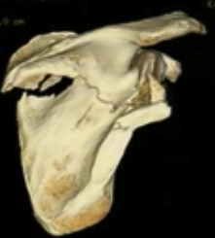
Intra-articular Glenoid fractures
Medial exits

Slide 41
Intra-articular Glenoid fractures
Medial and lateral border fix

Slide 42
Intra-articular Glenoid fractures
Comminuted

Slide 43
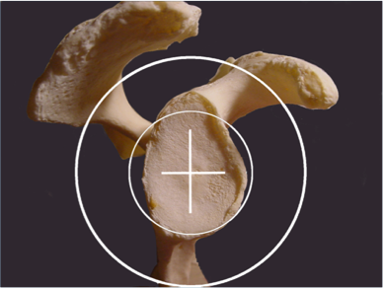
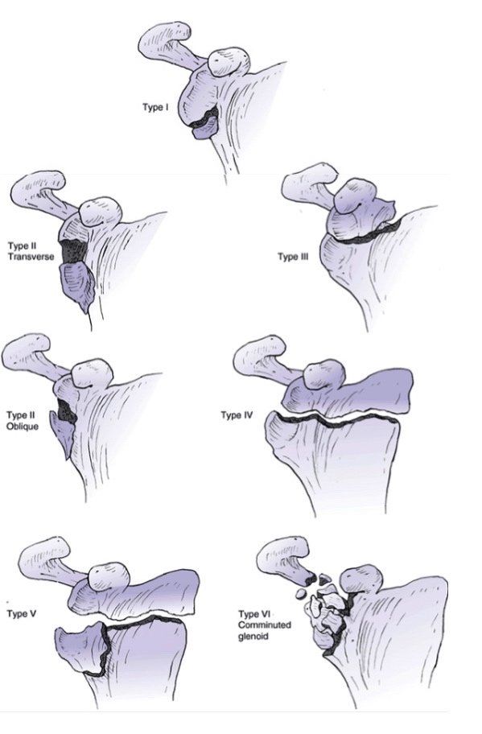
IA Glenoid fractures: Ideberg

Slide 44
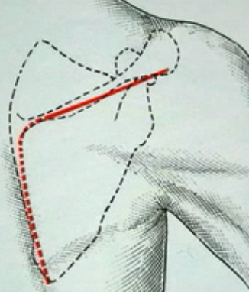
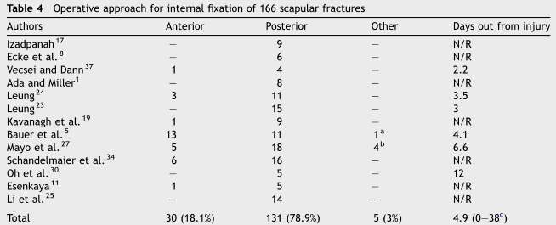
Surgical Approachs
Majority of fractures are best approached posteriorly
Notes:
References:
Lantry JM, Roberts, CS, Giannoudis PV. Operative treatment of scapular fractures: A systematic review. Injury. 2008 Mar;39(3):271–283.

Slide 45
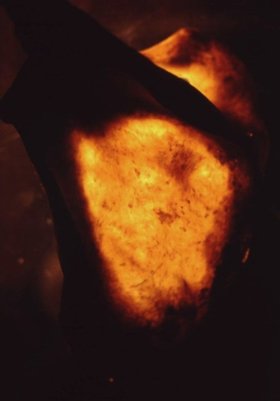
Plate positioning
Areas strong enough to support fixation:
Scapular spine
Glenoid neck
Borders of the scapula
Scapula trans-illumination

Slide 46
A case example [floating shoulder]
Neck and Clavicle

Slide 47
A case example [floating shoulder]

Slide 48
A case example [floating shoulder]

Slide 49
Conclusion
Associated injuries
Surgery is needed in some patients
Extensile approach
Posterior approach is the most commonly used

Slide 50
Conclusion
Neck & Body
Glenoid Fossa
Angulation
30 in Y-scapular view
<20 GPA
Displacement
1cm
Floating Shoulder
Incongruency
Gap 5mm ????
Step-off 2mm
Subluxation
Narrow Outlet

