Slide 2
Which is the bad side? I’m sorry.
Mr Lee Van Rensburg
01223 800210

Slide 3
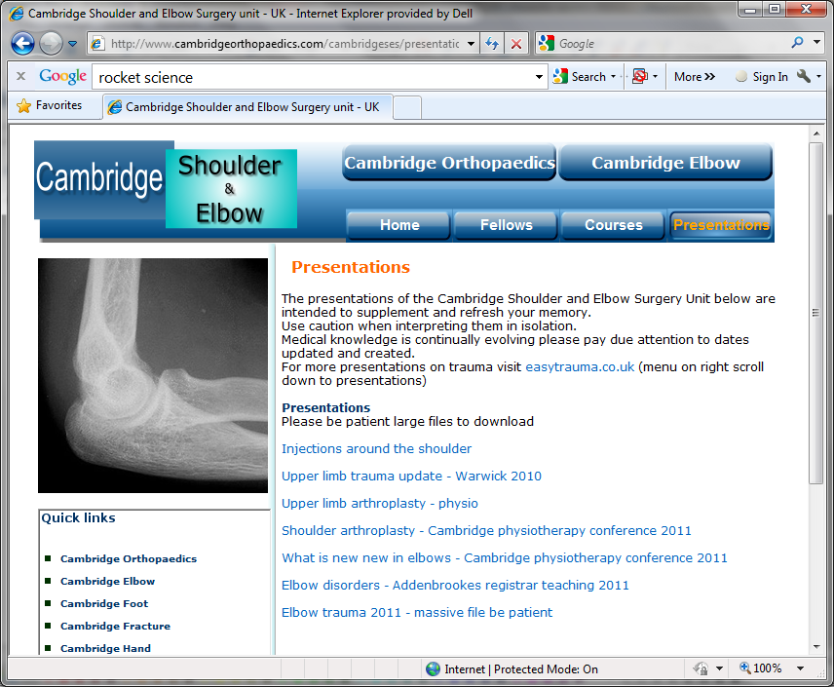
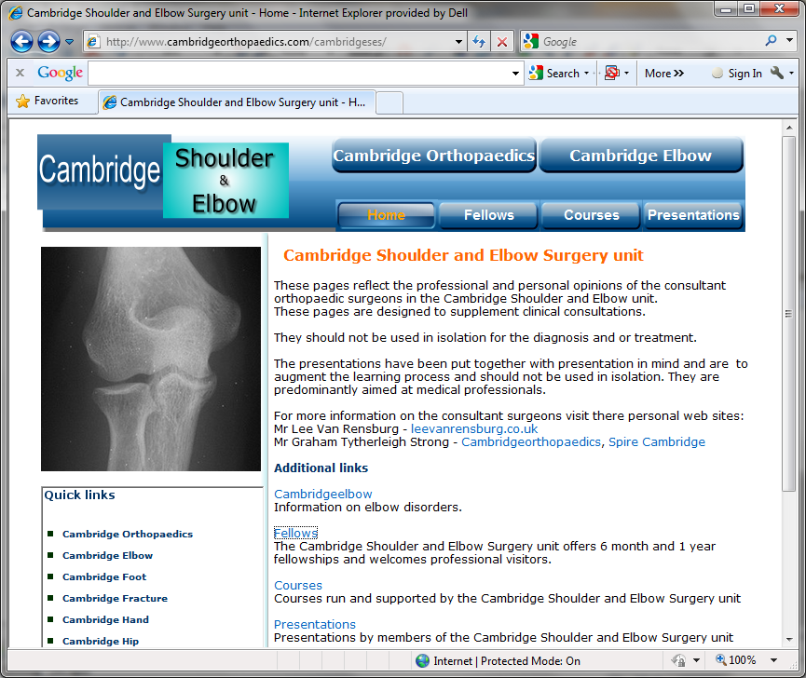
www.cambridgeses.co.uk

Slide 4
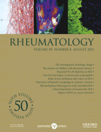
Rheumatology 2006;45:215–221

Slide 5
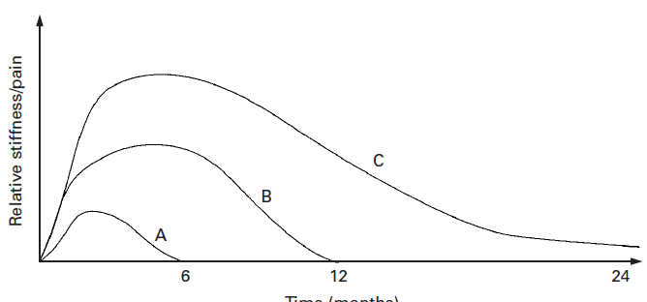
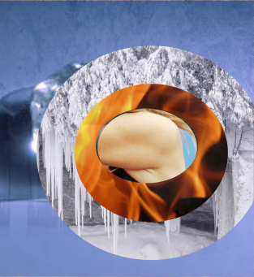
VOL. 85-B, No. 6, AUGUST 2003

Slide 6
Shoulder assessment
History
Examination
Look
Feel
Move
Active
Passive
Special tests
ACJ
Rotator cuff
Instability
Special investigations
Radiographs
Ultrasound
MRI

Slide 7
Shoulder assessment
History
Pain
Stiffness
Weakness
Instability
Examination
Special investigations

Slide 8
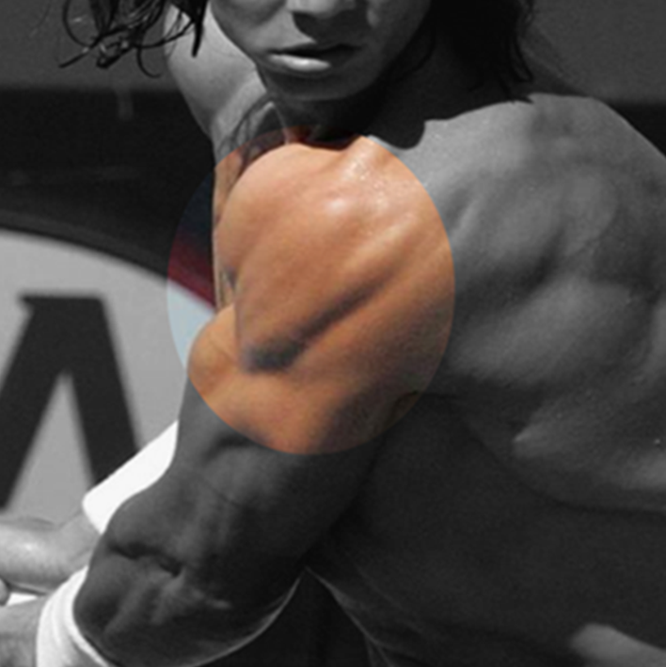
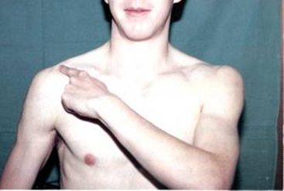
History
Pain
Stiffness
Weakness
Instability

Slide 9
History
Pain
Stiffness
Weakness
Instability

Slide 10
History
Pain
Stiffness
Weakness
Instability

Slide 11
History
Pain
Stiffness
Weakness
Instability

Slide 12
Shoulder assessment
History
Examination
Look
Feel
Move
Active
Passive
Special tests
Special investigations

Slide 13
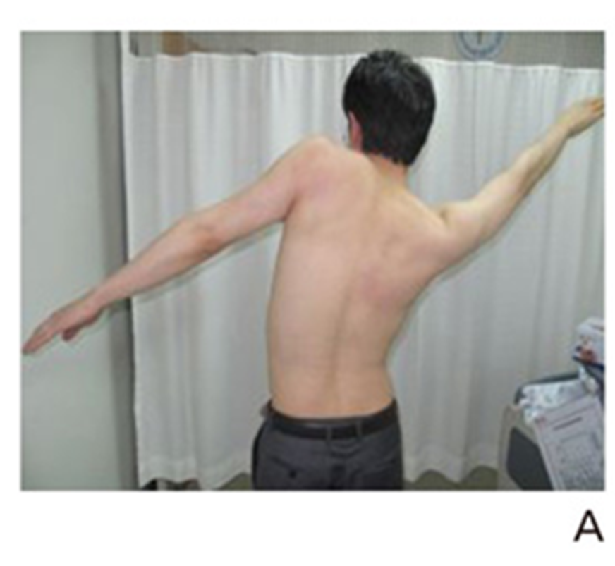
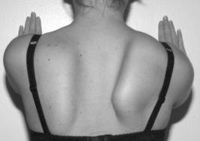
Shoulder assessment
History
Examination
Look
Feel
Move
Active
Passive
Special tests
Special investigations

Slide 14
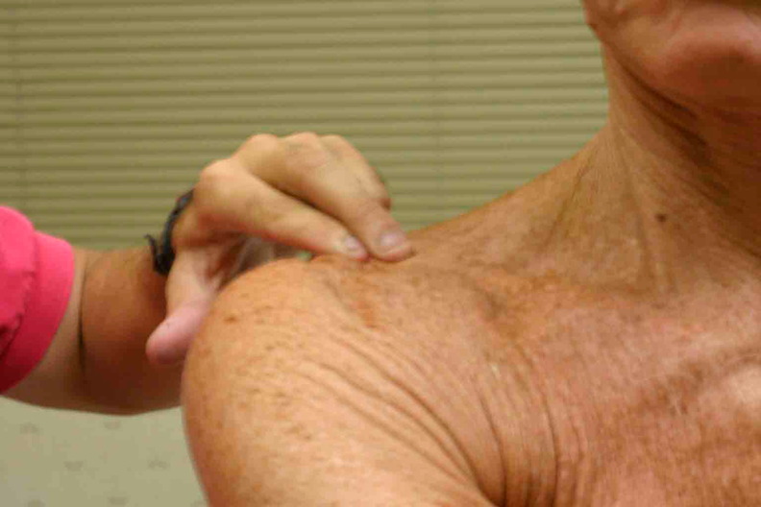
Shoulder assessment
History
Examination
Look
Feel
Move
Active
Passive
Special tests
Special investigations
Which is the bad side?

Slide 15
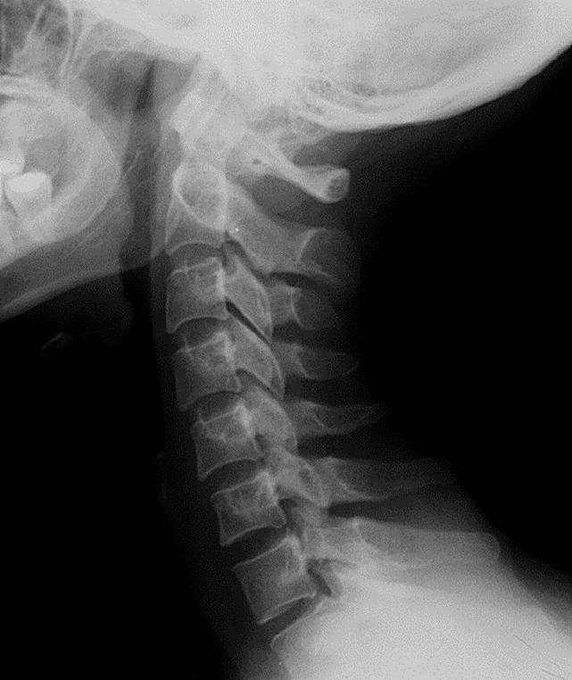
Shoulder assessment
History
Examination
Look
Feel
Move
Active
Passive
Special tests
Special investigations

Slide 16
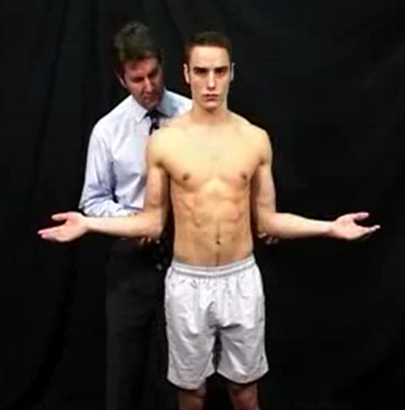
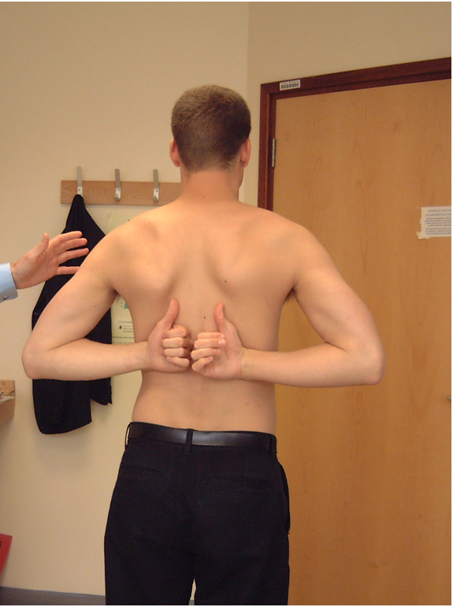
Shoulder assessment
History
Examination
Look
Feel
Move
ER
Elevation
Internal rotation
Active
Passive
Special tests
Special investigations

Slide 17
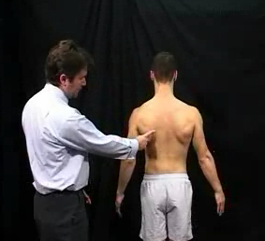
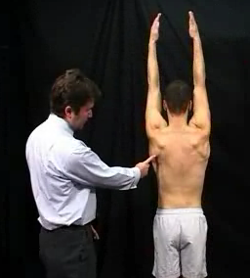
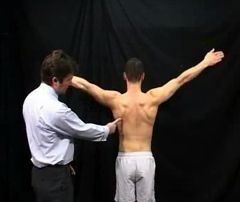

Slide 18
Shoulder assessment
History
Examination
Look
Feel
Move
Special tests
ACJ
Rotator cuff
Instability
Special investigations

Slide 19
Shoulder assessment
History
Examination
Look
Feel
Move
Special tests
ACJ
Rotator cuff
Instability
Special investigations

Slide 20
Shoulder assessment
History
Examination
Look
Feel
Move
Active
Passive
Special tests
ACJ
Rotator cuff
Instability
Special investigations

Slide 21
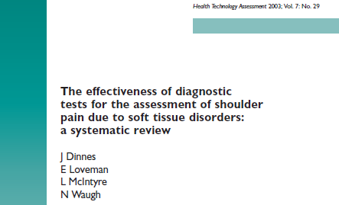
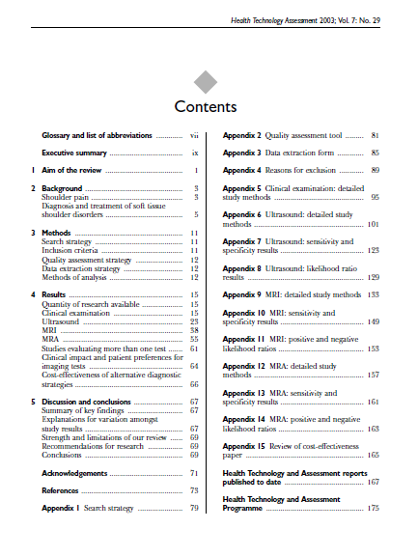
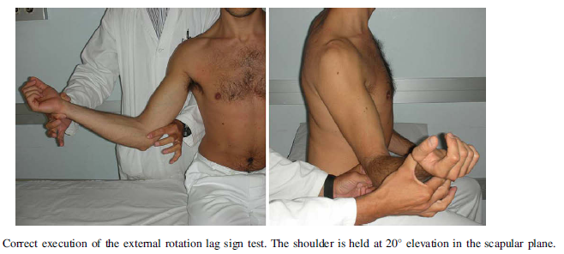
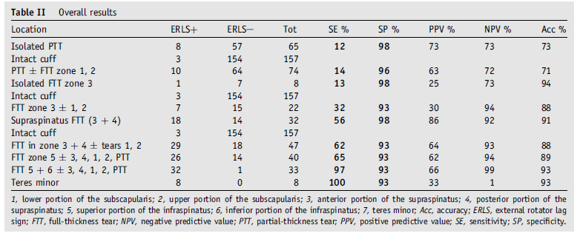
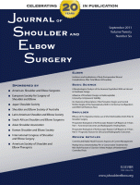
175
J Shoulder Elbow Surg. 2009 Jul-Aug;18(4):529-34

Slide 22
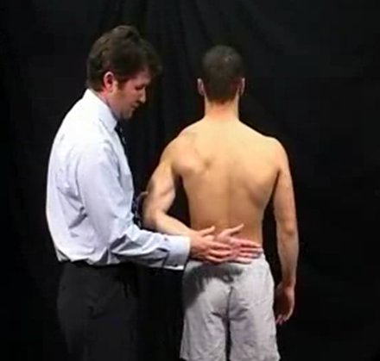
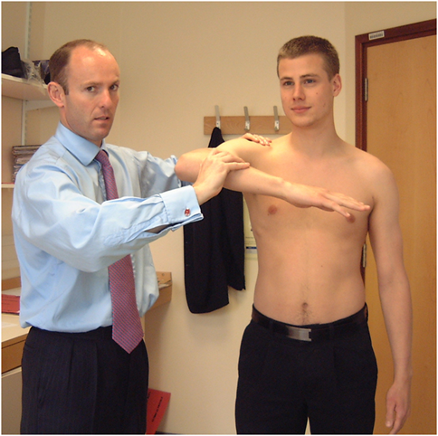
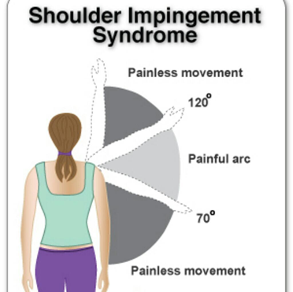
Shoulder assessment
History
Examination
Look
Feel
Move
Active
Passive
Special tests
ACJ
Rotator cuff
Instability
Special investigations
I’m sorry

Slide 23
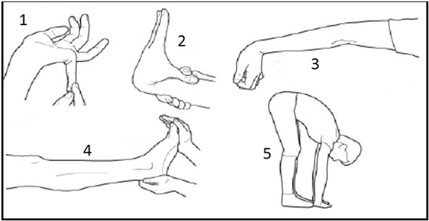
Shoulder assessment
History
Examination
Look
Feel
Move
Active
Passive
Special tests
ACJ
Rotator cuff
Instability
Special investigations

Slide 24
Shoulder assessment
History
Examination
Look
Feel
Move
Active
Passive
Special tests
ACJ
Rotator cuff
Instability
Special investigations

Slide 25
Shoulder assessment
History
Examination
Look
Feel
Move
Special tests
Special investigations
Radiographs
Ultrasound
MRI

Slide 26
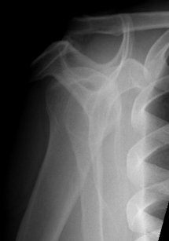
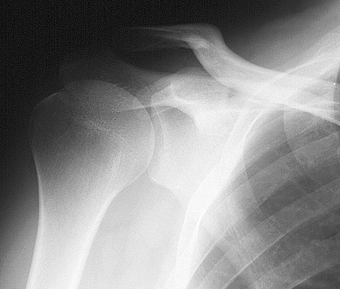
Normal X rays

Slide 27
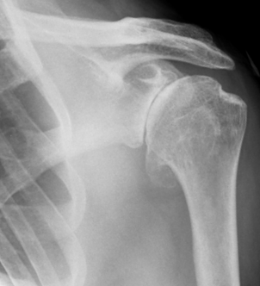
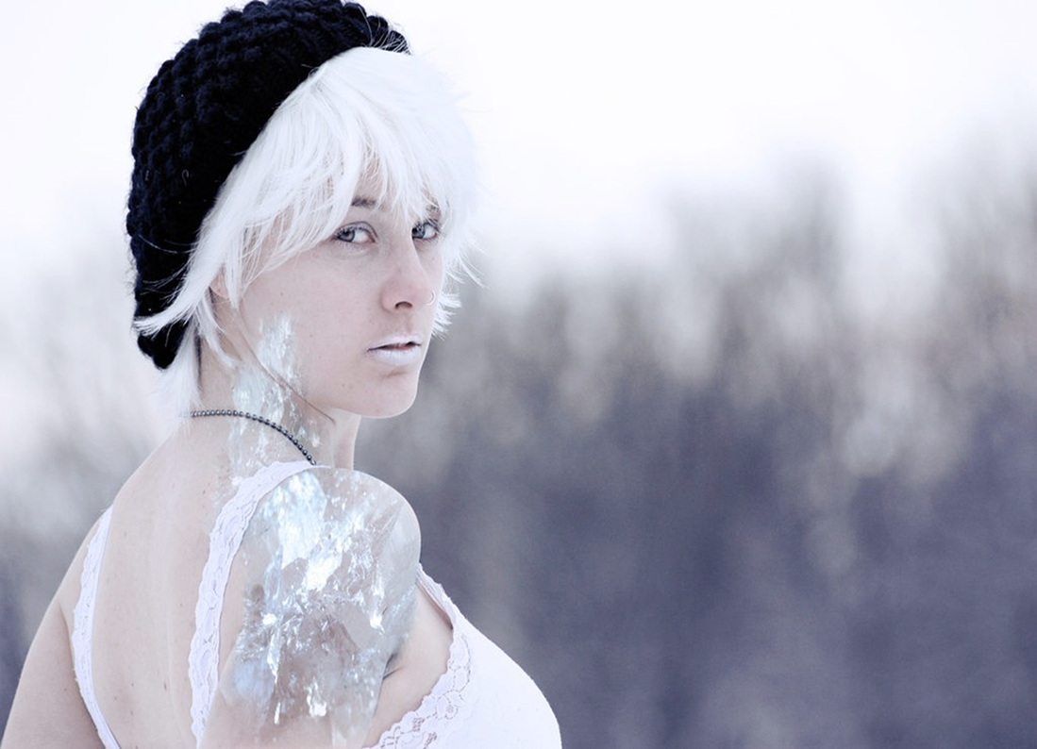
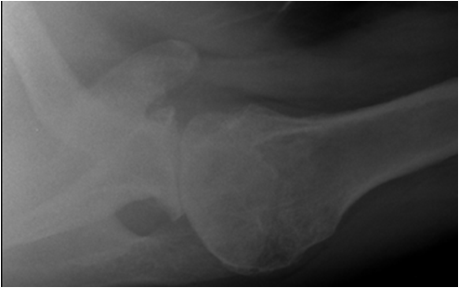
Arthritis

Slide 28
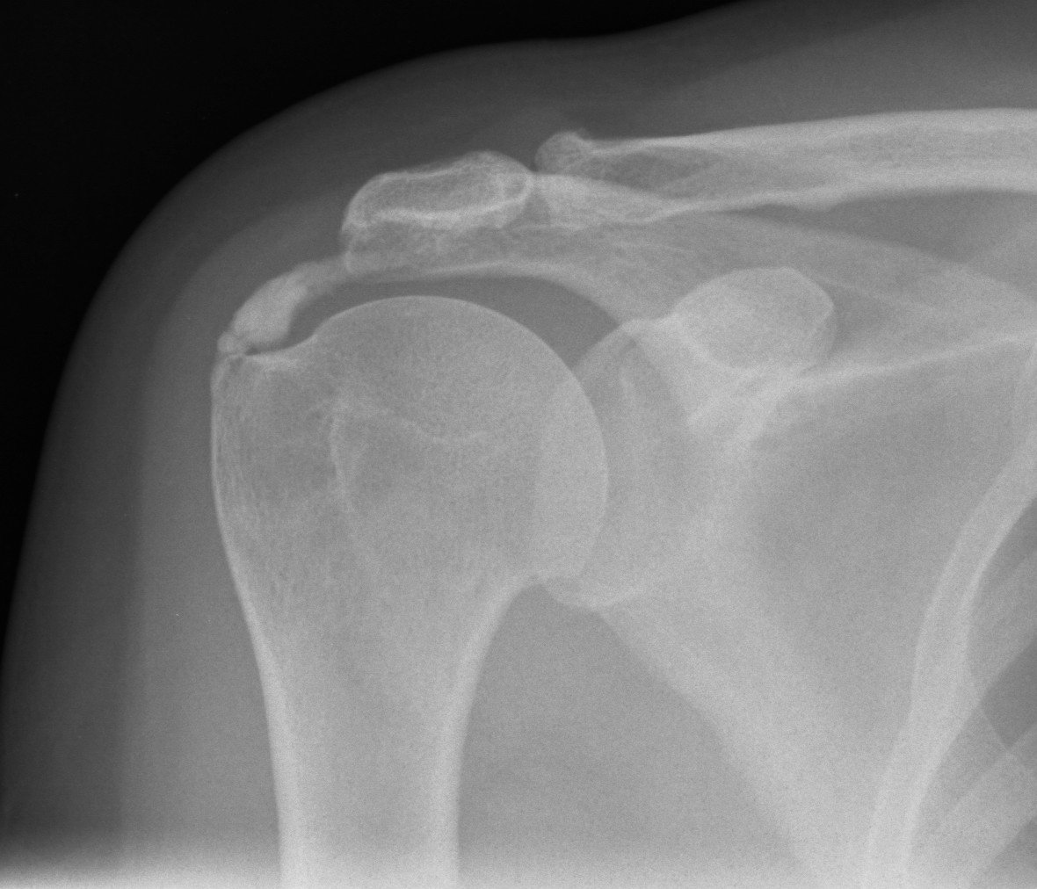
Calcific tendonitis

Slide 29
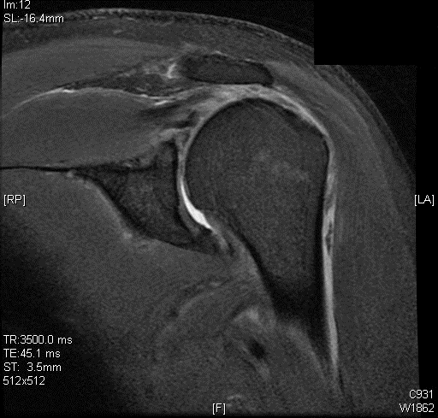
Perhaps this patient needs a scan
Full thickness tear
Supraspinatus

Slide 30
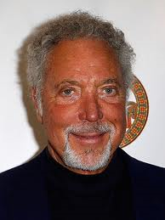
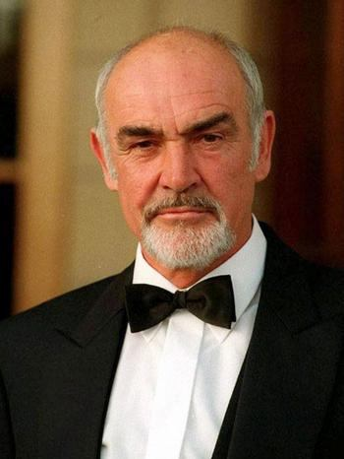
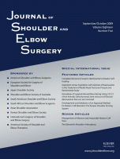
1953 - 65
60-69 =30% FTRCT
1940 -78
70-79 = 50% FTRCT
1930 - 88
80-89 = 80% FTRCT
Age-related prevalence of rotator cuff tears in asymptomatic shoulders; Tempelhof et al; JSES July 1999 (Vol. 8, Issue 4, Pg 296-299

Slide 31
104 shoulders chronic, atraumatic shoulder pain
41% had pre evaluation MRI scans
90 % pre-evaluation MRI scans had no impact on the outcome
JSES 2005;14:233-237

Slide 32
Summary
History
Examination
Look
Feel
Move
Active
Passive
Special tests
ACJ
Rotator cuff
Instability
Special investigations
Radiographs
Ultrasound
MRI

Slide 34
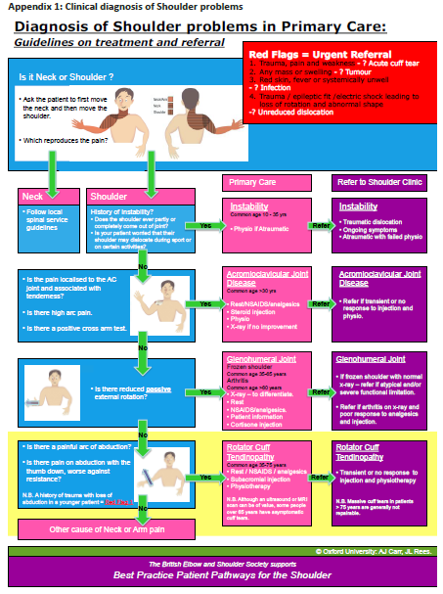
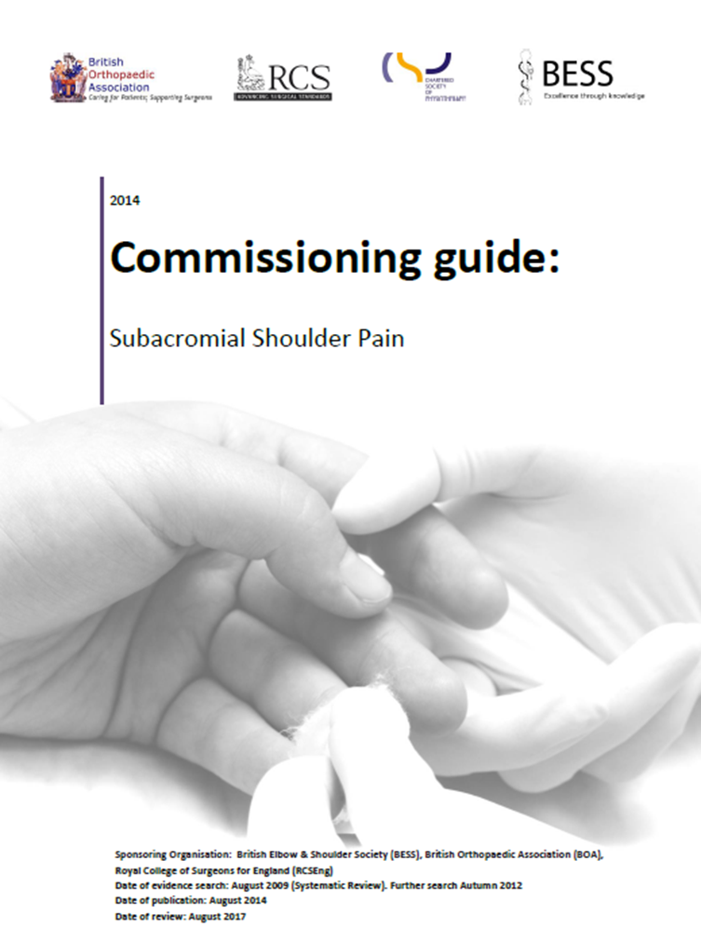
www.boa.ac.uk

Slide 35
www.boa.ac.uk

Slide 36
www.boa.ac.uk
Relative rest
NSAID
Physiotherapy
Steroid injection

Slide 37
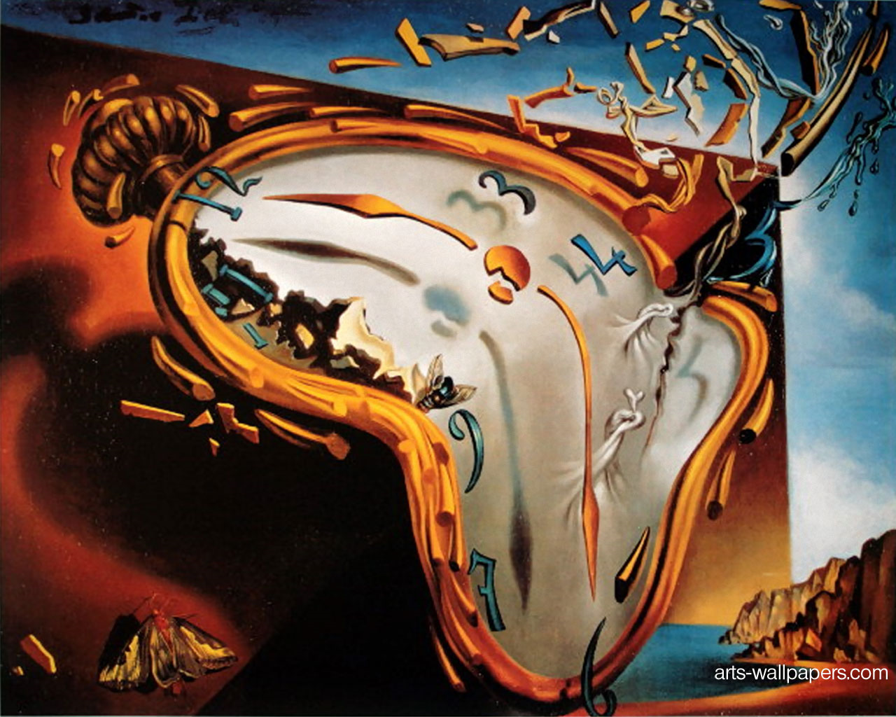

Slide 38
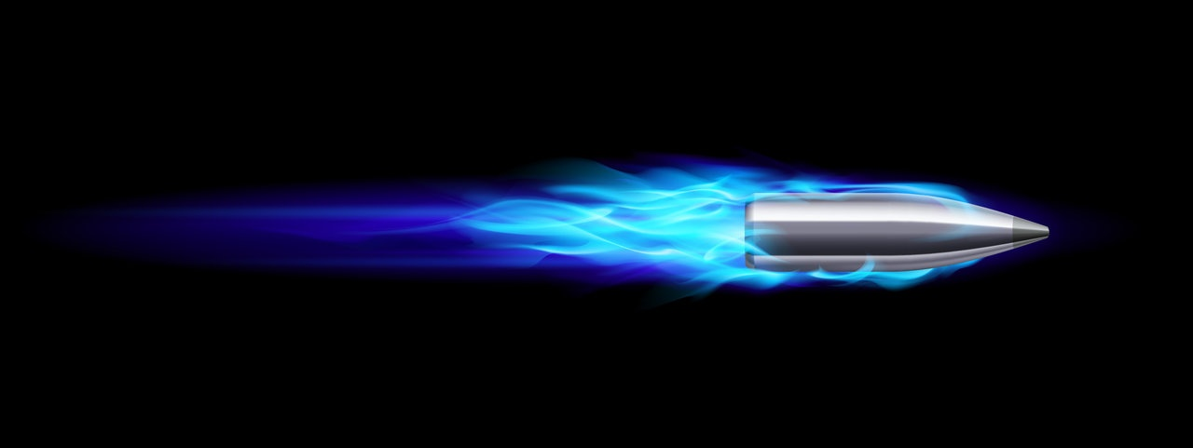
Times
BOA
6 weeks
Carr Oxford
3 months
Surgery
6 months

Slide 39
Questions ?
Mr Lee Van Rensburg
01223 800210

