Slide 1
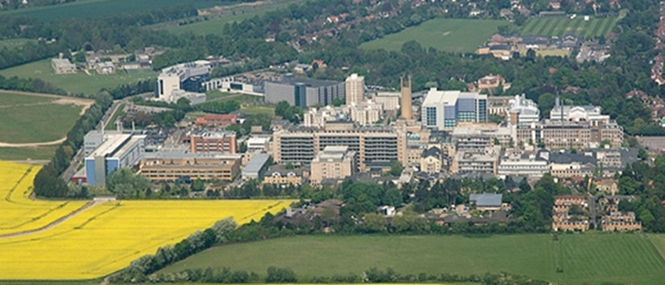
Anatomic basis of proximal humeral surgery: Deltopectoral or deltoid split?
Mr Lee Van Rensburg
Cambridge University hospitals NHS trust
09:20 to 09:30

Slide 3
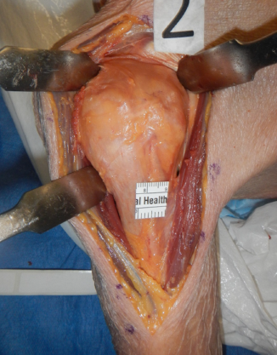
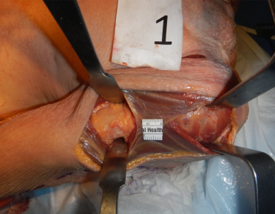
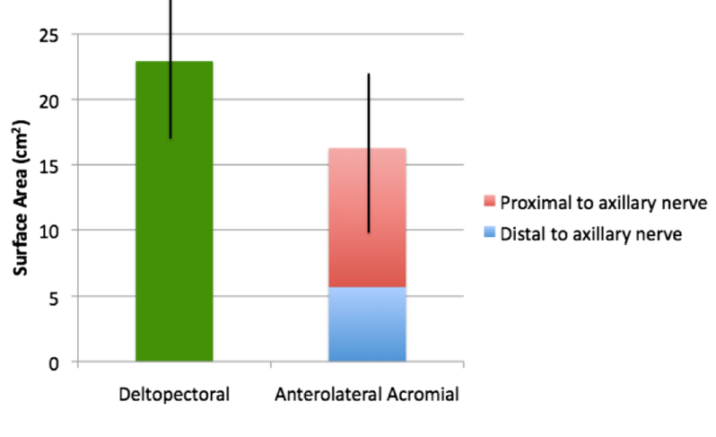
J Am Acad Orthop Surg Glob Res Rev 2 (6), e017 2018 Jun 13

Slide 4
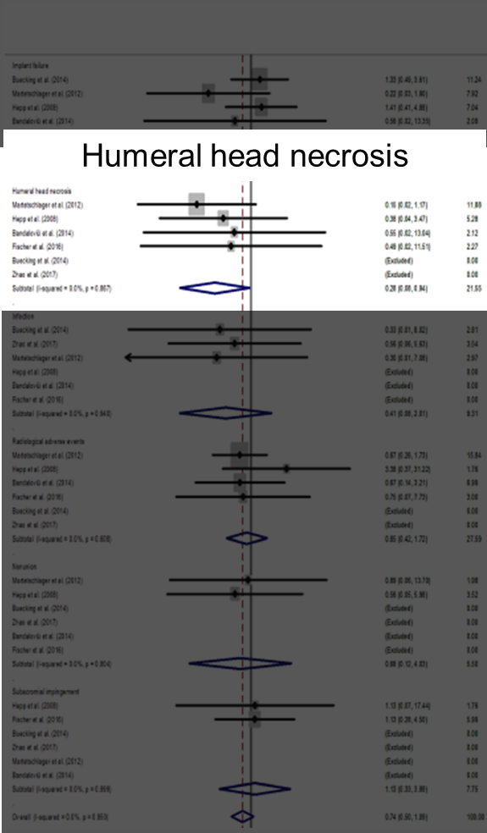
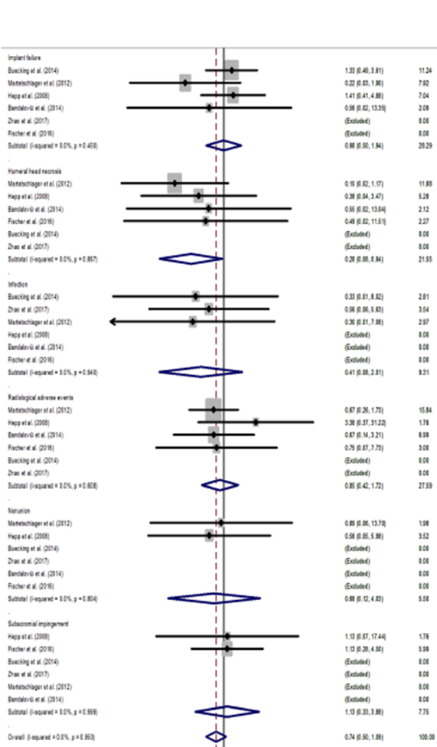
Implant failure
6 Studies
3 RCT’s
3 Comparative studies
198 Deltoid split (DS)
228 Deltopectoral (DP)
Humeral head necrosis
Significant difference
4 studies
DS 2 of 198 (1%)
DP 11 of 228 (4.8%)
Orthopaedics & Traumatology: Surgery & Research 105 (2019) 307–316

Slide 5
Largest contributor to cases of avn
Comparative series
DP n=33
DS n=37
AVN
DP n=6 (18%)
DS n= 1 (2.7%)
Average time to follow-up
Deltoid split 20 months
Deltopectoral 48 months
Greiner et al incidence of avascular necrosis
doubled after 45 months compared
with the incidence observed after
12 months.
Orthopedics 2012;35 [e1606–e1612].[19]

Slide 6
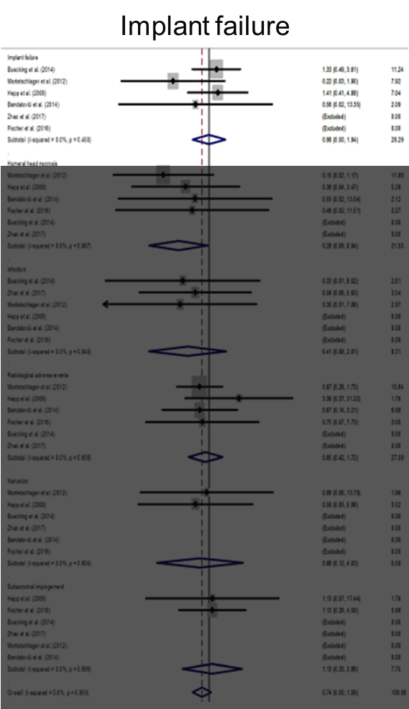
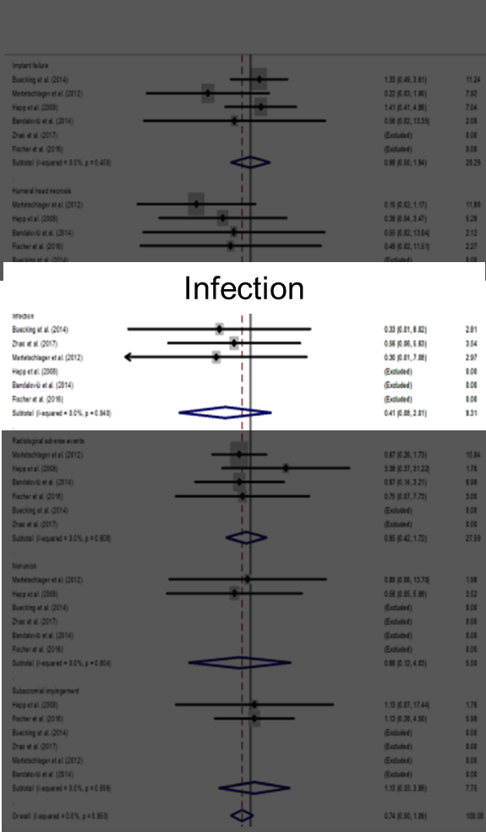
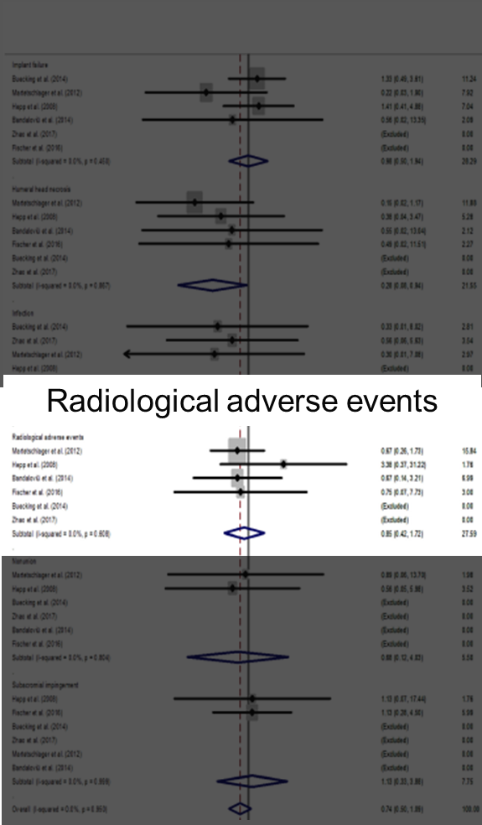
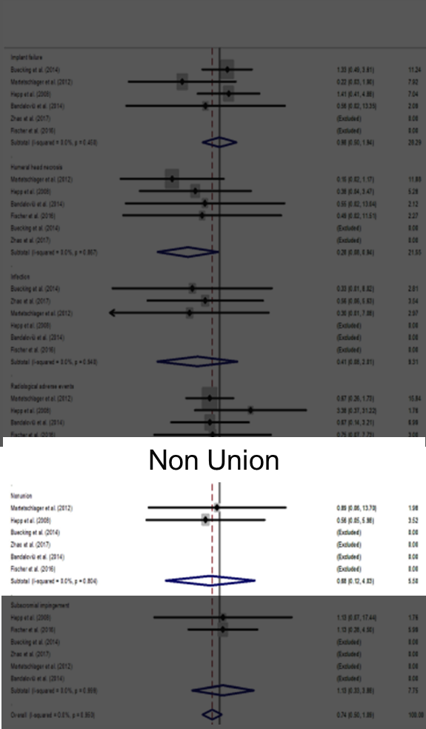
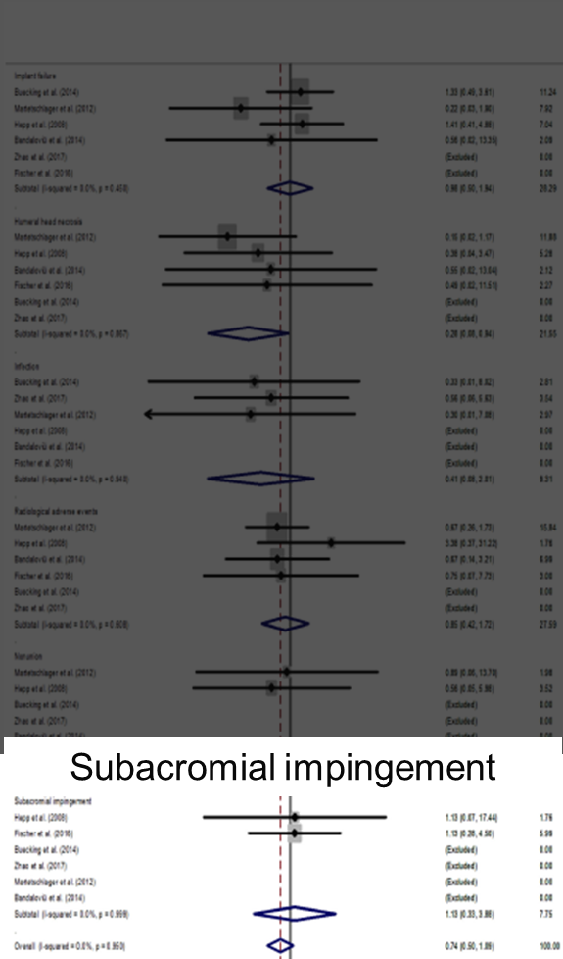
6 Studies
3 RCT’s
3 Comparative studies
198 Deltoid split (DS)
228 Deltopectoral (DP)
Implant failure
Orthopaedics & Traumatology: Surgery & Research 105 (2019) 307–316

Slide 7
What is the Deltoid split?

Slide 8
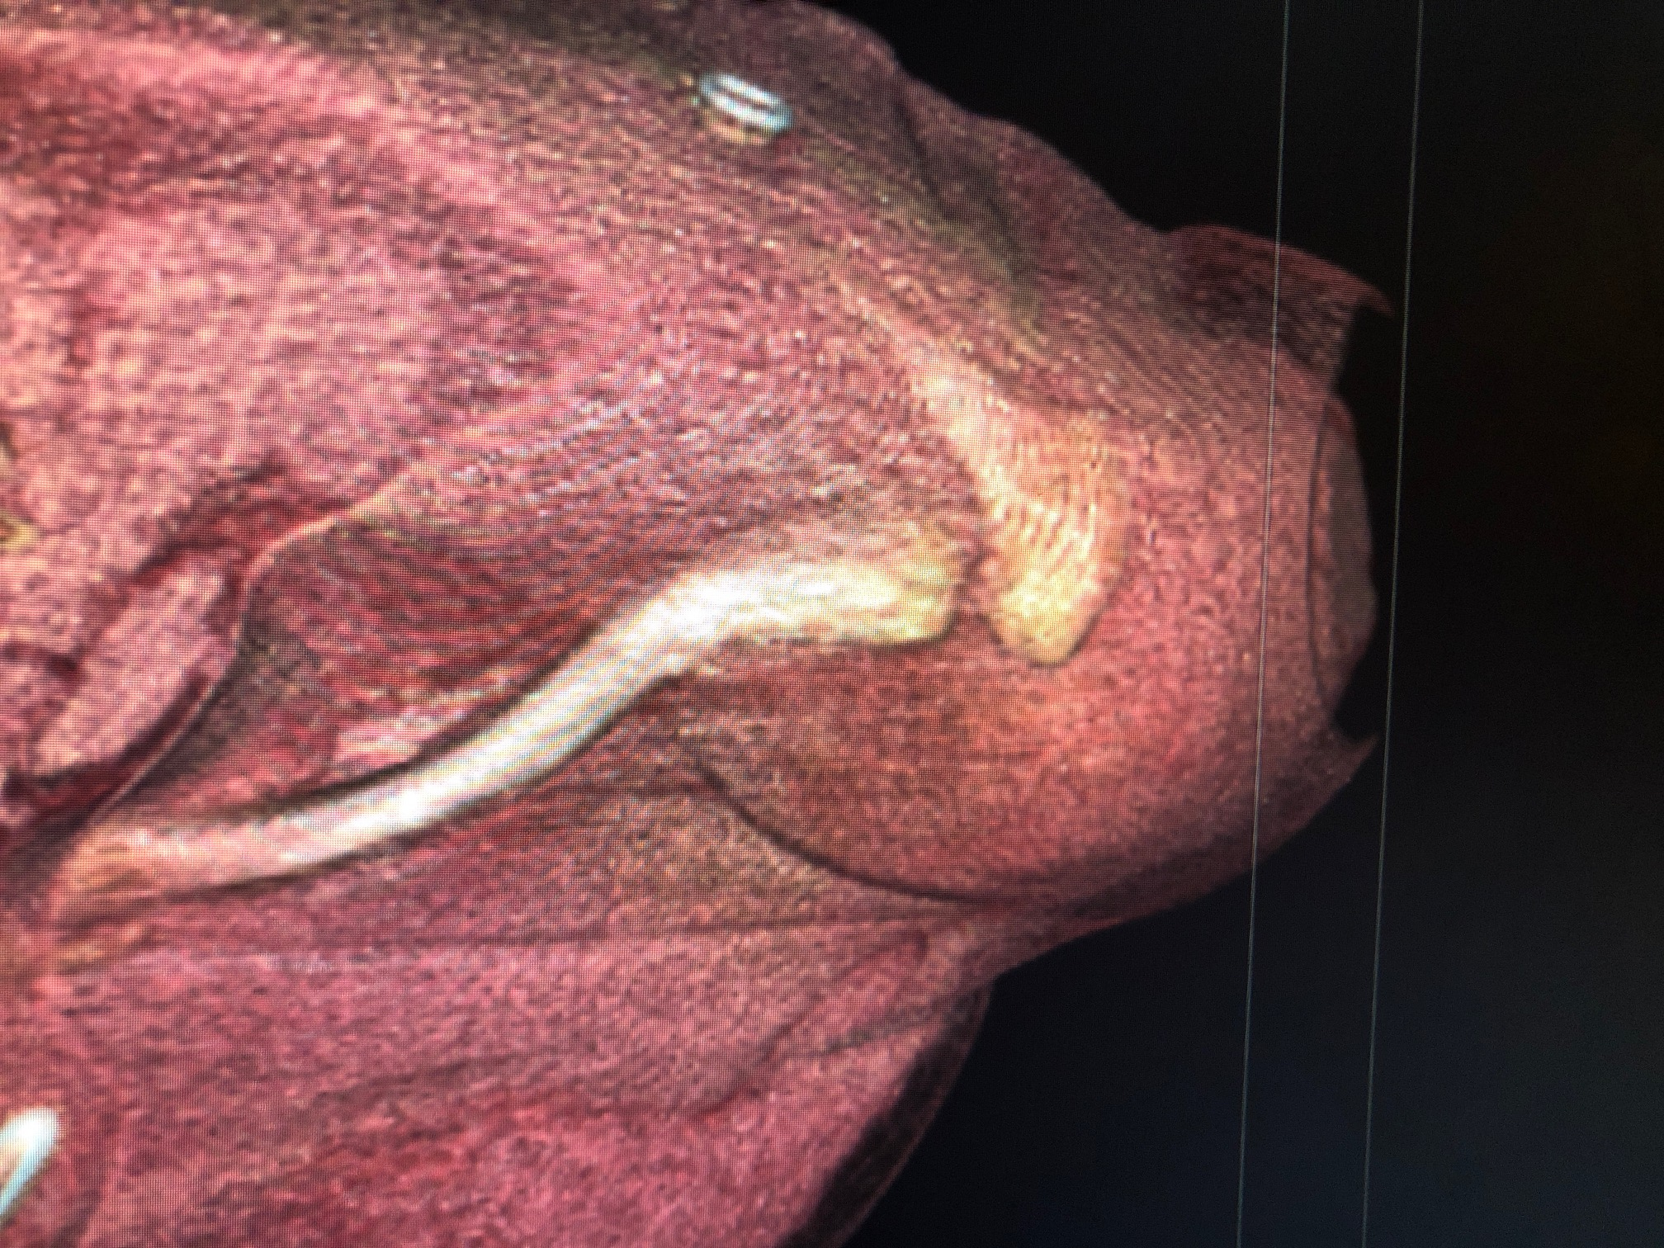
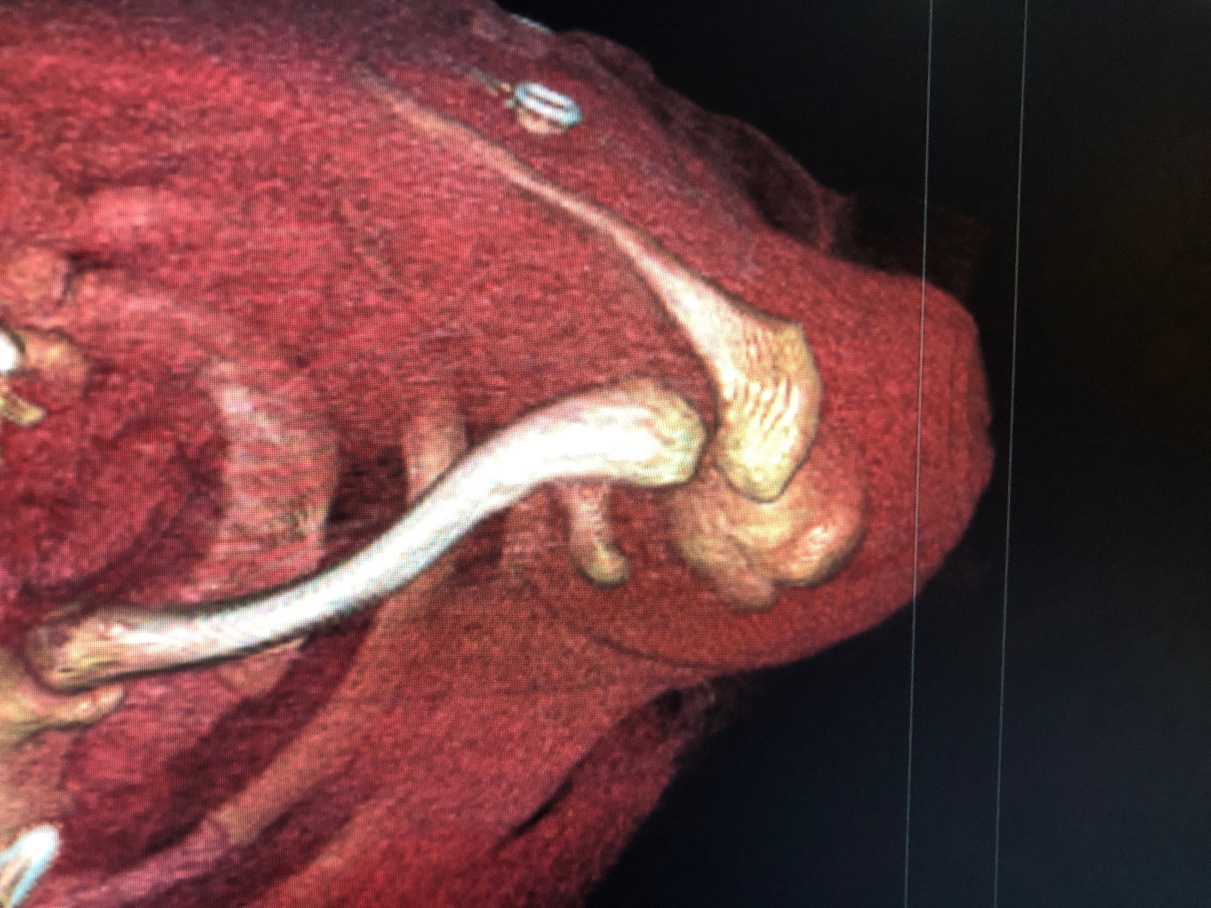
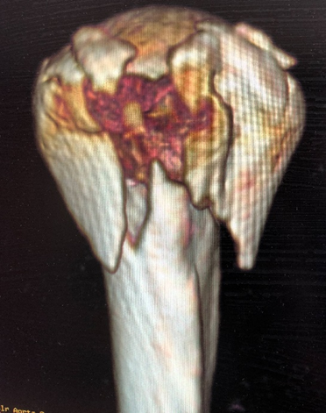
ANTEROLATERAL APPROACH

Slide 9
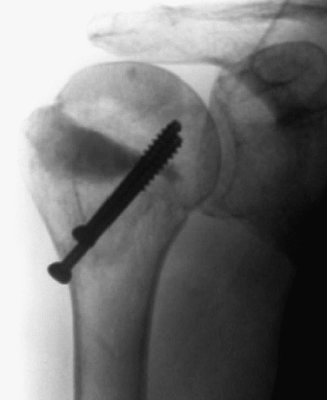
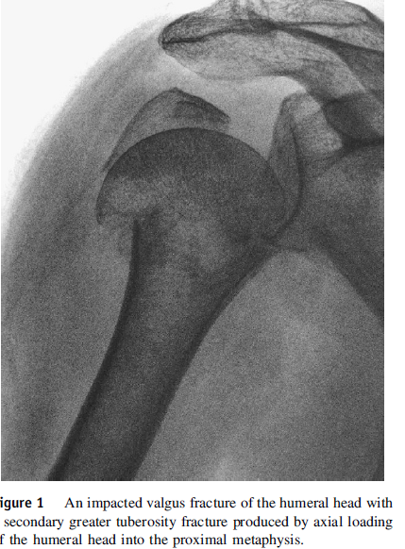
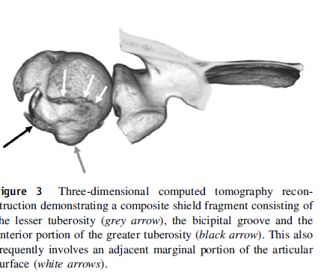
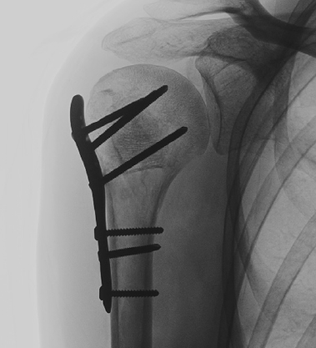
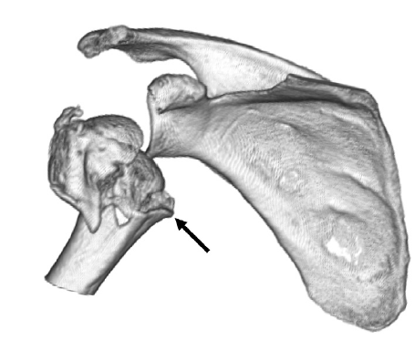
J Shoulder Elbow Surg (2010) 19, 1105-1114

Slide 10
Anterior and middle heads

Slide 11
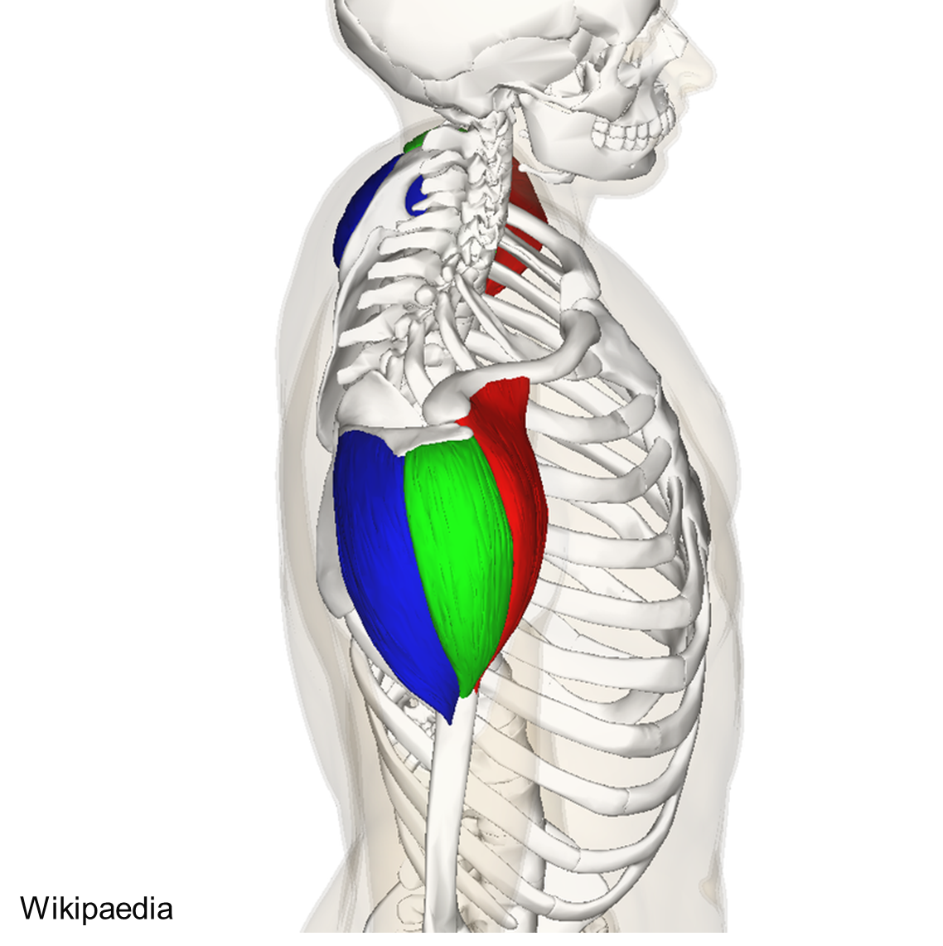
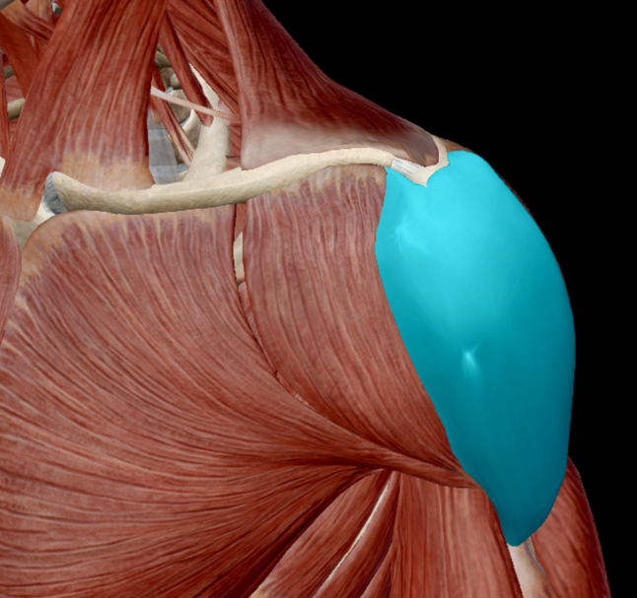

Slide 12
Clin Orthop Relat Res2005;123-129.

Slide 13
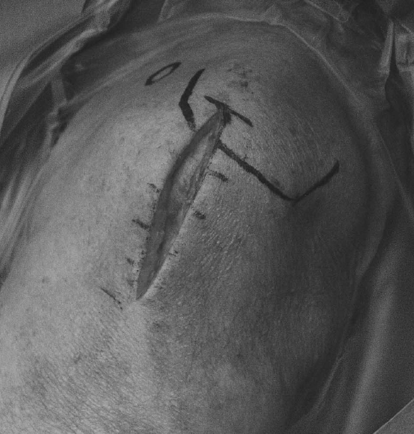
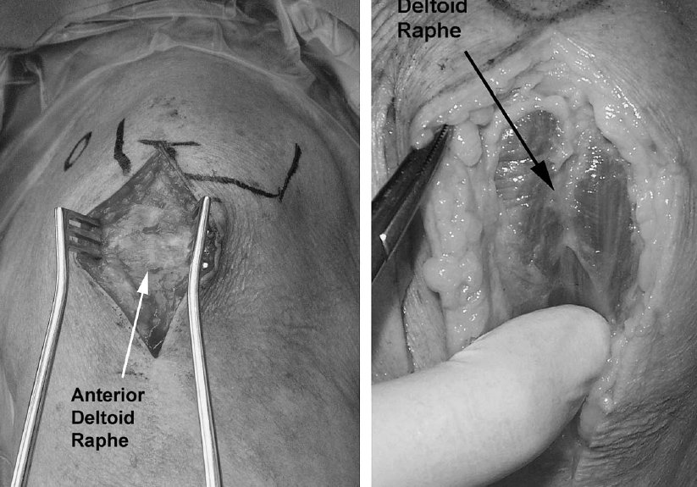
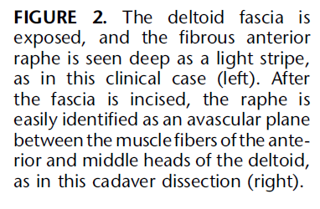
J Orthop Trauma Volume 22, Number 2, February 2008

Slide 14
No Pictures
Video
J Orthop Trauma 2016;30:S11–S12)

Slide 15
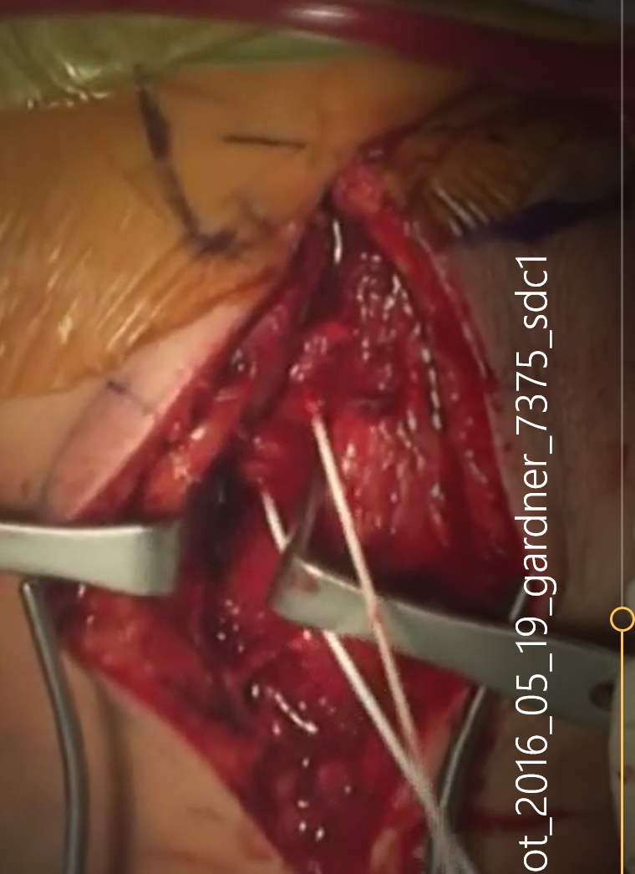
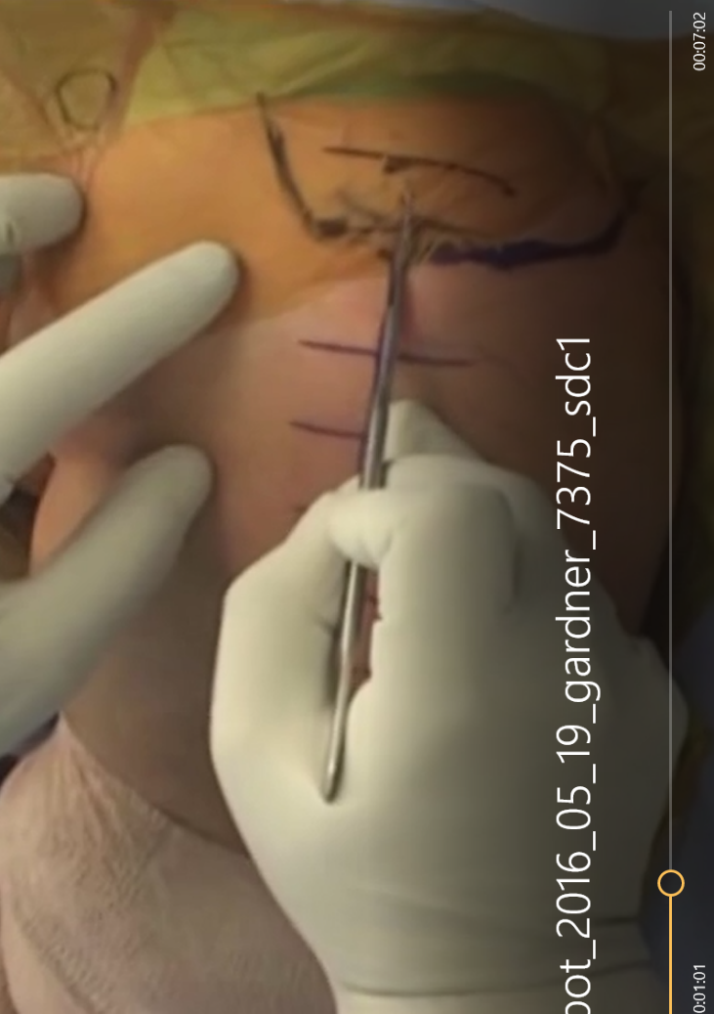
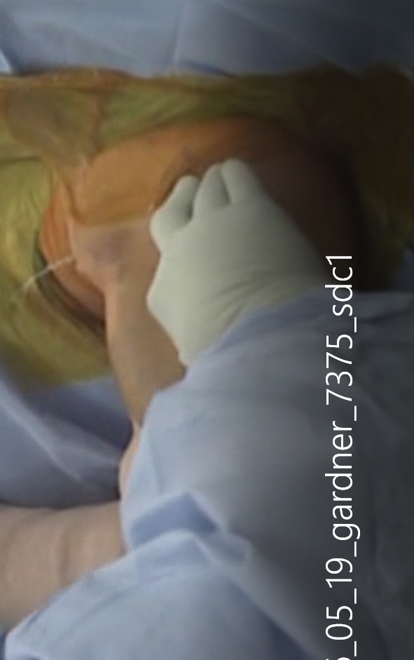
Acromion and
Raphe palpated
Incision Posterior to anterolateral acromion
Axillary nerve identified and preserved
? 6 Cm
J Orthop Trauma 2016;30:S11–S12)

Slide 16
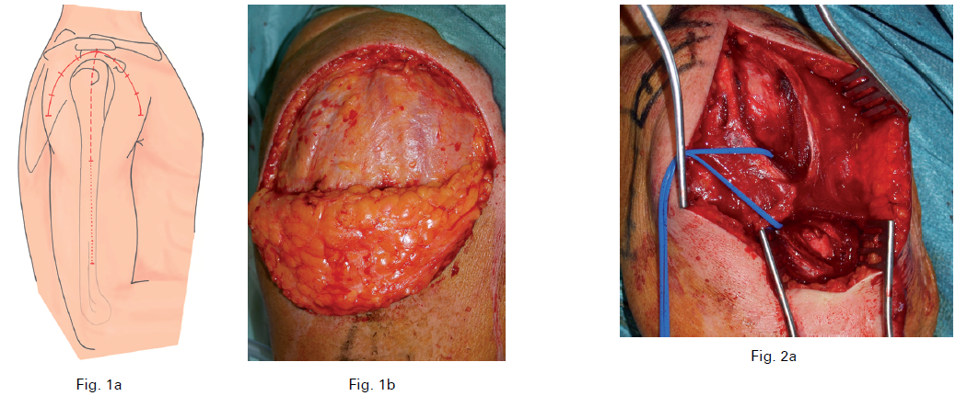
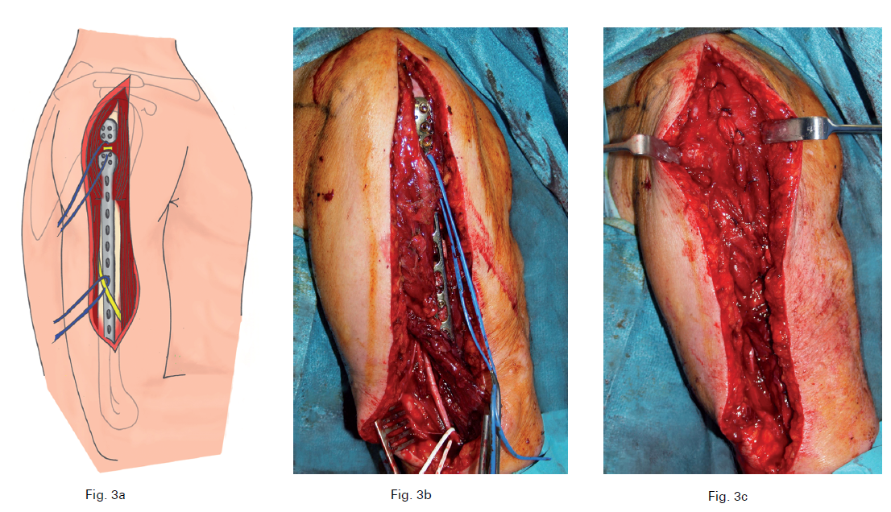
JBJS B VOL. 93-B, No. 3, MARCH 2011

Slide 17
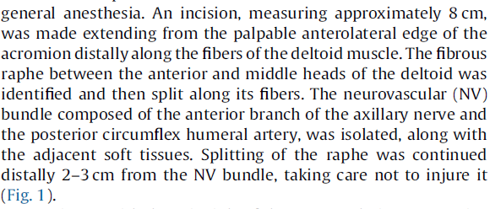
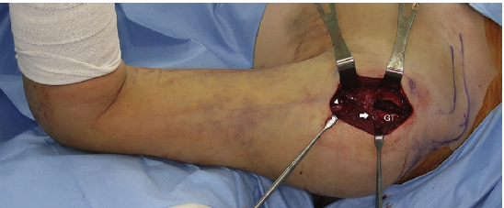
Injury , 48 (11), 2569-2574 Nov 2017

Slide 18
Arthroscopy , 34 (3), 795-803 Mar 2018

Slide 19
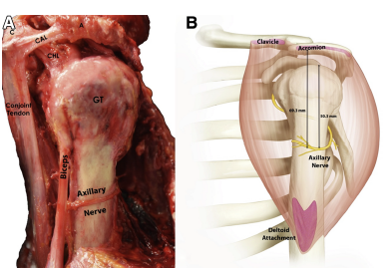
6.7 to 6.8cm
Arthroscopy , 34 (3), 795-803 Mar 2018

Slide 21
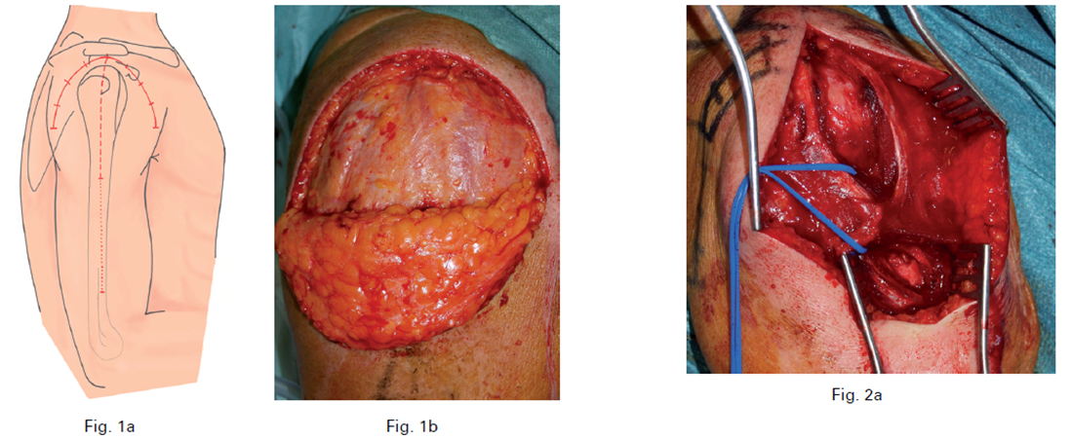
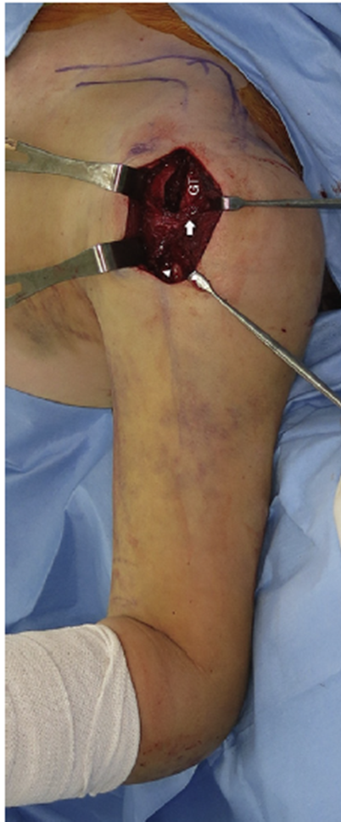
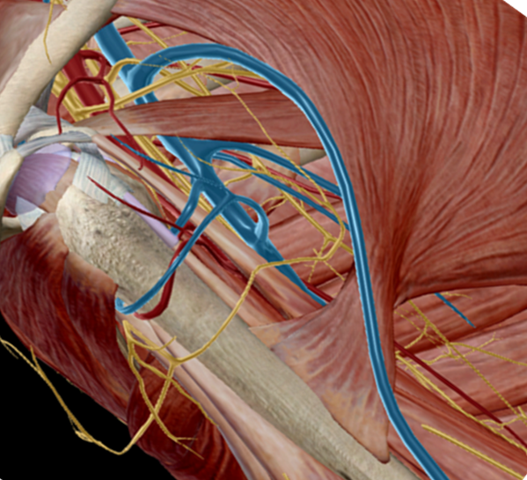
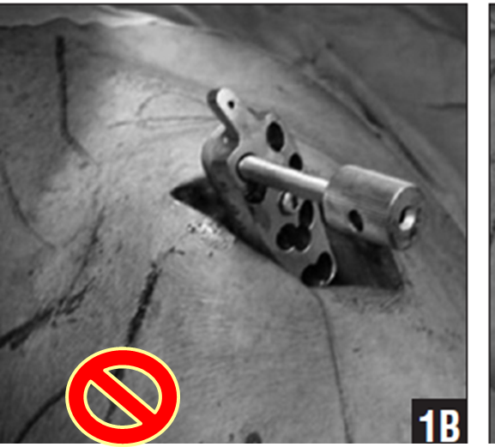
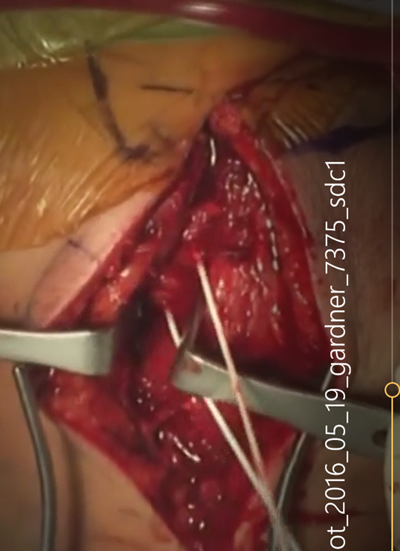
Preferred
Orthopedics 2012;35 [e1606–e1612].[19]

Slide 22
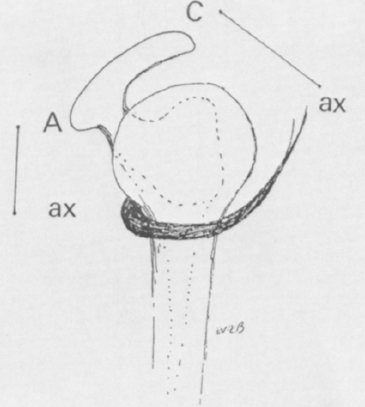
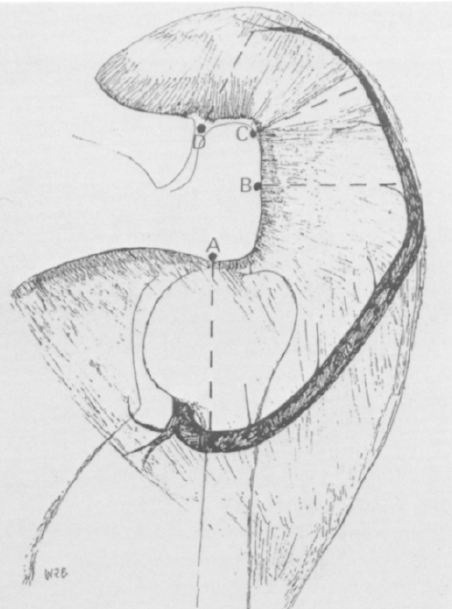
A: 5.5 cm (3.1 – 7.3)
Female 5.0 (3.1 – 7.0)
B: 5.8 cm (4.3 – 7.4)
Female 5.4 (4.3 – 7.4)
C: 5.7 cm (4.1 – 7.1)
Female 5.2 (4.1 – 6.6)
D: 5.8 cm (4.6 – 7.7)
Female 5.2 (4 – 6.7)
J SHOULDER ELBOW SURG 7992; 7:37-6

Slide 23
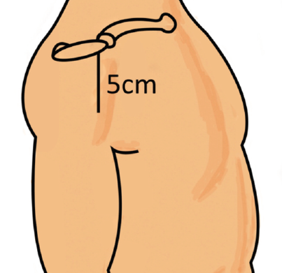
5 cm not Enough
Cadaver
5cm incision from anterior tip of acromion
12% injury axillary nerve
20% of the total arm length
Malaysian Orthopaedic Journal 2018 Vol 12 No 3

Slide 24
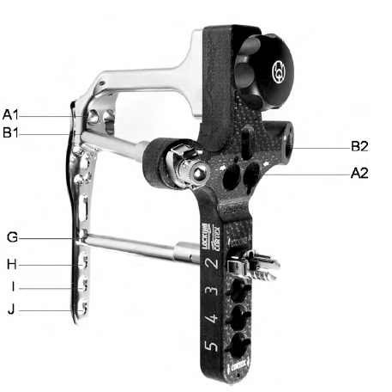
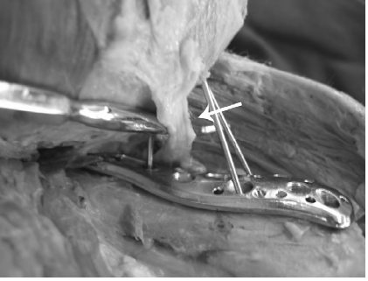
Injury, Int. J. Care Injured 41 (2010) 1037–1040

Slide 25
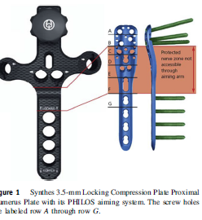
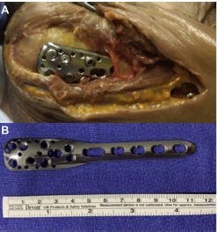
J Shoulder Elbow Surg (2019) -, 1–6

Slide 26
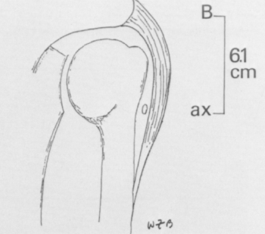
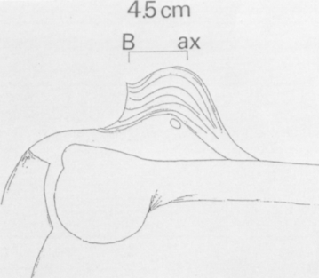

Slide 28
Deltopectoral

Slide 29
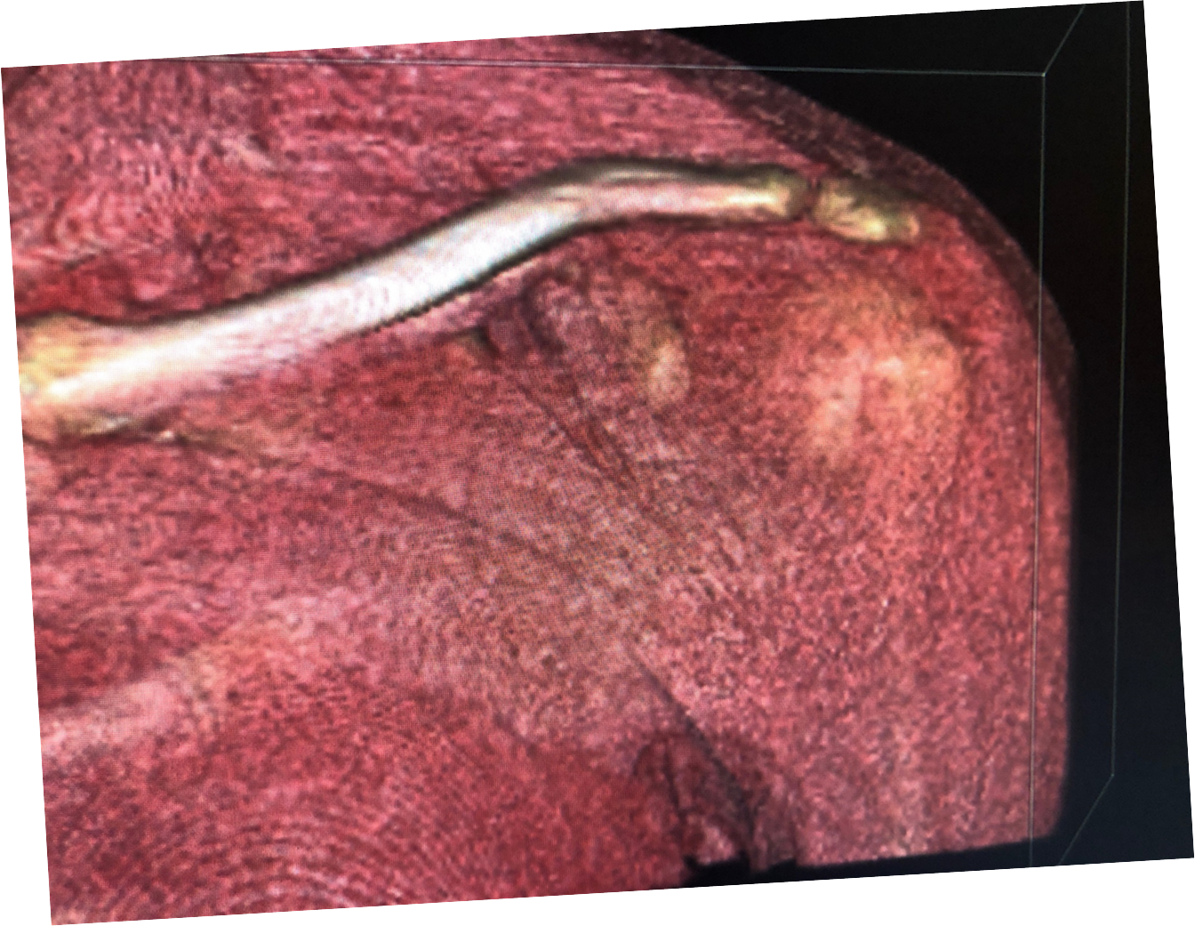
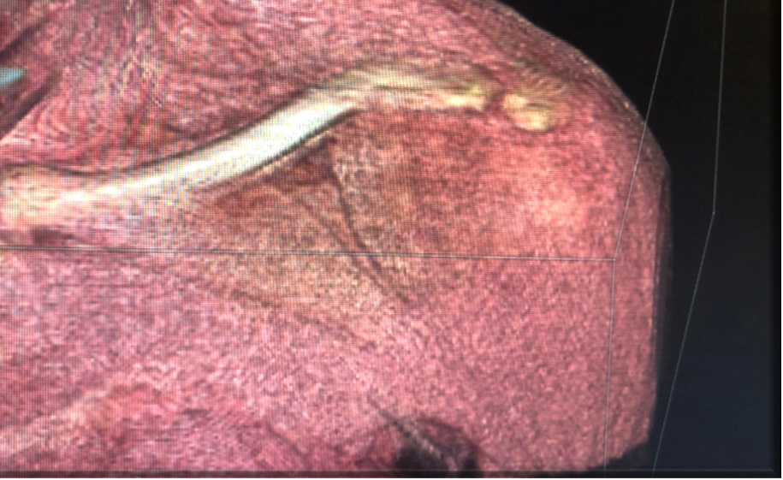

Slide 30
