Slide 1
Some Shoulders need to see a surgeon.
Most don’t need an operation….
  Mr Lee Van Rensburg
  01223 789721
  www.leevanrensburg.com
  lorna@cambridgeelbow.co.uk

Slide 2

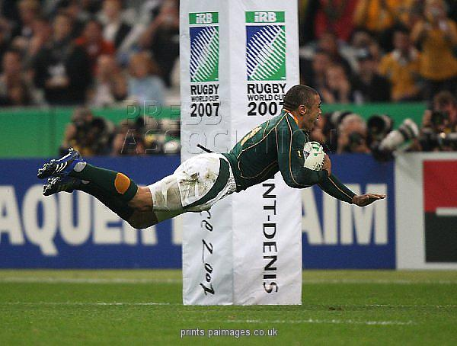
Disclaimer

Slide 3
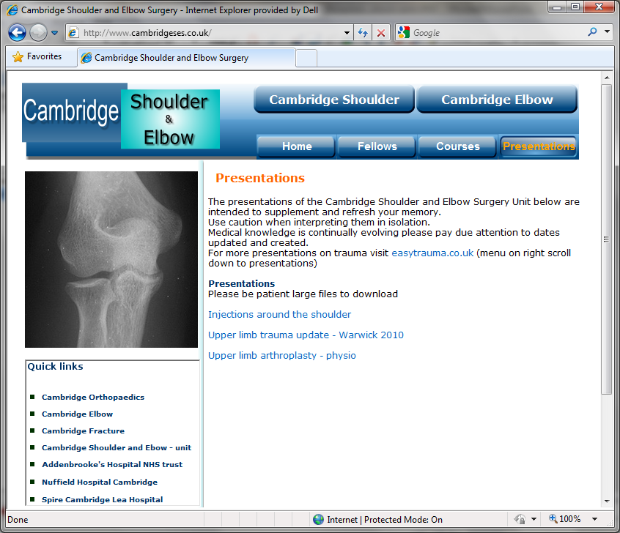
www.cambridgeses.co.uk

Slide 4
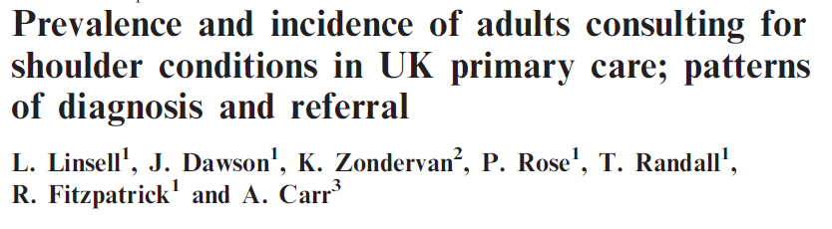
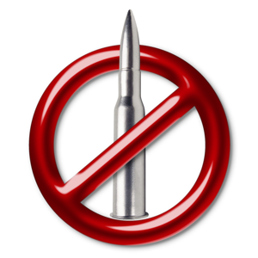
Prevalence
Prevalence of shoulder pain - adults
    7% overall
    26% in elderly
    Only 20-50% present to primary care
1% of primary care consultations
  20% referred to secondary care
  Over 50% only 1 consultation
Rheumatology 2006;45:215–221

Slide 5
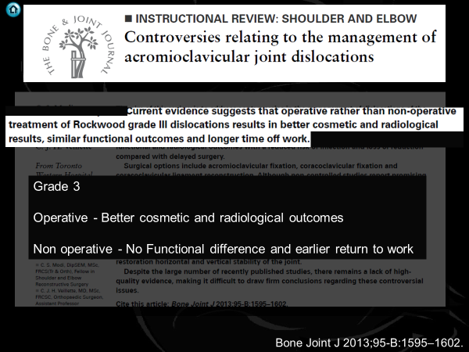
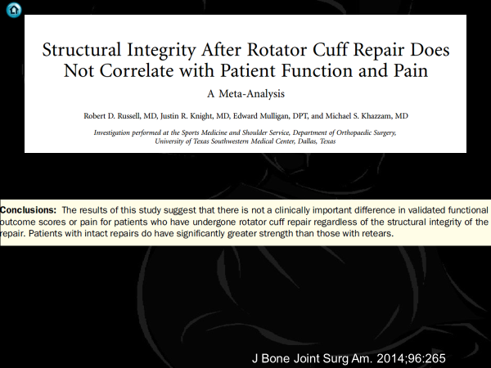
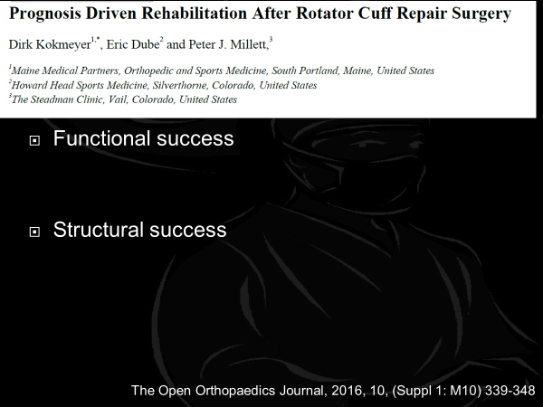
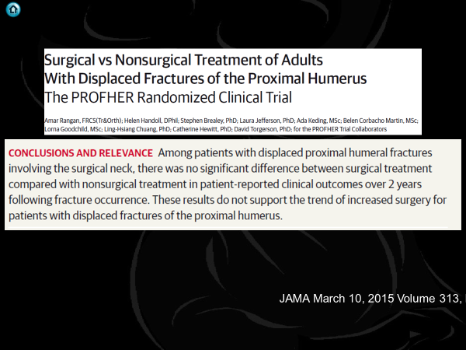
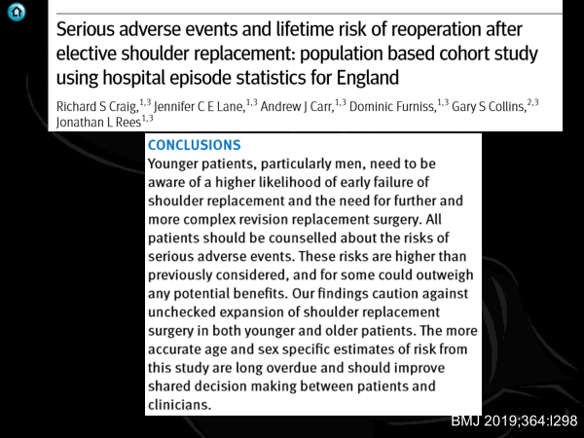

Slide 6
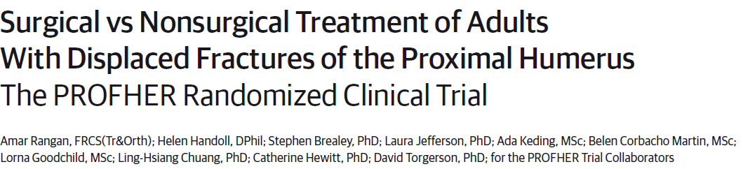
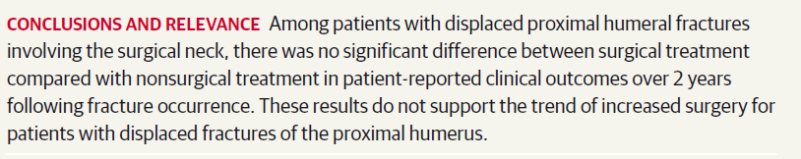
JAMA March 10, 2015 Volume 313, Number 10

Slide 7
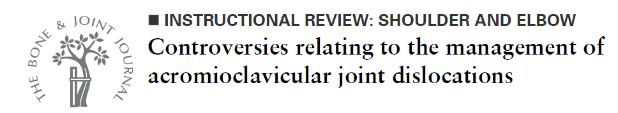
Grade 3
Operative - Better cosmetic and radiological outcomes
Non operative - No Functional difference and earlier return to work
Bone Joint J 2013;95-B:1595–1602.

Slide 8
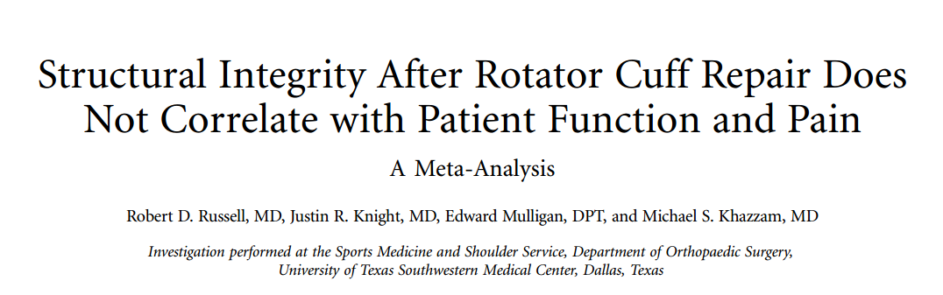
J Bone Joint Surg Am. 2014;96:265

Slide 9
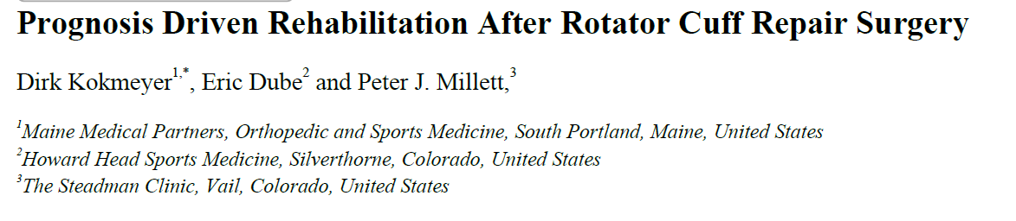
Functional success
Structural success
The Open Orthopaedics Journal, 2016, 10, (Suppl 1: M10) 339-348

Slide 10
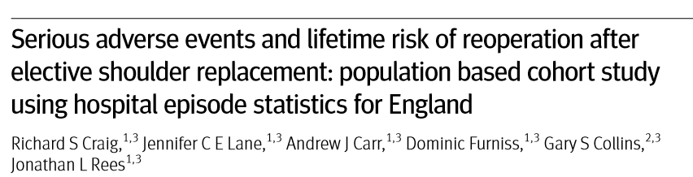
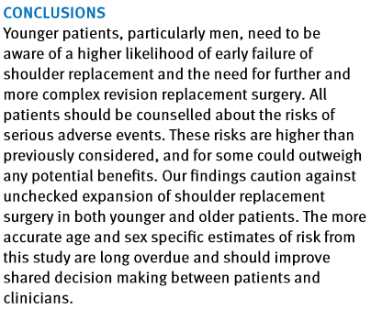
BMJ 2019;364:l298

Slide 11
Summary
Treat the Whole not the Hole………..
The goal of RCR is to:
“Restore the normal anatomy of the rotator cuff in order to reduce pain and restore function.”

Slide 12
JAMA March 10, 2015 Volume 313, Number 10

Slide 13
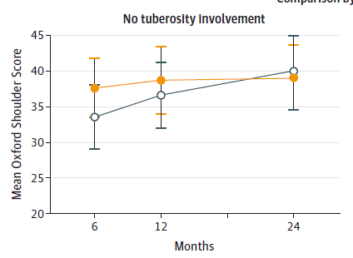
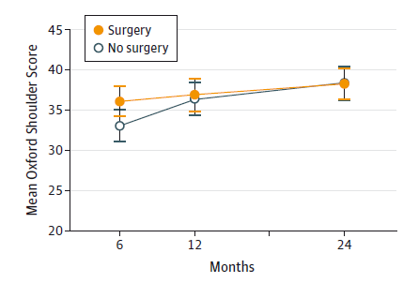
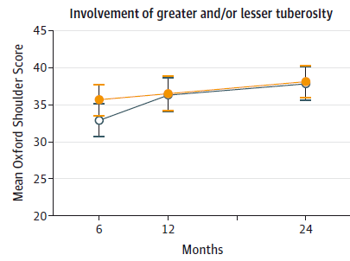
Overalll
JAMA March 10, 2015 Volume 313, Number 10

Slide 14
JAMA March 10, 2015 Volume 313, Number 10

Slide 15
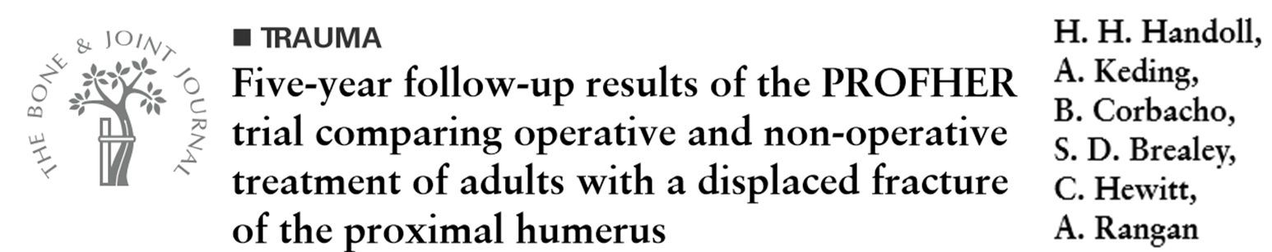
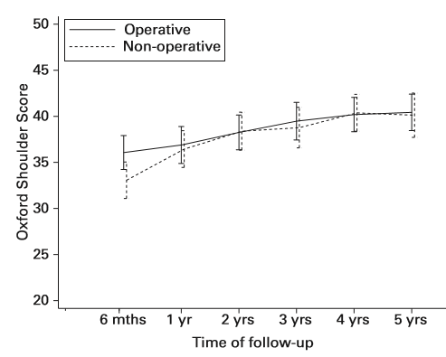
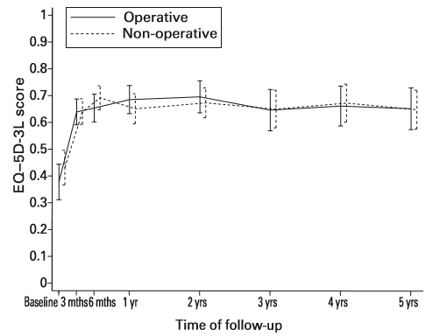
Further surgery
  2 years
    11 Operative
    10 Non operative
  5 years
    11 both groups
Bone Joint J 2017;99-B:383–92.

Slide 16
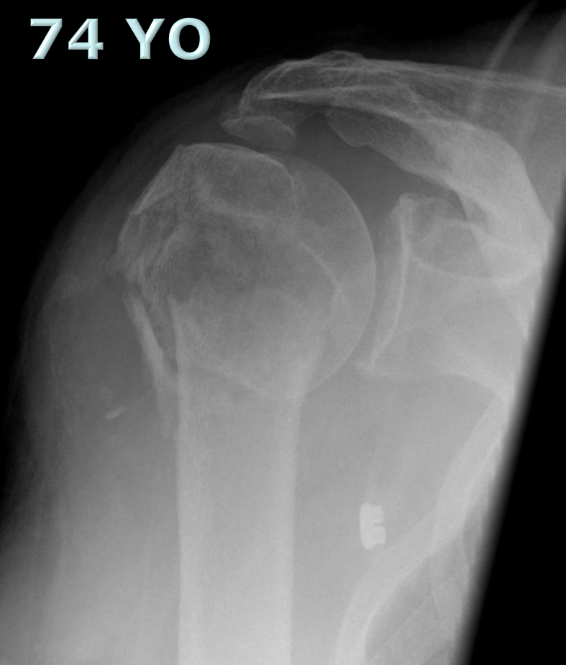
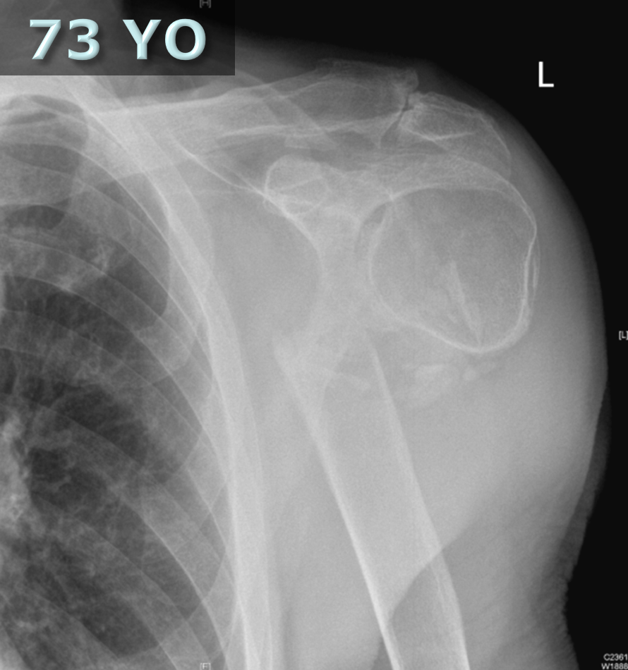
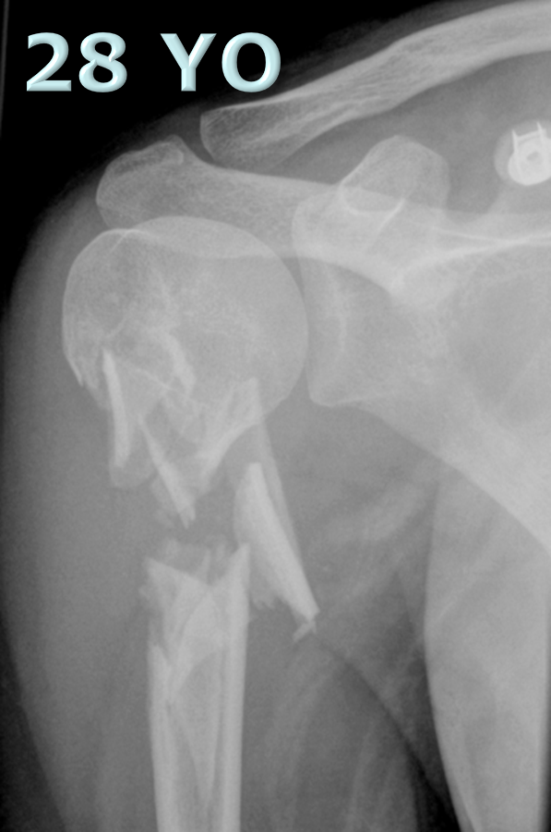
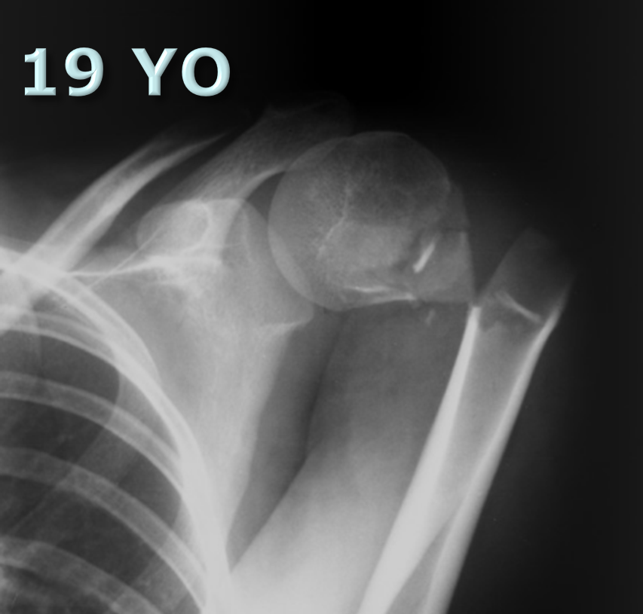

Slide 17
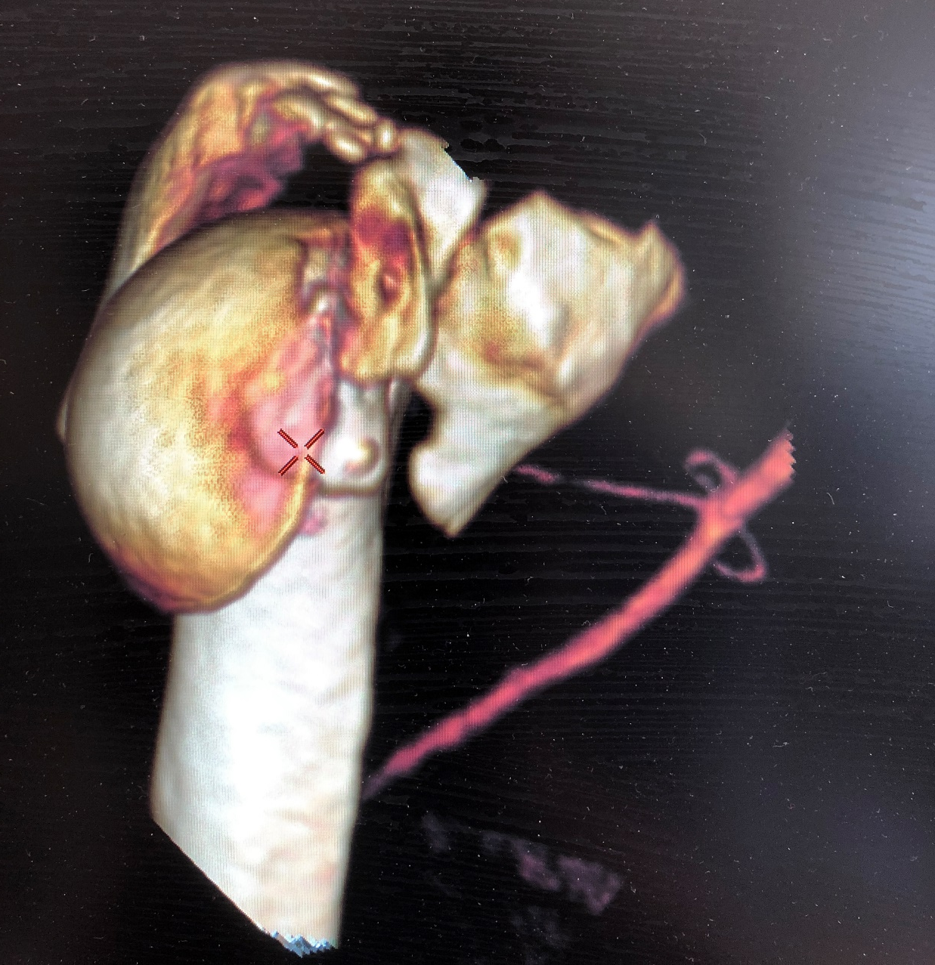
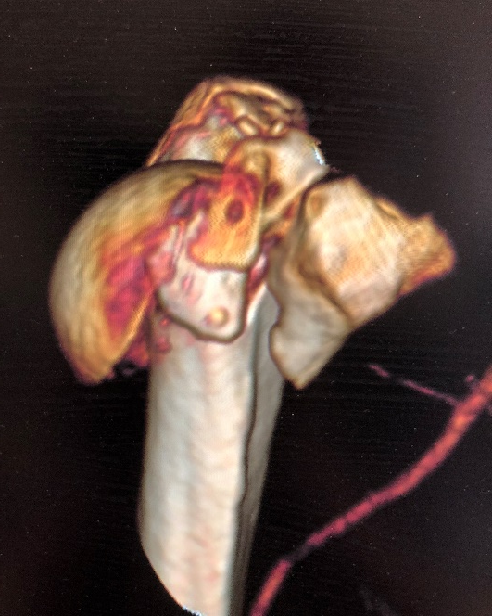
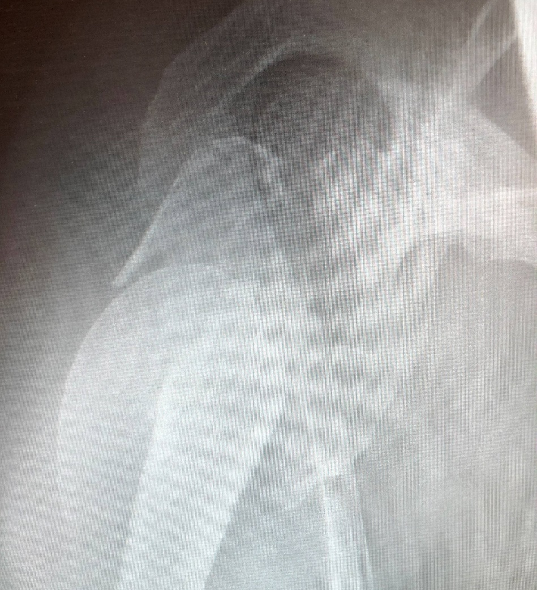
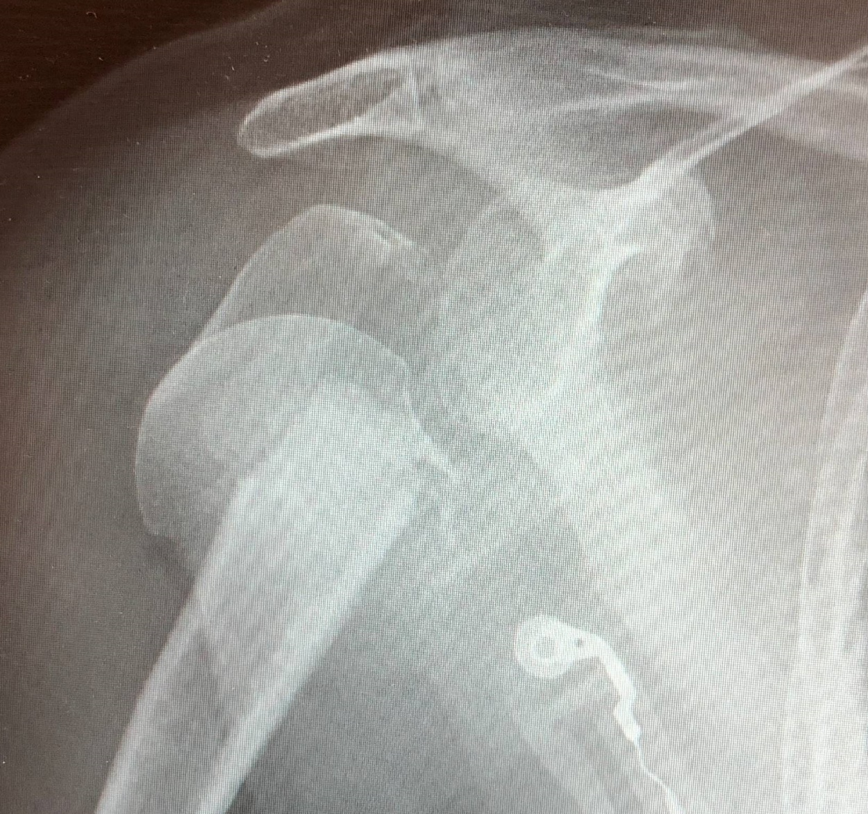
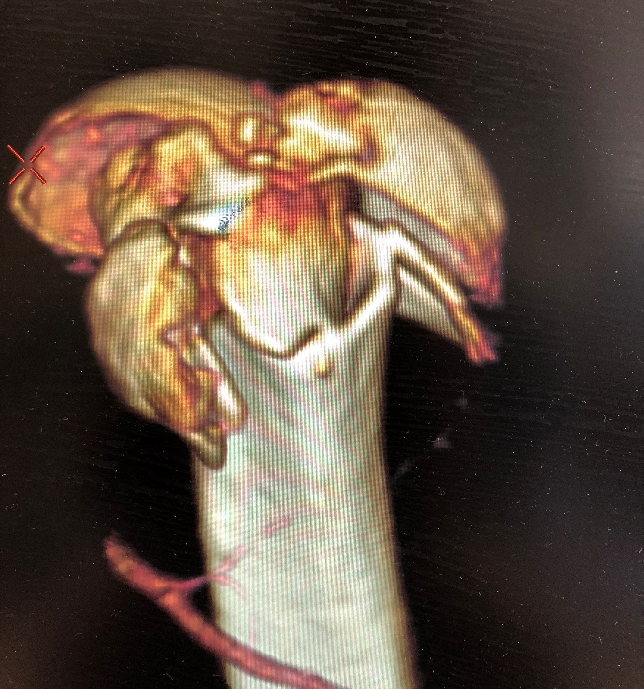
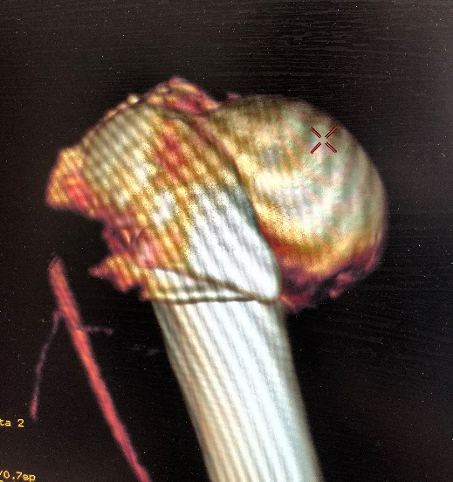
60 YO

Slide 18
J Bone Joint Surg Am. 2014;96:265

Slide 19

Traumatic
Vs
Atraumatic

Slide 20
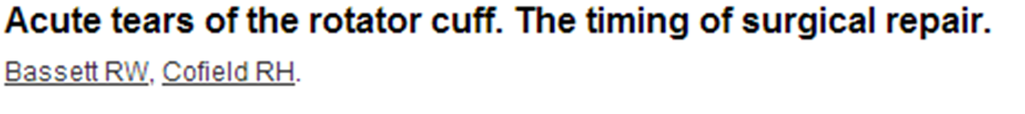
N = 37
  Group 1 – Operated within 3 weeks (n=12)
  Group 2 – Operated within 3 to 6 weeks (n=6)
  Group 3 – Operated within 6-12 weeks (n=19)
F/U ave. 7.0 years (range, 1 - 21 years)
Abduction
  Group 1 = 168°
  Group 2 = 126°
  Group 3 = 129°
Pain relief good for all
Repair best within 3 weeks
Clin Orthop 1983;175:18-24.

Slide 21
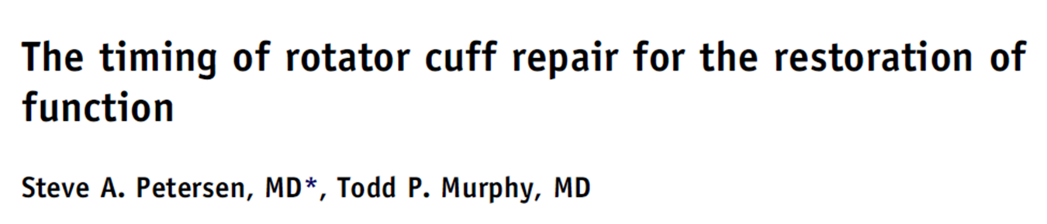
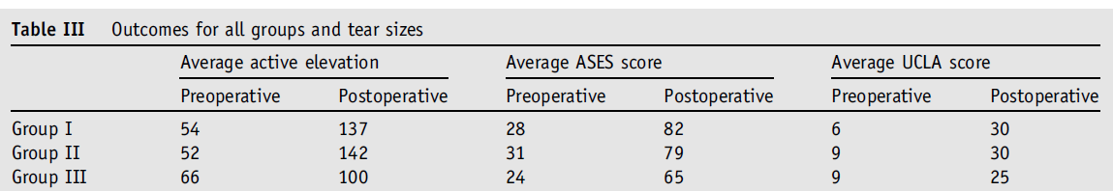
N= 36
3 groups
  Group 1 - 0-8 weeks
  Group 2 - 8-16 weeks
  Group 3 - > 16 weeks
All improved
Pain 7 down to 1
Elevation 55 to 133
J Shoulder Elbow Surg (2011) 20, 62-68

Slide 22


RCR
Surgery
Rehabilitation

Slide 23
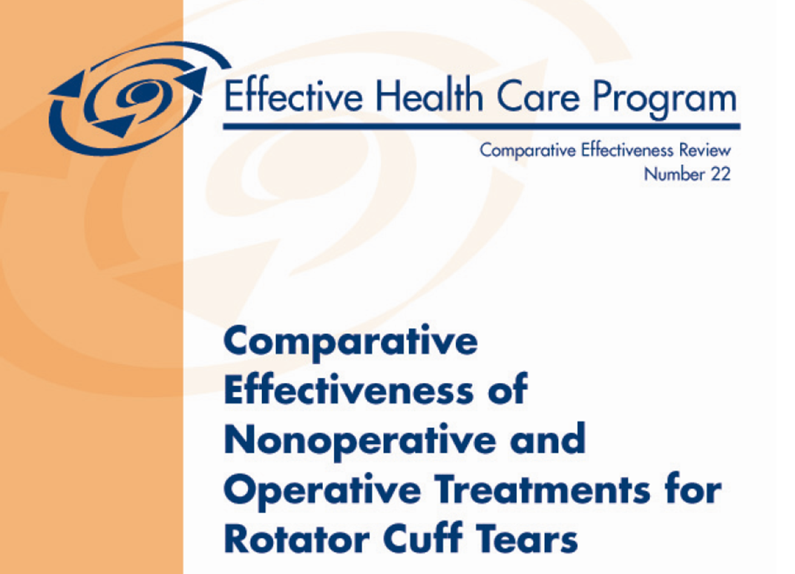
Operative vs Non Operative
Agency for healthcare research and quality
USA July 2010

Slide 24
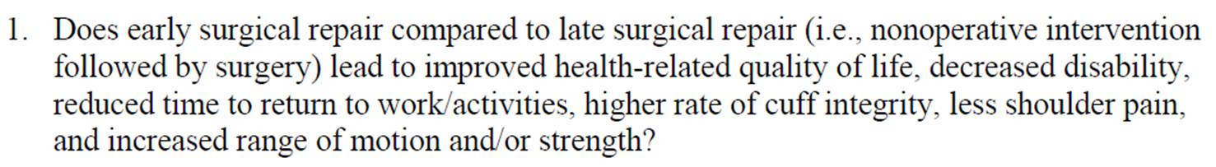
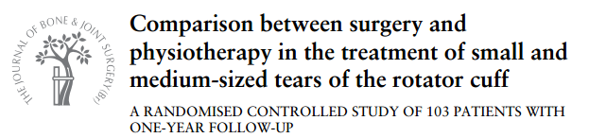
Early Surgery
Vs
Physiotherapy
1 study

Slide 25
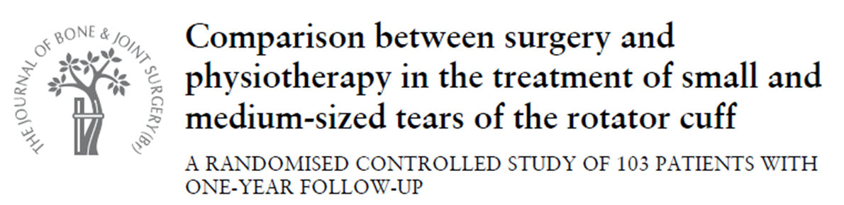
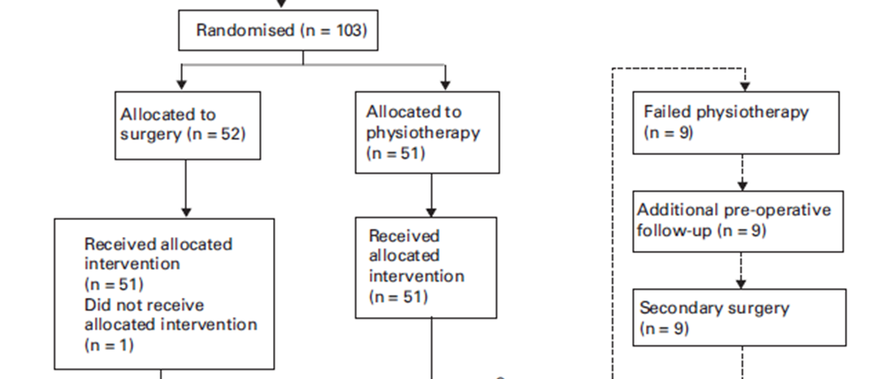
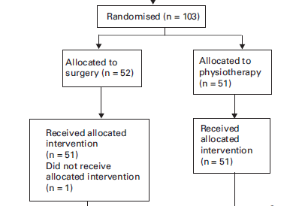
Age 59 (44-75)
Age 61 (46-75)
Symptoms 10 - 12 months
+- 50:50 traumatic and atraumatic
J BJS - Br January 2010 vol. 92-B no. 1 83-91

Slide 26
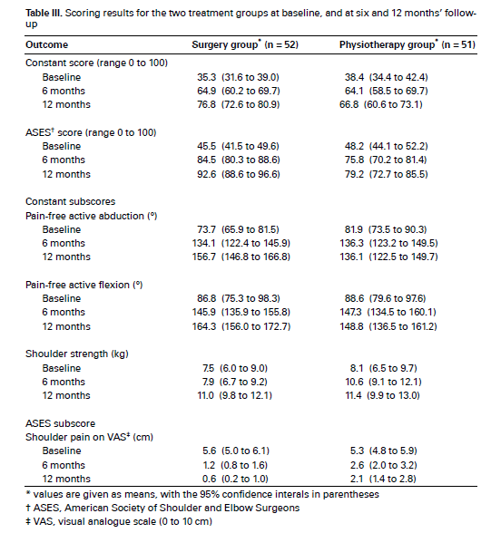
J BJS - Br January 2010 vol. 92-B no. 1 83-91

Slide 27
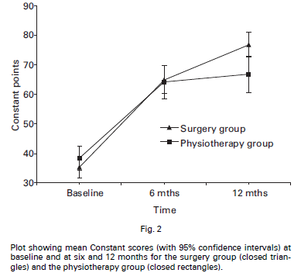
Constant score
Satisfaction
Physiotherapy 7.2 (1-10)
Surgery 9 (1-10)
J BJS - Br January 2010 vol. 92-B no. 1 83-91

Slide 28
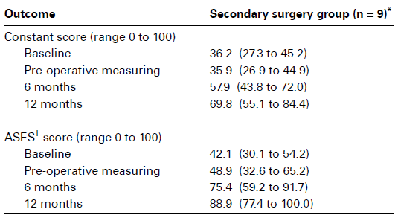
Secondary surgery group
Delay in surgery 5 months
Final outcome
7.5 points less constant score
J BJS - Br January 2010 vol. 92-B no. 1 83-91

Slide 29
Surgery did better
9 no surgery
constant score 7.5 less
BUT
42 Happy not surgery
J BJS - Br January 2010 vol. 92-B no. 1 83-91

Slide 30
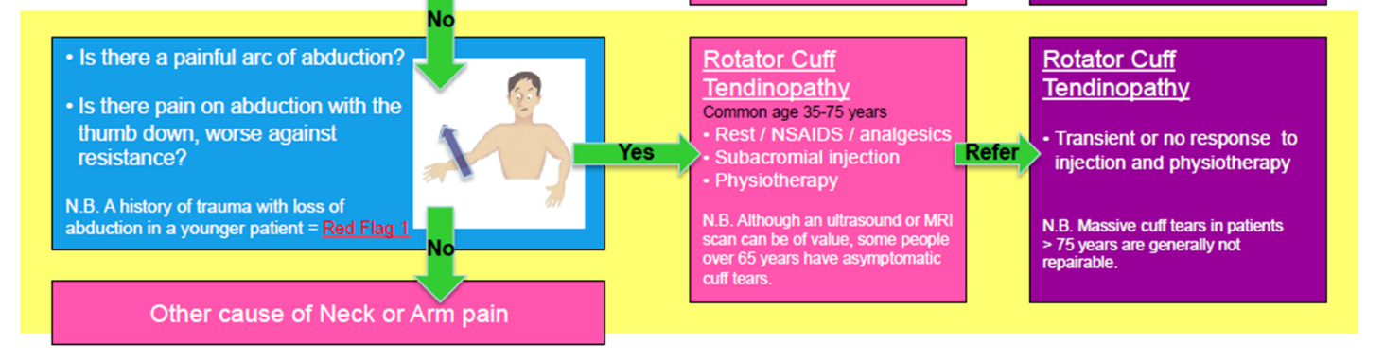

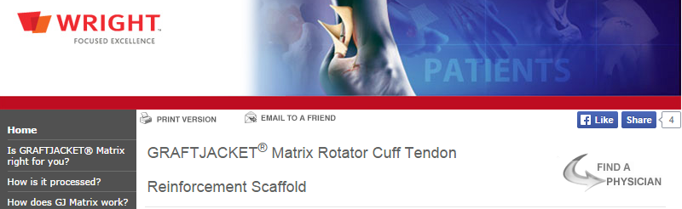
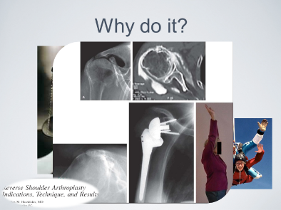

Slide 31

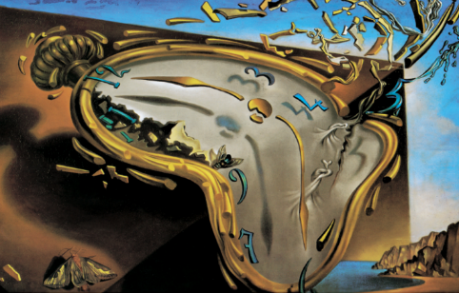

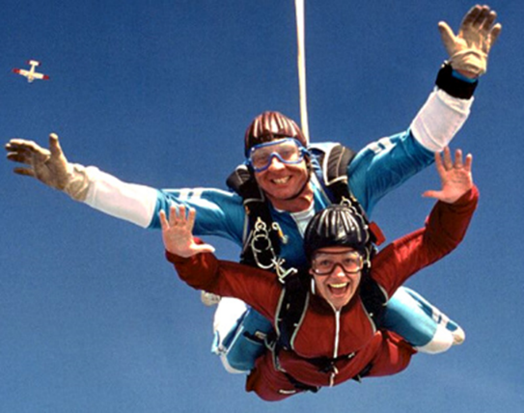
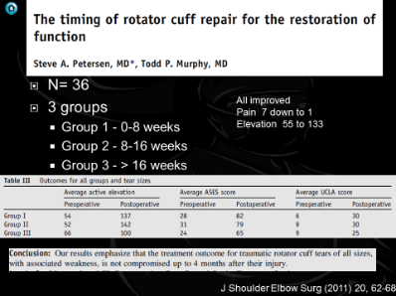

RCR
Surgery
Rehabilitation

Slide 32
Rehabilitation following rotator cuff repair

Slide 33

Tendons gently stressed while healing
  Heal stronger
No Gapping
Sharma P., Maffulli N. J Bone Joint Surg 2005:87:187-202

Slide 34

2 protocols
    Aggressive
    Limited early passive ROM
Pain, range of motion and function all significantly improved after arthroscopic rotator cuff repair
Regardless of early post operative rehabilitation protocols
Arthroscopy. 2012 Jan;28(1):34-42

Slide 35

However, aggressive early motion may increase the possibility of anatomic failure at the repaired cuff
Postoperative MRI scans – re tears
7 of 30 cases (23.3%) in limited group
3 of 34 cases (8.8%) in aggressive
But the difference was not statistically significant (P = 0.106)
Arthroscopy. 2012 Jan;28(1):34-42

Slide 36
6 RCT’s
n=462
No Significant difference in function between protocols
Am J Sports Med 2015; 43(5): 1265-73.

Slide 37
Early ROM group
  Greater forward flexion
      7.45° (95% CI, 3.20°-11.70°) at 6 months
      3.51° (95% CI, 0.31°-6.71°) at 12 months
  Higher re tear rate
    Statistically significant (OR, 1.93; 95% CI, 1.04-3.60)
    after excluding 2 RCTs small to medium-sized tears
Is 3-8 degrees clinically significant
Am J Sports Med 2015; 43(5): 1265-73.

Slide 38
J Bone Joint Surg Am. 2014;96:265

Slide 39
J Bone Joint Surg Am. 2014;96:265

Slide 40
Conclude
Pain relief
Function
  Independent of rehab protocol
  Independent on tendon healing
Strength
  “Better if tendon heals”
Tendon healing only statistically significant in large tears

Slide 41
Functional success
Structural success
The Open Orthopaedics Journal, 2016, 10, (Suppl 1: M10) 339-348

Slide 42
Numerous factors affect outcome
  Age
  Bone mineral density
  Fatty infiltration/ atrophy
  BMI
  Smoker
  Tear size
  Retraction
  Tissue quality
  Pre op strength
The Open Orthopaedics Journal, 2016, 10, (Suppl 1: M10) 339-348

Slide 43

The Open Orthopaedics Journal, 2016, 10, (Suppl 1: M10) 339-348

Slide 44

The Open Orthopaedics Journal, 2016, 10, (Suppl 1: M10) 339-348

Slide 45


Slide 46


Slide 47


Slide 48
Numerous factors affect outcome
  Age
    <50 better >60-65 poorer
The Open Orthopaedics Journal, 2016, 10, (Suppl 1: M10) 339-348

Slide 49
Numerous factors affect outcome
  Bone mineral density
    Osteopoenia and osteoporosis
      Increased structural failure, pull out strength of anchors
The Open Orthopaedics Journal, 2016, 10, (Suppl 1: M10) 339-348

Slide 50
Numerous factors affect outcome
  Fatty infiltration/ atrophy
    Goutallier scale 0-4
      100% tear failure stage 2 FI and MA
      92% healing stage 1 or less
The Open Orthopaedics Journal, 2016, 10, (Suppl 1: M10) 339-348

Slide 51
Numerous factors affect outcome
  BMI
    >30 associated with longer stay higher failure rates and more stiffness
The Open Orthopaedics Journal, 2016, 10, (Suppl 1: M10) 339-348

Slide 52
Numerous factors affect outcome
  Tear size
    Re tear rates significantly higher for larger tears
The Open Orthopaedics Journal, 2016, 10, (Suppl 1: M10) 339-348

Slide 53





Summary

Slide 54
Trends in shoulder joint replacement

Slide 55
BMJ 2019;364:l298

Slide 56

BMJ 2019;364:l298

Slide 57

BMJ 2019;364:l298

Slide 59

2013 to 2016
Resurfacing hemi
565 (13%)
337 (6%)

Slide 60
2013 to 2016
Resurfacing Total
219 (5%)
127 (2%)

Slide 61

Revision rate
Total Vs Reverse

Slide 62

Total shoulder by age

Slide 63


Australian Joint registry
Reverse
Total
Stemmed
Total
Mid head

Slide 64

Questions ?

