Slide 1
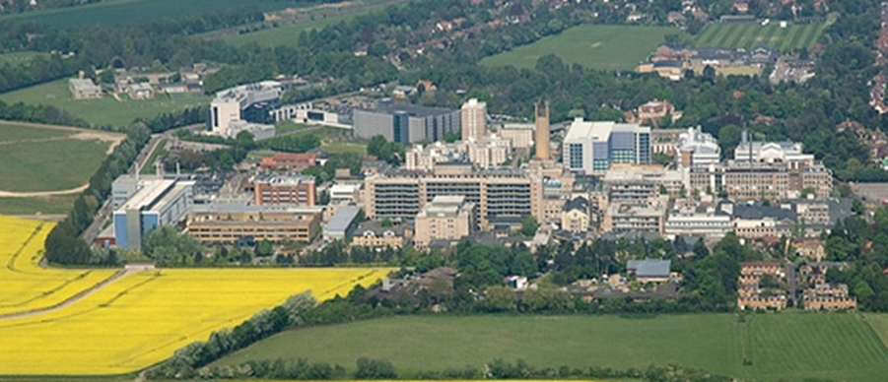
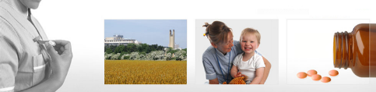
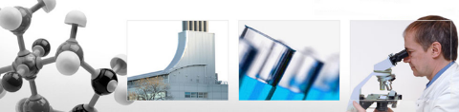
A Peep into the future
Pick your winners
Mr Lee Van Rensburg
Cambridge University Hospitals NHS trust
2017

Slide 2

Disclaimer
Acumed – Consultancy work
  Non shoulder arthroplasty

Slide 3


Slide 4

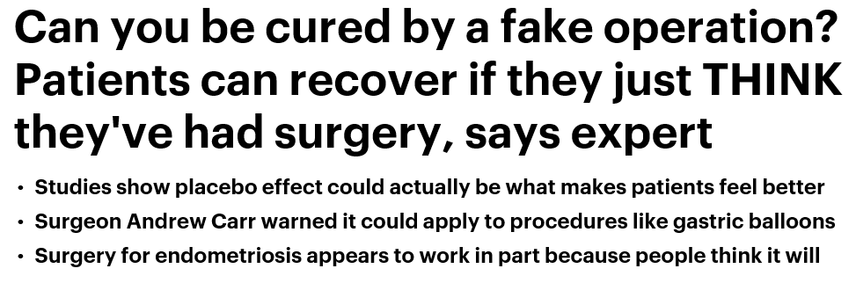

Slide 5
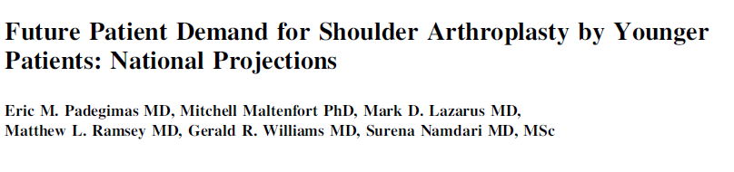
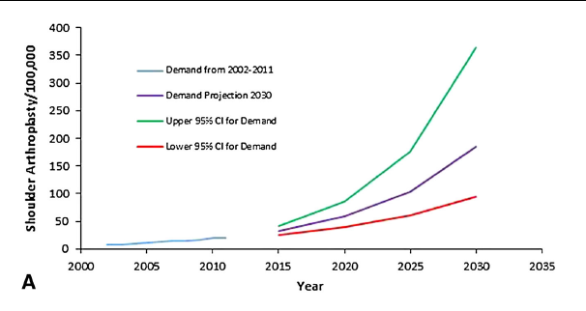
Entire Population
Clin Orthop Relat Res (2015) 473:1860–1867

Slide 6
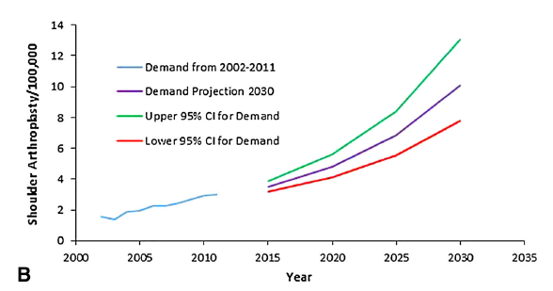
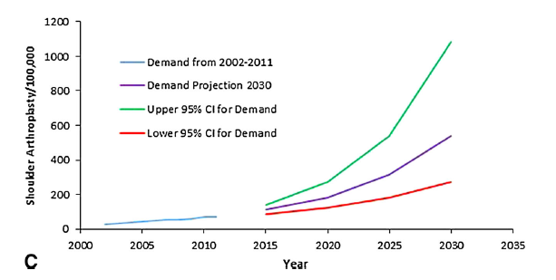
> 55 years of age
<= 55 Years of age
Clin Orthop Relat Res (2015) 473:1860–1867

Slide 7
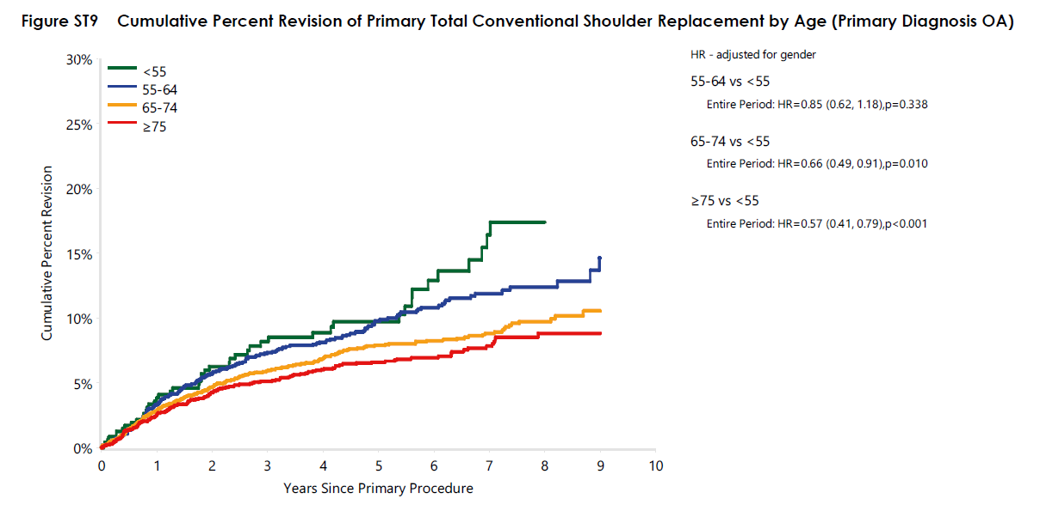
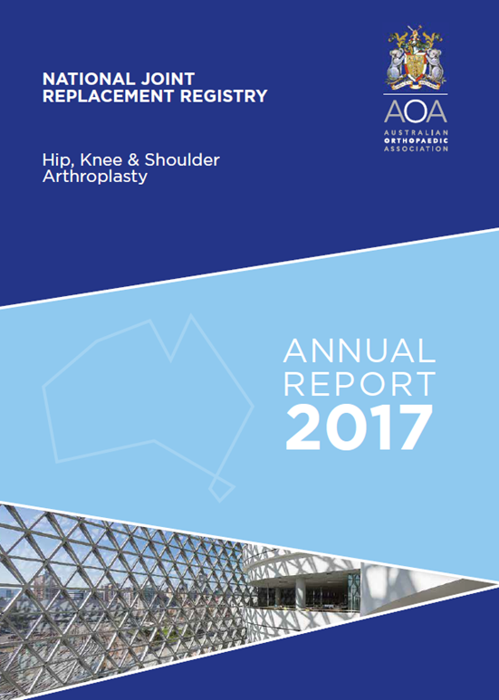
Australian Joint registry
AGE <55
Age >= 75

Slide 8
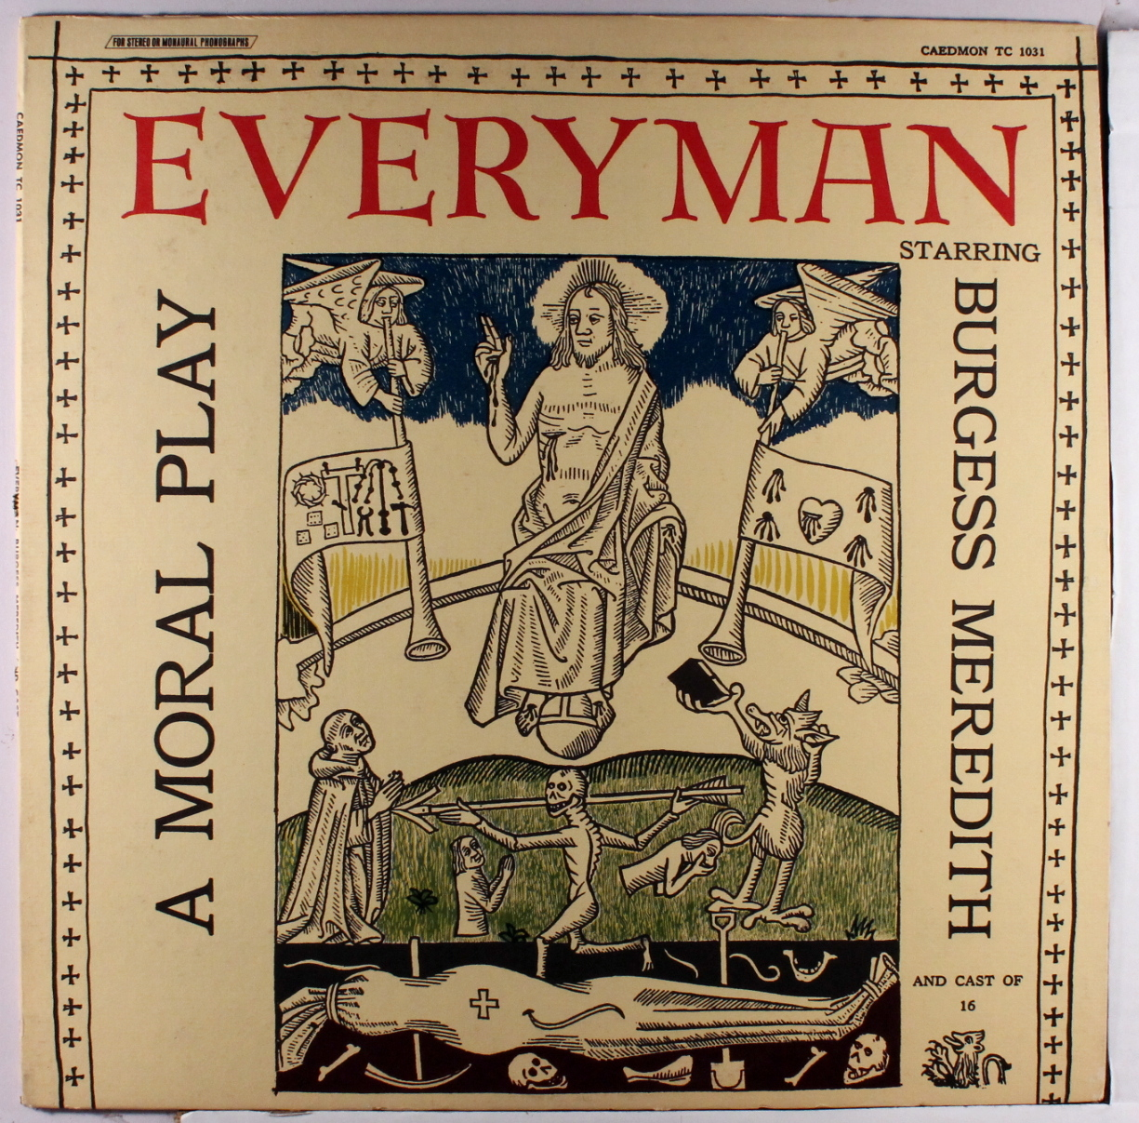

Slide 9

Haines et al; J Bone Joint Surg Br. 2006 Apr;88(4):496-501.

Slide 10
OA - Pain
Haines et al; J Bone Joint Surg Br. 2006 Apr;88(4):496-501.

Slide 11
OA – Range of Motion
Haines et al; J Bone Joint Surg Br. 2006 Apr;88(4):496-501.

Slide 12
OA - Function
Haines et al; J Bone Joint Surg Br. 2006 Apr;88(4):496-501.

Slide 13
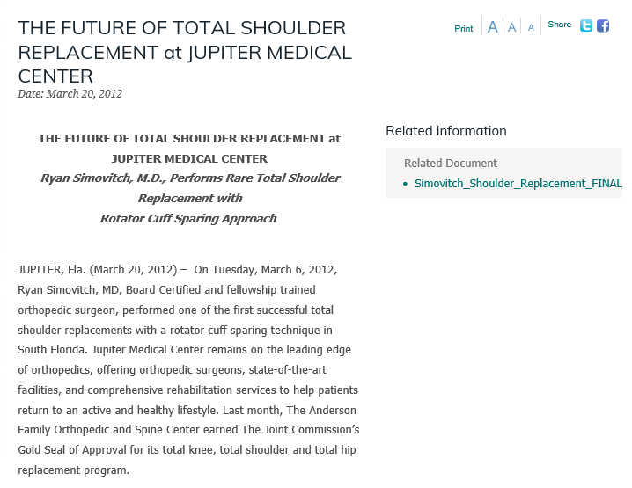
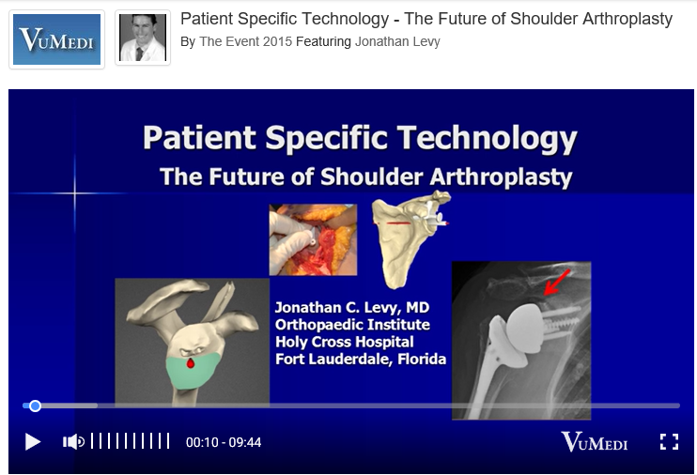

Slide 14

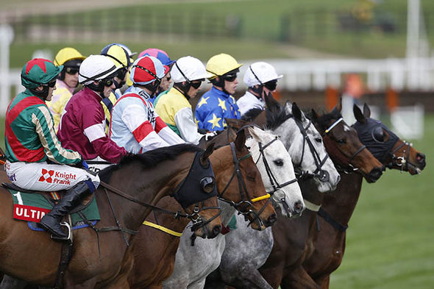

Slide 15
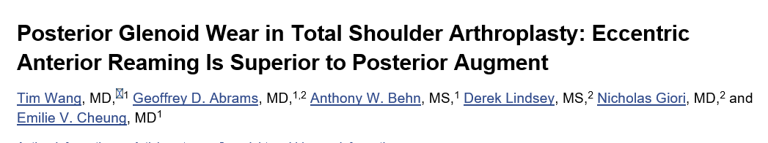
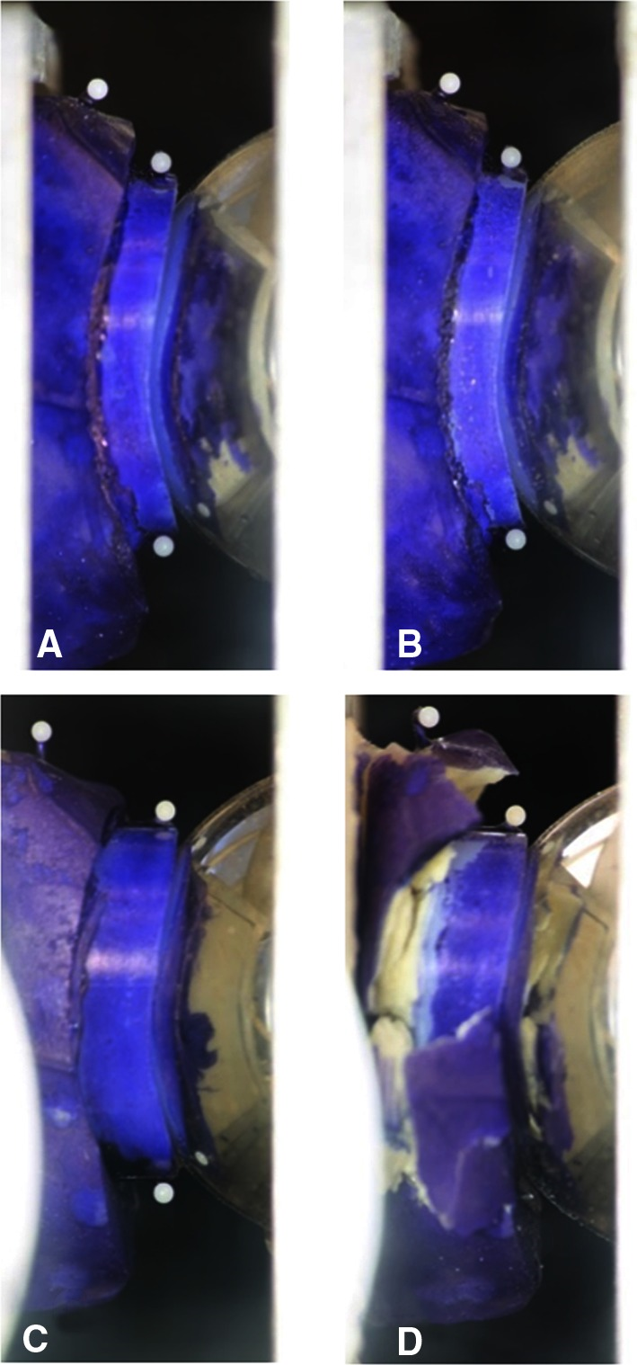
Clin Orthop Relat Res. 2015 Dec; 473(12): 3928–3936

Slide 16

Glenoid

Slide 17
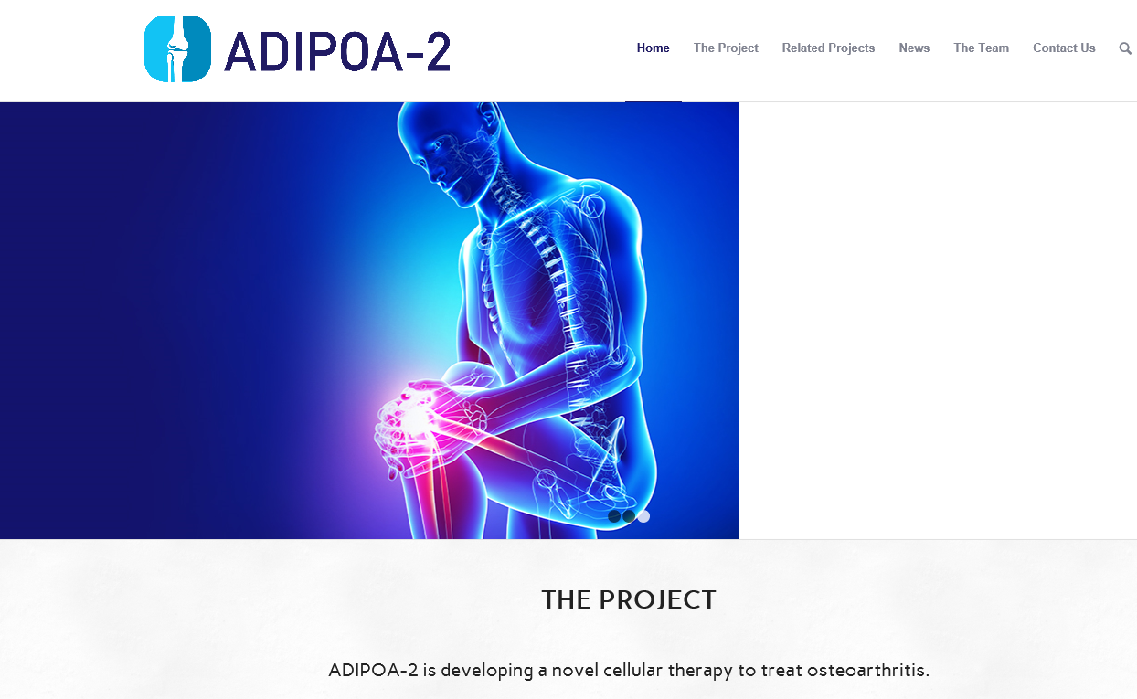
Stem cell therapy

Slide 18
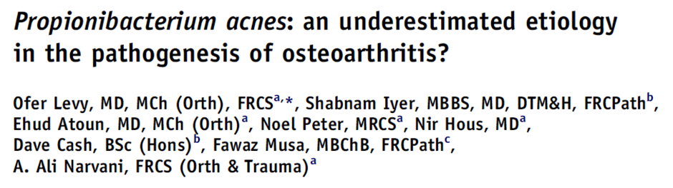
Cultured Shoulder arthroplasty
23 of 55 (42%) consecutive patients having TSR
  P acnes
High incidence suggests role in pathogenesis arthritis
J Shoulder Elbow Surg (2013) 22, 505-511

Slide 19
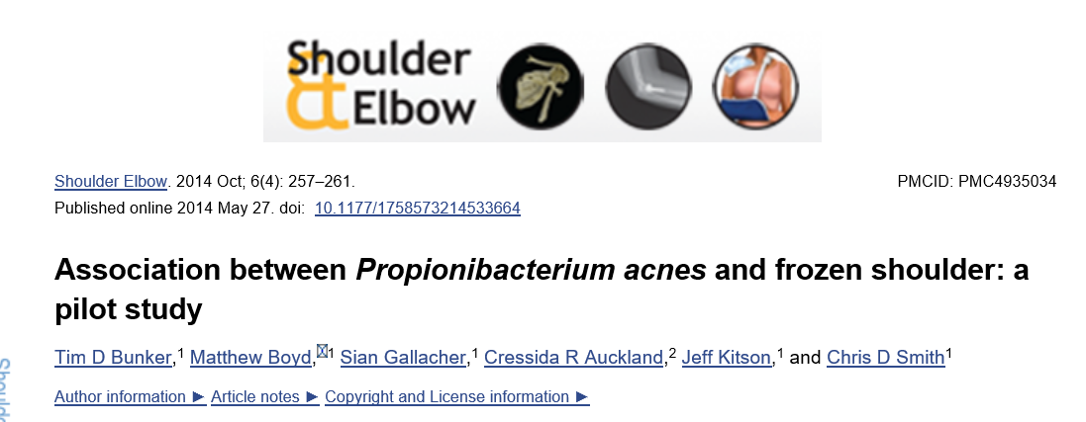
6 out of 10 Positive P acnes
Shoulder & Elbow 2014, Vol. 6(4) 257–261

Slide 20
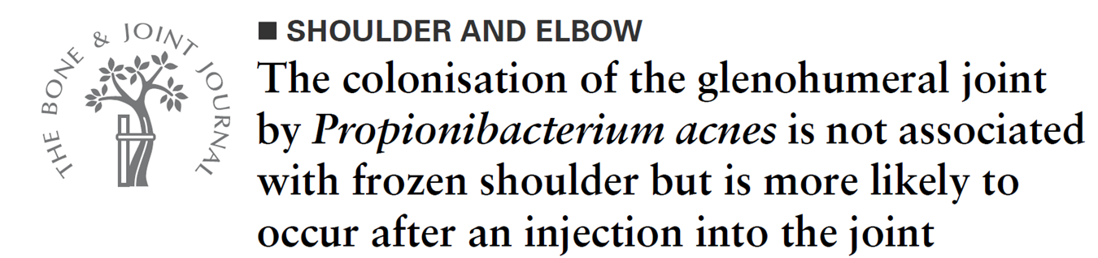
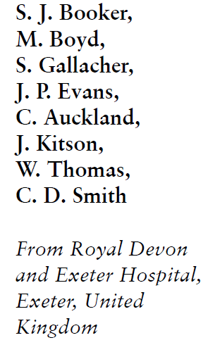
Scope
  Stabilisation or capsular release
n=46
25 (53%) had p acnes
No Association P acnes with Frozen Shoulder
Bone Joint J 2017;99-B:1067–72.

Slide 21
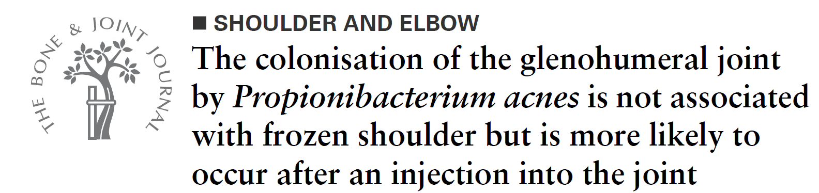
A pre-operative glenohumeral injection
significantly associated with capsular P. acnes colonisation
Bone Joint J 2017;99-B:1067–72.

Slide 22
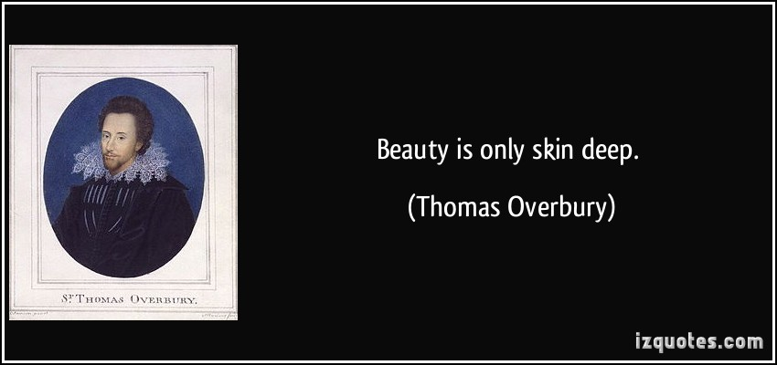
Proprioni Bacterium
Acnes

Slide 23
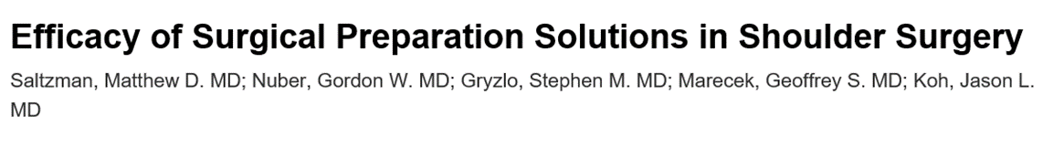
Skin preparation solutions
Positive cultures
  31% Povidone-iodine
        (0.75% iodine scrub and 1.0% iodine paint)
  19% DuraPrep
        (0.7% iodophor and 74% isopropyl alcohol)
  7% ChloraPrep
        (2% chlorhexidine gluconate and 70% isopropyl alcohol)
American Volume: 01 August 2009 - Volume 91 - Issue 8 - p 1949–1953

Slide 24
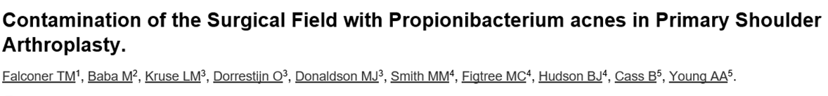
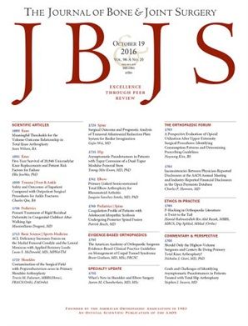
n = 40
    Subdermal layer
    Tip of the surgeon's glove
    Inside scalpel blade
    Forceps
    Skin blade
13 (33%) positive swab
Male 66 X more likely +ve swab
Sub dermal most common
Volume . 98(20):1722-1728, October 19, 2016

Slide 25
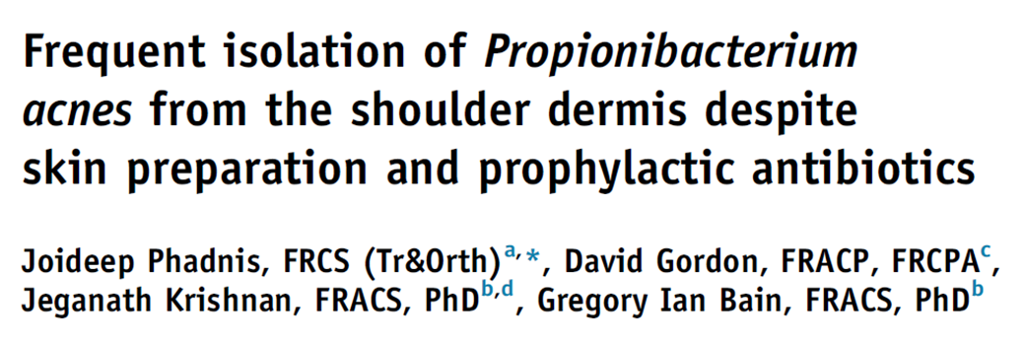
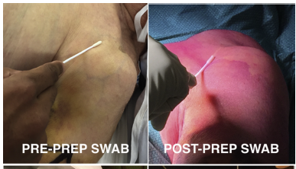

n=50 cases
    70% Chlorhexidine and alcohol
    IV antibiotics
      2G Cefazolin (30 min before)
Positive
    42% (21) pre prep swabs
    14% (7) post prep
    52 %(26) dermal swabs
    40% (20) dermal biopsy
J Shoulder Elbow Surg (2016) 25, 304-310

Slide 26
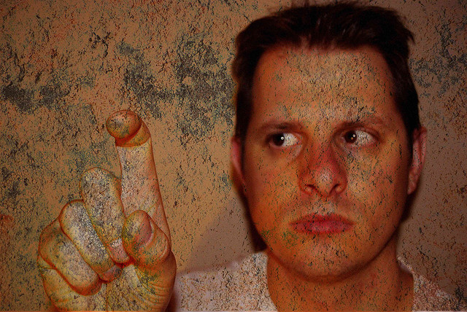

Slide 27
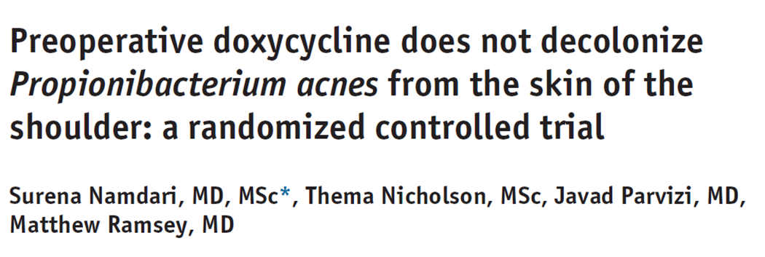
RCT n=74 (37 each)
    Males undergoing shoulder arthroscopy
    > 18 YO
Doxycyline 100mg BD 7 Days Vs Nothing
J Shoulder Elbow Surg (2017) 26, 1495–1499

Slide 28
Two - 3mm punch biopsies were taken from anterior and posterior scope portal sites.
J Shoulder Elbow Surg (2017) 26, 1495–1499

Slide 29
Out of all cases (74)
  51% (38) - at least 1 positive
  30% (22) had 2 positive
Non Drug (37)
  60% (22) – at least 1 positive
Drug Group (37)
  43% (16) – At least 1 positive
Difference 17%
Not significant
35% Reduction clinically significant
J Shoulder Elbow Surg (2017) 26, 1495–1499

Slide 30
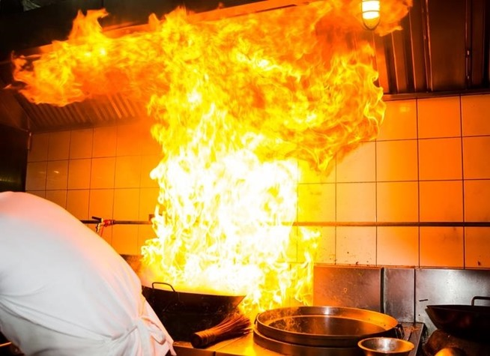
So What ?

Slide 31
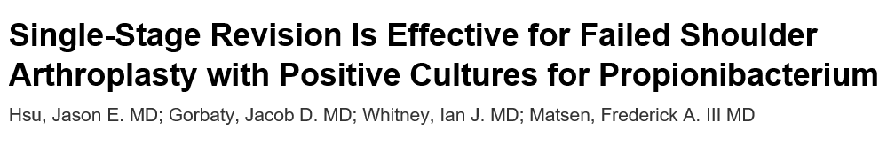

P Acnes
n=55; 2 year follow up
1 stage revision for presumed aseptic loosening
Cultured them all prior to antibiotics
27 had 2 positive cultures – p acnes
    89% of culture positive group were male
Volume 98 (20) - Issue 24 - p 2047–2051

Slide 32
P Acnes
Compared Culture Positive Vs Culture negative
  SST (Simple Shoulder Test)
  Secondary procedures
No difference in outcome
Volume 98 (20) - Issue 24 - p 2047–2051

Slide 33
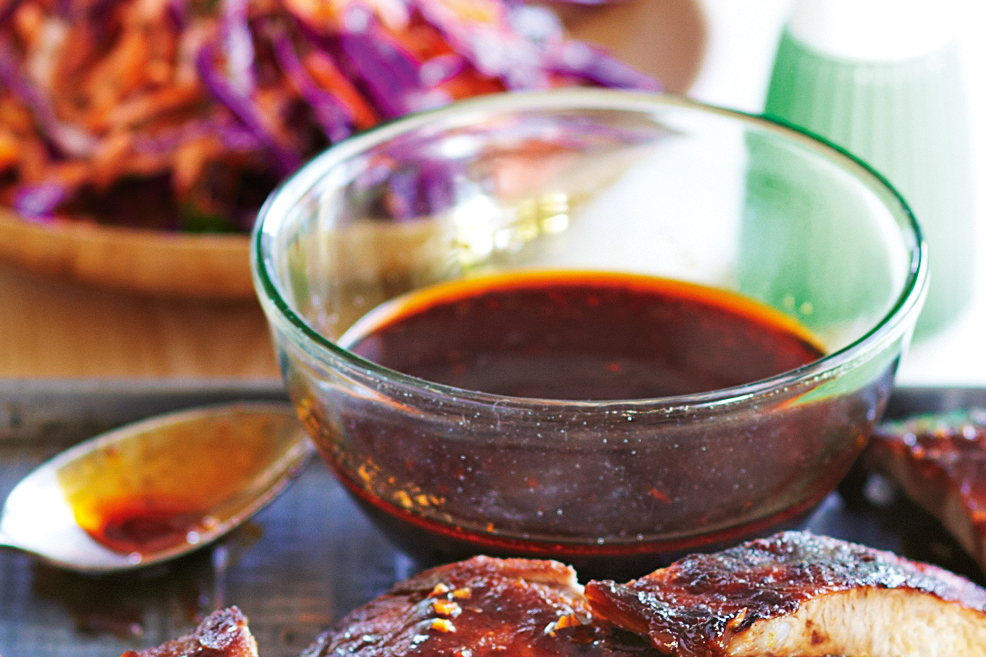
P Acnes
Antibiotic Protocol
5 Specimens taken then
  15 mg/kg of vancomycin and 2 g of ceftriaxone / Allergy Clindamycin
Split into high index or low index suspicion infection
.
Volume 98 (20) - Issue 24 - p 2047–2051

Slide 34
P Acnes
High Index
  Intravenous ceftriaxone continued till 3 week culture back
  Vancomycin discontinued unless cultures were positive for mecA coagulase-negative Staphylococcus
  If the cultures were negative at 3 weeks, all antibiotics were discontinued.
Low index
  Oral amoxicillin and clavulanate
  either until the cultures negative at 21 days
  or until 2 cultures with the same bacterial species became positive.
Volume 98 (20) - Issue 24 - p 2047–2051

Slide 35
P Acnes
2 cultures positive
ID input
6 weeks
  Intravenous ceftriaxone and/or vancomycin
  Oral rifampicin
Followed by minimum 6 months
  amoxicillin and clavulanate
  or doxycycline
Volume 98 (20) - Issue 24 - p 2047–2051

Slide 36


Friend or Foe
Clin Microbiol Rev. 2014 Jul;27(3):419-40

Slide 37
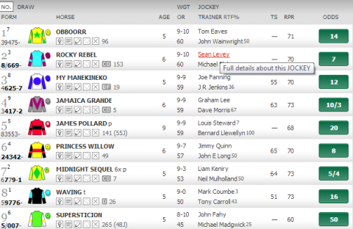
Racing form guide

Slide 38
Australian joint registry
Started 2004
Full implementation 2008
38 265 cases in total
  2008 to 2016
    Increase 115%

Slide 39
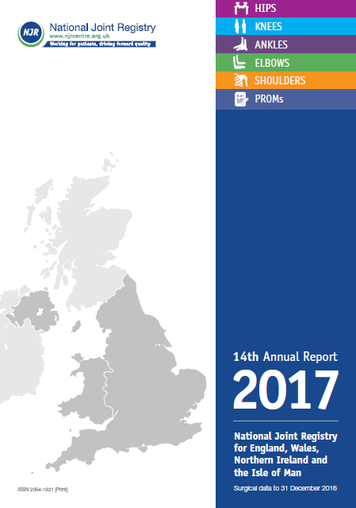
UK NJR Shoulders
April 2012 – 2017
23608 procedures in register
  2013 – 4345 cases
  2016 – 5944 cases

Slide 40
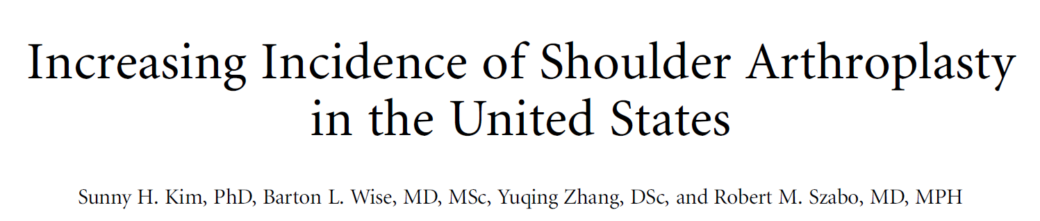
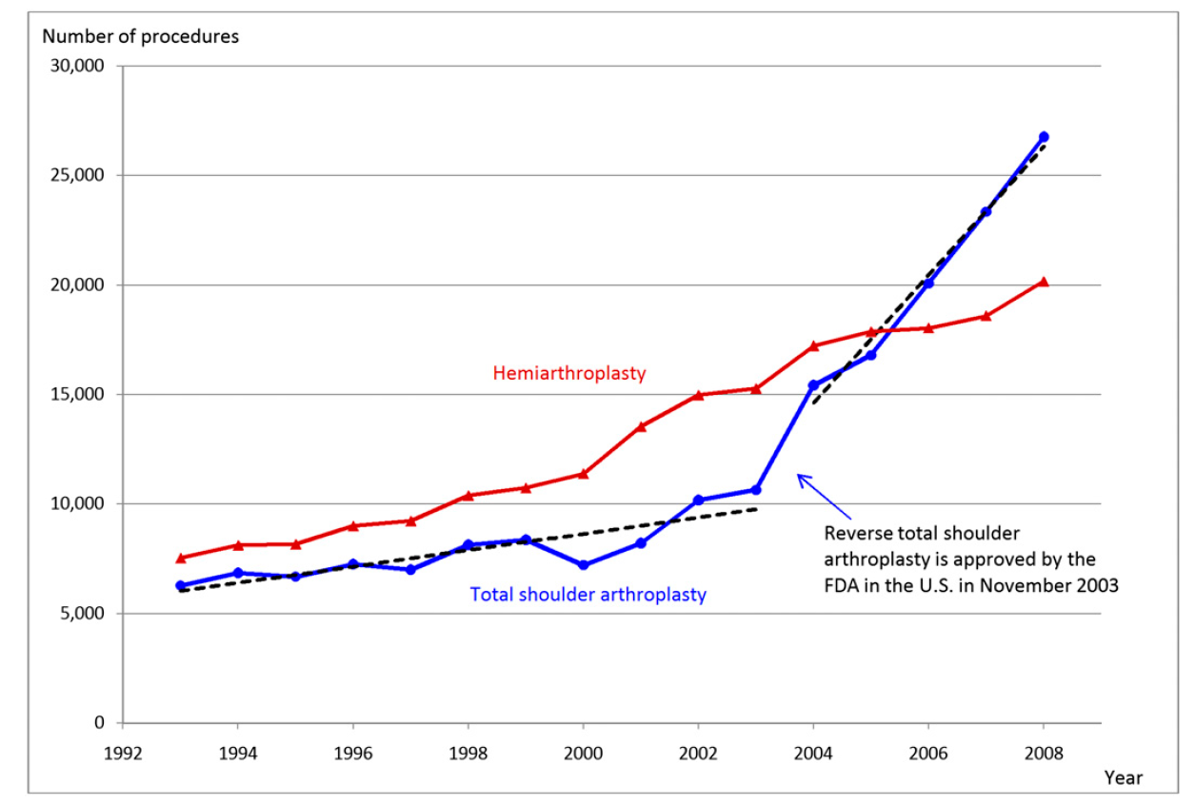
From 1993 to 2003
Increase 373/ yr
From 2004
Increase 2922/ yr
J Bone Joint Surg Am. 2011;93:2249-54

Slide 41
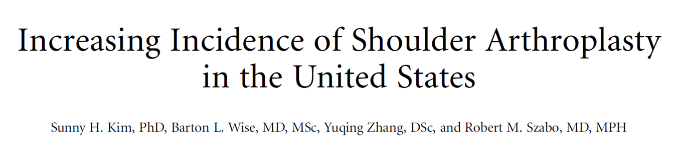
1998 – 19000 shoulder arthroplasties
2008 – 47000 shoulder arthroplasties (2.5*)
Expanding elderly population
  Increased 11% time period
Increased shoulder and elbow surgeons
  2000 – 16266
  2008 – 21658 (+ve 5392)
Sudden change 2004
  FDA approval reverse prosthesis
J Bone Joint Surg Am. 2011;93:2249-54

Slide 42
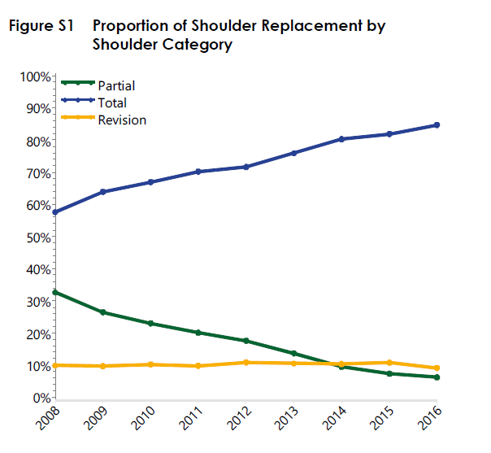
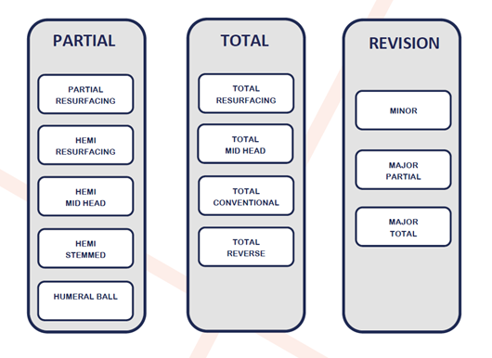
Australian joint registry
TSR (reverse and anatomic)
  2008 = 58%
  2016 = 85%
Partial (hemiarthroplasty)
  2008 = 33%
  2016 = 6%
Revision static
  9-10%
Total
Partial

Slide 43
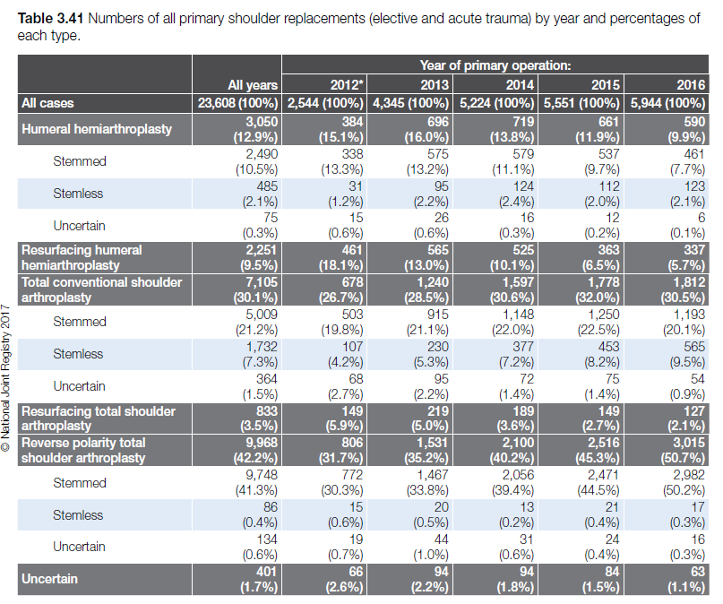

Slide 44
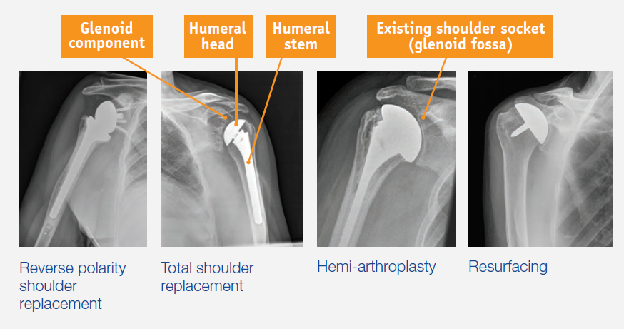
2013
All indications - 4345
Reverse
35%(1363)
Total
29%(1110)
Hemiarthroplasty
31%
Resurfacing
Total
5%
Stemmed
hemi
16%
Resurfacing
hemi
15%

Slide 45
2013 (4345) to 2016 (5944)
Reverse
1363 (35%)
3015 (51%)

Slide 46
2013 - 2016
Total
1110 (29%)
1812 (31%)

Slide 47
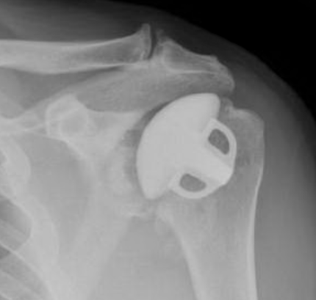
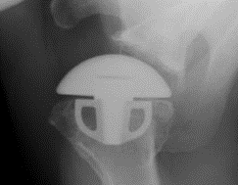
2013 - 2016
Total
1110 (29%)
1812 (31%)
Total
Stemless
230 (5%)
Total
Stemmed
915 (21%)
565 (10%)
1193 (20%)

Slide 48
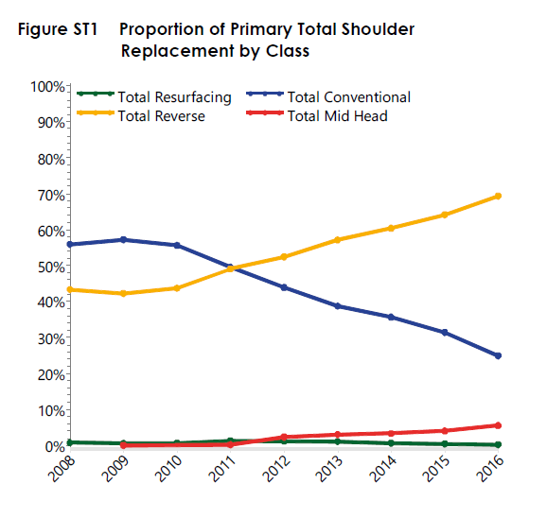
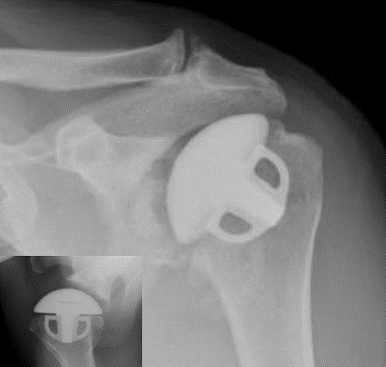
Australian Joint registry
Reverse
Total
Stemmed
Total
Mid head

Slide 49
2013 to 2016
Resurfacing hemi
565 (13%)
337 (6%)

Slide 50
2013 to 2016
Resurfacing Total
219 (5%)
127 (2%)

Slide 51
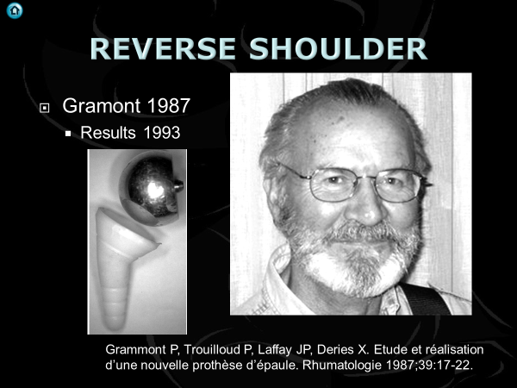
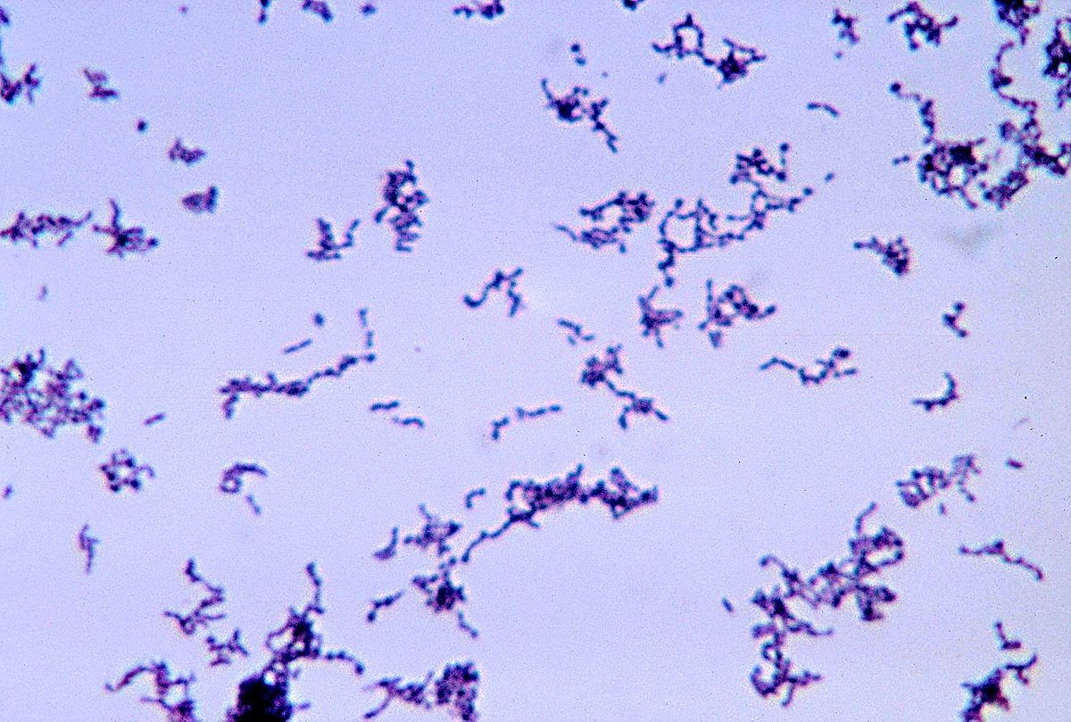

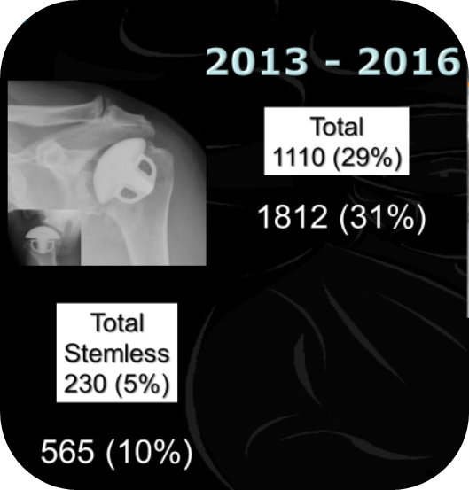
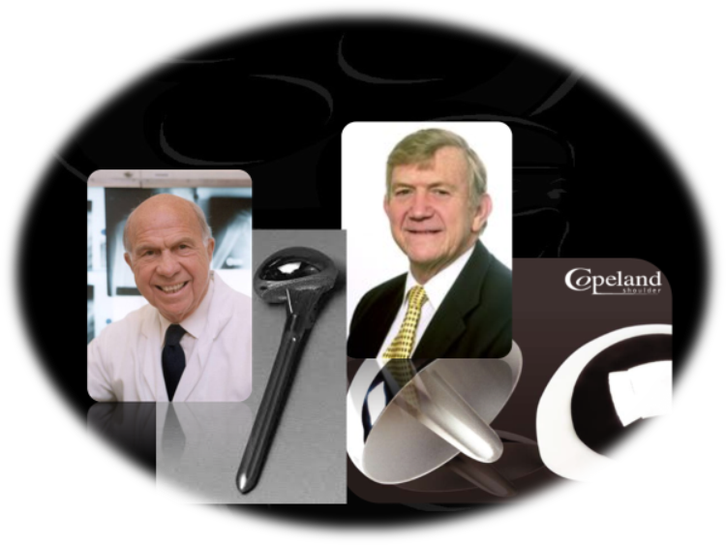





Peep into future

Slide 52

Revision rate
Total Vs Reverse

Slide 53


Slide 54

Total shoulder by age

Slide 55

Fixation

Slide 56
Revision
TSR 12% at 10 years

Slide 57

% Revision by diagnosis

Slide 58

Reverse

Slide 59

Age of reverse

Slide 60

Fixation Reverse

Slide 61

Revision rate reverse

Slide 62

Reason revision reverse

Slide 63

Revision rate reverse fracture

Slide 64

Revision fracture maleVs Female

Slide 65
UK Joint Registry

Slide 66





Slide 67




Shoulder Arthroplasty
1893 - Jules Émile Péan, French surgeon
  Themistocles Gluck, 1890, Romania, Ivory
Modern day arthroplasty - Neer 1950’s
  Initially trauma
Glenoid weak point
Resurfacing – Copeland 1986

Slide 68


REVERSE SHOULDER
Gramont 1987
  Results 1993
Grammont P, Trouilloud P, Laffay JP, Deries X. Etude et réalisation
d’une nouvelle prothèse d’épaule. Rhumatologie 1987;39:17-22.

Slide 69




