Slide 1
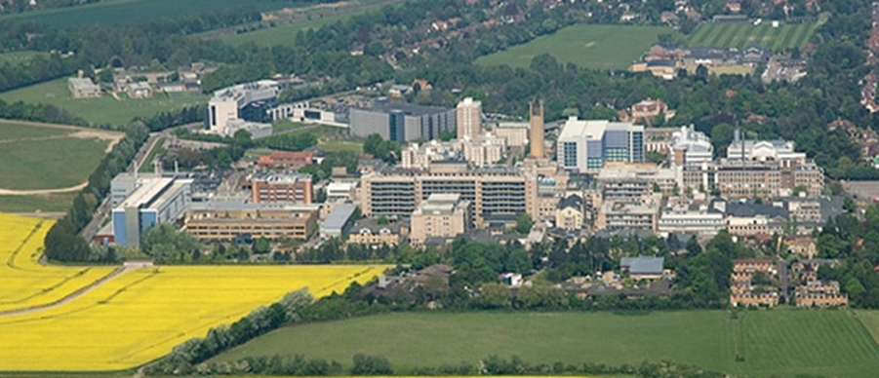

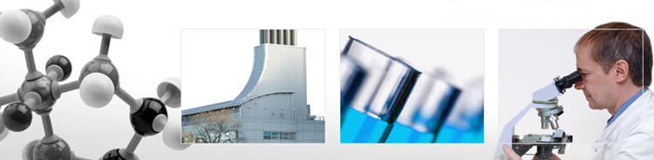
Mr Lee Van Rensburg
Cambridge University Hospitals NHS trust
Oxford March 2020

Slide 2
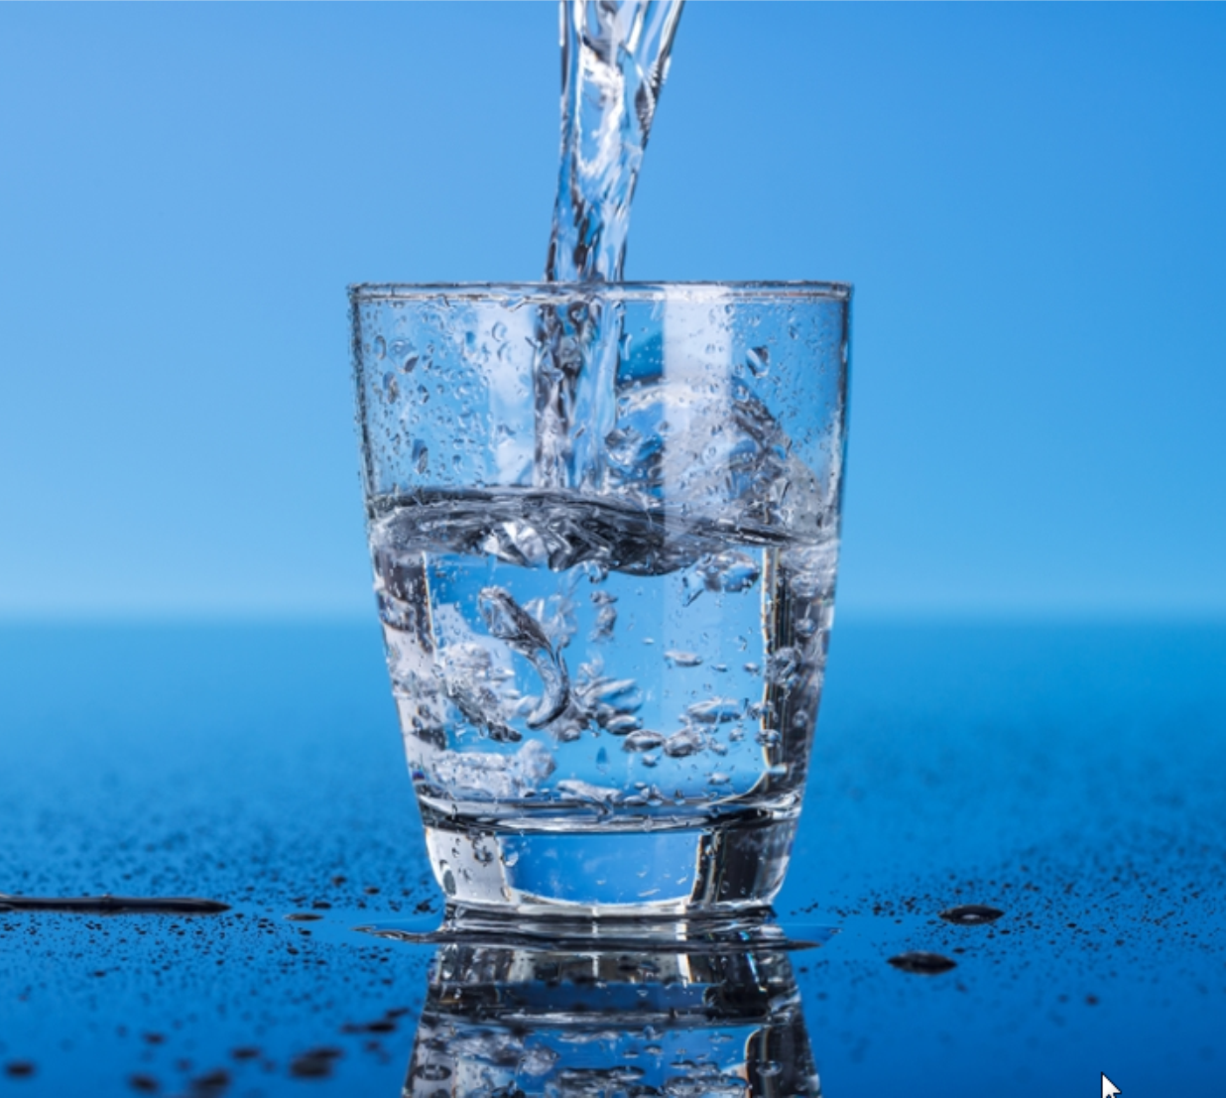
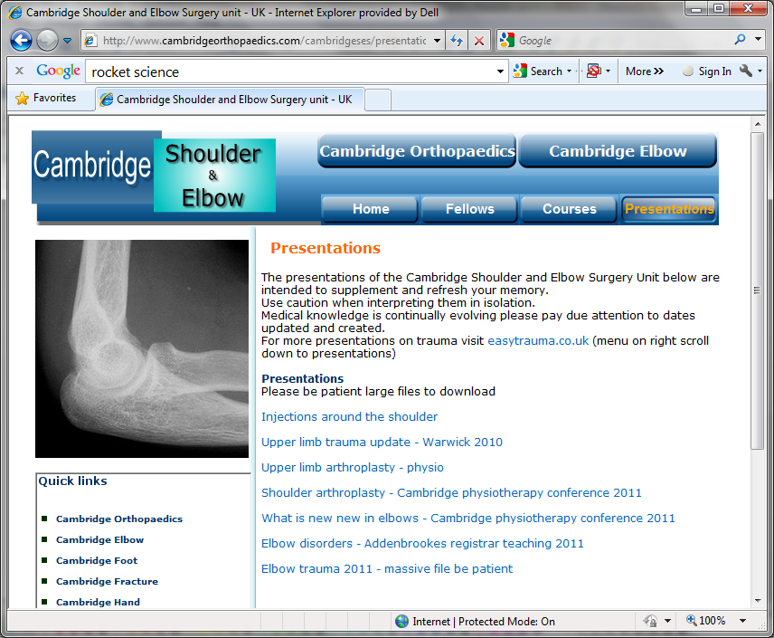
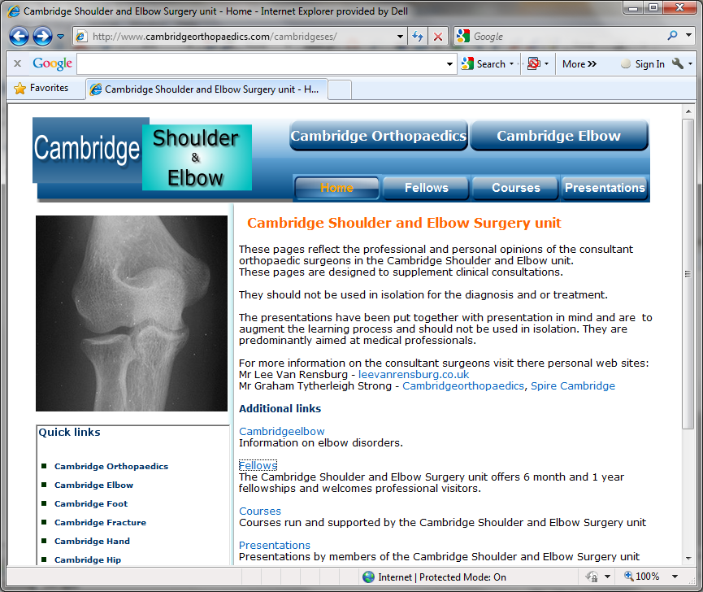
www.Cambridgeses.co.uk

Slide 3

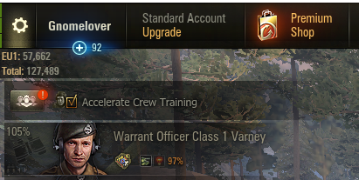
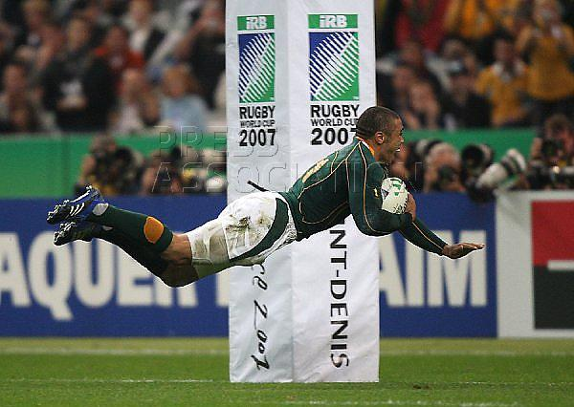
Disclaimer

Slide 4
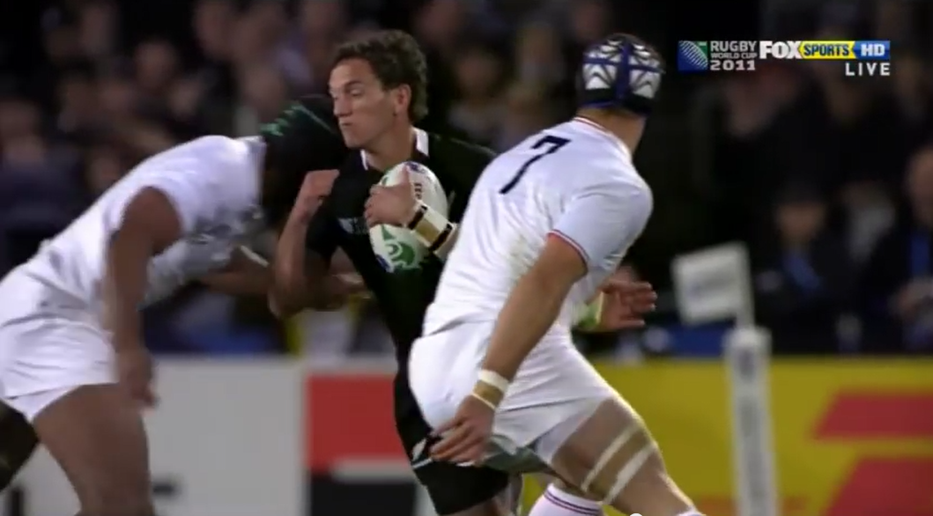
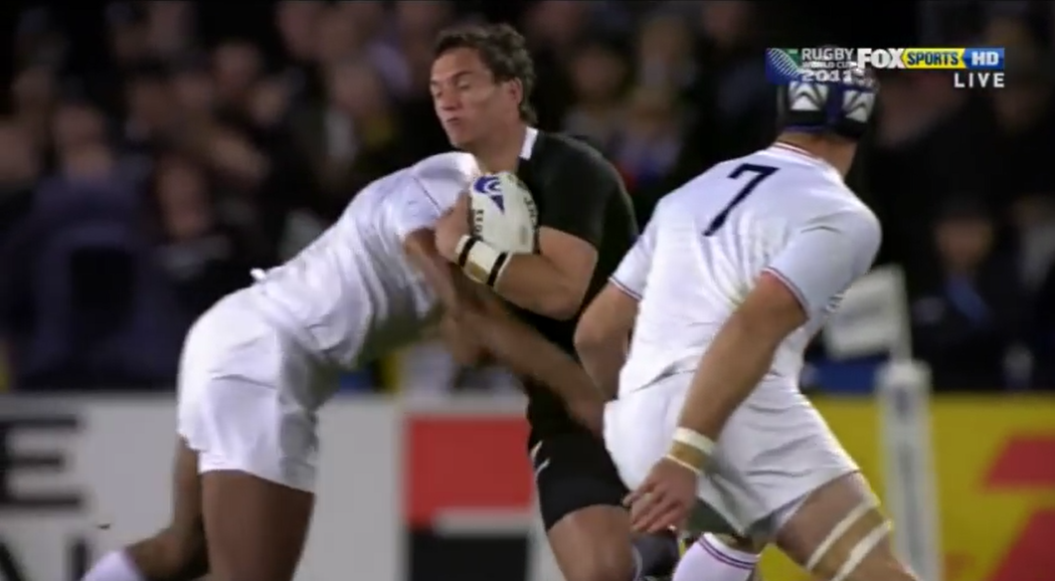
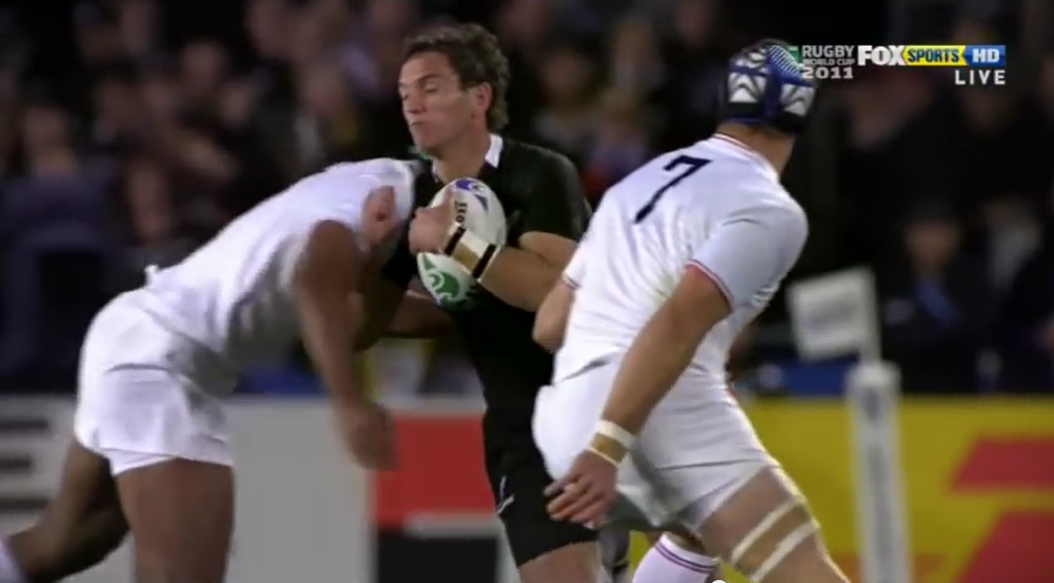
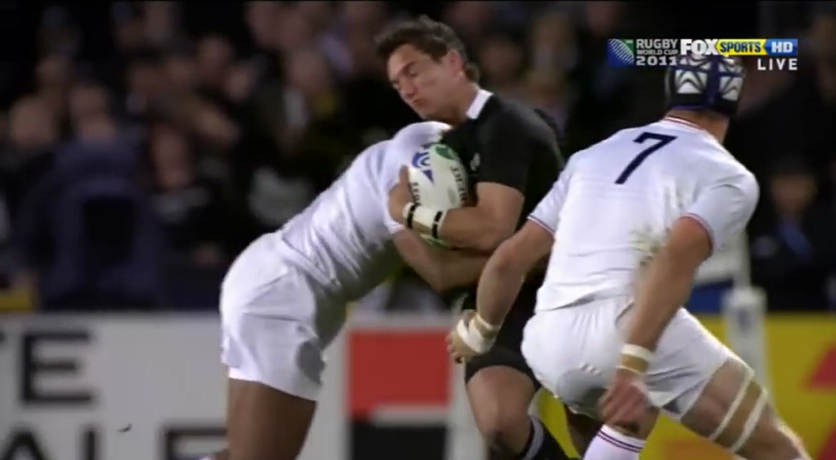
Direct blow 1

Slide 5
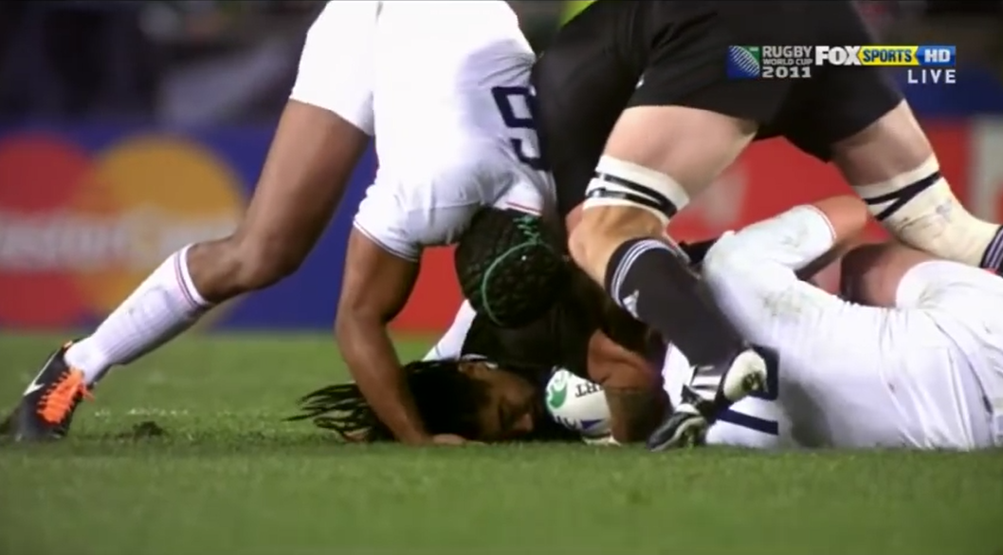
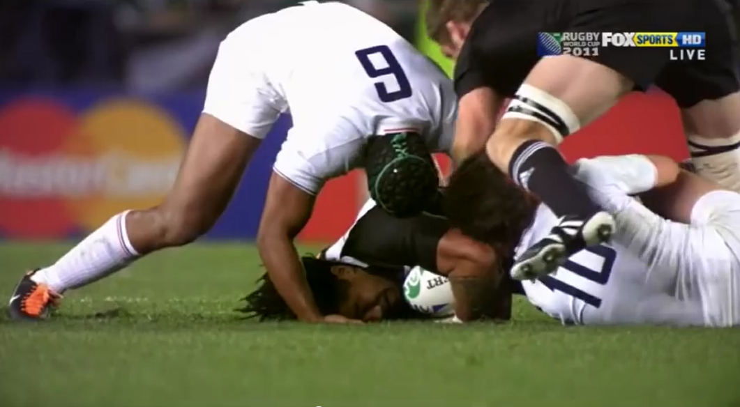
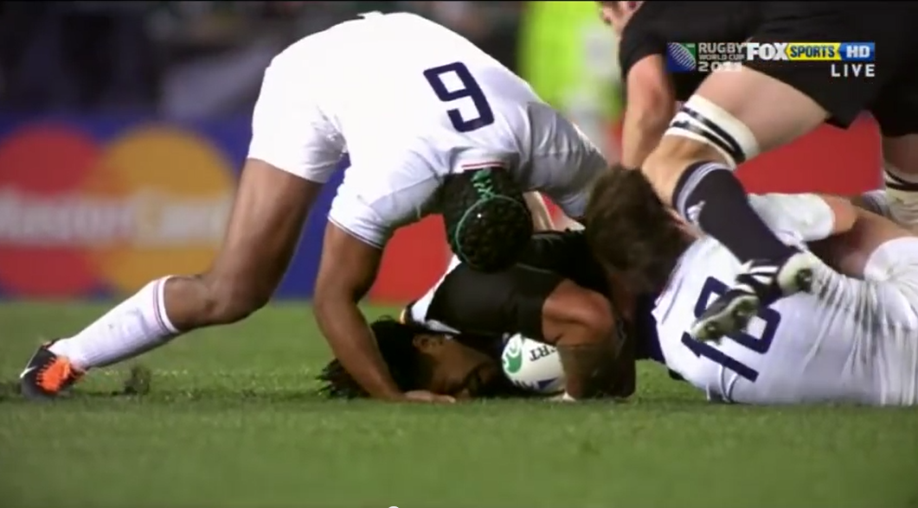
Direct blow 2

Slide 6
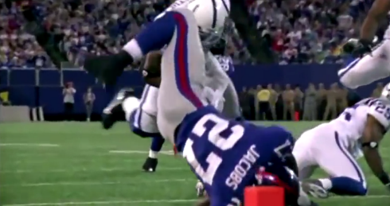
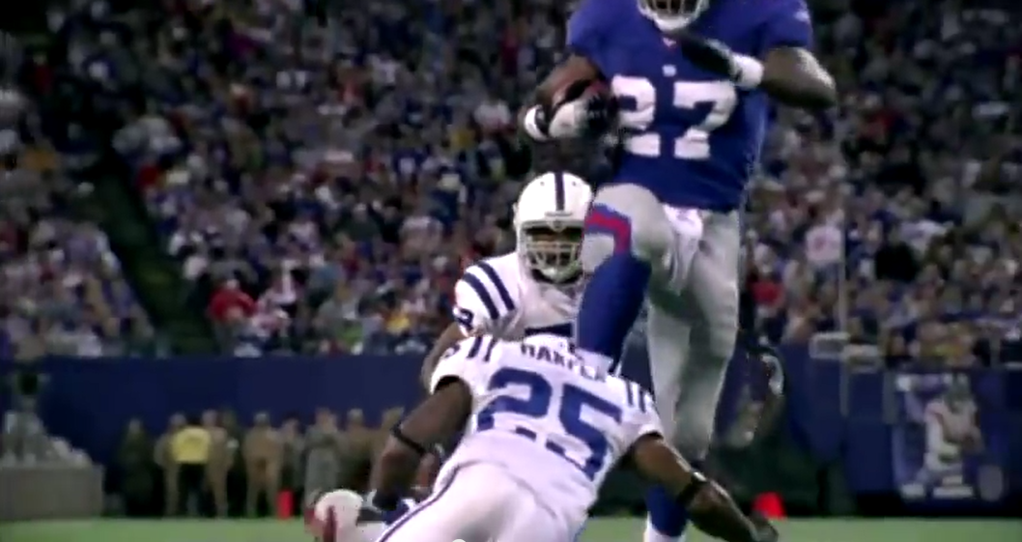
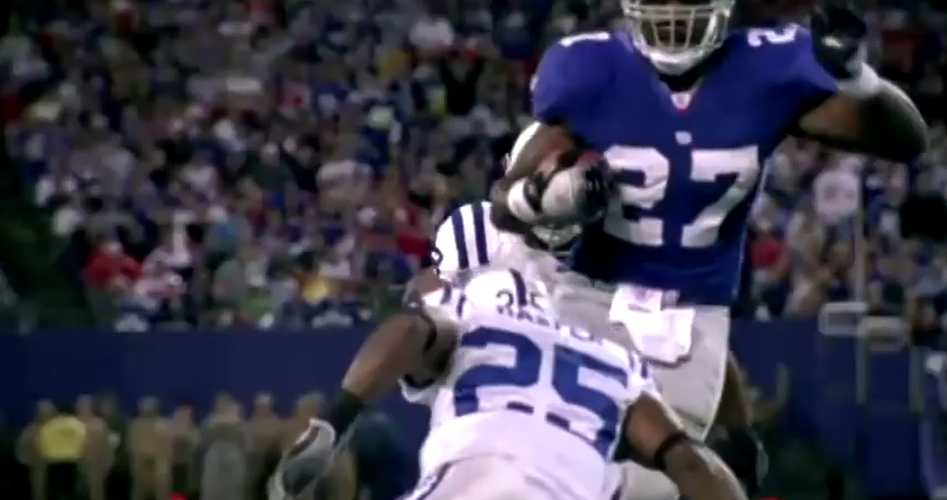
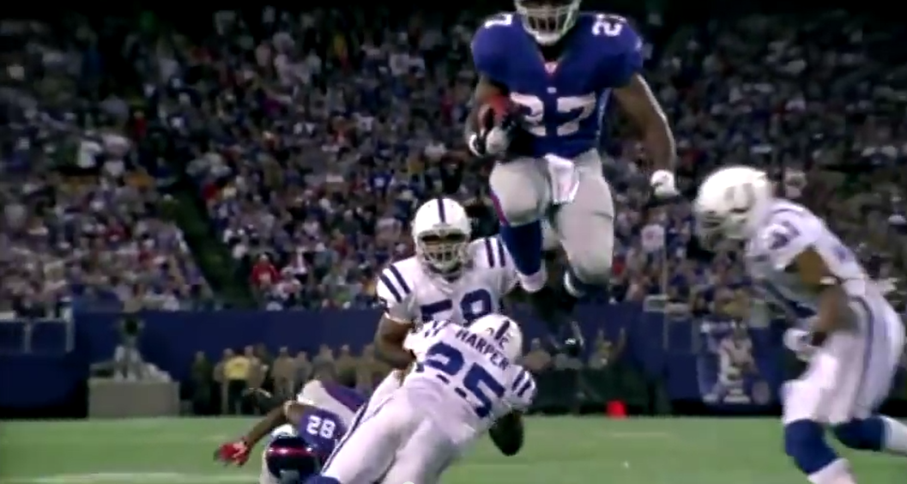
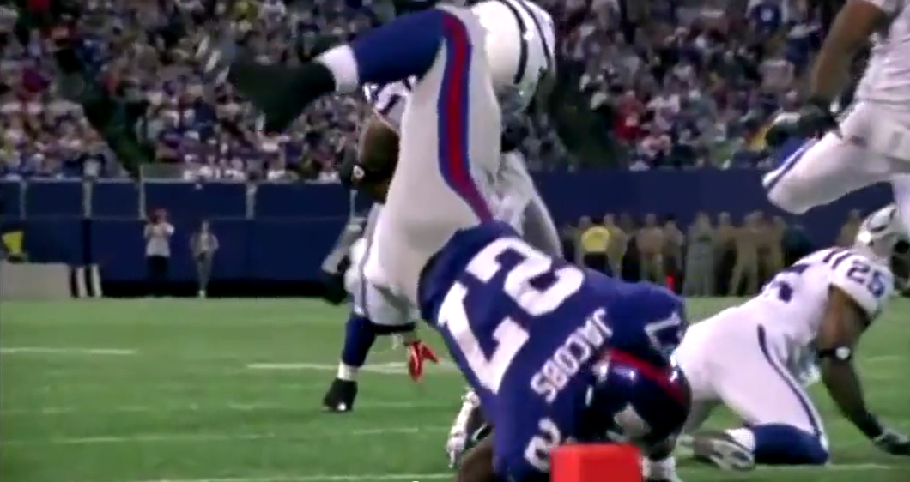
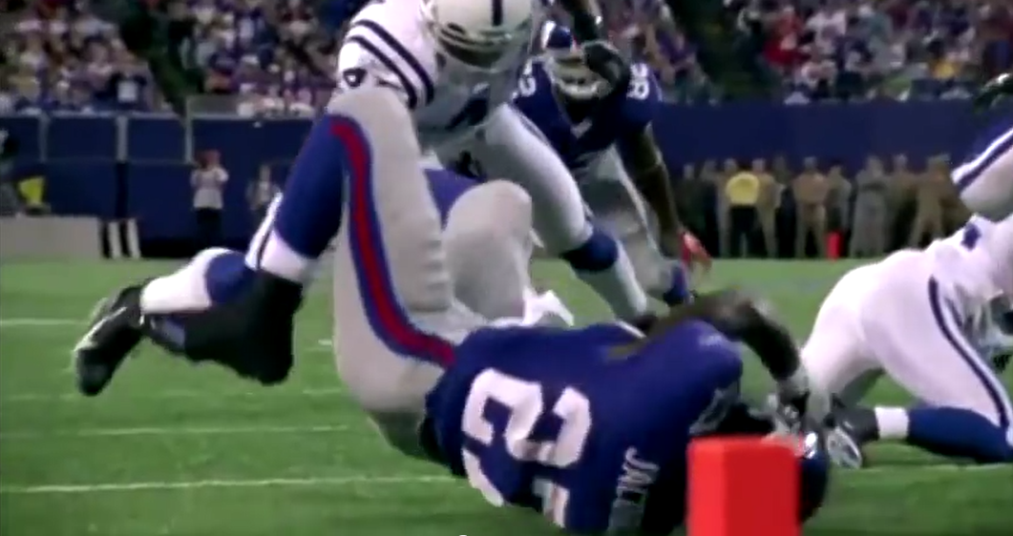
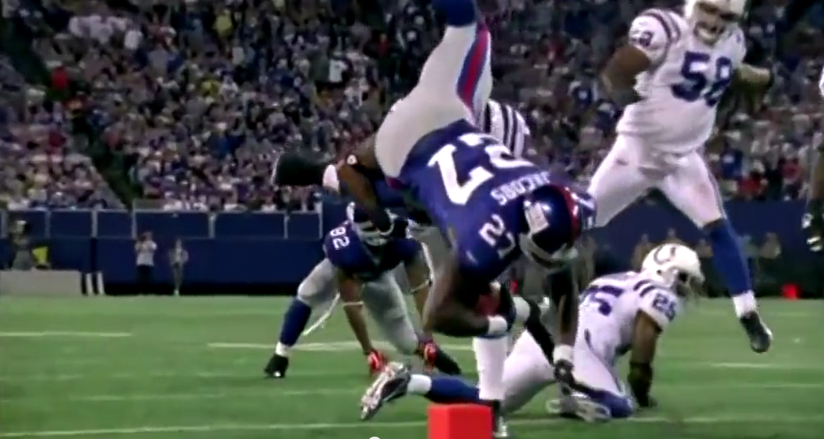
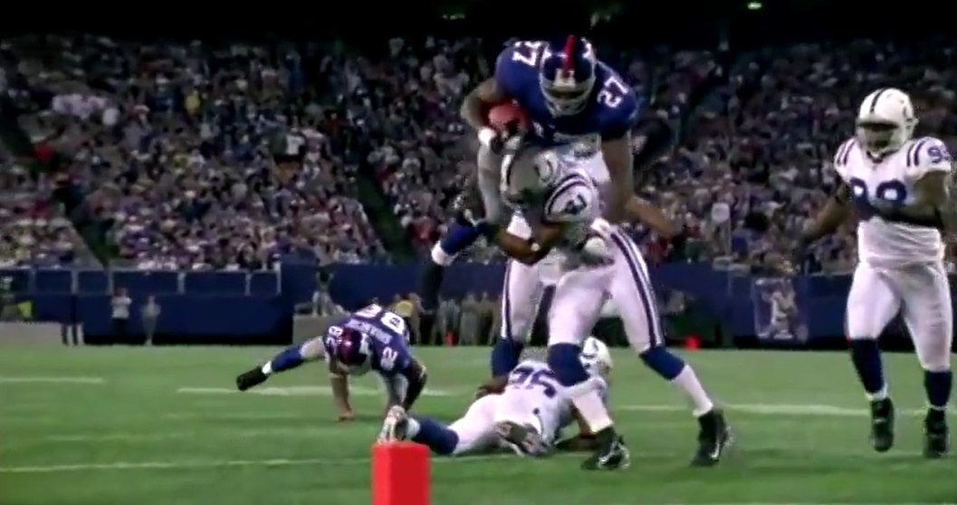
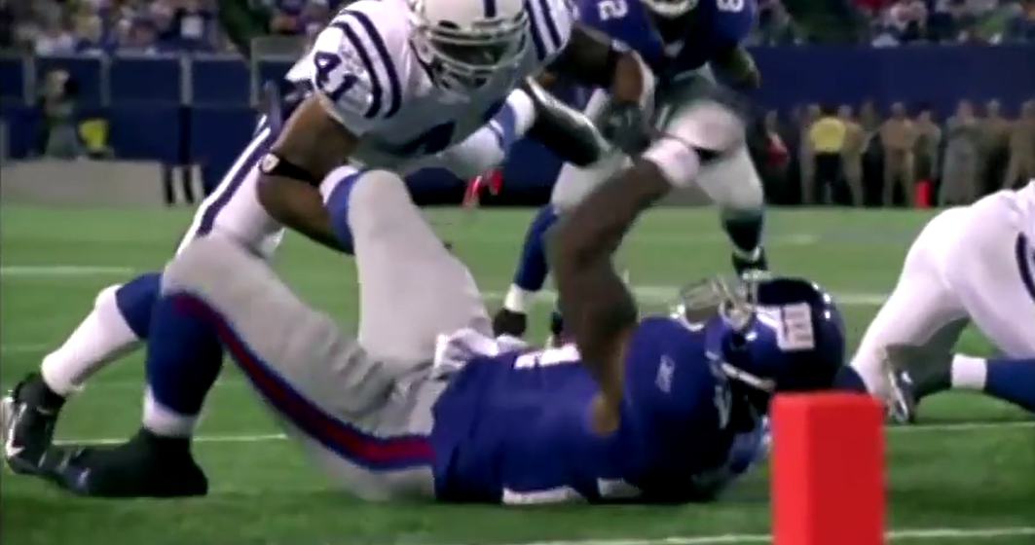
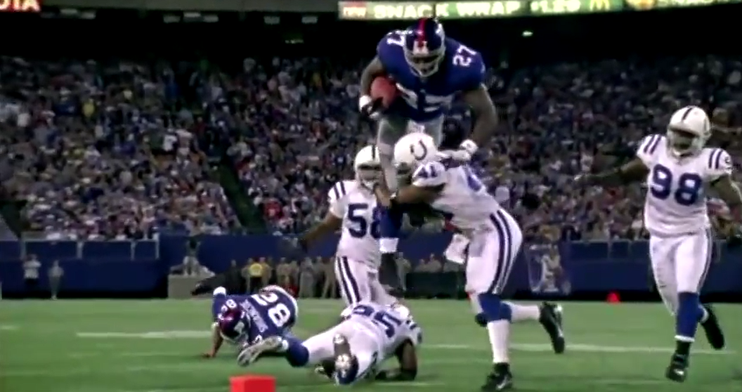
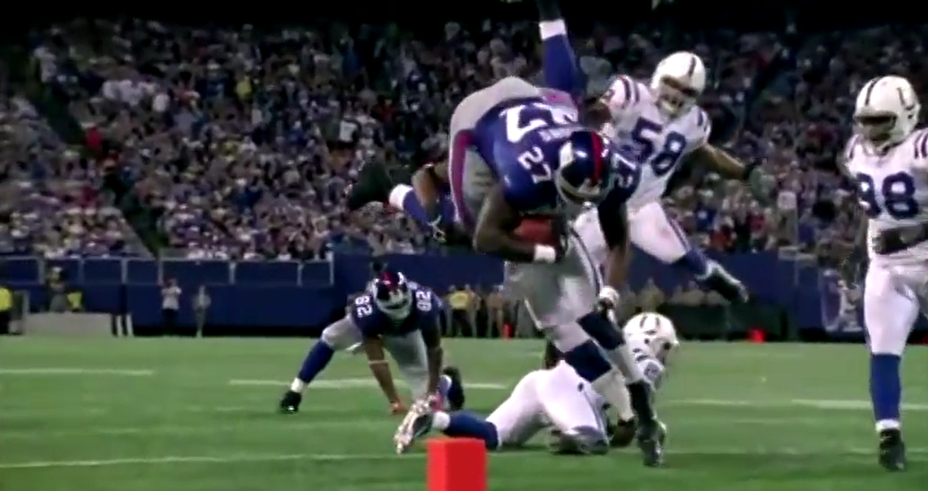
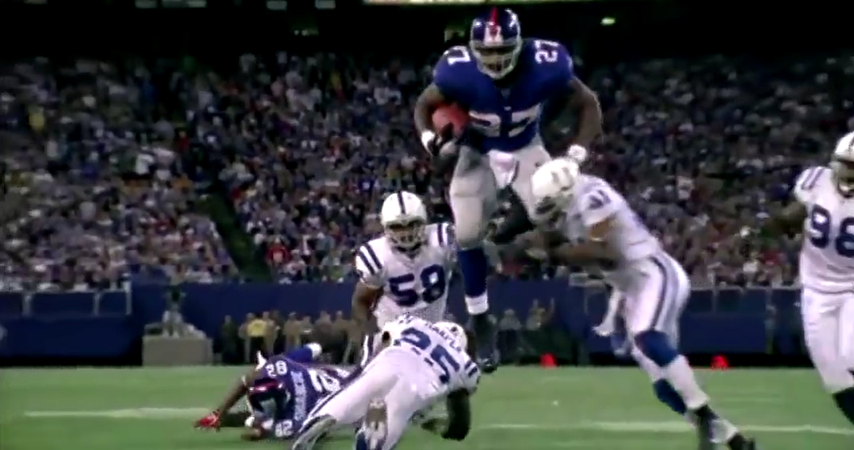
Direct blow 3

Slide 7
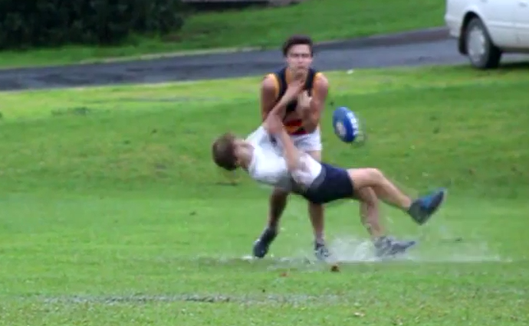
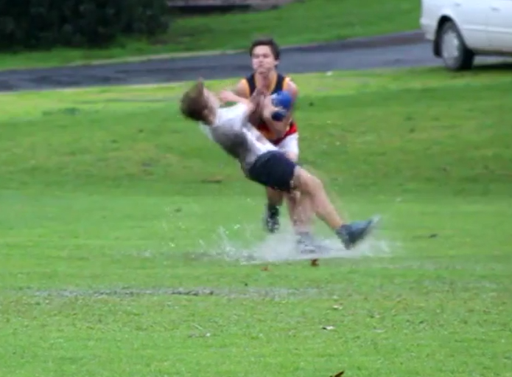
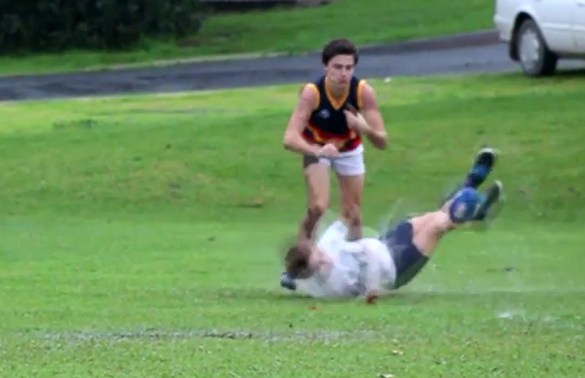
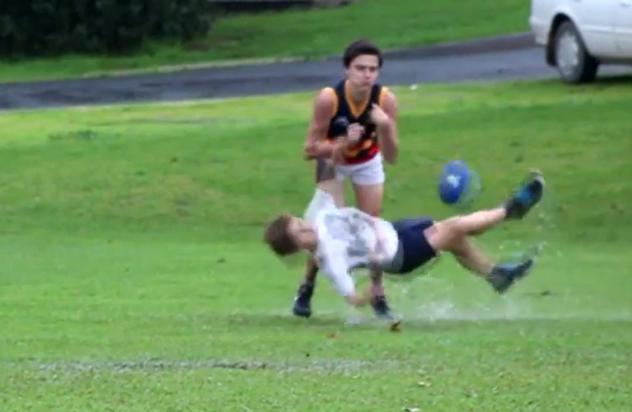
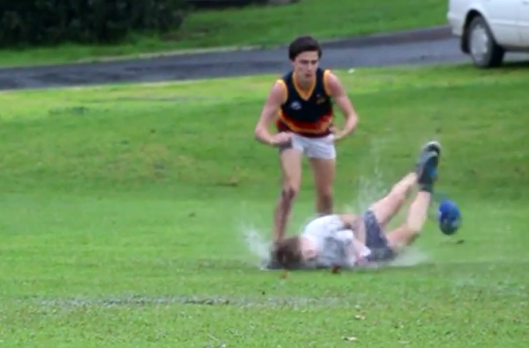
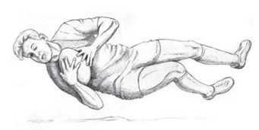
Direct blow 4

Slide 8
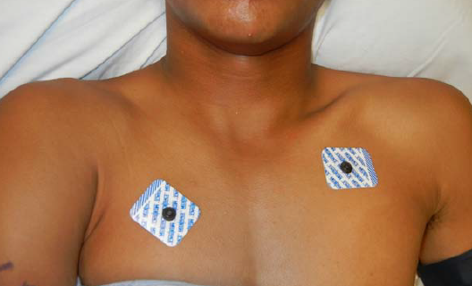
Clinical
Perm J. 2013 Fall; 17(4): e147–e148.

Slide 9
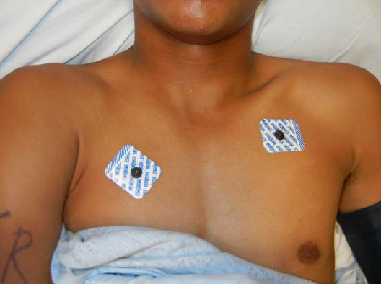
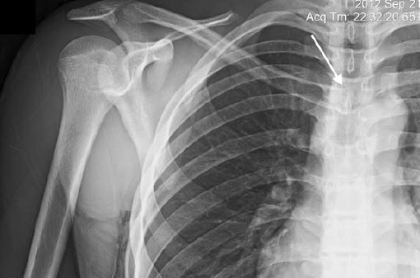
Clinical
Clinical beware
Mild symptoms and signs
Perm J. 2013 Fall; 17(4): e147–e148.

Slide 10
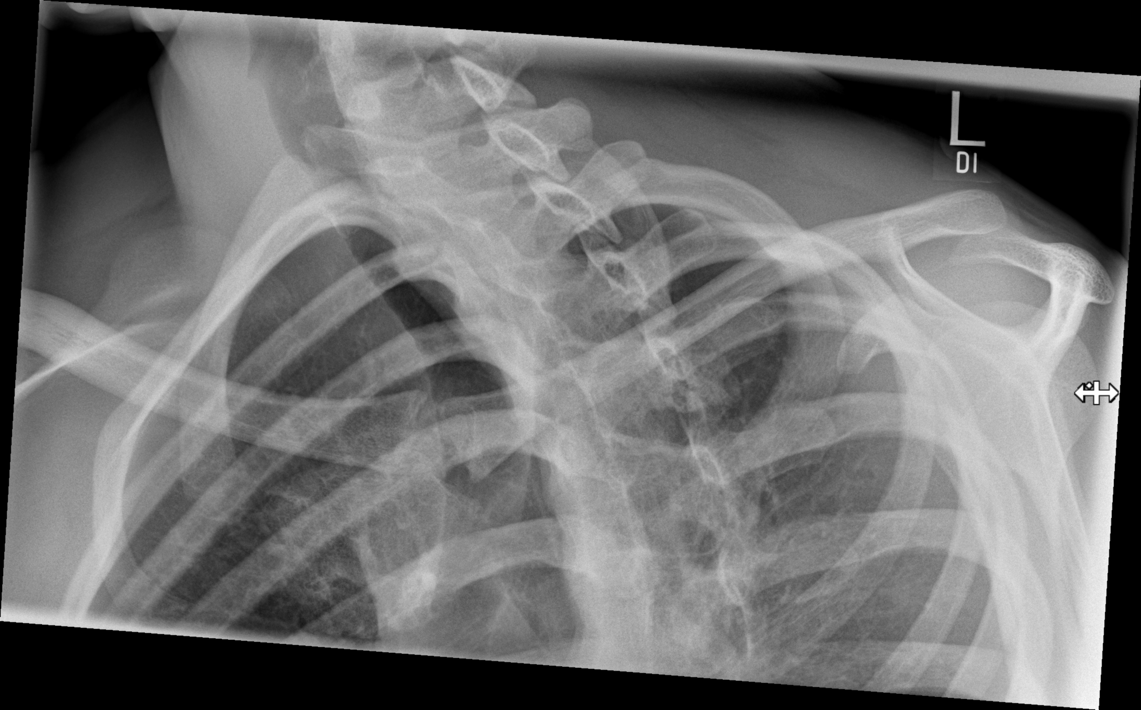
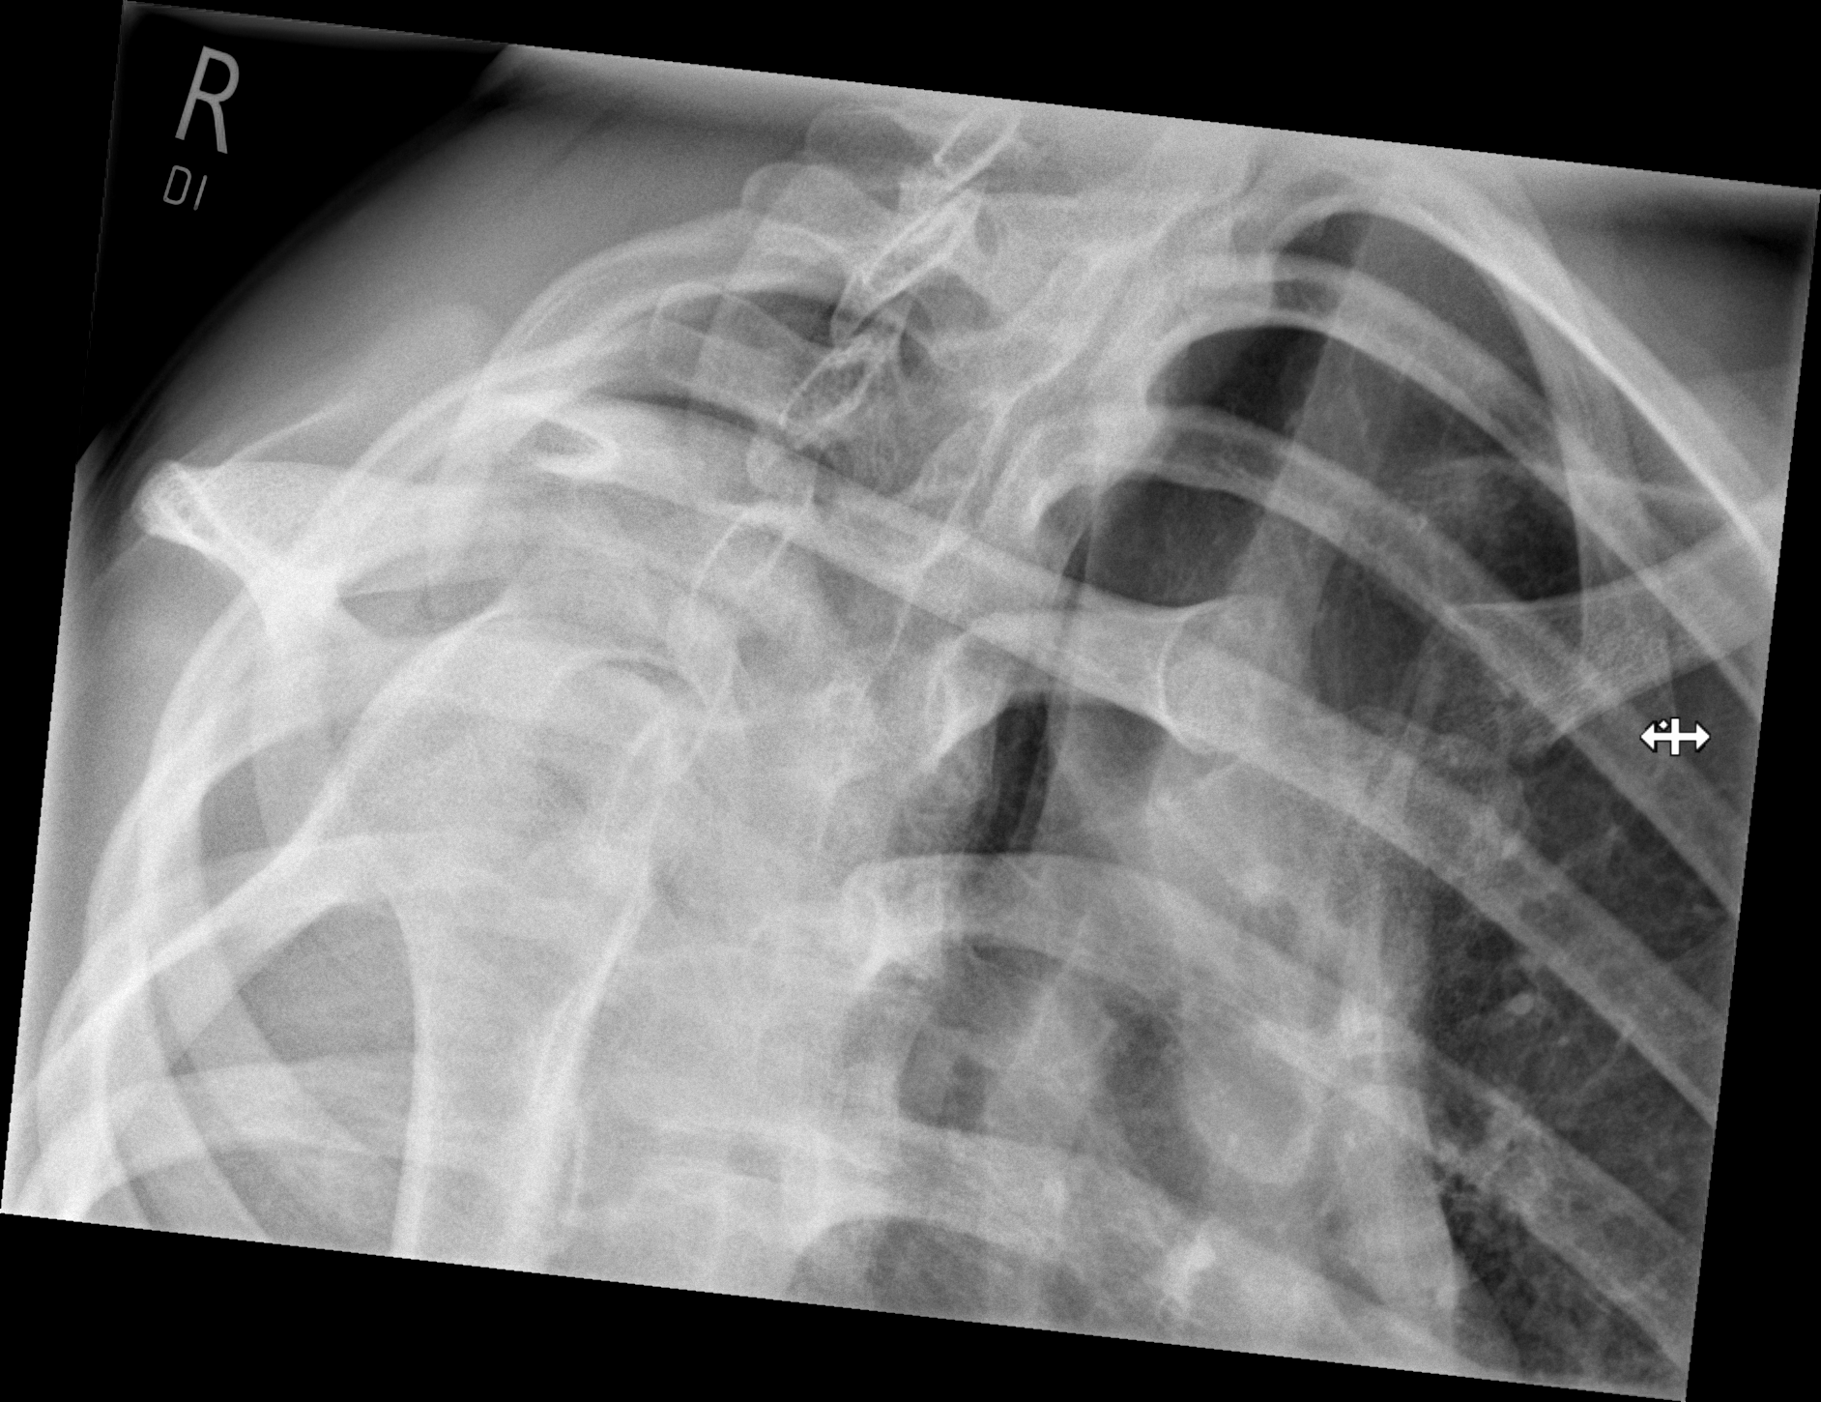

Slide 11
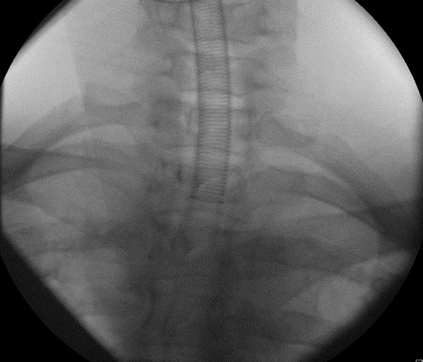
Serendipity view
AP Chest x ray
Cephalad 40 Degrees to vertical
Normally same level
Posterior lower

Slide 12
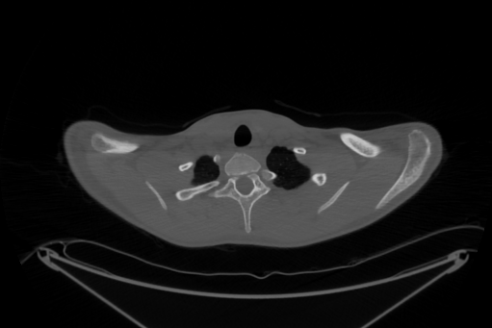
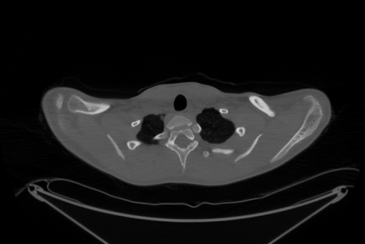
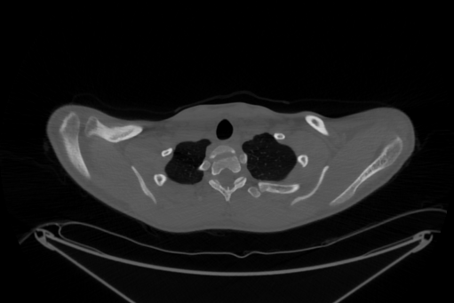
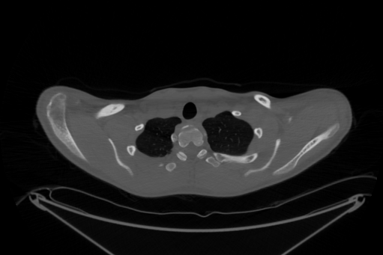
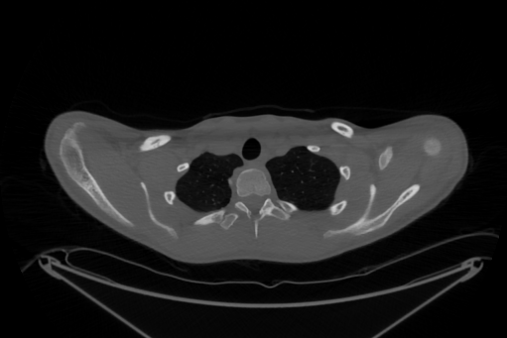
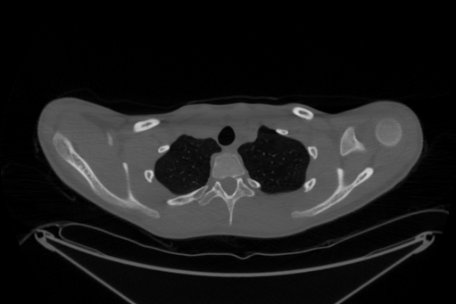
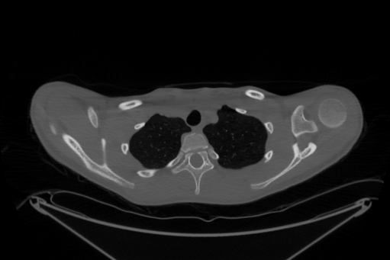
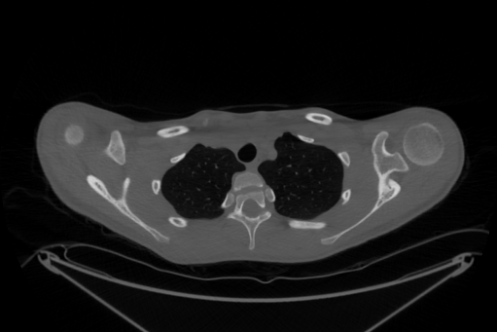
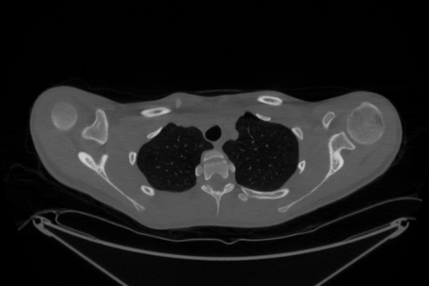
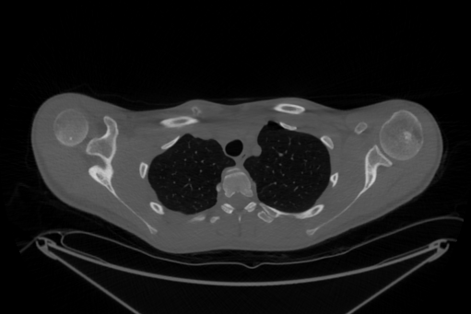
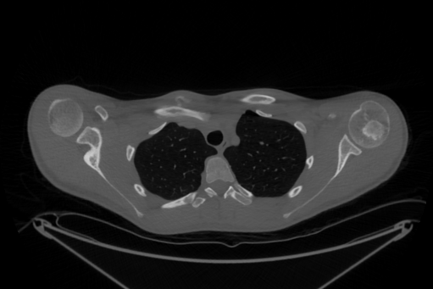
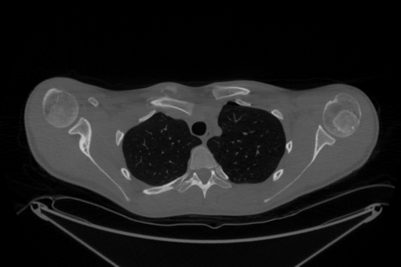













16 YO CT 3 weeks

Slide 13













Slide 14















Slide 15



















Slide 16

Clinical
Clinical beware
Mild symptoms and signs
Perm J. 2013 Fall; 17(4): e147–e148.

Slide 17

Clavicle anatomy
secondary centre 18th yr
enchondral ossification
fuses 25th year
Notes:
Primary centres x 2 appear 5th week and fuse by day 48. Secondary centre at sternal end appear 18th year ossifies ta 25th year

Slide 18



Slide 19



Slide 20





3 months

Slide 21






6 months

Slide 22



12 YO

Slide 23






12 YO MRI

Slide 24









Slide 25














12 YO CT Bone windows

Slide 26

































12 YO CT Angiogram

Slide 27


S2 :10
S2 :11

Slide 28

12 YO CT Angiogram

Slide 29






12 YO 3D CT
Asymptomatic

Slide 30




12 YO
3 week tomograms

Slide 31



12 YO CT 6 weeks

Slide 32

Anatomy
synovial joint
convcavoconvex
only articulation between upper limb & axial skeleton
Notes:
Saddle/sellar joint. Convex vertically, concave AP

Slide 33


Joint anatomy
Small area of bony congruence
Very little bony stability
Ligaments
  intra-articular disc ligament
  A & P SC ligaments
  rhomboid ligament
    Costoclavicular ligament
  intraclavicular
Notes:
And the costo clavicular ligament

Slide 34


Posterior structures
Brachiocephalic v
L common carotid a
L subclav a
R brachiocephalic a
Trachea
Left

Slide 35
Brachiocephalic veins most often the closest
Mean of 6 mm
Note shortest 1 mm
J Shoulder Elbow Surg (2013) 22, 993-999

Slide 36


More detail
Importance of the costoclavicular ligament
J Bone Joint Surg Am. 2014;96:e166(1-10)

Slide 37

Sternoclavicular joint

Slide 38

Sternoclavicular injuries
Dislocation / Fracture Dislocation
    Traumatic
    Atraumatic
Intra-articular Fracture
Medial 1/3rd Clavicle Fracture

Slide 39
Sterno clavicular Dislocation
< 3% of UL dislocations
High Energy - usually
    RTA
    Sports
Mechanism
    Direct (rare)
    Indirect
Bicos J eat al.Treatment and results of sternoclavicular joint injuries. Clin Sports Med 2003
Notes:
Dislocations are uncommon because the energy from blunt trauma usually causes injury to more peripherally placed shoulder girdle bones / joints. Force of a large magnitude and PARTICULAR vector is required

Slide 40


Mechanism of injury
Indirect injury – patient lying on ground
A lateral compression
P lateral compression
Notes:
Force transmitted along shoulder girdle to SC joint

Slide 41
Classification
Anterior or Posterior Dislocation
Grade I - mild sprain (ligaments intact)
Grade II - moderate sprain (subluxation)
Grade III - dislocation
Acute
Recurrent
Unreduced
Notes:
Maybe classified by direction.

Slide 42
Clinical
Acute
  Anterior → prominence
  Posterior → defect
    25% mediastinal compromise; venous congestion, hoarseness, dysphagia
Delayed
  Soft-tissue swelling ?
    imaging

Slide 43



J Shoulder Elbow Surg (2011) 20, e1-e4
Rugby injury
Missed injury, attended ED 2* before CVA
MILD SIGNS AND SYMPTOMS

Slide 44

Clinical
Patient age
Acute and < 25 year
  s/c dislocation ‘v’ Salter-Harris II physeal injury

Slide 45

Investigations
Plain Radiograph
  Shoulder AP, oblique
  Serendipity
Not Serendipity
Injuries to the sternoclavicular joint. In: Rockwood CA, Green DP; Fracture in adults. 2006. p. 1363-97

Slide 46
Serendipity view
AP Chest x ray
Cephalad 40 Degrees to vertical
Normally same level
Posterior lower

Slide 47

Investigations
CT Scan

Slide 48


Investigations
CT Angiogram

Slide 49



Investigations
Volume rendered CT angiogram

Slide 50
Management
Minor Injury (Grade I & II)
Minimally displaced physeal separation
  analgesia, ice
  immobilisation 2/52
  avoid re-injury for 3 months

Slide 51

Management
Dislocation: Acute Posterior (48 hours)
  closed reduction (Posterior)
  check II or CT
  irreducible or unstable
    open reduction
    +/- stabilisation

Slide 52

Management
Dislocation: Acute Posterior
  Closed reduction (Posterior)
  CardioThoracic Surgeon
Classic picture

Slide 53



Describe method of closed reduction
If Abduct arm see effect on clavicle
JBJS – A VOL. 66-A, NO. 3. MARCH 1984

Slide 54



Suggest
  Bolster between shoulder
    So shoulders off bed
  Downward traction on adducted arm
    Levers on first rib
  Shoulder retraction
    Push back on both shoulders
JBJS – A VOL. 66-A, NO. 3. MARCH 1984

Slide 55

Management
Mediastinal Injuries
Mediastinal compromise 25%
  Venous congestion
  Laceration to SVC
  Subclavian art injury
  Dysphagia
  Cough
  Hoarseness
  Oesophageal rupture
Notes:
Normal to falsetto on abduction of the arm

Slide 56

Lafosse et al
Laffosse J-M et al.
Retrospective multicentre study SCJ dislocation
  30 patients Posterior S/C injury
  14 patients < 48hr attempted closed reduction
  16 patients > 48hr open reduction
J Bone Joint Surg [Br] 2010;92-B: 103-9.

Slide 57
Management
Posterior Dislocation
14 closed reduction < 48 hrs (10 dislo, 4 epi #)
- 7 reduced (2 unstable → stabilisation)
- 7 open (4 epiph # →4 stabilisations(2 epi))
Laffosse J-M et al. Posterior dislocation of the sternoclavicular joint and epiphyseal disruption of the medial clavicle with posterior displacement in sports participants. JBJS Br 2010

Slide 58
Management
Posterior Dislocation
16 open reduction > 48 hrs (10 dislo, 6 epi #)
- 10 dislo → stabilisation
- 2 epi # → stabilisation
stabilisation → repair capsule & disc, subclav tenodesis k – wires, sternomastoid turn-down
Laffosse J-M et al. Posterior dislocation of the sternoclavicular joint and epiphyseal disruption of the medial clavicle with posterior displacement in sports participants. JBJS Br 2010

Slide 59
Management
Posterior Dislocation
- 30 posterior s/c injuries
- 25 required open reduction
- 18 required stabilisation
- all epiphyseal # open reduction
Laffosse J-M et al. Posterior dislocation of the sternoclavicular joint and epiphyseal disruption of the medial clavicle with posterior displacement in sports participants. JBJS Br 2010

Slide 60
Management
Chronic / Irreducible Dislocation
Posterior
- reduce & stabilize (age & position)
mediastinal complications
scapulothoracic dysfunction

Slide 61
Stabilisation
soft-tissue reconstruction
local tissue tenodesis
tendon graft
Spencer E et al. Biomechanical analysis of reconstructions for sternoclavicular joint instability. JBJS Am 2004

Slide 62

Stabilisation
Biomechanical study 3 techniques
  36 ff cadavers
  materials testing machine
  A & P forces
Spencer E et al. Biomechanical analysis of reconstructions for sternoclavicular joint instability. JBJS Am 2004

Slide 63



Stabilisation
Stabilisation - Subclavius Reconstruction
Spencer E et al. Biomechanical analysis of reconstructions for sternoclavicular joint instability. JBJS Am 2004

Slide 64



Stabilisation
Stabilisation - Intra-articular Ligt Reconstruction
Spencer E et al. Biomechanical analysis of reconstructions for sternoclavicular joint instability. JBJS Am 2004
Notes:
Medial end of clavicle excised and the ligament and disc are islolated

Slide 65



Stabilisation
Stabilisation - semi-tendinosus figure-of-eight
Spencer E et al. Biomechanical analysis of reconstructions for sternoclavicular joint instability. JBJS Am 2004
Notes:
Medial end of clavicle excised and the ligament and disc are islolated

Slide 66



Stabilisation
Stabilisation
- figure-of-eight reconstruction best
- anterior & posterior displacement
Composite graft
Spencer E et al. Biomechanical analysis of reconstructions for sternoclavicular joint instability. JBJS Am 2004

Slide 67

Stabilisation

Slide 68



Revision case

Slide 69

Chronic cases/ variations

Slide 70

38 YO Male – Moto X

Slide 71


Post reduction 6 weeks

Slide 72



22YO Female – 4 months

Slide 73


22YO Female

Slide 74



22 YO Female

Slide 75


18 YO Male - Quadbike

Slide 76


18 YO - Quadbike

Slide 77

16 YO

Slide 78



Slide 79



16 YO

Slide 80

16 YO

Slide 81


Slide 82




Slide 83
3 months

Slide 84







Slide 85

Thank You

