Slide 1
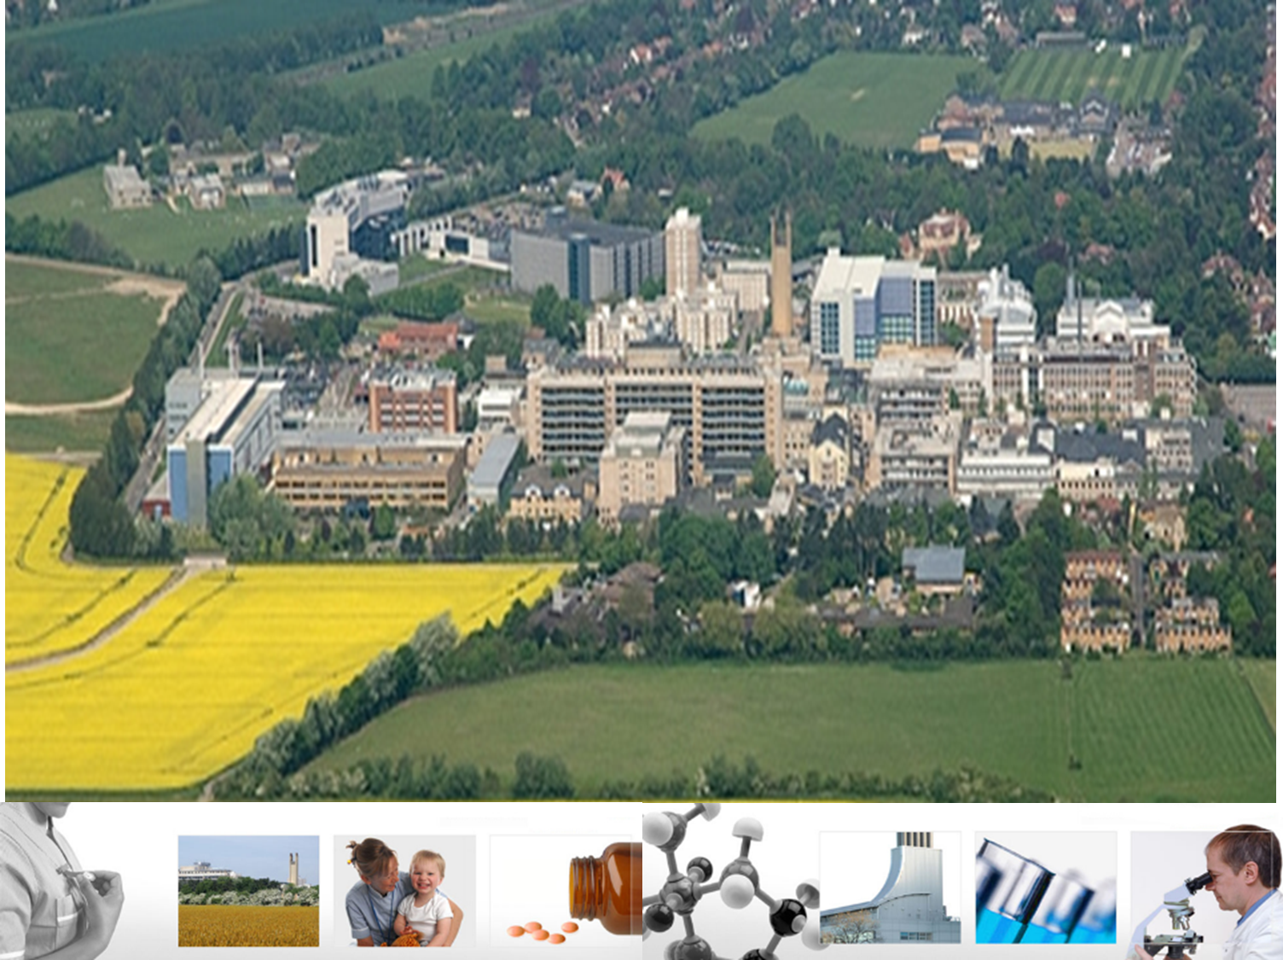
Shoulder rehabilitation
Post cuff repair
Mr Lee Van Rensburg
2018

Slide 2
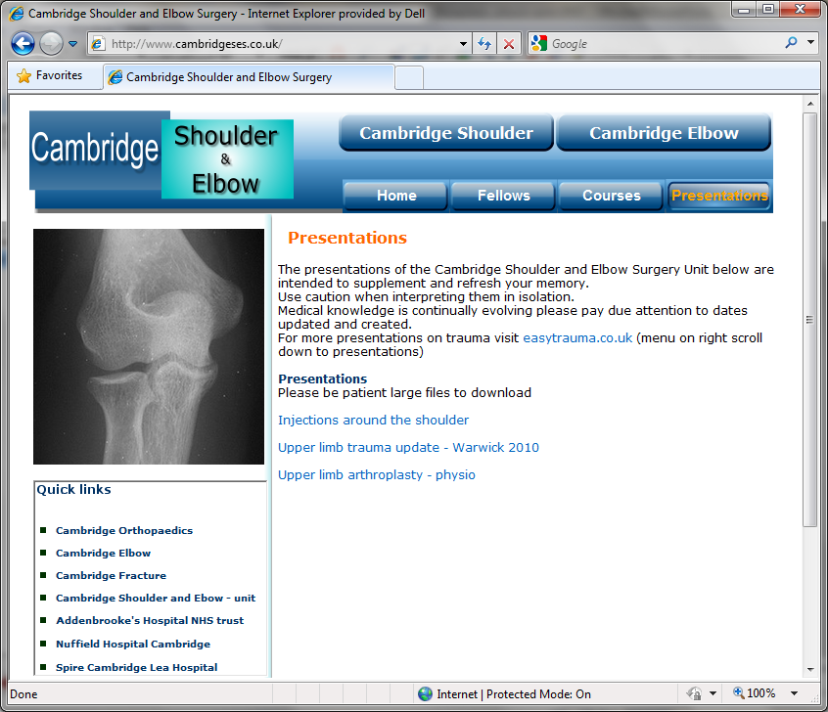
www.cambridgeses.co.uk

Slide 3
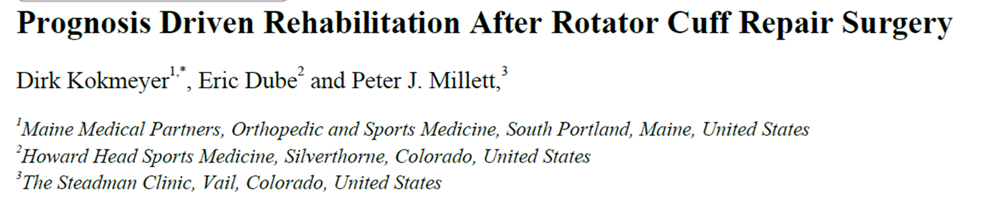
Protocols
Lorna@cambridgeelbow.co.uk
  Me
Lorna@cambridgeshoulder.co.uk
  GMTS
Shoulderdoc.co.uk

Slide 4
Summary
Treat the Whole not the Hole………..
The goal of RCR is to:
“Restore the normal anatomy of the rotator cuff in order to reduce pain and restore function.”

Slide 5
Summary
Treat the Whole not the Hole………..
The goal of RCR is to:
“Restore the normal anatomy of the rotator cuff in order to reduce pain and restore function.”

Slide 6
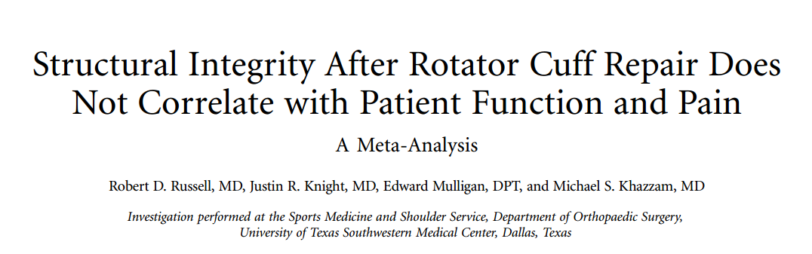
J Bone Joint Surg Am. 2014;96:265

Slide 7
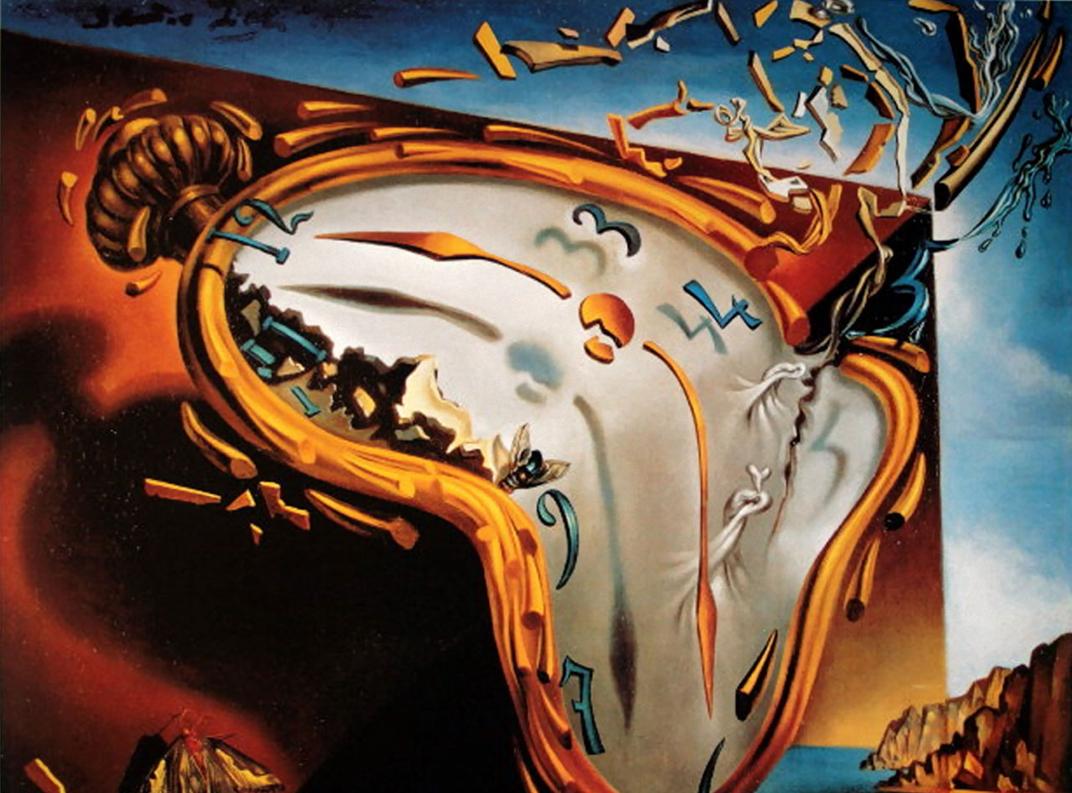
Rehab or surgery
Step back

Slide 8

Traumatic
Vs
Atraumatic

Slide 9
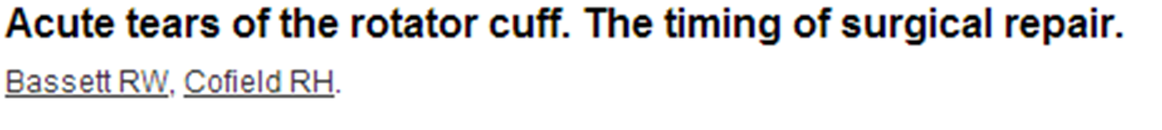
N = 37
  Group 1 – Operated within 3 weeks (n=12)
  Group 2 – Operated within 3 to 6 weeks (n=6)
  Group 3 – Operated within 6-12 weeks (n=19)
F/U ave. 7.0 years (range, 1 - 21 years)
Abduction
  Group 1 = 168°
  Group 2 = 126°
  Group 3 = 129°
Pain relief good for all
Repair best within 3 weeks
Clin Orthop 1983;175:18-24.

Slide 10
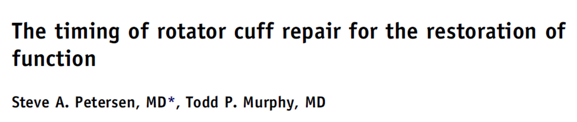
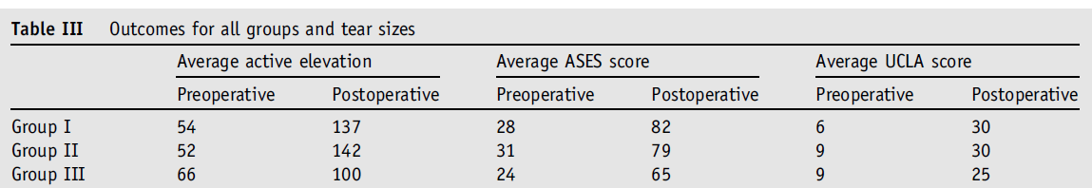
N= 36
3 groups
  Group 1 - 0-8 weeks
  Group 2 - 8-16 weeks
  Group 3 - > 16 weeks
All improved
Pain 7 down to 1
Elevation 55 to 133
J Shoulder Elbow Surg (2011) 20, 62-68

Slide 11


RCR
Surgery
Rehabilitation

Slide 12
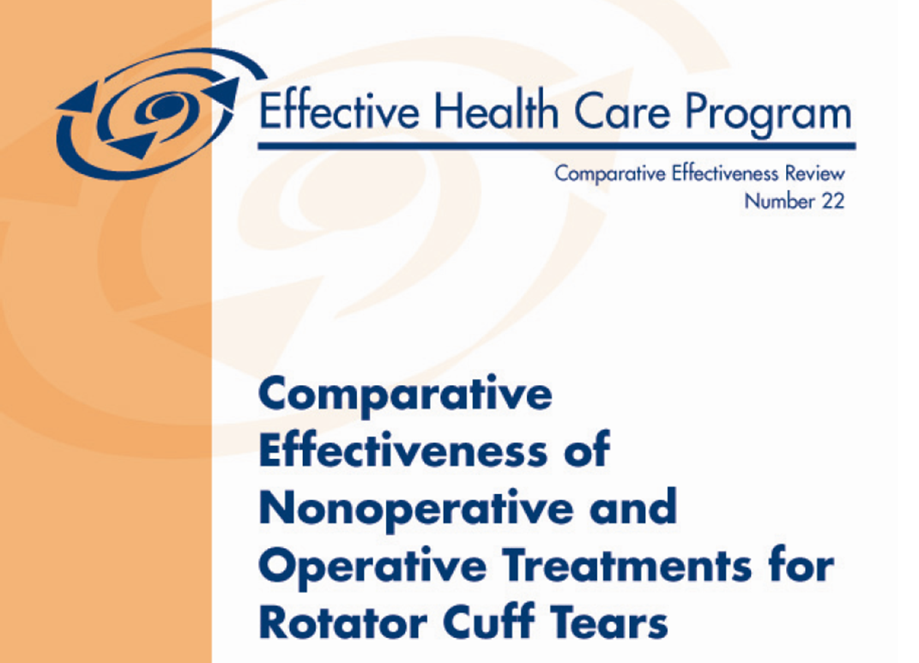
Operative vs Non Operative
Agency for healthcare research and quality
USA July 2010

Slide 13
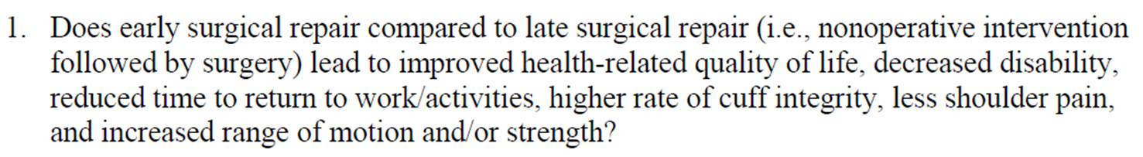
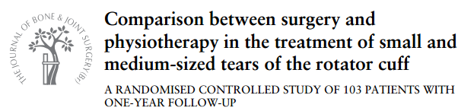
Early Surgery
Vs
Physiotherapy
1 study

Slide 14
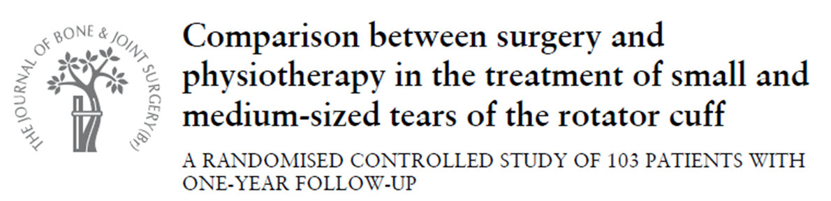
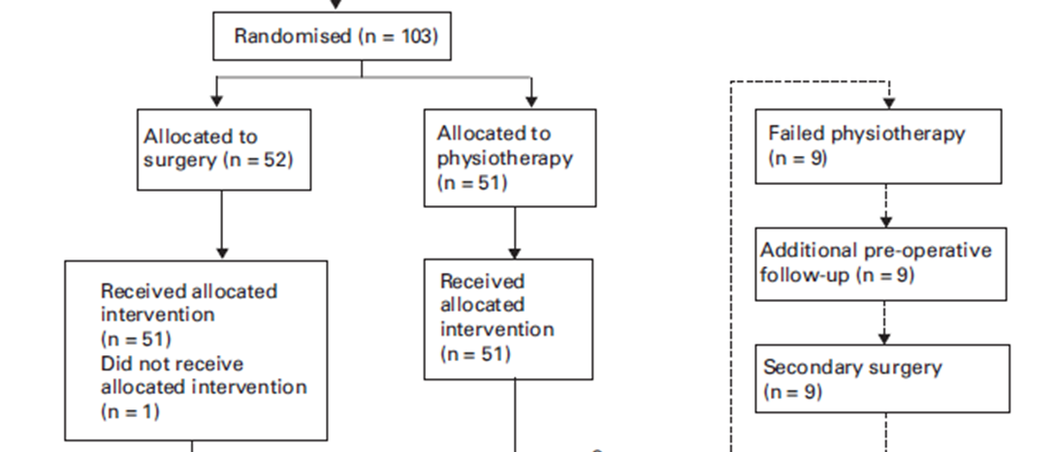
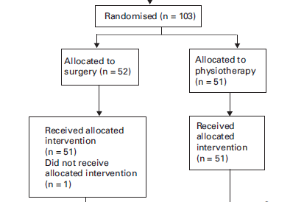
Age 59 (44-75)
Age 61 (46-75)
Symptoms 10 - 12 months
+- 50:50 traumatic and atraumatic
J BJS - Br January 2010 vol. 92-B no. 1 83-91

Slide 15
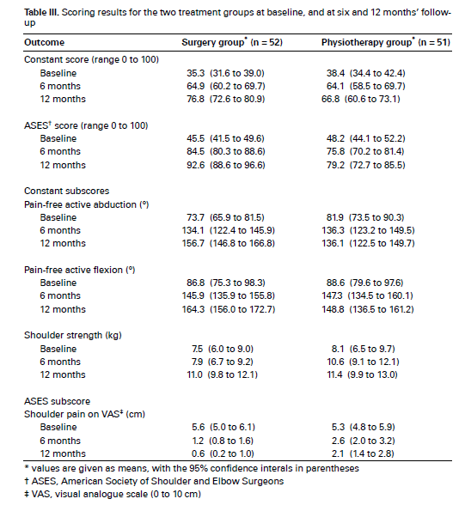
J BJS - Br January 2010 vol. 92-B no. 1 83-91

Slide 16
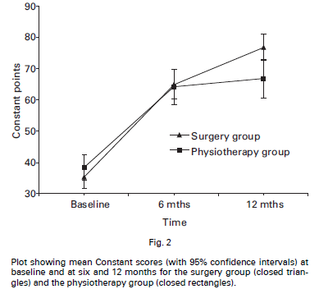
Constant score
Satisfaction
Physiotherapy 7.2 (1-10)
Surgery 9 (1-10)
J BJS - Br January 2010 vol. 92-B no. 1 83-91

Slide 17
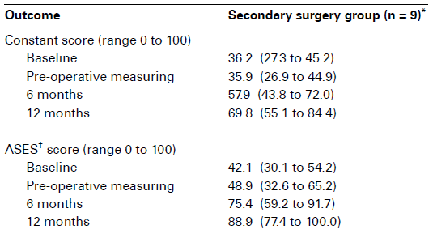
Secondary surgery group
Delay in surgery 5 months
Final outcome
7.5 points less constant score
J BJS - Br January 2010 vol. 92-B no. 1 83-91

Slide 18
Surgery did better
9 no surgery
constant score 7.5 less
BUT
42 Happy not surgery
J BJS - Br January 2010 vol. 92-B no. 1 83-91

Slide 19
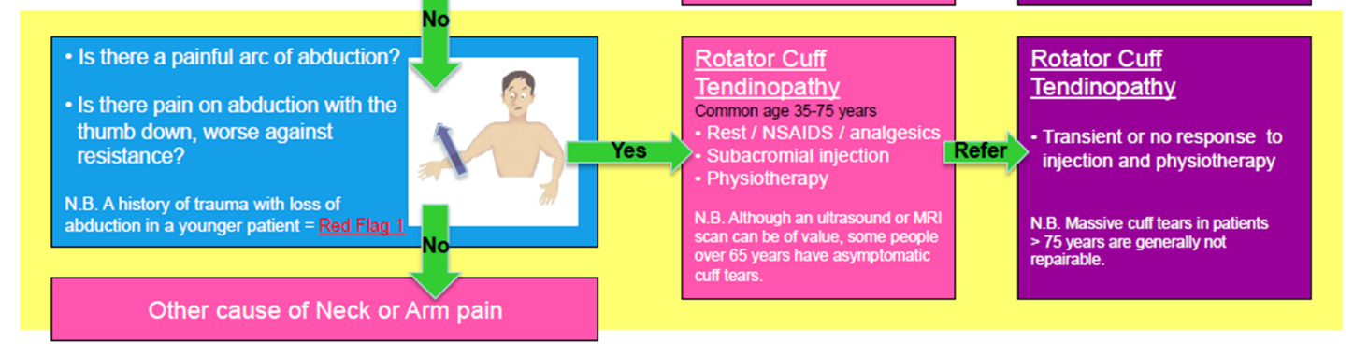


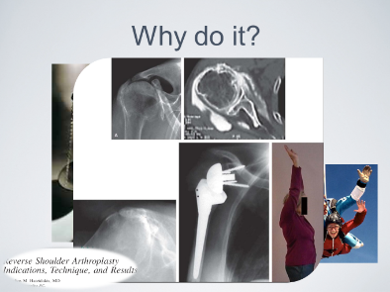

Slide 20

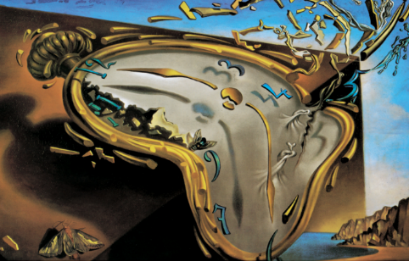

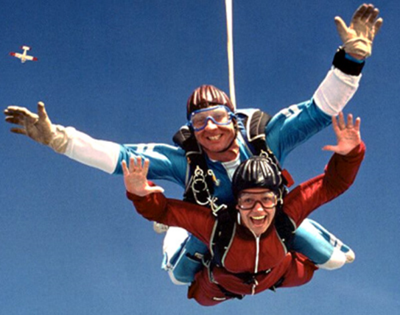
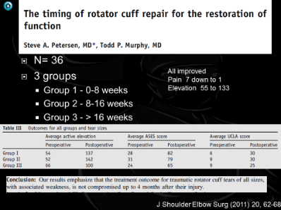

RCR
Surgery
Rehabilitation

Slide 21
Rehabilitation following rotator cuff repair

Slide 22
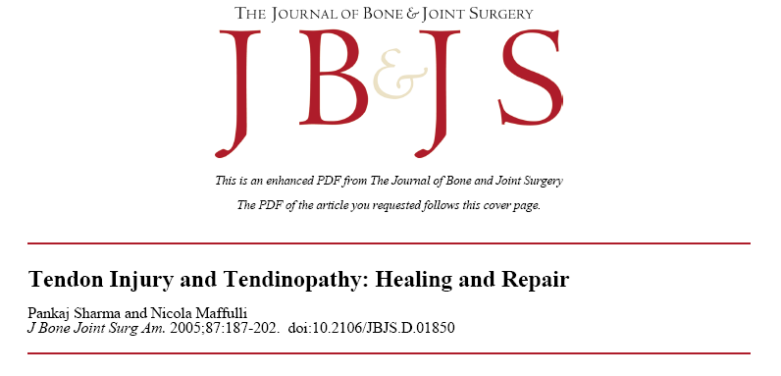
Tendons gently stressed while healing
  Heal stronger
No Gapping
Sharma P., Maffulli N. J Bone Joint Surg 2005:87:187-202

Slide 23
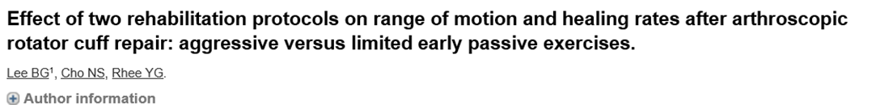
2 protocols
    Aggressive
    Limited early passive ROM
Pain, range of motion and function all significantly improved after arthroscopic rotator cuff repair
Regardless of early post operative rehabilitation protocols
Arthroscopy. 2012 Jan;28(1):34-42

Slide 24

However, aggressive early motion may increase the possibility of anatomic failure at the repaired cuff
Postoperative MRI scans – re tears
7 of 30 cases (23.3%) in limited group
3 of 34 cases (8.8%) in aggressive
But the difference was not statistically significant (P = 0.106)
Arthroscopy. 2012 Jan;28(1):34-42

Slide 25
6 RCT’s
n=462
No Significant difference in function between protocols
Am J Sports Med 2015; 43(5): 1265-73.

Slide 26
Early ROM group
  Greater forward flexion
      7.45° (95% CI, 3.20°-11.70°) at 6 months
      3.51° (95% CI, 0.31°-6.71°) at 12 months
  Higher re tear rate
    Statistically significant (OR, 1.93; 95% CI, 1.04-3.60)
    after excluding 2 RCTs small to medium-sized tears
Is 3-8 degrees clinically significant
Am J Sports Med 2015; 43(5): 1265-73.

Slide 27
J Bone Joint Surg Am. 2014;96:265

Slide 28
J Bone Joint Surg Am. 2014;96:265

Slide 29
Conclude
Pain relief
Function
  Independent of rehab protocol
  Independent on tendon healing
Strength
  “Better if tendon heals”
Tendon healing only statistically significant in large tears

Slide 30
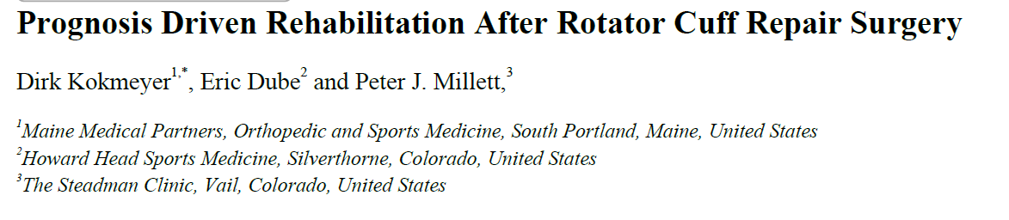
Functional success
Structural success
The Open Orthopaedics Journal, 2016, 10, (Suppl 1: M10) 339-348

Slide 31
Numerous factors affect outcome
  Age
  Bone mineral density
  Fatty infiltration/ atrophy
  BMI
  Smoker
  Tear size
  Retraction
  Tissue quality
  Pre op strength
The Open Orthopaedics Journal, 2016, 10, (Suppl 1: M10) 339-348

Slide 32
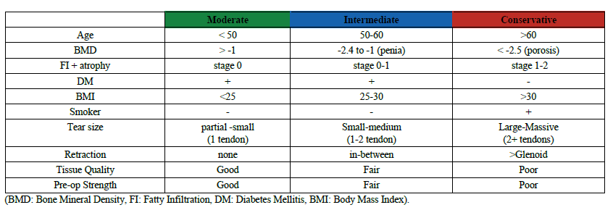
The Open Orthopaedics Journal, 2016, 10, (Suppl 1: M10) 339-348

Slide 33
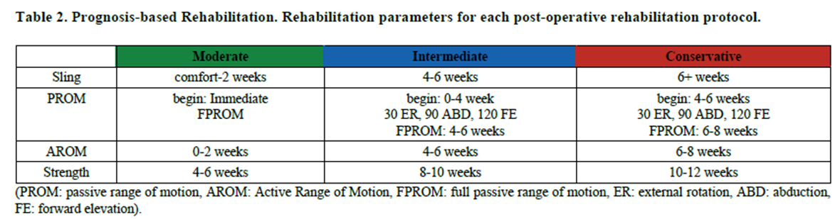
The Open Orthopaedics Journal, 2016, 10, (Suppl 1: M10) 339-348

Slide 34


Slide 35
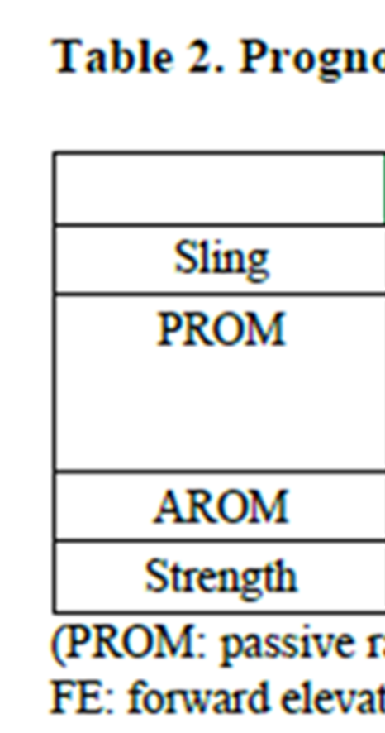

Slide 36
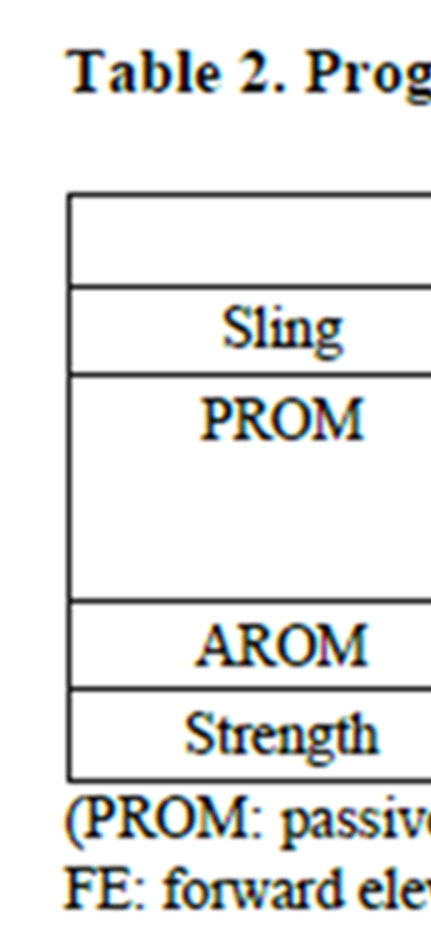

Slide 37
Numerous factors affect outcome
  Age
    <50 better >60-65 poorer
The Open Orthopaedics Journal, 2016, 10, (Suppl 1: M10) 339-348

Slide 38
Numerous factors affect outcome
  Bone mineral density
    Osteopoenia and osteoporosis
      Increased structural failure, pull out strength of anchors
The Open Orthopaedics Journal, 2016, 10, (Suppl 1: M10) 339-348

Slide 39
Numerous factors affect outcome
  Fatty infiltration/ atrophy
    Goutallier scale 0-4
      100% tear failure stage 2 FI and MA
      92% healing stage 1 or less
The Open Orthopaedics Journal, 2016, 10, (Suppl 1: M10) 339-348

Slide 40
Numerous factors affect outcome
  BMI
    >30 associated with longer stay higher failure rates and more stiffness
The Open Orthopaedics Journal, 2016, 10, (Suppl 1: M10) 339-348

Slide 41
Numerous factors affect outcome
  Tear size
    Re tear rates significantly higher for larger tears
The Open Orthopaedics Journal, 2016, 10, (Suppl 1: M10) 339-348

Slide 42
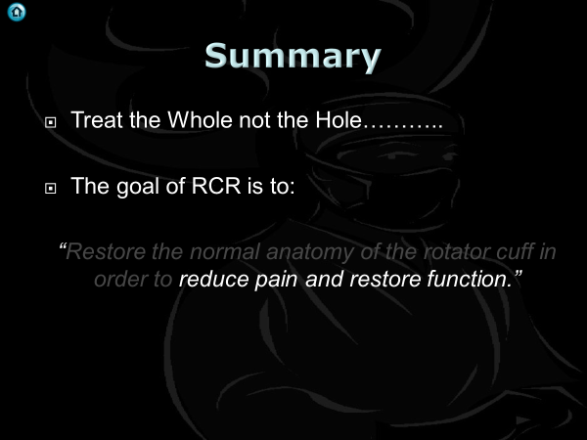
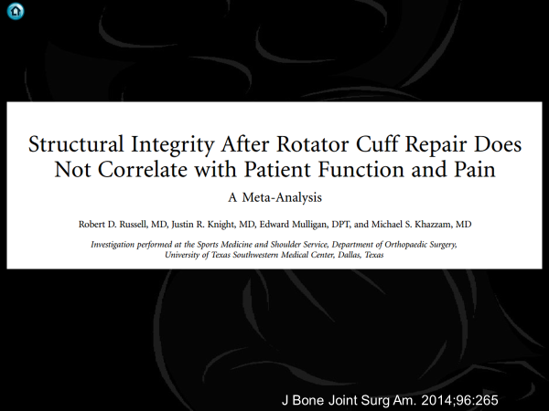
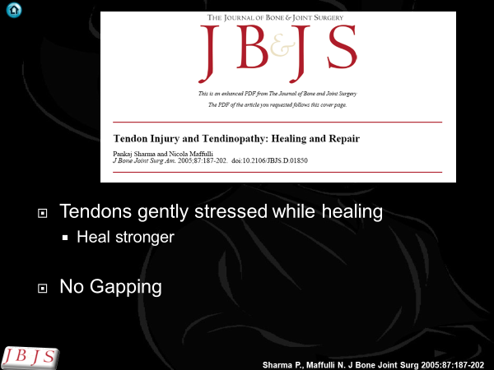
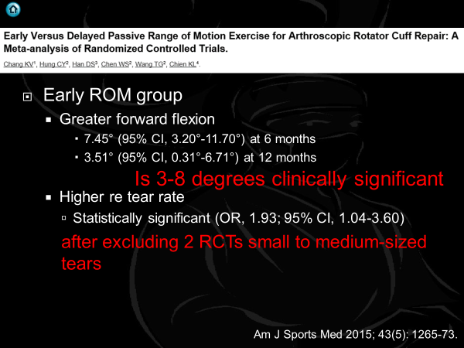
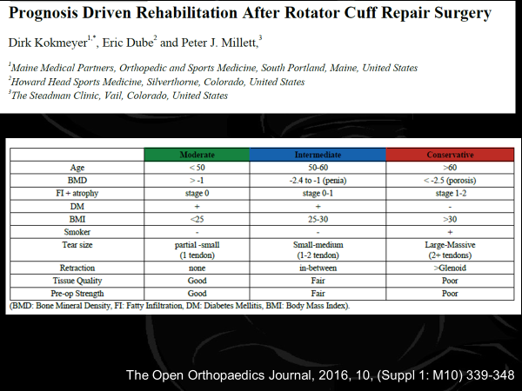
Summary

Slide 43
Questions ?

