Slide 1
Shoulder Hemiarthroplasty for fracture Is There a role
Mr Lee Van Rensburg
2017

Slide 3
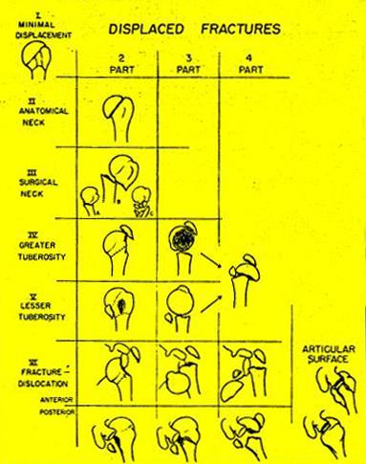
NEER’S CLASSIFICATION
> 1 cm
> 45º
Codman’s
4 parts

Slide 4
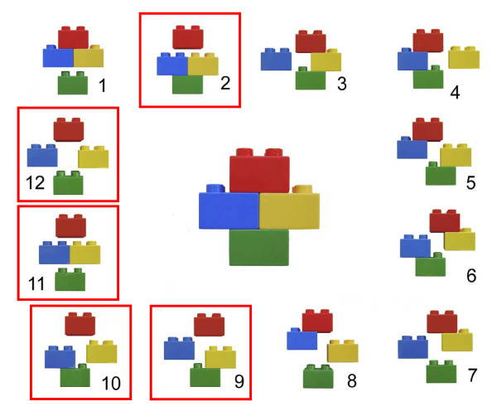
J Shoulder Elbow Surg 2004;13: 427–33.)

Slide 5
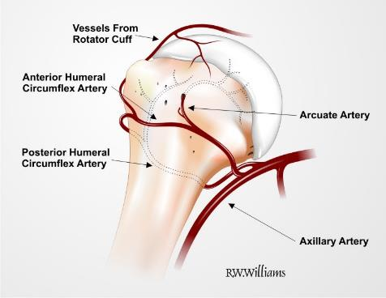
Blood supply
In the fractured Humerus, the arcuate artery is
generally interupted.
Recent anatomic and clinical findings confirm
that perfusion from the posterior circumflex vessels
alone may be adequate for head survival.
Contributes 64% of the head supply*
Brooks, JBJS 1993; Coudane, JSES, 2000; Duparc, Surg Rad Anat, 2001;
Meyer et al Zentralbl Chir. 2005; Hettrich et al JBJS 2010*

Slide 6
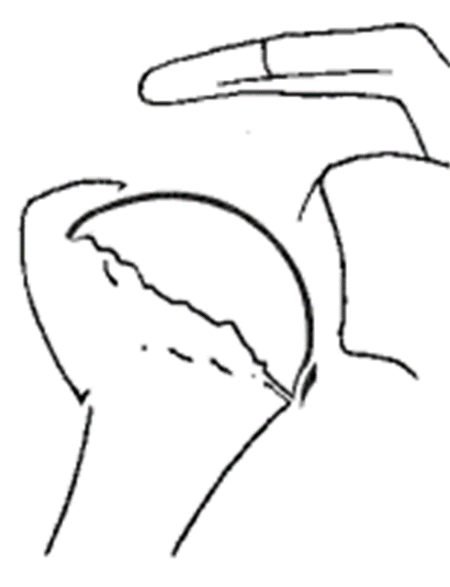
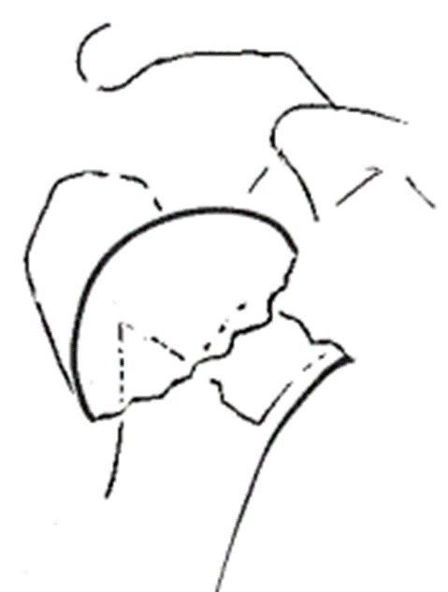
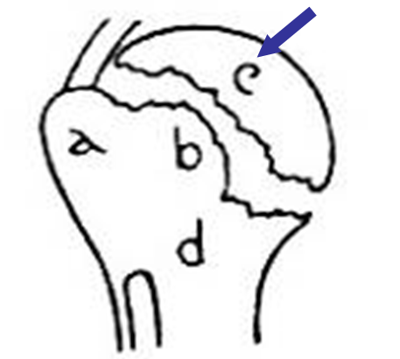
97% predictive
J Shoulder Elbow Surg 2004;13: 427–33.)

Slide 7
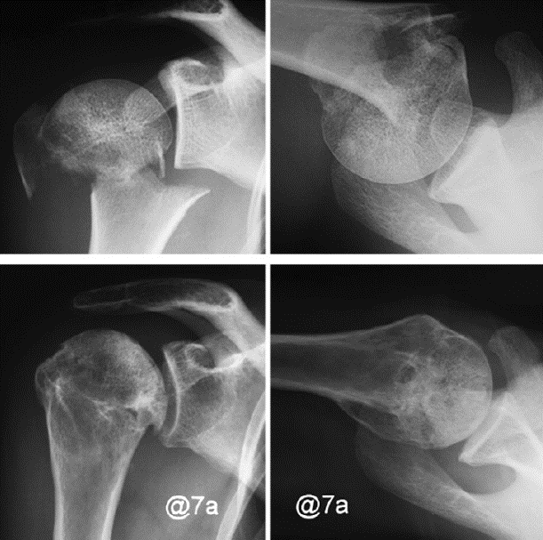
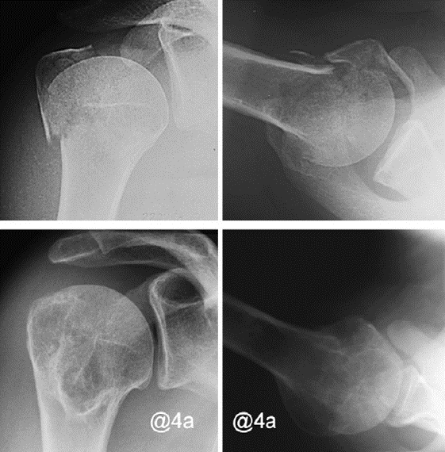
Not all Ischaemic heads collapse
J Shoulder Elbow Surg 2008;17:2-8.)

Slide 8
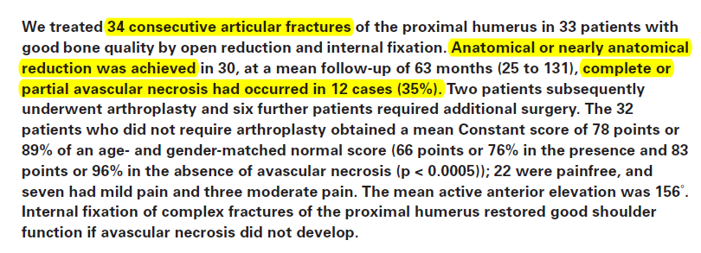
Gerber et al, JBJS (B) 2004
Clinical results of anatomically reduced
fractures of the proximal humerus which undergo avascular necrosis are functionally satisfactory and with a mean Constant score of 66 points or 76%, this is comparable to the results of hemiarthroplasty

Slide 9
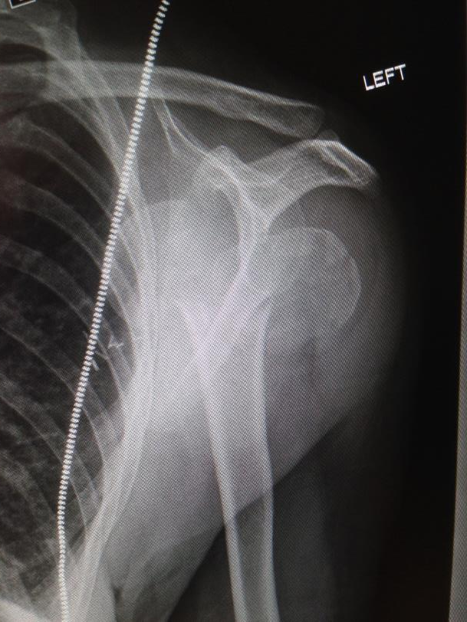
58 M YO

Slide 12
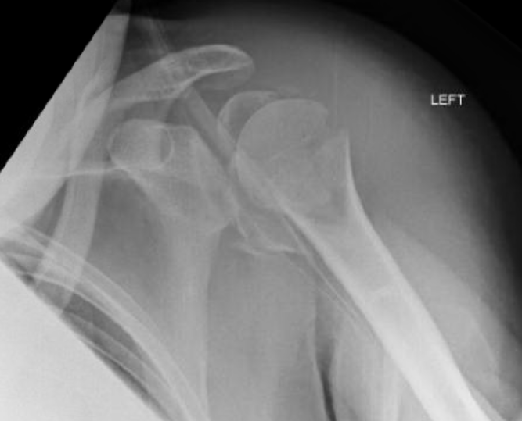
57 YO male

Slide 13
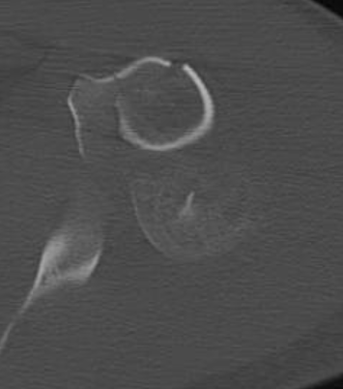
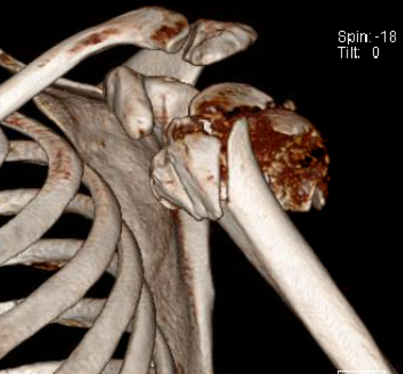
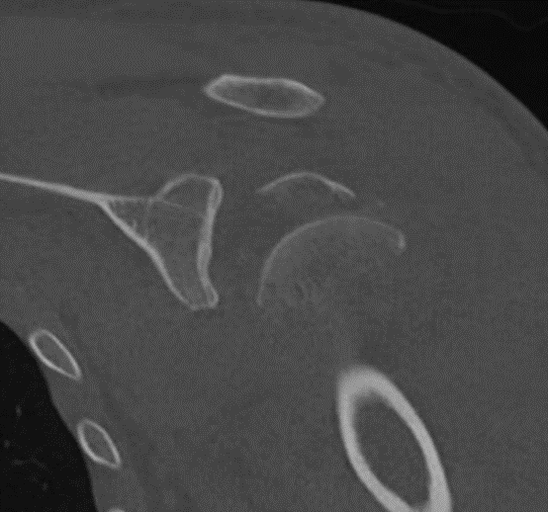
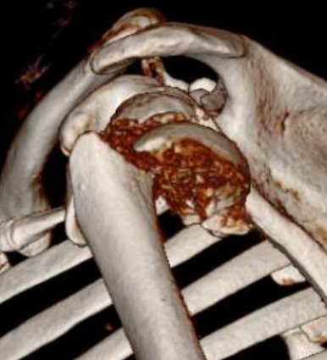

Slide 14
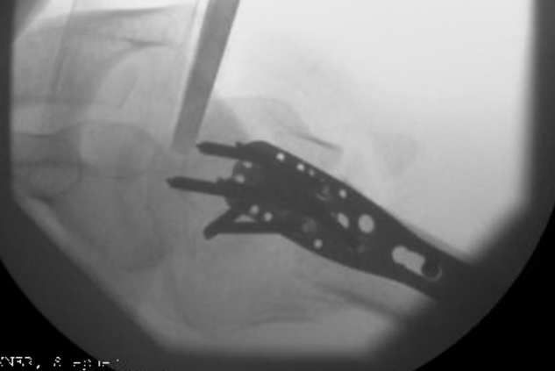
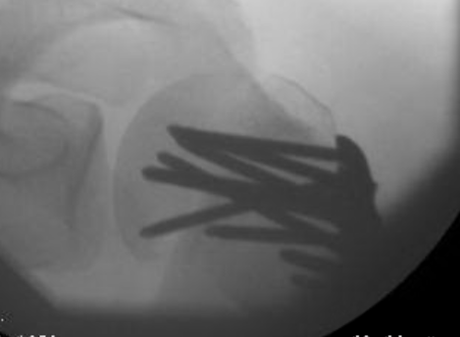

Slide 15
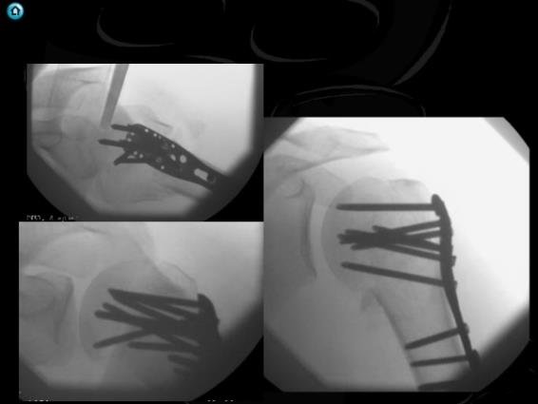
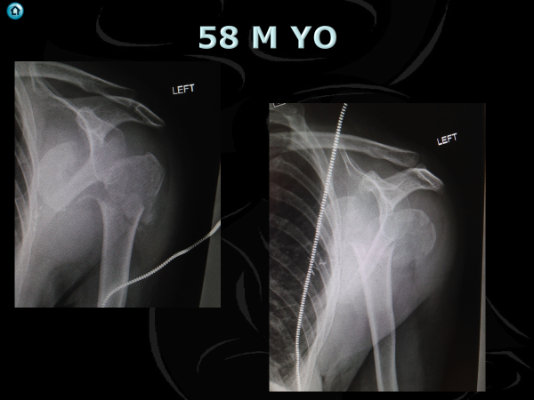
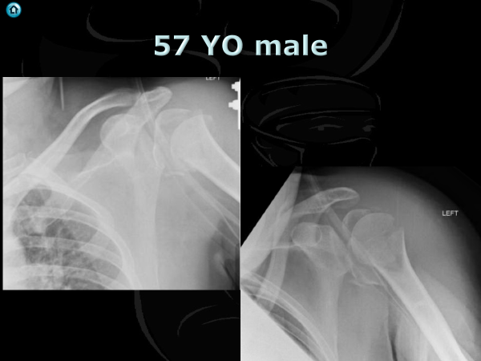
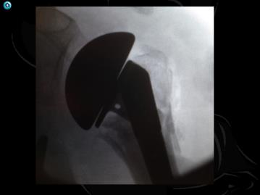

Slide 16
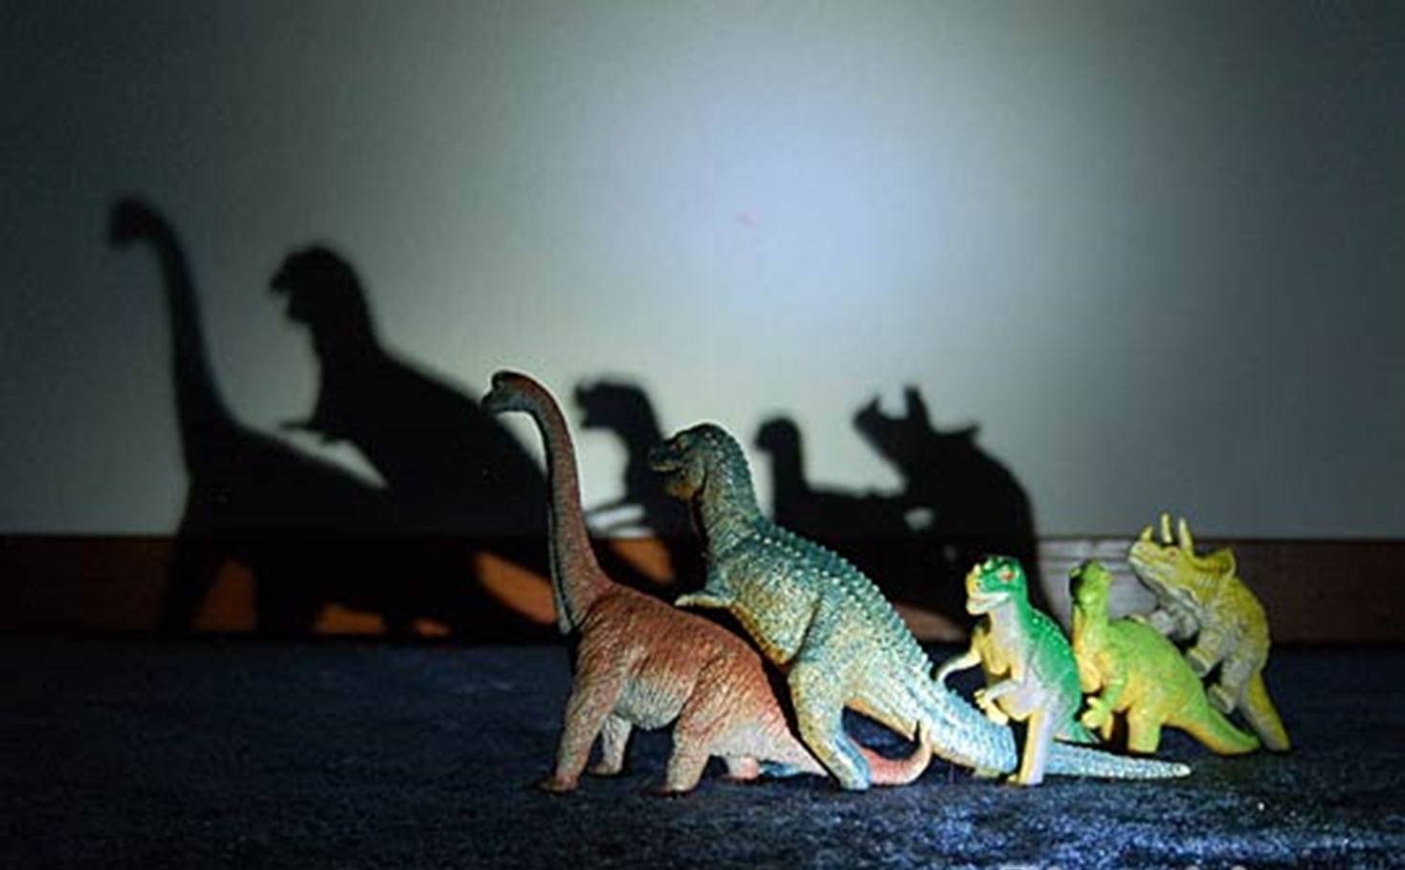
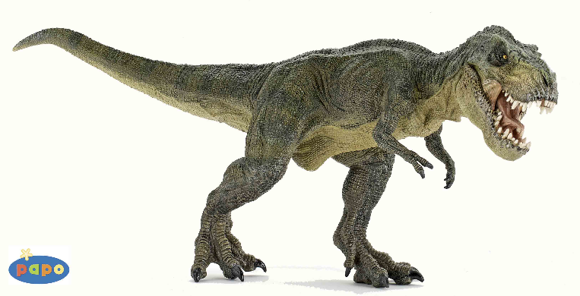
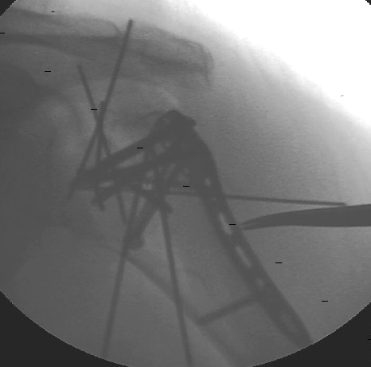
Fix or replace

Slide 17
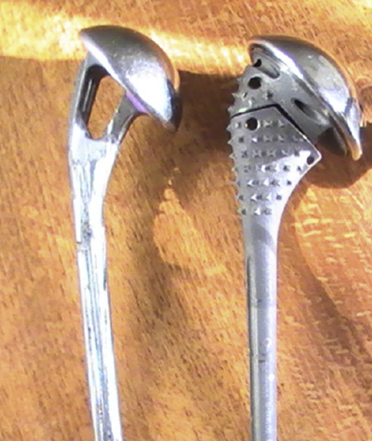
Hemiarthroplasty for trauma
Which one
Fracture stem ?

Slide 18
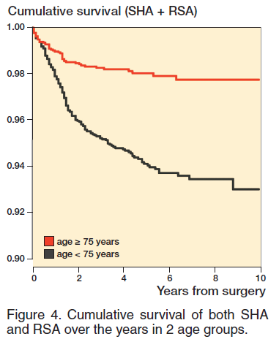
Risk of revision
Age < 75
Relative risk increased 2.8
Acta Orthopaedica 2017; 88 (4): 446–450

Slide 19
1 Year
SST, ASES, SF 12
No Difference
Forward elevation > 90
More RTS group
Medicare cost
RTS Saved money compared HA and ORIF
Less Physio
JUST GET GOING
J Shoulder Elbow Surg (2014) 23, 197-204

Slide 20
Revision Fracture stem Vs Non fracture stem

Slide 22
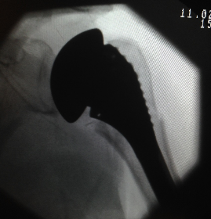
6 months

Slide 23
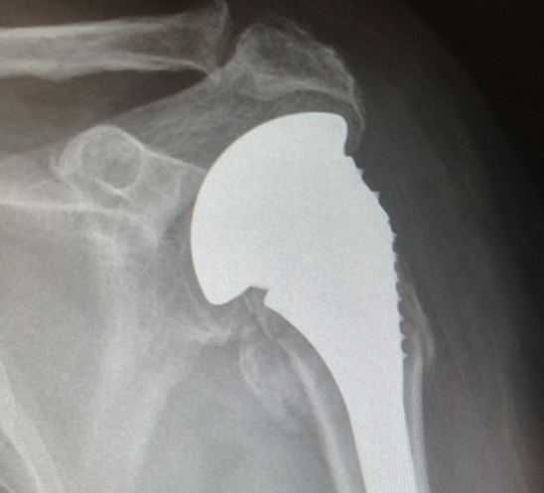

Slide 24
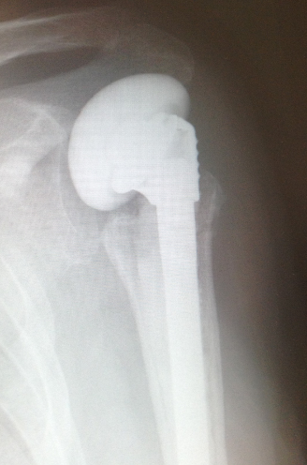
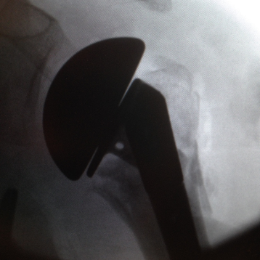
Revision Fracture Vs Non Fracture Vs Cemented Vs Non cemented

Slide 25
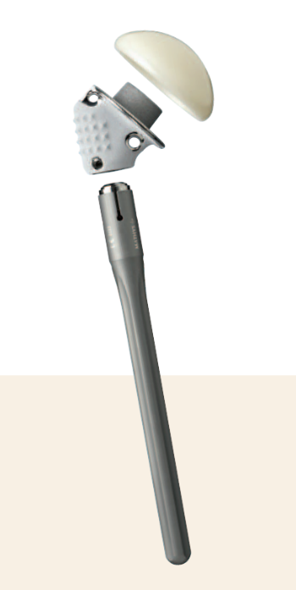
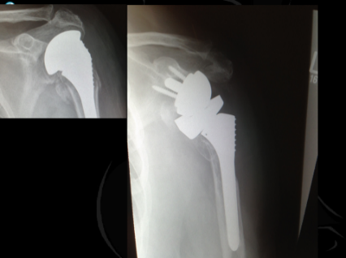

Slide 26
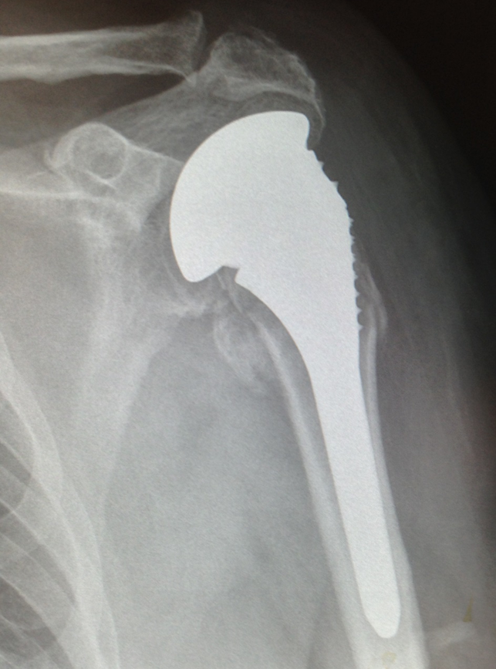
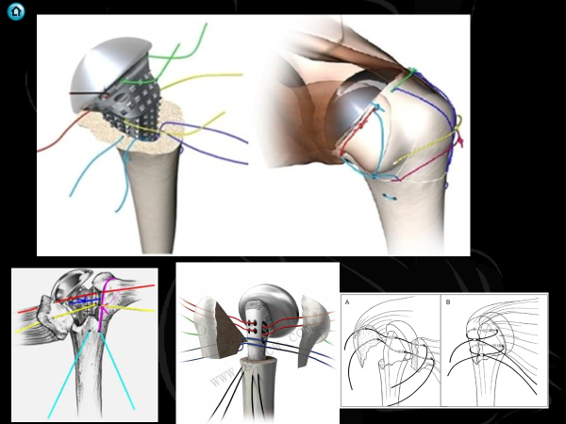

Slide 27
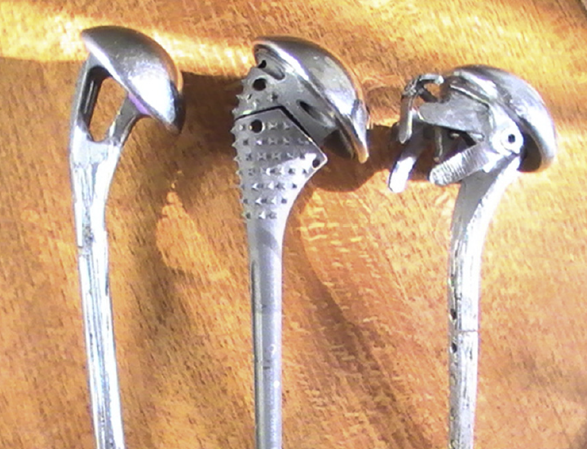
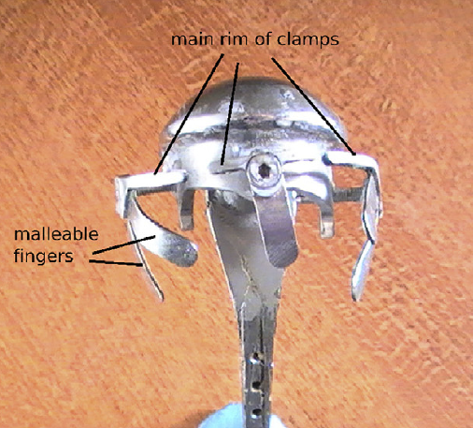
J Shoulder Elbow Surg (2015) 24, 561-568

Slide 28
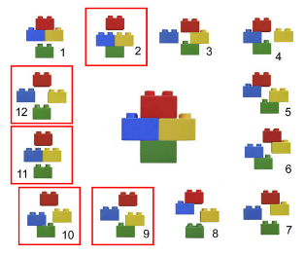
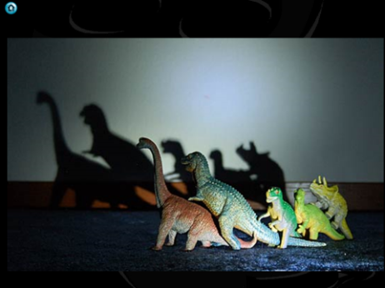
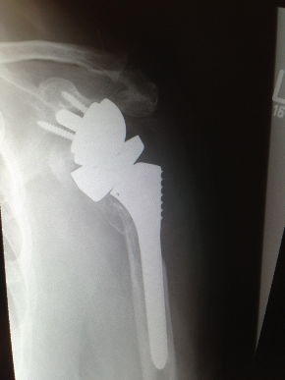
Summary

Slide 29
50 : 50 ball

Slide 30
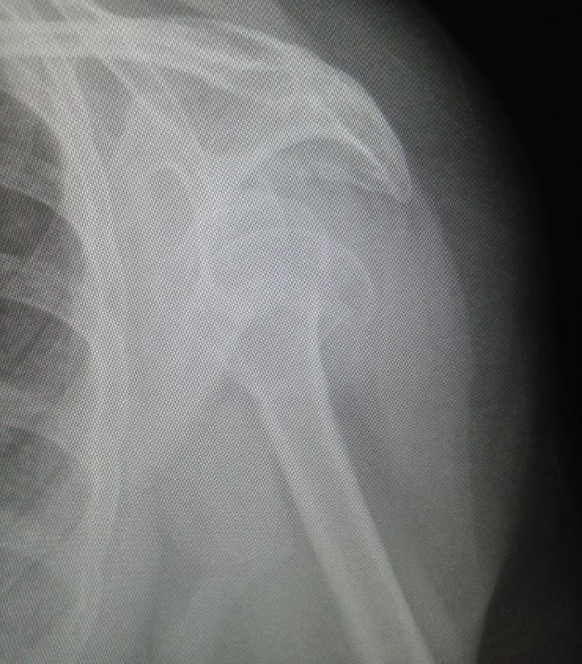
69 YO F 1 Yr

Slide 31
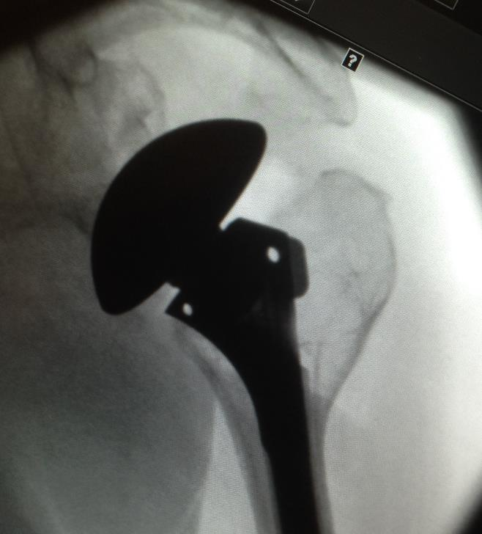
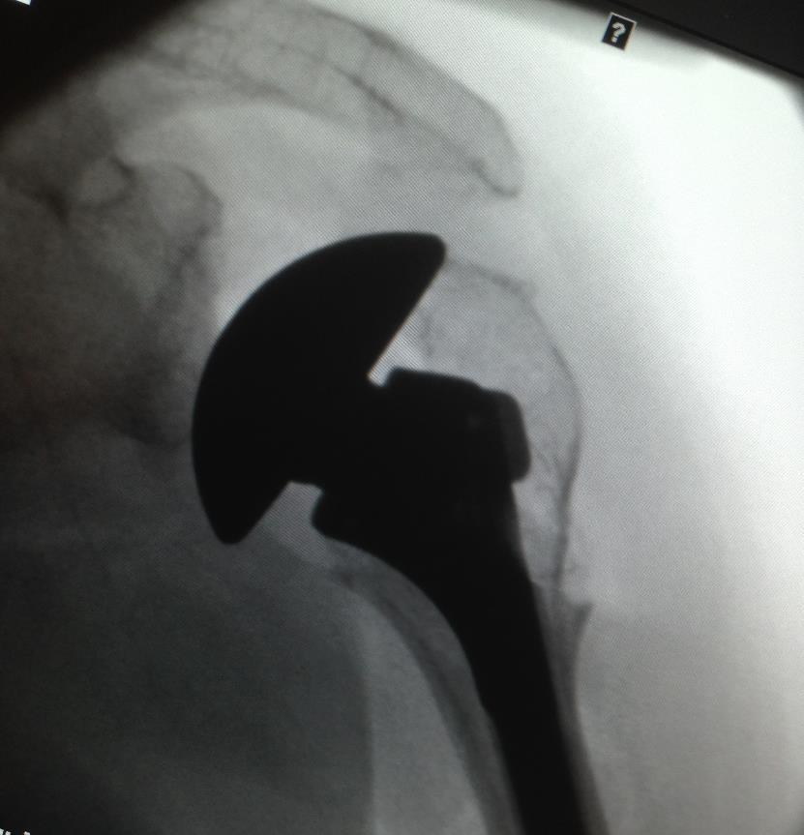

Slide 32
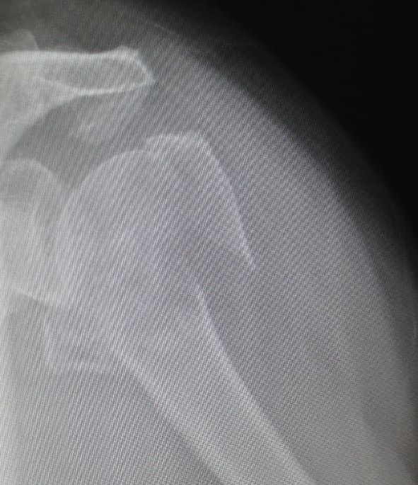
80 YO F

Slide 33
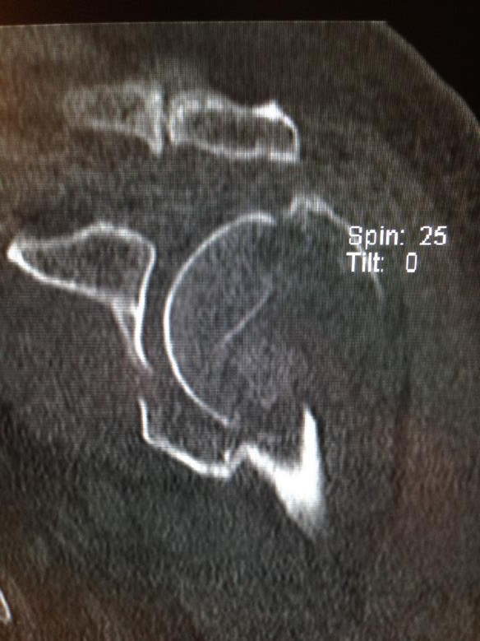

Slide 34
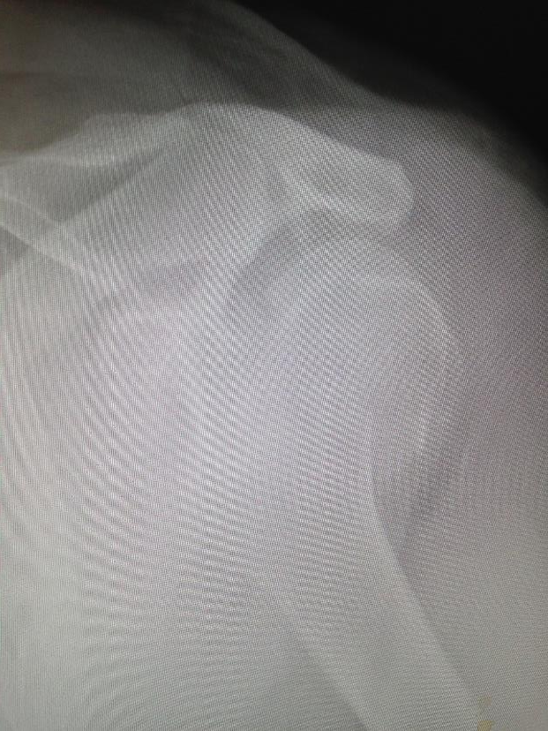
70 YO

Slide 35
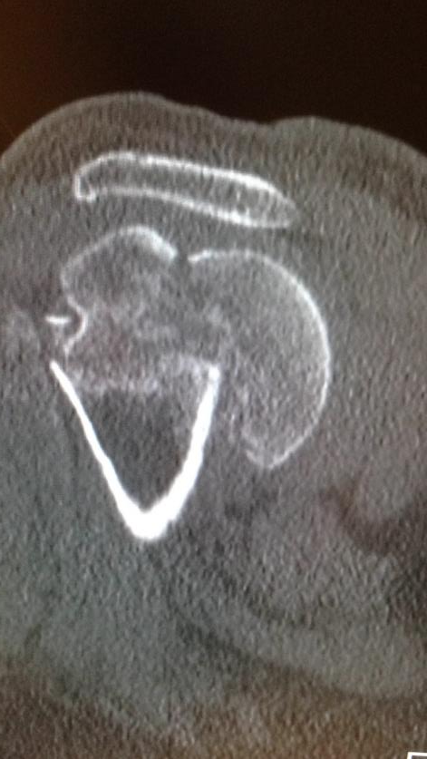

Slide 36
