Slide 1
Scapula fractures
Mr Lee Van Rensburg

Slide 2
36 YO Female

Slide 3
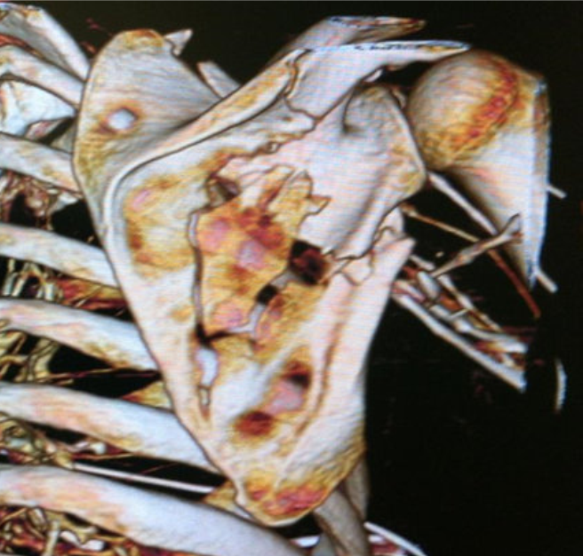

Slide 4
Introduction
3-5% of shoulder girdle fractures
<1% of fractures
Traditionally treated nonoperatively with acceptable results
Operative treatment more recently prescribed, surgery safe and effective
Deficient literature

Slide 5
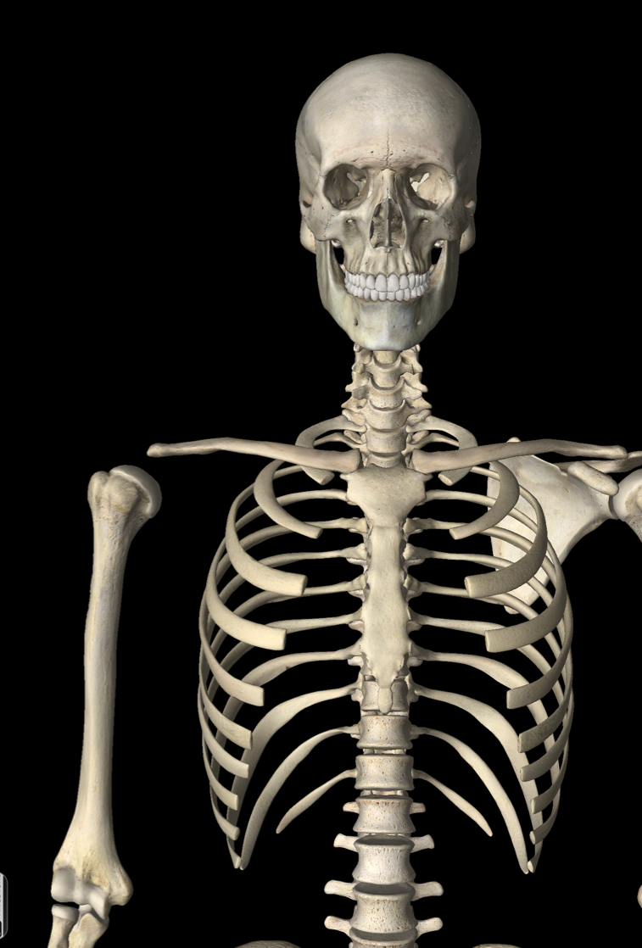
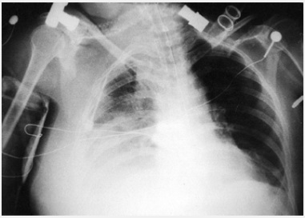
90% Associated injuries → Mortality

Slide 6
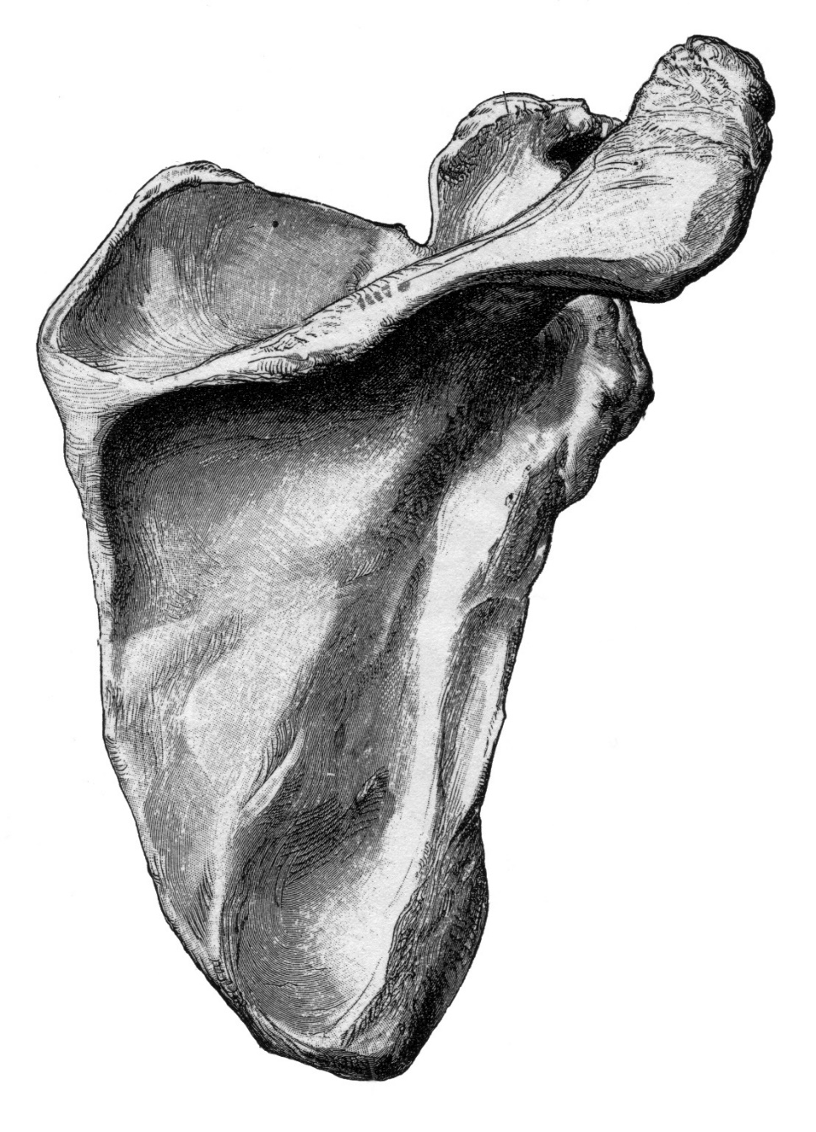
Scapula
Anatomic location
  Glenoid neck
  Intra- articular Glenoid
  Scapula body & Spine
  Coracoid
  Acromion
Grouped
Miller and Ada
I – Acromion or coracoid
II – Neck fractures
III – Intra-articular glenoid
IV - Body
Thompson
I – Coracoid & Acromion
II – Glenoid and neck
III – Major body
Zdravkovic & Damholt
I – Body fractures
II – Coracoid or Acromion
III – Neck or glenoid

Slide 7
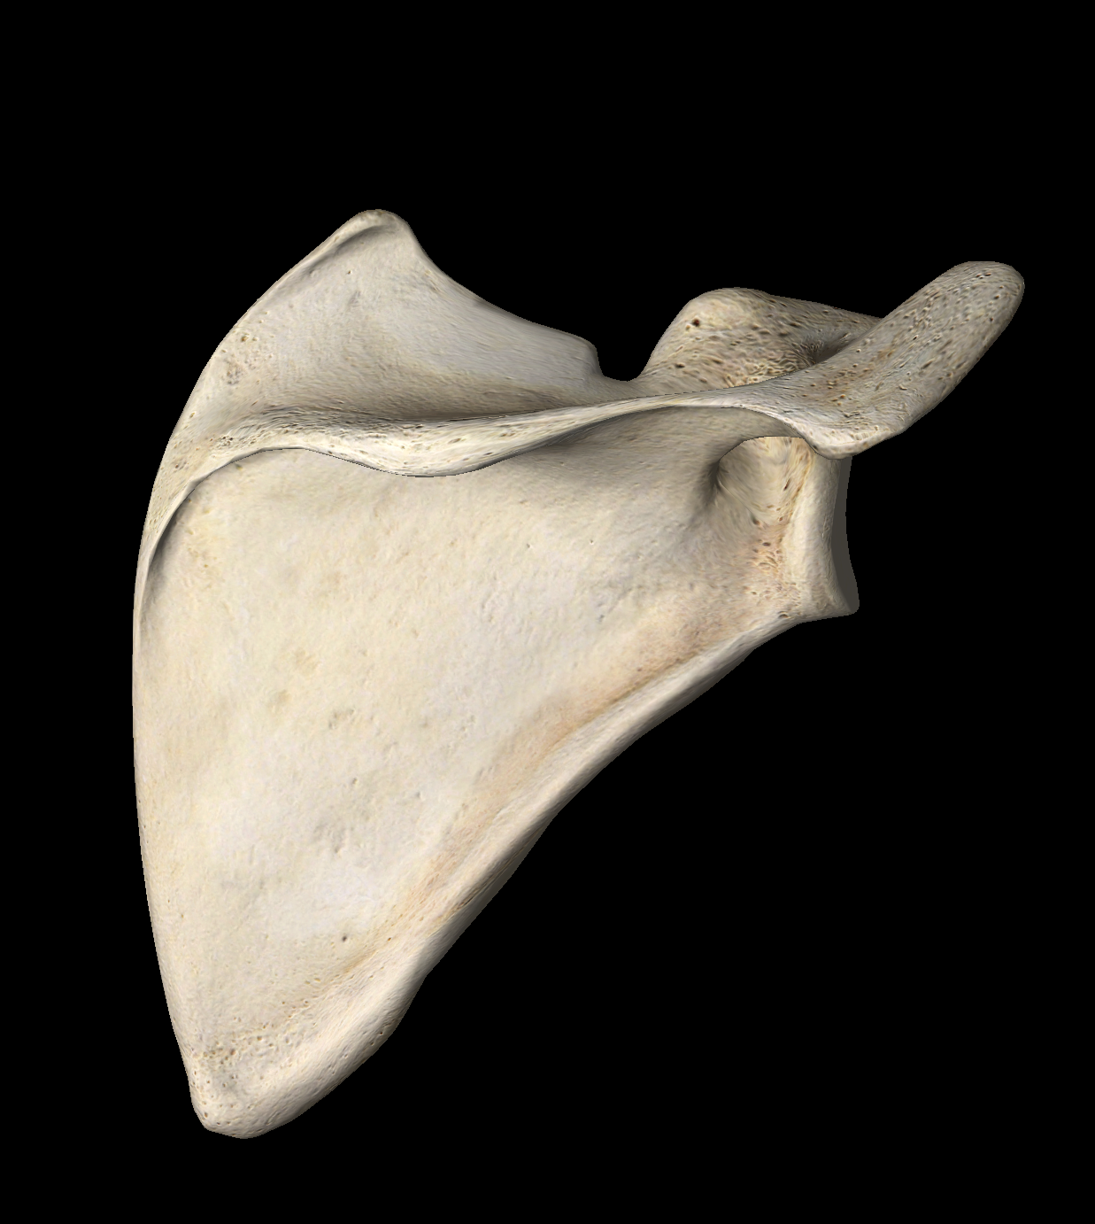
Incidence
15% Co & Ac
10%
IAG
50% Body
25% Neck

Slide 8
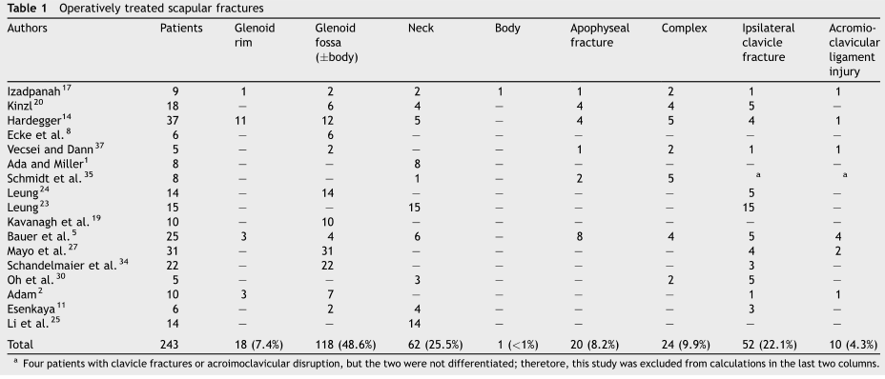

Which scapula fractures treated surgically?
IA Glenoid fractures
Neck fractures
Ipsilateral clavicular fractures
Notes:
In published series of factures treated with surgery, there is a preponderance of glenoid fossa and glenoid neck fractures. Many of them had ipsilateral clavicular fractures.

Slide 9
Body fractures
50% Body

Slide 10
Body fractures
90% may be treated CONSERVATIVE
  Sling for comfort, up to 10–14 days
  Pendulum and passive/AAROM for 4–6 weeks
  AROM at 6–12 weeks
  Strengthening for more than 8–12 weeks
Improvement in strength and ROM for up to 1 year

Slide 11
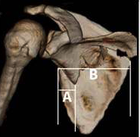
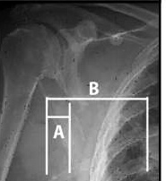
Body fractures
Medialization
+ 10–20 mm
Notes:
Some have suggested operation based on a medialization of the glenoid fossa. If looked at on a chest x-ray, it may be that the medial fragment is lateralized, and not that the joint is medialized.
References:
Romero J, Schai P, Imhoff AB. Scapular neck fracture – the influence of permanent malalignment of the glenoid neck on clinical outcome. Arch Orthop Trauma Surg. 2001 June, 12(16); 313–316.

Slide 12
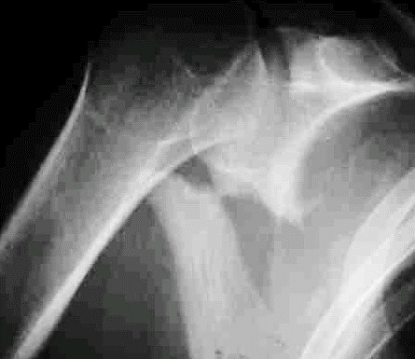
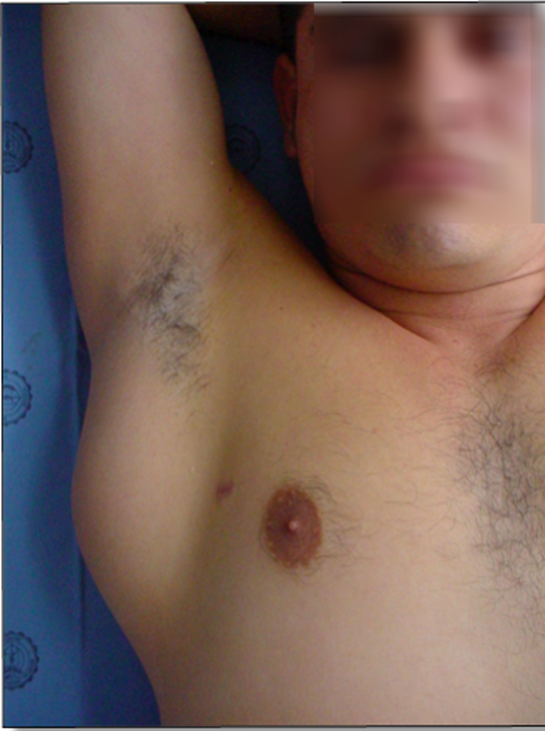
Notes:
Two months after injury, this displaced fracture was operated. Callus was taken down to realign the bone.

Slide 13
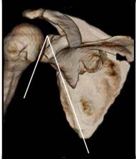
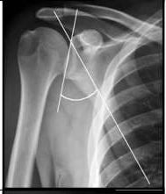
Body fractures
Glenopolar angle
>20° difference
.
Notes:
Change in the glenopolar angle by 20 degrees or more (compared to opposite shoulder) has also been suggested as operative indication.
References:
Kim KC, Rhee KJ, Shin HD, et al. Can the glenopolar angle be used to predict outcome and treatment of the floating shoulder? J Trauma. 2008 Jan;64(1):174–178.

Slide 14
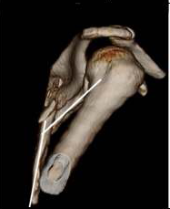
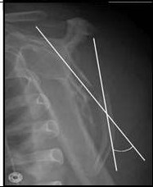
Body fractures
Angulation
> 30°
Notes:
Angulation measured on the scapular Y-view of more than 30 degrees has been suggested as operative indication.
References:
Romero J, Schai P, Imhoff AB. Scapular neck fracture the influence of permanent malalignment of the glenoid neck on clinical outcome. Arch Orthop Trauma Surg 2001;121:313–316.

Slide 15
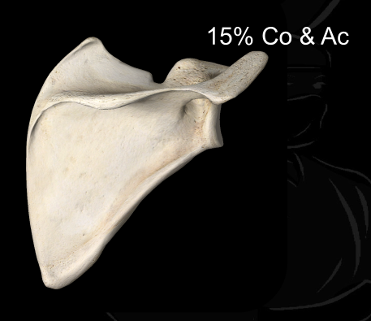
Apophyseal fractures

Slide 16
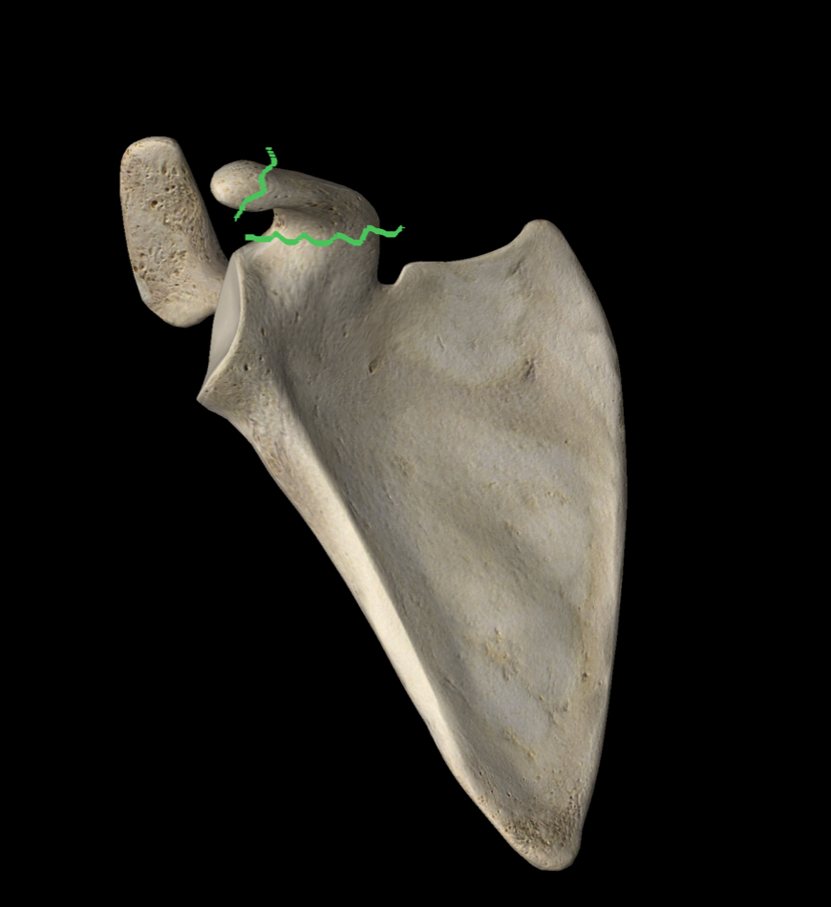
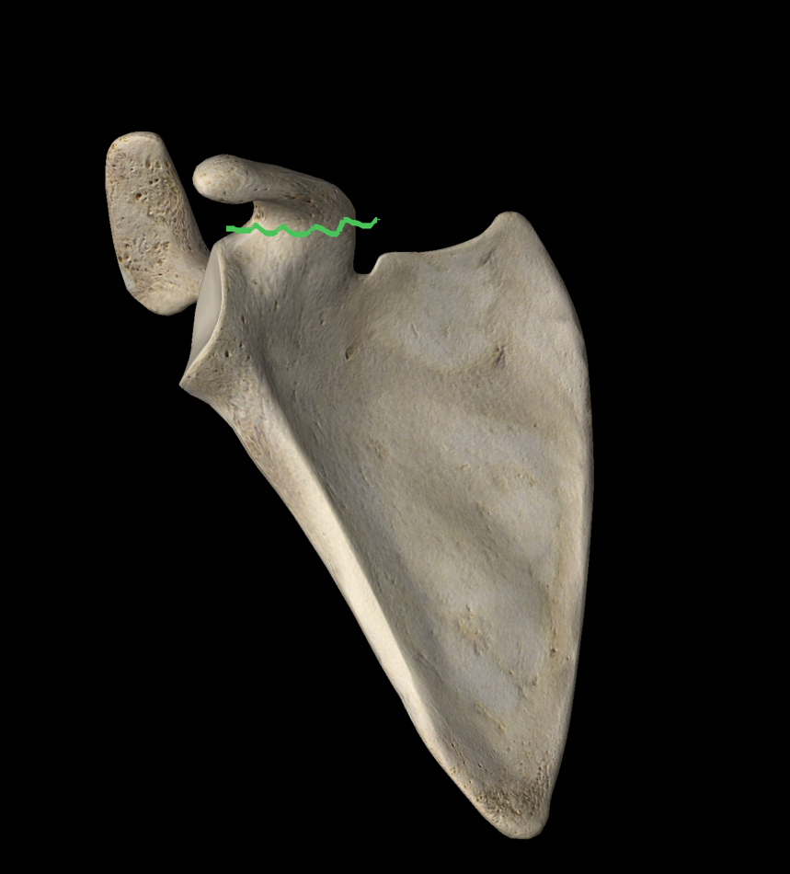
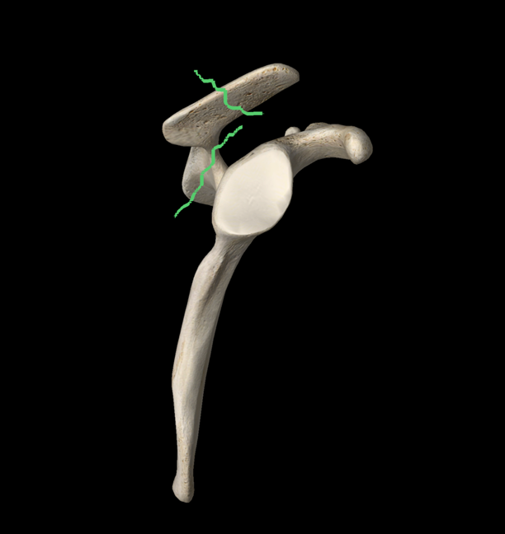
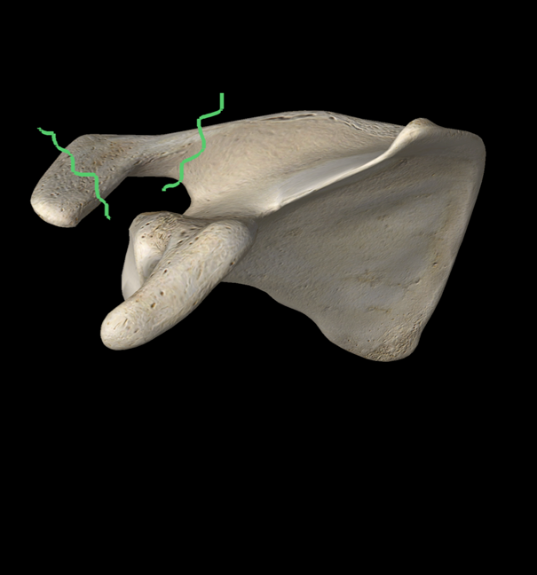

Slide 17
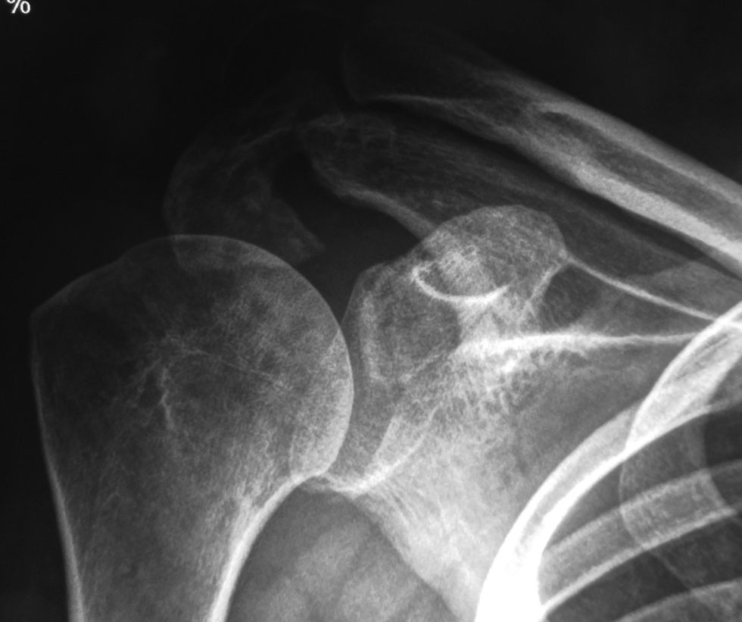
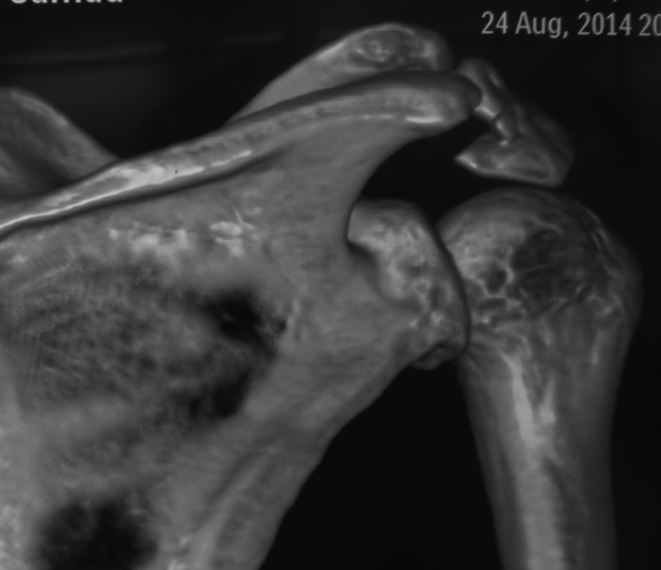
Acromial non-union

Slide 18
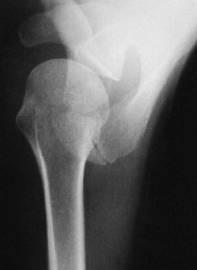
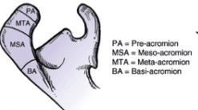
DD Os acromiale

Slide 19
Glenoid neck
25% Neck

Slide 20
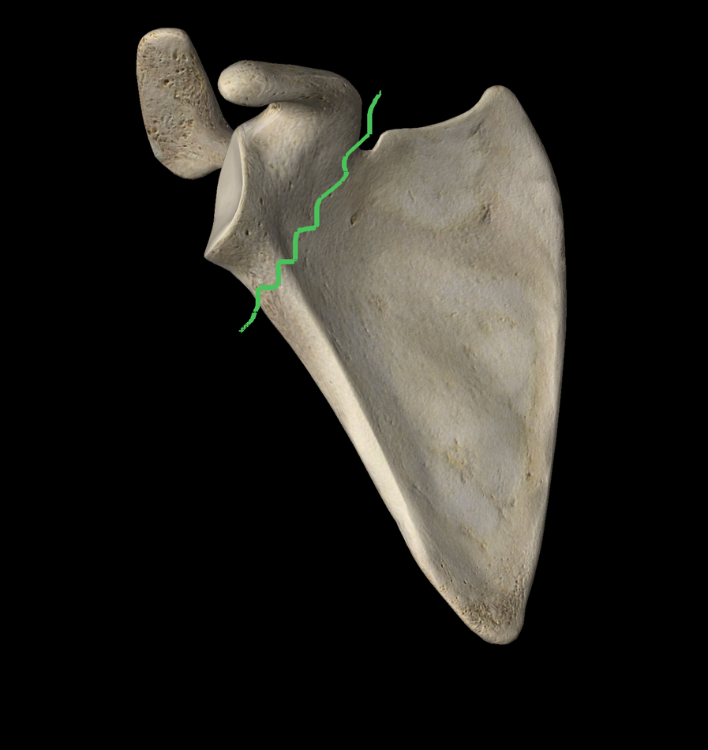
Neck fractures
Share common surgical indications as body fractures

Slide 21
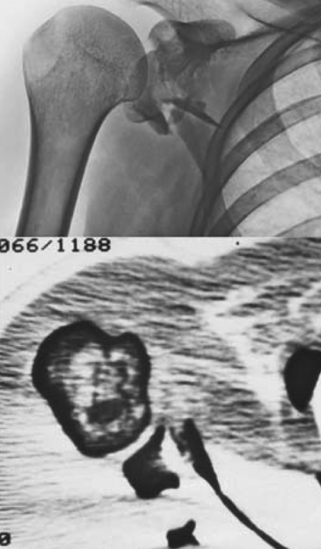
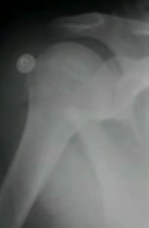
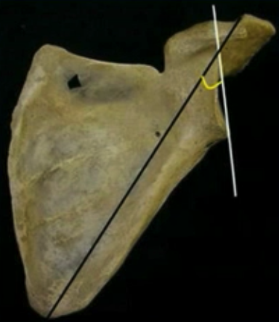
Neck fractures
>10mm
Gleno-Polar angle <20

Slide 22
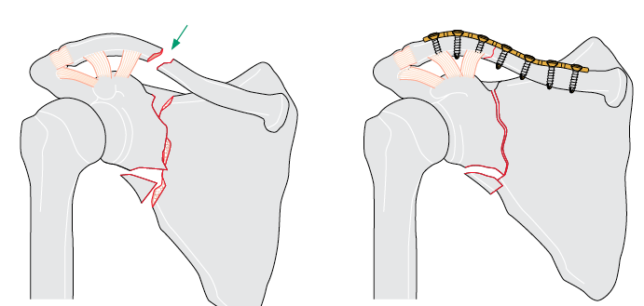
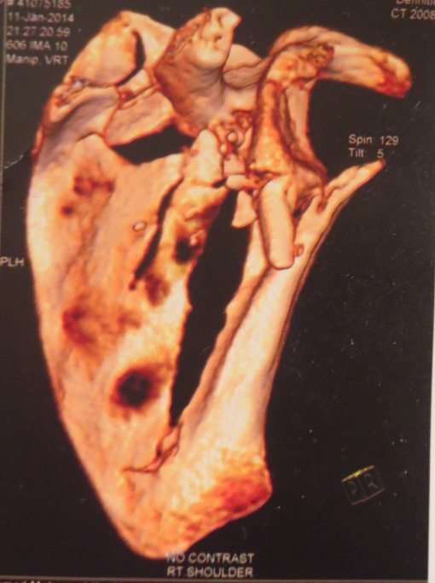
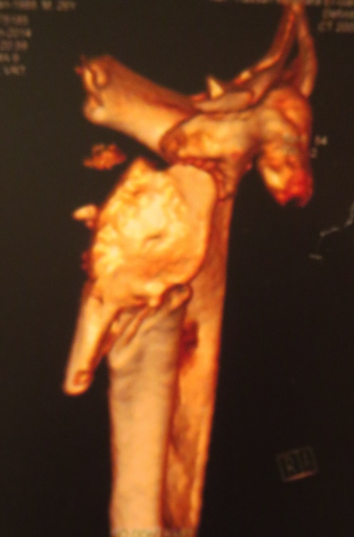
Neck fractures
Angulation > 30
Floating Shoulder
Discussed in the case example

Slide 23
Co & Ac
Glenoid
Body
Neck

Slide 24
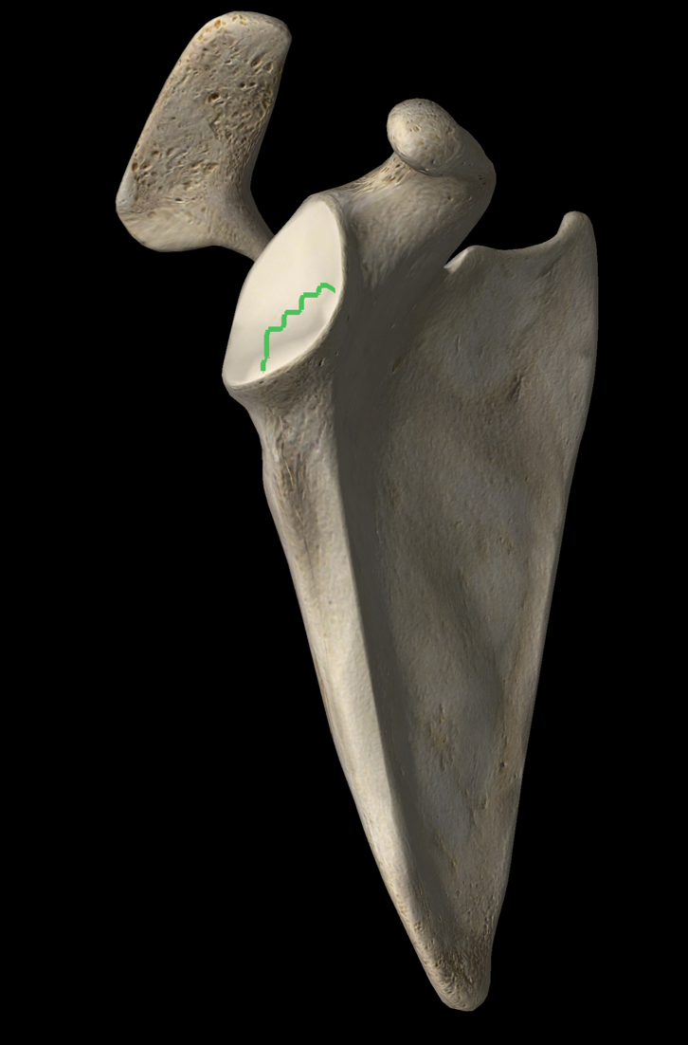
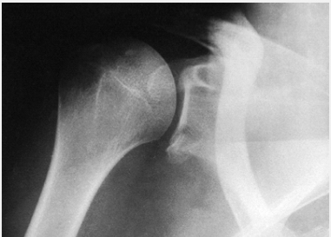
Intra-articular Glenoid fractures
Bony labral fractures
25%
5mm
Subluxation

Slide 25
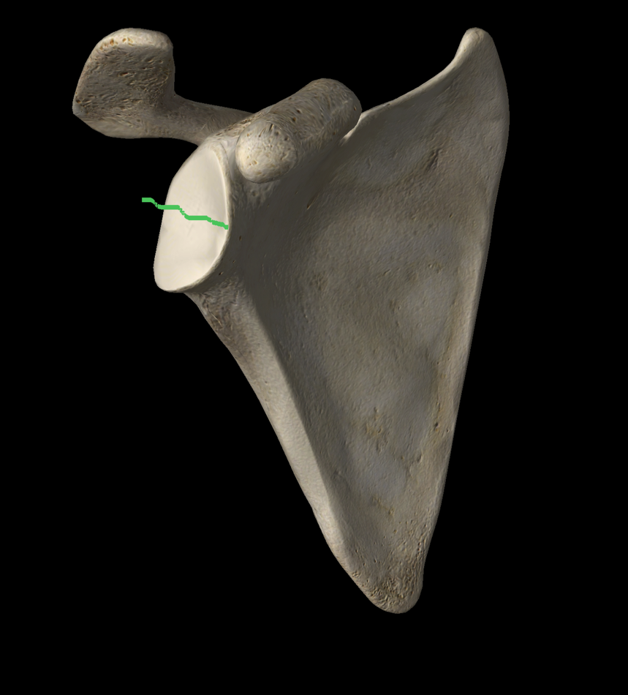
Intra-articular Glenoid fractures
Transverse glenoid fractures
Gap >5mm
Step-off >2mm

Slide 26
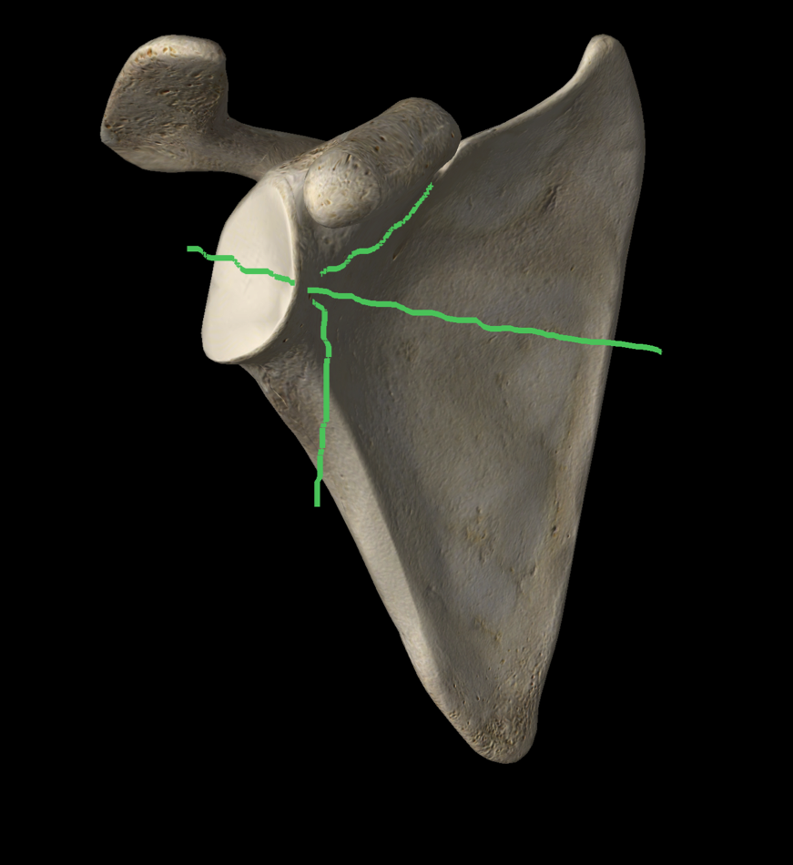
Intra-articular Glenoid fractures
Exit
Superior
Medial
Inferior

Slide 27
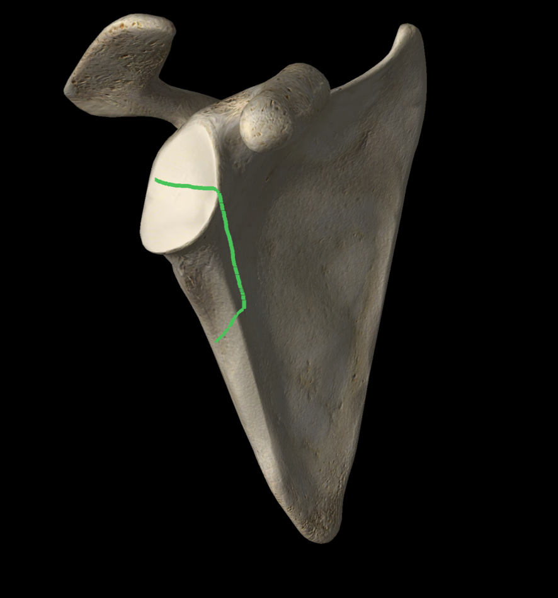
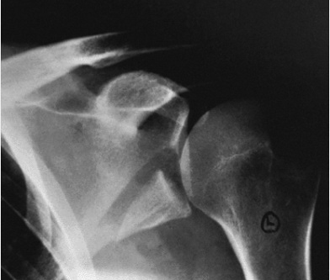
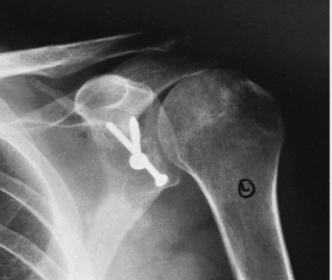
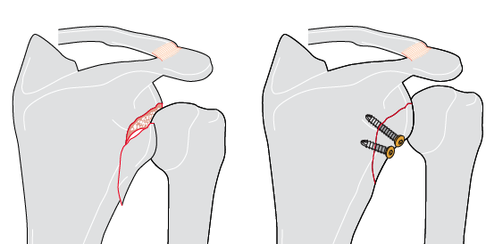
Intra-articular Glenoid fractures
Inferior exit
➔ Subluxation

Slide 28
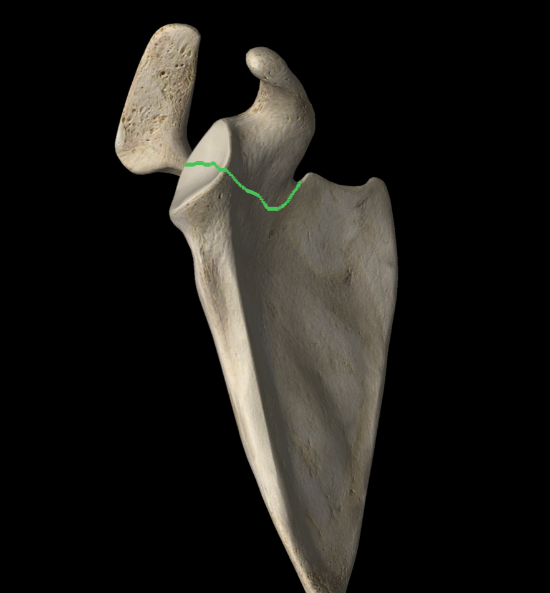
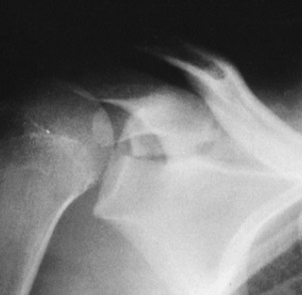
Intra-articular Glenoid fractures
Superior exit
Flexed coracoid
Narrow outlet

Slide 29
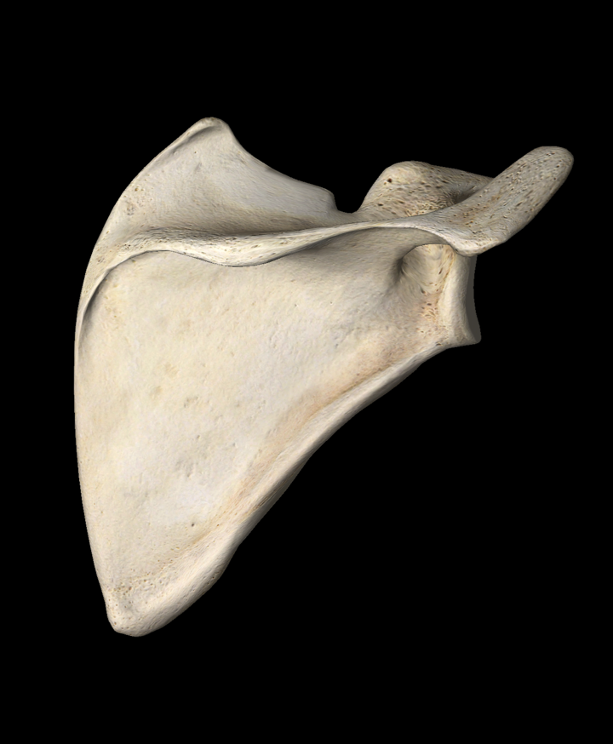
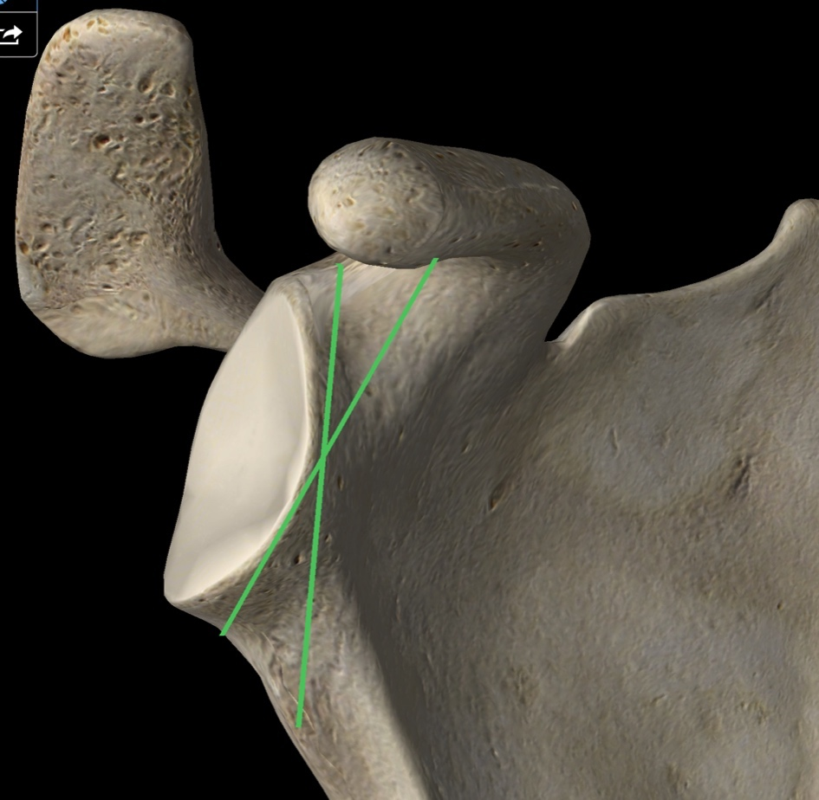
Intra-articular Glenoid fractures
Screws direction
Coracoid osteotomy

Slide 30
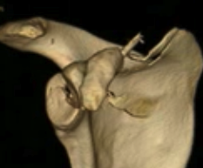
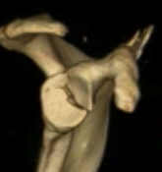
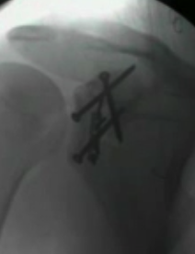
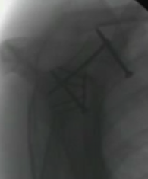
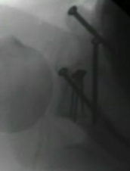

Slide 31
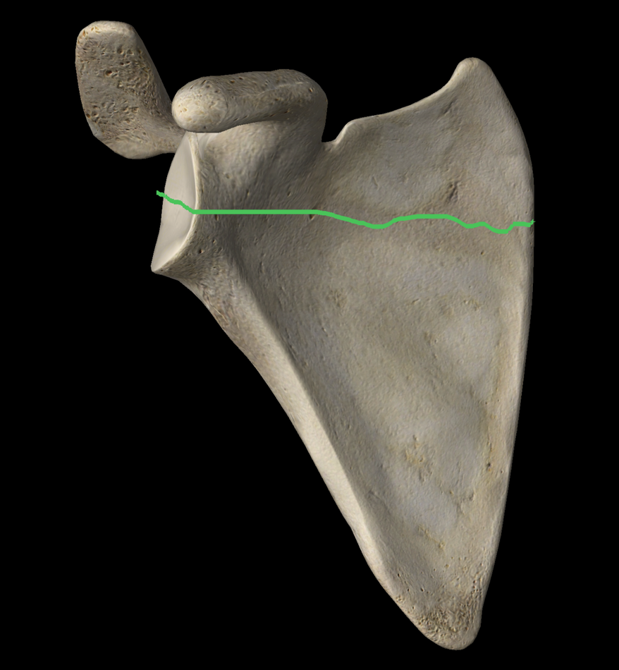
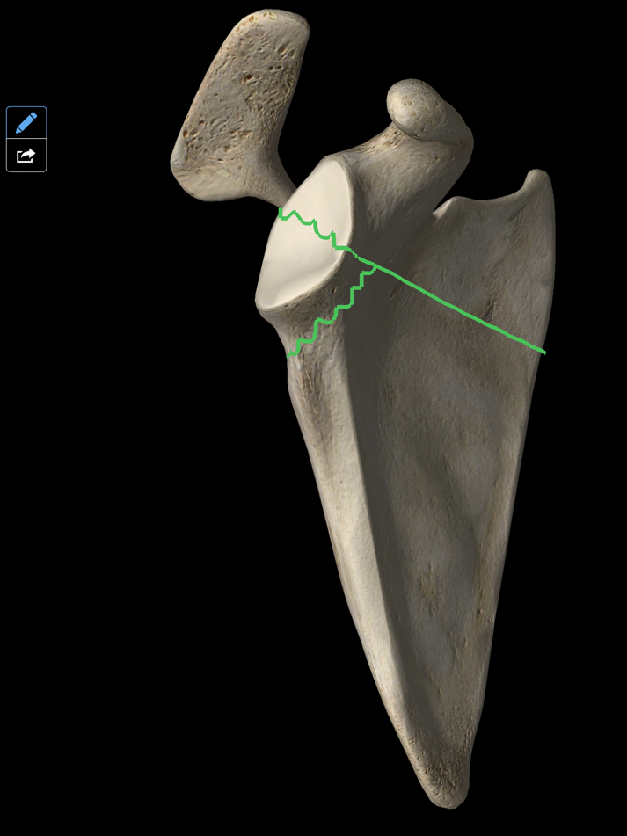
Intra-articular Glenoid fractures
Medial exits

Slide 32
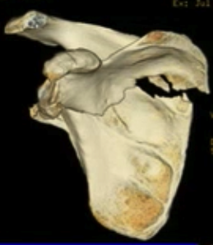


Intra-articular Glenoid fractures
Medial exits

Slide 33



Intra-articular Glenoid fractures
Medial and lateral border fix

Slide 34


Intra-articular Glenoid fractures
Comminuted

Slide 35


IA Glenoid fractures: Ideberg

Slide 36



Surgical Approachs
Majority of fractures are best approached posteriorly
Notes:
References:
Lantry JM, Roberts, CS, Giannoudis PV. Operative treatment of scapular fractures: A systematic review. Injury. 2008 Mar;39(3):271–283.

Slide 37


Plate positioning
Areas strong enough to support fixation:
Scapular spine
Glenoid neck
Borders of the scapula
Scapula trans-illumination

Slide 38


A case example [floating shoulder]
Neck and Clavicle

Slide 39

A case example [floating shoulder]

Slide 40


A case example [floating shoulder]

Slide 41
A case example [floating shoulder]

Slide 42
Conclusion
Associated injuries
Surgery is needed in some patients
Extensile approach
Posterior approach is the most commonly used

Slide 43
Conclusion
Neck & Body
Glenoid Fossa
Angulation
  30 in Y-scapular view
  <20 GPA
Displacement
  1cm
Floating Shoulder
Incongruency
  Gap 5mm ????
  Step-off 2mm
Subluxation
Narrow Outlet

