Slide 1
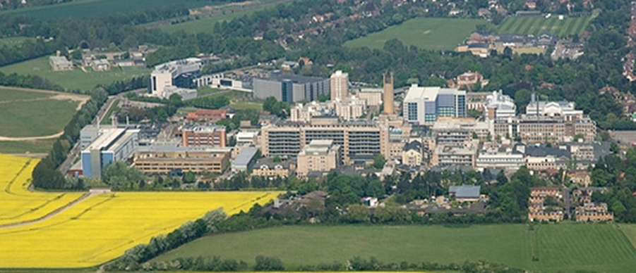
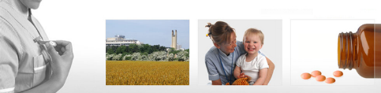
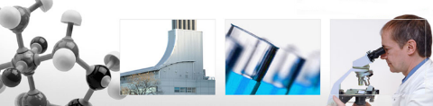
Radial head and neck fixation: The limits
Mr Lee Van Rensburg
Cambridge University hospitals NHS trust
11:15 to 11:25

Slide 2
Disclaimer
Acumed
  Paid consultancy and teaching work
  Financial support for elbow masterclass course
Wright medical
  Financial support for elbow masterclass course
No Endorsing any particular implants

Slide 3
Radial head
Classification
Mason Classification (1954)
Hotchkiss adaption (1997)
Mason – Mayo (2008)

Slide 4
Radial head
Classification
Mason Classification (1954)
3 types
    1. Undisplaced fracture (<2mm)
    2. Marginal or rim fracture, displaced
    3. Multifragmentary fracture involving whole head

Slide 5
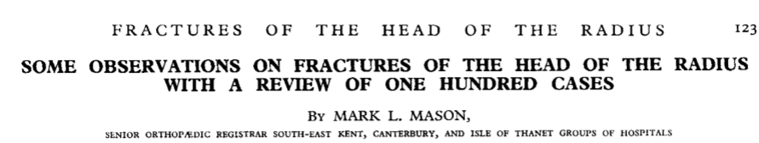
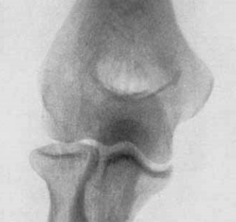
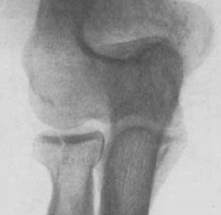
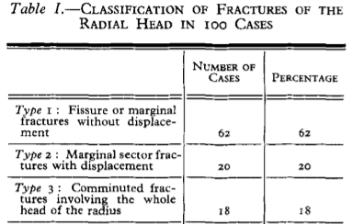
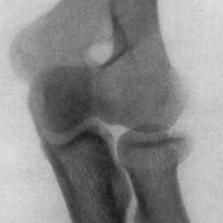
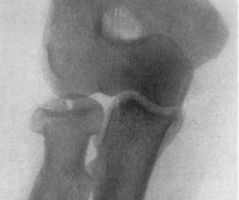
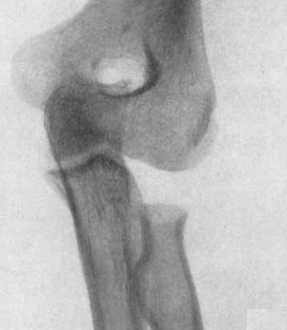
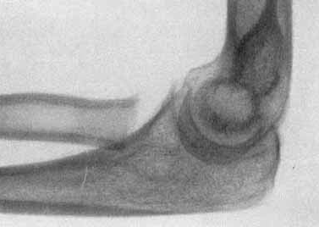
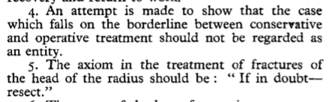
Mason 1954
Type 1
Type 1 Fissure
Type 2
Type 2
Type 3
Br J Surg 1954; 42:123-132

Slide 6
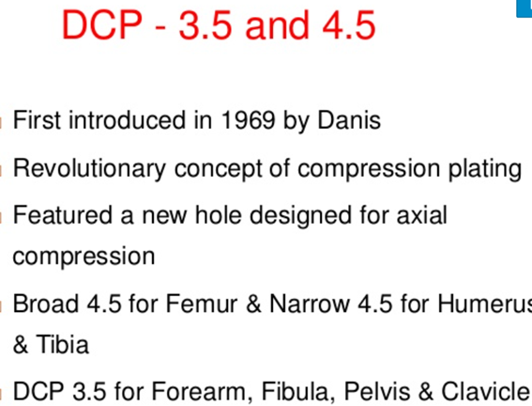
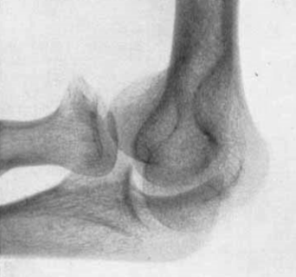
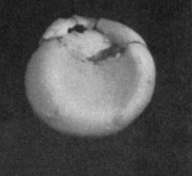
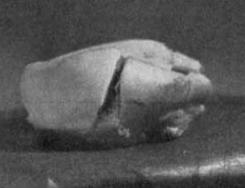
Mason 1954
Br J Surg 1954; 42:123-132

Slide 7
Radial head
Classification
Hotchkiss (1997)
Adaption of Mason
    1. Undisplaced or minimally displaced (<2mm)
    2. Displaced but amenable to internal fixation
    3. Fracture not amenable to internal fixation

Slide 8
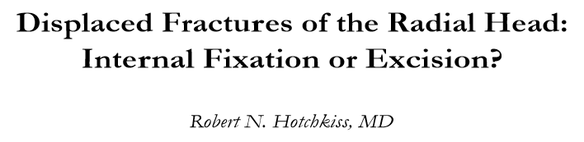
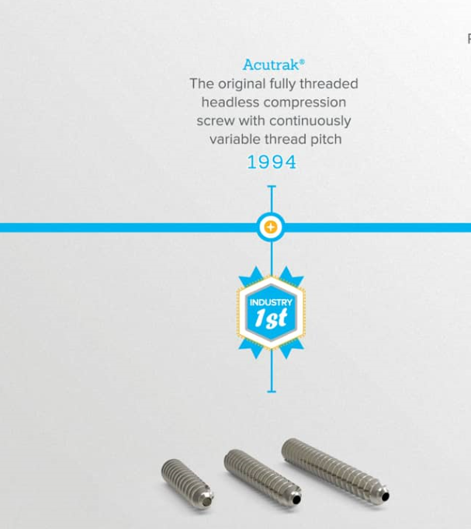
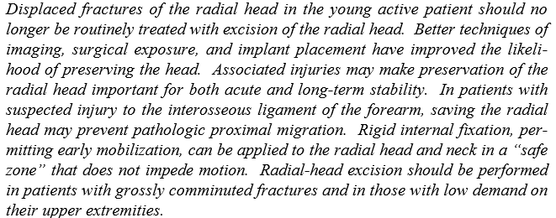

Hotchkiss 1997
J Am Acad Orthop Surg 1997;5:1-10

Slide 9
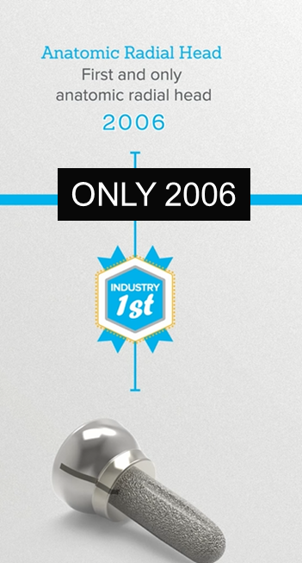
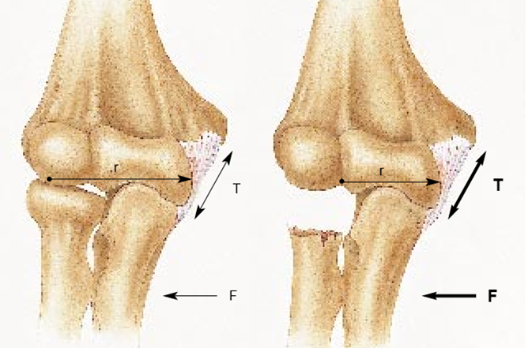
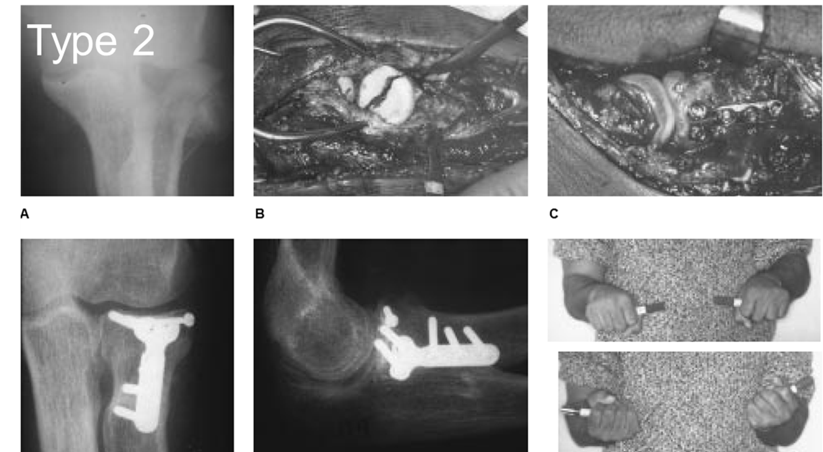
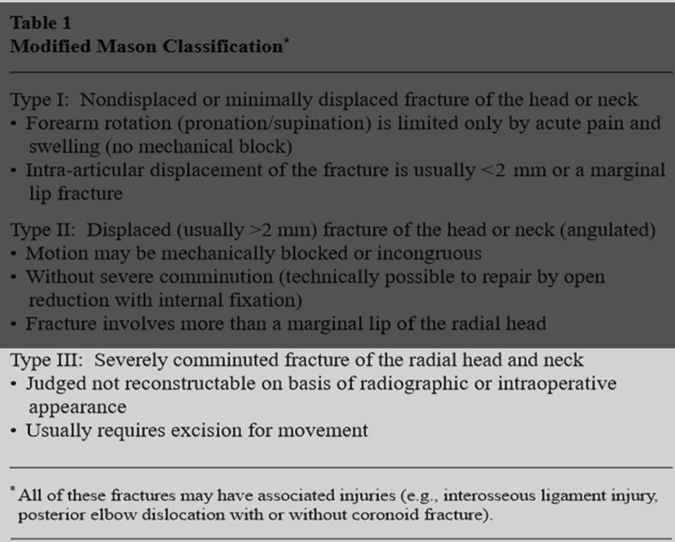
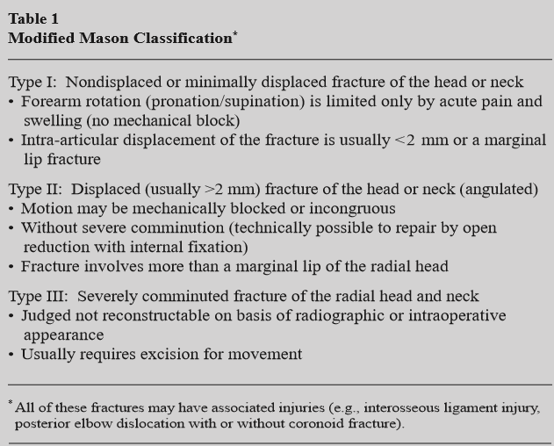
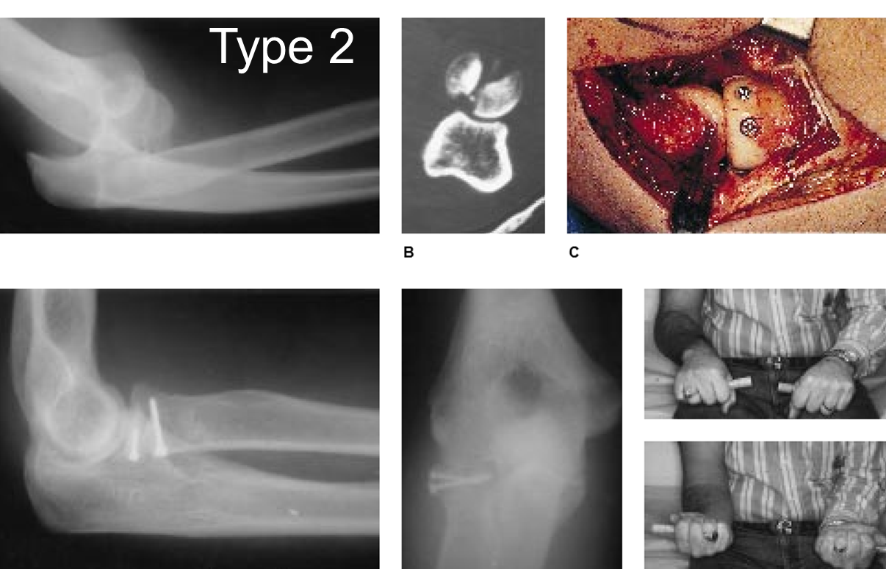
Hotchkiss 1997
J Am Acad Orthop Surg 1997;5:1-10

Slide 10
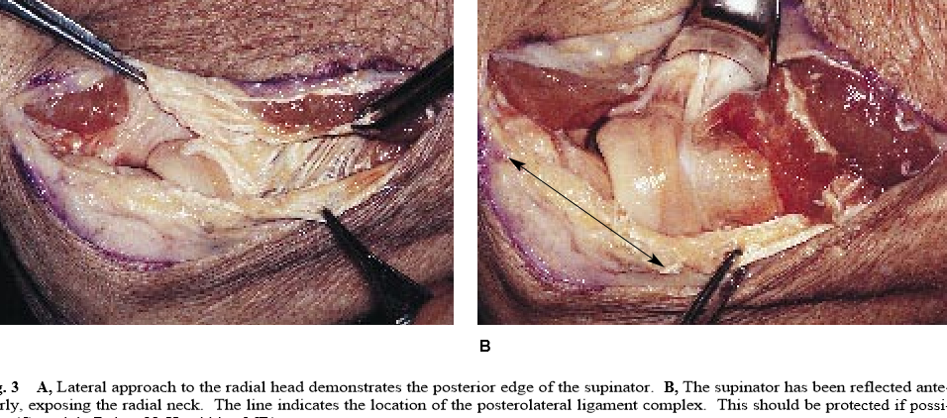
Hotchkiss 1997
J Am Acad Orthop Surg 1997;5:1-10

Slide 11
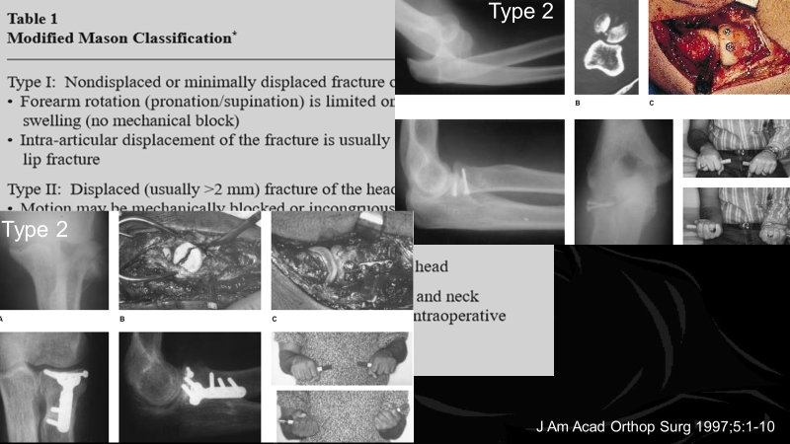

Radial head
Classification
Mason – Mayo (2008)
Adaption of Mason
    Includes suffix to denote associated
      Articular injury
        c = coronoid
        o = olecranon
      Ligamentous injury
        l = lateral collateral ligament
        m = medial collateral ligament
        d = distal radioulnar joint
van Riet RP, Morrey BF.; Clin Orth Relat Res. 2008 Jan;466(1):130-4.

Slide 12
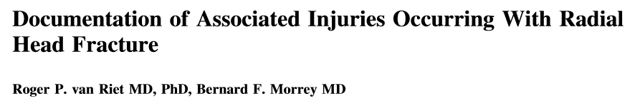
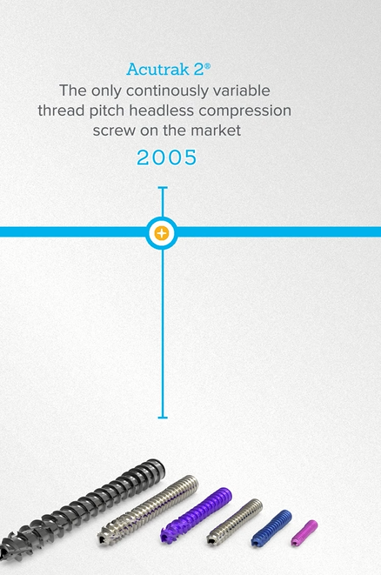
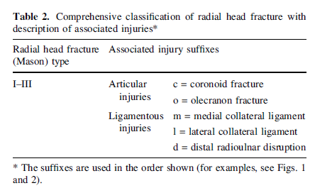
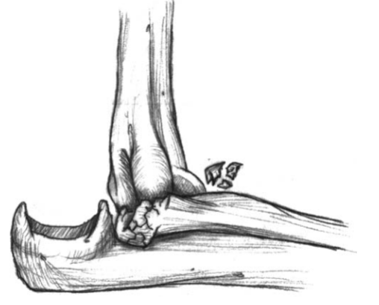
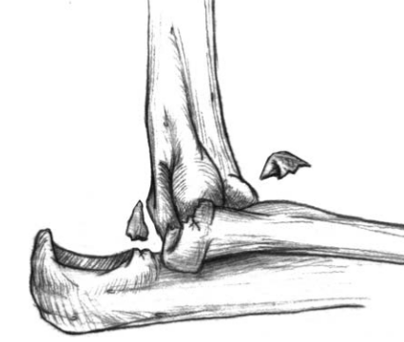
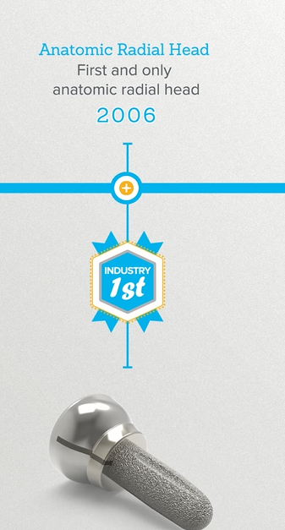
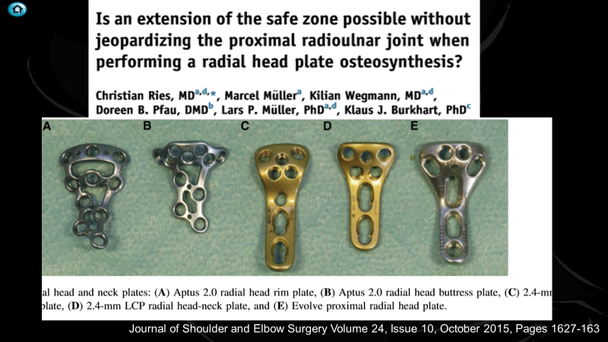
Mason Mayo 2008
Type 3 l m
Type 2 c l m
Clin Orthop Relat Res (2008) 466:130–134

Slide 13
Database 2007 – 2011
58404 Radial head fractures
2981 Operative treatment 2981
Fix 57%
Replace 38%
Excision 5%
Hardware no longer the limit
J Hand Surg Am. 2018 Mar;43(3):241-247

Slide 14
Limited appreciation of
The Degrees of badness

Slide 15
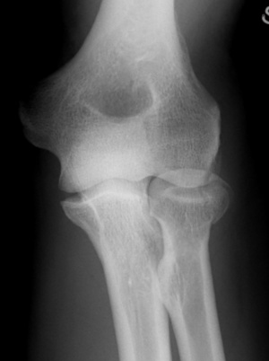
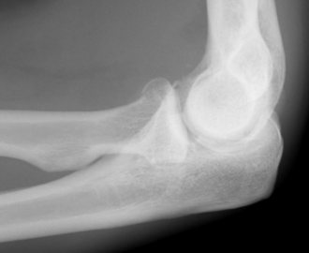
32 YO Fall

Slide 16
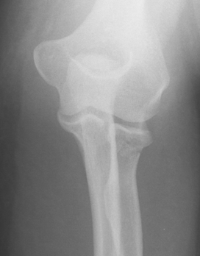
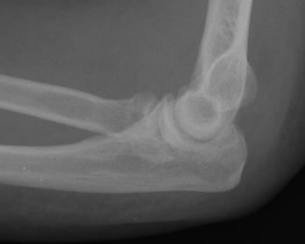
32 YO fall

Slide 17

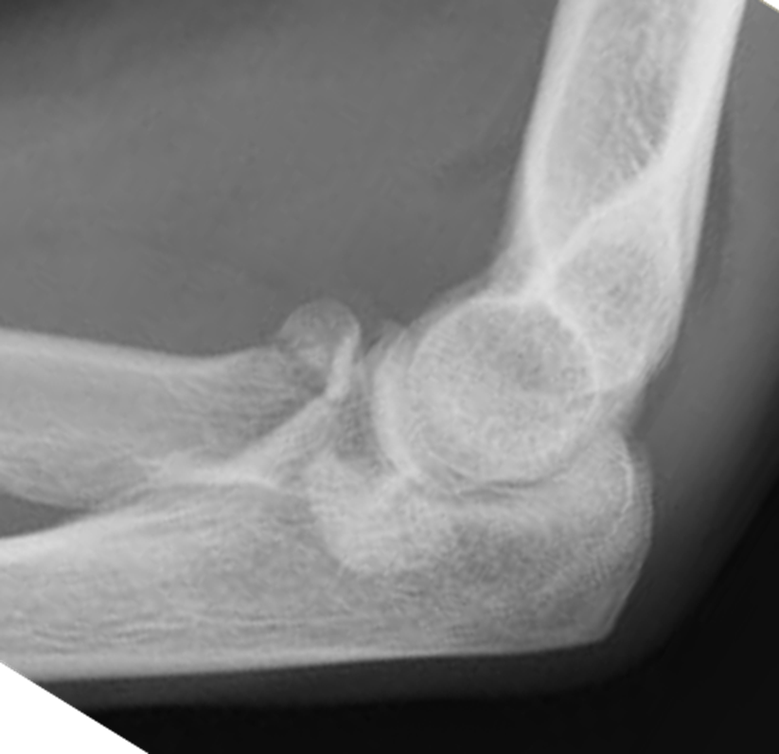

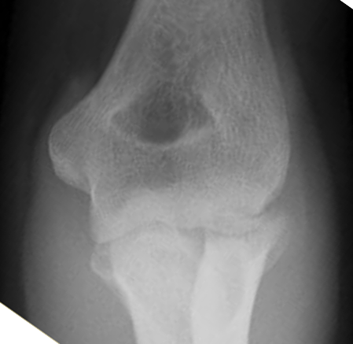


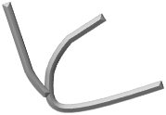
21 YO F

Slide 18

J Orthop Surg (Hong Kong). 2017 May-Aug;25(2)
J Hand Surg Am. 2018 Jun;43(6):575

Slide 19
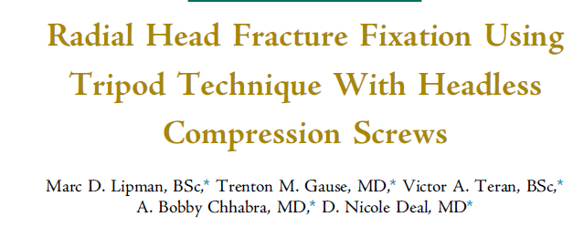
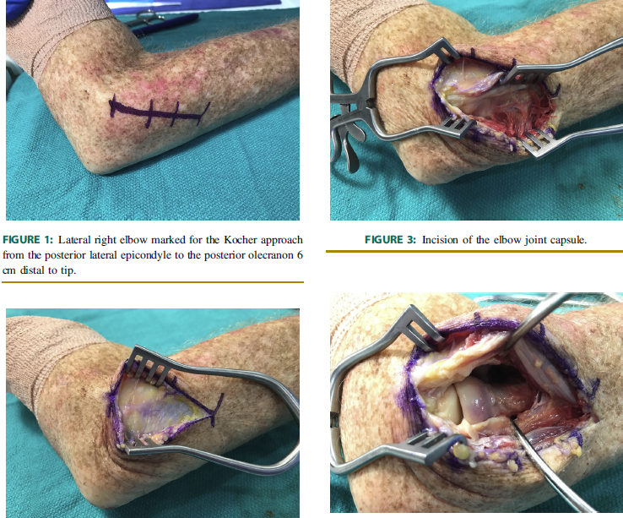
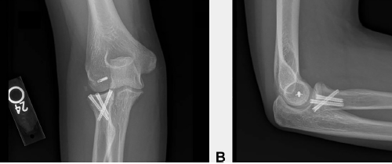
J Hand Surg Am, 43 (6), 575.e1-575.e6 Jun 2018

Slide 20
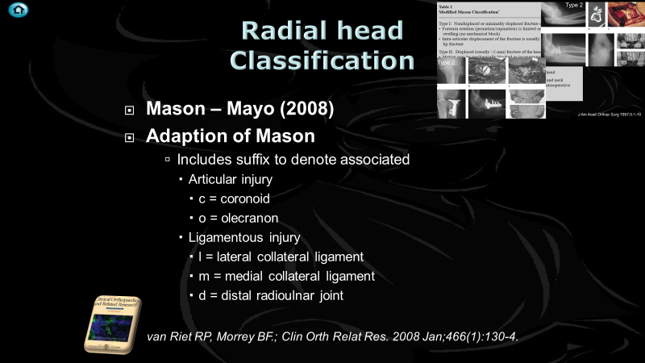
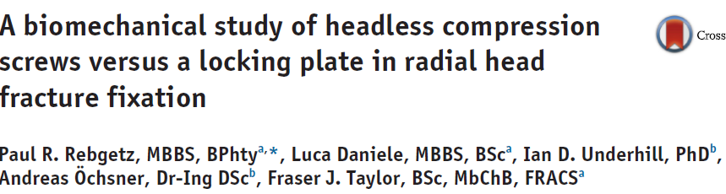
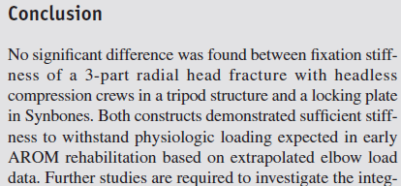
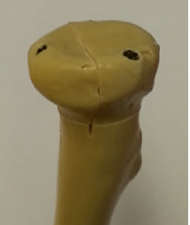
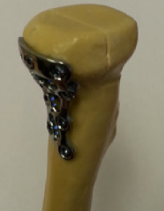
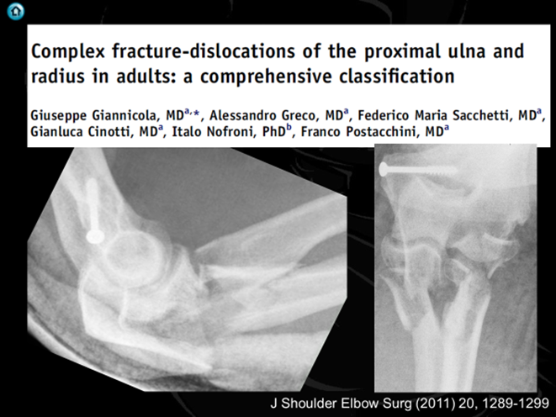


J Shoulder Elbow Surg (2019) 28, e111–e116

Slide 21




50 YO

Slide 22





Slide 23




45 YO manual worker

Slide 24



3 pieces generally reconstructable
  If see 2 generally 3 if see 3 then is 4
On table reconstruction of radial head
  Acceptable
Ring more likely to replace
  If Replace don’t overstuff
JSES (2011) 20, S107-S112

Slide 25


Limited View

Slide 26






Lateral intervals
Kocher
    between anconeus and ECU
Kaplan
    between ERCB and EDC
EDC Split
Distal extension puts PIN at risk
    Particularly Kaplan
LUCL
    Kocher
Clin ortho and related research; (370), January 2000, pp 19-33

Slide 27



J Bone Joint Surg Am. 2014;96:387-93

Slide 28


Kocher
Posterolateral
Clin ortho and related research; (370), January 2000, pp 19-33;

Slide 29


JBJS: January 1941 - Volume 23 - Issue 1 - p 86-92

Slide 30


Kaplan approach
PIN
J Bone Joint Surg Am, 1941 Jan 01;23(1):86-92

Slide 31





Supination
Pronation
Supination
Pronation
Diliberti T. et.al. J Bone Joint Surg 2000:82:809-809

Slide 32
From Capitellar surface, crosses mid axis
Full supination
Ave. 33.4 ± 5.7 mm
Range 22 – 47 mm
Full pronation
Ave. 52.0 ± 7.8 mm
Range 38 – 68 mm
More parrallel
More anterior
Diliberti T. et.al. J Bone Joint Surg 2000:82:809-809

Slide 33

Minimum distance from PIN to RCJ
  Supination 4.0 cm
  Pronation 4.3 cm
Limit dissection to 4cm during lat approach
Pronation does not reliably increase the distance to the PIN
Limit is 4 cm
J Shoulder Elbow Surg 2007;16:502-507

Slide 34




25 YO
Farmer

Slide 35
Posterolateral approaches
Wrightington
Modified Wrightington/ Boyd

Slide 36


J Bone Joint Surg Br September 2006 88-B: 1178-1182

Slide 37


Boyd interval
Surg. , Gynec. and Obstet,, 71: 87-88, 1940

Slide 38







Boyd interval
Humerus
Ulna
Anconeus

Slide 39

Boyd - No Limits

Slide 40







Conclusion

