Slide 1
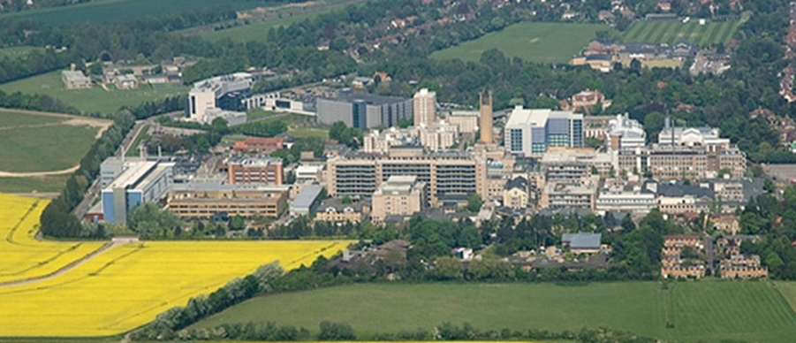

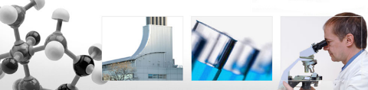
Transitioning to Major Trauma Care
The Cambridge Experience
Mr Lee Van Rensburg
Cambridge University hospitals NHS trust
12:15 to 12:35

Slide 2
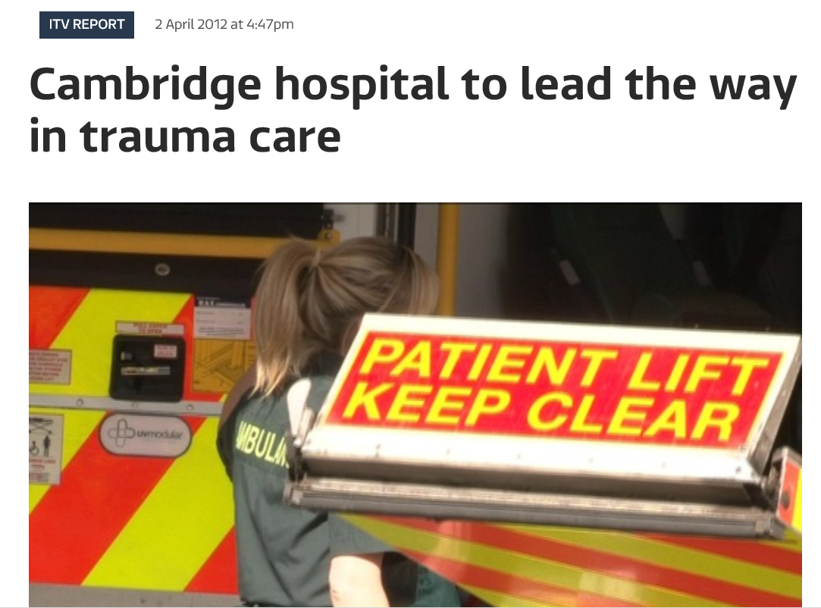
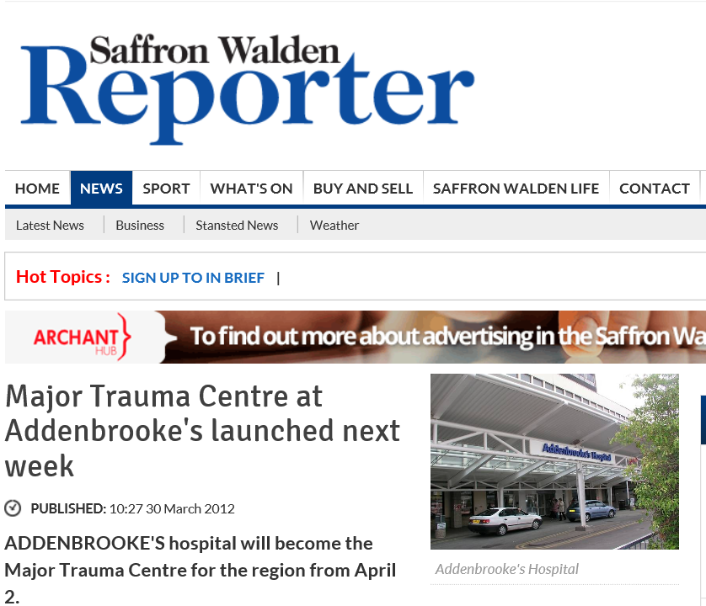
2nd April 2012

Slide 3
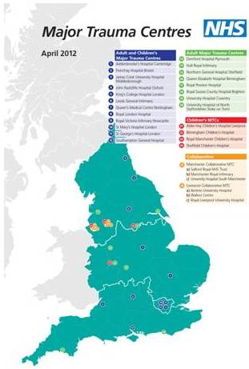
1 of 22

Slide 4
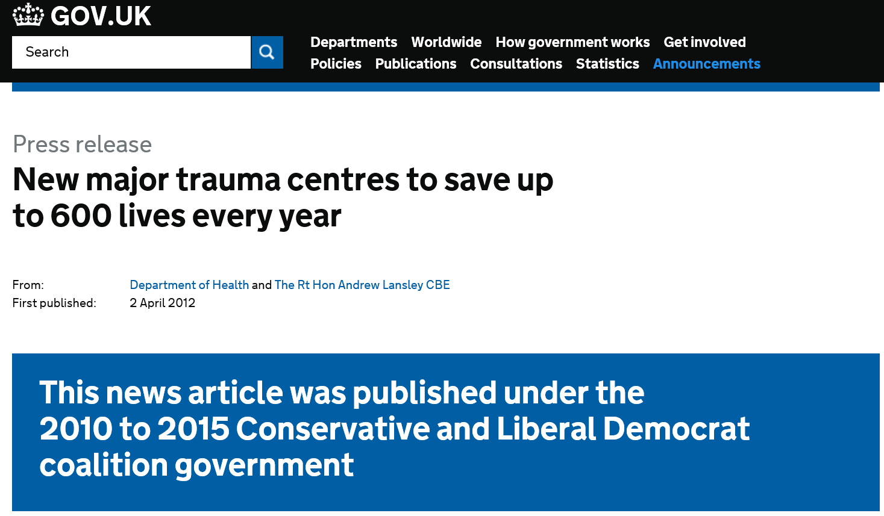
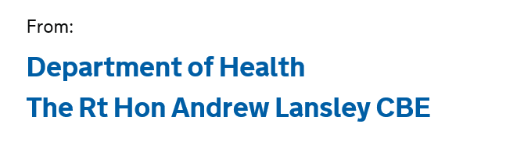
2012

Slide 5
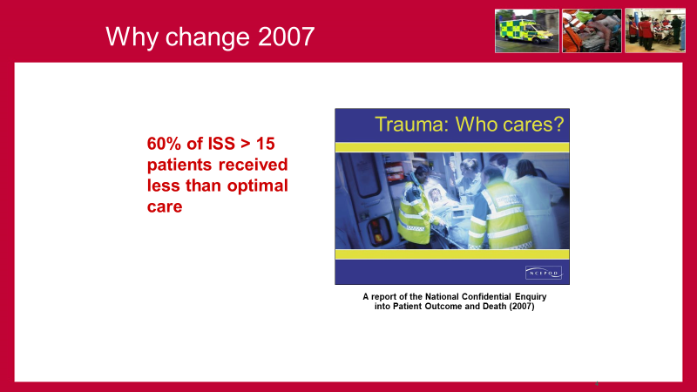
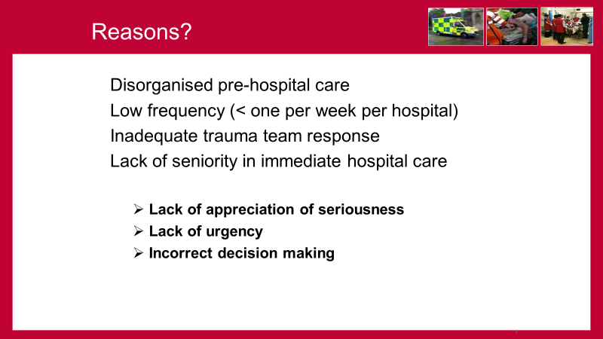
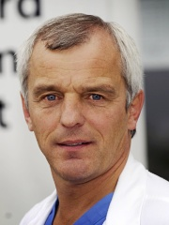
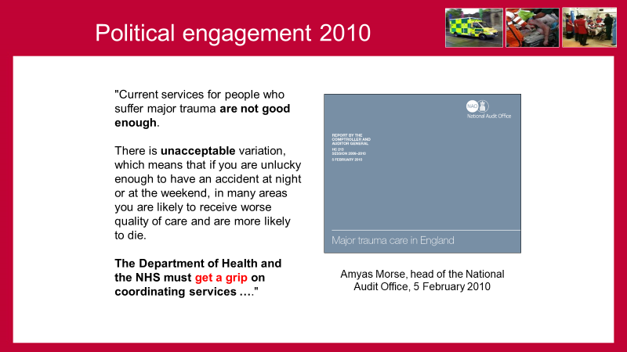
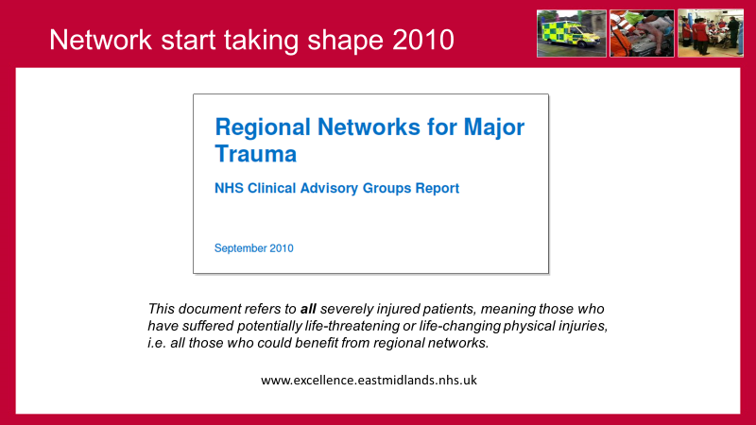
Prof Keith Willett
Trauma Tsar 2009

Slide 6
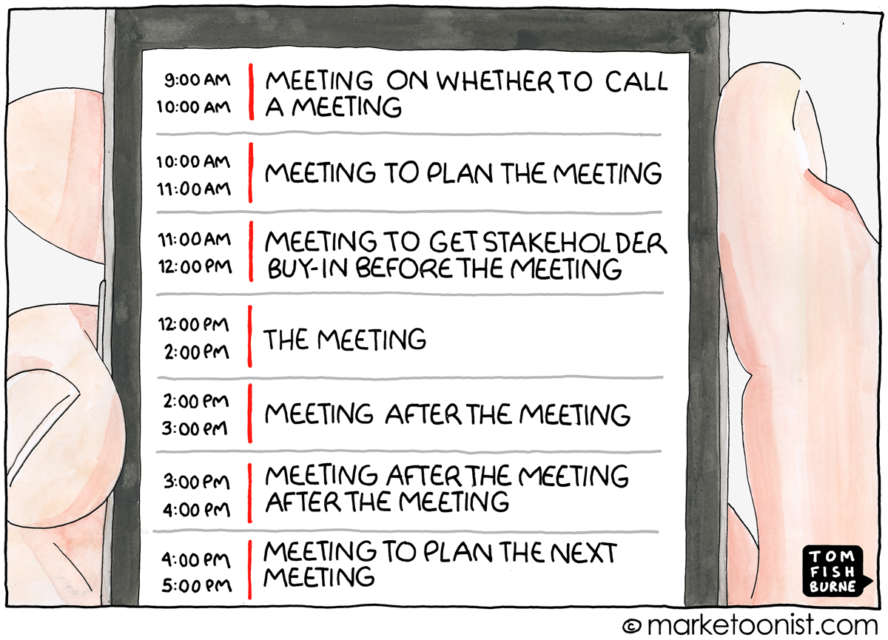


MTC - 22

Slide 7

Why change
Dr Sardesai

Slide 8
12 YO Pelvic fracture

Slide 9

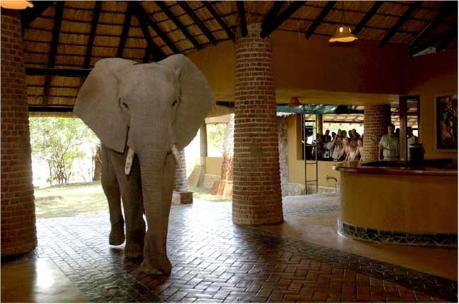
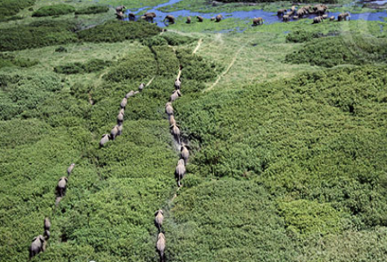
Why change
Dr Sardesai
Polytrauma is a problem
Networks and pathways established over time

Slide 10
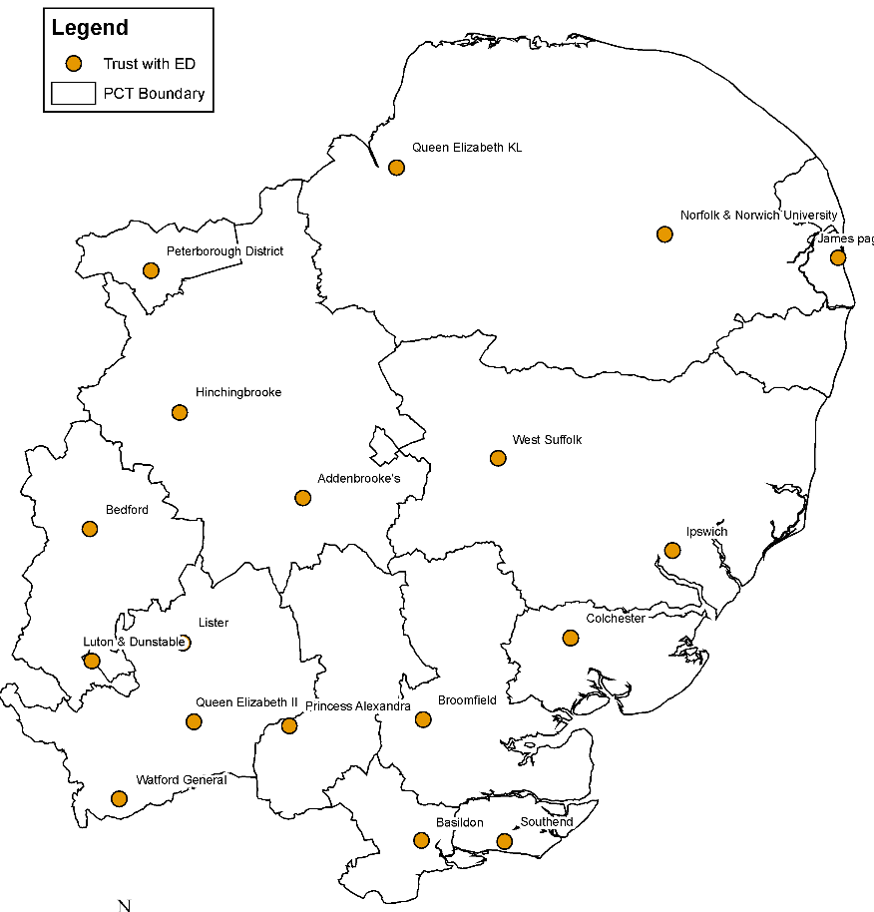

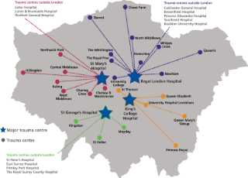


East of England … X mas past
18 Acute Hospitals
One regional Ambulance Service (EEAST)
Range of charity sector pre-hospital ‘enhanced care’ providers (e.g. Air Ambulance Charities)
Range of specialist acute, reconstruction and rehabilitation services
Range of specialist and general community rehabilitation services
5.9 Million

Slide 11
50 YO male
Road traffic accident rolled lorry
  Pain in pelvis and legs
    A – clear talking (neck immobilised)
    B – O2 sats 95 chest clear slight tachypnoea
    C – Initially H/D stable
    D – No head injury
    E – Pain in pelvis

Slide 12
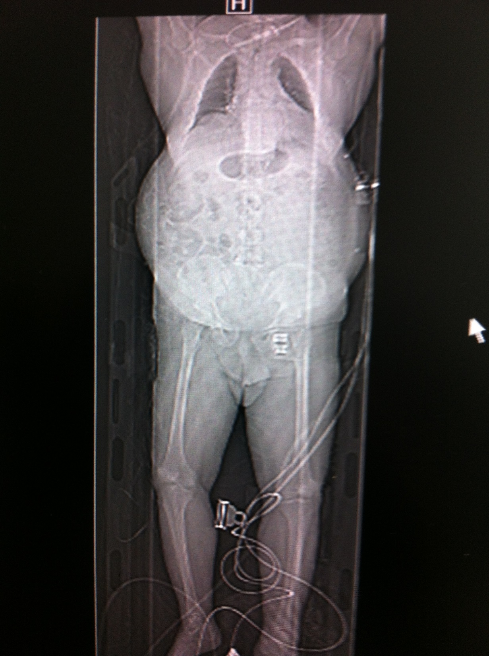
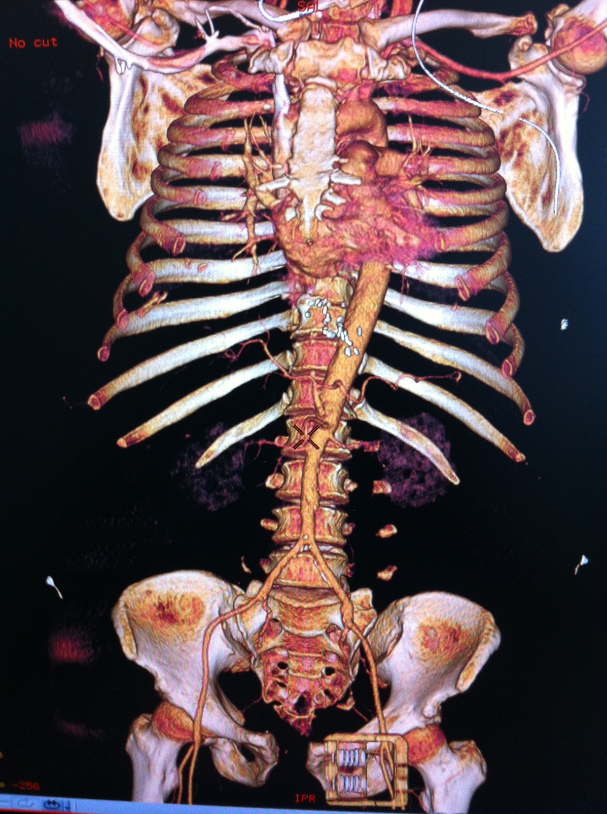
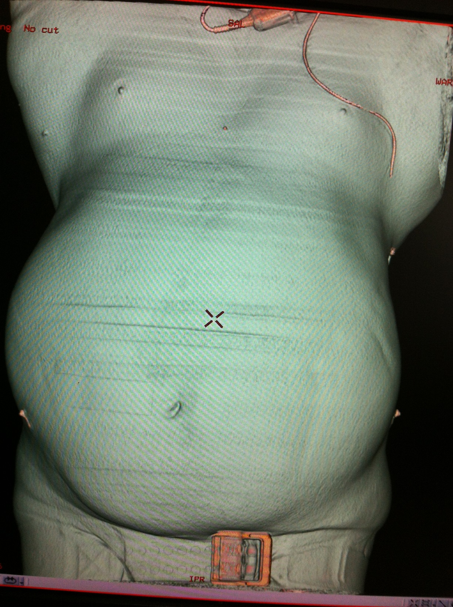
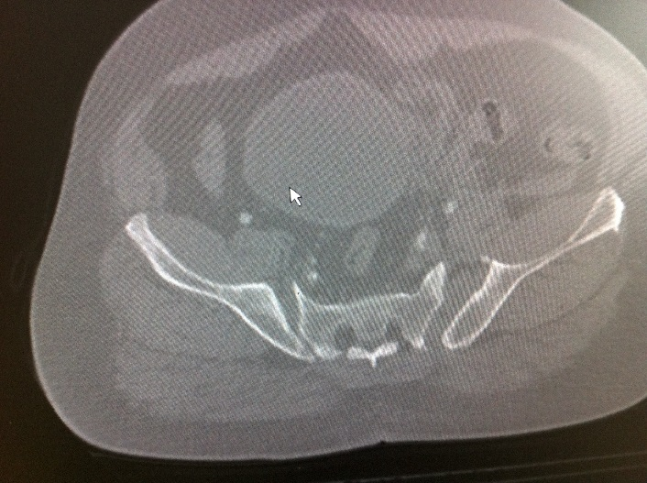
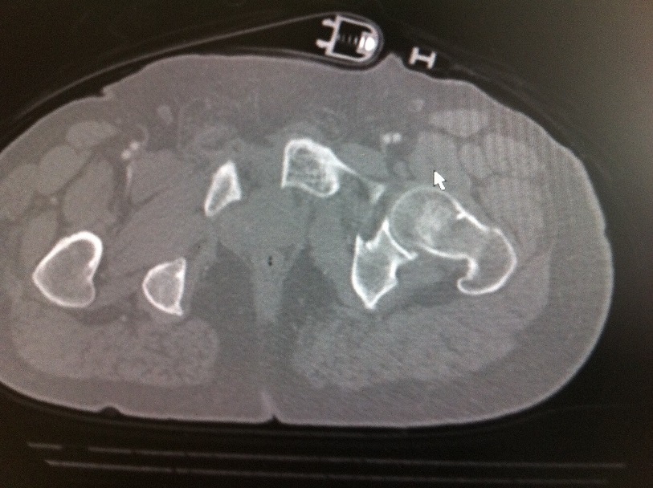
No distended, that’s him
No intraperitoneal blood
No visceral injury

Slide 13
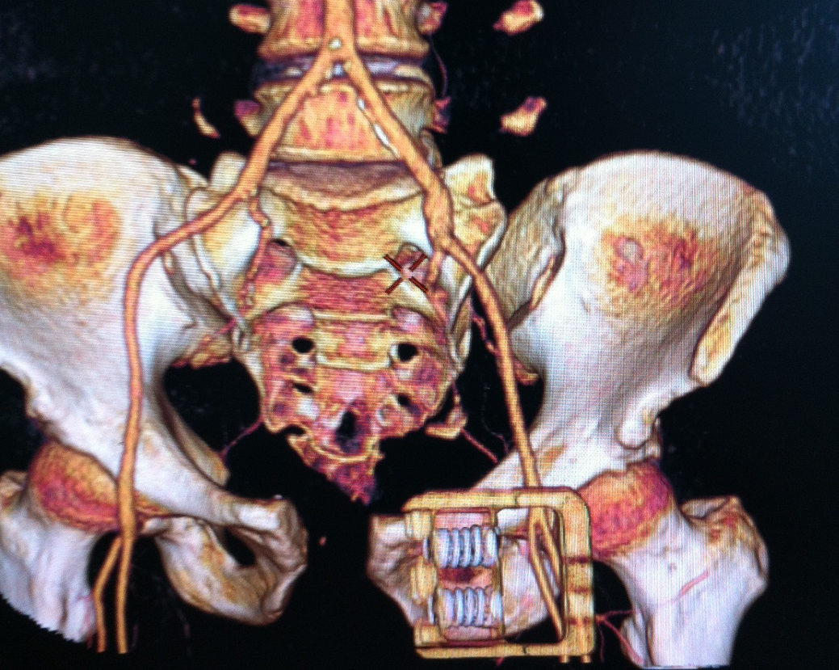
Orthopaedics called
Isolated pelvic injury
Drops his BP after CT
    Agitated, tachypnoeic
    Intubate

Slide 14

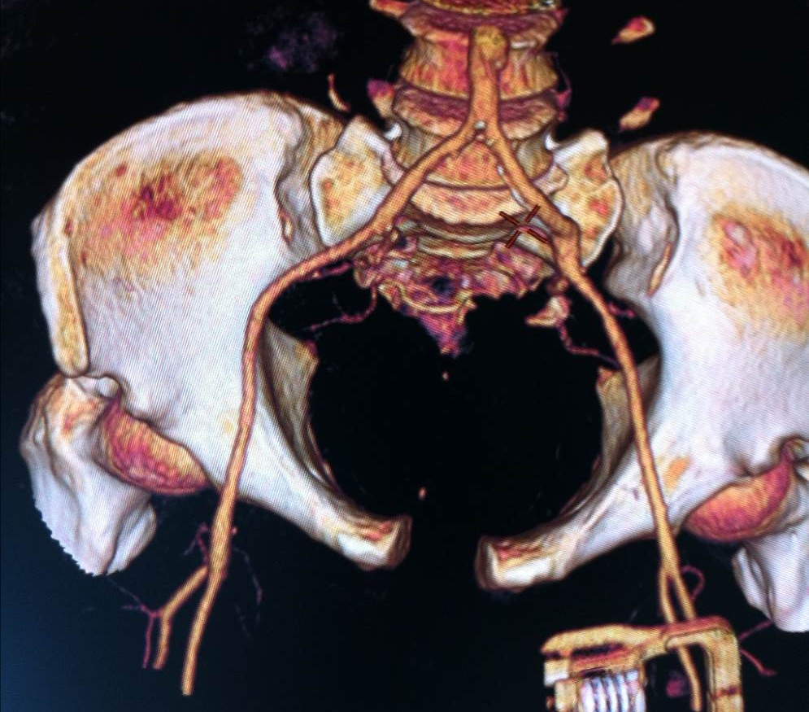
Now what?
Hypotensive, not responding to fluids
No abdominal injury

Slide 15
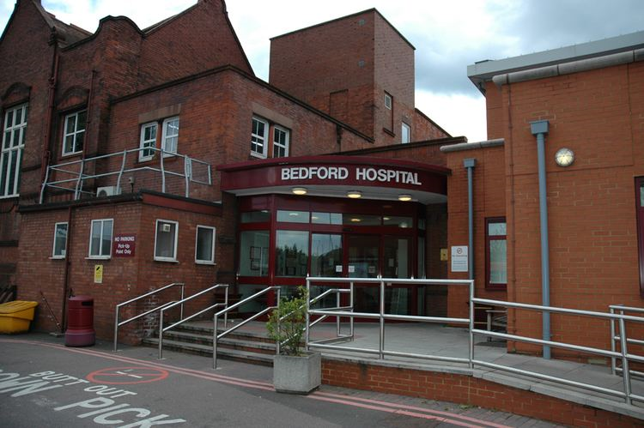
East of England … X mas past

Slide 16
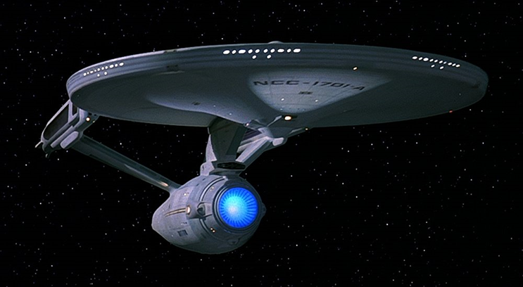
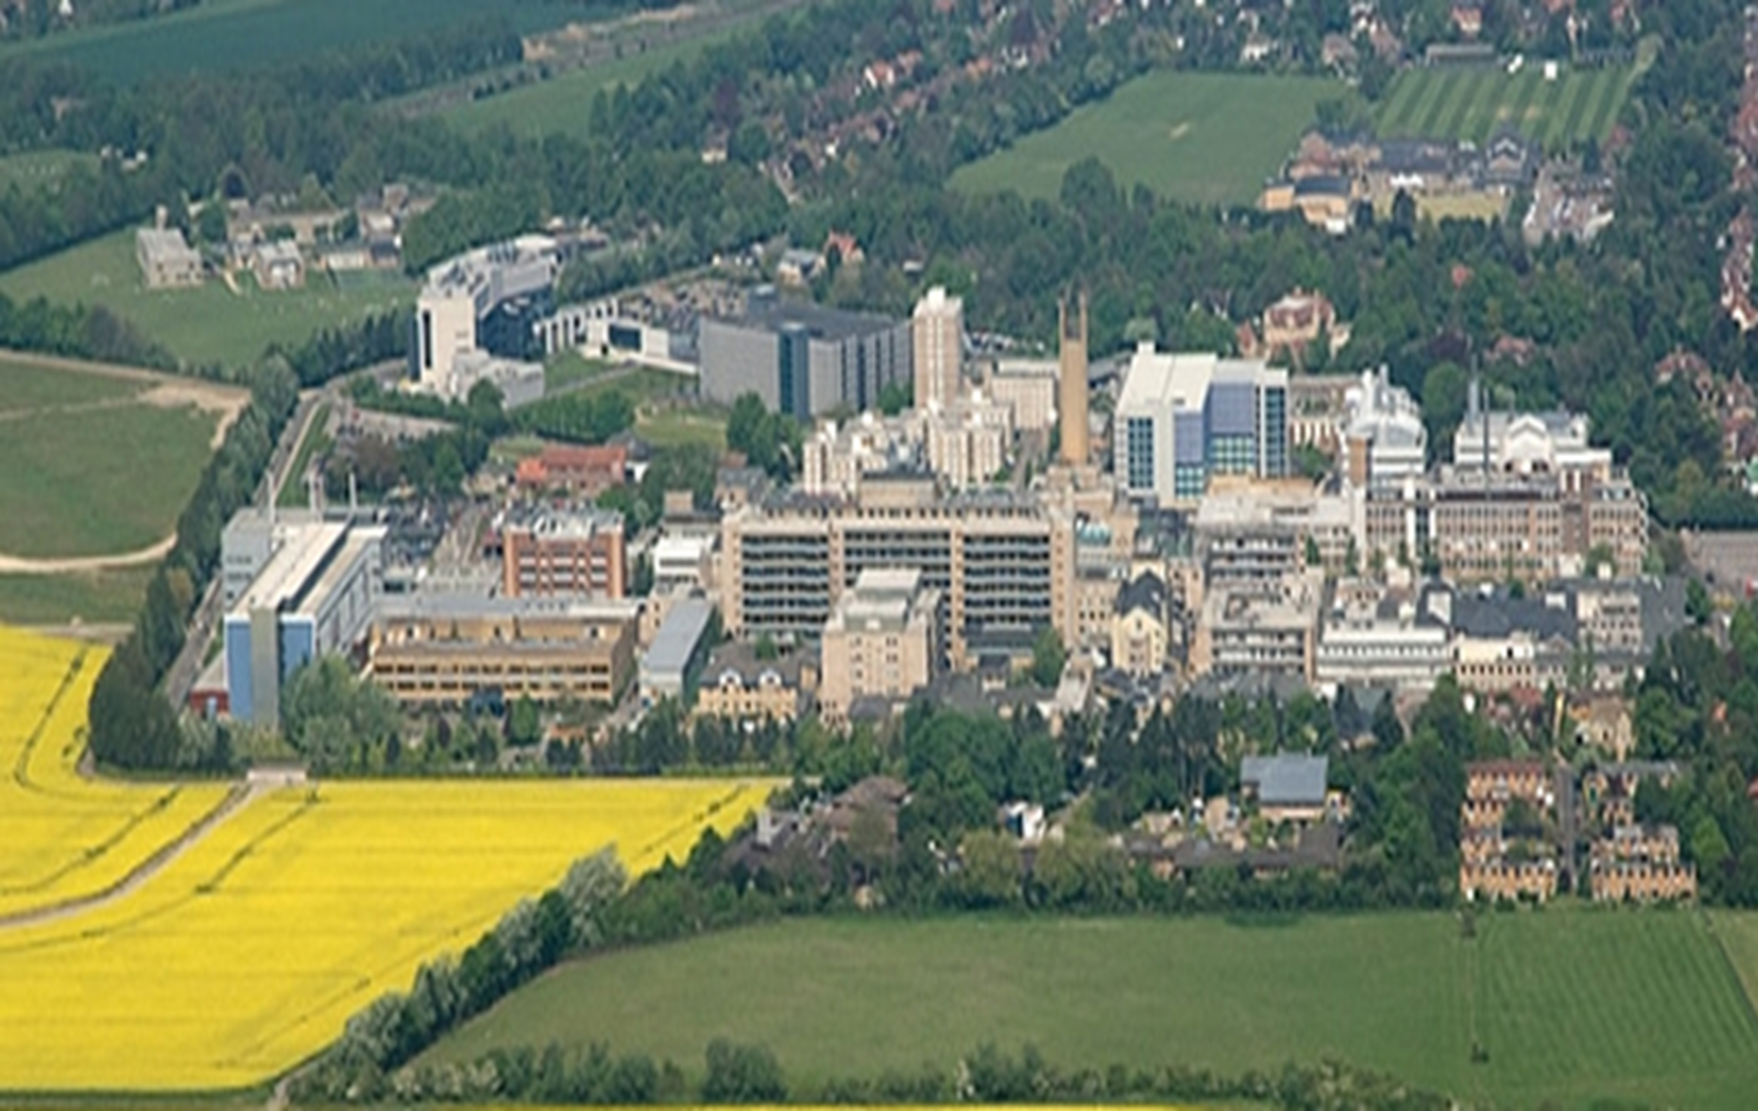
East of England … X mas present

Slide 17
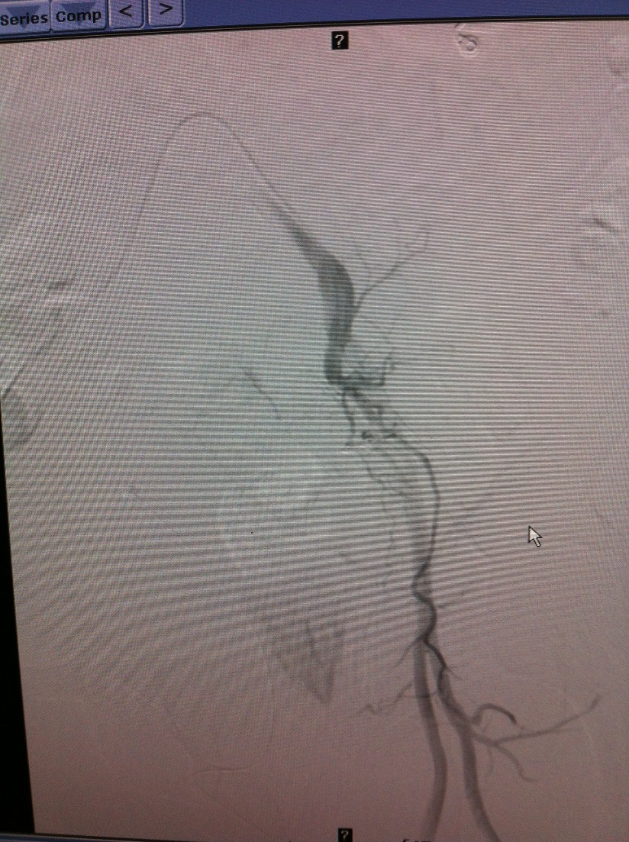
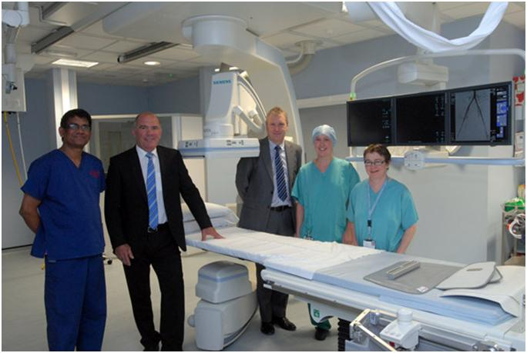
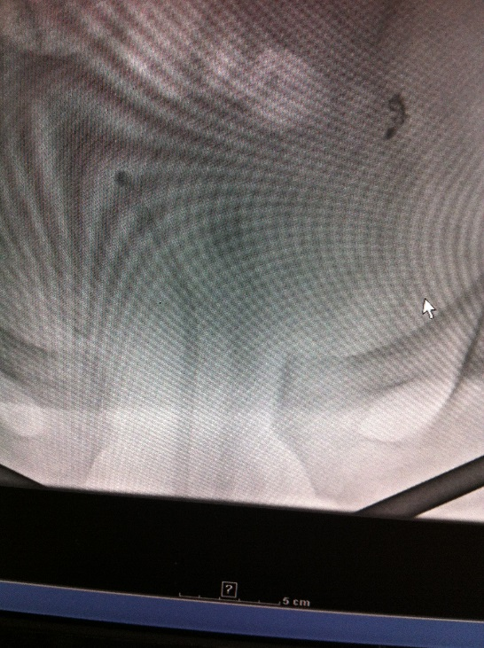
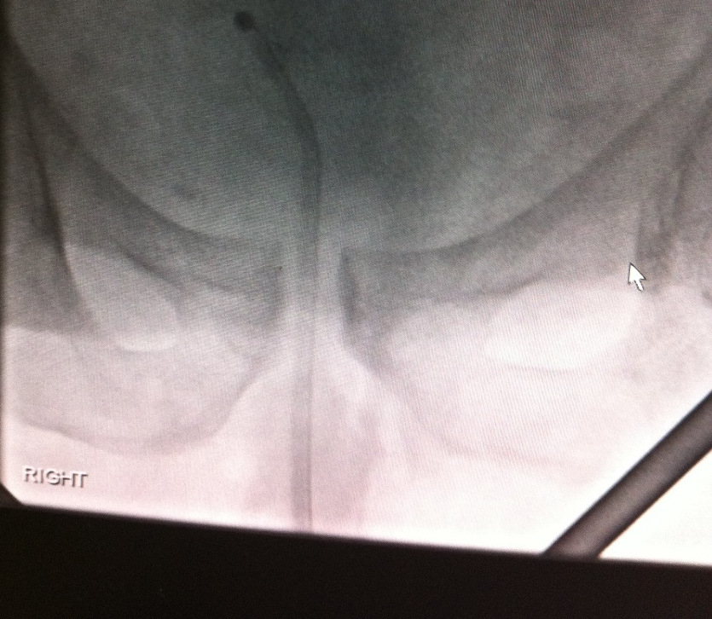
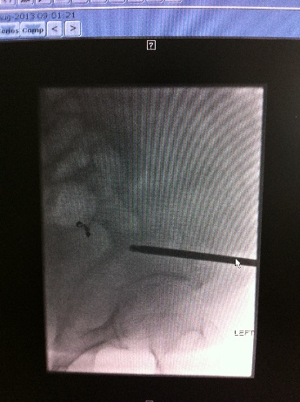
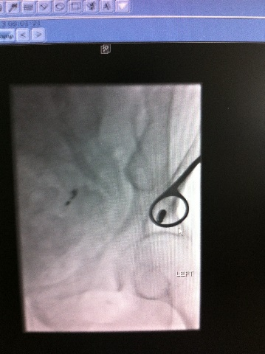
What next?
Interventional radiology suite
    200m up corridor from ED
Retrograde Urethrogram
  Catheter
Angiogram
  Coil bleeding vessel
Anterior supra acetabular pins
  C Clamp available – not needed
Trauma ICU

Slide 18

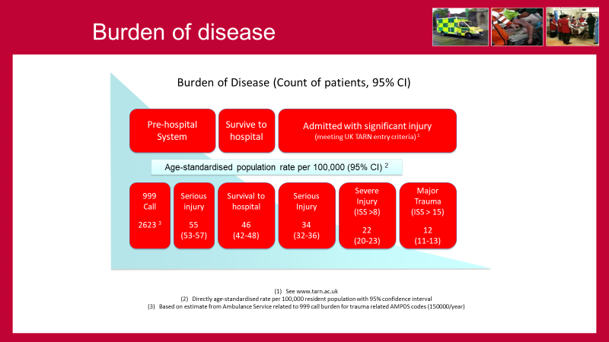
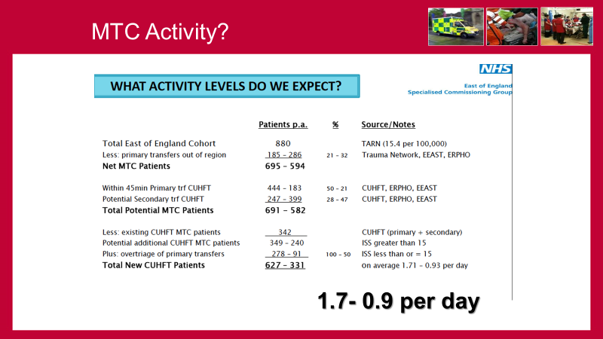
Planning

Slide 19
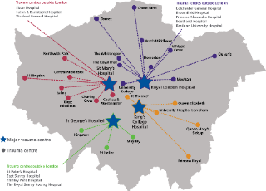

Primary transfer zone?
EoE Hospital Type 1 ED
EoE Major Trauma Centre
Primary (peak and off –peak
45 minute) transfer zone
Drive-time isochrones on this map were generated using averaged GPS-based road segment speeds from
ITIS GPS Floating Vehicle Data against the Navteq Premium Streets database.
For normal peak speeds, ITIS vehicle (car) speeds between the hours 07:00-09:00 and 16:00-19:00 were averaged. For off-peak speeds, ITIS vehicle (car) speeds excluding the hours 07:00-09:00 and 16:00-19:00
were averaged.

Slide 20
Network

Slide 21

East of England
Integrated Trauma System
Trauma Network Office
Ambulance Service
Network Co-ordination Service
Trauma Units
Network Transfer Services
Major Trauma Centre
Re-habilitation Services
EoE Hospital Type 1 ED
EoE Major Trauma Centre
Primary (peak and off –peak
45 minute) transfer zone*
Burns Centre secondary transfer pathways
Brain injury secondary transfer pathways
Notes:
Components

Slide 22
Network Co-ordination
Network Co-ordination provides three key functions:
co-ordination of components of the trauma system (from acute care through to rehabilitation);
(2) a dedicated 24/7 single point of telephone contact for healthcare professionals seeking access to immediate clinical advice, bed bureau functions related to critical care / specialist beds and access to a directory of services for complex injury and rehabilitation services;
(3) a means for monitoring patient flow and system performance (for professionals, patients and families).
03003303999

Slide 23
Key steps
Road side trauma triage tool
Inclusive – Just send
Collect
Imaging transfer - IEP

Slide 24
Major Trauma Centre

Slide 25
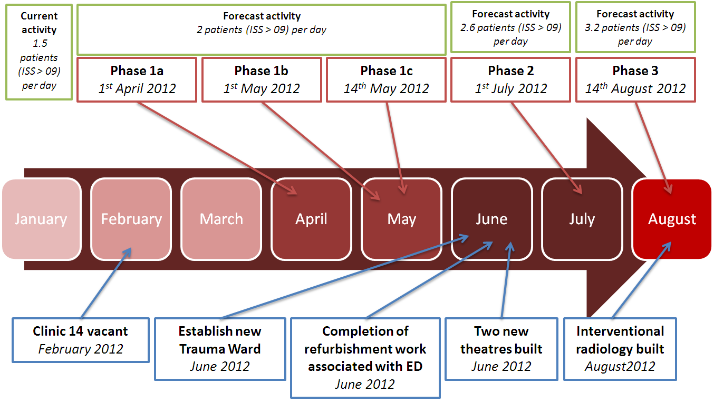
Implementation

Slide 27
1366
79
737
844
15
175

Slide 28

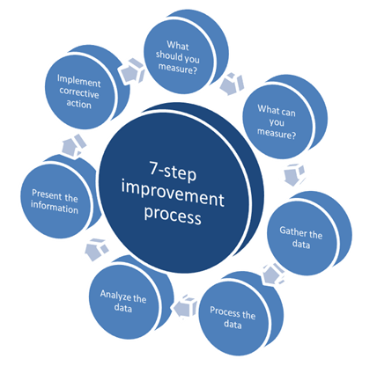
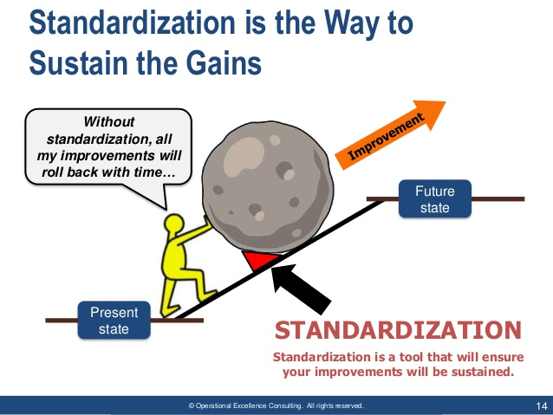
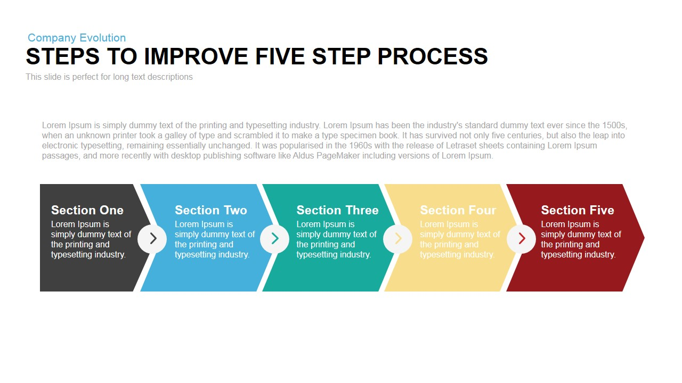

Slide 29
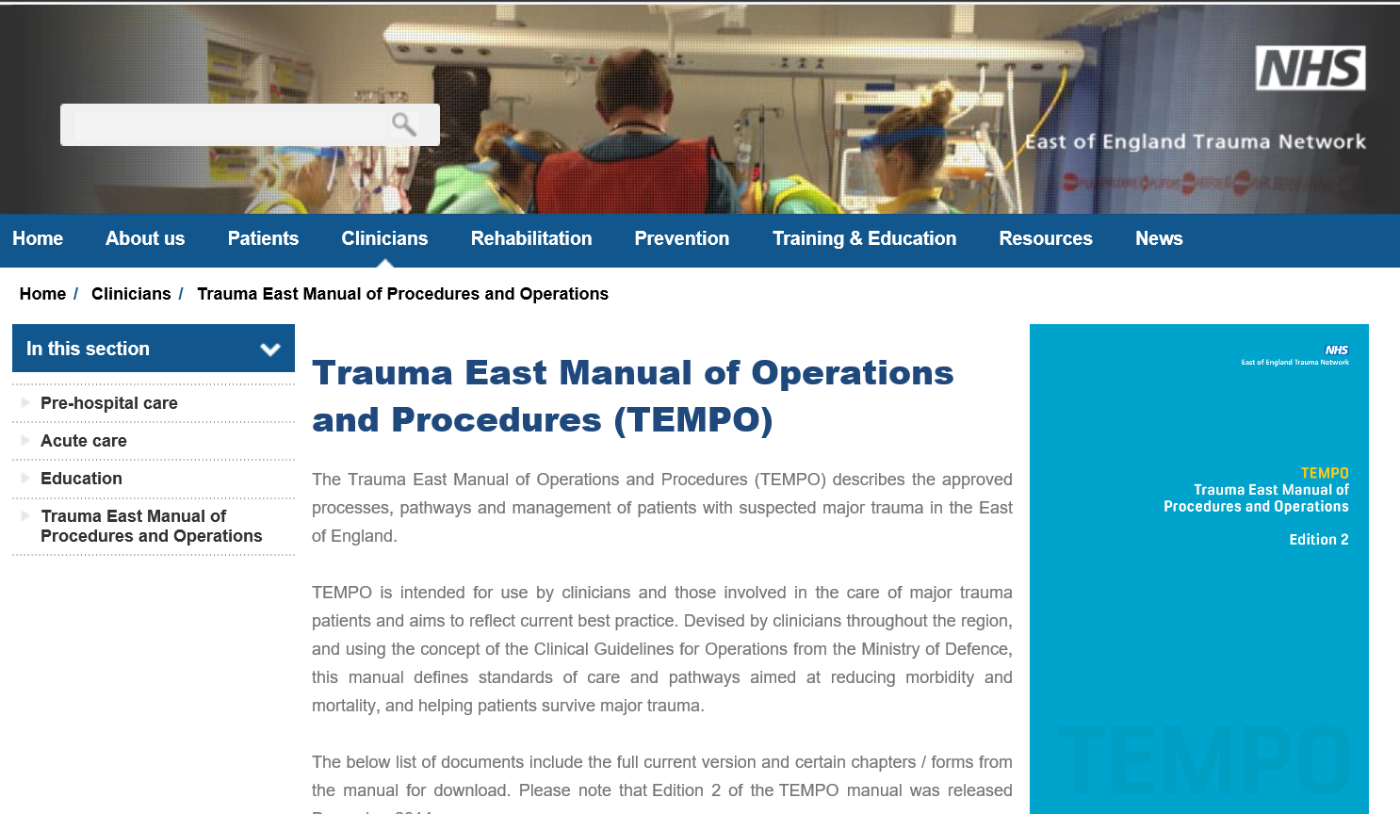
TEMPO

Slide 30


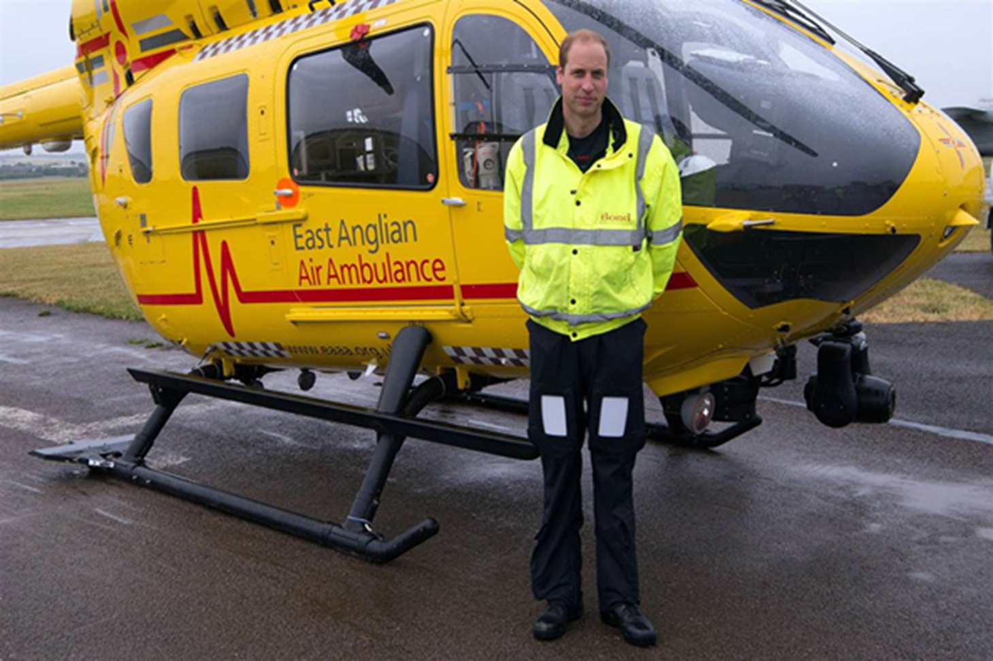
MTOS
Major trauma outreach service

Slide 31
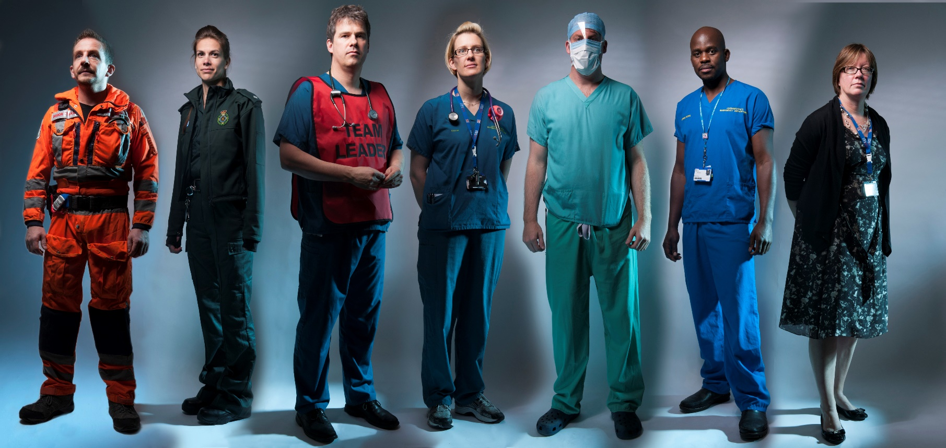

Clinical performance
So how are we doing?

Slide 32


Slide 33
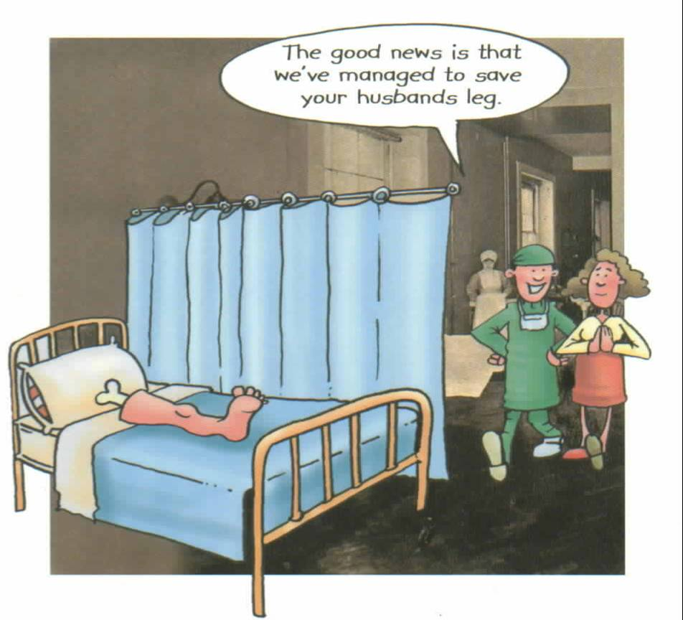

Slide 34
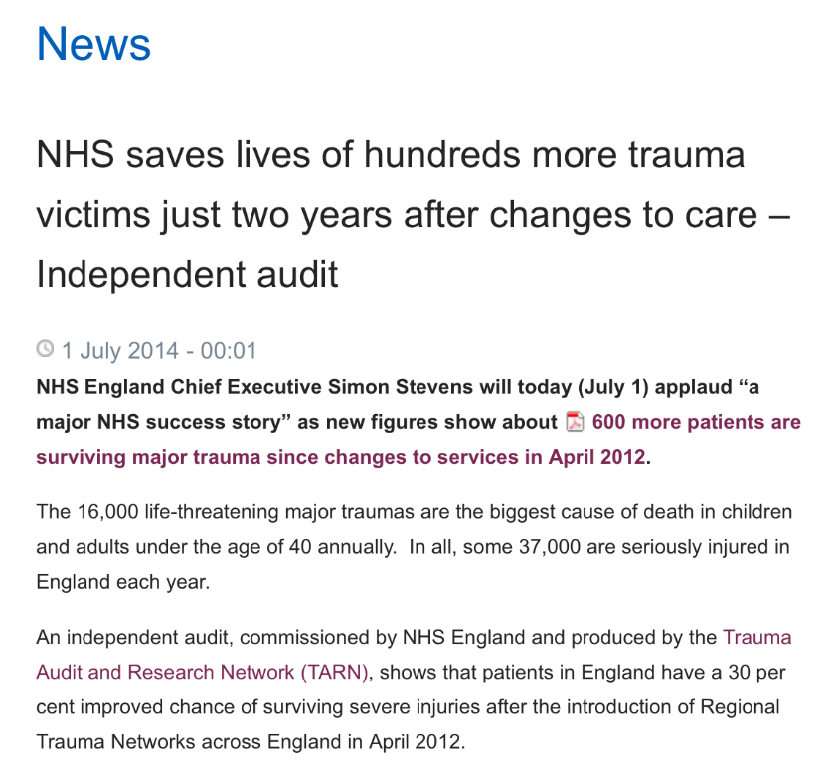
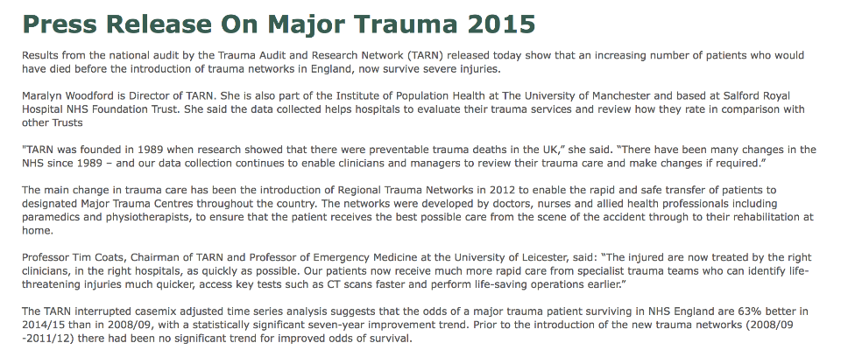
2014

Slide 35

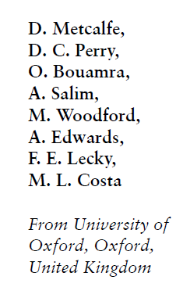
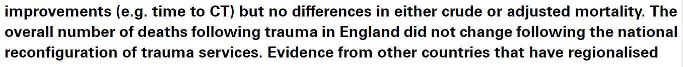
Bone Joint J 2016;98-B:1253–61

Slide 36
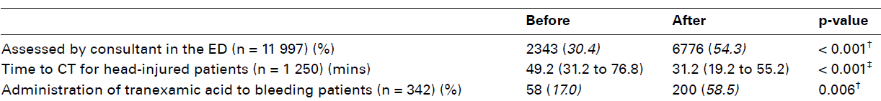

96% of triage positive Consultant TTL
Bone Joint J 2016;98-B:1253–61

Slide 37
Bone Joint J 2016;98-B:1253–61

Slide 38
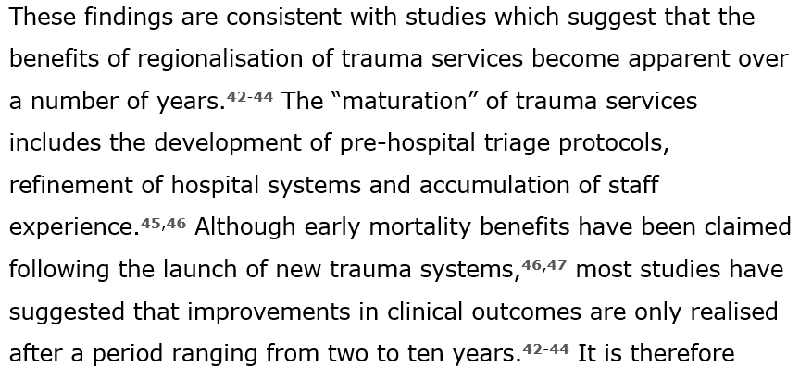
Bone Joint J 2016;98-B:1253–61

Slide 39
Mischief
Network teething
  ED network review
  4th Thursday month
  Simon Lewis
Lost legs

Slide 40



Slide 41



Injury. 2015 Feb;46(2):384-7.
Injury. 2015 Oct;46(10):1975-7

Slide 42


NOF England within 36 hrs
MTC
Pre 67% Post 71%
Non MTC
Pre 70% Post 74%
NOF at Addenbrookes
26 Hrs Vs 32 Hrs
MTC Led to significant increase in delay to surgery
Injury. 2015 Feb;46(2):384-7.
Injury. 2015 Oct;46(10):1975-7

Slide 43



1st Year as MTC
Over and above what already comes
Neurosurgery
Spinal service
Plastics
Pelvic and acetabular trauma
March 2016 Bulletin of The Royal College of Surgeons of England 98(3):122-126

Slide 44

March 2016 Bulletin of The Royal College of Surgeons of England 98(3):122-126

Slide 45
CONCLUSIONS
Population of 5.9 Million
110/ year
MTC already receiving neurosurgery/ spinal and plastics trauma
Require
An additional one-day orthopaedic trauma list
Three extra beds/ day
As the MTC matures, re-evaluation will be neccessary
March 2016 Bulletin of The Royal College of Surgeons of England 98(3):122-126

Slide 46


Bone Joint J 2016;98-B:1253–61

Slide 47
Lungs like liver

Slide 48




Lungs like liver
EClinicalMedicine 2–3 (2018) 13–21

Slide 49




Slide 50












Summary
Notes:
50

Slide 51
Questions and Comments?
03003303999

Slide 52

Tarn
Network East of England
August 2015
1.13 extra survivors per 100 patients more than expected

Slide 53



Slide 54



Trauma System
East of England Trauma System

Slide 55





Slide 56





Slide 57





Slide 58

www.tarn.ac.uk
MTC - CUHFT

Slide 59


Slide 60
Questions and Comments?
03003303999

Slide 61

2014 – 2016 = 1.5

Slide 62

MTC - CUHFT

Slide 63
60% Home
22% Trauma unit
15% Specialized rehab unit
Bone Joint J 2016;98-B:1253–61

