Slide 1
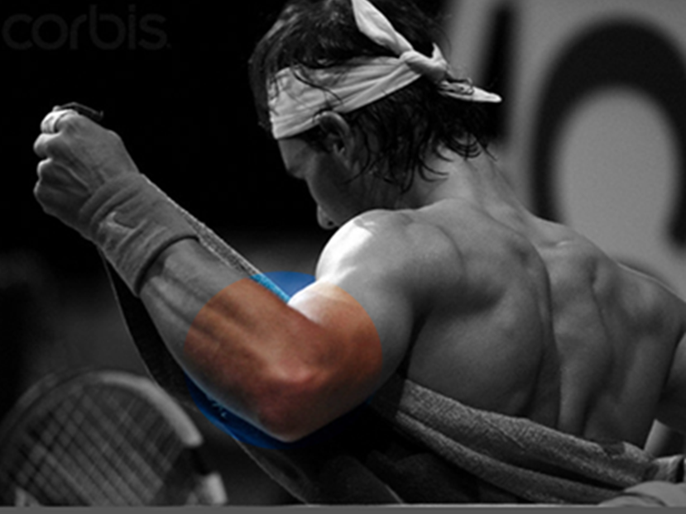
Elbow update
Mr Lee Van Rensburg
2018

Slide 2
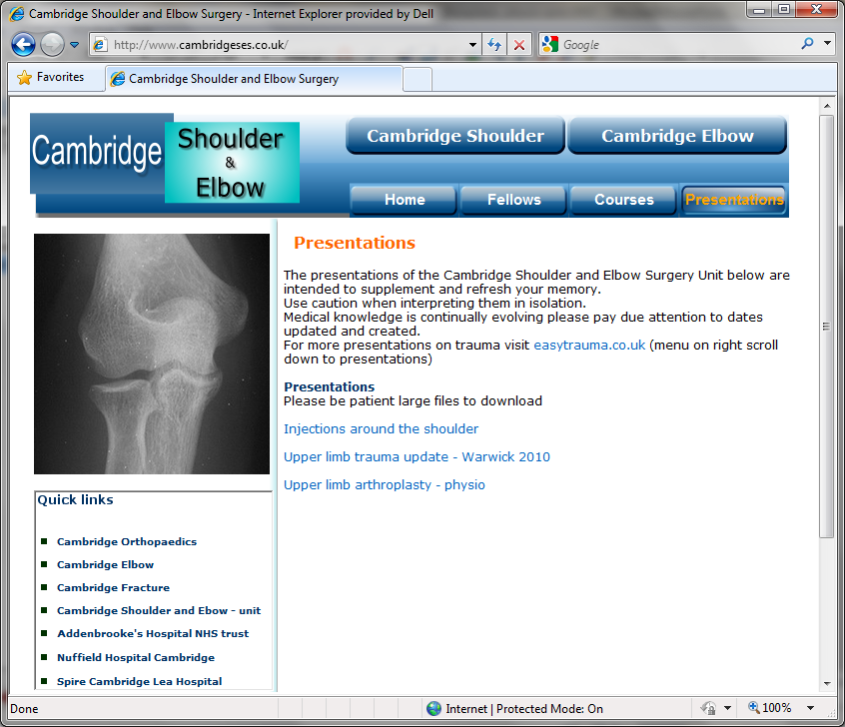
www.cambridgeses.co.uk

Slide 3
Locking
Pain
Lateral
Medial
Posterior
Anterior
General deep
Stiffness
Loose bodies
Arthritis
PLRI
Post traumatic
Post surgical
Heterotopic ossification
Arthritis
Postero Lateral Rotatory Instability

Slide 4
Pain
Lateral
  “Lateral sided elbow pain” ≠ tennis elbow
Medial
  Medial epicondylitis
  Ulnar Neuritis
Posterior
  Hyperextension valgus overload
  Posteromedial impingement
Anterior
  Biceps pathology
General deep
  Arthritis

Slide 5
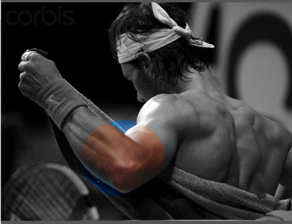

Lateral sided elbow pain
Lateral epicondylitis
Radial tunnel syndrome (PIN)
Cervical radiculopathy
Osteochondral radiocapitellar lesion
Posterolateral elbow plica
Posterolateral elbow instability
Volume 16, Number 1, January 2008

Slide 6
Lateral Epicondylitis
(Tennis elbow)
Clinical
    Pain over the lateral aspect of the elbow
    Power grip, forced extension
    Point tender common extensor origin
    Stiffness unusual
Volume 16, Number 1, January 2008

Slide 7
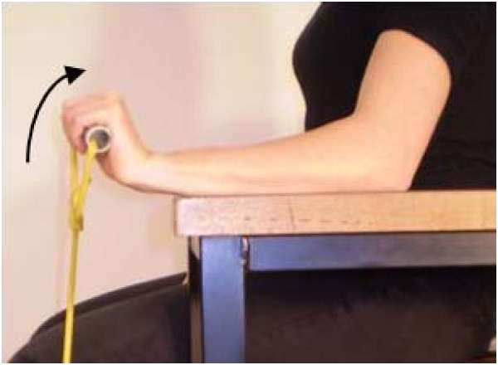
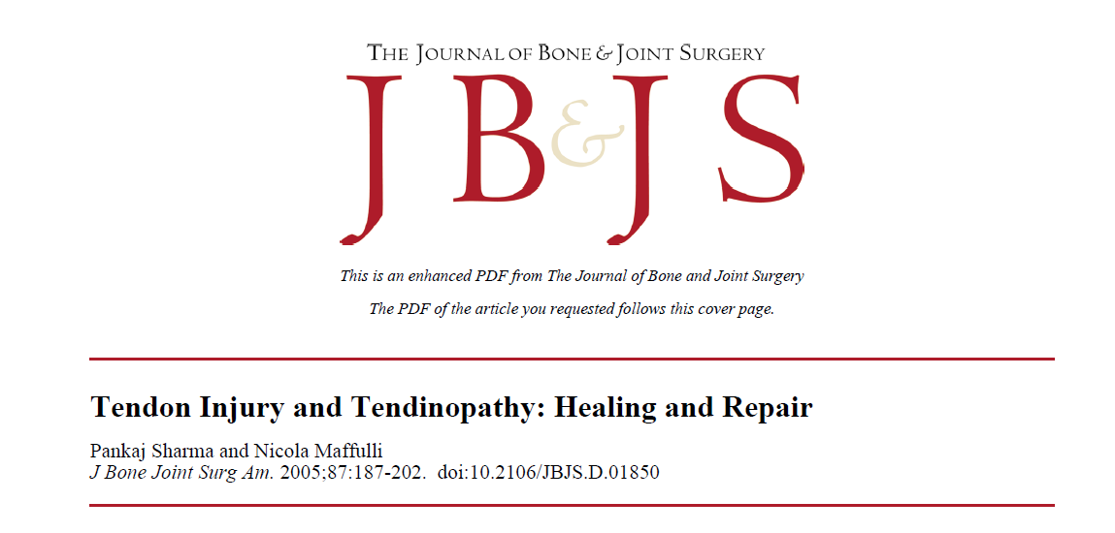
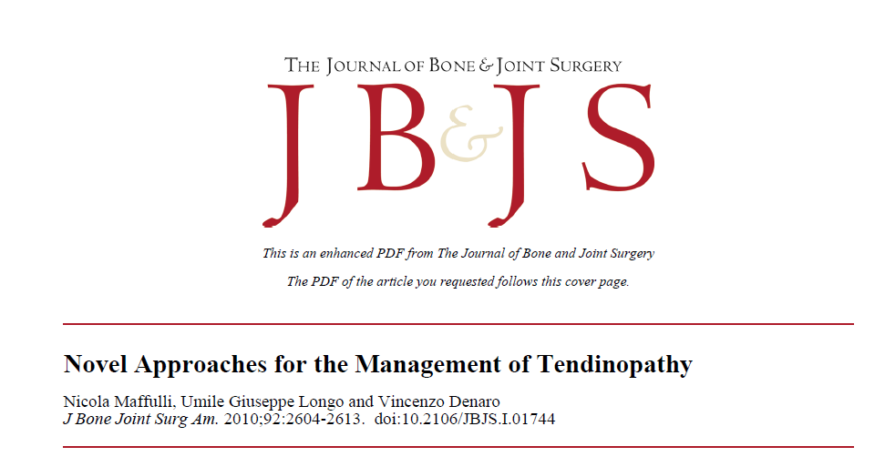
Tendinosis
Pathology
  Degenerative – NOT “itis”
  Tendinosis ECRB
J Bone Joint Surg Am. 2005;87:187-202

Slide 8
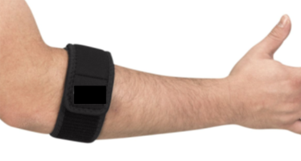
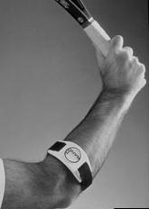
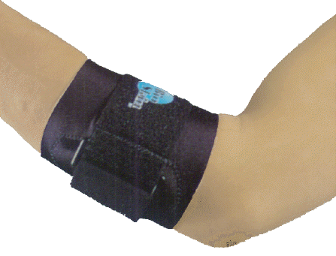
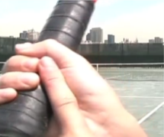
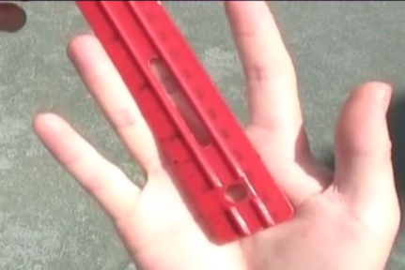
Lateral Epicondylitis
(Tennis elbow)
Treatment
    Non operative
      Relative rest
      Activity modification
      Counterforce bracing
      Physiotherapy
      Injection – What?
      ECSW ??????
    Operative
Volume 16, Number 1, January 2008

Slide 9
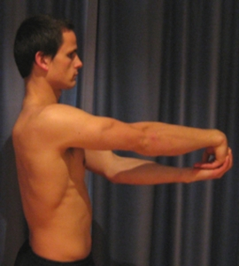
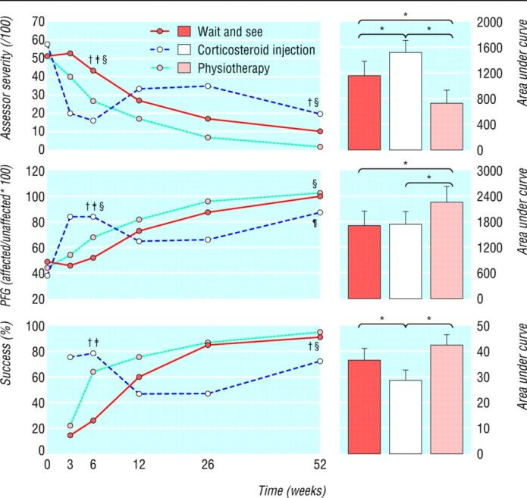



Lateral Epicondylitis
(Tennis elbow)
Physiotherapy
    Stretches
    Eccentric strengthening - lengthen
How do ecentric exercises work
Rheumatology (2008) 47 (10): 1444-1445
Bisset L, Beller E, Jull G, et al: Mobilisation with movement and exercise, corticosteroid injection, or wait and see for tennis elbow: Randomised trial.

Slide 10
Lateral epicondylitis
Injections
  Local anaesthetic and steroid
  Hyaluronic acid
  Botox
  Blood
  Platelet rich plasma
  Mesenchymal Stem cells

Slide 11


Lateral epicondylitis
Injections
  Local anaesthetic and steroid
Bisset L, Beller E, Jull G, et al: Mobilisation with movement and exercise, corticosteroid injection, or wait and see for tennis elbow: Randomised trial.
BMJ; 2006;333:939

Slide 12

Lateral epicondylitis
Injections
  Local anaesthetic and steroid
Lindenhovius A, Henket M, Gilligan BP, Lozano-Calderon S, Jupiter JB, Ring D. Injection of dexamethasone versus placebo for lateral elbow pain: a prospective, double-blind, randomized clinical trial.
CONCLUSIONS:
Corticosteroid injection did not affect the apparently self-limited course of lateral elbow pain.
J Hand Surg Am. 2008 Jul-Aug;33(6):909-19.

Slide 13
Lateral epicondylitis
Injections
  Local anaesthetic and steroid
  Hyaluronic acid
  Botox

Slide 14
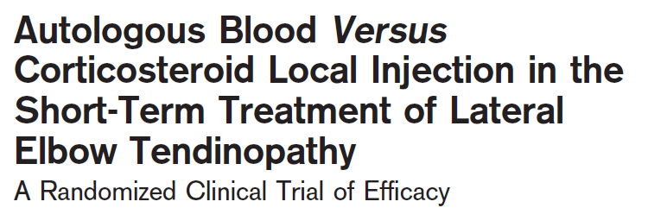
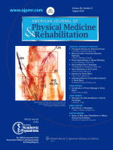
Lateral epicondylitis
Injections
  Local anaesthetic and steroid
  Hyaluronic acid
  Botox
  Blood
American Journal of Physical Medicine & Rehabilitation; Volume 89(8), August 2010, pp 660-667

Slide 15
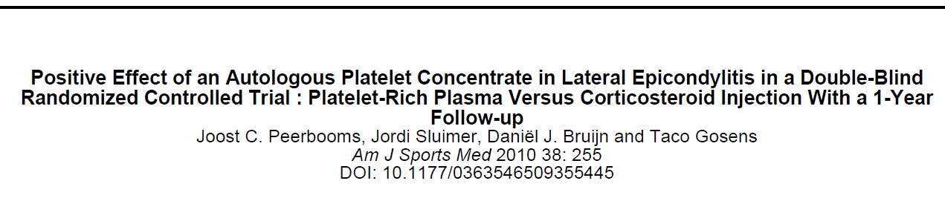

Lateral epicondylitis
Injections
  Local anaesthetic and steroid
  Hyaluronic acid
  Botox
  Blood
  Platelet rich plasma - PRP
Am J Sports Med 2010 38: 255

Slide 16
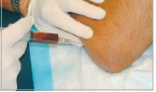
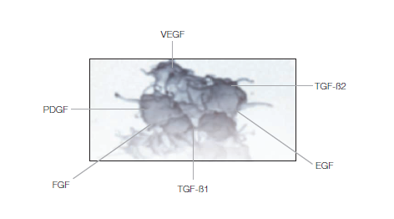
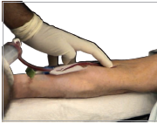
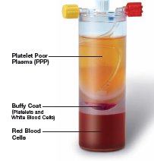
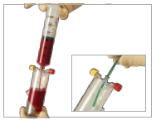
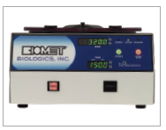
Lateral epicondylitis
Platelets
    VEGF – Vascular endothelial growth factor
    PDGF – Platelet derived growth factor
    FGF – Fibroblast growth factor
    TGF B – Transforming growth factor
    EGF – Epithelial growth factor

Slide 17
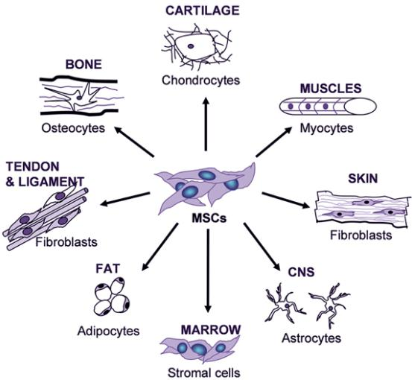
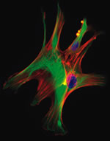
Lateral epicondylitis
Injections
  Local anaesthetic and steroid
  Hyaluronic acid
  Botox
  Blood
  Platelet rich plasma - PRP
  Mesenchymal Stem cells

Slide 18
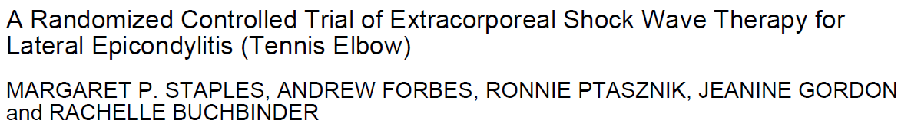
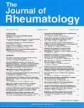
Lateral epicondylitis
ECSWL
J Rheumatol. 2008;35:2038-46.

Slide 19
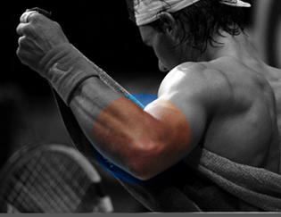
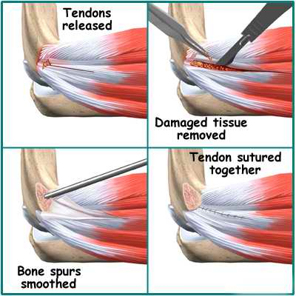
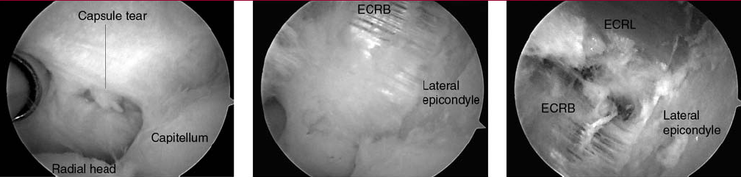
Operative Lateral epicondyle
Percutaneous
Open
Arthroscopic

Slide 20
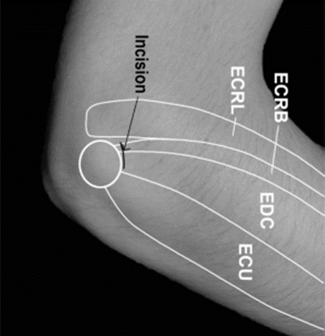
Prospective, randomised, controlled trial
Open Vs Percutaneous release
  n = 45 patients (47 elbows)
Significantly better improvement in percutaneous group
  Patient satisfaction
  Time to return to work
    average 3 weeks earlier
  DASH score
  Sporting activities
Quicker and simpler
J Bone Joint Surg [Br] 2004;86-B:701-4.

Slide 21
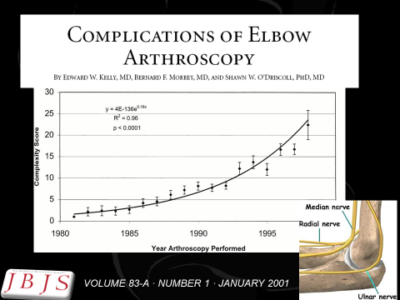
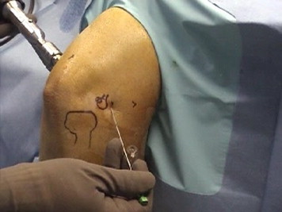
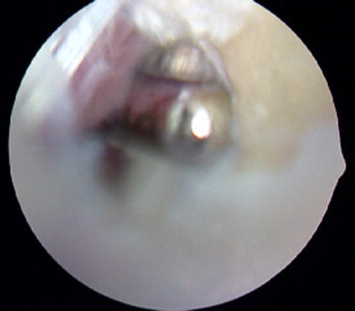
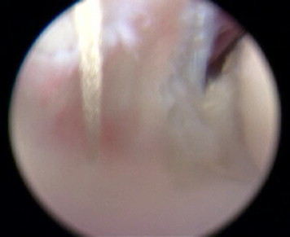
Proximal anteromedial viewing portal
Tennis elbow lateral portal
    (site of percutaneous release)
Debride ERCB
Decorticate lat epicondyle
Repair ERCB
J Shoulder Elbow Surg (2010) 19, 31-36

Slide 22
Lateral epicondylitis
What I say/ do –
  No magic bullet – Non operative 6 months
  Physiotherapy
      5 – 10 minutes won’t do TENDINOSIS
  Use counter force brace
  Reassure – Hurts no long term harm
  Injection
        No steroids
        Try PRP (£)
  Percutaneous release ( x - ray/ MRI - a scope)
  www.cambridgeelbow.co.uk
    Patient information

Slide 23
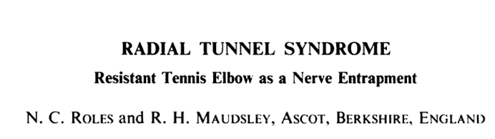
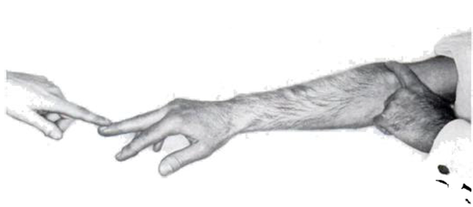
Most start classic Tennis elbow
Associated with activities of repeated pronation and supination
Tenderness 3 - 4 cm distal and anterior
Middle finger tightens fascial origin of ERCB pinches PIN
Occ Sensory – superficial radial nerve
Slight loss extension
EMG’s not much use
JBJS-B VOL. 54, NO. 3, AUGUST 1972

Slide 24
JBJS-B VOL. 54, NO. 3, AUGUST 1972

Slide 25
Passive pronation ERCB indents PIN

Slide 26
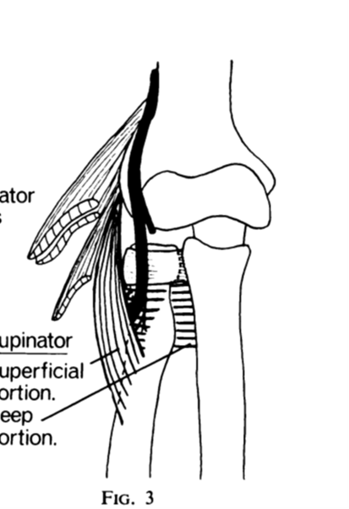
Arcade of Frohse fibrous band beginning of Superficial portion of supinator

Slide 27
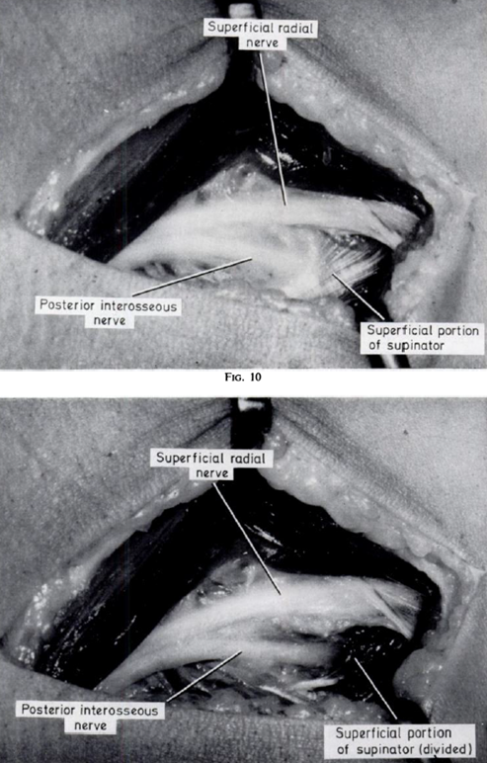
Radial tunnel
Treatment
Release ERCB
Release supinator

Slide 28
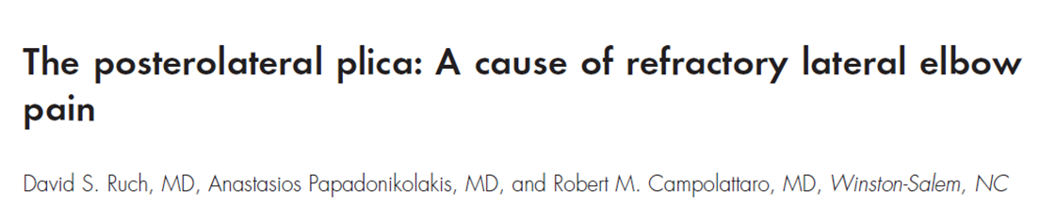
Painful snapping on flexion and pronation
Vague laterally based pain
Worse with flexion and extension
J Shoulder Elbow Surg 2006;15: 367-370

Slide 29
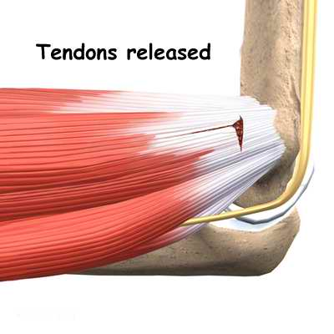
Medial epicondylitis
(Golfer’s elbow)
Clinical
    Pain over medial aspect of the elbow
    Ulnar nerve symptoms
Treatment
    Non operative
    Surgical release

Slide 30
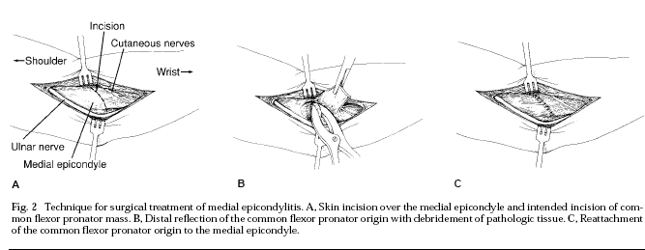
Medial epicondylitis
(Golfer’s elbow)
Surgery
    Subluxing ulna nerve
J Am Acad Orthop Surg 1994;2:1-8

Slide 31
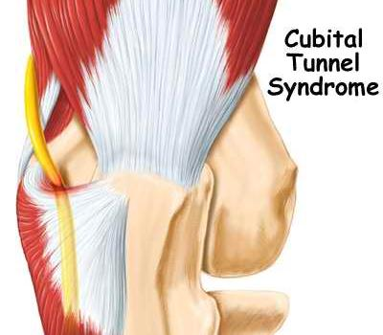
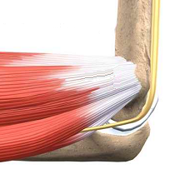
Ulnar nerve compression
(Cubital tunnel)
History
  Numbness, weakness, clumsiness
Examination
  Sensory
  Motor
  Tenderness, Tinel sign positive, wasting
Treatment
  Conservative
    nightsplints
  Surgical release
Volume 15, Number 11, November 2007

Slide 32
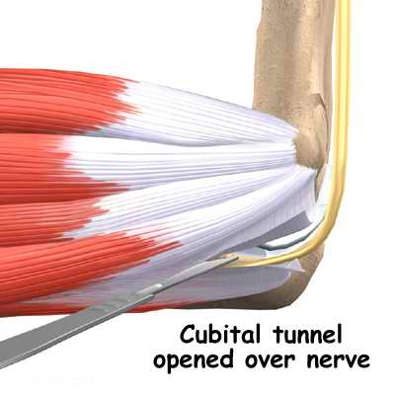
Ulnar nerve surgery
Decompression,
Medial epicondylectomy
Anterior transposition
    Subcutaneous
    Intramuscular
    Submuscular
Endoscopic decompression

Slide 33
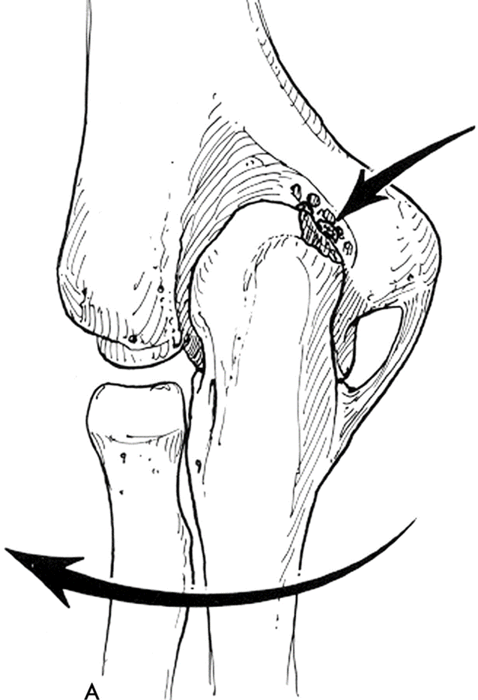
Hyperextension valgus overload
Laxity/ continued stress on MCL
Olecranon mal-tracks
    Posteromedial impingement
Treatment
  Re training
    Strengthen flexor pronator muscle mass
  Athroscopic debridement posteromedial corner
  Reconstruct MCL

Slide 34
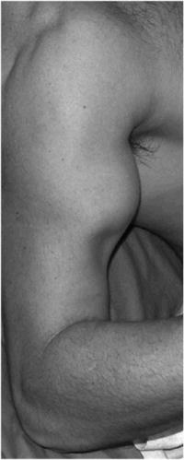
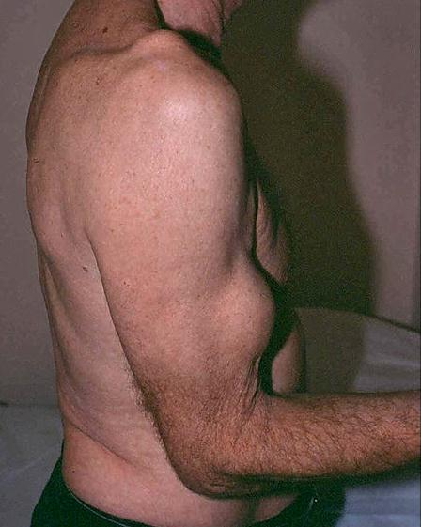
48 YO fireman lifting car


Slide 35
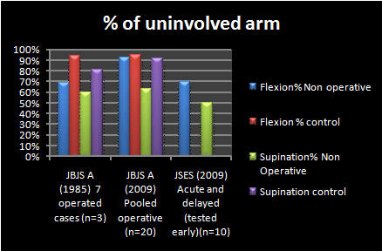
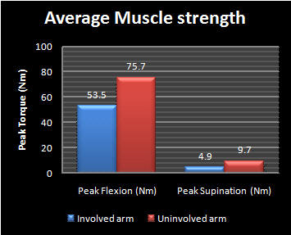
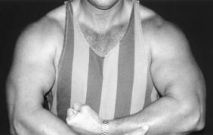
Distal biceps rupture
Increasingly recognized
Operative
Non operative
  Reasonable Viz Brachialis
    Lose
      15-30 % flexion strength
      30-50% Supination
        Fatiguability

Slide 36
Distal biceps

Radiographs:
    Often normal
    May show irregularity or bony avulsion
MRI, U/S:
    Indicated if Dx in doubt
    Partial tear
    Delayed presentation
    Intact lacertus fibrosus

Slide 37







Acutely < 3 weeks
Chronic/ Delayed

Slide 38




Rupture bifurcated distal biceps tendon
Separate musculotendinous junctions
Sassmannshausen G. et.al. J Bone Joint Surg 2004:86:2737-2740

Slide 39
Arthritic conditions
Rheumatoid Arthritis
Osteoarthritis
Crystal arthropathies
  Gout
  Pseudogout

Slide 40

Osteoarthritis
Primary / secondary
Pain
  forced extension e.g. carrying objects
Stiffness, locking, effusion
Treatment
  Conservative
  Surgical
    Removal of loose bodies
    Debridement
    Joint replacement (Arthroplasty)

Slide 41
Rheumatoid Arthritis
Constant ache, worse on lifting objects, elbow gives way
Synovial thickening, bone erosion
Treatment
  Conservative
  Surgical => synovectomy elbow replacement

Slide 42


Rheumatoid Arthritis

Slide 43


Slide 44

Numbers
10 Total elbows per year
30 Shoulder arthroplasties per year
About 5 hips per day ADH
USA Medicare 2003
    6,700 shoulder joints
    106,887 hip replacements
    199,195 total knee replacements

Slide 45






Slide 46

Unlinked Vs Sloppy hinge
5 yrs
30°
13%
Little et al. J Bone Joint Surg; Br.2005; 87-B: 437-444

Slide 47
Sloppy Hinge - 5 yrs
11% revision rate
Improved ROM 35°
82% good to excellent results
Little et al. J Bone Joint Surg; Br.2005; 87-B: 437-444

Slide 48
TER Complications
Overall 30%
  Infection 5%
  Wound healing 10%
  Triceps detachment 3%
  Ulna nerve palsy 5% (permanent)
  Disassembly (linked) 1-6%
  Dislocation (unlinked) 5%, instability 14%
  Loosening 9%
Little et al. J Bone Joint Surg; Br.2005; 87-B: 437-444

Slide 49



Loose bodies/ osteochondritis
Loose bodies alone
Osteochondritis
    Young athlete
    Little leaguers elbow
Arthroscopy
    Very satisfying loose bodies
    Osteochondritis
      Debridement
      Micro fracture

Slide 51









J Bone Joint Surg Am, 2000 May 01;82(5):724-724

Slide 52

Introduction
Simple Vs Complex
Simple
    No bony injury
    Stable in full extension
Complex
    Unstable
    Bony injury (may be stable, EUA)
O Driscoll; JBJS - A. 2000;82:724.

Slide 53
47 YO Lady
Post reduction films

Slide 54

D2

Slide 55
MUA D5
.
Backslab

Slide 56
2 weeks later x ray

Slide 57
Radial head replaced

Slide 58
6 weeks post injury

Slide 59
Better cast

Slide 60

Treatment Complex Instability
Simple
  Turn complex dislocation into simple dislocation
GET IT MOVING
Simple dislocation
  No Bony injury
  Elbow stable to within 30° of extension
O Driscoll; JBJS - A. 2000;82:724.

Slide 61





24 YO
68 YO
XR at 6 weeks out
(J Shoulder Elbow Surg 2005;14:312-317.)

Slide 62






Dynamic congruity
Several weeks later with exercises
24 YO post reduction
JSES 2008;17:276-280

Slide 63










58YO Fall
EUA
Stable in full extension
2nd Reduce ED told only stable flexed 130⁰
1st Reduction
Valgus
Varus
Simple or complex

Slide 64






40 YO Fall
What do you see?
Treat like simple
EUA Stable full extension
Simple or Complex

Slide 65



48 YO Male

Slide 66






48 YO Male
Good enough?
Why ?
Ligament repair
Now ?

Slide 67
Movement Brings stability
PLRI
PMRI
Varus
Valgus

Slide 68




J Shoulder Elbow Surg (2013) 22, 81-87

Slide 69


Questions

Slide 70



Slide 71

J Am Acad Orthop Surg 2004;12:405-415

Slide 72

Postero medial impingement

Slide 73

Myositis Ossificans
Heterotopic ossification
Trauma / HI / Passive exercises
Clinical
  Lump
  Pain
  Reduced ROM
Treatment
    Prophylaxis => radiotherapy, NSAID
    Curative => excision

Slide 74
Elbow arthroscopy
Diagnostic
Removal of loose bodies
Radial head excision
Debridement osteophytes OK procedure
Capsular release

Slide 75



Slide 76




Slide 77
Lateral position
    L bar
Tourniquet
Low pressure FMS or no FMS
No suction on shavers
4 mm standard scope for adult
    2.7 mm
Portals
J Am Acad Orthop Surg 2006;14:312- 318

Slide 78



VOLUME 83-A · NUMBER 1 · JANUARY 2001

Slide 79

Complications
VOLUME 83-A · NUMBER 1 · JANUARY 2001

Slide 80



Complications (nerve)
VOLUME 83-A · NUMBER 1 · JANUARY 2001

Slide 81


Olecranon bursitis
RA, gout, pseudogout, trauma, repetitive stress
Non infected / infected
Treatment
  Cause

Slide 82
Medial collateral ligament
Acute
    Context of other injuries
      Isolated
      Terrible triad
        Dislocation
        Coronoid
        Radial head
Chronic
    Throwing athletes

Slide 83

Medial collateral ligament
Medial view
Ulnar collateral ligament
    Anterior cord
    Posterior cord
    Oblique cord
J Shoulder Elbow Surg 2005;14: 179S-185S

Slide 84
Posterior bundle forms floor of cubital tunnel
    tighten in flexion
Anterior bundle composed of two distinct bands of fibers
  Tighten reciprocally as elbow flexed and extended
  Isometric fibre
JBJS A VOL. 79-A, NO. 8, AUGUST 1997

Slide 85
Medial collateral ligament
Origin anterior bundle MCL
    Antero inferior medial epicondyle
Insertion
    Sublime tubercle
    Long and thin
J Shoulder Elbow Surg 2007;16:657-660

Slide 86
J Bone Joint Surg Am. 2009;91 Suppl 2 (Part 2):191-9

Slide 87
Chronic MCL
Primary repair not possible
Several options
    Autograft
      Palmaris longus
    Allograft
    Synthetic
Different anchoring methods
    Figure of 8
      Jobe 1986
        Take down CFO
        Submuscular Transposition Ulnar nerve
    Docking
      Altcheck 2002
        Split CFO (FCU)
        Leave ulna nerve insitu
    Tension slide
      Intereference screws
      Endobuttons
J Shoulder Elbow Surg 2005; 14:207-215

Slide 88
J Shoulder Elbow Surg (2012) 21, 1674-1679
Docking Vs Tension slide
  Docking better

Slide 89


Dock 1 strand, tension and measure second
Split FCU posterior third
Expose sublime tubercle
Drill ulna tunnel and pass sutures graft A to P
Drill humeral entry and 2 exits both anterior if possible

