Slide 1
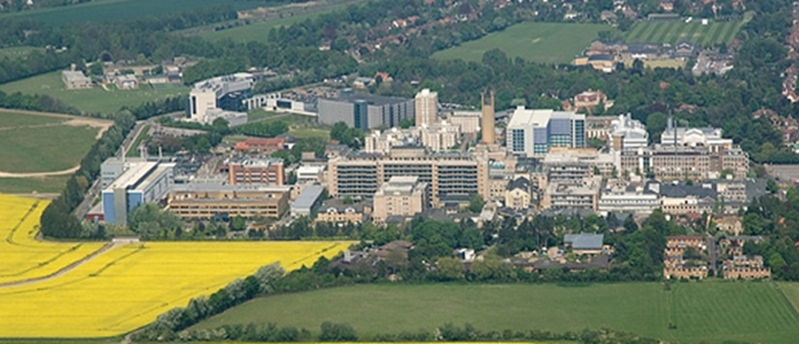
Multiply injured patient
Mr Lee Van Rensburg
Cambridge University Hospitals NHS trust
2020

Slide 2
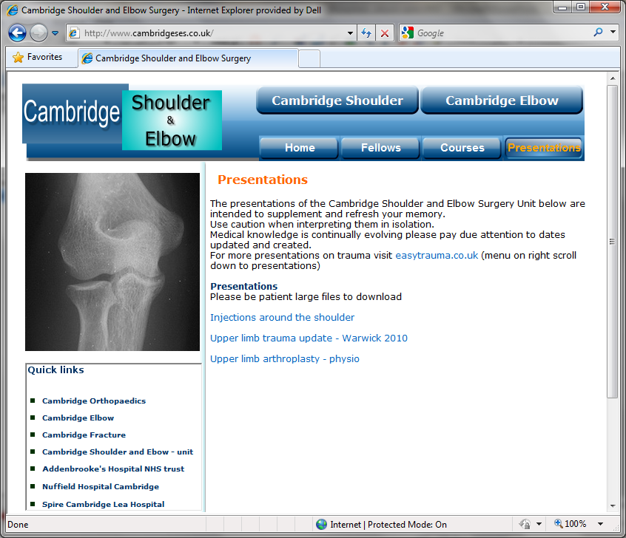
www.cambridgeses.co.uk

Slide 3
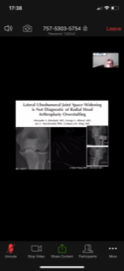
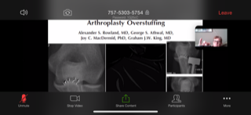
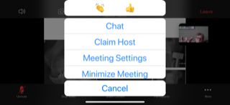
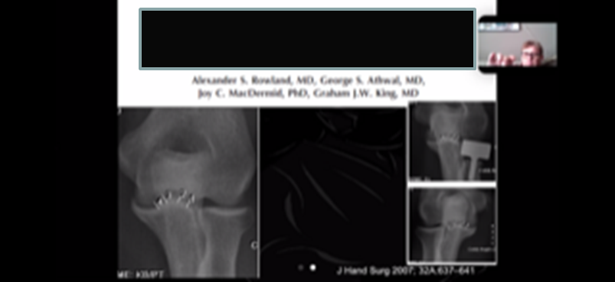
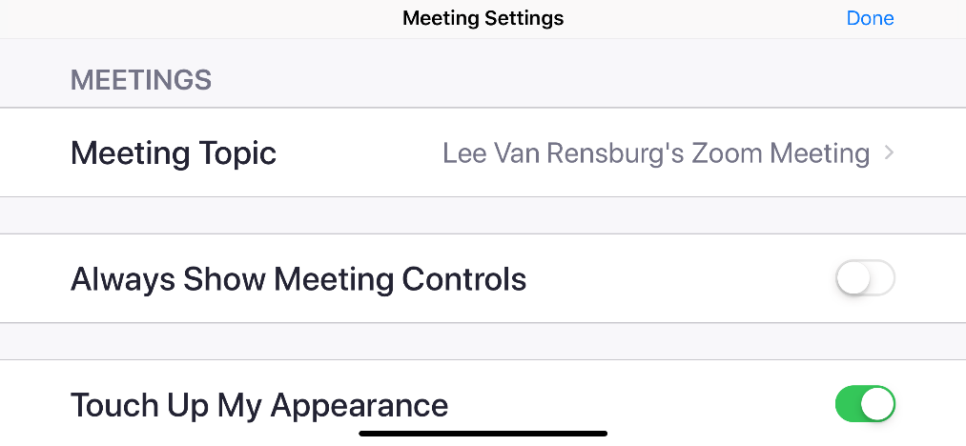
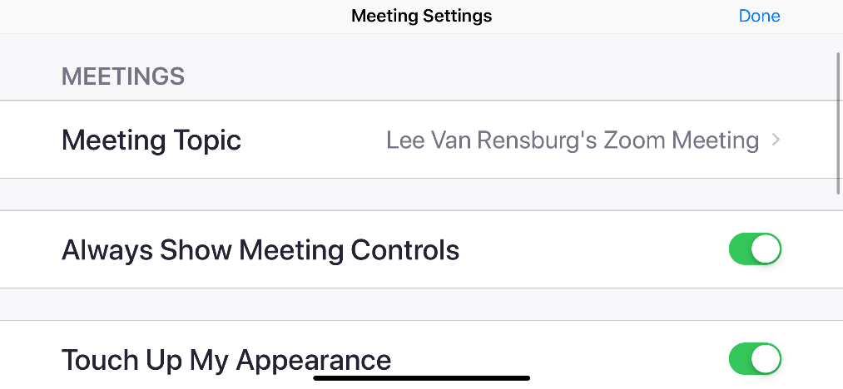
Zoom

Slide 4
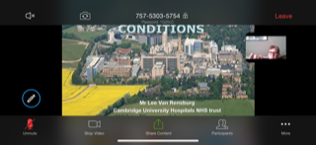
Annotation

Slide 5
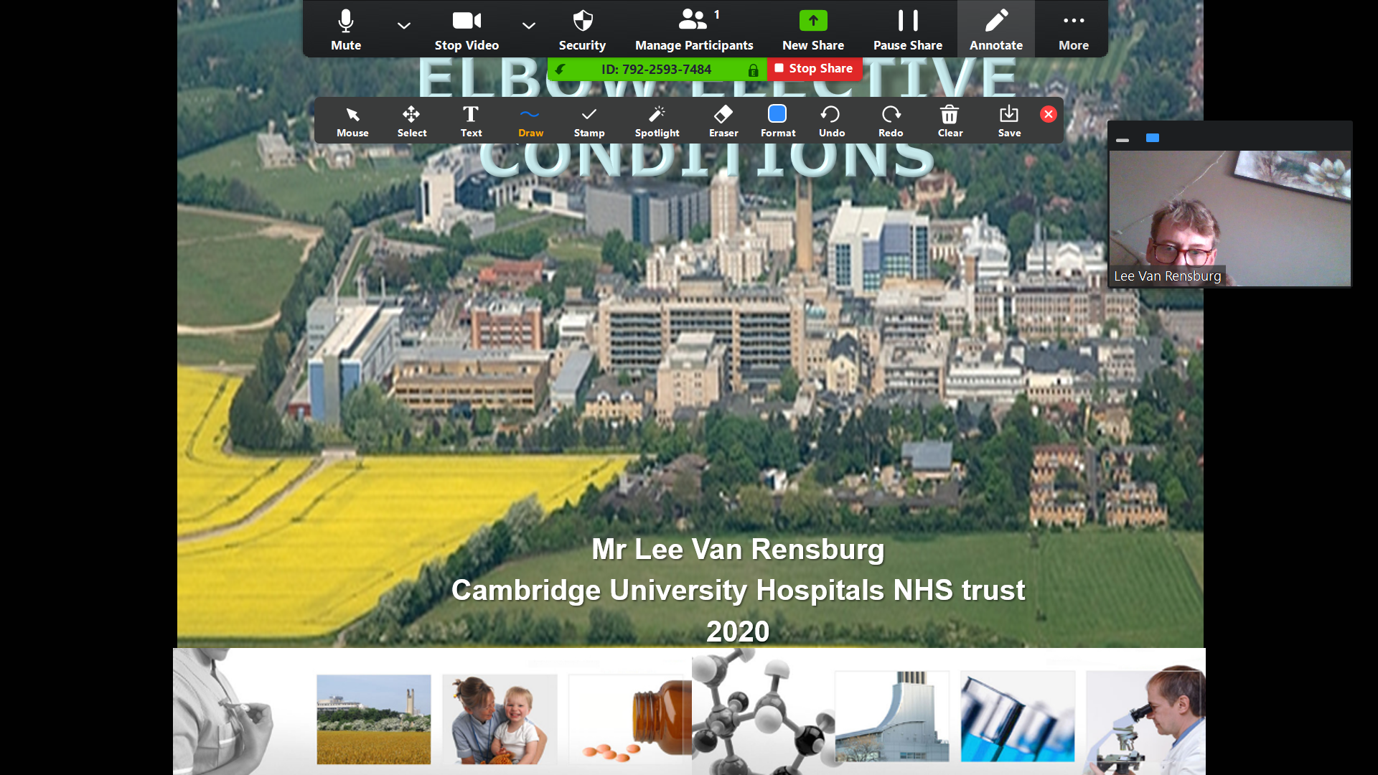
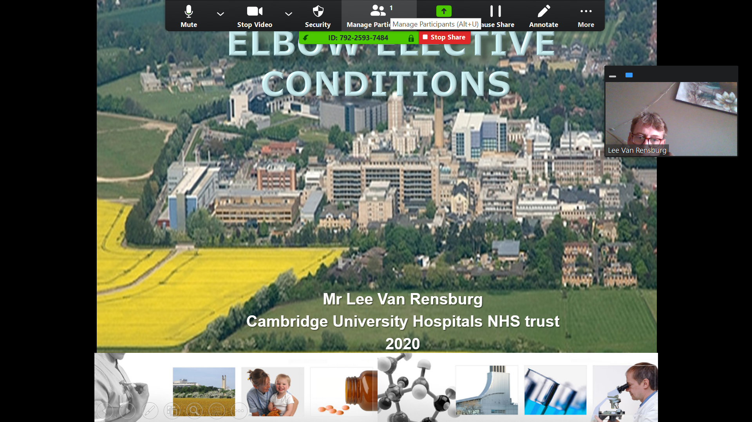
Annotate on PC

Slide 6
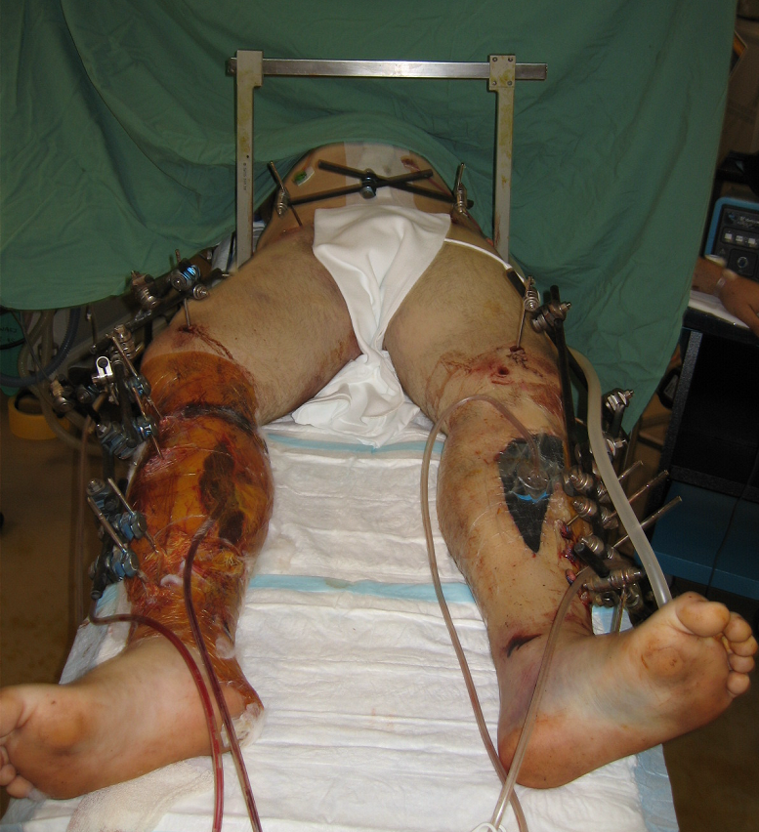

Slide 7
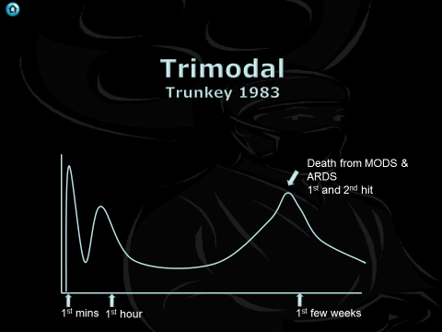
Trunkey DD. Trauma. Sci Am. 1983; 249:28–35

Slide 8
The ‘Second Hit’
Cytokine storm
Severe trauma can result in a life threatening inflammatory response (SIRS)
Threshold for fatal inflammatory response
DEATH: from multiorgan failure or adult respiratory distress syndrome
In some individuals the lengthy surgery of early total care exacerbates the the systemic inflammatory response resulting in death
inflammatory response
time
2nd Hit: the surgery
1st Hit: the trauma

Slide 10
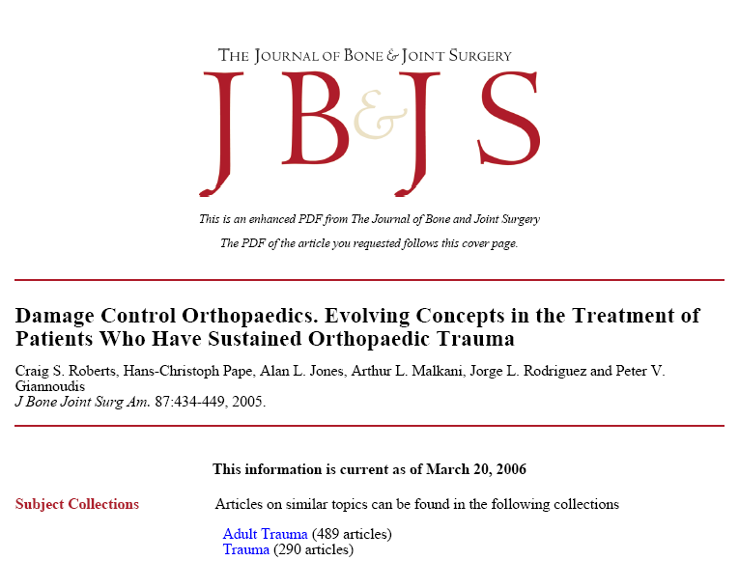

Slide 11
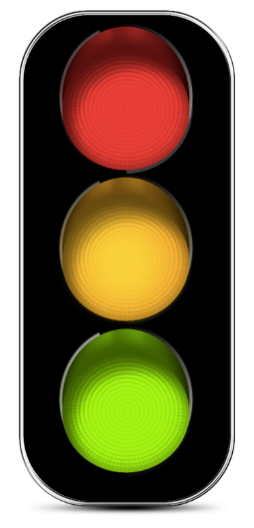
Lactate controlled ETC
Lactate easy to measure
Often high in 1st few hours but will drop in ITU if resuscitation adequate
2.5 magic number!
> 3 DC Surgery
2.5 – Look at TREND
< 2.5 ETC

Slide 12
Lactate >2.5 mmol
Occult Hypo perfusion, raised lactate increased mortality
Initial lactate:
< 2.5 mg/dL,
5.4% (4.5-6.2%) Mortality
2.5 mg/dL to 4.0 mg/dL,
6.4% (5.1-7.8%) Mortality
>=4.0 mg/dL,
18.8% (15.7-21.9%) Mortality

Slide 13
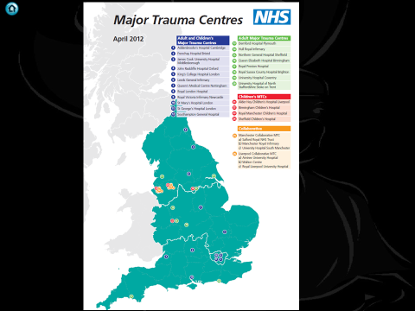
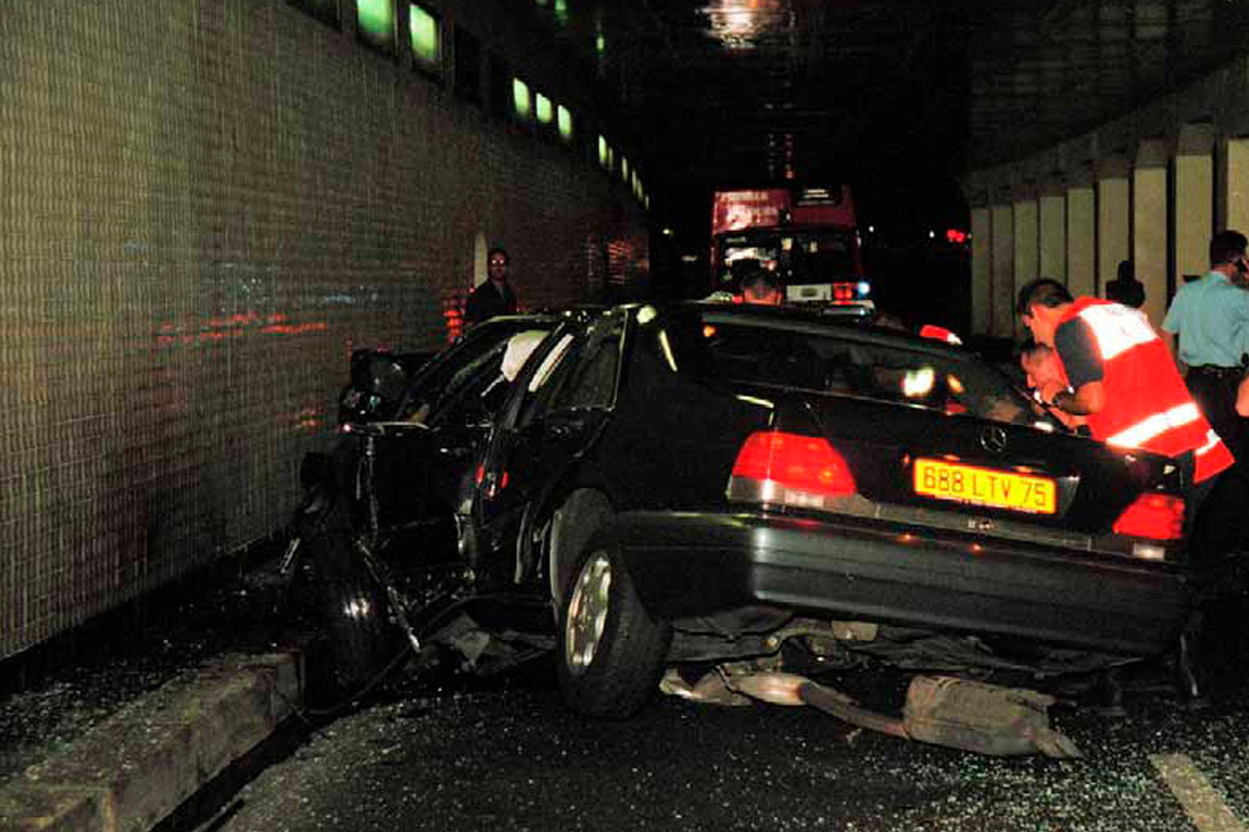
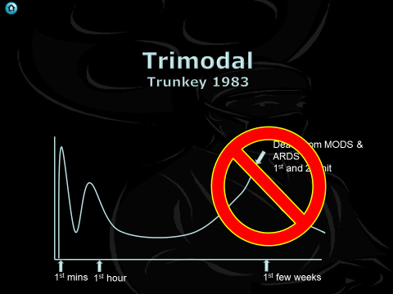
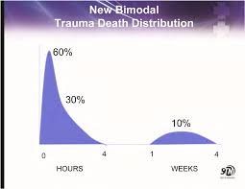
Proc (Bayl Univ Med Cent). 2010 Oct; 23(4): 349–354

Slide 14
2013
No single physiological parameter or blood marker
Accepted level of 2.5mmol/L is too conservative
Patient centred approach
Physiological improvement and reversal of acidosis reflected by:
lactate< 4.0 mmol/L
pH ≥7.25
BE above 5.5 mmol/L
JTO; Volume 02 / Issue 02 / May 2014

Slide 15
JM 20 YO, Male 27/02/06 – 15:48
#BOS
#Nasal bone
APC pelvic injury
# R Supracondylar femur
# R Tibia shaft (open)
# L Tibial plateau (open)
# Bimalleolar L ankle

Slide 16
Pre hospital
Intubated through window
Pre hospital arrest
Hr 144, Systolic 60
GCS 3

Slide 17
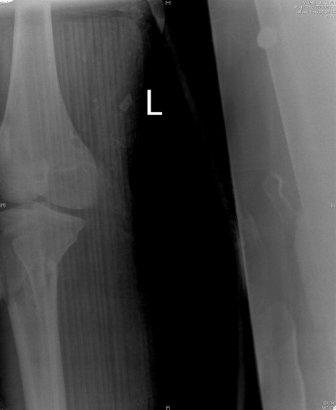

Slide 18
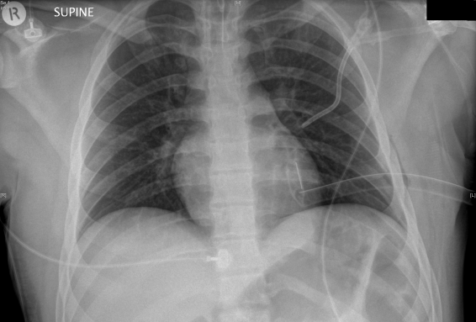
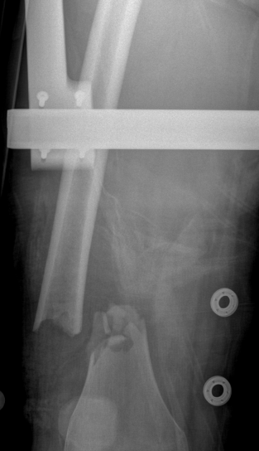
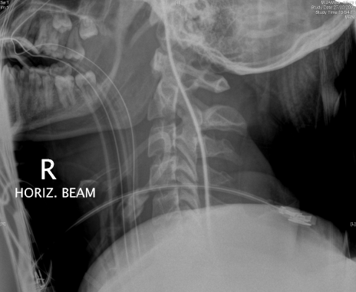

Slide 19
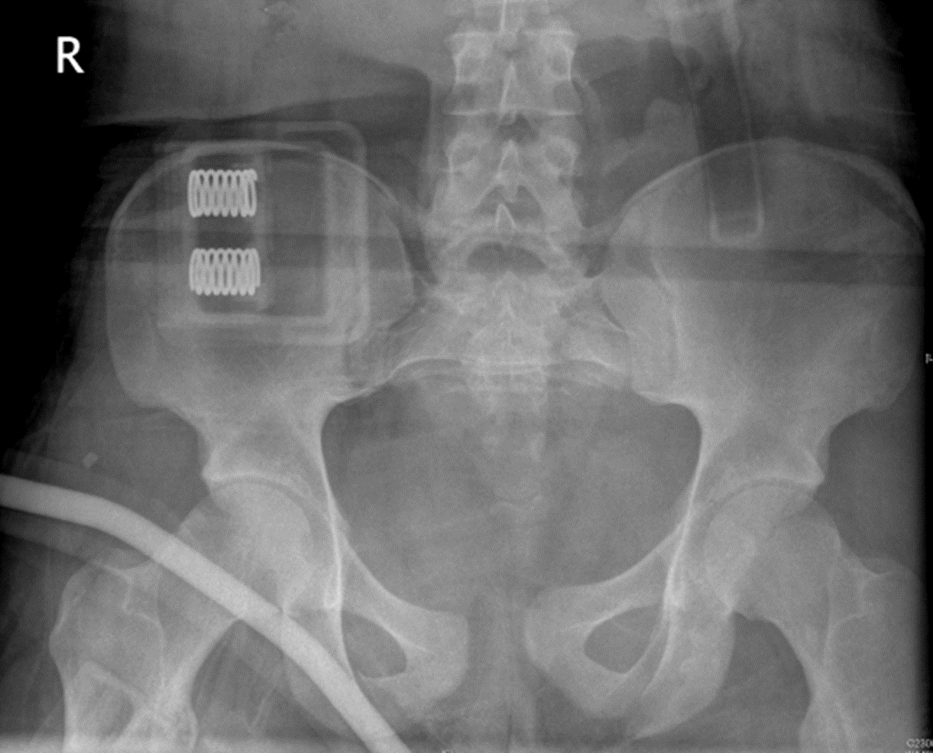

Slide 20
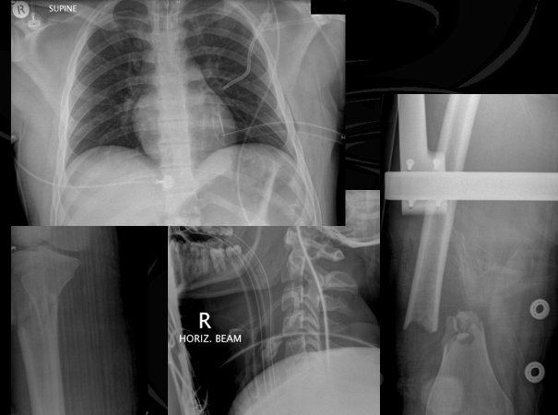
Priorities

Slide 21
Priorities
Control haemorrhage
Reduce inflammatory response
Removal of devitalised tissue
Prevention of ischaemia-reperfusion injury
Pain relief
Facilitation of nursing care
J Bone Joint Surg [Br] 2003;85-B:478-83

Slide 22
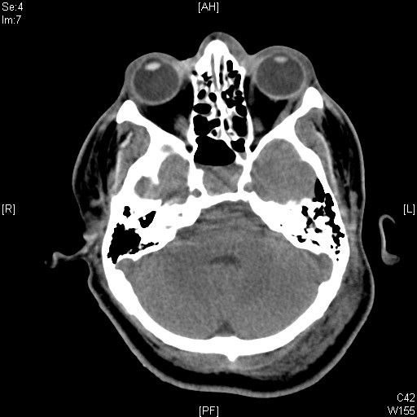
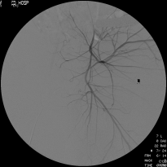
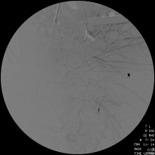
Pre theatre
CT brain
BOS
Angiogram
Very small bleeder embolised

Slide 23
Priorities
ATLS
Permissive hypotension
Haemostatic resuscitation
Rewarming
Correction of acid base
Haemorrhage control
Decompress
Decontaminate/ debride
Stabilise
Resucitate
Reasses

Slide 25
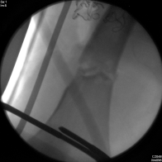
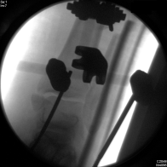
Theatre 27/05/06
External fixator
Pelvis
R leg
L leg
Debridement washout, fasciotomy and vac dressing
R thigh
R lower leg
L lower leg
Laparotomy
EVD

Slide 26
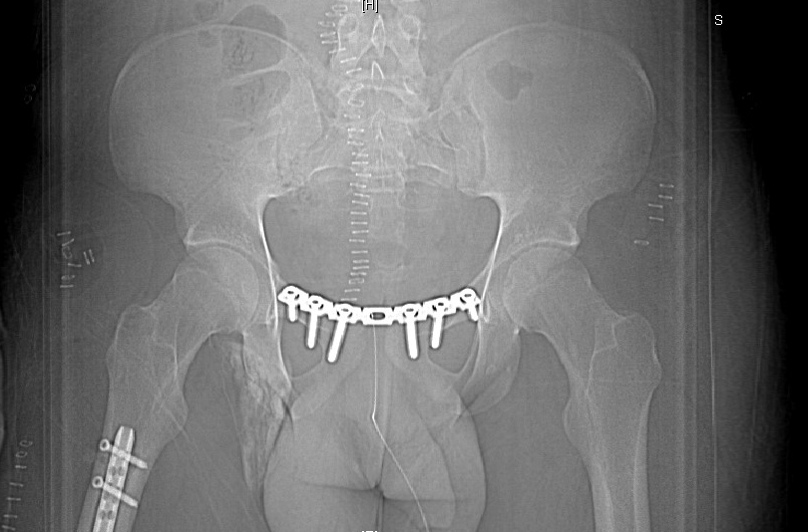
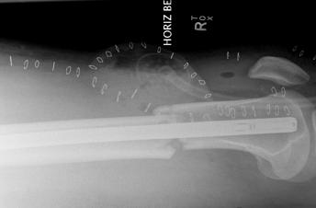
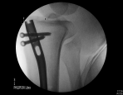
Theatre – 01/03/06
Plating pubic symphysis
Intramedullary nail
R femur retrograde
R tibia
Change of Vacs
D 2

Slide 27
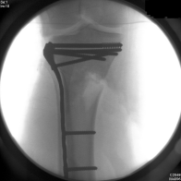
Theatre 05/03/06
ORIF L Tibial plateau
ORIF L fibula
Free Flap R tibia
Rotation flap L Tibia

Slide 28
Theatre 23/03/06
Debridement and SSG L Ankle
Medial side

Slide 30
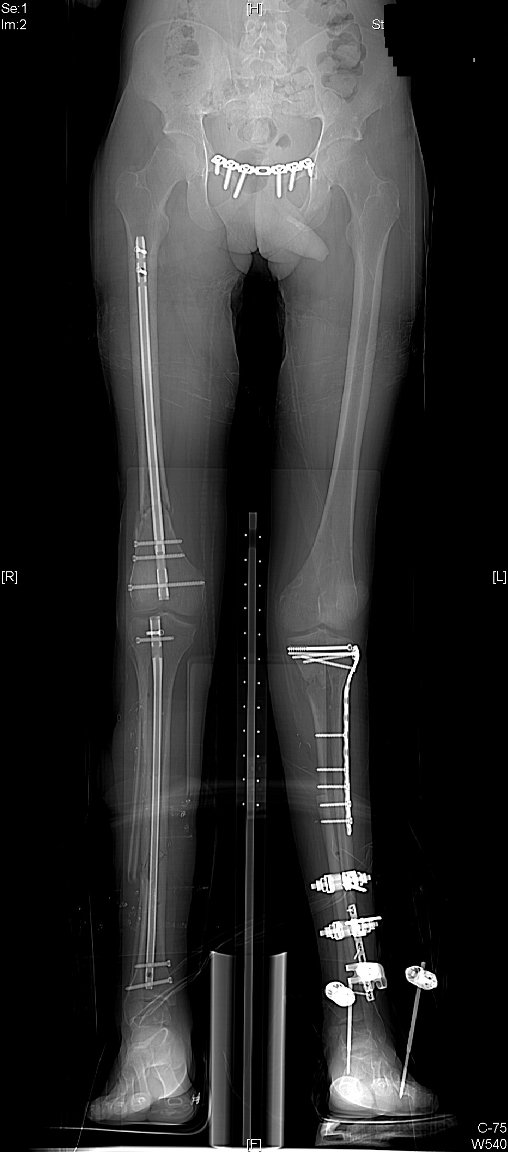

Slide 31
4 Groups
Stable
Borderline
Unstable
Extremis
Stable, unstable patients, and patients in extremis are fairly easy to define.
Borderline patients are more difficult to define.

Slide 32
Borderline shift to DCO Louisville
pH of <7.24
Temperature <35°C
Operative time > 90 minutes
Coagulopathy
Transfusion of more than ten units of packed red blood cells.
Certain specific orthopaedic injury complexes more amenable to damage control orthopaedics:
Femoral fractures in a multiply injured patient
Pelvic ring injuries with exsanguinating hemorrhage
Polytrauma in a geriatric patient.

Slide 33
Borderline shift to DCO Hanover
Polytrauma + injury severity score of >20 points and additional thoracic trauma (abbreviated injury score >2 points)
Polytrauma with abdominal/pelvic trauma (Moore score75 >3 points) and hemorrhagic
Shock (initial blood pressure <90 mm Hg)
Injury severity score of >40 points in the absence of additional thoracic injury
Radiographic findings of bilateral lung contusion
Initial mean pulmonary arterial pressure of >24 mm Hg
Increase of >6 mm Hg in pulmonary arterial pressure during intramedullary nailing

Slide 34
Head Injury
Femoral shaft fracture and head injury
Less controversial as long as patient “stable and resuscitated”

Slide 35
Timing of return
Used to hold true
Days 2, 3, and 4 are not safe for performing definitive surgery
During this period, marked immune reactions are ongoing and increased generalized oedema is observed
Pape et al in a prospective study demonstrated that multiply injured patients subjected to secondary definitive surgery between days 2 and 4 had a significantly increased inflammatory response compared with that in patients operated on between days 6 and 8

Slide 36
SR 21 YO, Male 13/05/06 - 23H50
ISS 57
SAH, DAI
R Haemothorax
Pelvic ring fracture
(Dissociation R hemipelvis)
# L Acetabulum
# L Femur
Compartment syndrome both lower legs and thighs

Slide 37
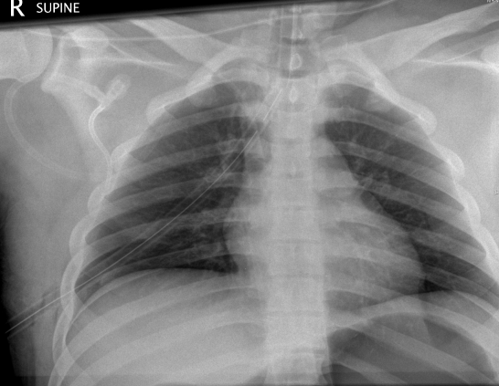
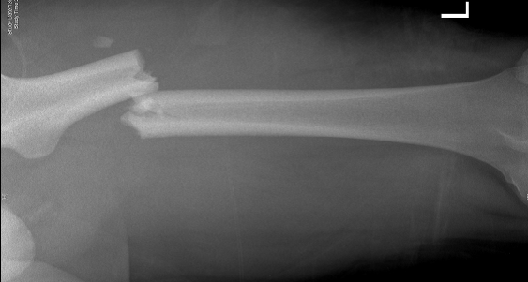
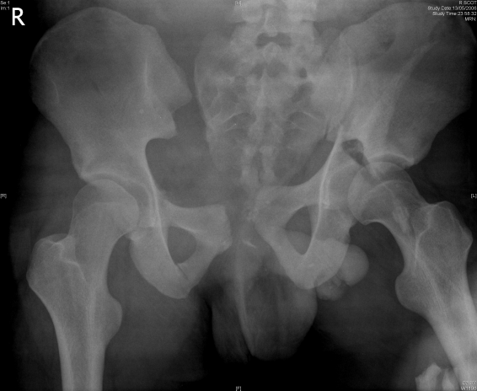
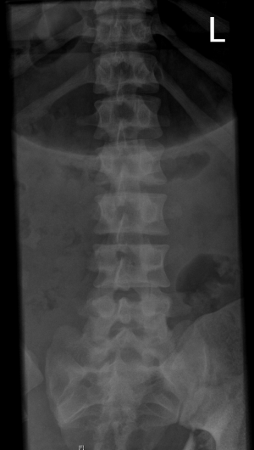
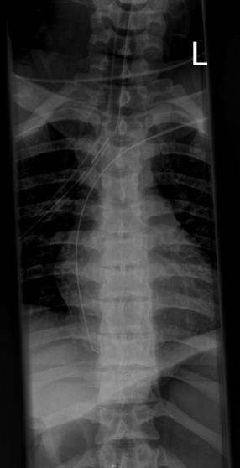

Slide 38
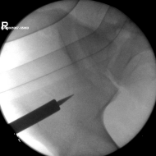
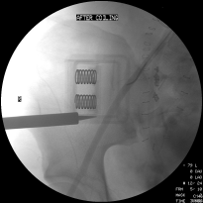
Theatre - 1 hr arrival
Laparotomy
Pelvis packed, Vac dressing
C clamp and pelvic ex fix
Angiogram
Embolisation

Slide 39
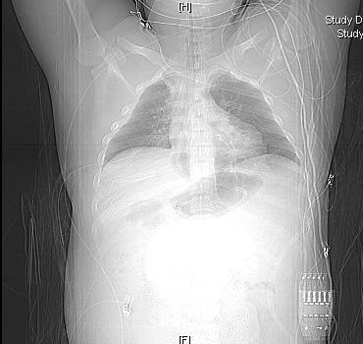
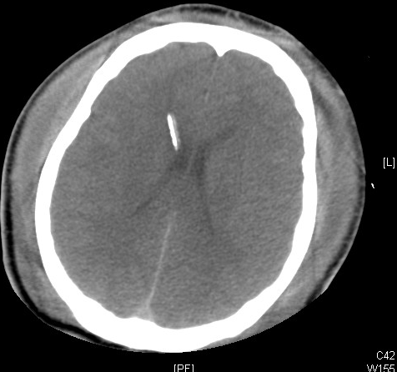
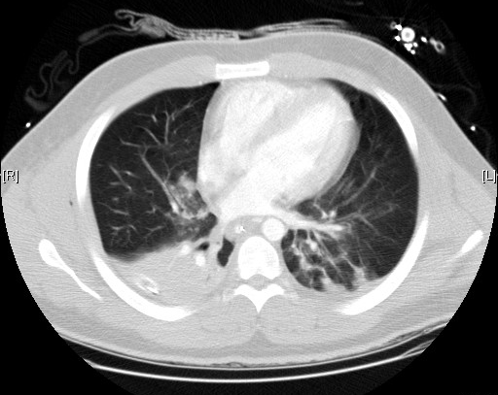
EVD 14/05/06 – 20:45

Slide 40
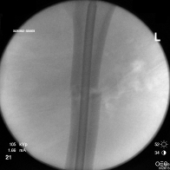
Theatre 14/05 08h20
Retrograde femoral nail
Fasciotomy
Both thighs both calves

Slide 41
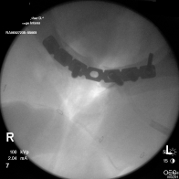
15/05/06
Angiogram
IVC filter
Repeat bleeding
Laparotomy change of packs
Bladder repair
Pubic symphysis ORIF

Slide 42
Theatre 15/05/06
Angiogram
IVC filter
Repeat bleeding
Laparotomy change of packs
Bladder repair
Pubic symphysis ORIF
2 hour rewarming on table

Slide 43
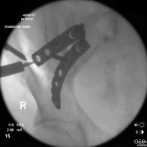
Theatre 15/05/06
Removal of C clamp
Anterior plating
R Sacroiliac joint
Debridement washout closure C clamp and Ex fix wounds

Slide 44
Theatre
Vac dressing change 17/05/06
Closure of thigh wounds
Vac dressing change 23/05/06
Closure of L lower leg wound
Vac dressing change 28/05/06
Closure R lower leg wound

Slide 45
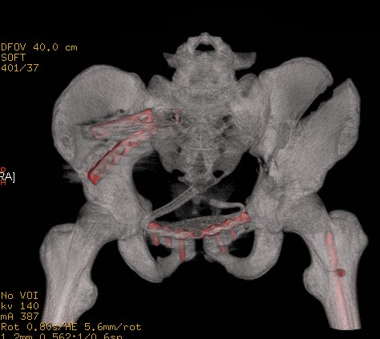
Theatre 30/05/06
Planned ORIF acetabulum
Wound breakdown
L iliac crest
Both thighs
Washout and vac dressings

Slide 46
Summary
1st phase – control haemorrhage, rapidly stabilise #’s, decontaminate wounds
2nd phase – resuscitate in ICU
Improve haemodynamics
Ventilatory support
Rewarm
Correct coagulopathy
Identify any other injuries
3rd phase – definitive correction/ repair

Slide 47
NPWT

Slide 48
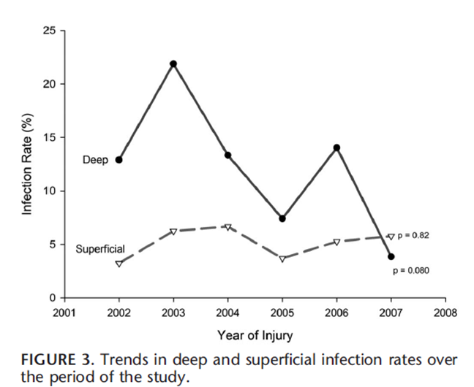
Retrospective
2002 – 2007
Deep infection
NPWT 8.4% (14/166)
Conventional dressings 20.6% (13/63)
J Orthop Trauma Volume 26, Number 9, Sept 2012

Slide 49
J Orthop Trauma Volume 26, Number 9, September 2012

Slide 50
Wollf trial
JAMA. 2018;319(22):2280-2288.

Slide 52
Pre WOLLF
Int J Surg . 2018 May;53:72-79

Slide 53
Pre WOLLF
Infection RCT
Fig. 4 (a) A forest plot showing the pooled results of the retrospective cohort studies reporting the post operative infection rate.
Fig. 3 (a) A forest plot showing the pooled results of the RCTs reporting the post-operative infection
rate.
Int J Surg . 2018 May;53:72-79

Slide 54
90 cases
Dressed to healing
Or vac dressing to healing
Pak J Med Sci. 32 (2016) 65-69.

Slide 56
Major Trauma Centre
Notes:
56

Slide 57
Trimodal Trunkey 1983
Death from MODS & ARDS
1st and 2nd hit
1st mins
1st hour
1st few weeks

Slide 58
Questions ?

