Slide 1
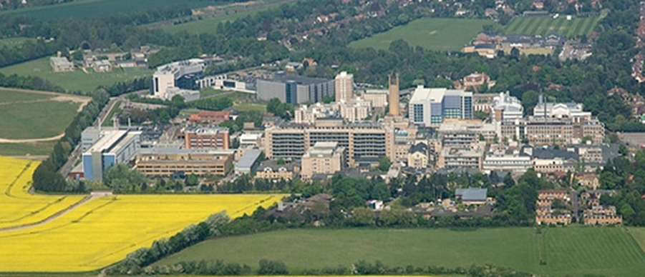



Humeral shaft
Distal humerus
Fractures
Mr Lee Van Rensburg
Cambridge University Hospitals NHS trust
Movember 2018

Slide 2

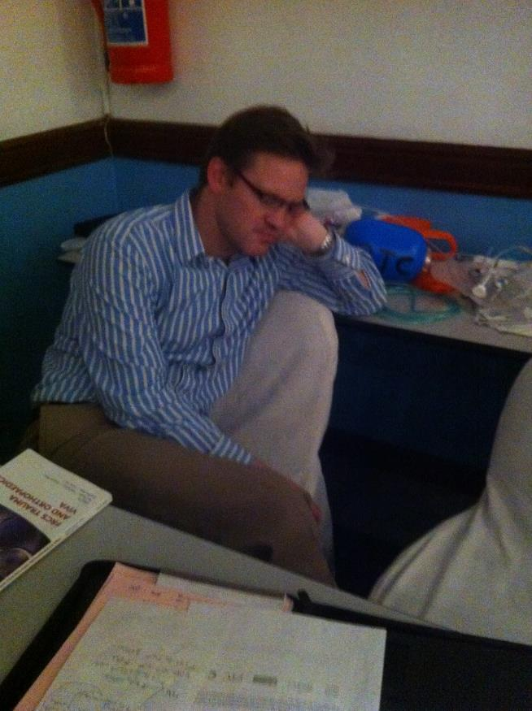
www.cambridgeses.co.uk

Slide 3
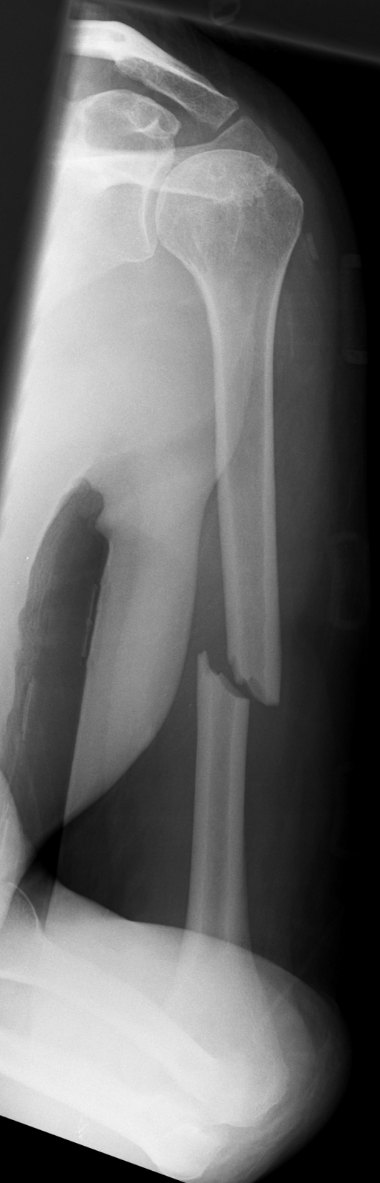
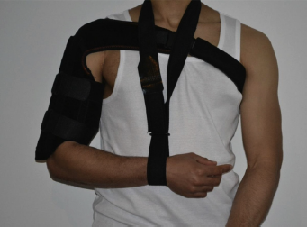
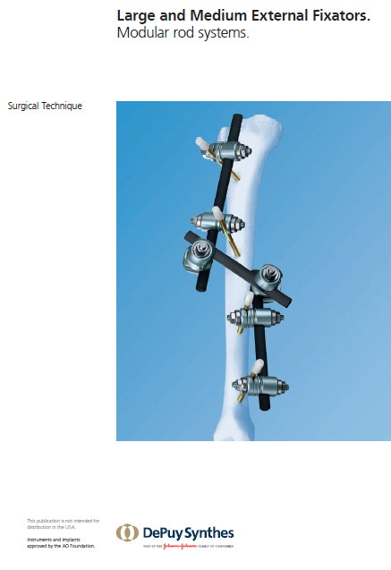
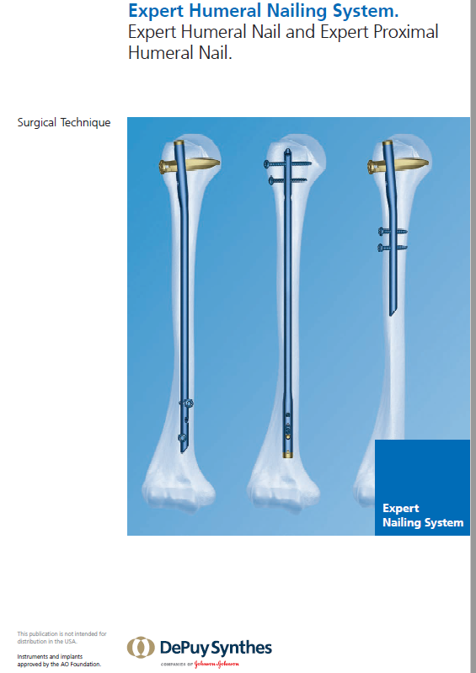
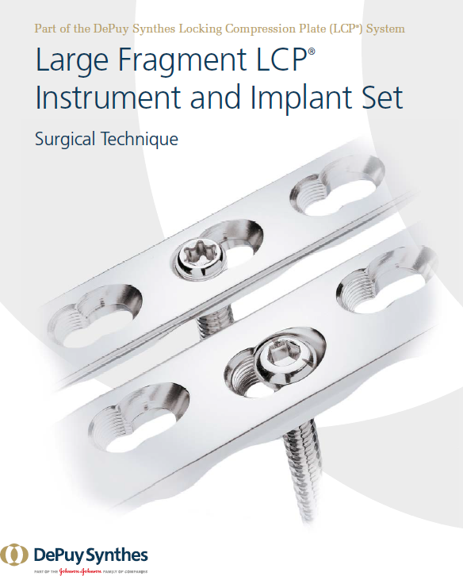
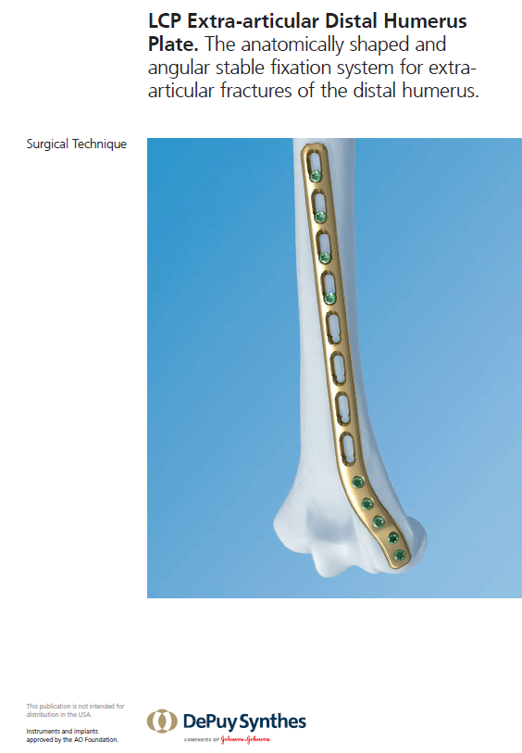
36 YO PVA
Radial n Normal

Slide 4
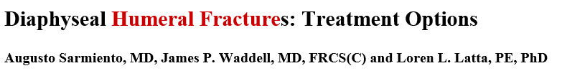
Non Operative
  Satisfactory healing and alignment 90%
Operative
  Open fracture (GRADE 3)
  Polytrauma
    Chest
    Head injury
  Ipsilateral both bone forearm (floating elbow)
  Extensive local associated injury
    Joint
    Brachial plexus, nerve
    Muscle and tendon
VOLUME 83-A · NUMBER 10 · OCTOBER 2001

Slide 5
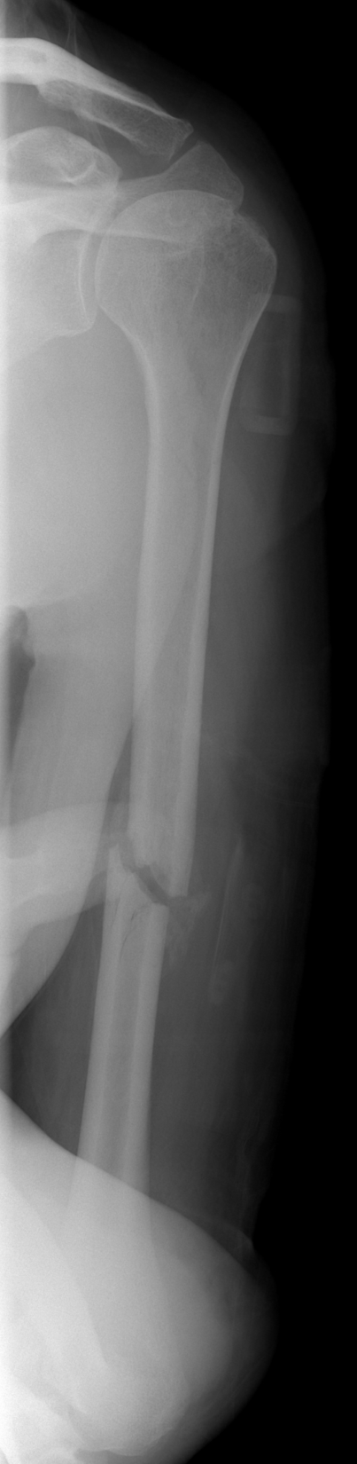
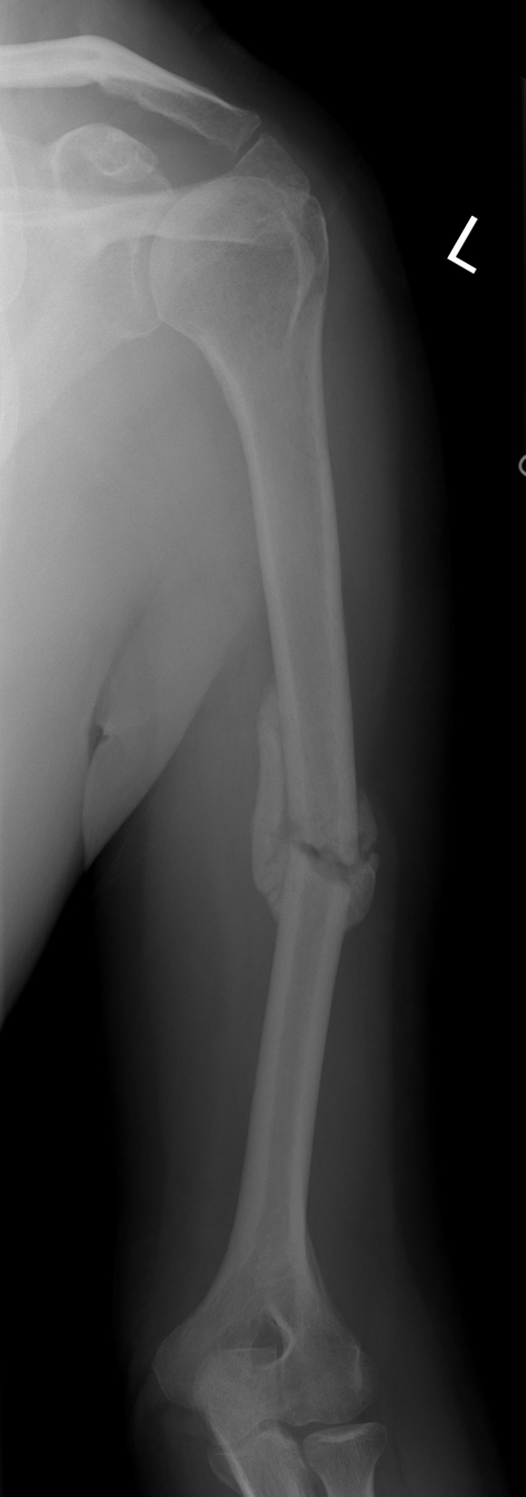
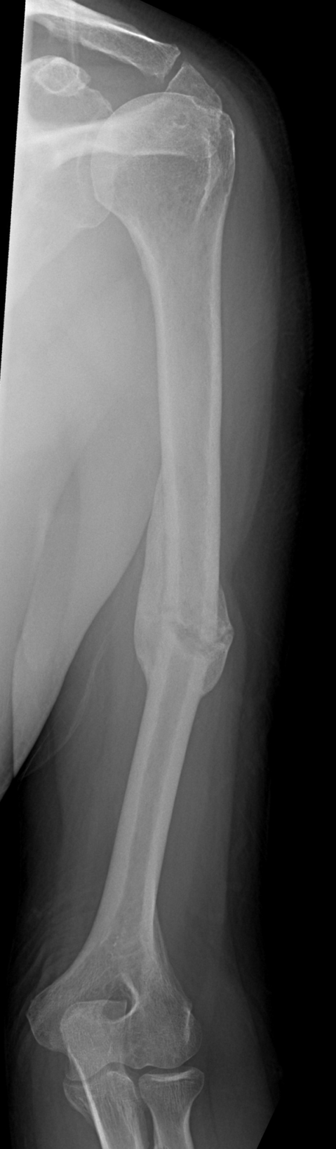
36 YO PVA
Radial n Normal
3 months
6 months
10 months

Slide 6
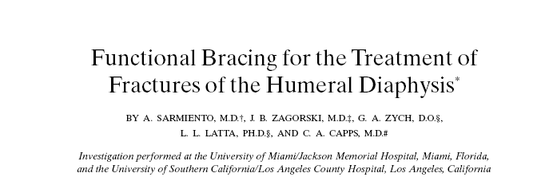
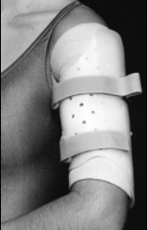
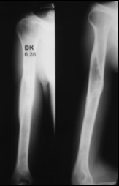
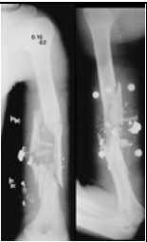
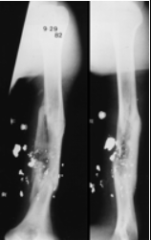
620 patients
Union 97%
Humeral Brace
  Average 11.5 weeks (4 – 22 weeks)
3 months

Slide 7
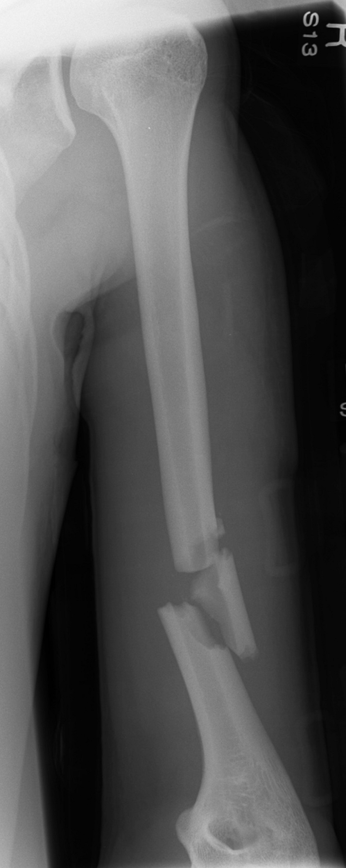
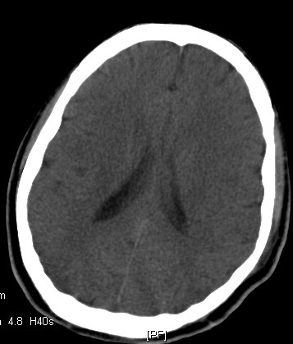
24 YO PVA
Head injury
Closed humeral shaft
Radial nerve intact

Slide 8
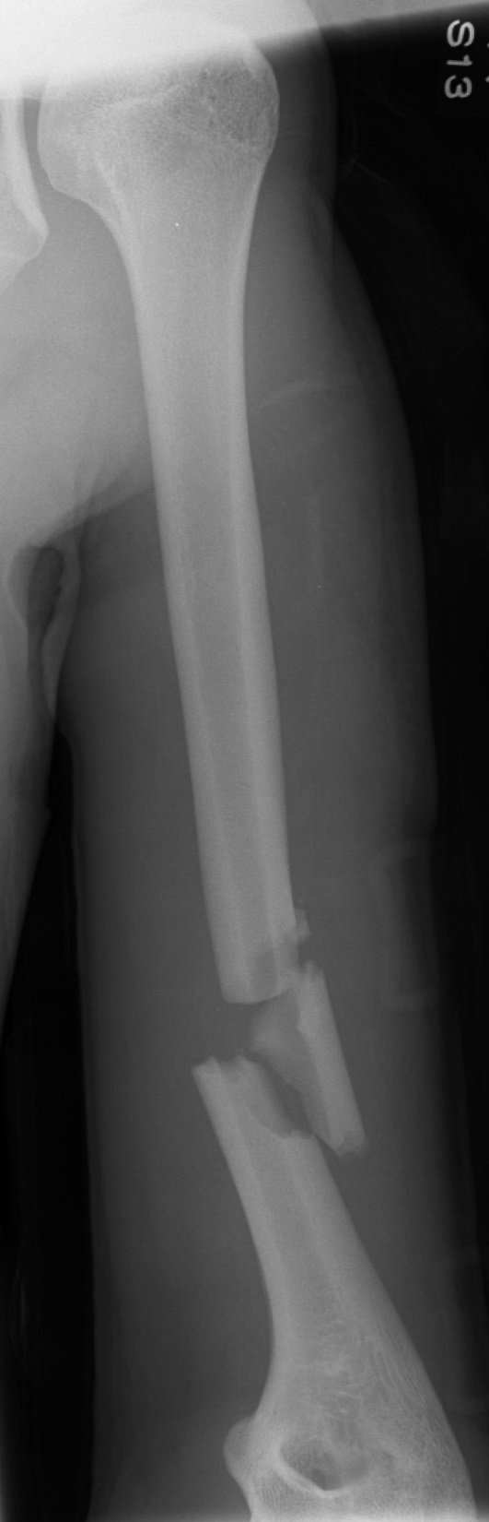
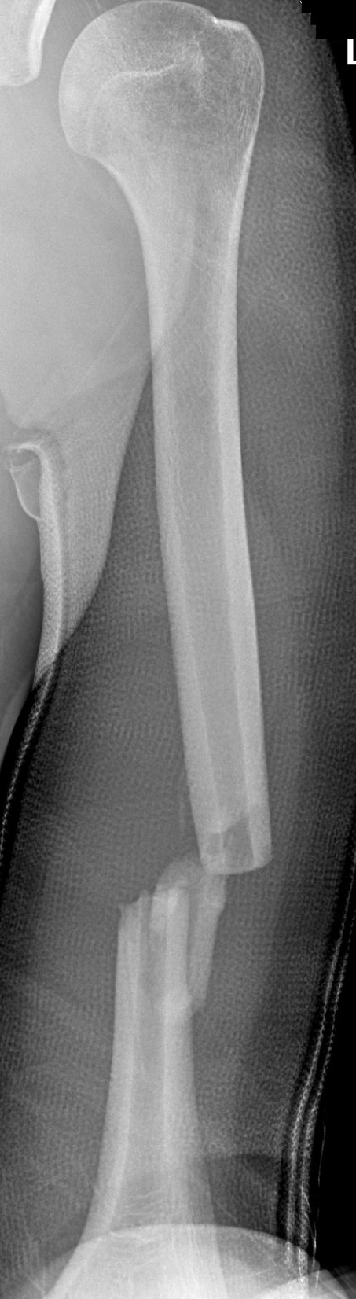
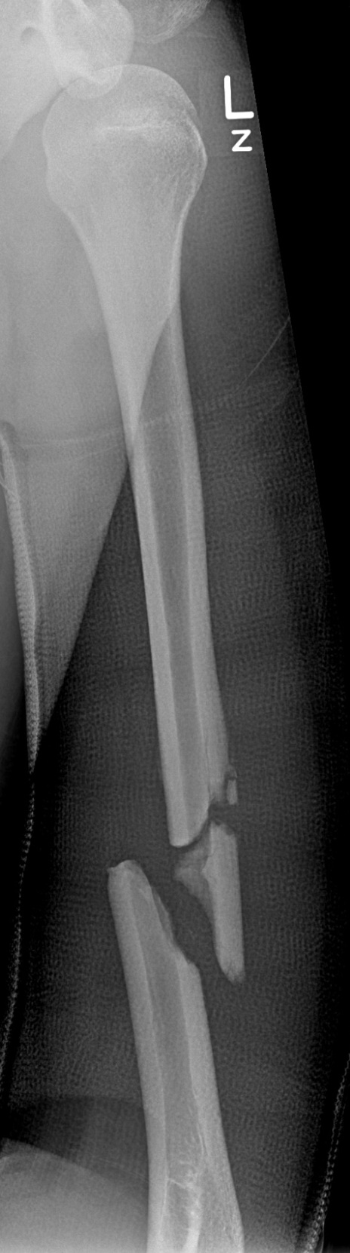
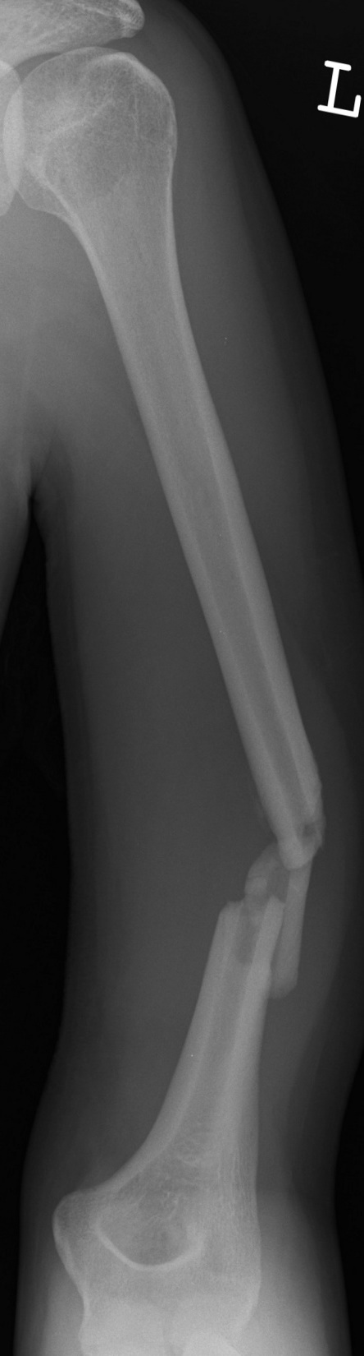
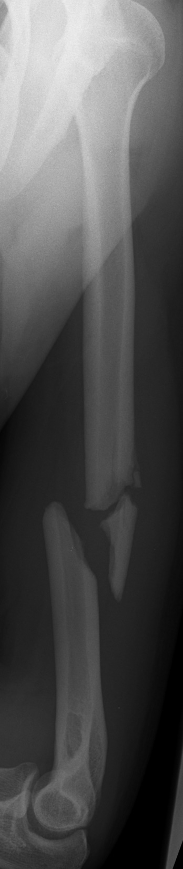
2 months
4 months

Slide 9
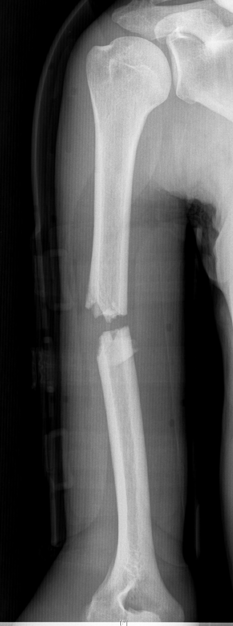
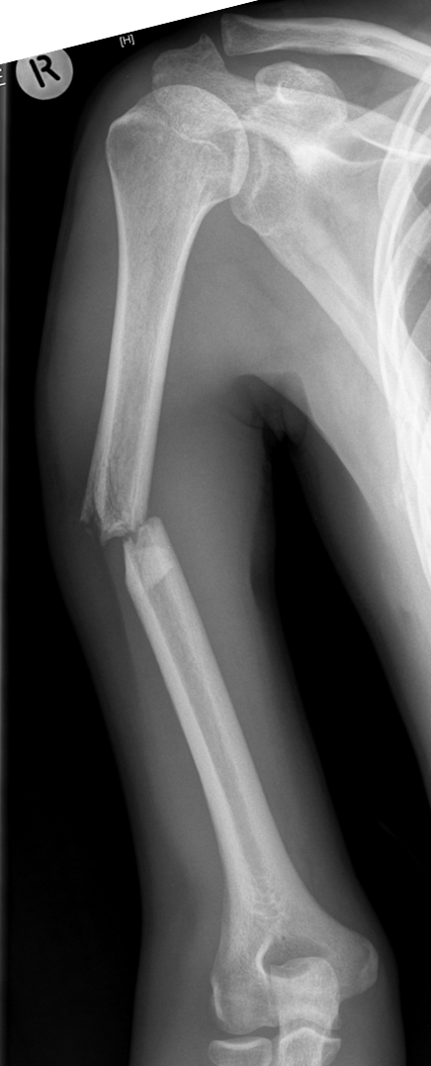
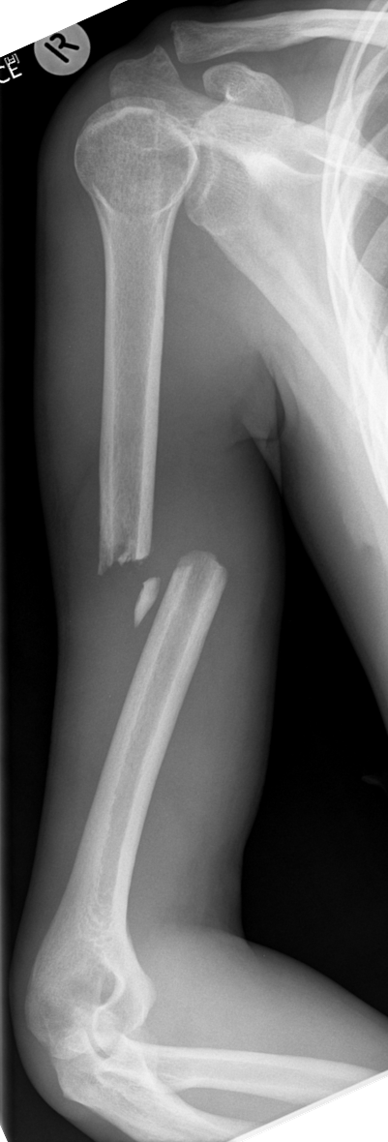
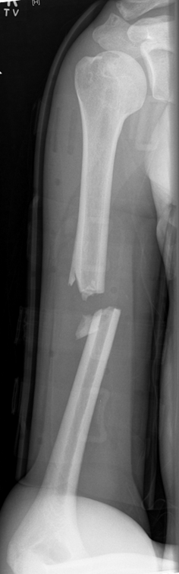
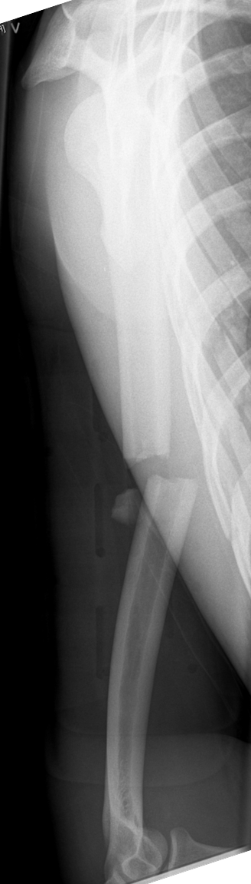
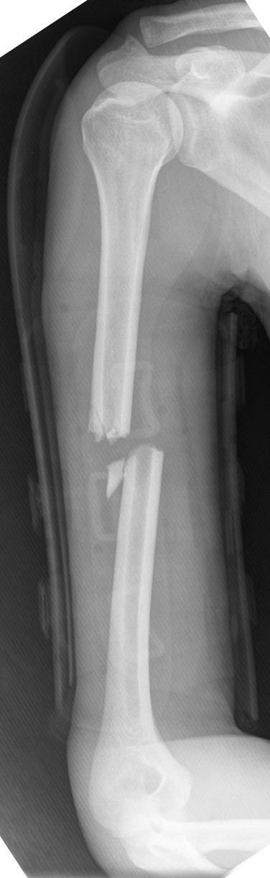
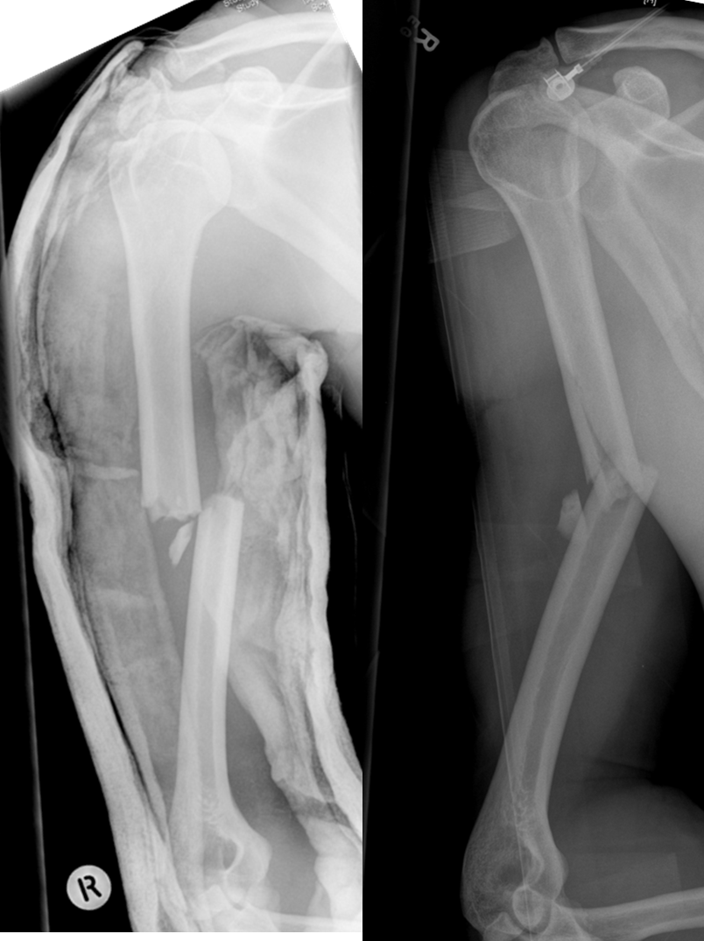
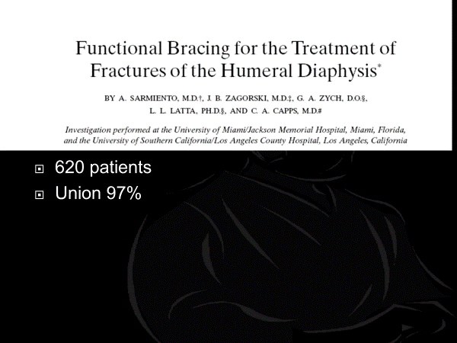
35 YO Bicycle
2 weeks
5 months
6 weeks

Slide 10
620 patients
Union 97%
67% follow up
“We were unable to follow most of the patients long-term, as they did not return to the clinic once the fracture had united and use of the brace had been discontinued.”
“Since our study population consisted primarily of indigent patients seen at teaching institutions, a large number of the patients failed to return for additional follow-up once the acute symptoms had subsided. This deprived us of the opportunity to perform an outcomes study.”

Slide 11
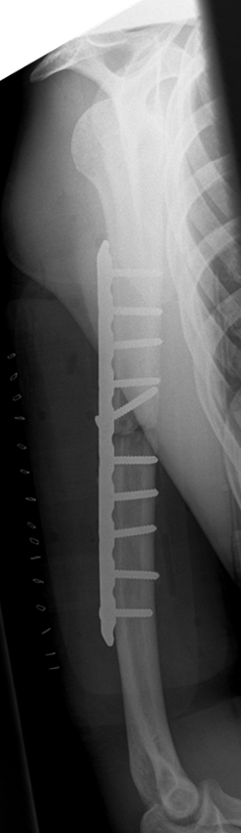
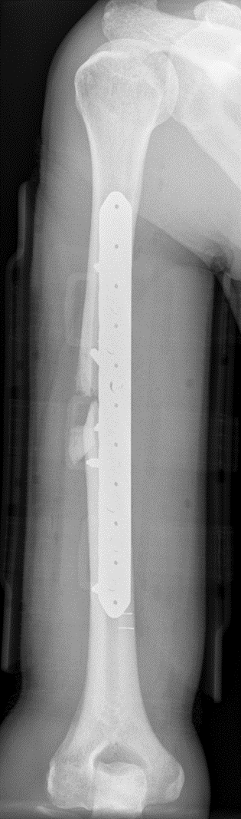
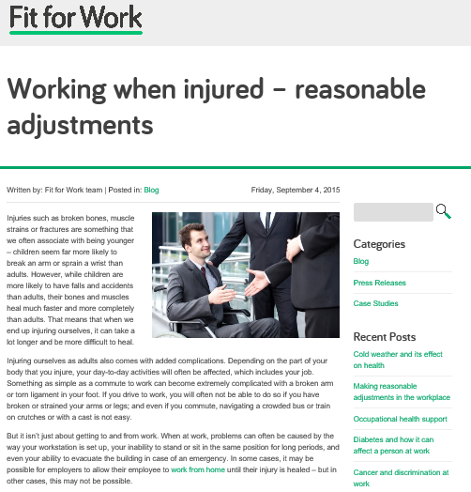
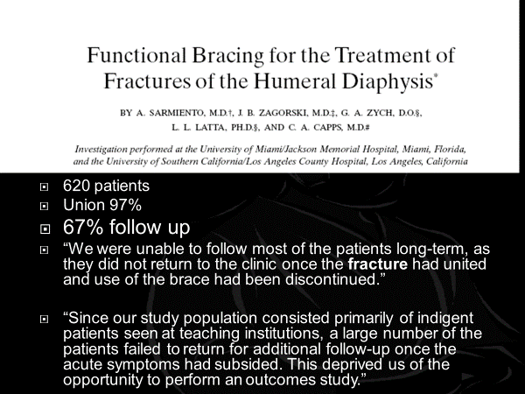
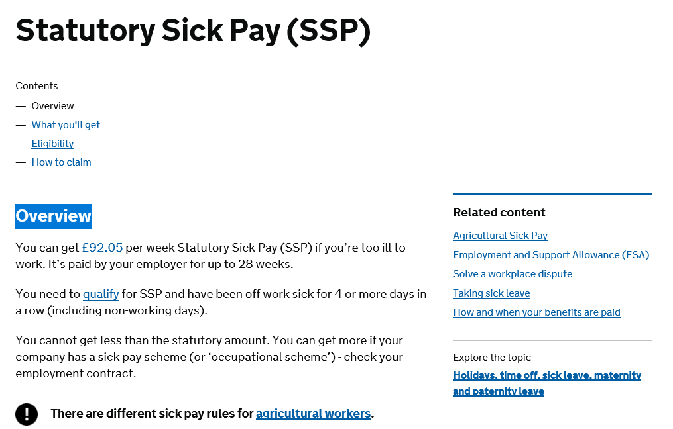
35 YO Bicycle
2 weeks
6 months
5 months
6 weeks

Slide 12
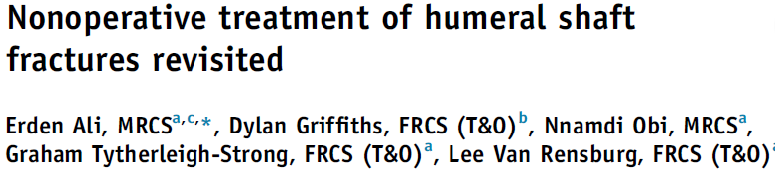
n = 207 (over 5 years)
Nonunion defined
  No evidence of bone union by 1 year
  Or
  Requiring delayed fixation
    Operative fixation undertaken more than 6 weeks after injury
F/U 89%
J Shoulder Elbow Surg (2015) 24, 210-214

Slide 13
Union
  83%
24 Non unions
  15 delayed fixation
  Average of 8.3 months after injury (3 -12 months)
J Shoulder Elbow Surg (2015) 24, 210-214

Slide 14
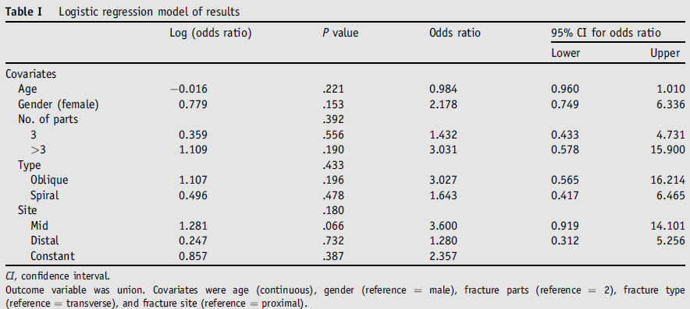
Nothing statistically significant
J Shoulder Elbow Surg (2015) 24, 210-214

Slide 15
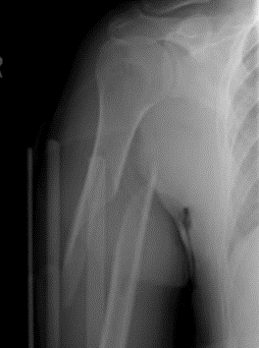
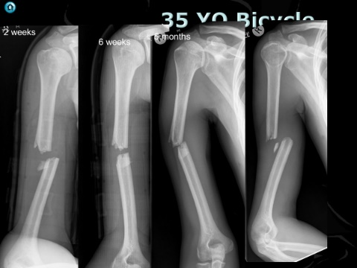
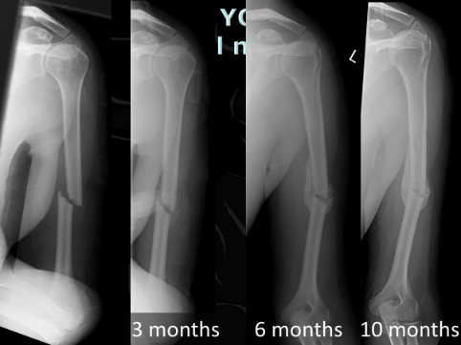
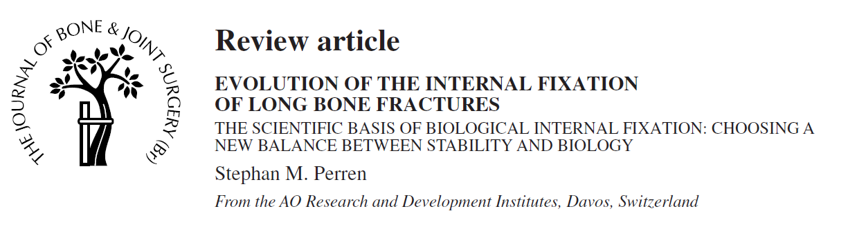
Oblique proximal third
  Suggested by Ring
Transverse
  not significant our study
  Others suggested yes
Multifragmentary
  89% union
J Shoulder Elbow Surg (2015) 24, 210-214

Slide 16
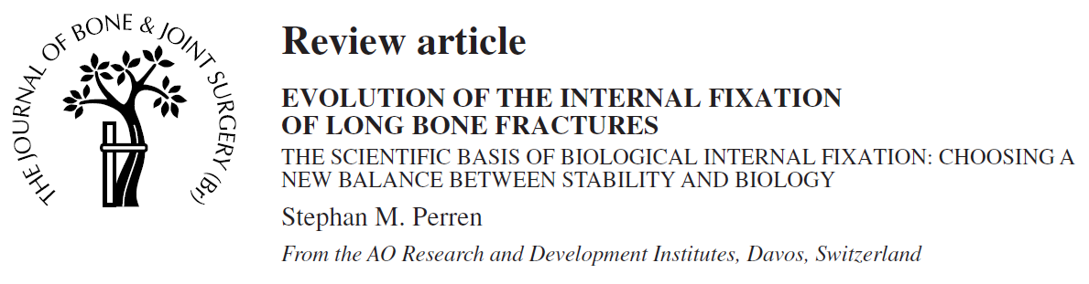
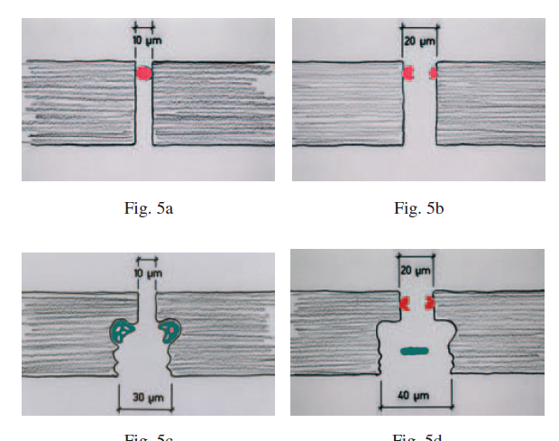
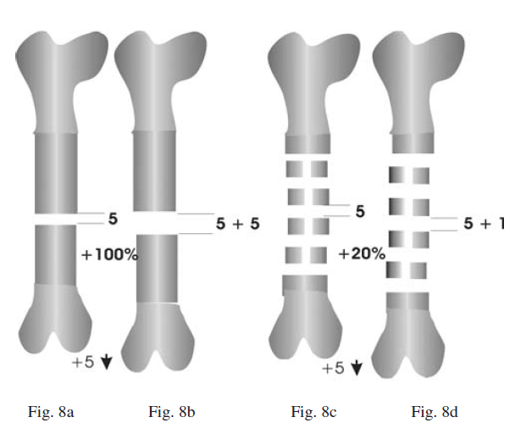
VOL. 84-B, No. 8, NOVEMBER 2002

Slide 17
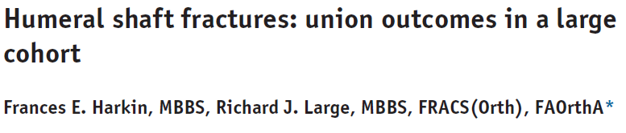
n = 96
54% united before 26 weeks (6 months)
33% non union
  67% Union rate
J Shoulder Elbow Surg (2017) 26, 1881–1888

Slide 18
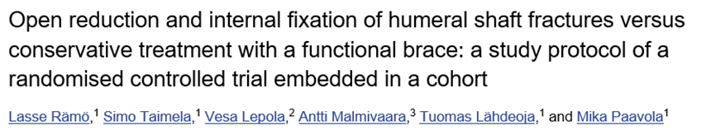
Protocol registered for RCT
Operative Vs Non operative
BMJ Open. 2017; 7(7): e014076.

Slide 19
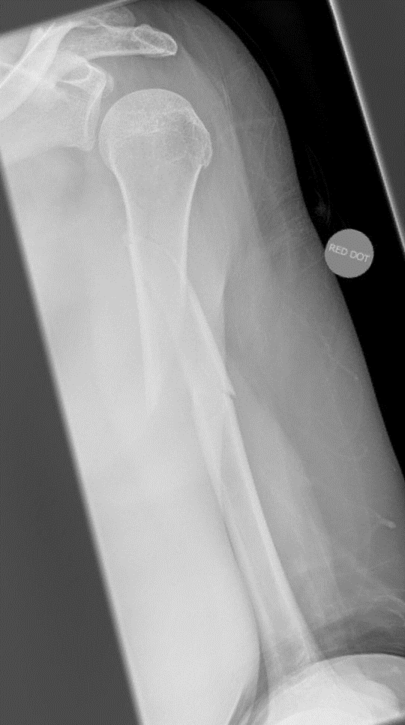
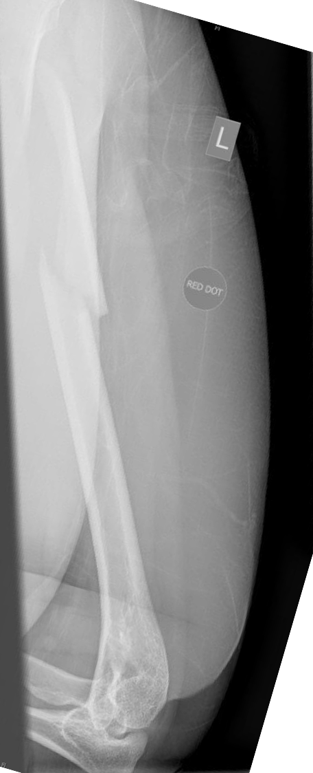


50 YO
Radial n Normal, referred 5 months
5 months
Elbow
80° -100°

Slide 20






Non Operative
  Not Conservative --- FUNCTIONAL
Biology
  Strain and stability
VOLUME 83-A · NUMBER 10 · OCTOBER 2001

Slide 21


Functional management
  Brace
    Adjust regularly
    Does not need to include all fracture
  Elbow extension
    Straight within 2 weeks
  Active assisted flexion
  Gravity extension
  No Shoulder abduction till union
    Pendulum
VOLUME 83-A · NUMBER 10 · OCTOBER 2001

Slide 22



Slide 23


F/U 6 Weeks XOA
See Week or 2
“Show me how you adjust your brace”
“Show me how your elbow straightening coming on”
“What must you not do”
      “ You can do these pendulum exercises stop shoulder stiffening”
“A little bit of movement stimulates healing”
“Too much slows it down”
“Listen to your arm
  Little bit of an ache OK
  Really hurts next day done a little too much”
  “Nothing heavier than a cup of tea”
“Stop smoking avoid NSAIDS”

Slide 24




Pseudo subluxation
48 YO Low energy
N Radial n
Day 0

Slide 25










Pseudo subluxation
48 YO Low energy
N Radial n
5 Months
2 Weeks
4 weeks
9 weeks
Day 0

Slide 26


Radial nerve
42 YO Running fall into wall
Dense radial nerve palsy
Holstein Lewis?

Slide 27




When paralysis of radial nerve complicates a humeral fracture
Fracture is in the distal third
Spiral
Distal Fragment displaced
  With proximal end deviated radial ward
Radial nerve is caught in the fracture site
Vol.. 45-A, NO. 7, OCTOBER 1963

Slide 28


21 YO
Normal Radial nerve
Not
Holstein Lewis

Slide 29
42 YO Running fall into wall
Dense radial nerve palsy
Not Holstein Lewis
Radial nerve palsy

Slide 30
Issues
Can take 4 months to recover
Easier when acute
Neuromuscular junction degradation
8/10 primary injuries will recover
Long term outcome operative non operative no different

Slide 31







Slide 32
Radial nerve and Humeral fracture
Primary Vs Secondary
  Secondary explore
Energy
  High Vs Low, high more likely to explore early
Open injuries
  Explore

Slide 33



Slide 34


Extra articular distal third
Normal radial nerve

Slide 35



Plate and screw n=19
Non operatively n=21
No functional difference
Three new post op palsies
  2 recovered
VOLUME 88-A · NUMBER 11 · NOVEMBER 2006

Slide 36






26 YO
Normal Radial n
2 weeks
4 Months

Slide 37



Non union - What now

Slide 38



Slide 39

Meta-analysis of randomized trials.
  Plate Vs Nail for humeral diaphyseal fractures
Plate fixation reduces risk of further surgery by at least 12% and by as much as 93%.
Small numbers over estimates benefit.
Acta Orthopaedica 2006; 77 (2): 279–284

Slide 40


2011
5 small trials – n = 260
    All 5 methodology flaws
No difference in
    Union
    Return to work
    Function
    Intra operative nerve injury
Nail
  Statistically significant increase shoulder impingement
    five trials, RR 0.12; 95% CI 0.04 to 0.38
Nails removed more frequently than plates
    three trials, RR 0.17; 95% CI 0.04 to 0.76
Cochrane Database Syst Rev. 2011 Jun

Slide 41





6 weeks
4 months

Slide 42
Humerus Plate fixation

Slide 43








Humerus Plating
40 Y0 High energy
Grade 2 open
14 Months
Revision
plating
4 months
post injury
10 months
Post injury
12 months
Post injury

Slide 44



Plating
Large Fragment plate
4 screws
  8 cortices
Compression if shelf
Ride out infection
3.5 stronger plate

Slide 45



Intramedullary nail
(Non) Union
Not a Tibia

Slide 46



Intra medullary nailing
Proc Instn Mech Engrs Vol 216 Part H: J Engineering in Medicine

Slide 47

Cuff

Slide 48




30 YO
Compression nail
Multiple injuries

Slide 49
Questions ?

