Slide 1
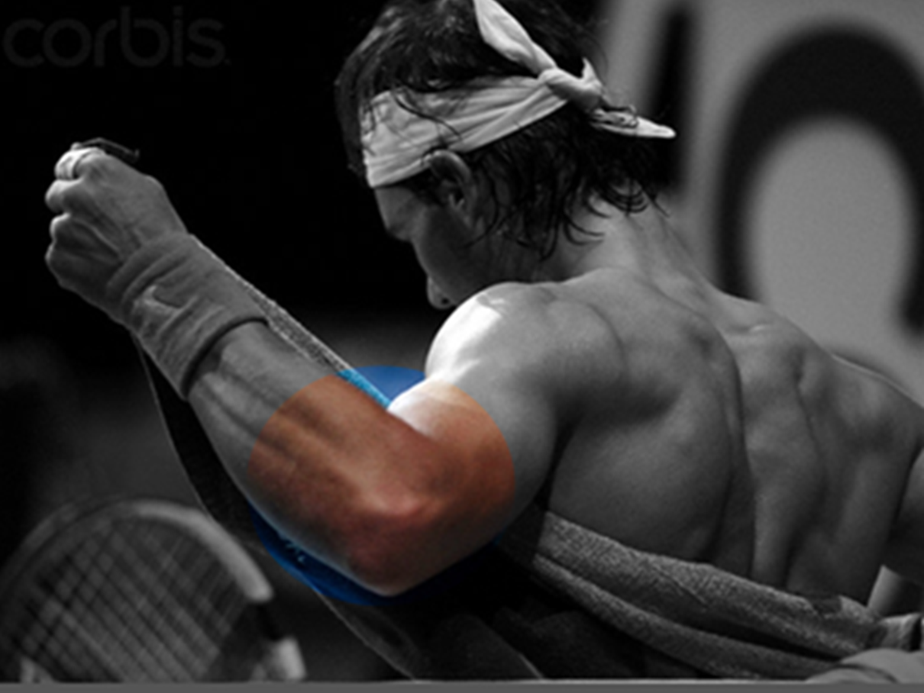
Not all lateral elbow pain is
Tennis elbow
Mr Lee Van Rensburg
September 2018
www.CambridgeElbow.co.uk

Slide 2
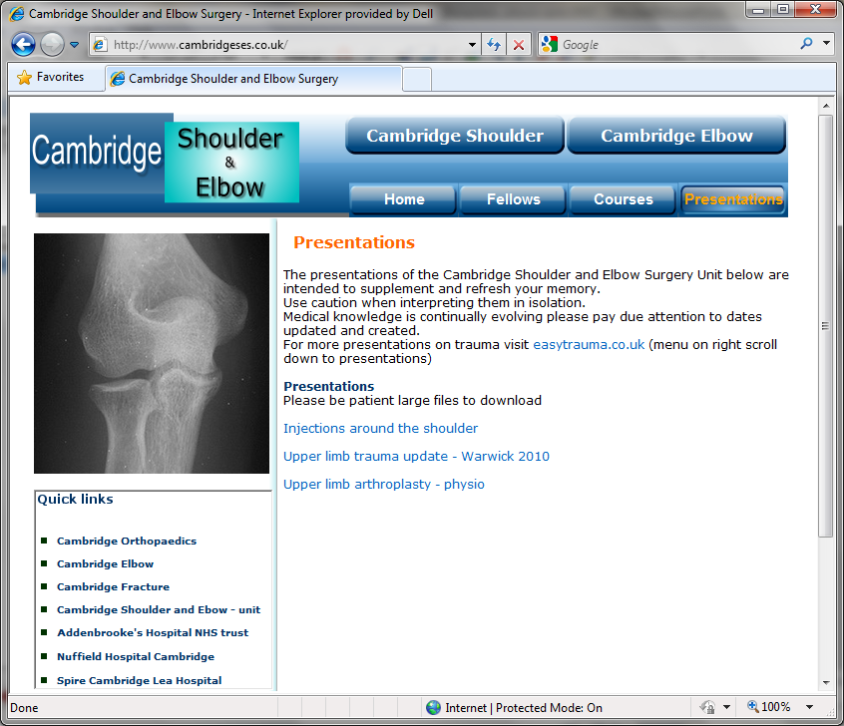
www.cambridgeses.co.uk

Slide 3
Pain
Lateral
Medial
Posterior
Anterior
General deep
Locking
Stiffnes
Loose bodies
Arthritis
PLRI
Post traumatic
Post surgical
Heterotopic ossification
Arthritis
Postero Lateral Rotatory Instability

Slide 4
Pain
Lateral
  “Lateral sided elbow pain” ≠ tennis elbow
Medial
  Medial epicondylitis
  Ulnar Neuritis
Posterior
  Hyperextension valgus overload
  Posteromedial impingement
Anterior
  Biceps pathology
General deep
  Arthritis

Slide 5
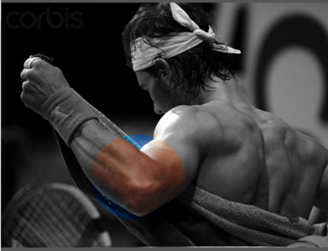

Lateral sided elbow pain
Lateral epicondylitis
Radial tunnel syndrome (PIN)
Cervical radiculopathy
Osteochondral radiocapitellar lesion
Posterolateral elbow plica
Posterolateral elbow instability
Volume 16, Number 1, January 2008

Slide 6
Lateral Epicondylitis (Tennis elbow)
Clinical
    Pain over the lateral aspect of the elbow
    Power grip, forced extension
    Point tender common extensor origin
    Stiffness unusual
Volume 16, Number 1, January 2008

Slide 7
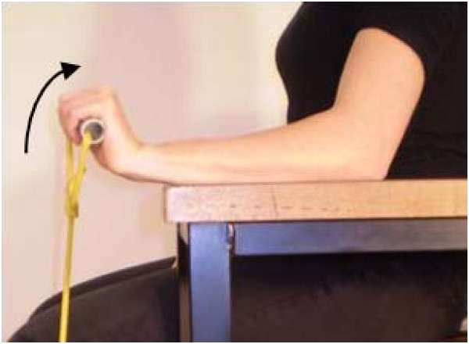
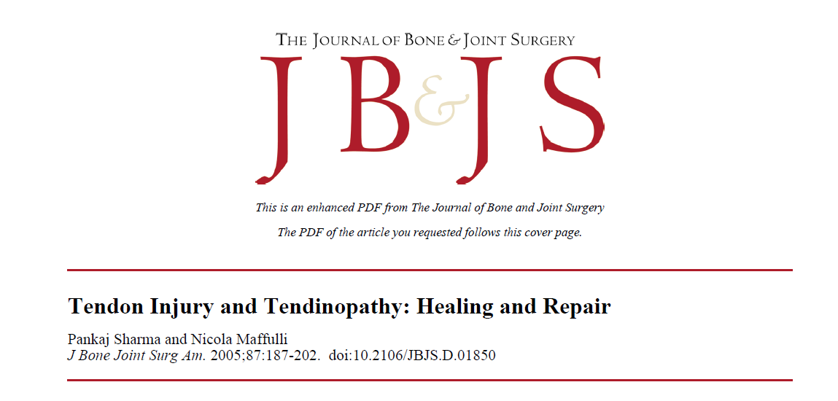
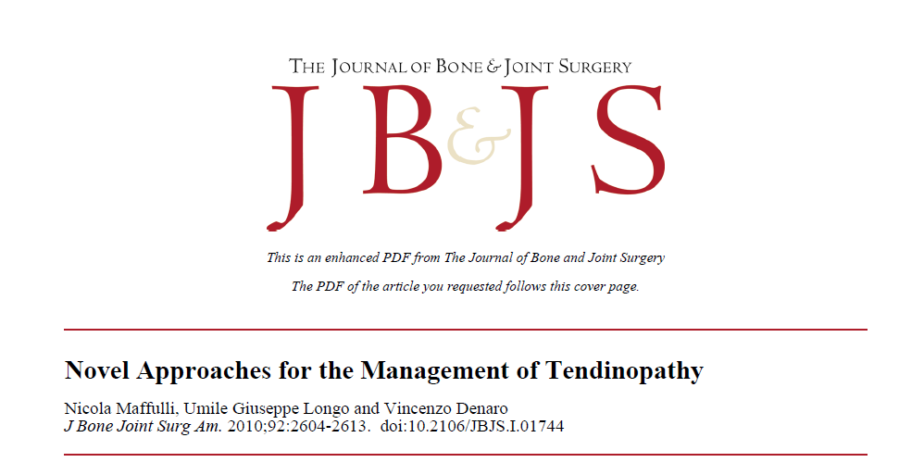
Tendinosis
Pathology
  Degenerative – NOT “itis”
  Tendinosis ECRB
J Bone Joint Surg Am. 2005;87:187-202

Slide 8
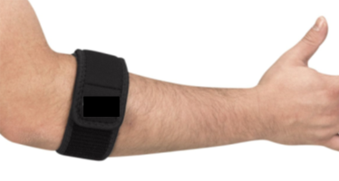
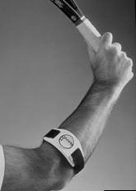
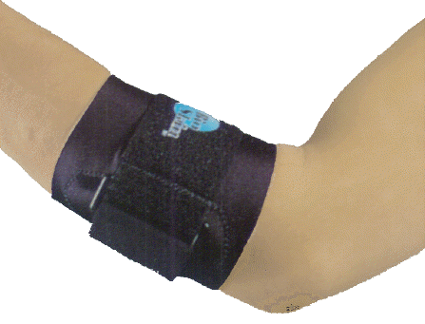
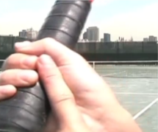
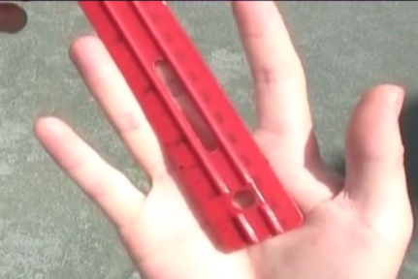
Lateral Epicondylitis
(Tennis elbow)
Treatment
    Non operative
      Relative rest
      Activity modification
      Counterforce bracing
      Physiotherapy
      Injection – What?
      ECSW ??????
    Operative
Volume 16, Number 1, January 2008

Slide 9
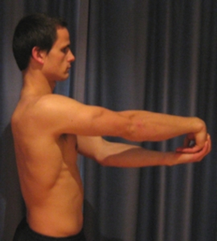
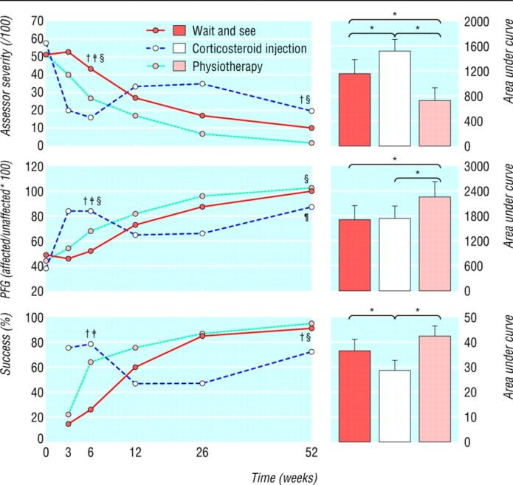



Lateral Epicondylitis
(Tennis elbow)
Physiotherapy
    Stretches
    Eccentric strengthening - lengthen
How do ecentric exercises work
Rheumatology (2008) 47 (10): 1444-1445
Bisset L, Beller E, Jull G, et al: Mobilisation with movement and exercise, corticosteroid injection, or wait and see for tennis elbow: Randomised trial.
BMJ; 2006;333:939

Slide 10
Lateral epicondylitis
Injections
  Local anaesthetic and steroid
  Hyaluronic acid
  Botox
  Blood
  Platelet rich plasma
  Mesenchymal Stem cells

Slide 11


Lateral epicondylitis
Injections
  Local anaesthetic and steroid
Bisset L, Beller E, Jull G, et al: Mobilisation with movement and exercise, corticosteroid injection, or wait and see for tennis elbow: Randomised trial.
BMJ; 2006;333:939

Slide 12

Lateral epicondylitis
Injections
  Local anaesthetic and steroid
Lindenhovius A, Henket M, Gilligan BP, Lozano-Calderon S, Jupiter JB, Ring D. Injection of dexamethasone versus placebo for lateral elbow pain: a prospective, double-blind, randomized clinical trial.
CONCLUSIONS:
Corticosteroid injection did not affect the apparently self-limited course of lateral elbow pain.
J Hand Surg Am. 2008 Jul-Aug;33(6):909-19.

Slide 13
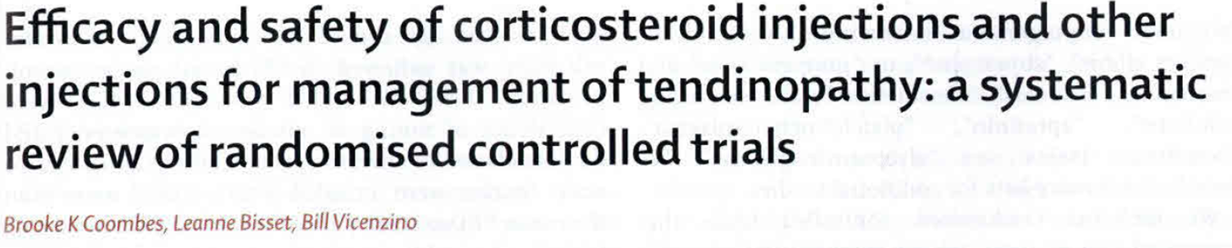
Short term benefit
Long term worse off
Lancet. 2010 Nov 20;376(9754):1751-67

Slide 14
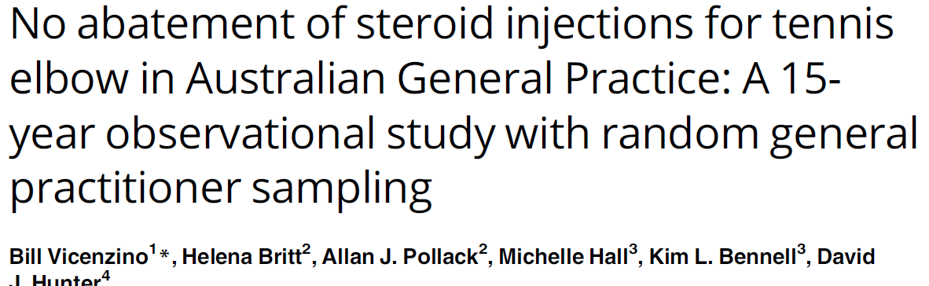
PLoS One. 2017 Jul 20;12(7):e0181631

Slide 15
Lateral epicondylitis
Injections
  Local anaesthetic and steroid
  Hyaluronic acid
  Botox

Slide 16
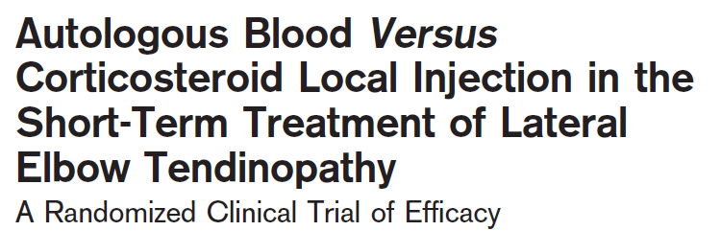
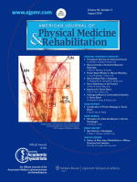
Lateral epicondylitis
Injections
  Local anaesthetic and steroid
  Hyaluronic acid
  Botox
  Blood
American Journal of Physical Medicine & Rehabilitation; Volume 89(8), August 2010, pp 660-667

Slide 17
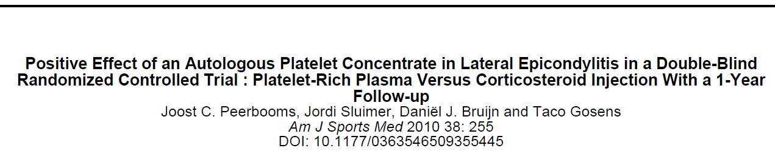

Lateral epicondylitis
Injections
  Local anaesthetic and steroid
  Hyaluronic acid
  Botox
  Blood
  Platelet rich plasma - PRP
Am J Sports Med 2010 38: 255

Slide 18
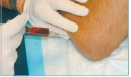
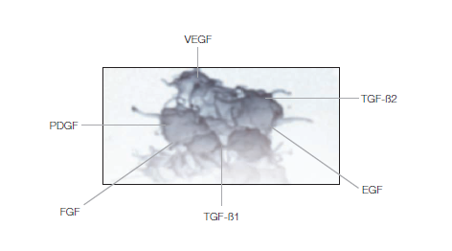
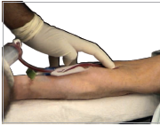
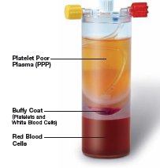
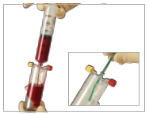
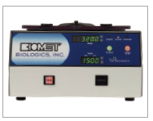
Lateral epicondylitis
Platelets
    VEGF – Vascular endothelial growth factor
    PDGF – Platelet derived growth factor
    FGF – Fibroblast growth factor
    TGF B – Transforming growth factor
    EGF – Epithelial growth factor

Slide 19
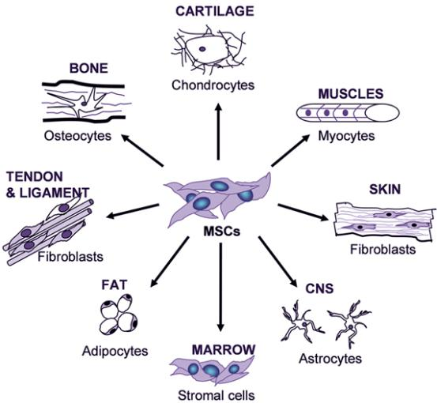
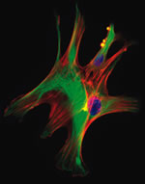
Lateral epicondylitis
Injections
  Local anaesthetic and steroid
  Hyaluronic acid
  Botox
  Blood
  Platelet rich plasma - PRP
  Mesenchymal Stem cells

Slide 20
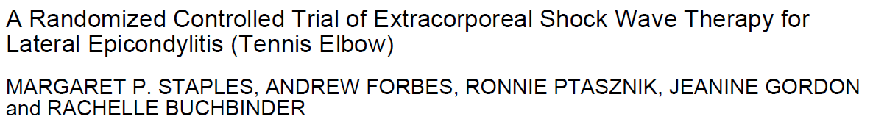
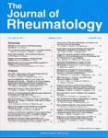
Lateral epicondylitis
ECSWL
J Rheumatol. 2008;35:2038-46.

Slide 21
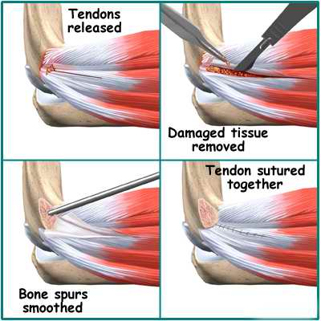

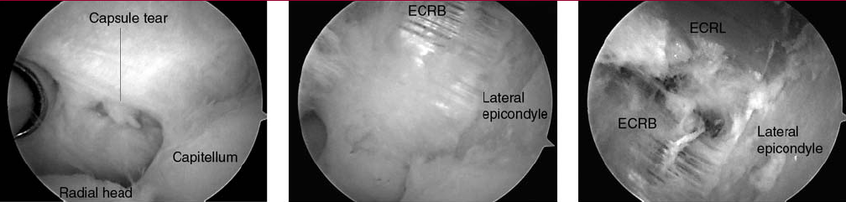
Operative Lateral epicondyle
Percutaneous
Open
Arthroscopic

Slide 22
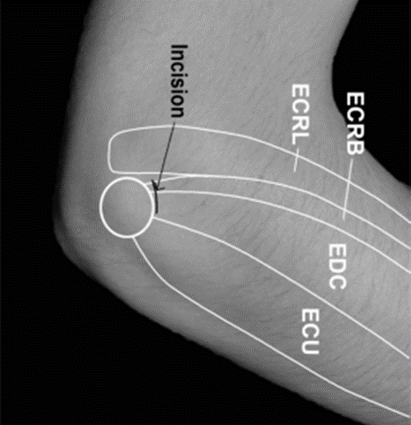
Prospective, randomised, controlled trial
Open Vs Percutaneous release
  n = 45 patients (47 elbows)
Significantly better improvement in percutaneous group
  Patient satisfaction
  Time to return to work
    average 3 weeks earlier
  DASH score
  Sporting activities
Quicker and simpler
J Bone Joint Surg [Br] 2004;86-B:701-4.

Slide 23
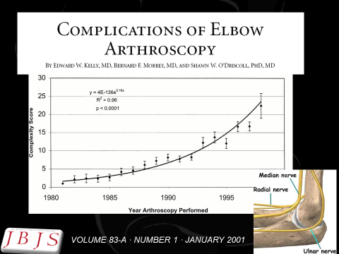
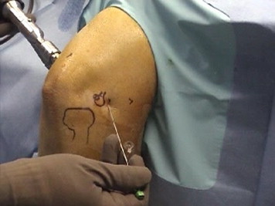
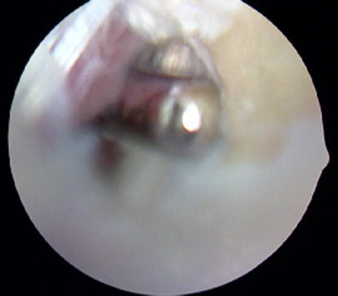
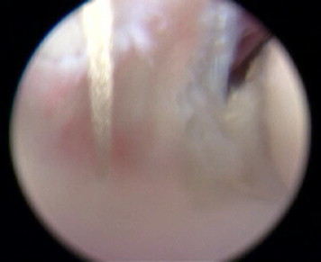
Proximal anteromedial viewing portal
Tennis elbow lateral portal
    (site of percutaneous release)
Debride ERCB
Decorticate lat epicondyle
Repair ERCB
J Shoulder Elbow Surg (2010) 19, 31-36

Slide 24
Lateral epicondylitis
What I say/ do –
  No magic bullet – Non operative 6 months
  Physiotherapy
      5 – 10 minutes won’t do TENDINOSIS
  Use counter force brace
  Reassure – Hurts no long term harm
  Injection
        No steroids
        Try PRP (£)
  Percutaneous release ( x - ray/ MRI - a scope)
  www.cambridgeelbow.co.uk
    Patient information

Slide 25
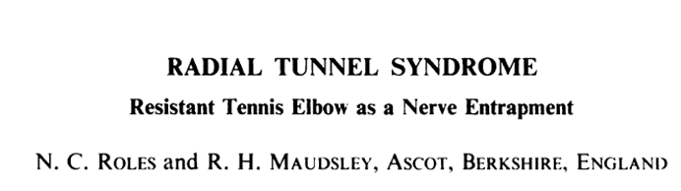
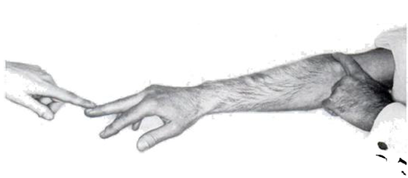
Most start classic Tennis elbow
Associated with activities of repeated pronation and supination
Tenderness 3 - 4 cm distal and anterior
Middle finger tightens fascial origin of ERCB pinches PIN
Occ Sensory – superficial radial nerve
Slight loss extension
EMG’s not much use
JBJS-B VOL. 54, NO. 3, AUGUST 1972

Slide 26
JBJS-B VOL. 54, NO. 3, AUGUST 1972

Slide 27
Passive pronation ERCB indents PIN

Slide 28
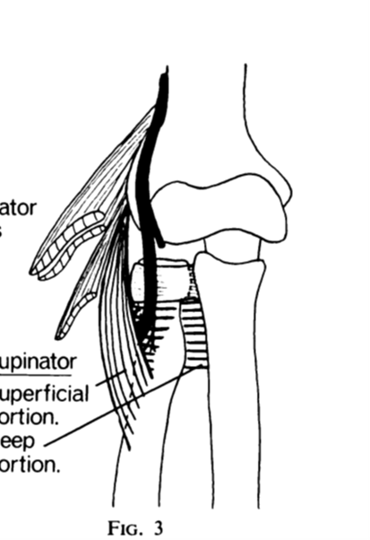
Arcade of Frohse fibrous band beginning of Superficial portion of supinator

Slide 29
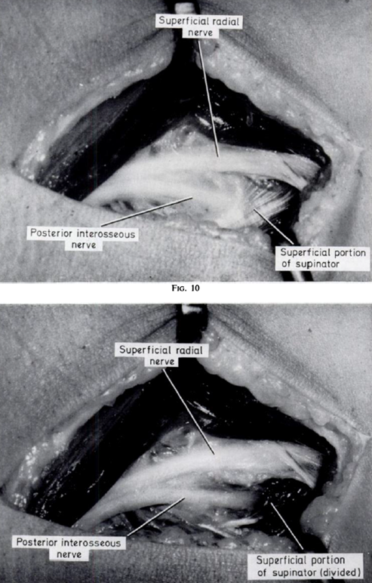
Radial tunnel
Treatment
Release ERCB
Release supinator

Slide 30
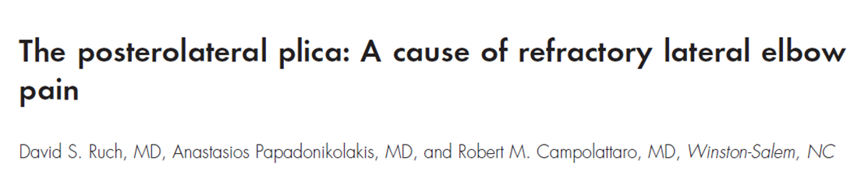
Painful snapping on flexion and pronation
Vague laterally based pain
Worse with flexion and extension
J Shoulder Elbow Surg 2006;15: 367-370

Slide 31
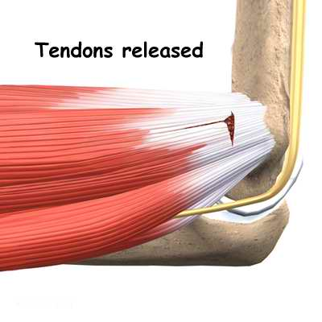
Medial epicondylitis
(Golfer’s elbow)
Clinical
    Pain over medial aspect of the elbow
    Ulnar nerve symptoms
Treatment
    Non operative
    Surgical release

Slide 32
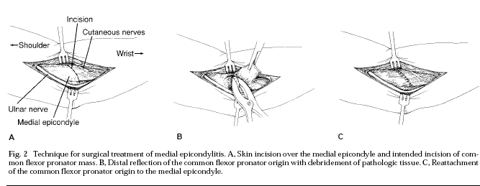
Medial epicondylitis
(Golfer’s elbow)
Surgery
    Subluxing ulna nerve
J Am Acad Orthop Surg 1994;2:1-8

Slide 33
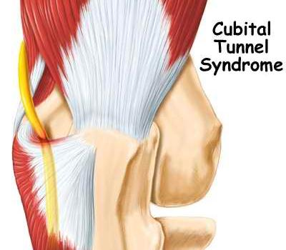
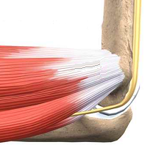
Ulnar nerve compression
(Cubital tunnel)
History
  Numbness, weakness, clumsiness
Examination
  Sensory
  Motor
  Tenderness, Tinel sign positive, wasting
Treatment
  Conservative
    nightsplints
  Surgical release
Volume 15, Number 11, November 2007

Slide 34
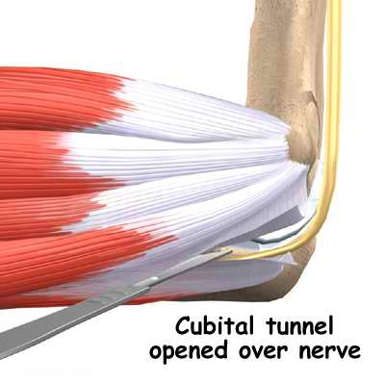
Ulnar nerve surgery
Decompression,
Medial epicondylectomy
Anterior transposition
    Subcutaneous
    Intramuscular
    Submuscular
Endoscopic decompression

Slide 35
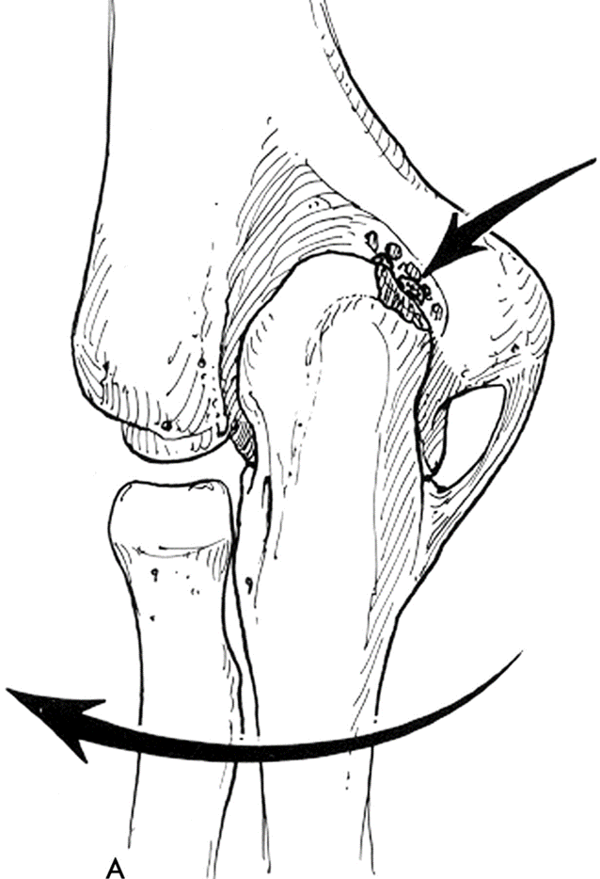
Hyperextension valgus overload
Laxity/ continued stress on MCL
Olecranon mal-tracks
    Posteromedial impingement
Treatment
  Re training
    Strengthen flexor pronator muscle mass
  Athroscopic debridement posteromedial corner
  Reconstruct MCL

Slide 36
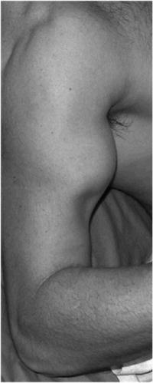
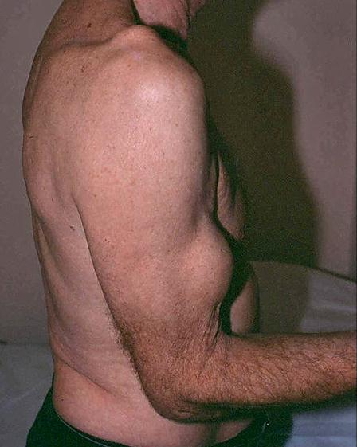
48 YO fireman lifting car


Slide 37
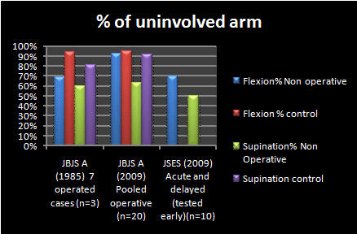
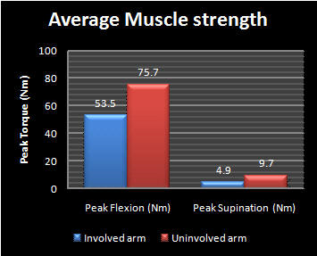

Distal biceps rupture
Increasingly recognized
Operative
Non operative
  Reasonable Viz Brachialis
    Lose
      15-30 % flexion strength
      30-50% Supination
        Fatiguability

Slide 38
Distal biceps

Radiographs:
    Often normal
    May show irregularity or bony avulsion
MRI, U/S:
    Indicated if Dx in doubt
    Partial tear
    Delayed presentation
    Intact lacertus fibrosus

Slide 39







Acutely < 3 weeks
Chronic/ Delayed

Slide 40




Rupture bifurcated distal biceps tendon
Separate musculotendinous junctions
Sassmannshausen G. et.al. J Bone Joint Surg 2004:86:2737-2740

Slide 41
Arthritic conditions
Rheumatoid Arthritis
Osteoarthritis
Crystal arthropathies
  Gout
  Pseudogout

Slide 42

Osteoarthritis
Primary / secondary
Pain
  forced extension e.g. carrying objects
Stiffness, locking, effusion
Treatment
  Conservative
  Surgical
    Removal of loose bodies
    Debridement
    Joint replacement (Arthroplasty)

Slide 43
Rheumatoid Arthritis
Constant ache, worse on lifting objects, elbow gives way
Synovial thickening, bone erosion
Treatment
  Conservative
  Surgical => synovectomy elbow replacement

Slide 44


Rheumatoid Arthritis

Slide 45


Slide 46

Numbers
10 Total elbows per year
30 Shoulder arthroplasties per year
About 5 hips per day ADH
USA Medicare 2003
    6,700 shoulder joints
    106,887 hip replacements
    199,195 total knee replacements

Slide 47






Slide 48

Unlinked Vs Sloppy hinge
5 yrs
30°
13%
Little et al. J Bone Joint Surg; Br.2005; 87-B: 437-444

Slide 49
Sloppy Hinge - 5 yrs
11% revision rate
Improved ROM 35°
82% good to excellent results
Little et al. J Bone Joint Surg; Br.2005; 87-B: 437-444

Slide 50
TER Complications
Overall 30%
  Infection 5%
  Wound healing 10%
  Triceps detachment 3%
  Ulna nerve palsy 5% (permanent)
  Disassembly (linked) 1-6%
  Dislocation (unlinked) 5%, instability 14%
  Loosening 9%
Little et al. J Bone Joint Surg; Br.2005; 87-B: 437-444

Slide 51



Loose bodies/ osteochondritis
Loose bodies alone
Osteochondritis
    Young athlete
    Little leaguers elbow
Arthroscopy
    Very satisfying loose bodies
    Osteochondritis
      Debridement
      Micro fracture

Slide 52









J Bone Joint Surg Am, 2000 May 01;82(5):724-724

Slide 53



Slide 54

Questions

