Slide 1
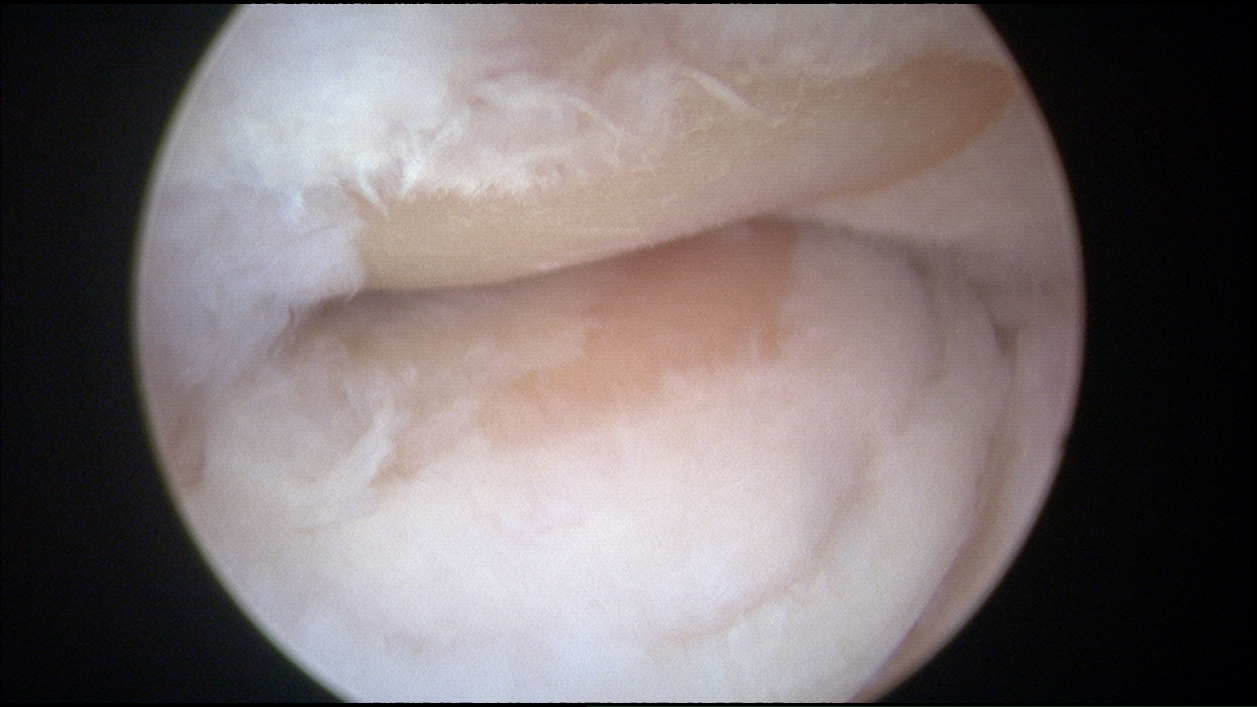
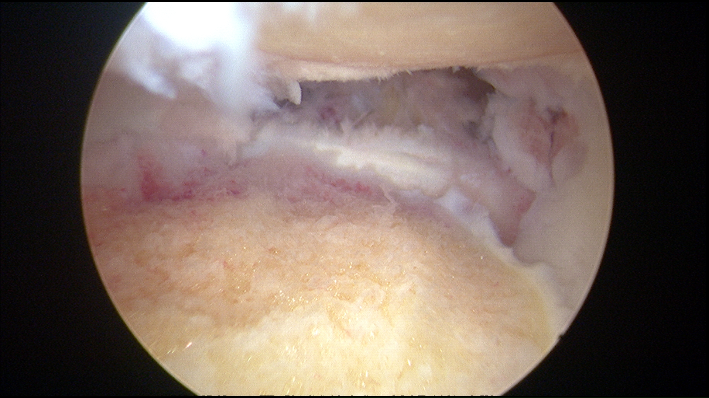
Elbow arthroscopic radial head excision
Mr Lee Van Rensburg
Jun 2018

Slide 2
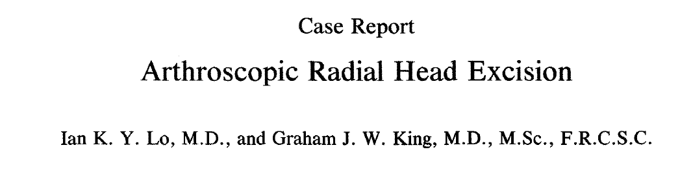
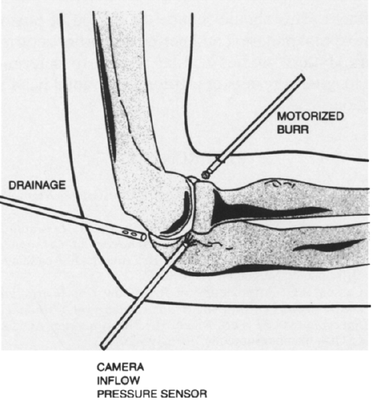
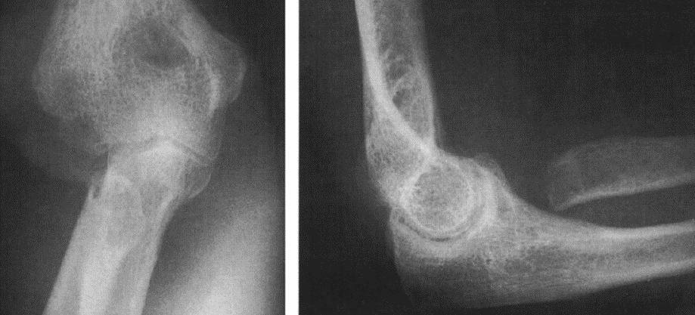
FIG. 3. Diagrammatic representation of arthroscopic radial head excision. A 5.5-mm motorized burr is introduced through the anterolateral portal under arthroscopic visualization through the mid-lateral portal. The radial head is resected piecemeal.
Prone
Arthroscopy, Vol. 10, No. 6, 1994

Slide 3
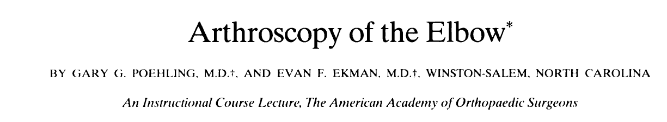
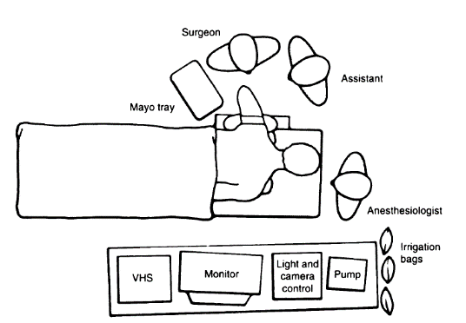
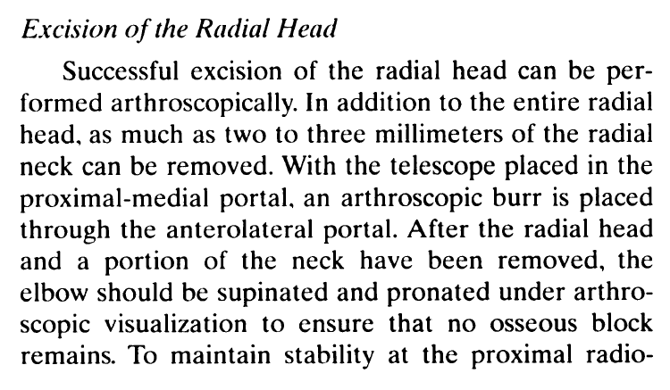
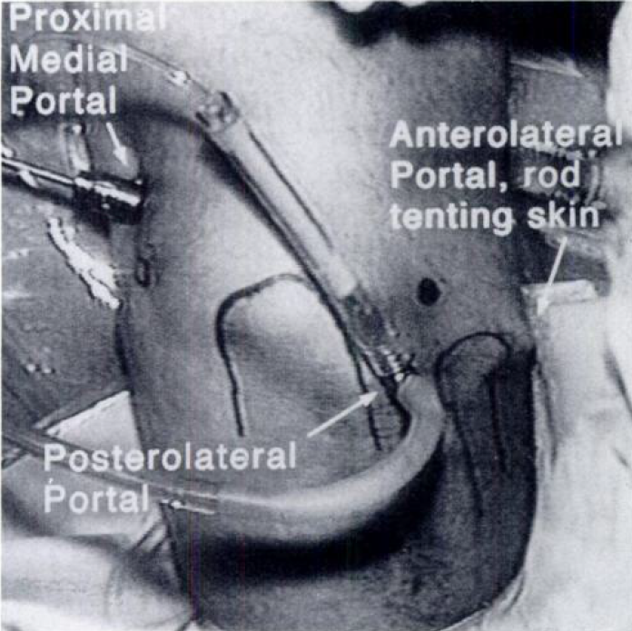
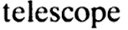

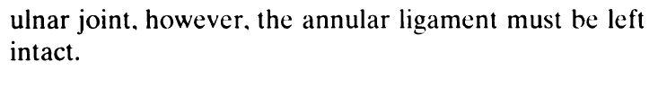
VOL. 76-A. NO. 8. AUGUST 1994

Slide 4
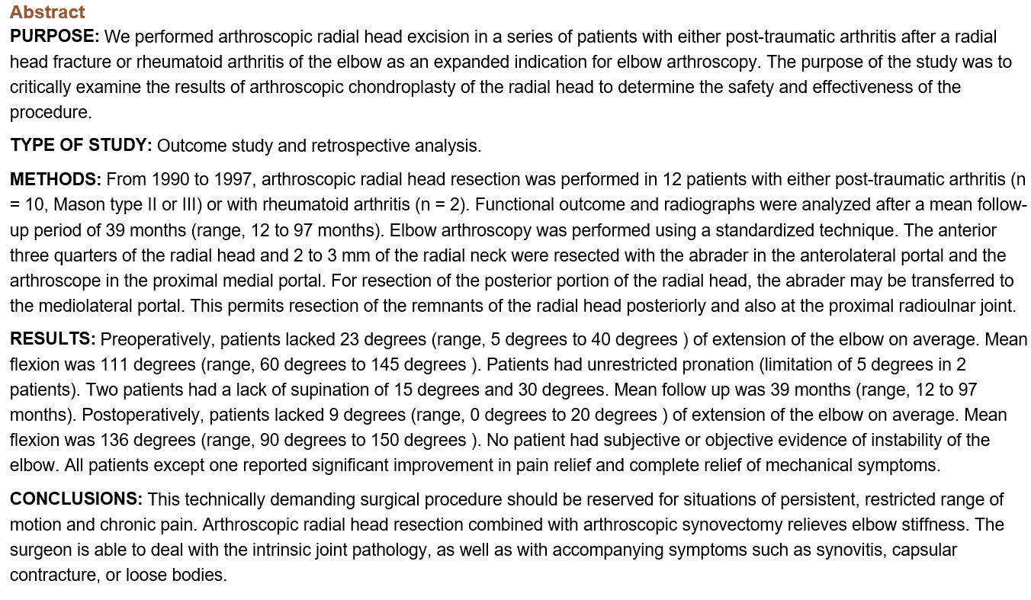

Viewing proximal medial portal
Anterior ¾ of head resected from anterolateral portal
Posterior ¼ then resected from mediolateral portal
Arthroscopy. 2001 Nov-Dec;17(9):918-23

Slide 5
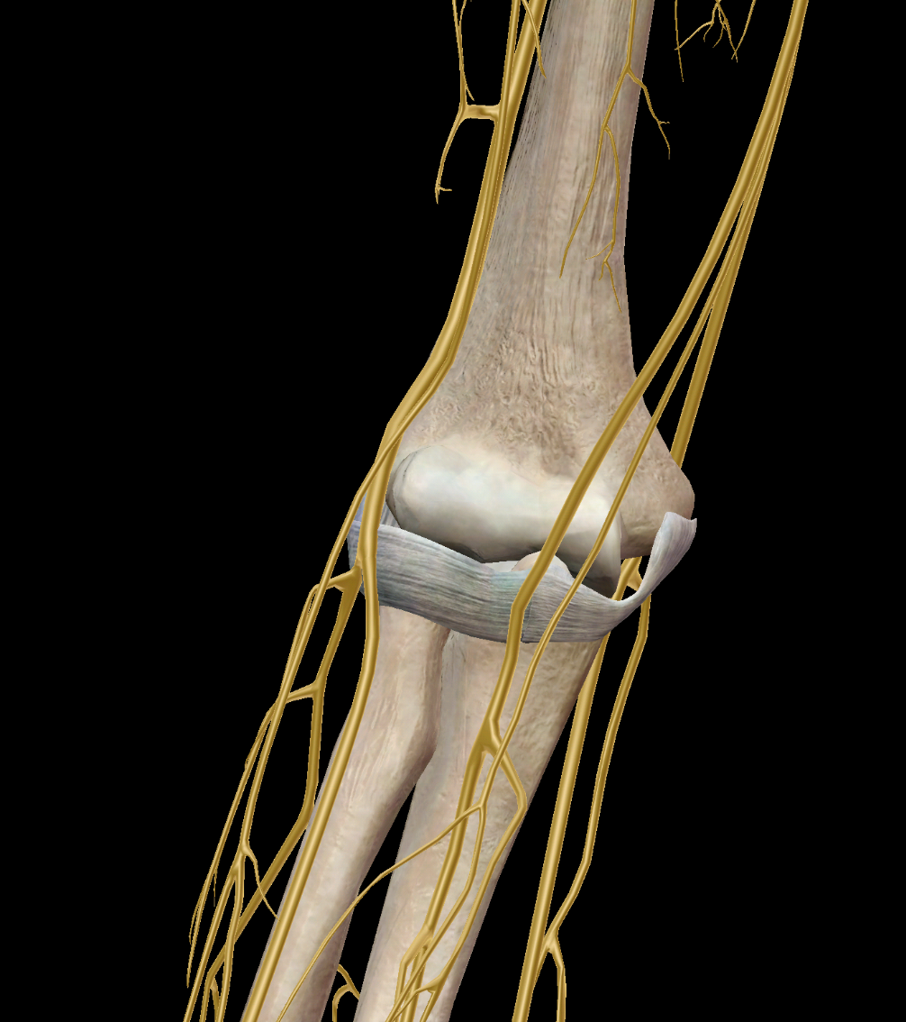
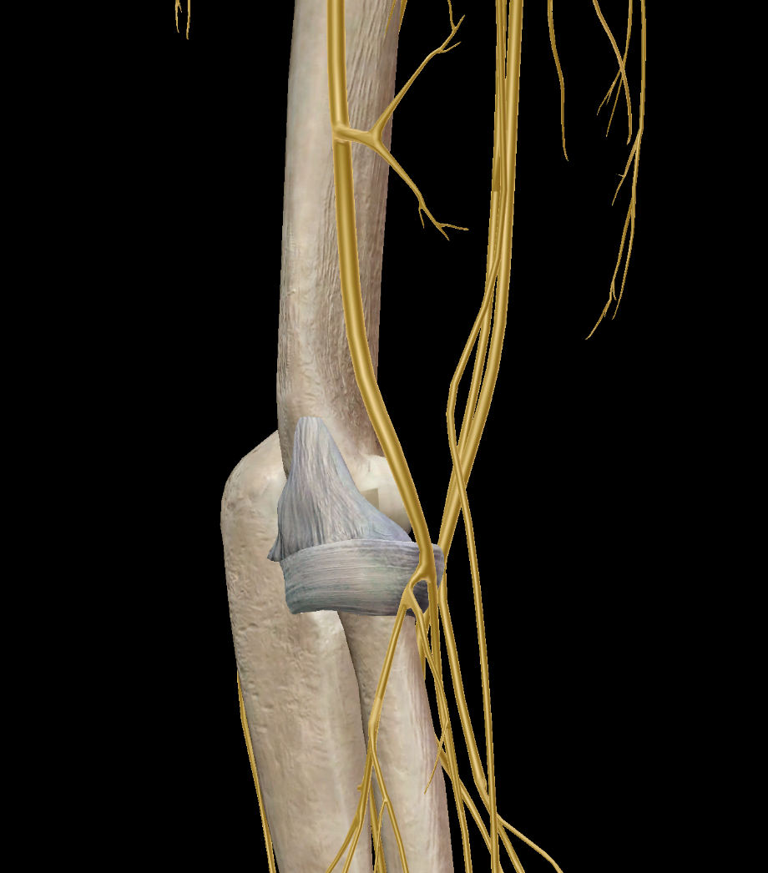
Anterolateral portal

Slide 6
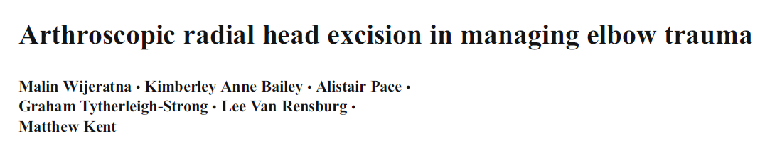
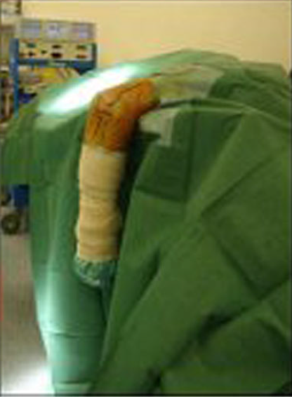
International Orthopaedics (SICOT) (2012) 36:2507–2512

Slide 7

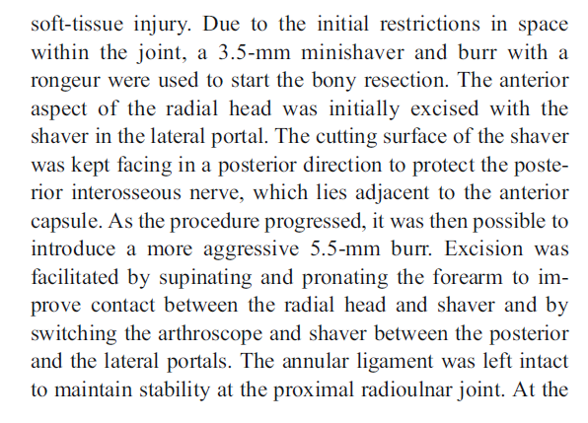
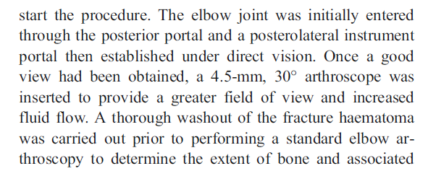
International Orthopaedics (SICOT) (2012) 36:2507–2512

Slide 8
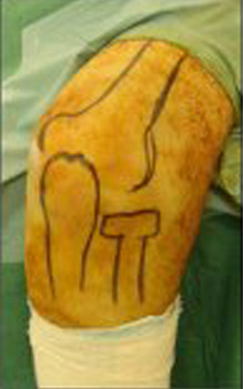
International Orthopaedics (SICOT) (2012) 36:2507–2512

Slide 9
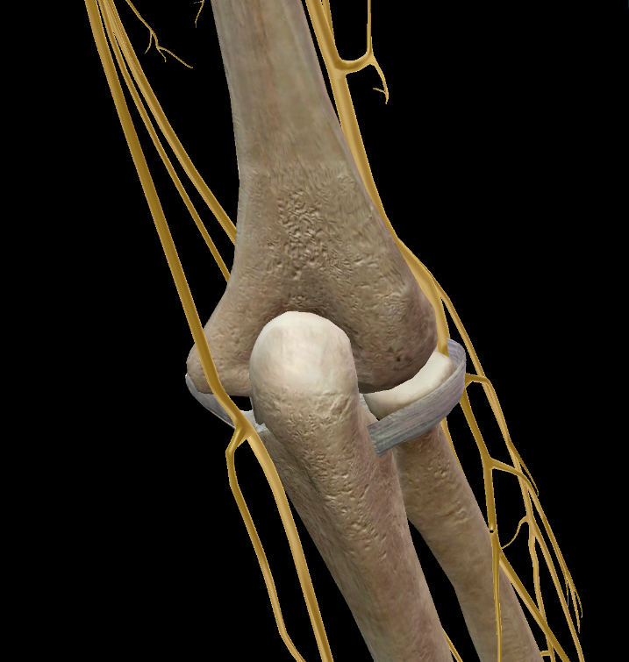
International Orthopaedics (SICOT) (2012) 36:2507–2512

Slide 11
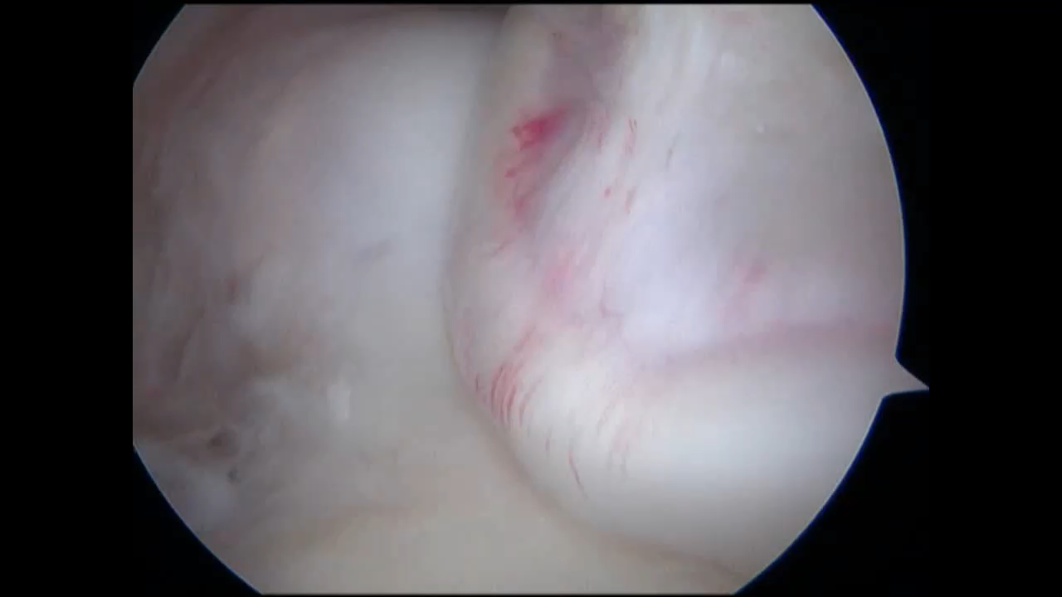

Slide 13
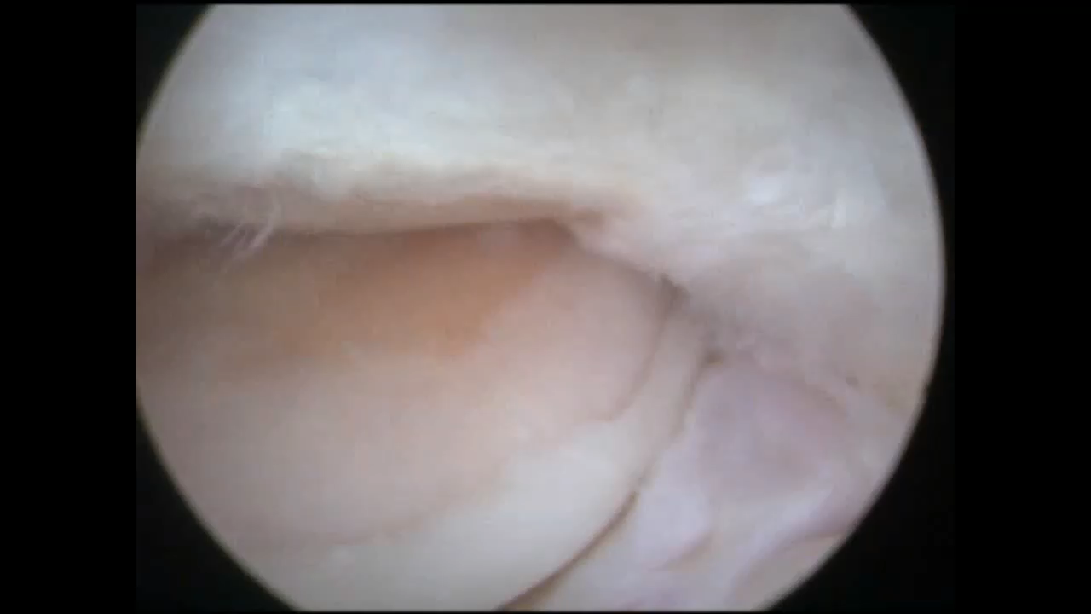

Slide 14
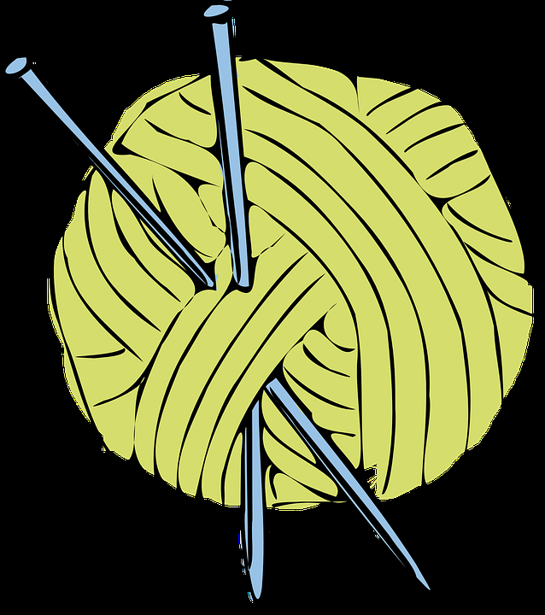
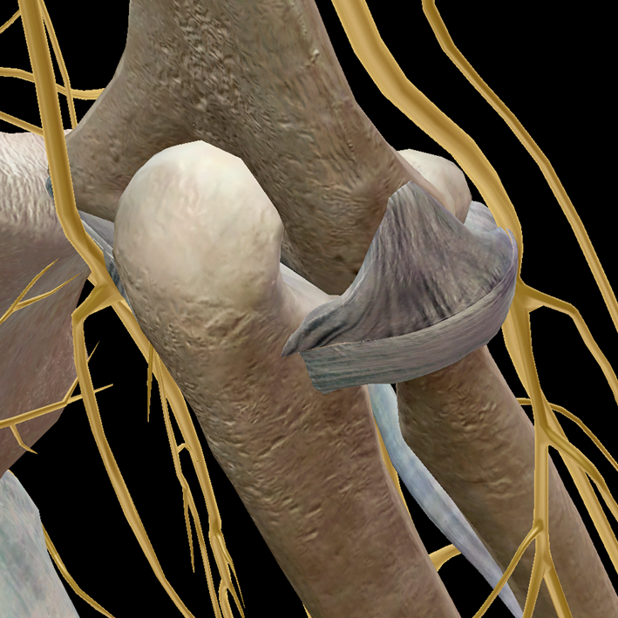
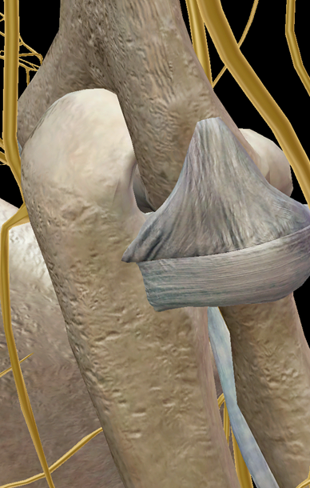

Slide 15
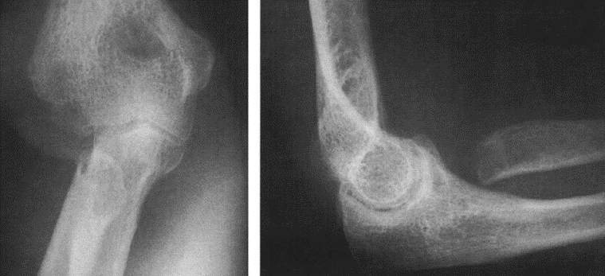
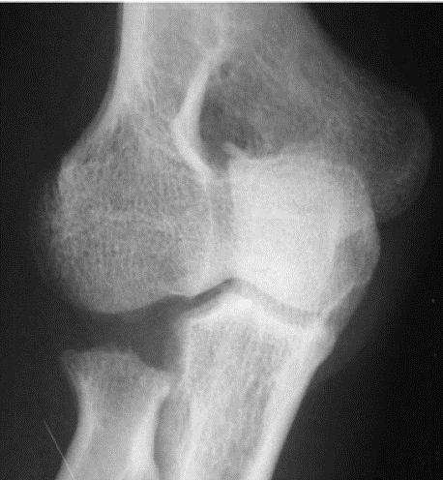

Slide 16

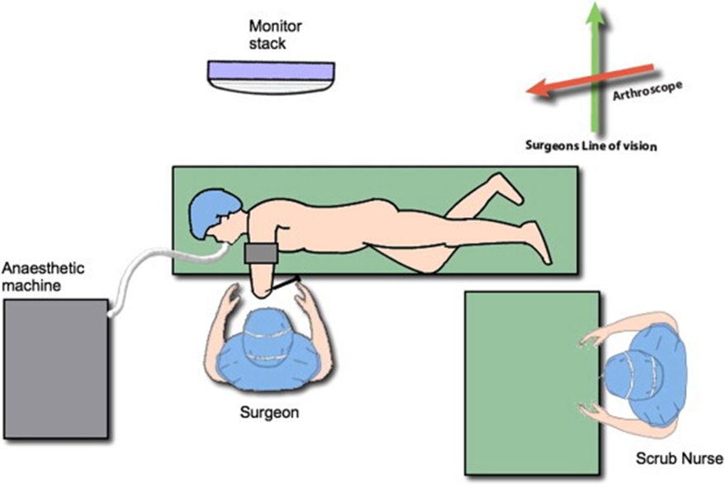
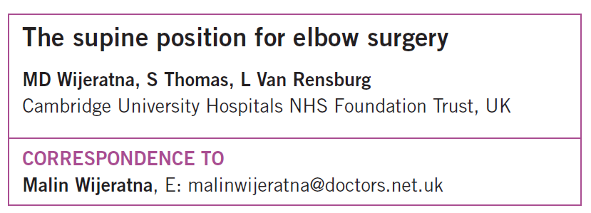

Slide 17
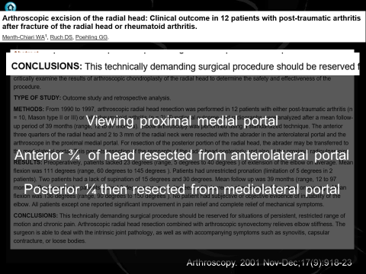
Personal
Standard shoulder scope side ported
  High flow
  5.5 mm stonecutter
FMS reduce to 30, tourniquet haemostasis, let fluid flow
No stockinette on forearm
1 temporary median nerve (2 hrs) anterior excision

Slide 18
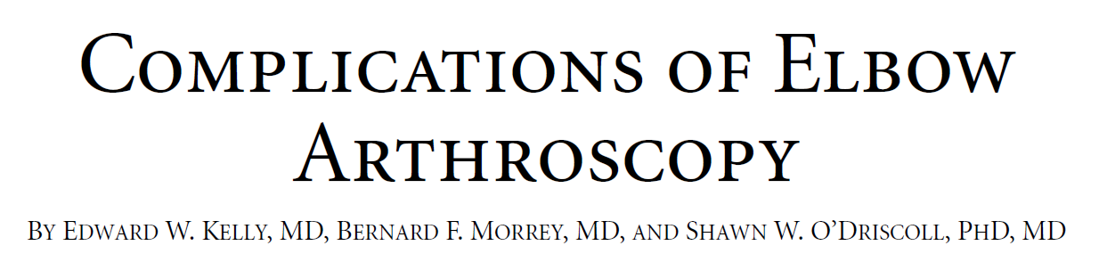
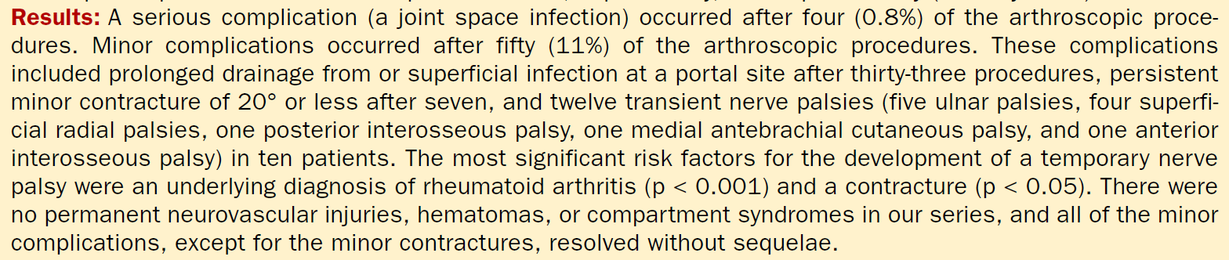
Minor complications 11%
  Prolonged drainage/ superficial infection 33 cases
  Lateral portal site
J Bone Joint Surg Am, 2001 Jan; 83 (1): 25 -25

Slide 19
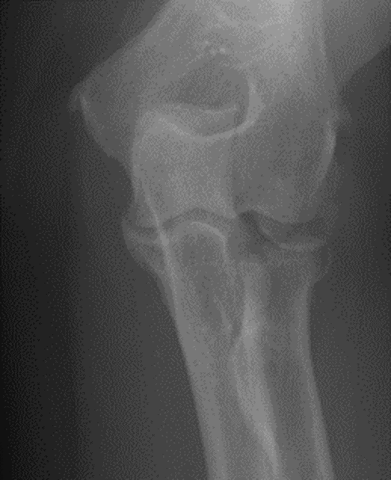
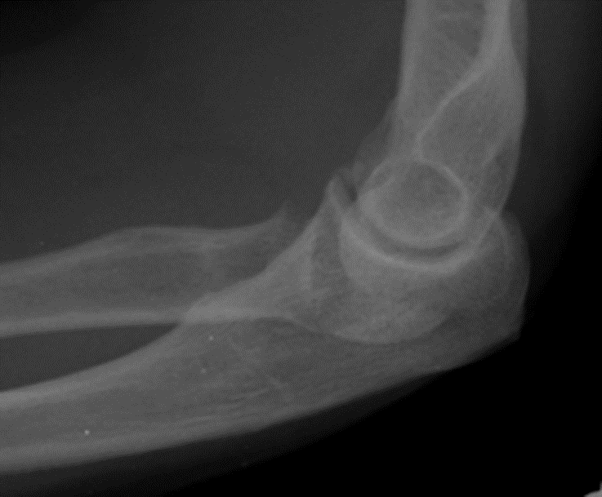
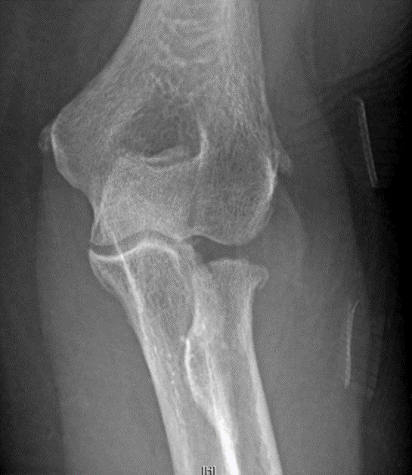
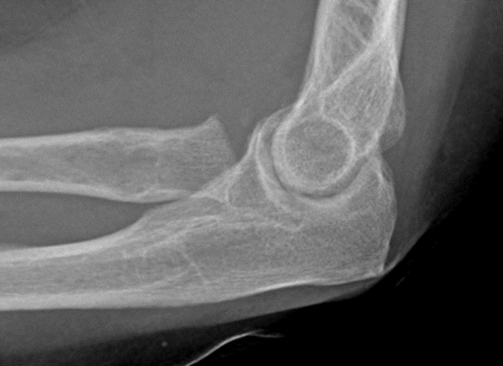
Questions ?

