Slide 1
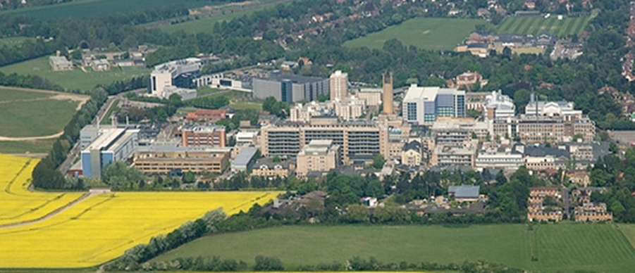


Elbow Instability
Overview
Mr Lee Van Rensburg
Cambridge University Hospitals NHS trust
2018

Slide 2
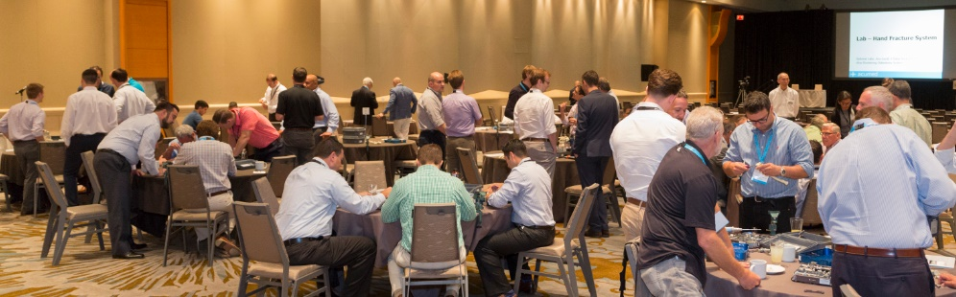
Educational Content
“The surgeon delivering this presentation is not an employee of Acumed or any of its affiliates. The views, opinions and commentary expressed in this presentation are solely those of the surgeon, and do not represent or reflect the views, opinions, policies or positions of Acumed. Acumed organized this presentation given by a surgeon for training, educational and informational purposes for other surgeons and sales representatives. Neither this presentation nor anything in it shall form the basis of any contract or commitment.”

Slide 3
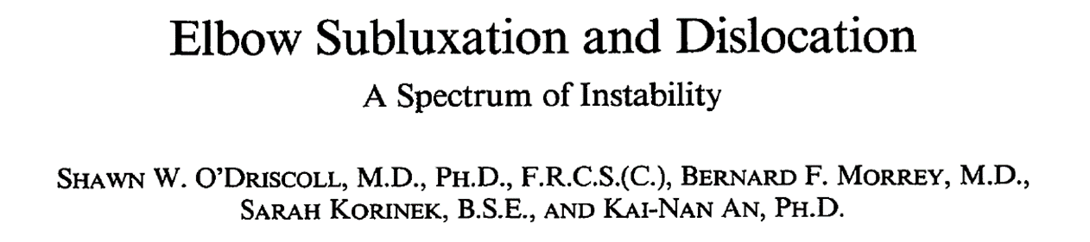
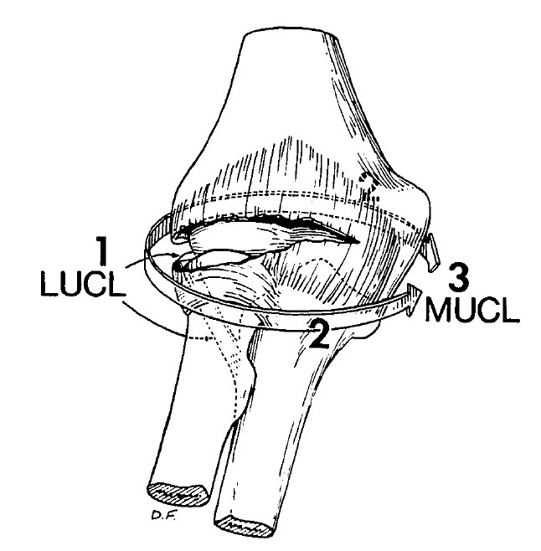
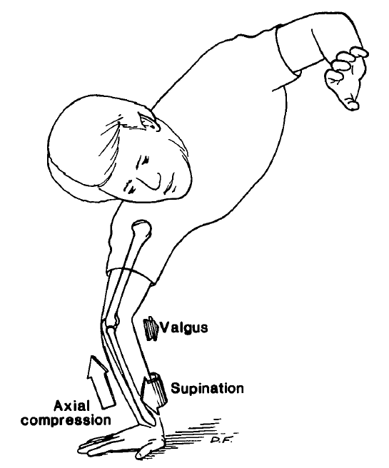
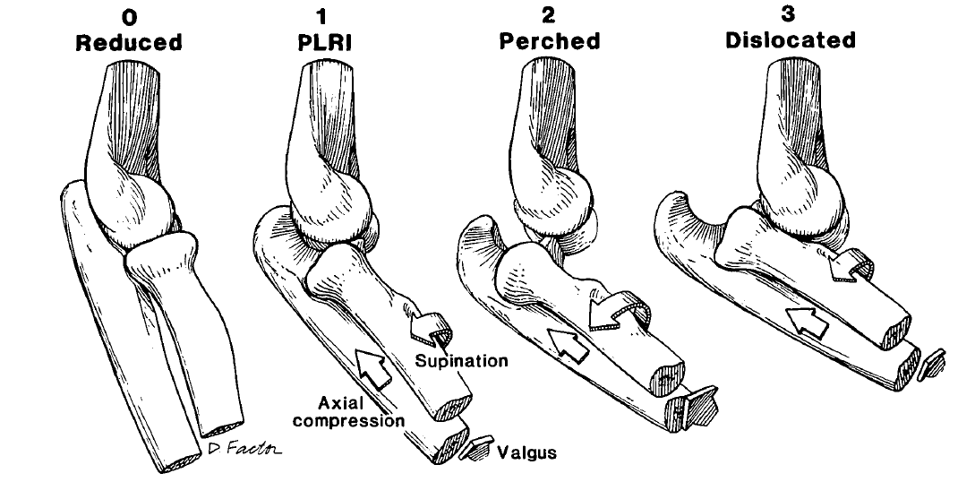
Clin Orthop Relat Res. 1992 Jul;(280):186-97

Slide 4
Dsipclaimer
Consultancy work for Acumed
No royalties
No affiliations

Slide 5
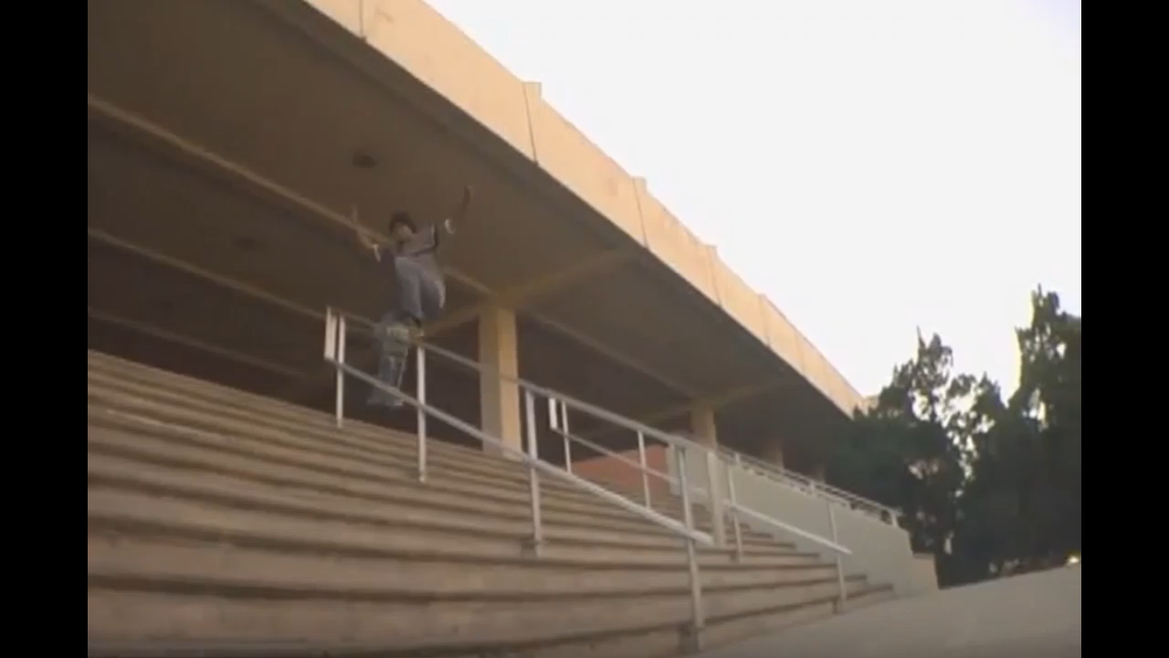

Slide 6
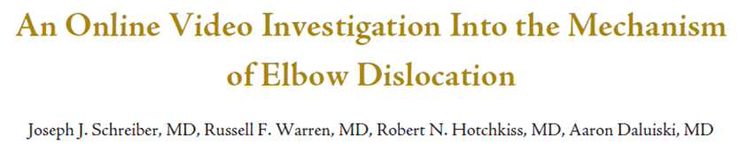
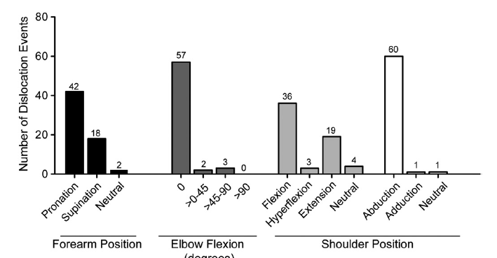
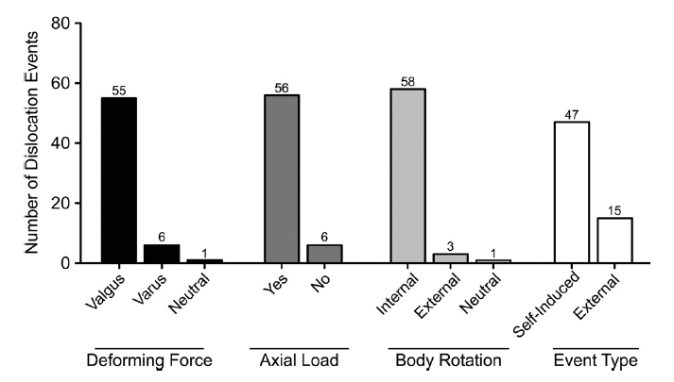
J Hand Surg 2013;38A:488–494.

Slide 7
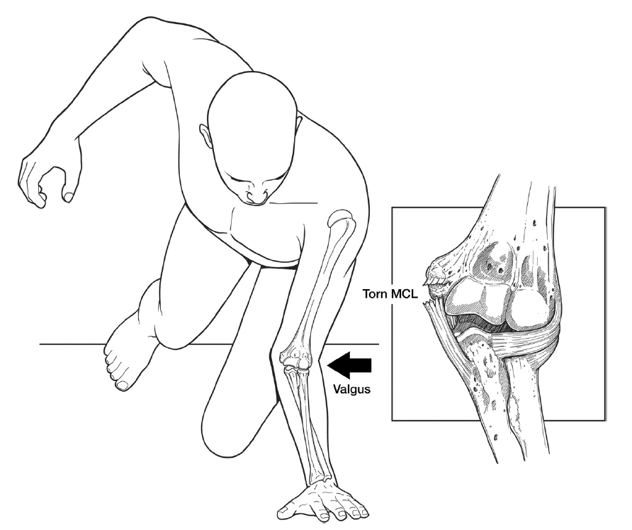
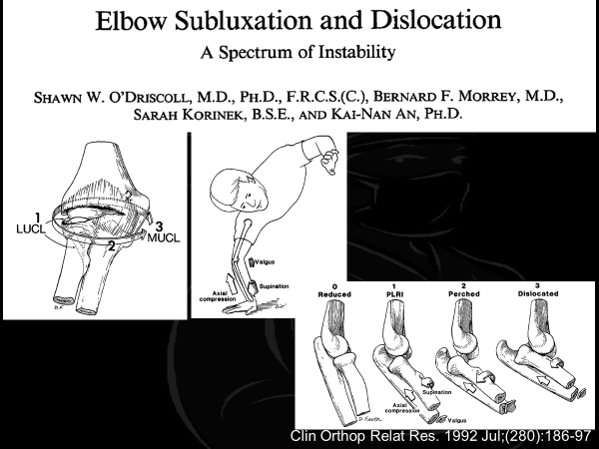
J Hand Surg 2013;38A:488–494.

Slide 8
MRI 16 elbow dislocations
Complete ligamentous tears were more common on the medial versus the lateral side
Lateral ligaments occasionally preserved
J Hand Surg Am. 2014 Feb;39(2):199-205

Slide 9
Unstable Elbow
Simple
  No Bony injury
  Stable within 30 degrees of extension
Complex
  Bony Injury
  Not stable within 30 degrees of extension

Slide 10

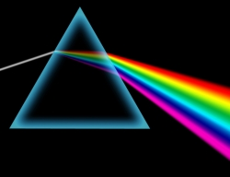
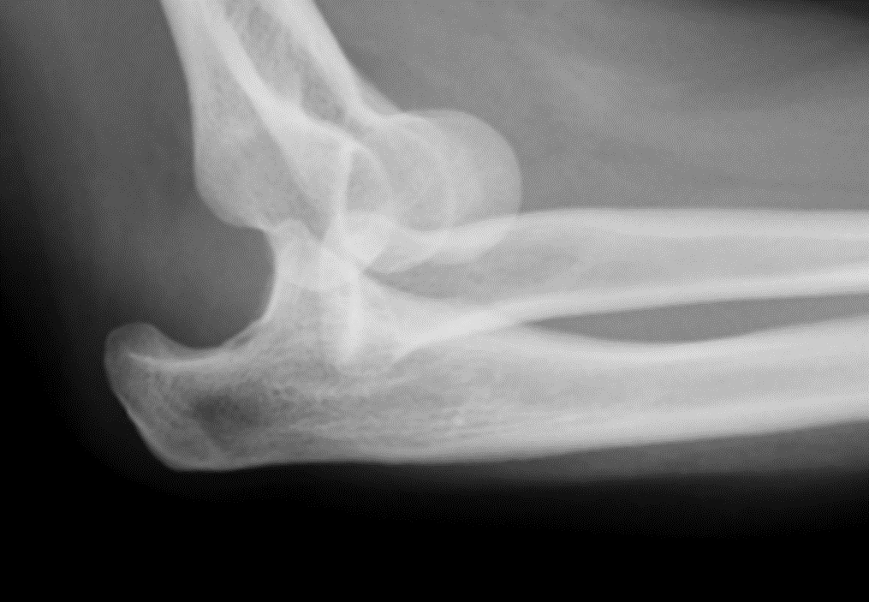
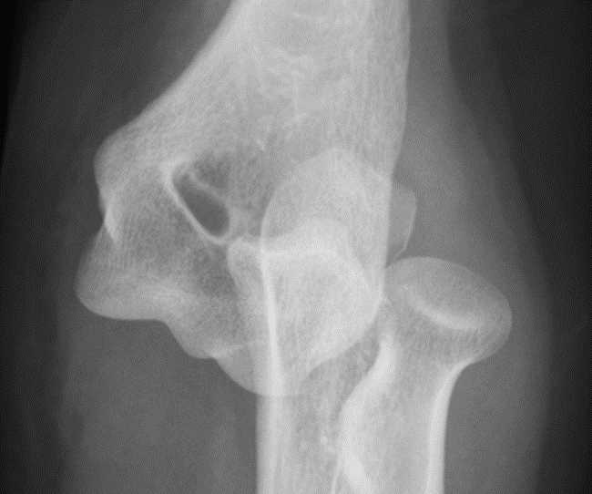
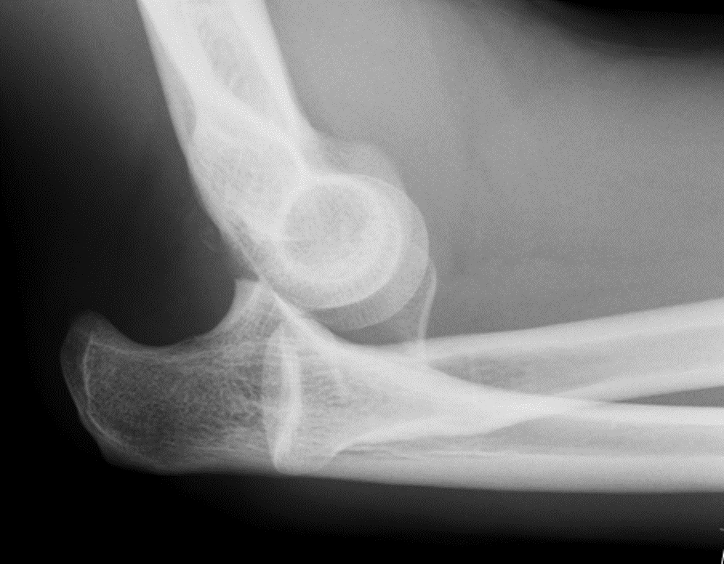
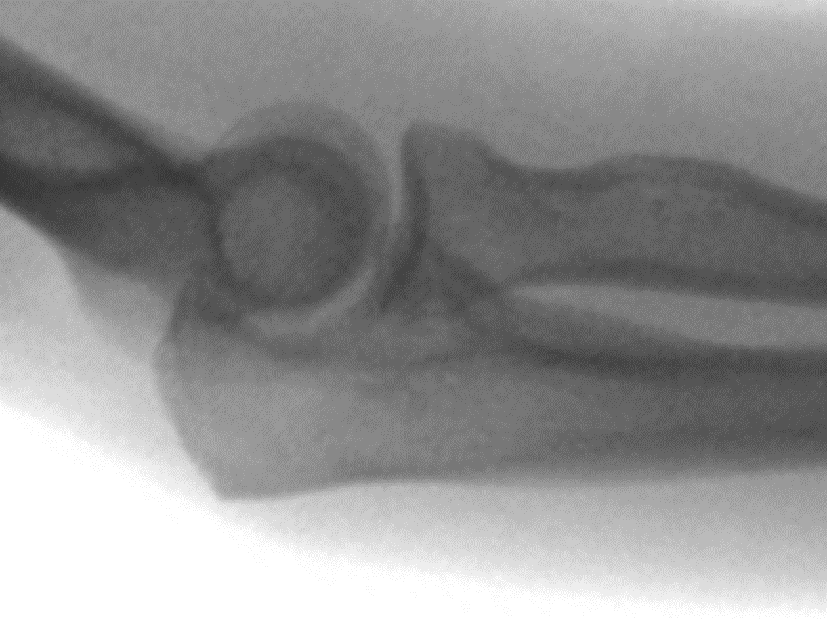
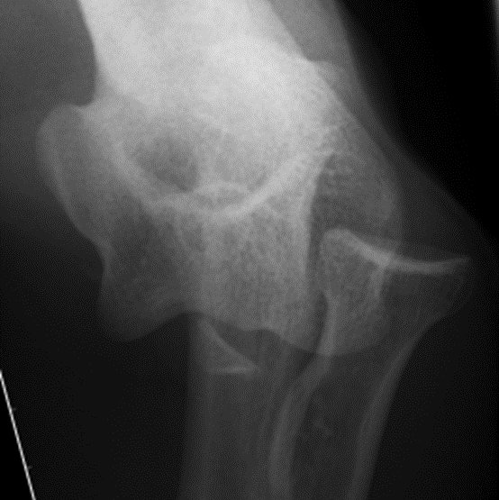
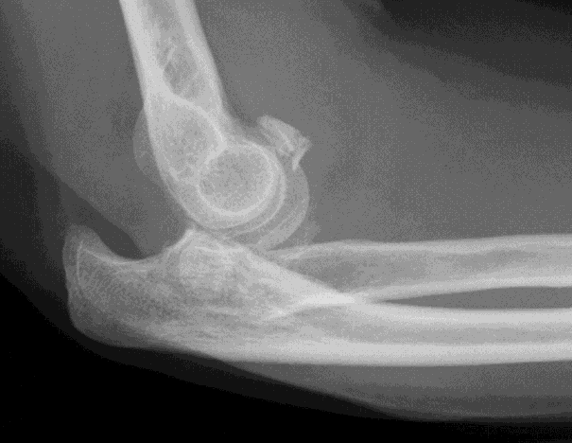
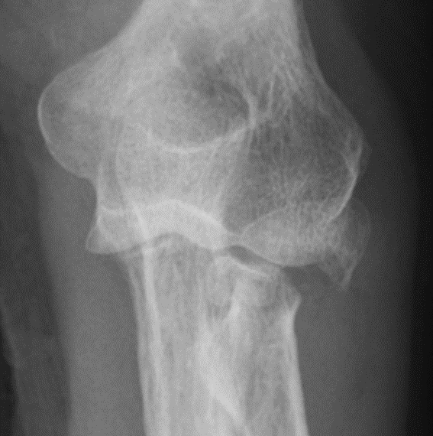

Slide 11
Management
Simple dislocation
  Assess stability
  Think of medial injury
  Get it moving
Complex dislocation
  Turn complex into simple
  Get it moving

Slide 12
Asses stability
Is this truly a simple dislocation or is it a complex dislocation
Is this elbow stable to within 30 degrees of extension ?

Slide 13
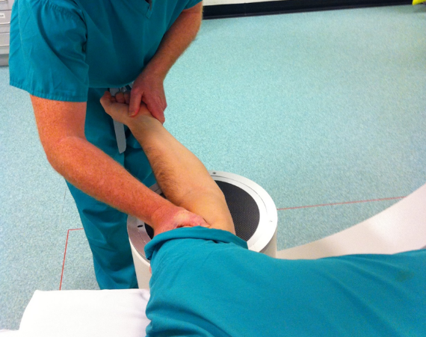
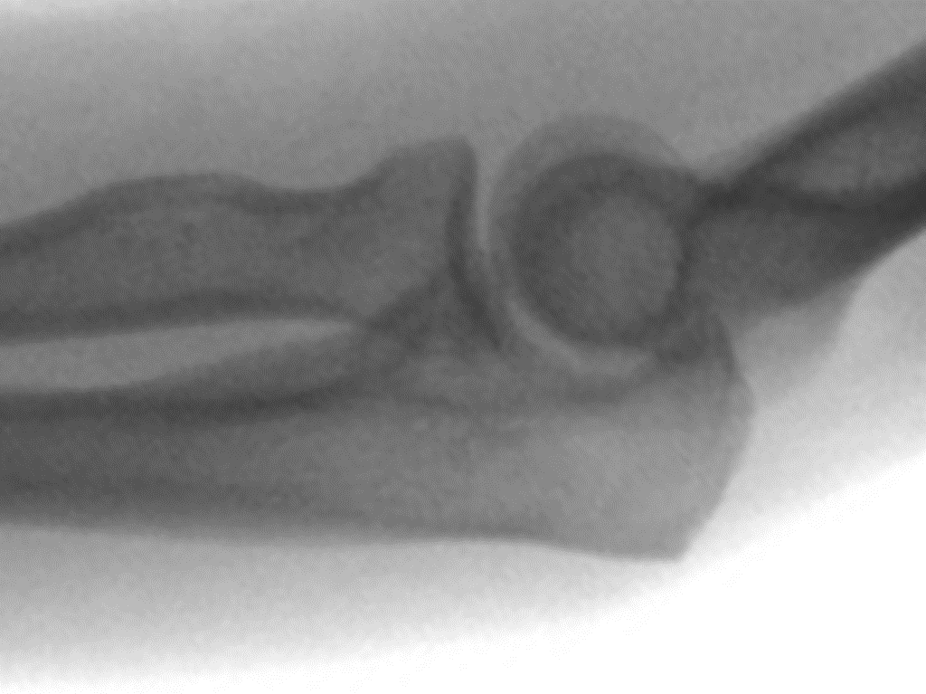
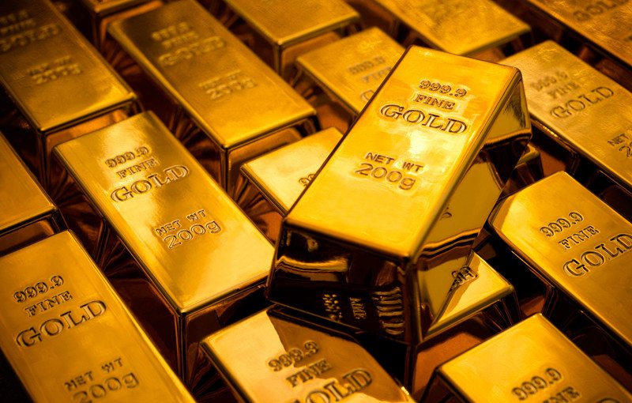
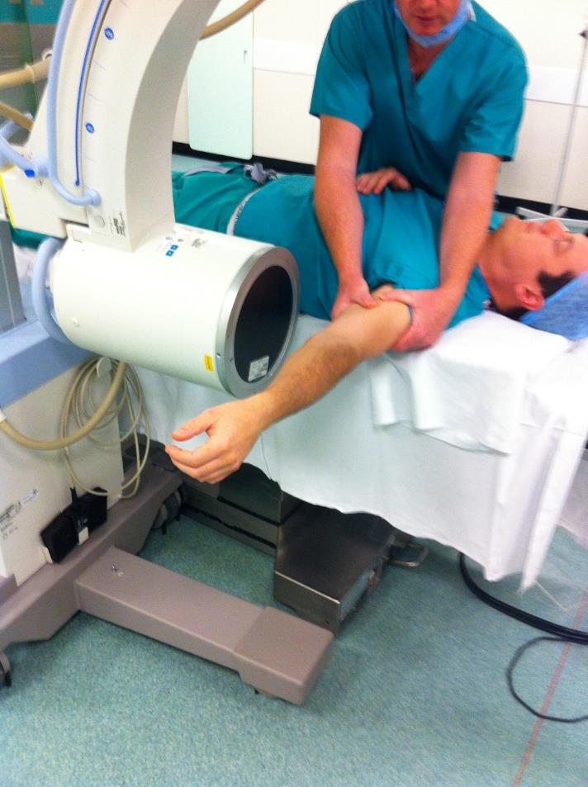
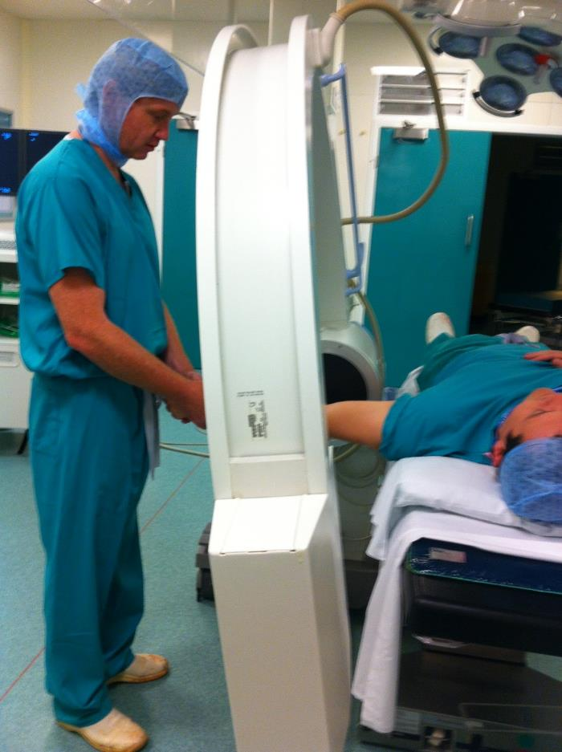
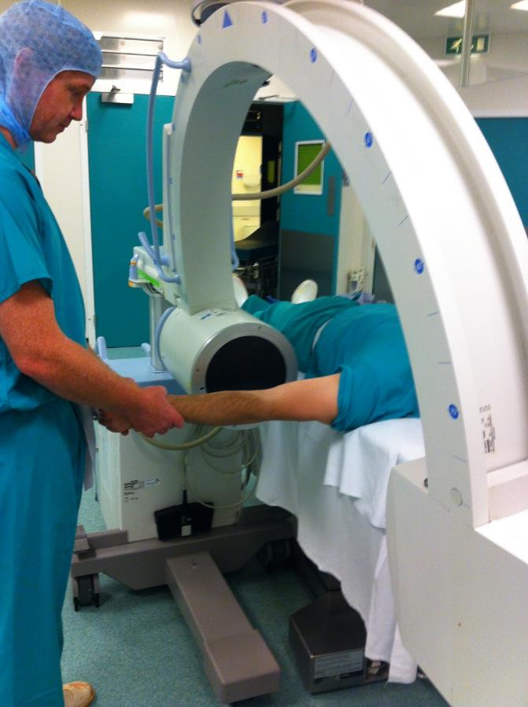
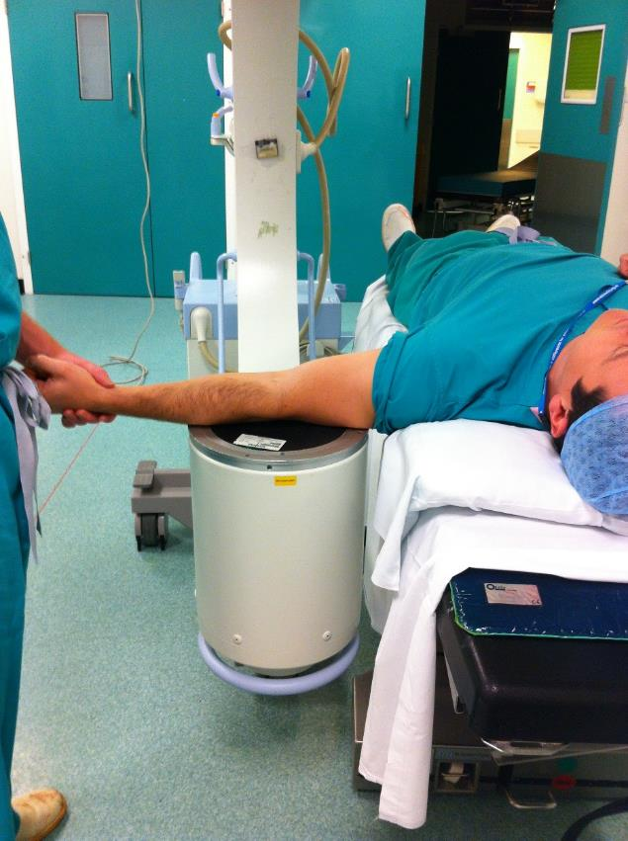
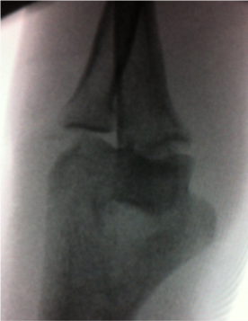
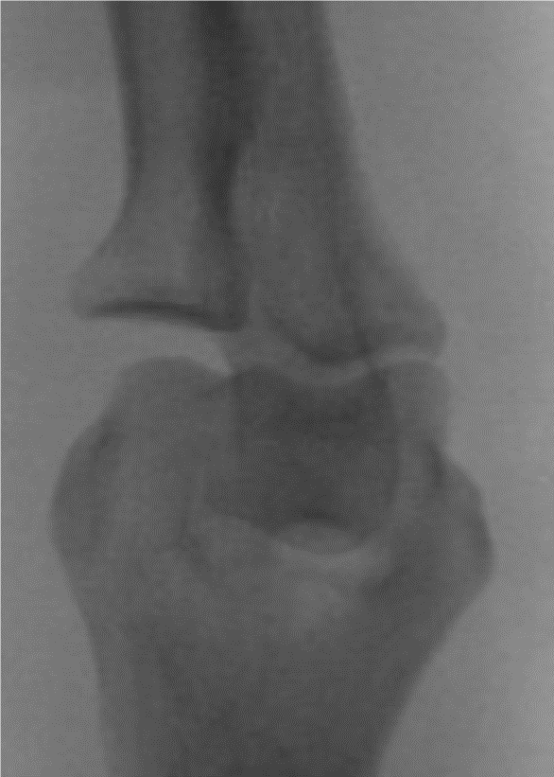
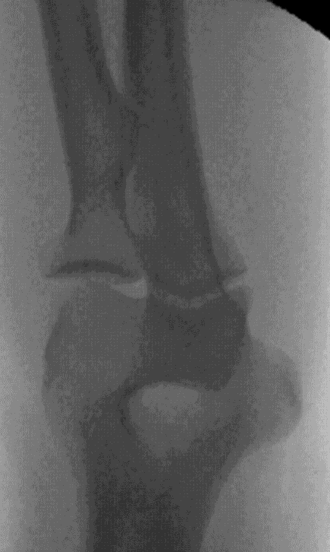
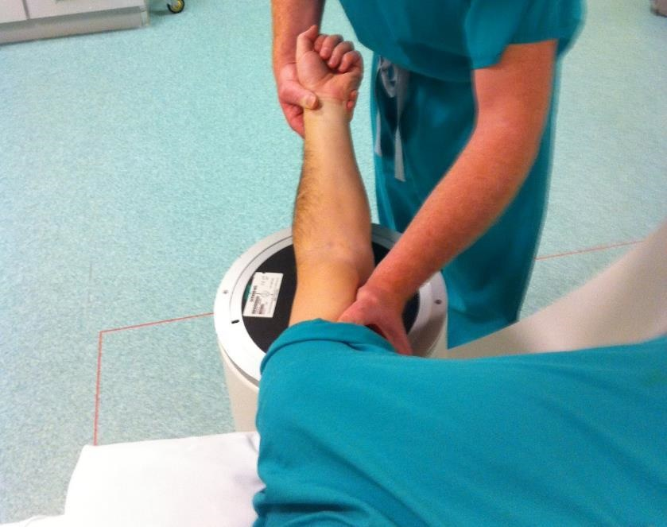
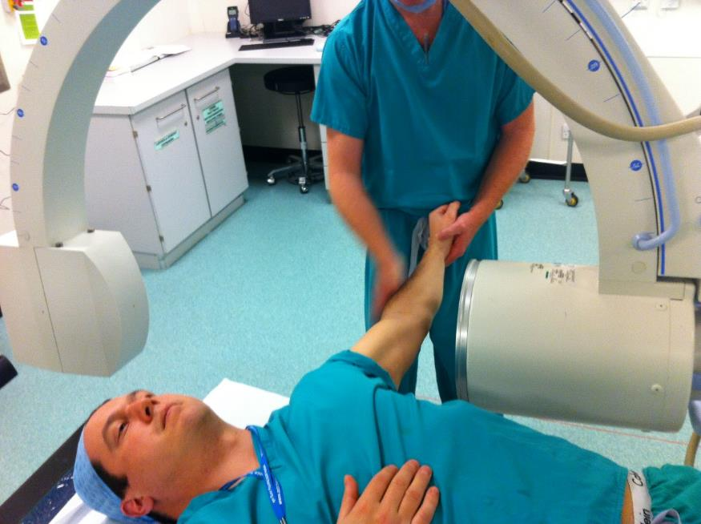
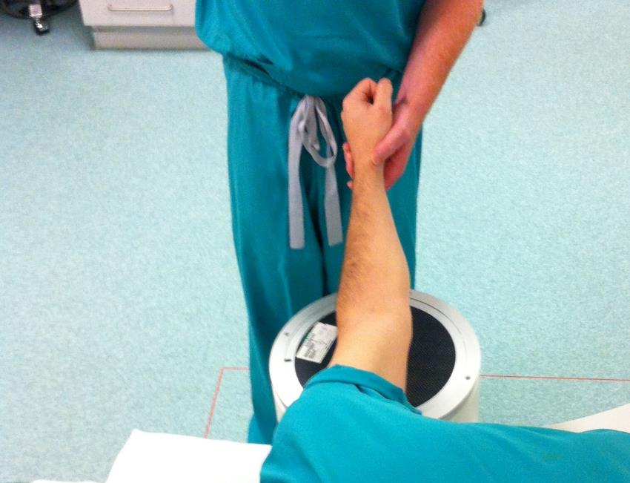
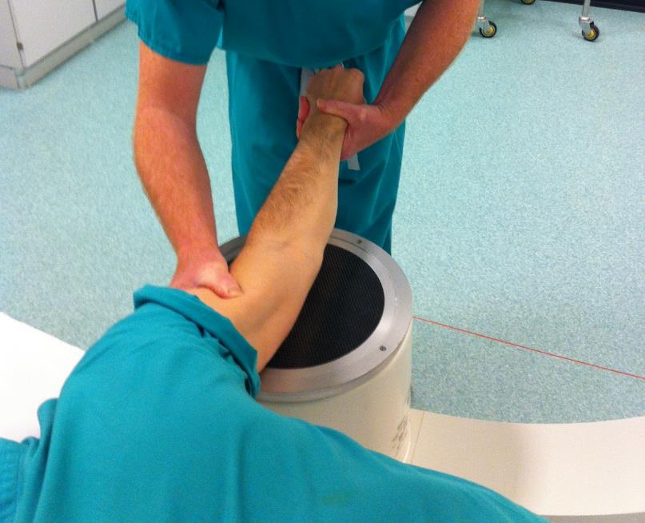
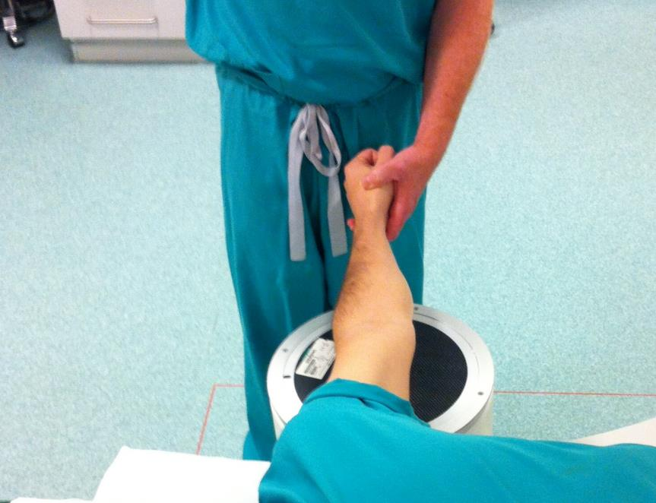

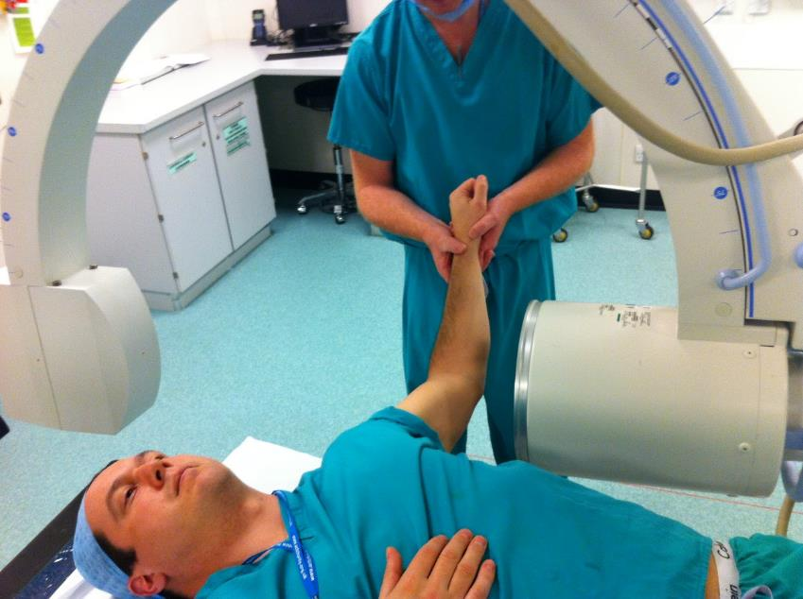
EUA Elbow
Pronate forearm - PLRI
Lock Radial head in place
What’s wrong??
If stable congruent in full extension
I/I parallel with bed
Valgus stress - MCL
Test stable full extension
Move I/I
Don’t twist arm
Start flexed
Ensure congruent lateral
Extend
Flex 30 degrees
Unlock olecranon
Ensure reduced on ap
Elbow in full extension
Varus stress - LCL

Slide 14
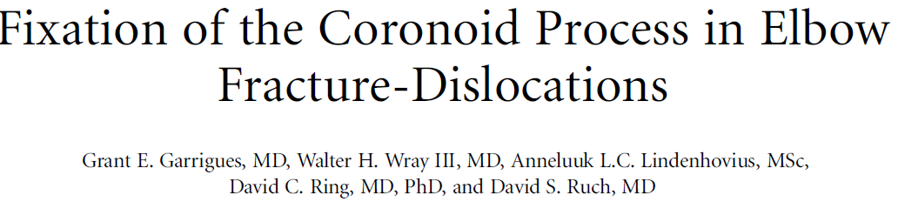
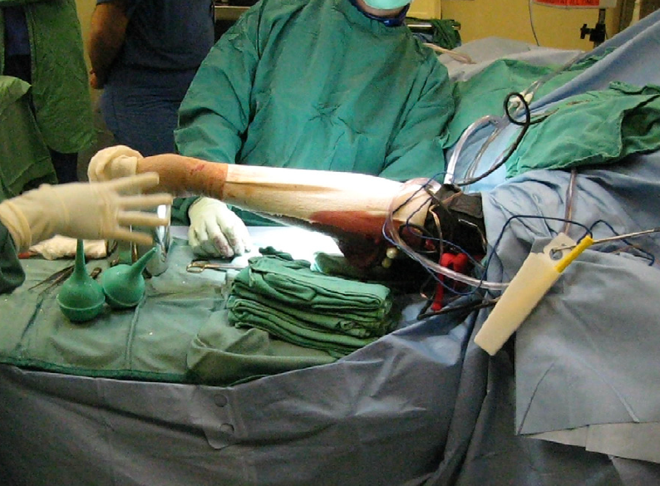
Hanging arm sign
JBJS - A 2011;93:1873-81

Slide 15
Asses stability
Look at initial radiographs

Slide 16
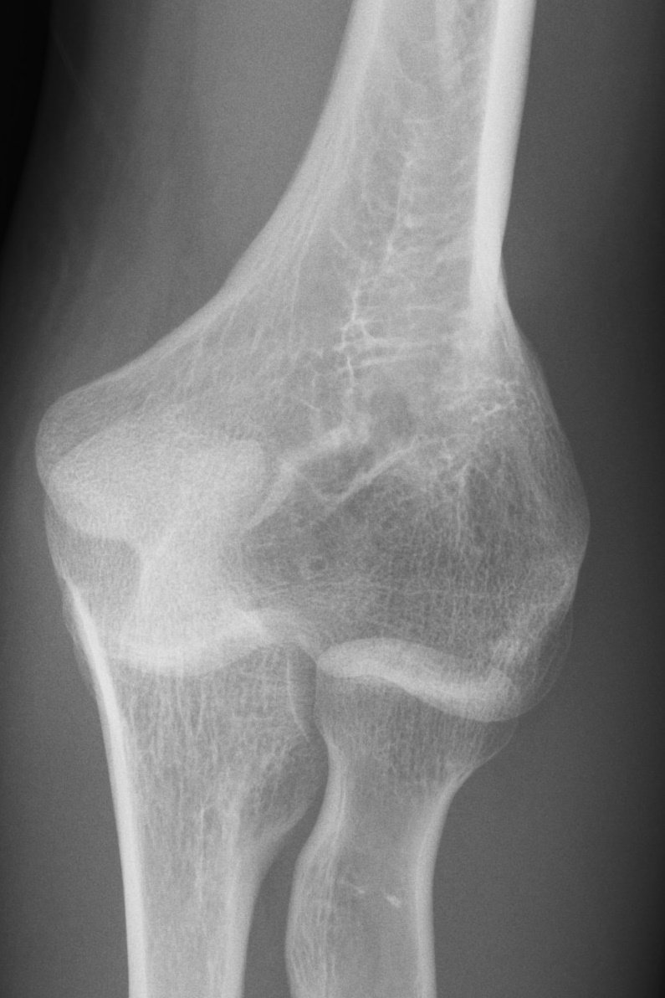
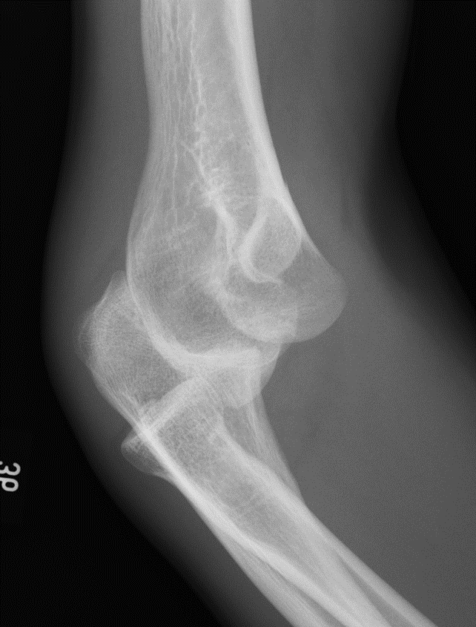


Slide 17
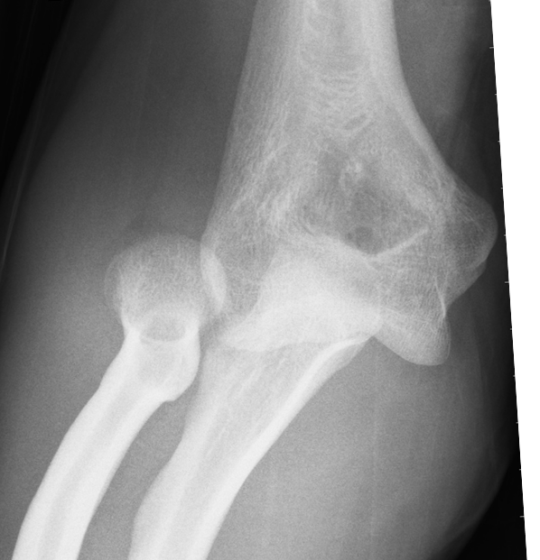
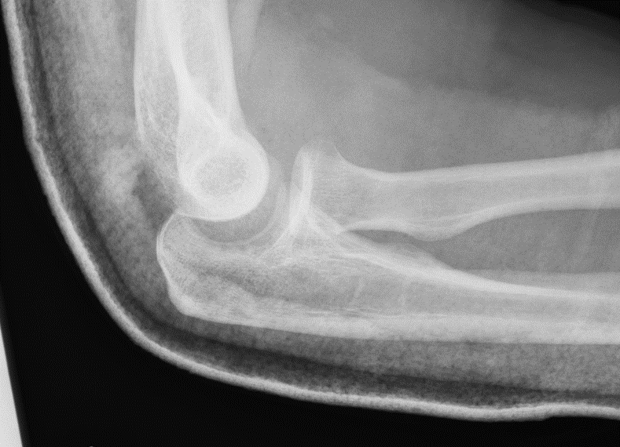

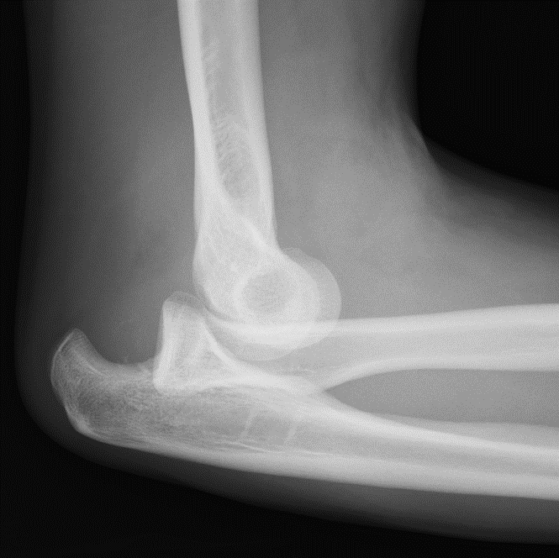
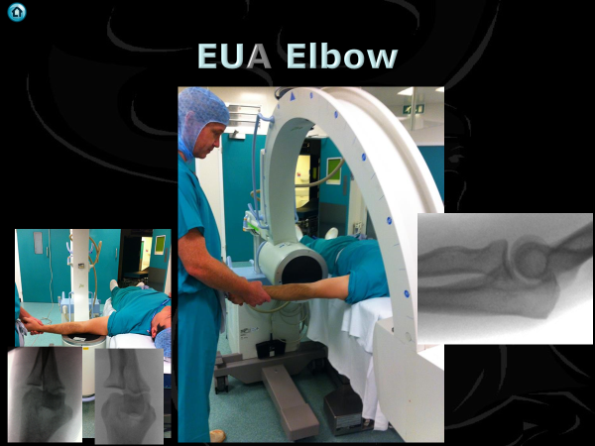
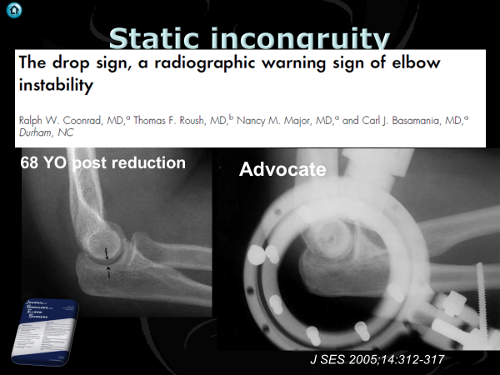
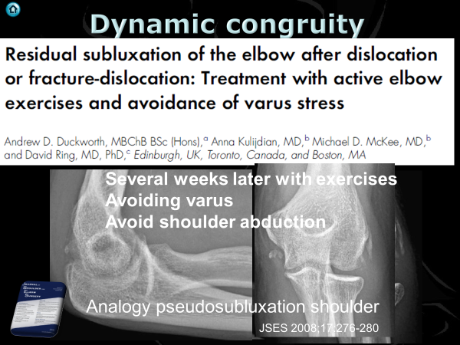

Slide 18
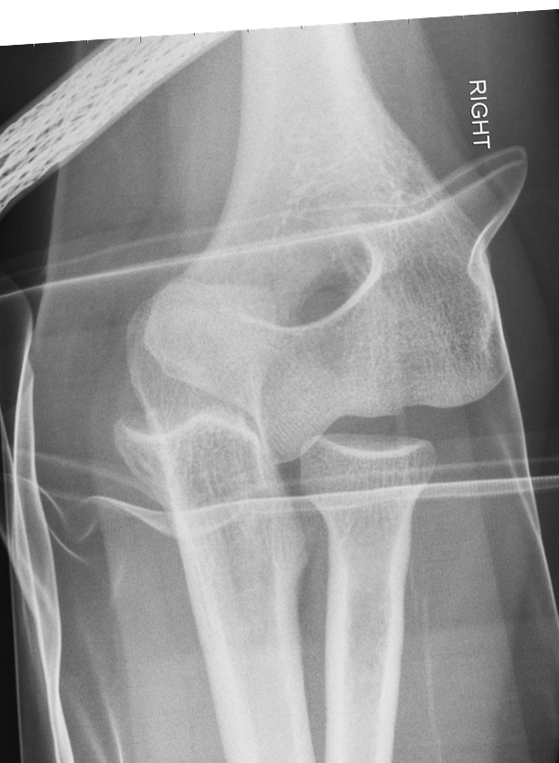
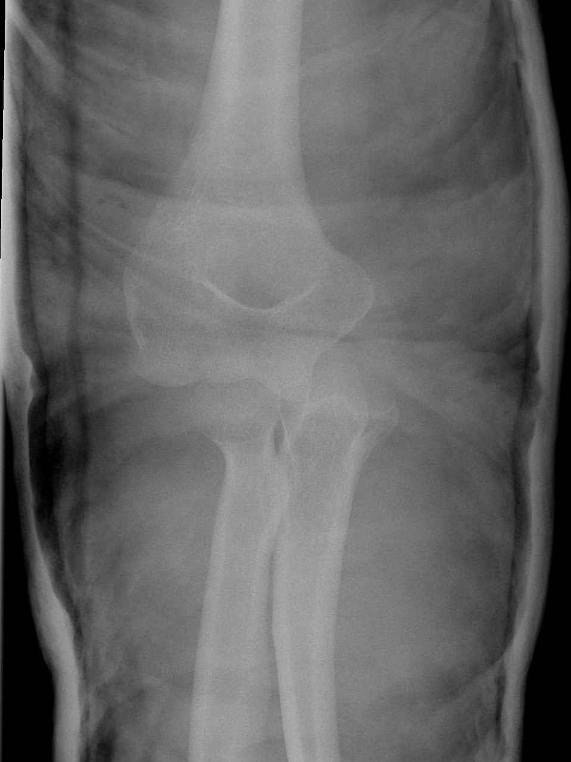
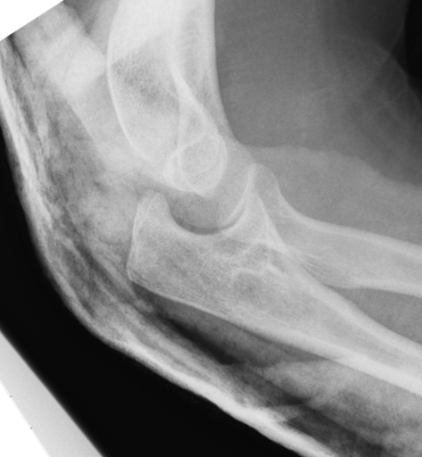
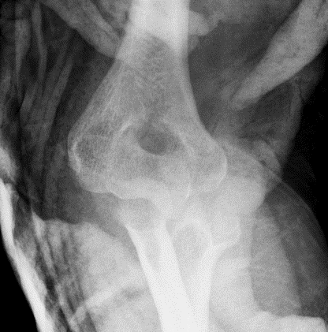



32 YO Male
D10 Post theatre reduction
Reduced in ED
D1 Theatre only image

Slide 19

N = 4 (11 years)
2 reduced, 2 not reduced
All redislocated within 2.5 weeks recurrent instability
Repair of LCL and common extensor origin
J Hand Surg Am. 2013 Sep;38(9):1768-73

Slide 20









6 months

Slide 21




55 YO
Post ED reduction
Told very unstable

Slide 22




Slide 23


N= 8 over 6 years
Severe - Soft tissue injury
Common flexor or common extensor origin
J Shoulder Elbow Surg (2017) 26, 1294–1297

Slide 24





Slide 25




Slide 26
Medial collateral ligament
J Shoulder Elbow Surg 2007;16:657-660

Slide 27





1. Humeral epicondylar bony avulsion – 8%
    Paediatric
2. LCL Sleeve avulsion, bare epicondyle – 52%
3. Mid substance tear – 29%
4. Soft tissue ulnar avulsion – 5%
5. Bony ulnar avulsion – 1%
6. Combined – 6%
J Shoulder Elbow Surg 2003;12:391-6

Slide 28



Common extensor origin
  Completely avulsed 66%
    Bare epicondyle
Dislocations worse than fracture dislocations
  Look at degree of displacement
J Shoulder Elbow Surg 2003;12:391-6

Slide 29






Medial injury

Slide 30


MRI
LCL ?
MCL ?

Slide 31


MRI
Interobserver agreement for LCL
  Fair to Moderate
All Exact agreement
  60%

Slide 32

Problem with MRI
Indication rupture of LCL and radial head subluxation

Slide 33






Dynamic congruity
Several weeks later with exercises
Avoiding varus
Avoid shoulder abduction
24 YO post reduction
Analogy pseudosubluxation shoulder
JSES 2008;17:276-280

Slide 34
Management
Simple dislocation
  Assess stability
  Think of medial injury
  Get it moving
Complex dislocation
  Turn complex into simple
  Get it moving

Slide 35

Simple dislocation outcome
N = 52, F/U 34.4 months
Closed reduction, variable immobilisation
General favourable prognosis
  60% residual symptoms
  FFD > 30⁰ in 15%
  Residual pain 45%
  Pain on valgus stress 35%
Prolonged immobilization = unsatisfactory result
J Bone Joint Surg Am. 1988;70:244-249.

Slide 36



Found medial instability:
    Worse functional ability
    More pain
    More signs of degeneration
?Varus brace longer if valgus instability
Eygendaal D. et.al. J Bone Joint Surg 2000:82:555-555

Slide 37
Management
Simple dislocation
  Assess stability
  Think of medial injury
  Get it moving
Complex dislocation
  Turn complex into simple
  Get it moving

Slide 38

No benefit early surgery
Benefit early movement
Dtsch Arztebl Int 2015; 112: 311–9.

Slide 39




Randomized surgical repair of ligaments to no repair
Both Groups put in cast 2-3 weeks
JBJS 1987 vol 69 – A; April 1987

Slide 40

Treatment

Slide 41
Management
Simple dislocation
  Assess stability
  Think of medial injury
  Get it moving
Complex dislocation
  Turn complex into simple
  Get it moving

Slide 43
Complex instability
Complex
  Complex soft tissue
  Terrible triad
  Facture dislocations of the proximal ulna
  Posteromedial instability

Slide 44








Summary
Simple
Complex

Slide 45



Slide 46



Slide 47











Slide 49


