Slide 1
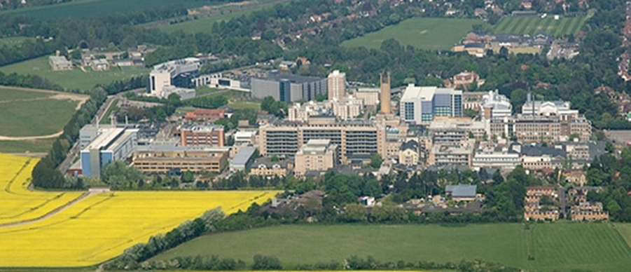


Distal humerus
Fracture
Mr Lee Van Rensburg
Cambridge University Hospitals NHS trust
2018

Slide 2


Slide 3
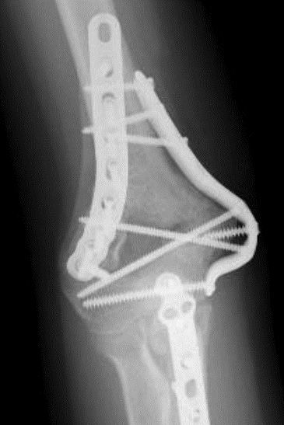
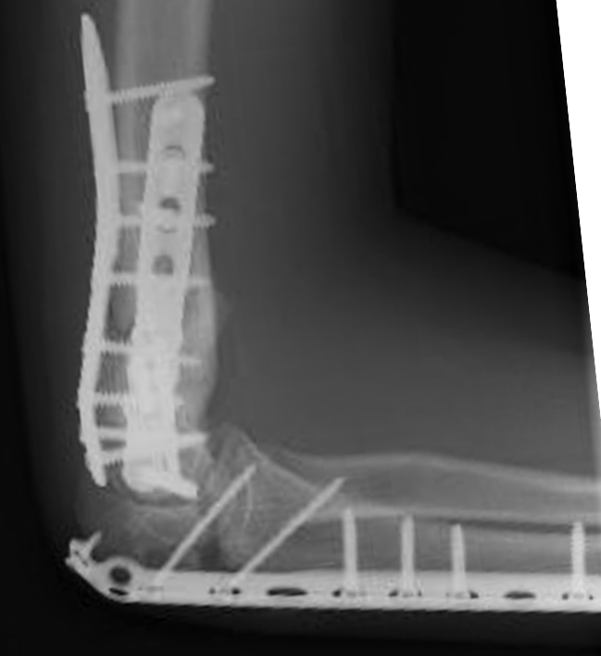
My First case - 2005
17 Y0

Slide 4
My First case - 2005
17 Y0

Slide 5
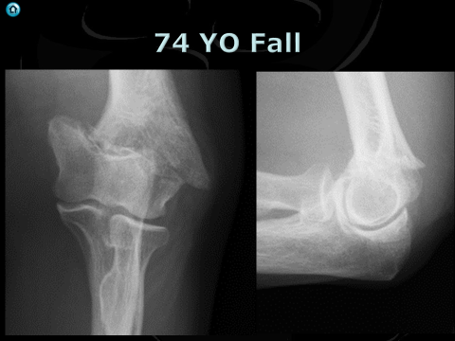
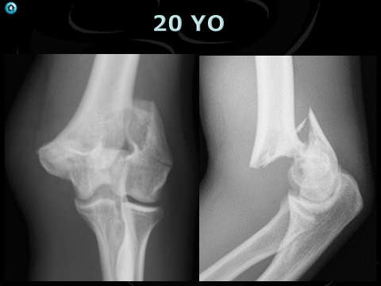
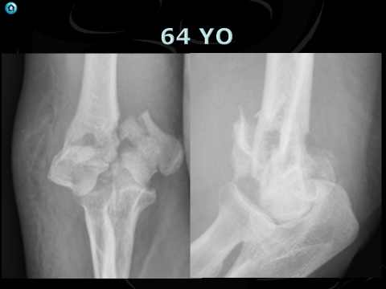
Degrees of badness

Slide 6
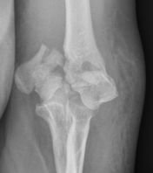
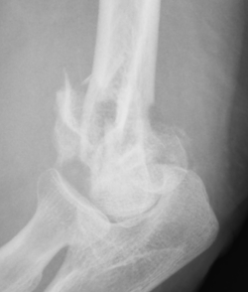
64 YO

Slide 7

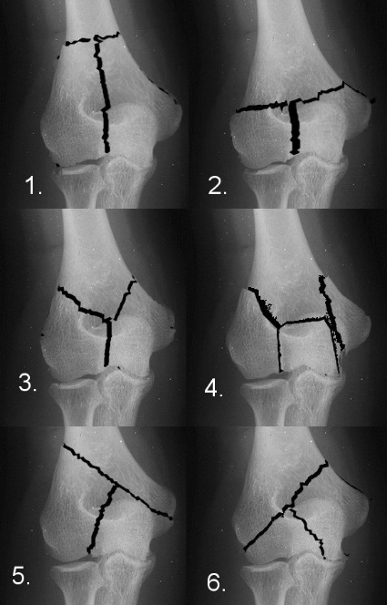
Jupiter Mehne
H

Slide 8
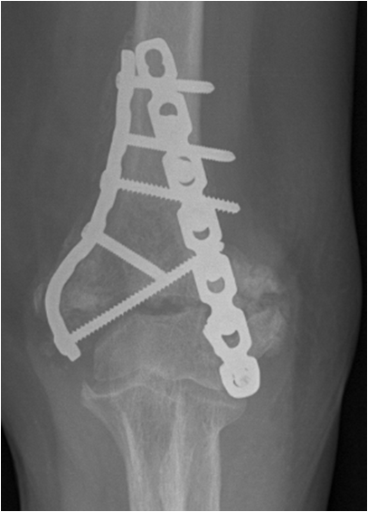
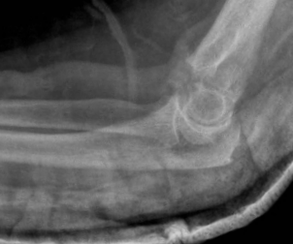
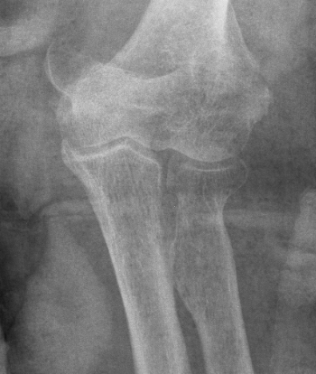
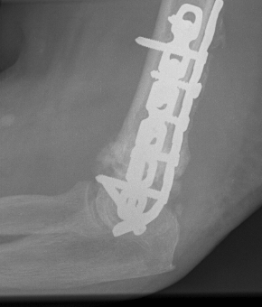
70 YO Fall
What is the problem ?
9 Proximal
At most 2 distal screws

Slide 9
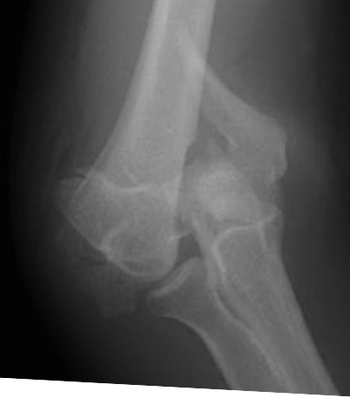
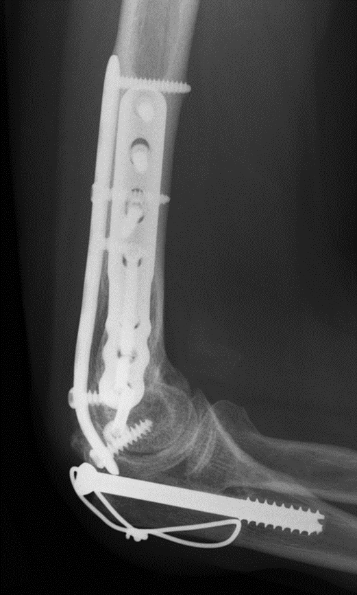
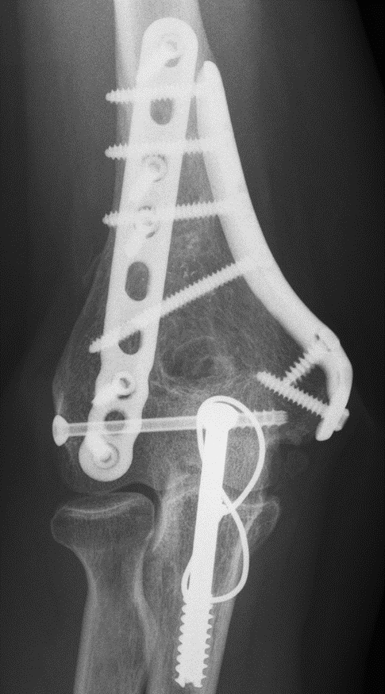
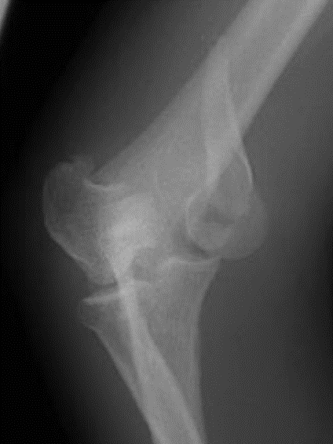
46 YO

Slide 10
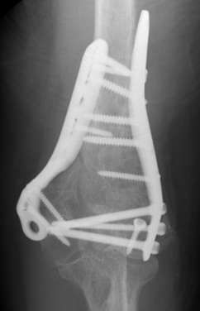


70 YO - 2008

Slide 11
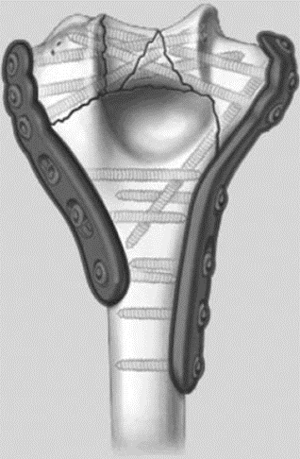
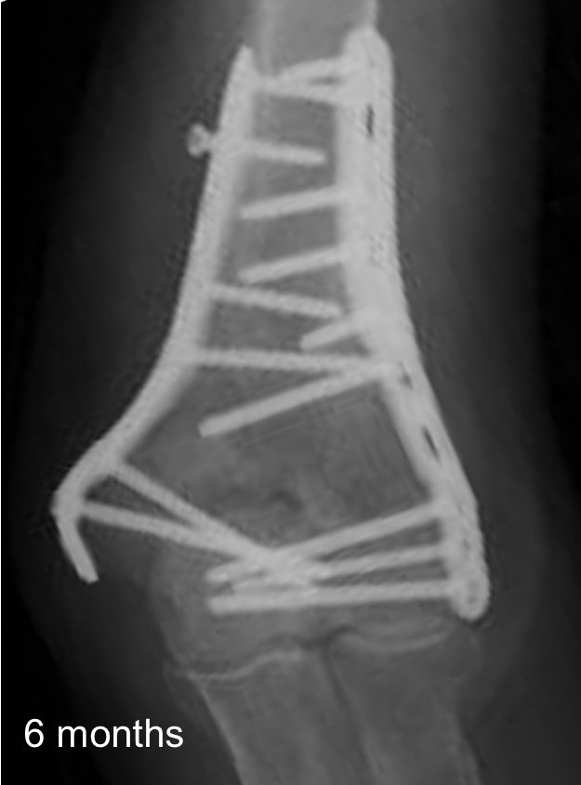
Tip
4 Good distal screws
Don’t need to be locking
First 2
Great screws
Long
Distal

Slide 12
Tip 2
No Home run screw

Slide 13
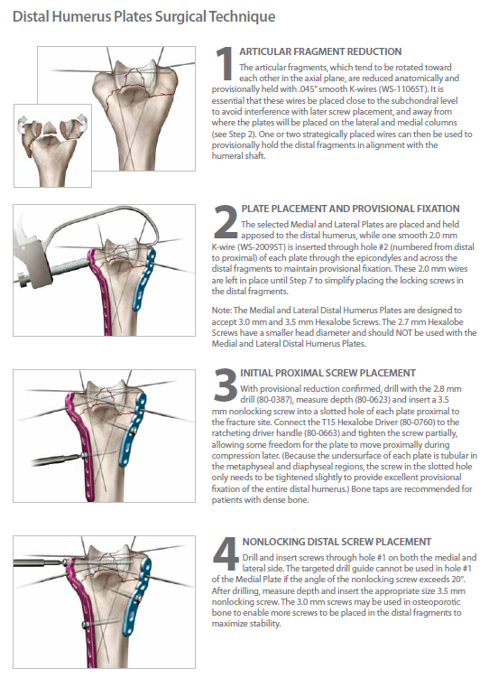
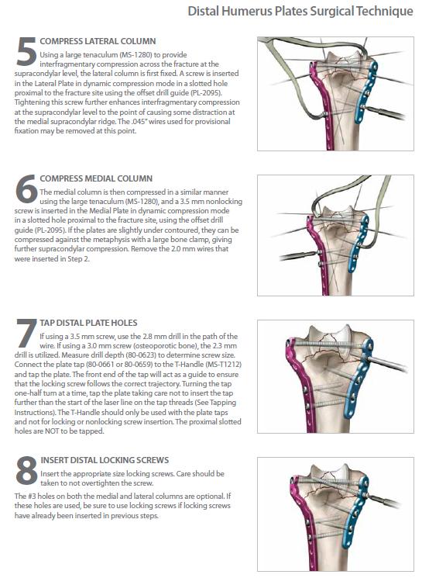
8 Steps to happiness

Slide 14
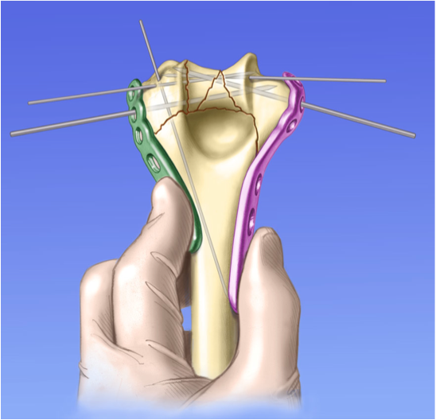
Step 2 – Plate application & provisional fixation
Place holding 2mm
K wires

Slide 15
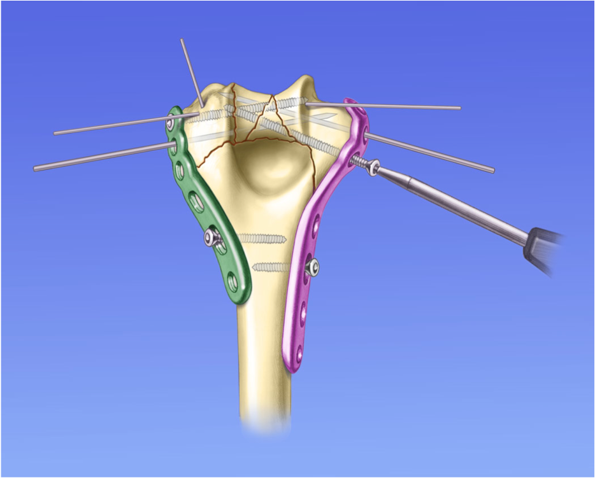
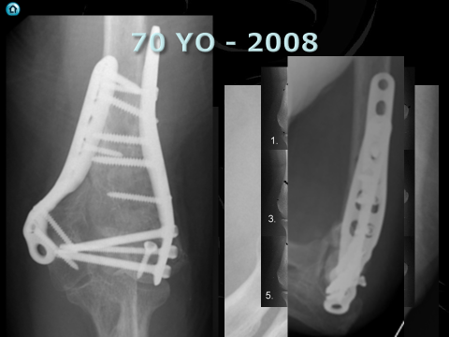
Step 3 – Distal fixation
Tip
1 from each side

Slide 16
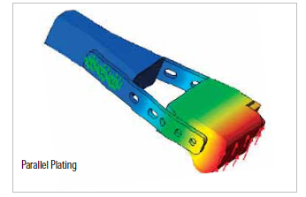
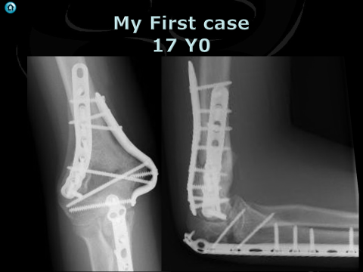
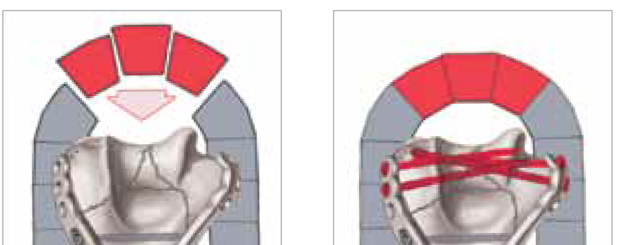
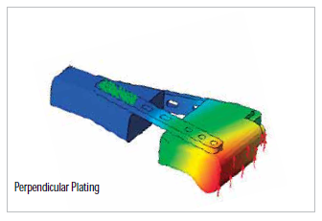
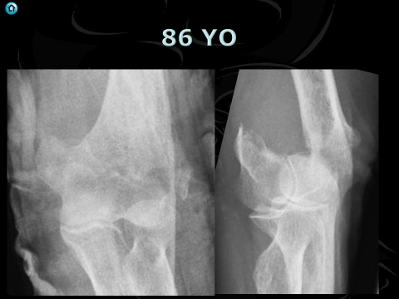

Slide 17

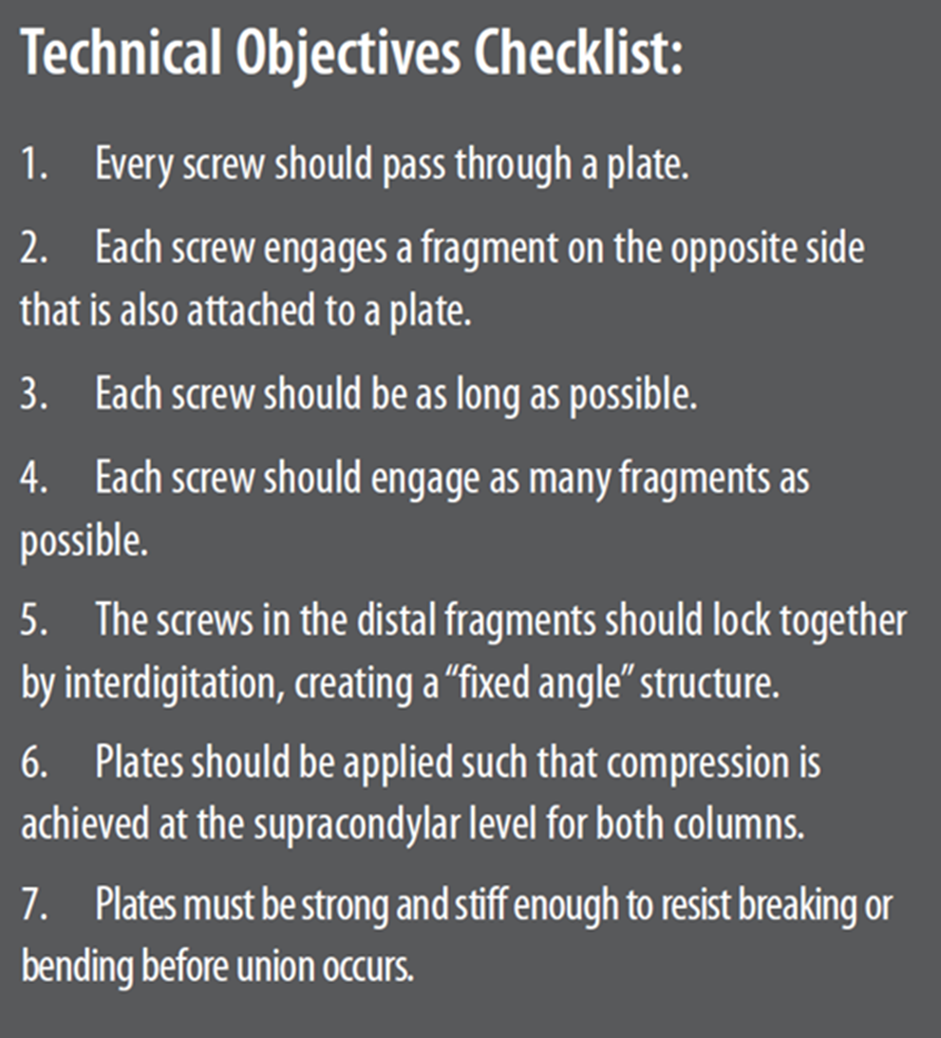

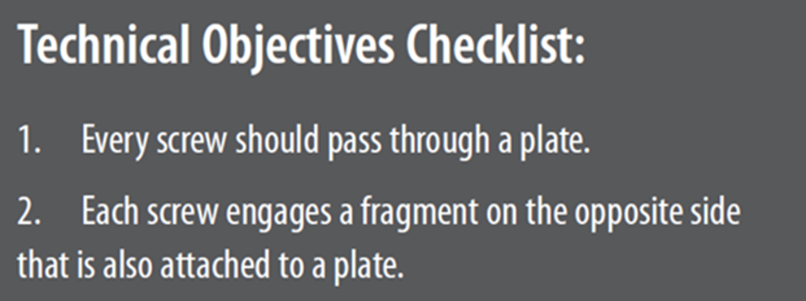
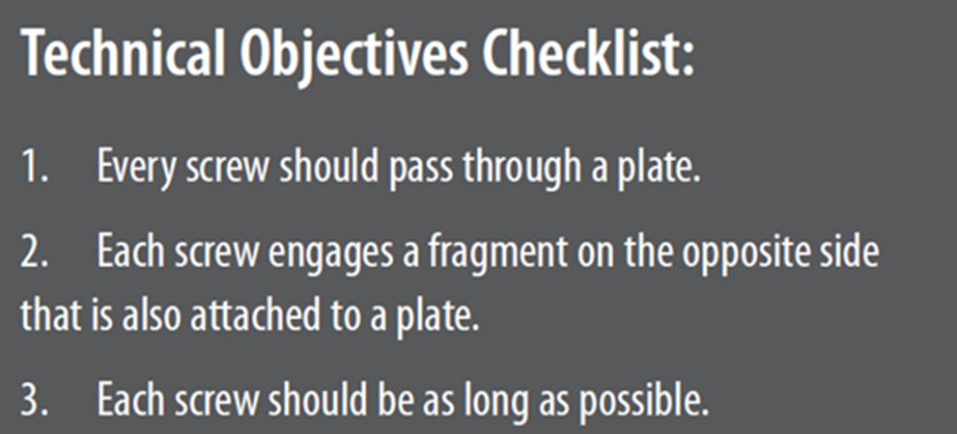
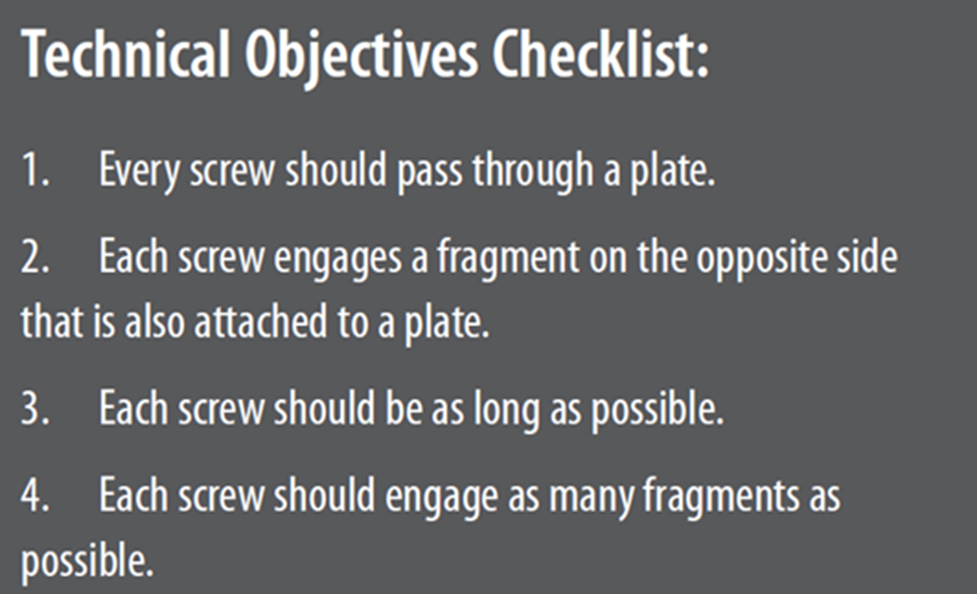
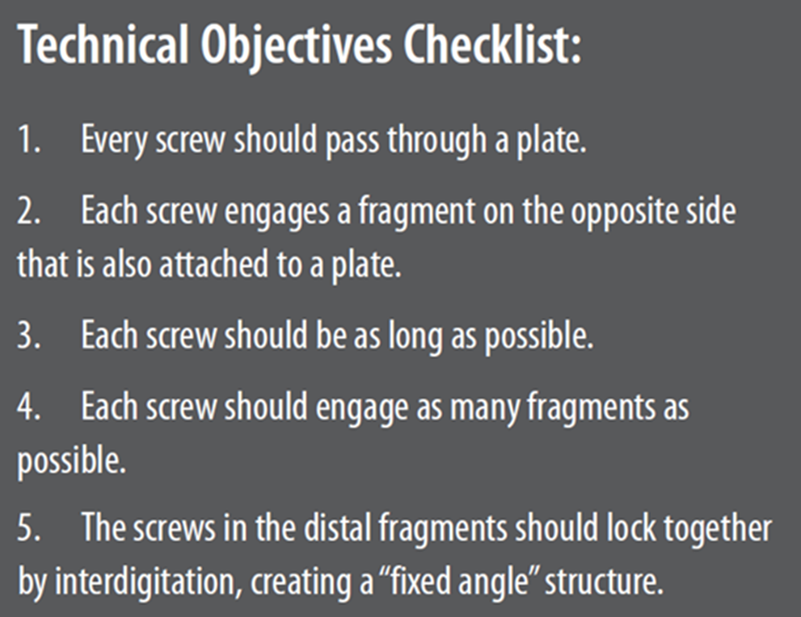
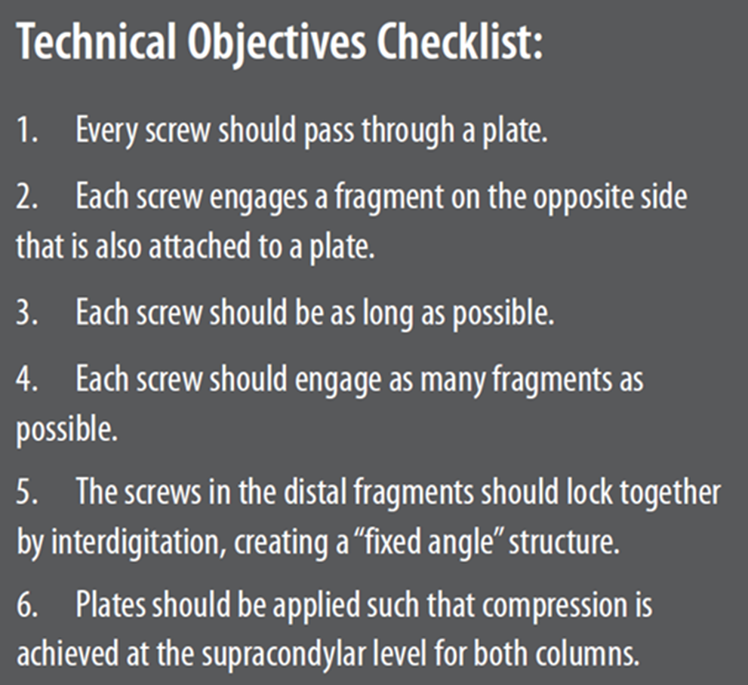
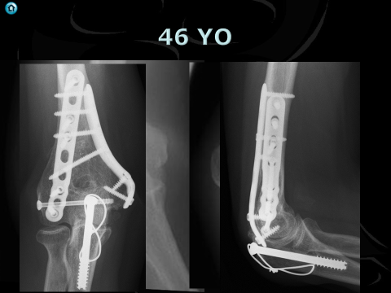
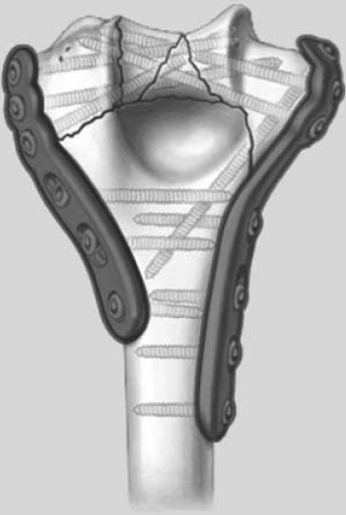
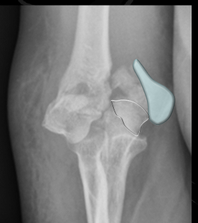
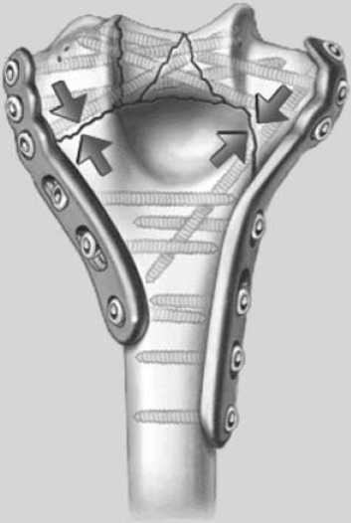
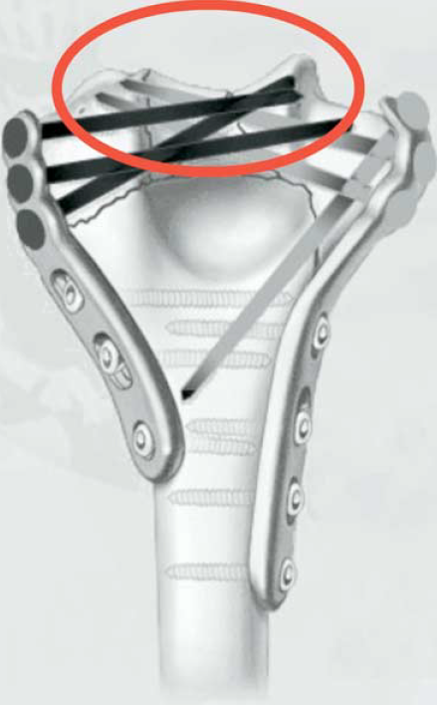
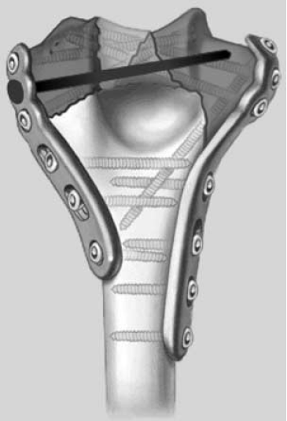
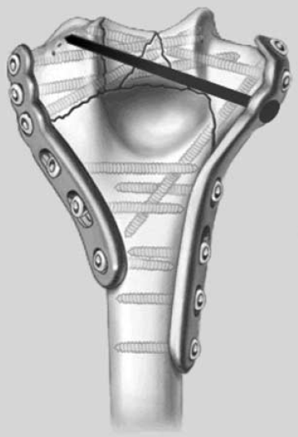
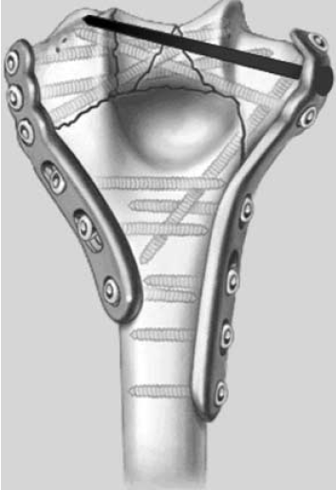
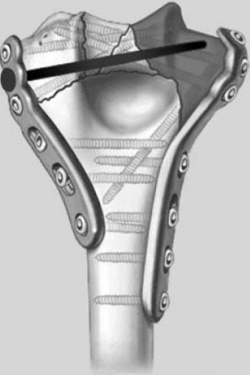

JSES 2005;14:186S-194S

Slide 18
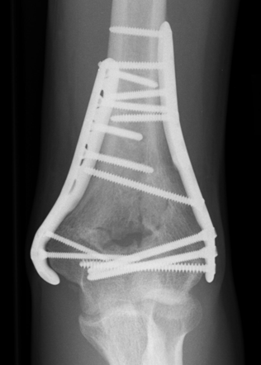
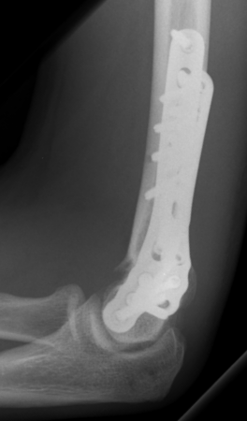
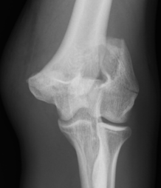
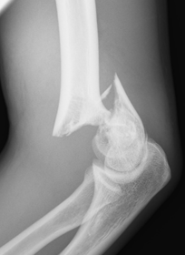
20 YO -2010

Slide 19
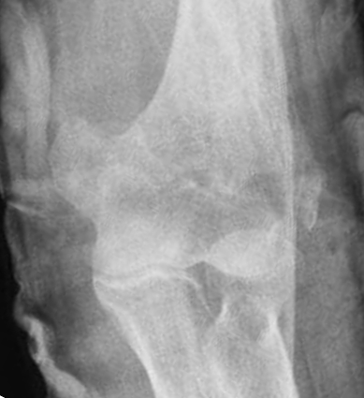

86 YO

Slide 20


Multicentre
Randomised
comminuted distal humeral fractures in patients aged over 65 years.
TER Vs ORIF
J Shoulder Elbow Surg (2009) 18, 3-12

Slide 21

TER superior to ORIF
    surgeon-based (MEPS)
    patient-based (DASH) outcome scores,
Trend toward a reduced reoperation rate and improved range of motion in the TER group
25% of patients randomized to ORIF required intraoperative conversion to TER
J Shoulder Elbow Surg (2009) 18, 3-12

Slide 22


We believe that our study supports the use of primary TER in elderly patients with comminuted, intra-articular distal humeral fractures.
J Shoulder Elbow Surg (2009) 18, 3-12

Slide 24




86 YO
6 months

Slide 25


What’s possible

Slide 26






32 YO Male
2 Years

Slide 27

Approach

Slide 28




Slide 29


Olecranon osteotomy

Slide 30

No difference
J Shoulder Elbow Surg (2012) 21, 126-135

Slide 31

110°
1/3rd
J Shoulder Elbow Surg (2012) 21, 126-135

Slide 32






Posterior approaches
Triceps tongue – Van Gorder
Paratricipital
Triceps reflection
  Medial to lateral – Morrey
  Lateral to medial – Deakin and Deshmukh
Olecranon osteotomy
  Intra articular
  Extra articular
Triceps split
TRAP

Slide 33
J Bone Joint Surg Am, 1940 Apr 01;22(2):278-292

Slide 34


Paratricipital

Slide 35
Extensive posterior exposure of the elbow: a triceps sparing approach.
Triceps medial to lateral (preserves anconeus)
Clin Orthop Relat Res 1982;116:188-92.
J Bone Joint Surg Am 1981;63:1050-63.)

Slide 36
TRIFCU
Lateral to medial
Ann R Coll Surg 240 Engl 2010; 92: 240–242

Slide 37
Triceps split
  2/3rd radial, 1/3rd ulna
Ulna 1/3rd protects ulna nerve
J Bone Joint Surg [Br] 1999;81-B:1020-2.

Slide 38

Olecranon osteotomy

Slide 39



Hardly ever do osteotomy

Slide 40



Slide 41
J Shoulder Elbow Surg (2010) 19, 399-405

Slide 42


Slide 43
Medial Rolled edge
J Shoulder Elbow Surg (2010) 19, 399-405

Slide 44
Lateral
Para olecranon

Slide 45
Lateral Para-olecranon approach
Boyd HB.
Surgical exposure of the ulna and proximal third of the radius through one incision.Surg Gynaecol Obstet1940;71:87-8.

Slide 46



Lateral para-olecranon

Slide 47
Posterior approach
Van Gorder
Triceps splitting
(Tongue)
Bryan Morrey
Triceps reflecting
Macausland
Transolecranon osteotomy
J Shoulder Elbow Surg 2001;10:380-2.

Slide 48

Lateral para-olecranon
J Shoulder Elbow Surg 2001;10:380-2.

Slide 49

Tip
Extensibility

Slide 50

Clin Orthop Relat Res (2008) 466:135–138

Slide 51


2.5 cm proximal to apex
+- 0.4 cm
10 Cadaver
30 Patients
Clin Orthop Relat Res (2011) 469:2638–2644

Slide 52


Slide 53
Thank You

Slide 54


76 YO
Fixation 2015
16 Months
No Pain
Lack of extension 20 degrees

Slide 55


74 YO Fall

