Slide 1
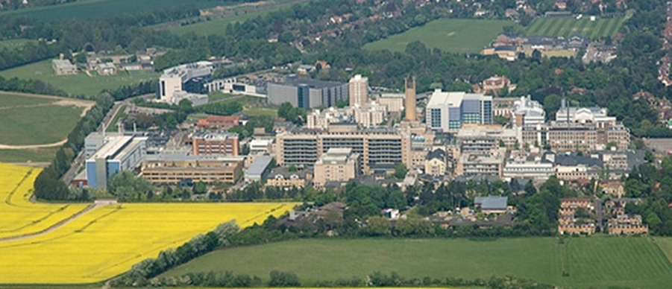

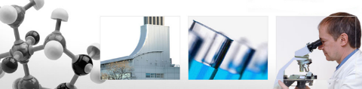
Boyd’s interval
Gateway to the elbow
Mr Lee Van Rensburg
Cambridge University Hospitals NHS trust
2018
www.cambridgeses.co.uk

Slide 2
www.cambridgeses.co.uk

Slide 3
Disclaimer
Acumed
  Paid consultancy work
  Not on radial head

Slide 4
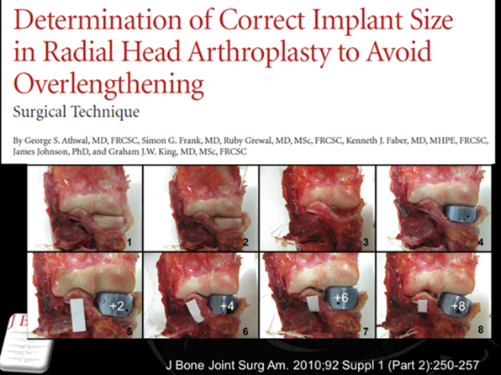
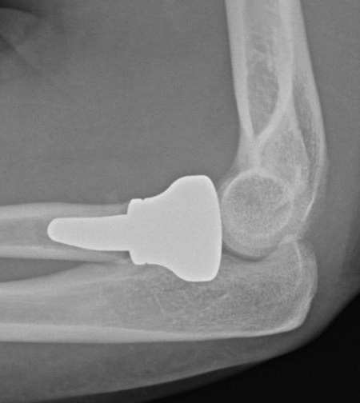
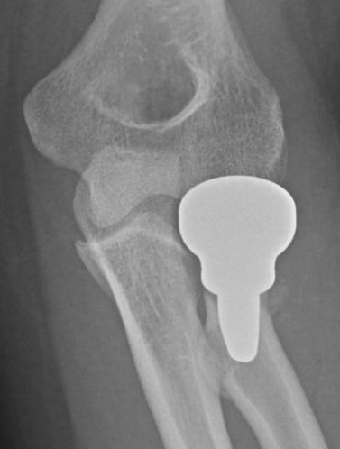
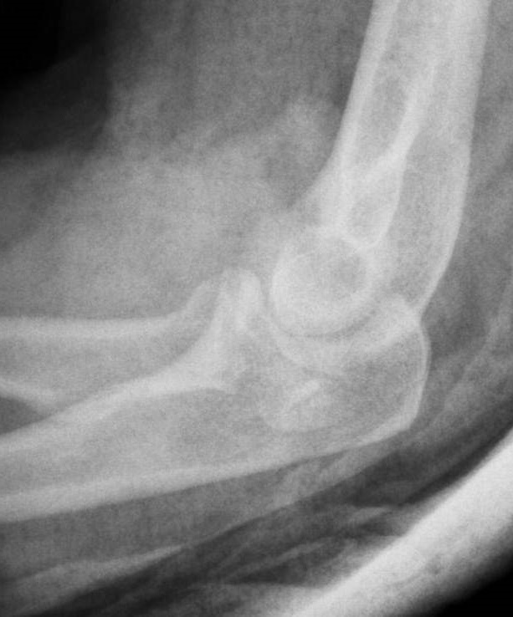
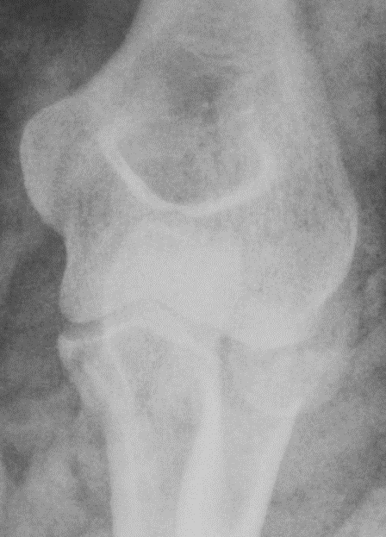
45 YO manual worker

Slide 5
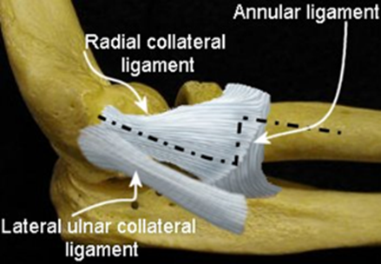
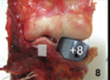
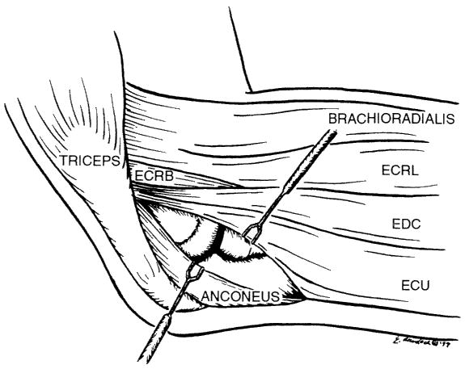
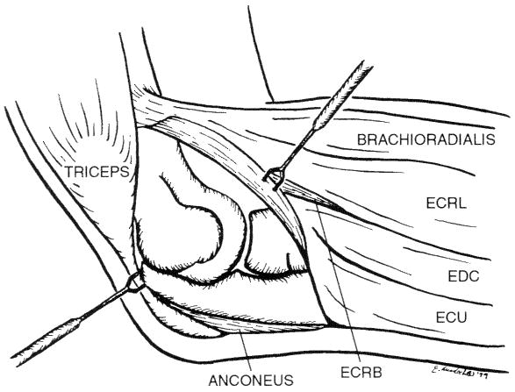
Kocher
Posterolateral
Clin ortho and related research; (370), January 2000, pp 19-33;

Slide 6
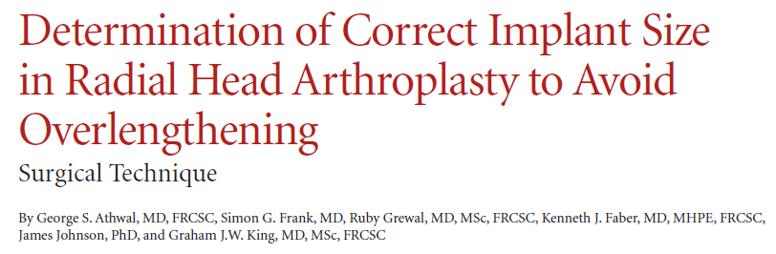
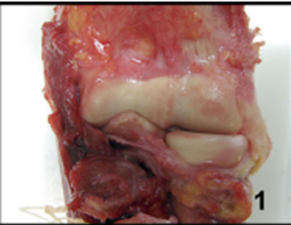
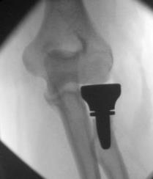

J Bone Joint Surg Am. 2010;92 Suppl 1 (Part 2):250-257

Slide 7
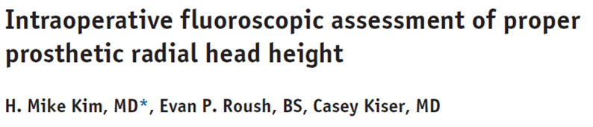
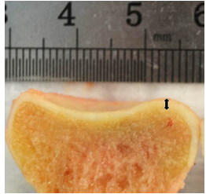
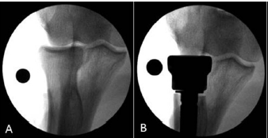
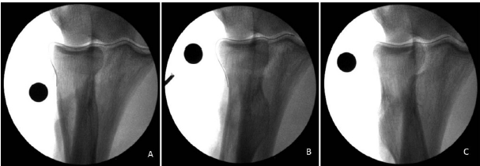
Avoid understuffing
  X ray 2mm proud neutral forearm
  Supination longer, pronation shorter
Perfect

Slide 8
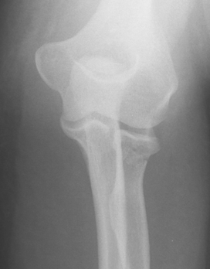
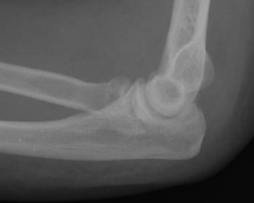
32 YO fall

Slide 9
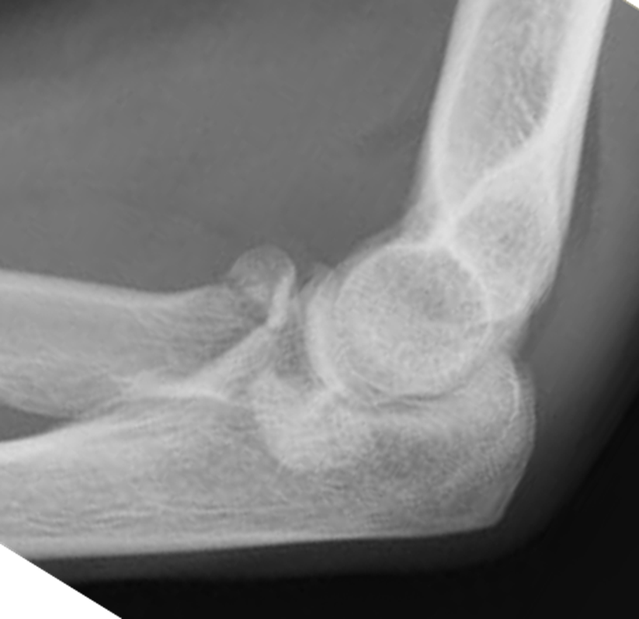

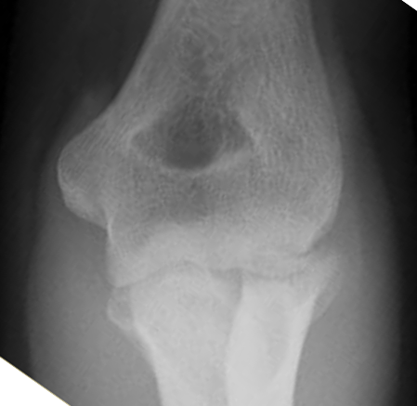


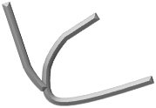
21 YO F

Slide 10
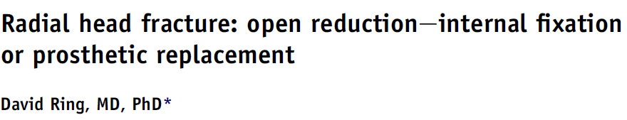
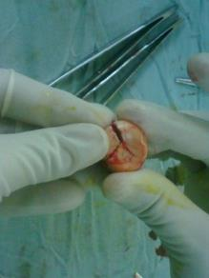
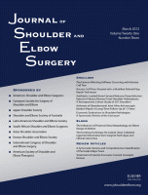
3 pieces generally reconstructable
  If see 2 generally 3 if see 3 then is 4
On table reconstruction of radial head
  Acceptable
JSES (2011) 20, S107-S112

Slide 11
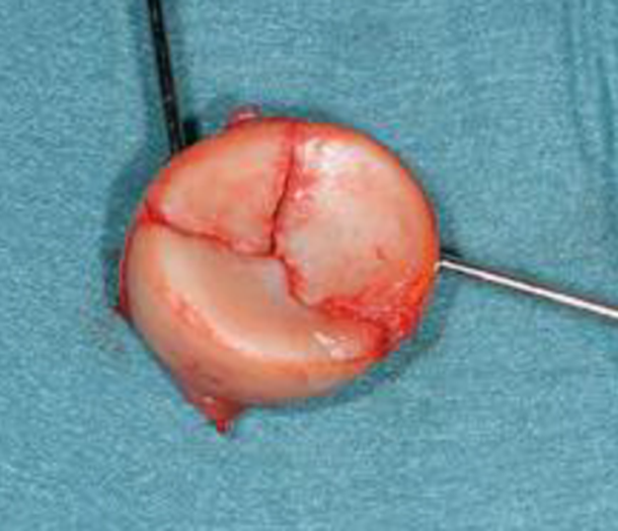
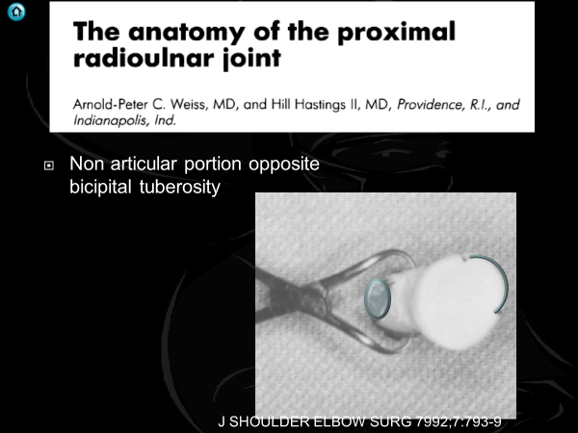

Slide 12
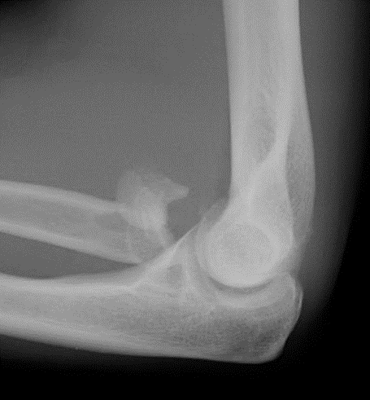

50 YO

Slide 13
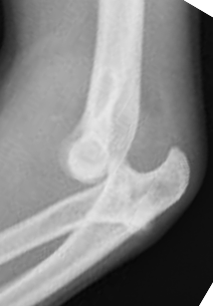
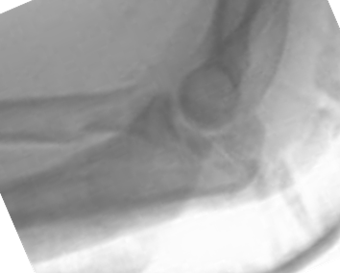
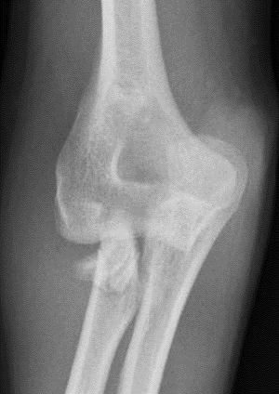
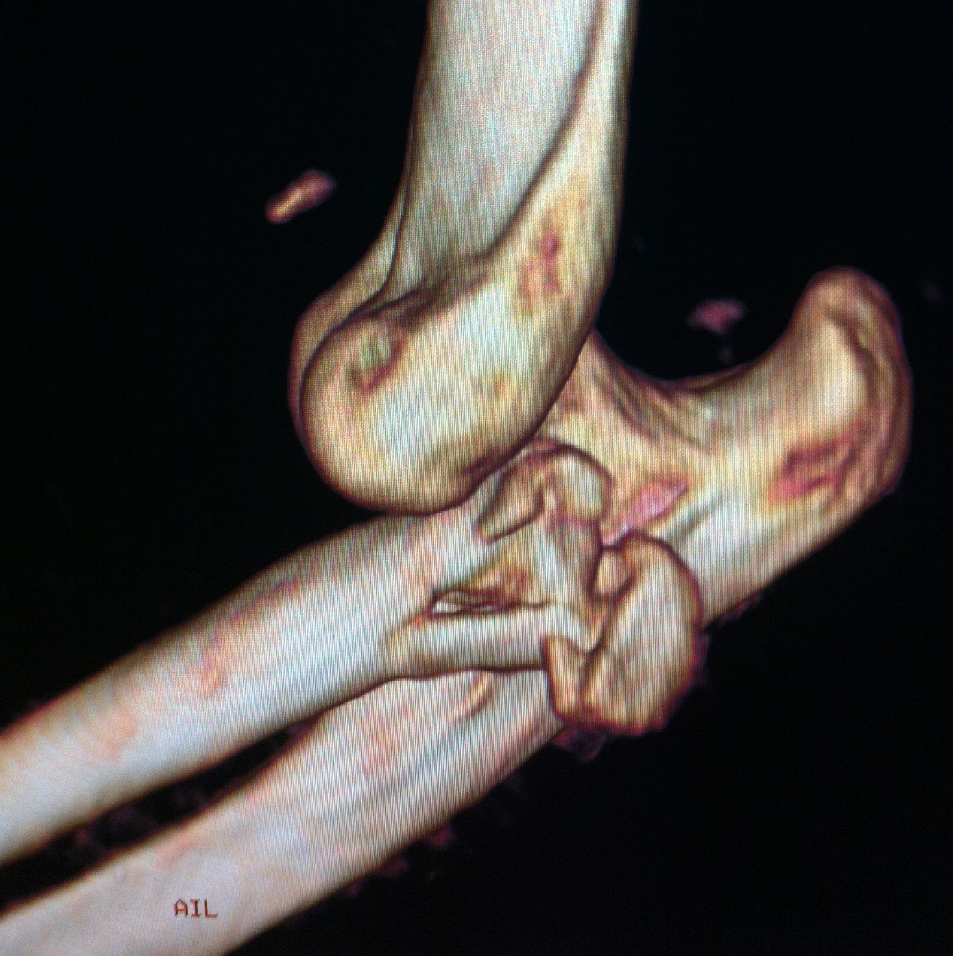
25 YO
Farmer

Slide 14
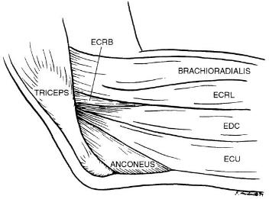

Lateral intervals
Kocher
    between anconeus and ECU
Kaplan
    between ERCB and EDC
EDC Split
Clin ortho and related research; (370), January 2000, pp 19-33

Slide 15
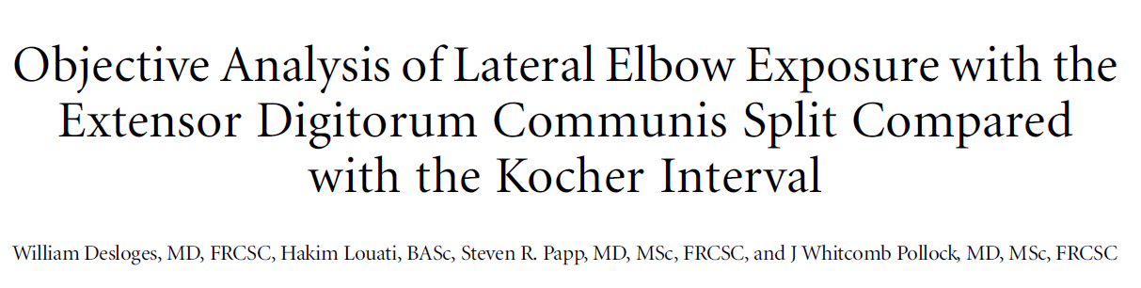
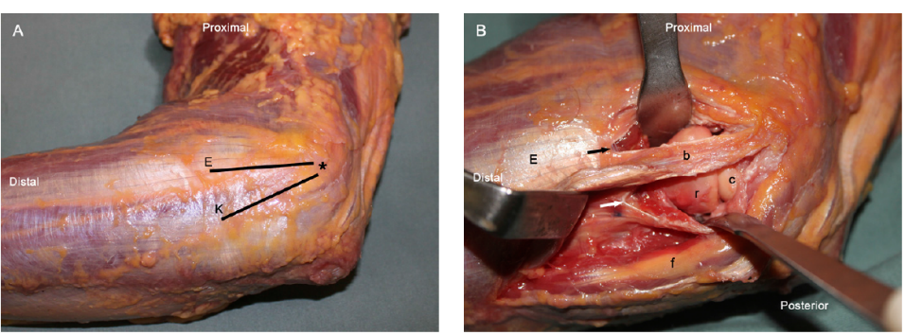
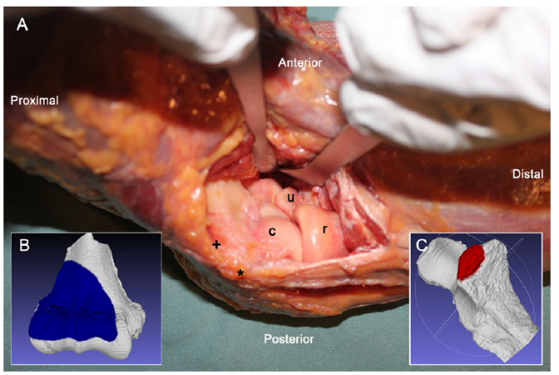
J Bone Joint Surg Am. 2014;96:387-93

Slide 16
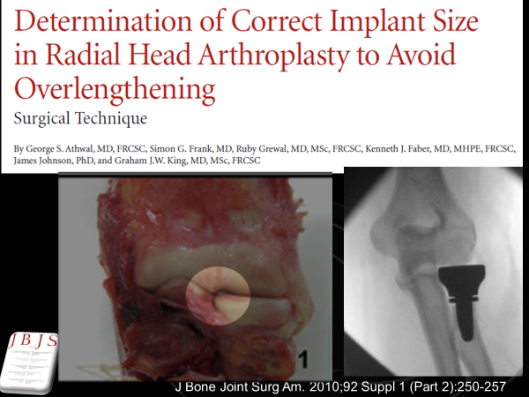

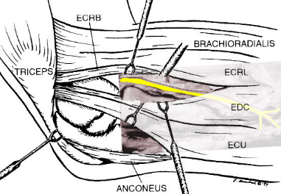
Lateral intervals
Kocher
  LUCL
  Lateral facet Coronoid
Kaplan
EDC Split
  PIN
Clin ortho and related research; (370), January 2000, pp 19-33

Slide 17
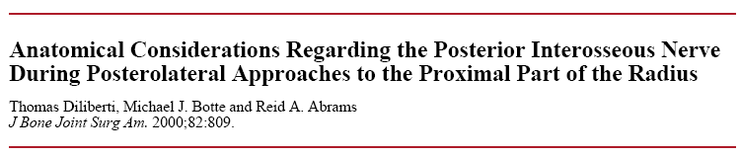
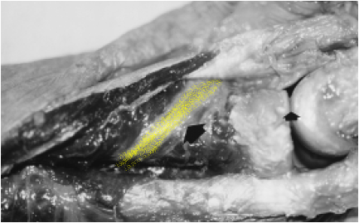
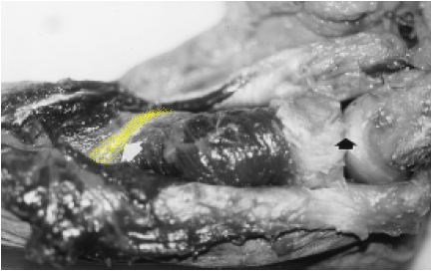
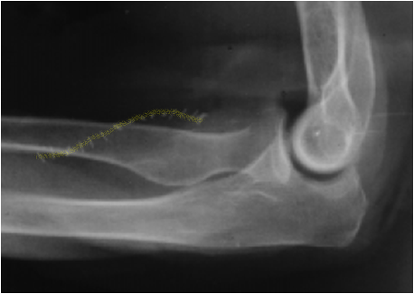
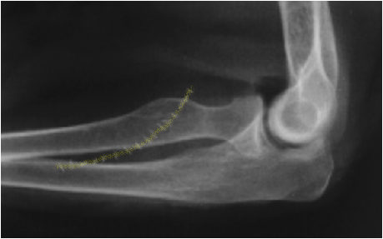
Supination
Pronation
Supination
Pronation
Diliberti T. et.al. J Bone Joint Surg 2000:82:809-809

Slide 18
From Capitellar surface, crosses mid axis
Full supination
Ave. 33 mm
Full pronation
Ave. 52 mm
Diliberti T. et.al. J Bone Joint Surg 2000:82:809-809

Slide 19
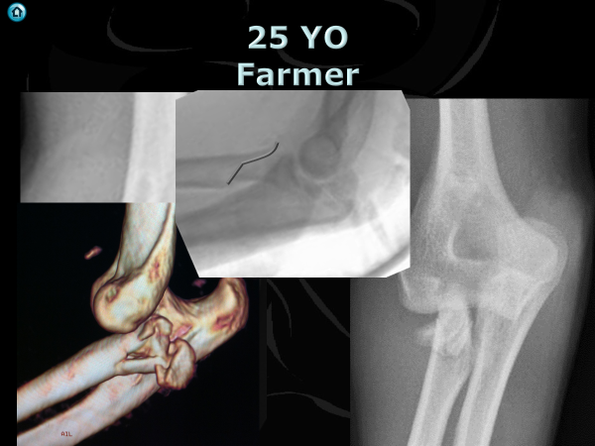
Minimum distance from PIN to RCJ
  Supination 4.0 cm
  Pronation 4.3 cm
J Shoulder Elbow Surg 2007;16:502-507

Slide 20
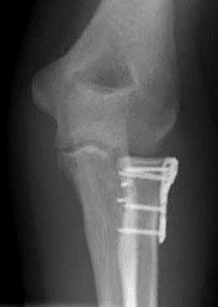
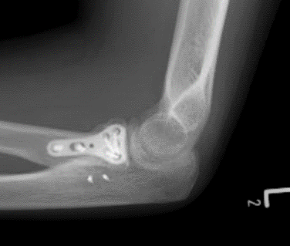
21 YO F

Slide 21
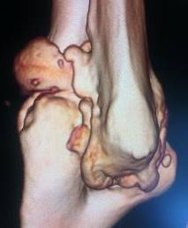
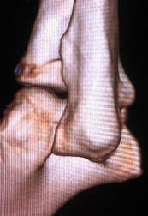
J Bone Joint Surg Br September 2006 88-B: 1178-1182

Slide 22
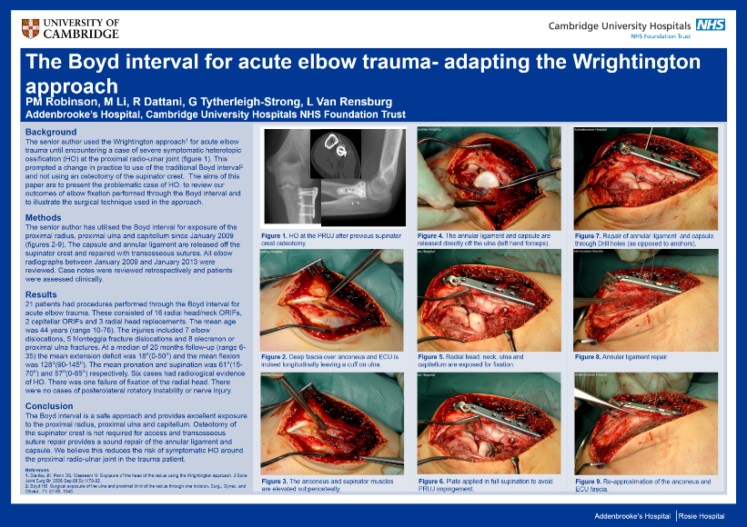

Boyd interval
Surg. , Gynec. and Obstet,, 71: 87-88, 1940

Slide 23








Boyd interval
Humerus
Ulna
Anconeus

Slide 24











Benefits

Slide 25

Downsides

Slide 26
n=21
Radial head and neck, capitellar fractures, articular fractures
Age
  Mean 44 (10 – 76)
ROM
  Extension Flexion - 18° to 129°
  Pronation 61° (15° to 70°)
  Supination 57° (0° to 85°)
Tech Hand Up Extrem Surg. 2016 Mar;20(1):37-41

Slide 27
Complications
  No Nerve injury
  No instability
  6 Heterotopic Ossification
    No further surgery
  1 Loss fixation
    76 YO
      Complex fracture dislocation proximal ulna and radial head
Tech Hand Up Extrem Surg. 2016 Mar;20(1):37-41

Slide 28

Gateway

Slide 29



Gateway

Slide 30



Gateway

Slide 31





Slide 32

Boyd interval
J Shoulder Elbow Surg 2001;10:380-2.

Slide 33














Slide 34


Gateway

Slide 35




Lateral para-olecranon

Slide 36



J Shoulder Elbow Surg (2015) 24, 1178-1186

Slide 37
Lateral Para-olecranon approach
Boyd HB.
Surgical exposure of the ulna and proximal third of the radius through one incision.Surg Gynaecol Obstet1940;71:87-8.

Slide 38



Extensibility
Proximal

Slide 39


Extensibility
Distal

Slide 40



Extensibility

Slide 41
Gateway

Slide 42


Paths

Slide 43

Questions
www.cambridgeses.co.uk

