Slide 1
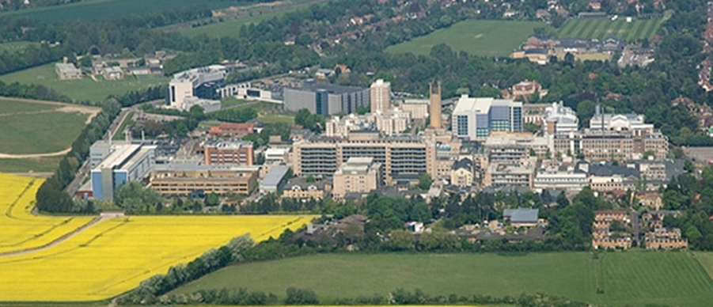

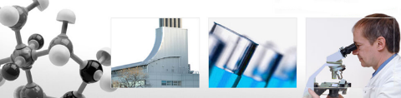
Coronoid Fractures
&
Capitellum fractures
Mr Lee Van Rensburg
Cambridge University Hospitals NHS trust
September 2019

Slide 2
www.cambridgeses.co.uk

Slide 3
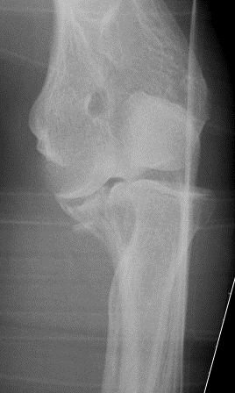
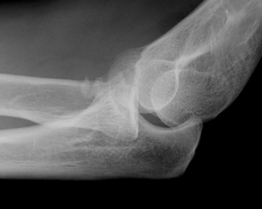
55 YO PVA 2006

Slide 4
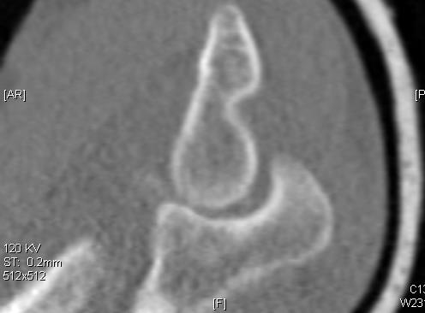
55 YO PVA
Rest of images not much help

Slide 5

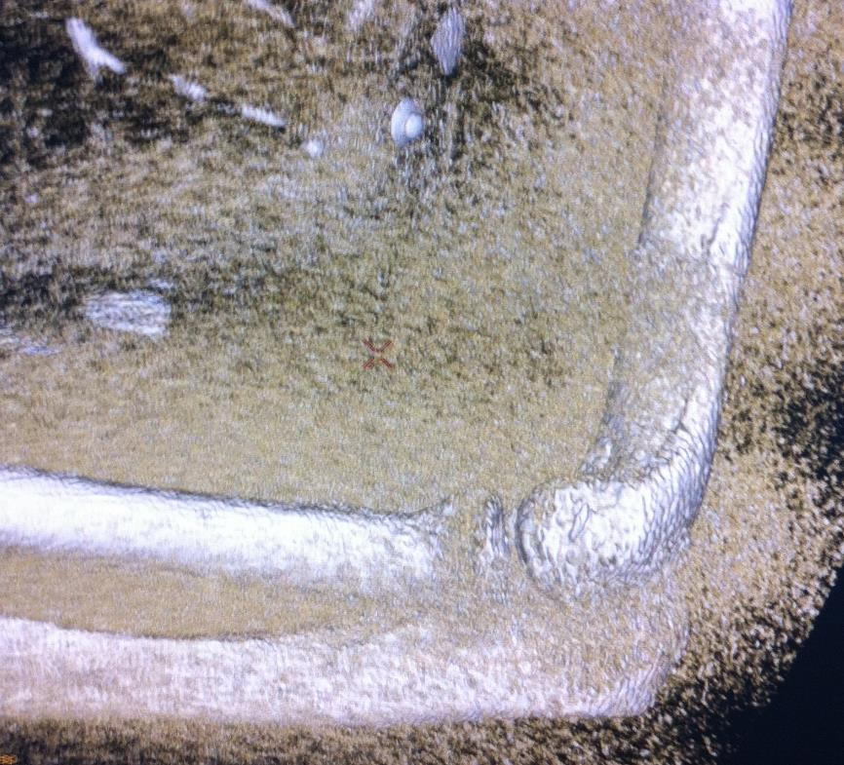
First Tip

Slide 6
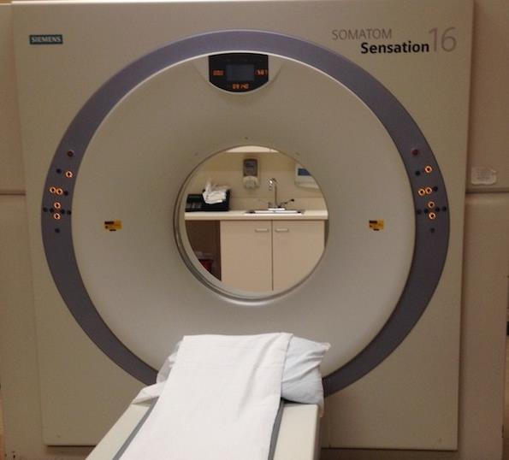
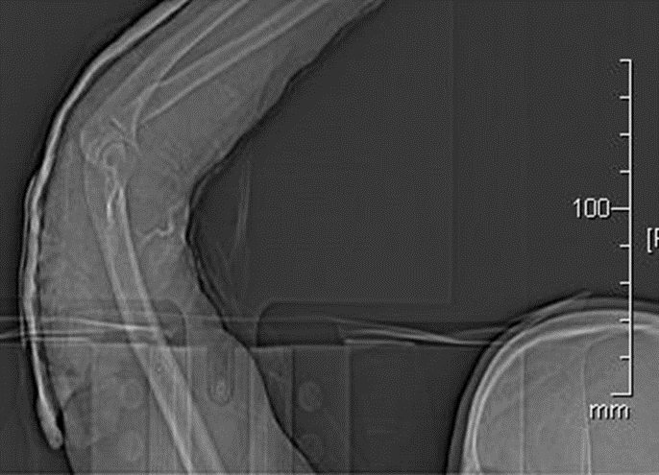
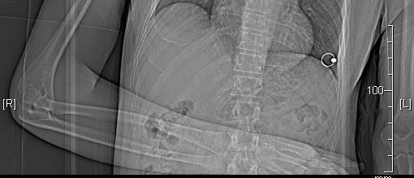
Distance from Centre of Gantry

Slide 7
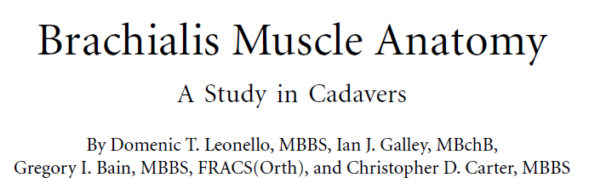
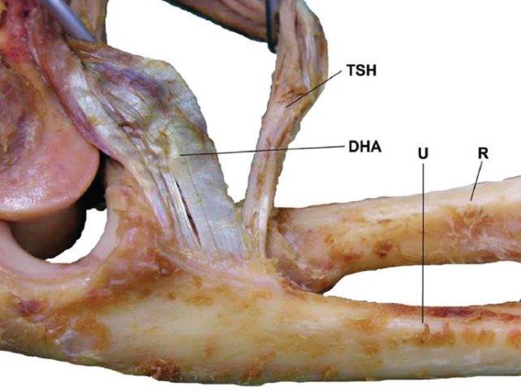
2nd Tip
Nothing attaches to the “Tip”
J Bone Joint Surg Am. 2007;89:1293-7

Slide 8
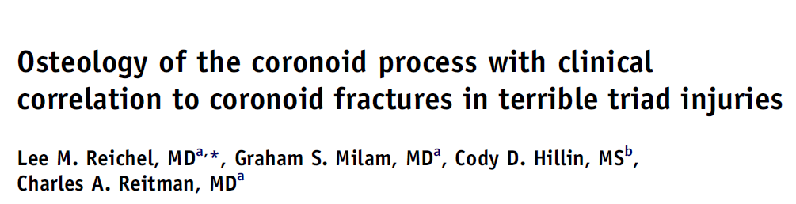
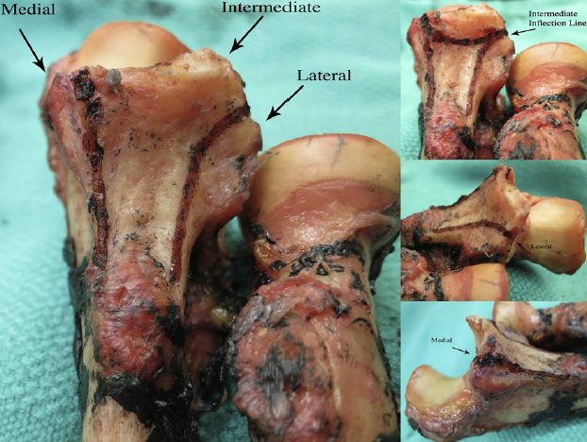
3rd Tip
There is no Tip
Three ridges
Medial
Intermediate
Lateral
J Shoulder Elbow Surg (2013) 22, 323-328

Slide 9
Coronoid
Classification
Regan and Morrey (1989)
O’Driscoll (2003)

Slide 10
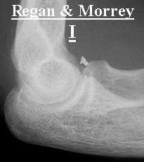
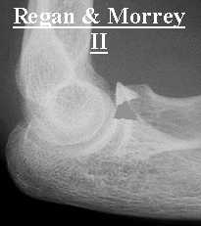
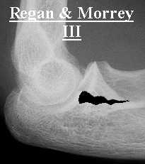
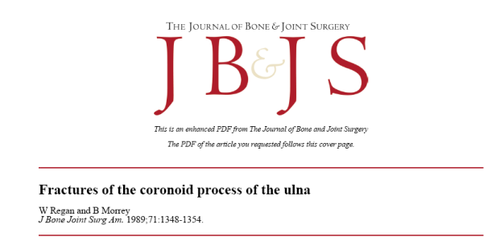
Regan Morrey 1989
  I. Small fleck of bone
  II. 50 % height of coronoid process or less
  III. More than 50 % height of coronoid process

Slide 11
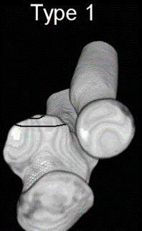
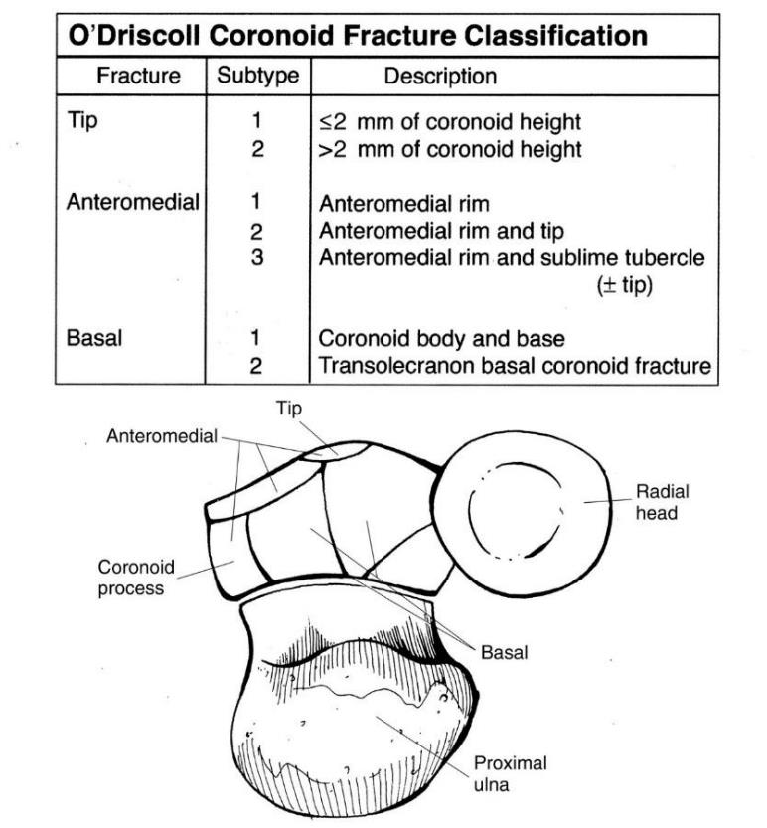
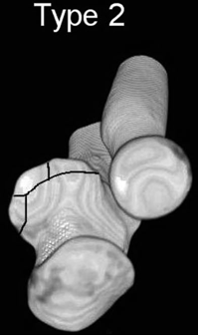
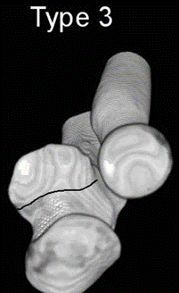
O’Driscoll 2003
    1. Tip
    2. Anteromedial fragment
    3. Base
Subtypes
Instr Course Lect. 2003;52:113-34.

Slide 12
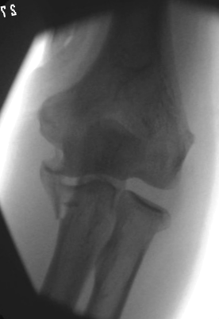
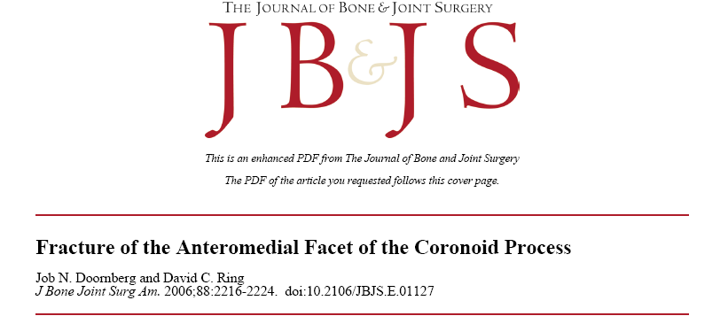
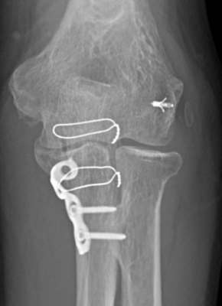
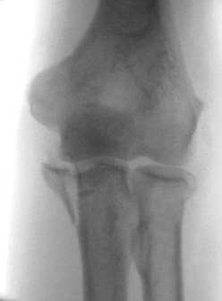
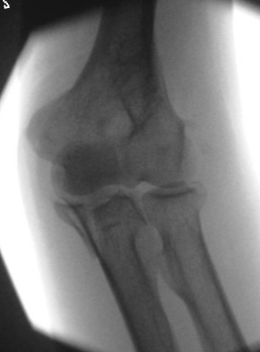
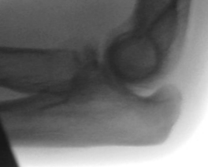
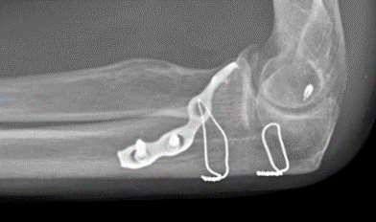
55 YO PVA 2006
Valgus
Varus

Slide 13
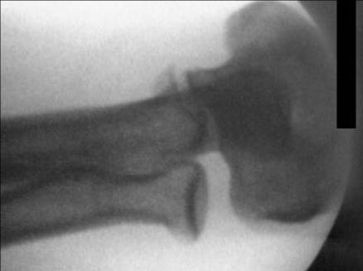
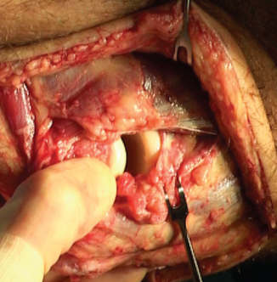
Anteromedial coronoid
Varus injury
Rupture of lateral collateral ligament
Push off of Anteromedial coronoid
Underestimate the injury
    Particularly on lateral side
Doornberg J. N., Ring D. C. J Bone Joint Surg 2006:88:2216-2224

Slide 14
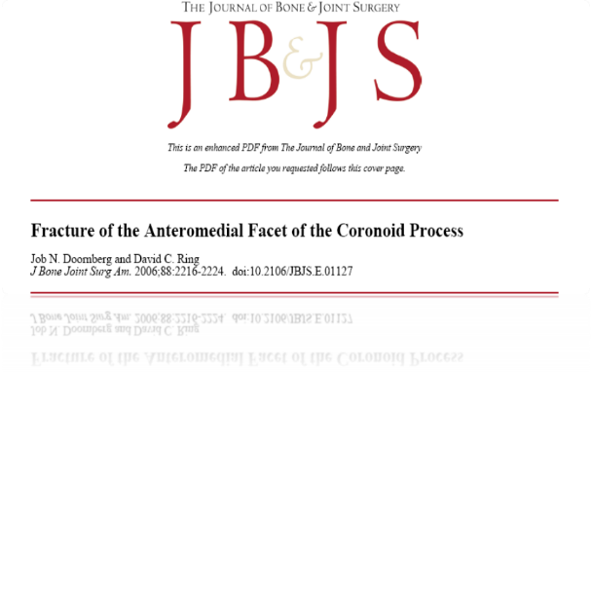
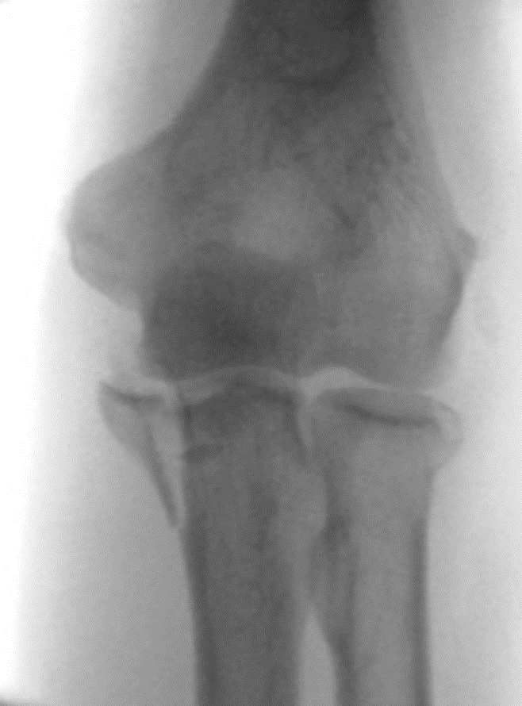
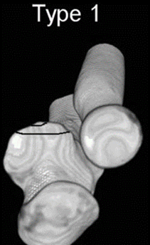


Terminology

Slide 15
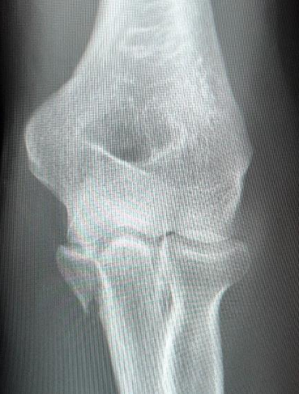
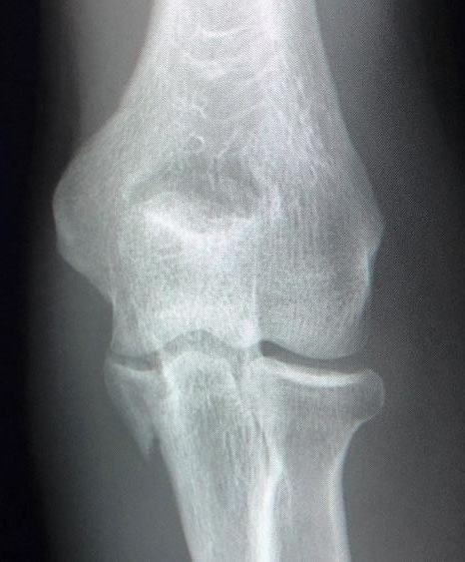
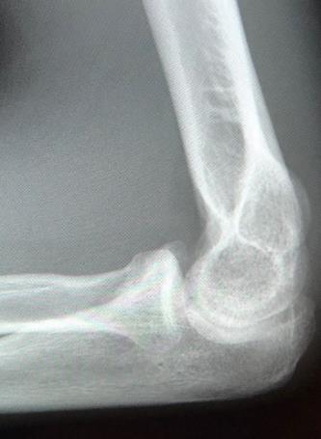
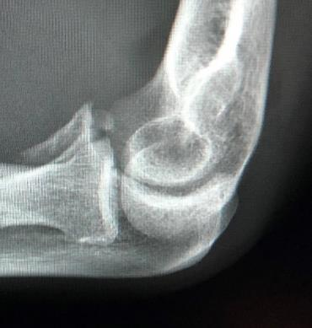
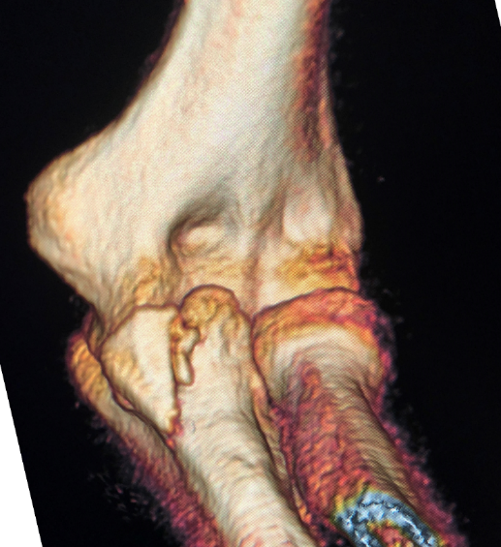
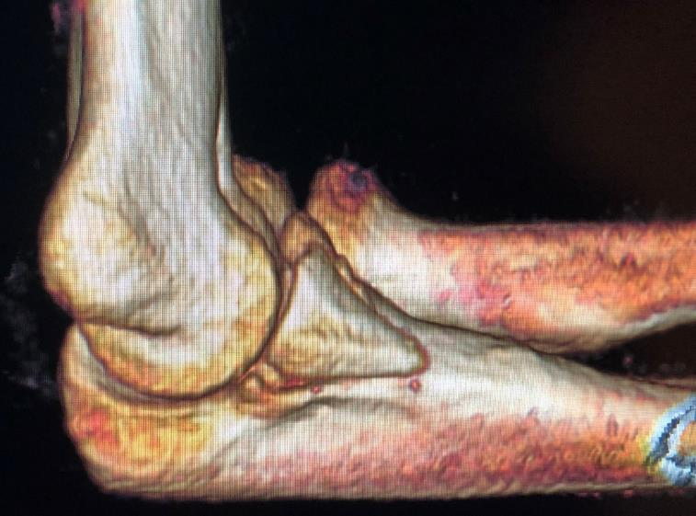
4 months

Slide 16
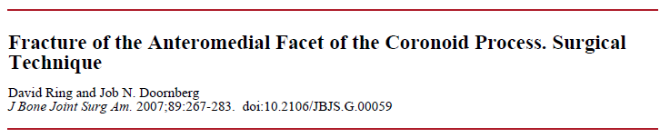
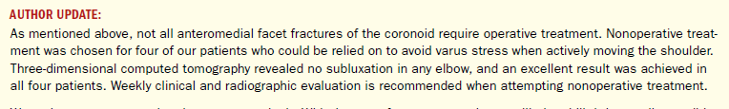
Conclusion
  Operative treatment in most cases
  Non operative only if:
    Very small fracture
    No subluxation of the elbow
    Minimal or no opening of the radiocapitellar joint on varus stress
2007
Doornberg J. N., Ring D. C. J Bone Joint Surg 2006:88:2216-2224

Slide 17
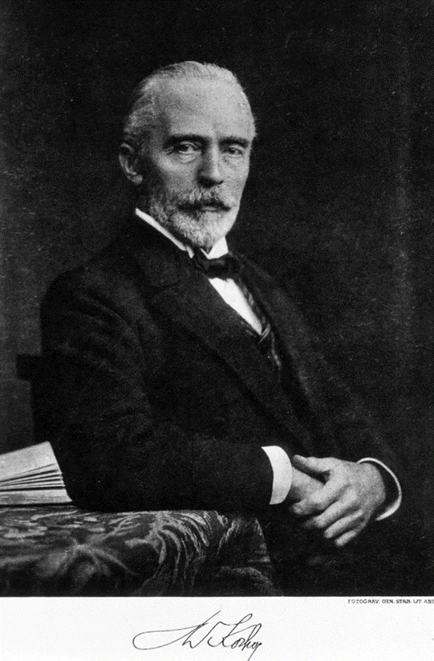
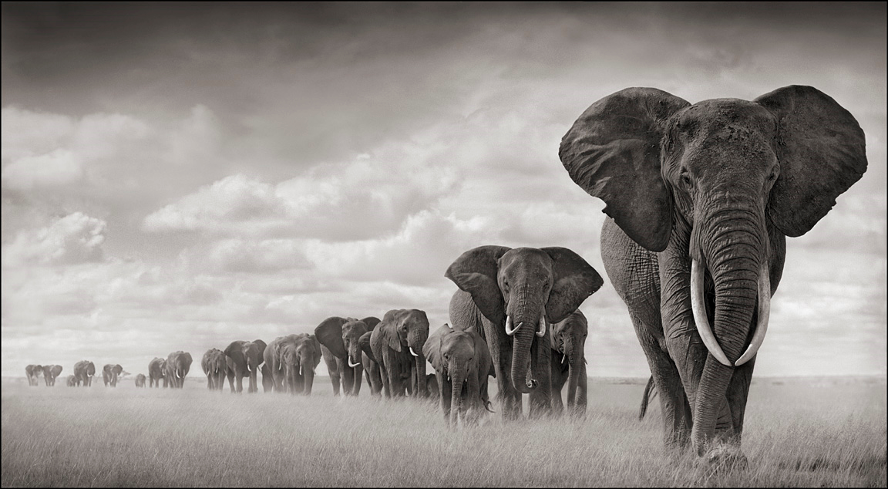
Paths

Slide 18
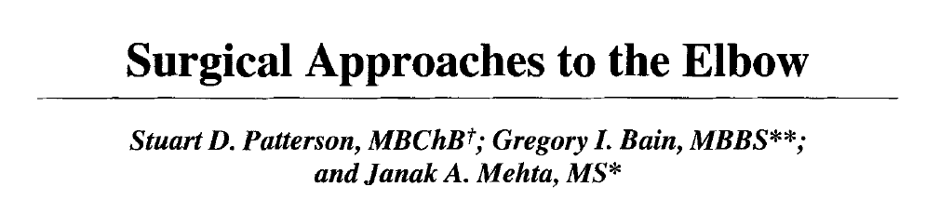
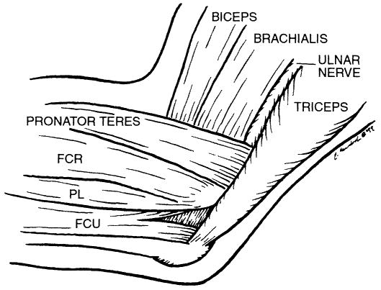

Taylor Scham
Split FCU
Hotchkiss
“Over Top”
Split Flexor pronator mass
Clin ortho and related research; (370), January 2000, pp 19-33;

Slide 19
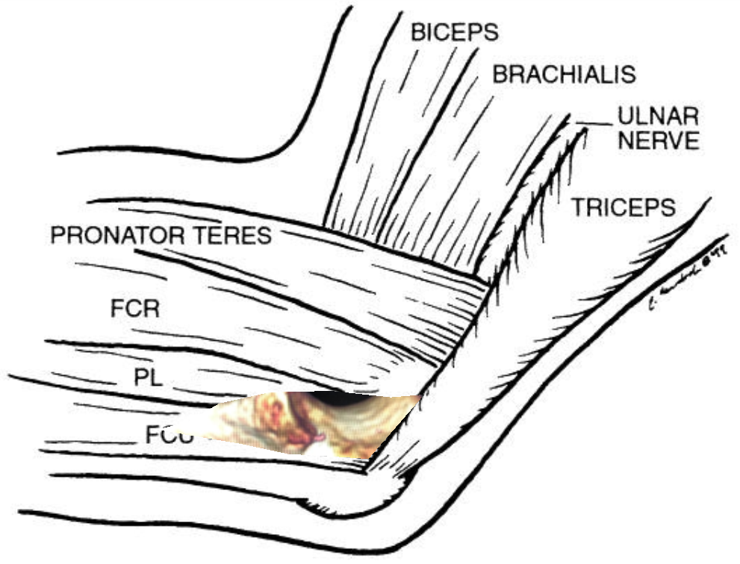

4 months

Slide 20
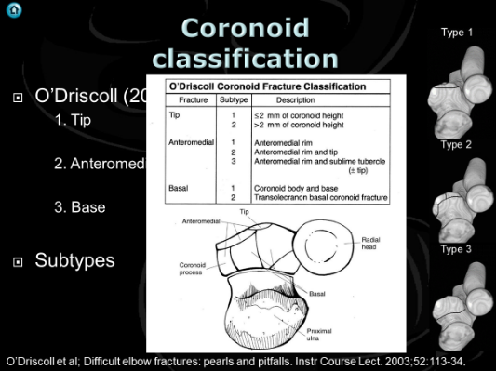
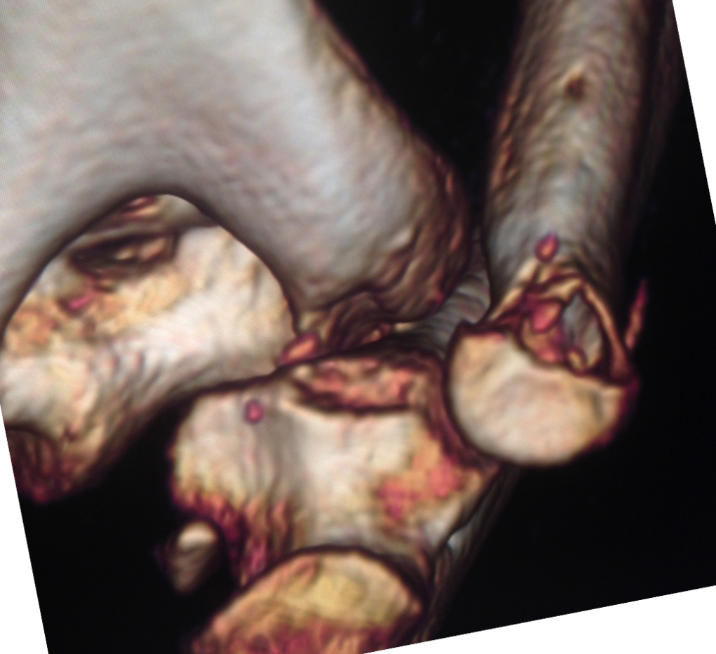
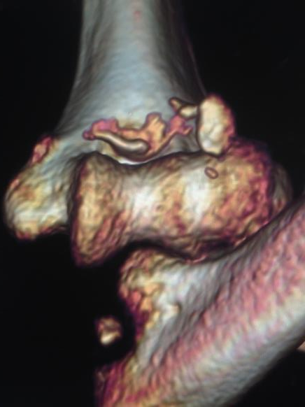

Slide 21
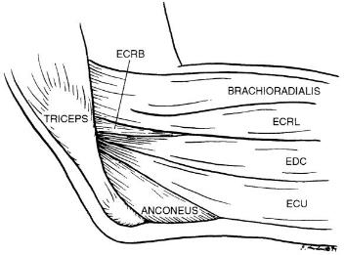
Lateral intervals
Kocher
    between anconeus and ECU
Kaplan
    between ERCB and EDC
EDC Split
Clin ortho and related research; (370), January 2000, pp 19-33

Slide 22
J Bone Joint Surg Br September 2006 88-B: 1178-1182

Slide 23


Slide 24




Slide 25





Slide 26







N = 52
5 patterns, Good kappa
4. AL oblique
7%
Tip
29%
4. AM Oblique
17%
Not Typo
Type 4 Oblique
Anteromedial
Anterolateral
2. Mid Transverse
24%
3. Basal
23%
JSES (2012) 21, 782-788

Slide 27


Taylor and Scham
Clin ortho and related research; (370), January 2000, pp 19-33;

Slide 28



EDC split to coronoid
Can get to it
Poor trajectory
Extend proximal and distal
Strip Capsule
J Shoulder Elbow Surg (2016) 25, 1268–1273

Slide 29









Slide 30





Summary

Slide 31


Two different cases
Notes:
Two different partial articular fractures value of CT

Slide 32
Classification
Historical
Ao
Brian Morrey
Ring Jupiter
Dubberley

Slide 33
Historical
Type I - Hahn-Steinthal (1853)
    Large segment of bone, whole of the capitellum
Type II - Kocher-Lorenz (1896)
    Shell of articular cartilage
Type III - Grantham 1981
    Comminuted fracture

Slide 34

AO

Slide 35
Bryan Morrey (1985)
I Complete osteochondral fracture of the capitellum
II Superficial osteochondral fracture fragment
III Comminuted fracture fragment
IV Coronal shear fracture involving the capitellum and section of trochlea

Slide 36





Dubberley (2006)
Three types
  Type 1 - Primarily the capitellum with or without the lateral trochlear ridge
  Type 2 - Capitellum and the trochlea as one piece
  Type 3 - Fractures of both the capitellum and the trochlea as separate fragments
  All Subdivided into (A) or (B)
    A No posterior condylar comminution
    B Posterior condylar comminution

Slide 37
Two different cases
Notes:
Two different partial articular fractures value of CT

Slide 38









Slide 39








Slide 40




JBJS A VOL 85-A · No. 2 · FEB 2003

Slide 41


Paths

Slide 42







55 YO
1 Year
Notes:
Articular fracture, not simple K wires, fully threaded threaded titanium wires, note no olecranon osteotomy
Paraolecranon approach lateral epicondylar fracture essentially osteotomy of lateral epicondyle (CEO and LCL complex allows subluxation of olecranon.
Lateral epicondyle and CEO secured with plate AND sutures into LCL/ CEO secured to plate

Slide 43


65 YO
Notes:
Articular fracture distal humerus, non reconstructible, hemiarthroplasty

Slide 44





65 YO

Slide 45







Slide 46
Paths

Slide 47




Cambridgesurgicaltraining.co.uk

