Slide 1
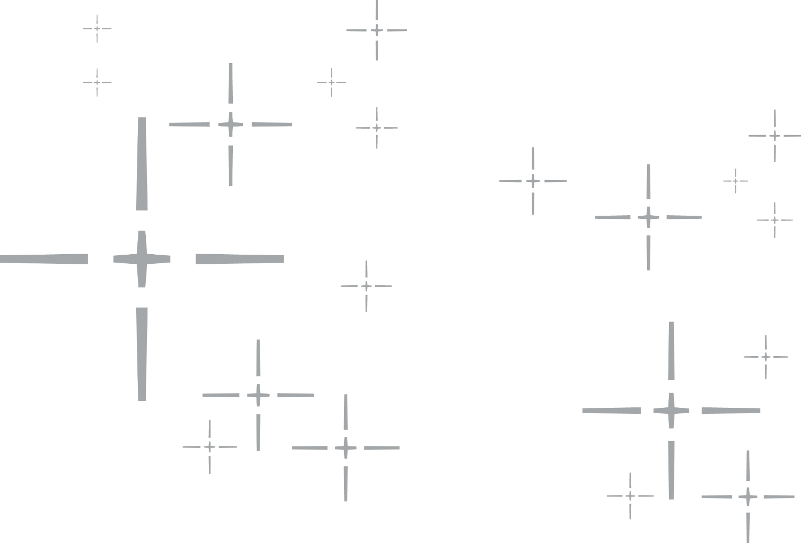

Advanced Elbow
Distal Humerus

Slide 2

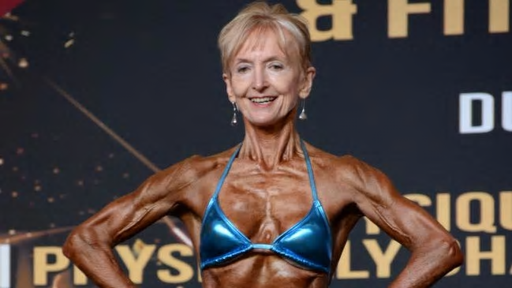
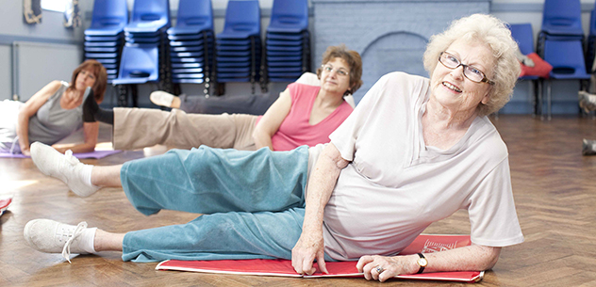
75 year old woman
Fall from Standing height
Isolated Closed injury
Neurovascular intact
No medical problems

Slide 3
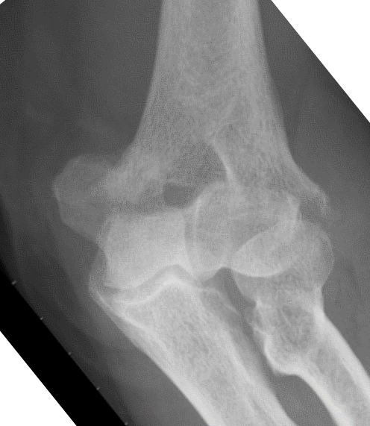
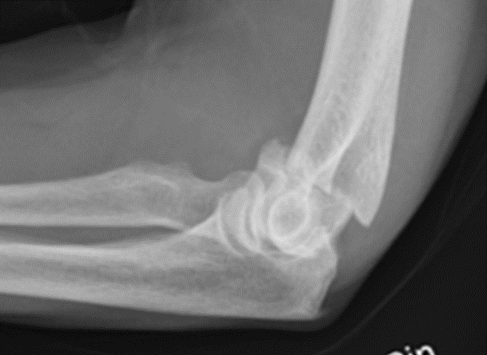
75 YO F Low energy fall
Closed Neurovascular intact
Notes:
Low supracondylar if ask for CT Extra articular

Slide 4
Injury
Treatment
Approach

Slide 5
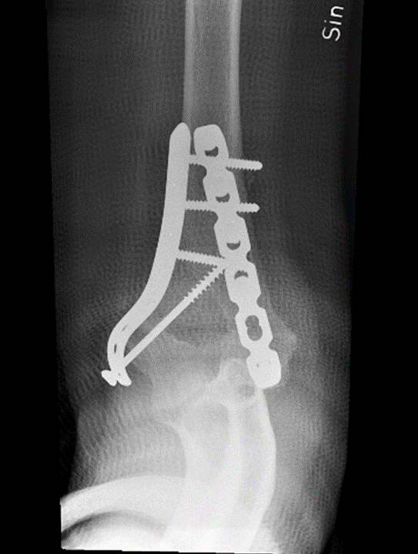
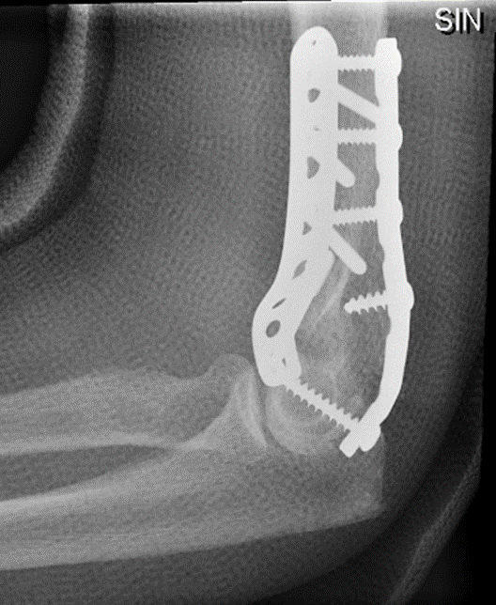
75 YO F Low energy fall
Week 4

Slide 6
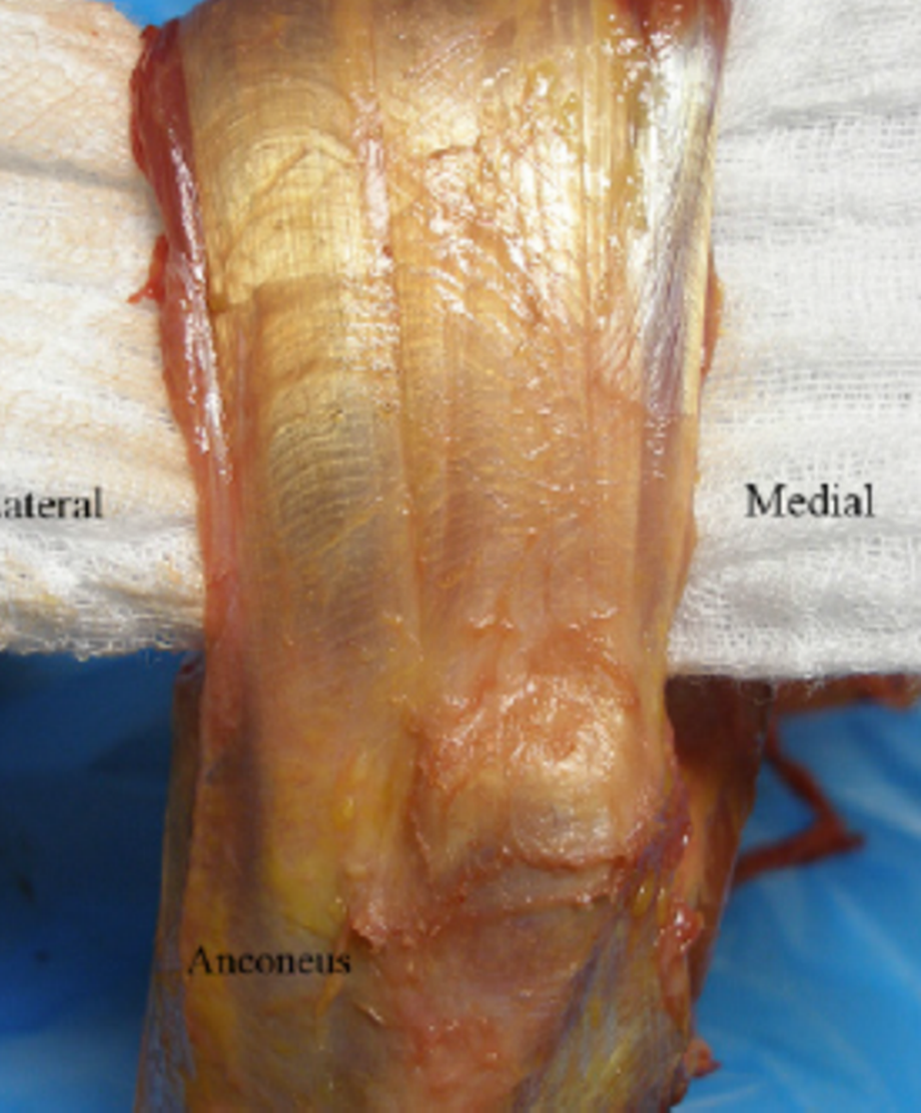
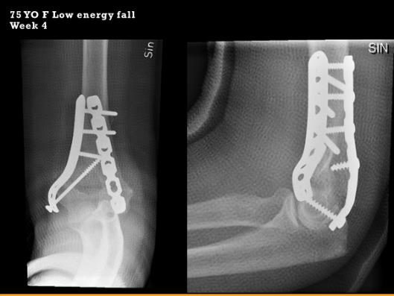
Approach

Slide 7
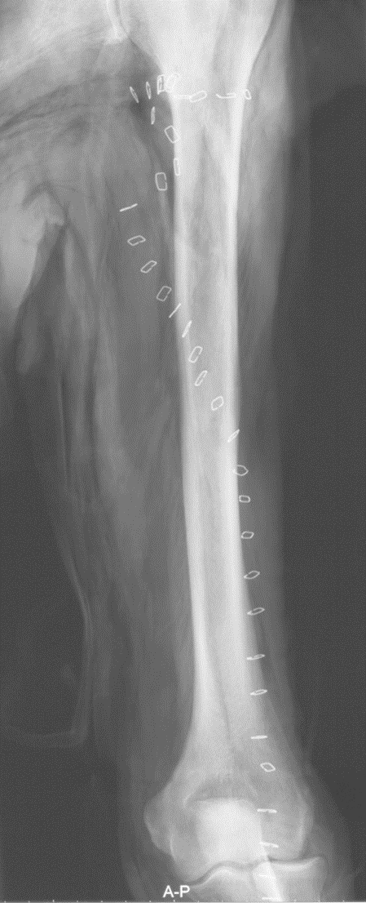
Radial Nerve

Slide 8
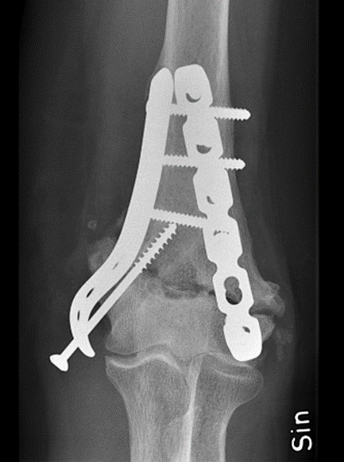
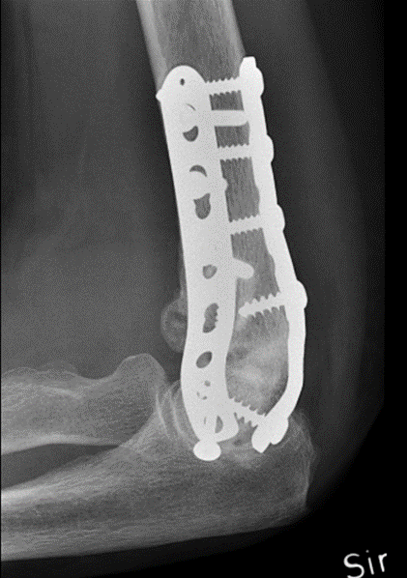
75 YO F Low energy fall
1Year, Persistent pain affecting Quality of Life and sleep

Slide 10
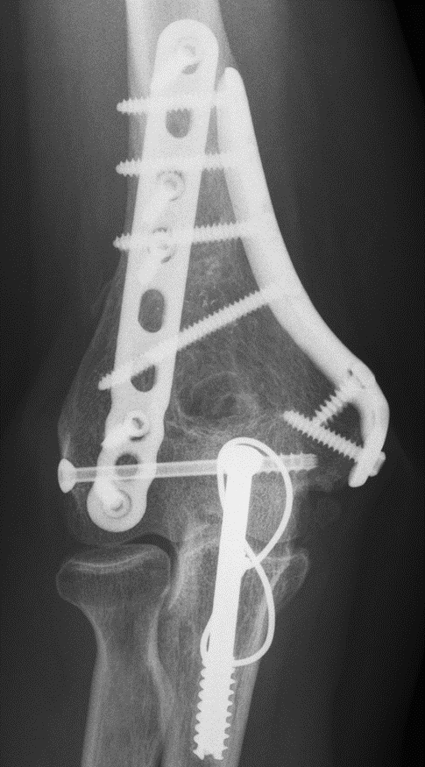
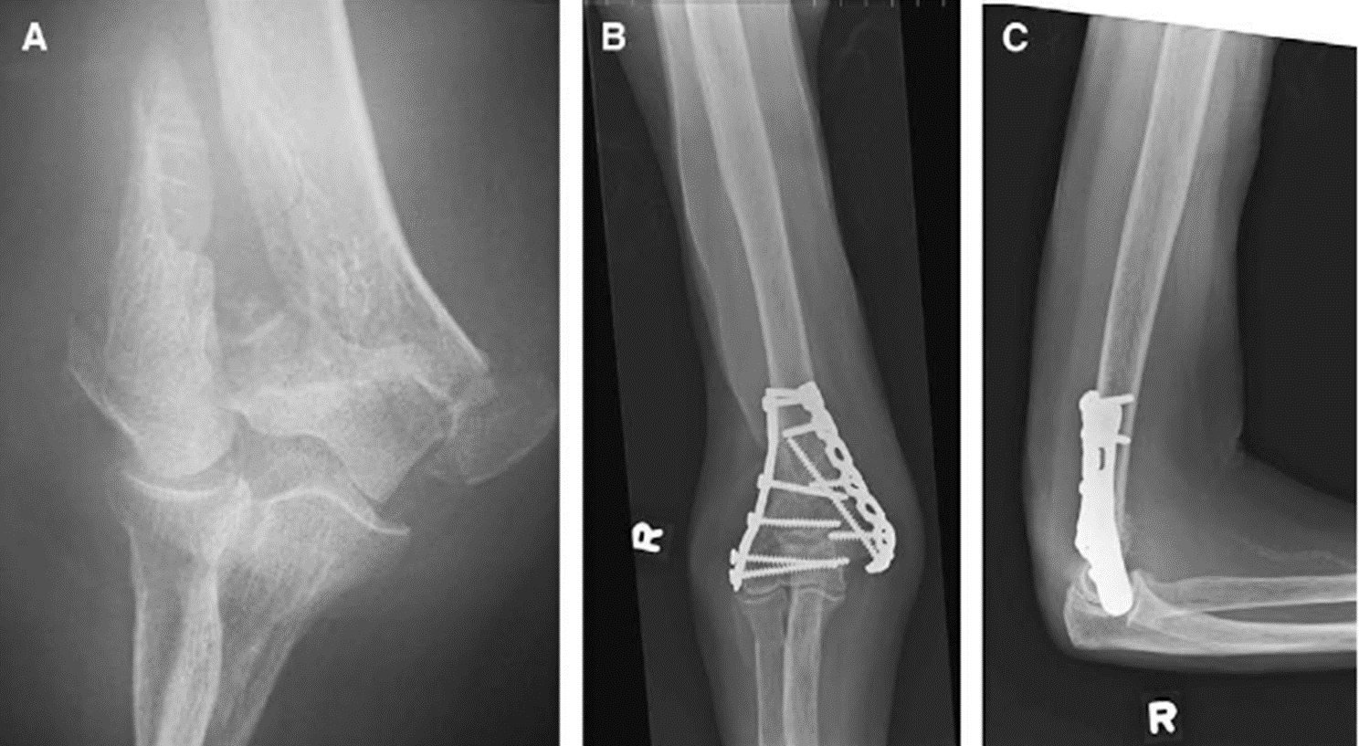
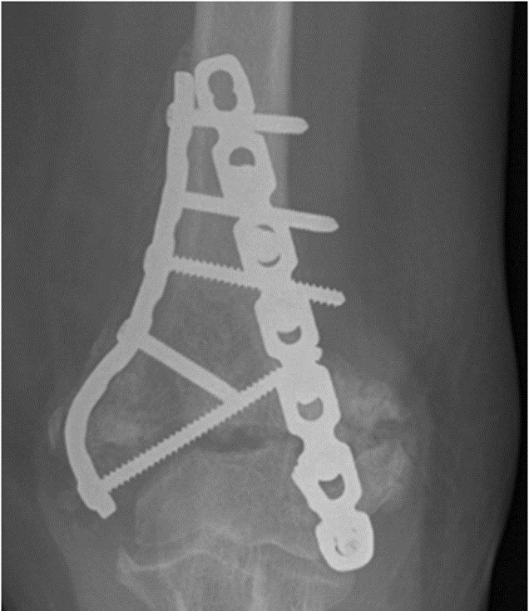
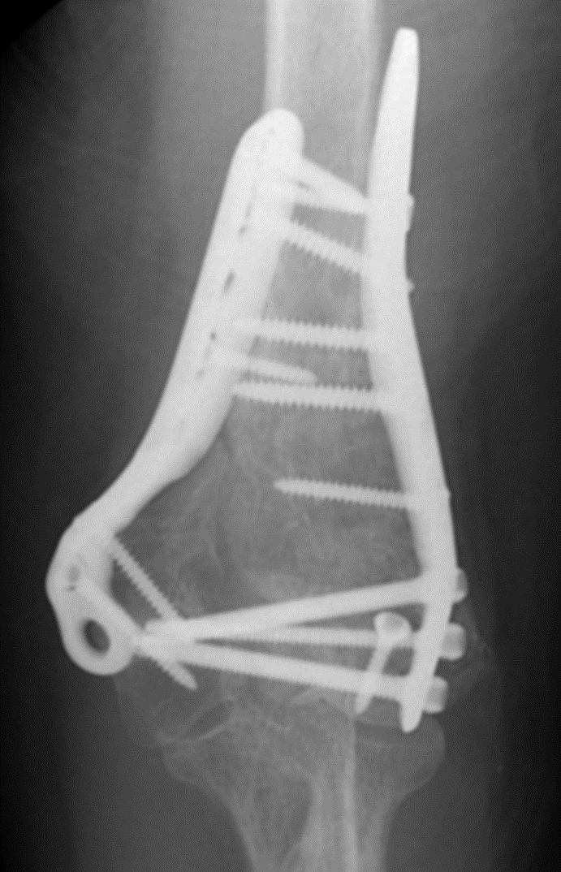
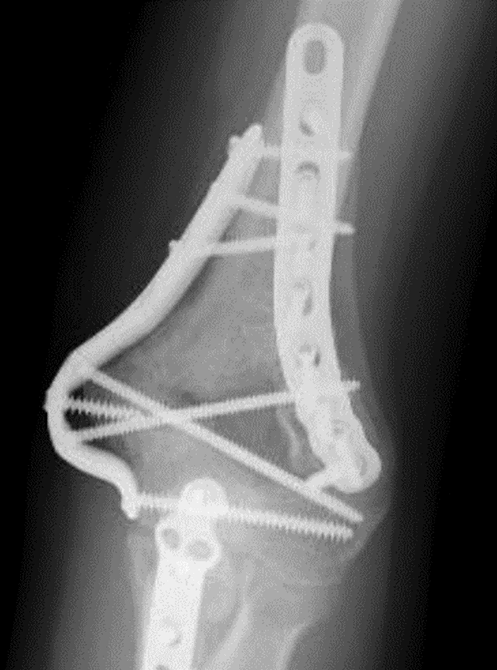
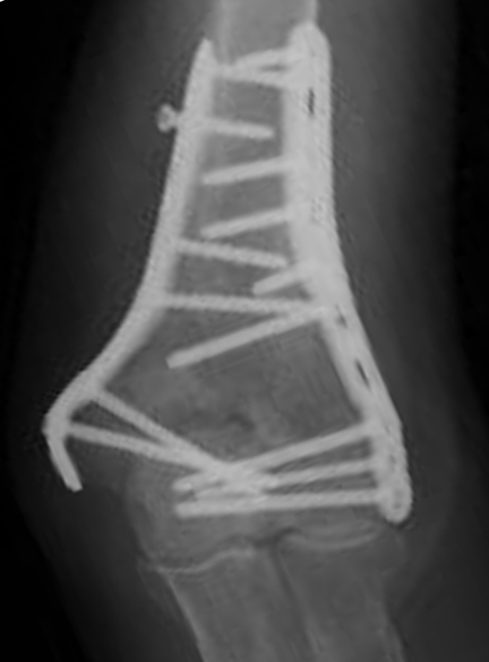
Usual Suspects
B
C
A
F
D
E

Slide 11
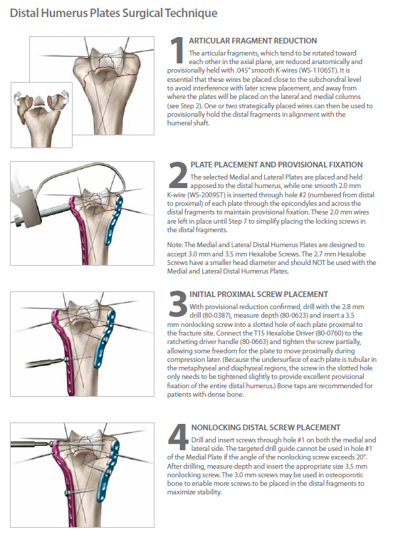
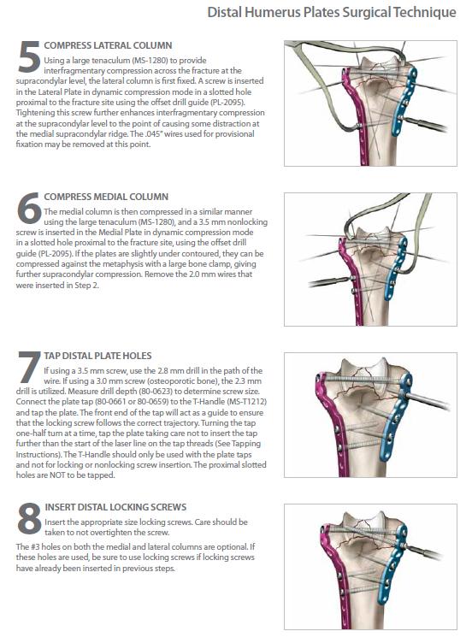
8 Steps to happiness

Slide 12
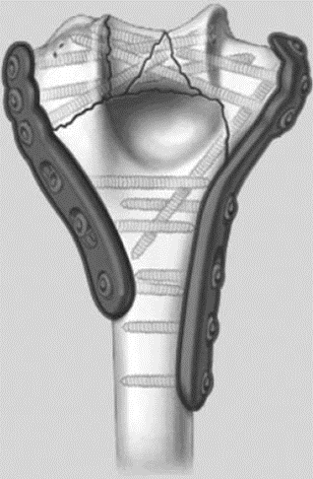
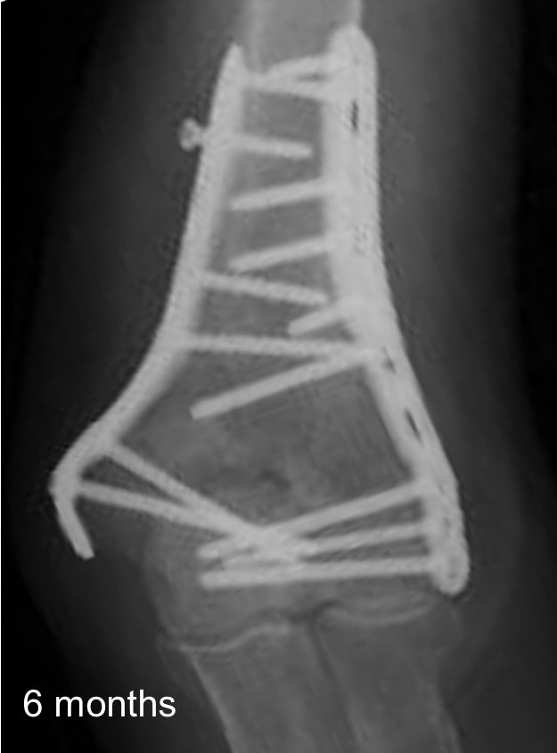
Tip
4 Good distal screws
Don’t need to be locking
First 2
Great screws
Long
Distal

Slide 13
Tip 2
No Home run screw

Slide 14
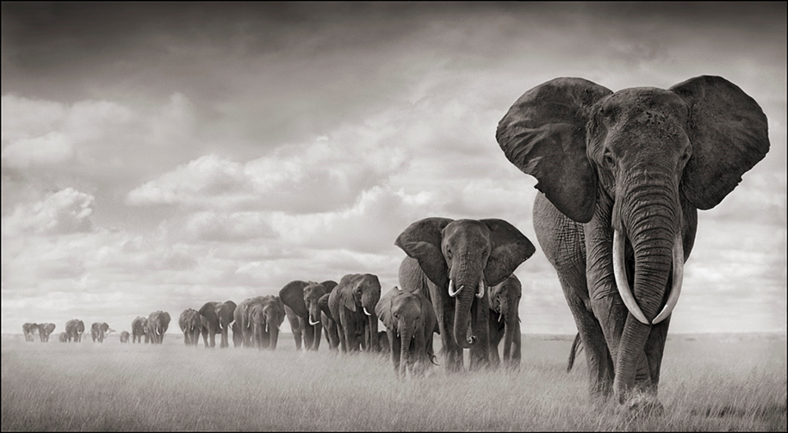
Approach

Slide 15
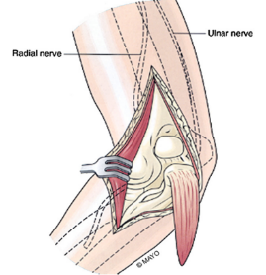
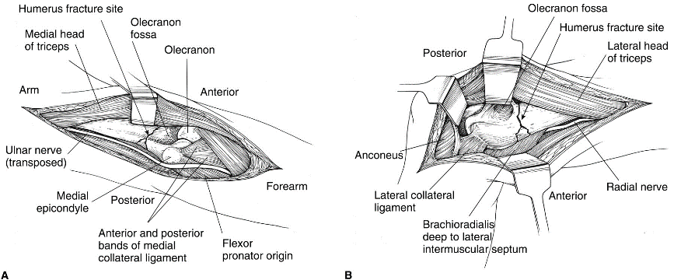
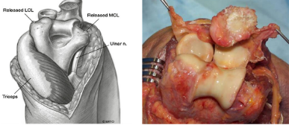
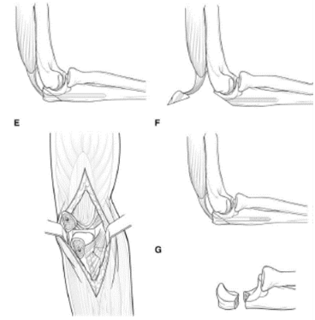
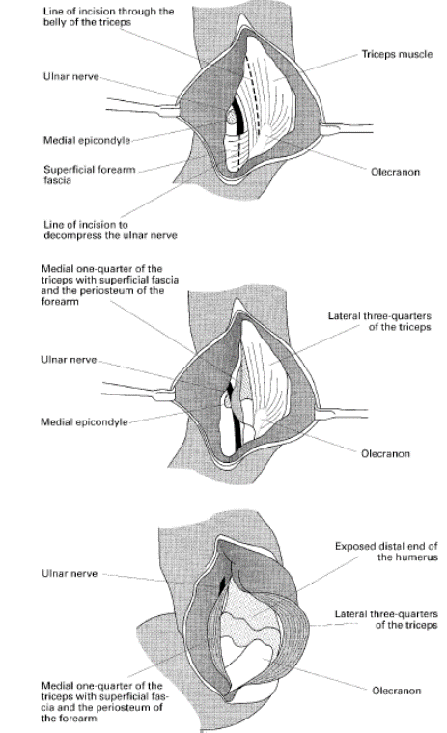
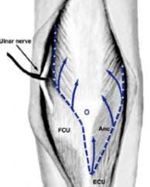
Posterior approaches
Triceps tongue – Van Gorder
Paratricipital
Triceps reflection
  Medial to lateral – Morrey
  Lateral to medial – Deakin and Deshmukh
Olecranon osteotomy
  Intra articular
  Extra articular
Triceps split
TRAP
Paraolecranon

Slide 16
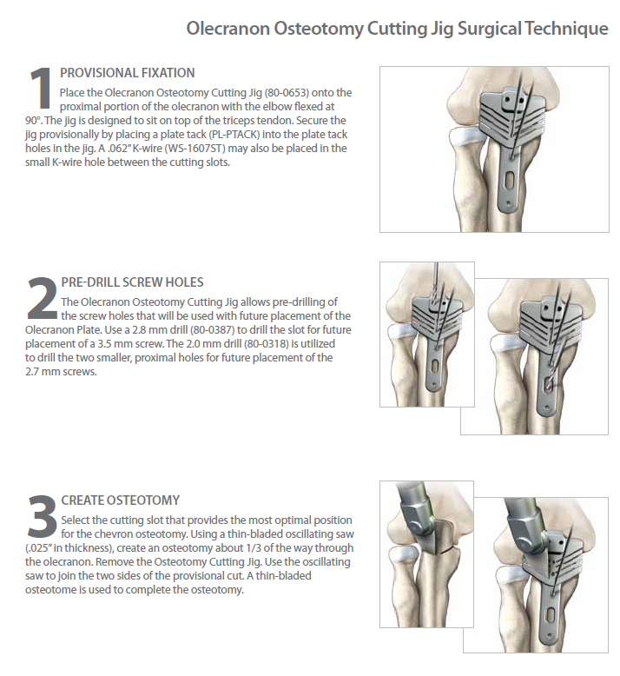

Olecranon osteotomy

Slide 17

No difference
J Shoulder Elbow Surg (2012) 21, 126-135

Slide 18
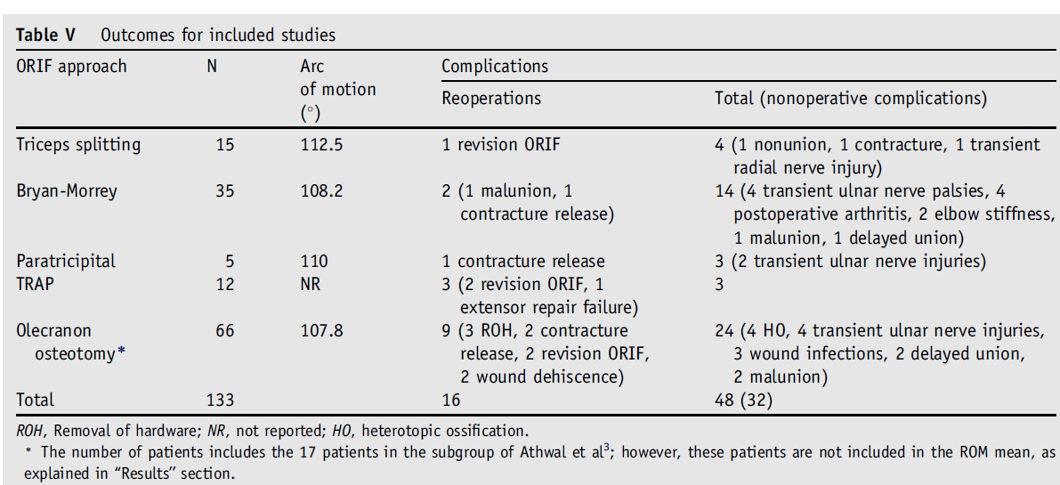
110°
1/3rd
J Shoulder Elbow Surg (2012) 21, 126-135

Slide 19
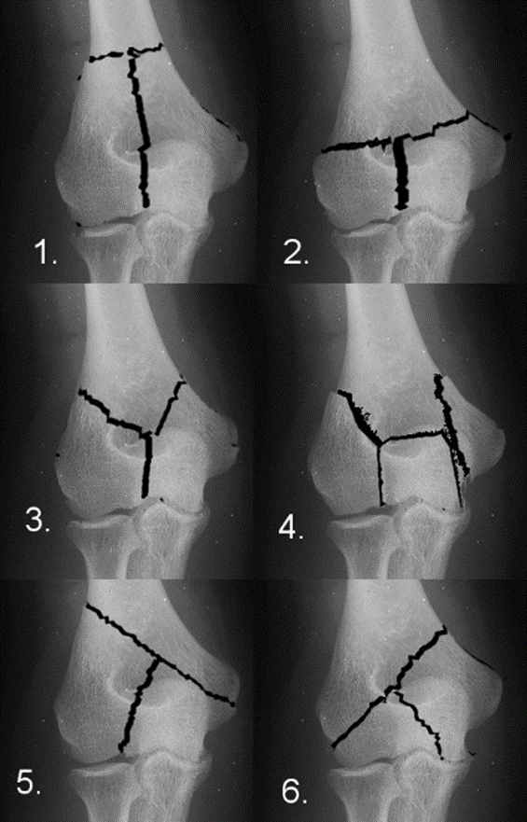


Slide 20
J Shoulder Elbow Surg (2010) 19, 399-405

Slide 21
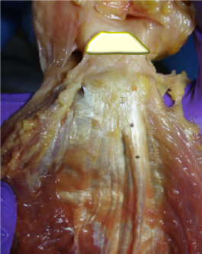

Slide 22
Medial Rolled edge
J Shoulder Elbow Surg (2010) 19, 399-405

Slide 23
Lateral
Para olecranon

Slide 24
Lateral Para-olecranon approach
Boyd HB.
Surgical exposure of the ulna and proximal third of the radius through one incision.Surg Gynaecol Obstet1940;71:87-8.

Slide 25
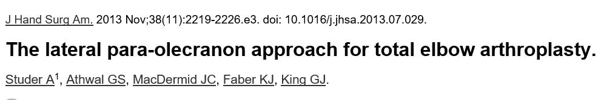
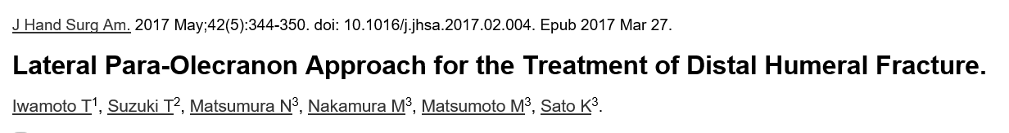
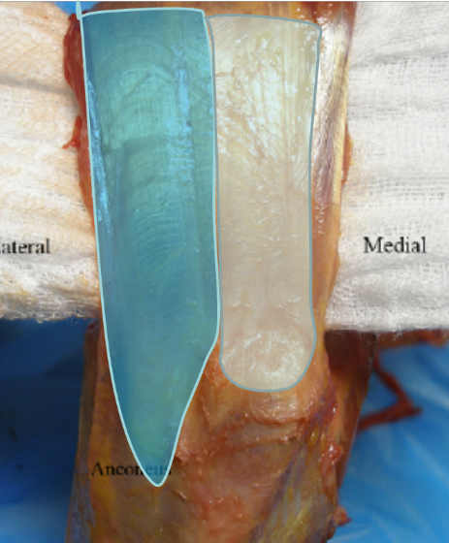
Lateral para-olecranon

Slide 26
Posterior approach
Van Gorder
Triceps splitting
(Tongue)
Bryan Morrey
Triceps reflecting
Macausland
Transolecranon osteotomy
J Shoulder Elbow Surg 2001;10:380-2.

Slide 27
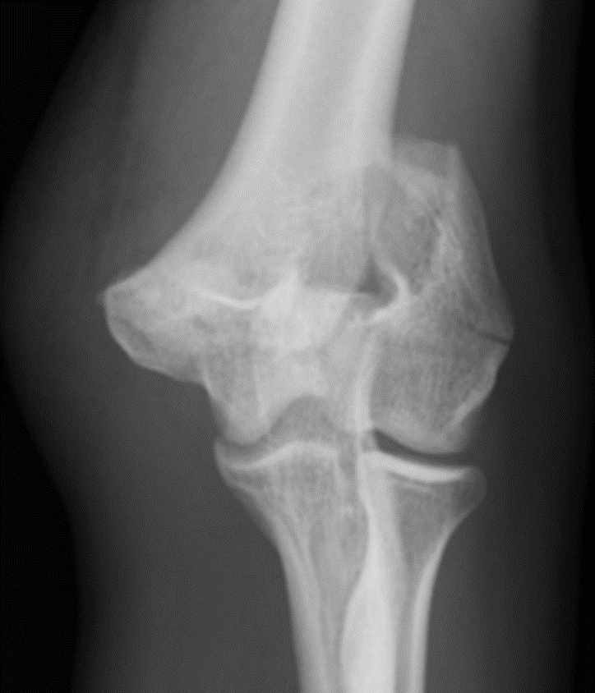
Lateral para-olecranon
J Shoulder Elbow Surg 2001;10:380-2.

Slide 28
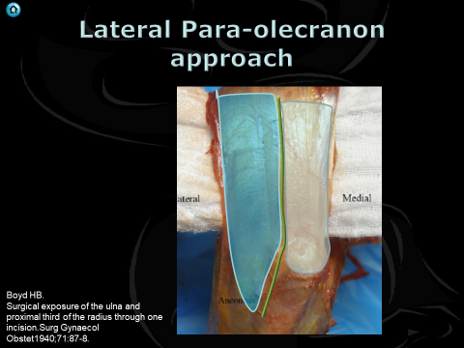
Tip
Extensibility

Slide 29
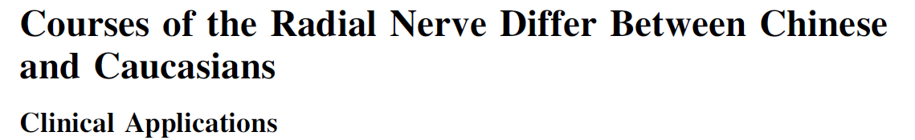
Clin Orthop Relat Res (2008) 466:135–138

Slide 30
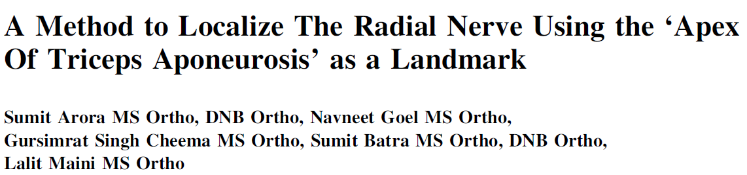
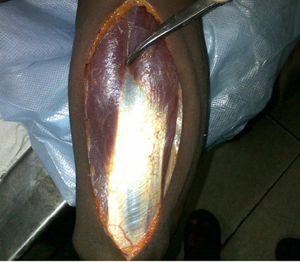
2.5 cm proximal to apex
+- 0.4 cm
10 Cadaver
30 Patients
Clin Orthop Relat Res (2011) 469:2638–2644

