Slide 1


Slide 2
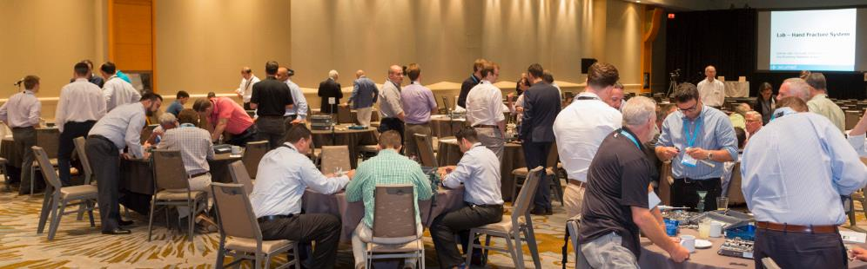
Educational Content
“The surgeon delivering this presentation is not an employee of Acumed or any of its affiliates. The views, opinions and commentary expressed in this presentation are solely those of the surgeon, and do not represent or reflect the views, opinions, policies or positions of Acumed. Acumed organized this presentation given by a surgeon for training, educational and informational purposes for other surgeons and sales representatives. Neither this presentation nor anything in it shall form the basis of any contract or commitment.”

Slide 3
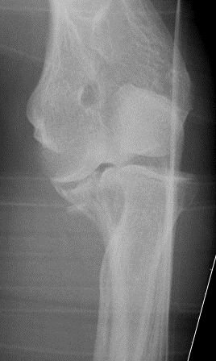
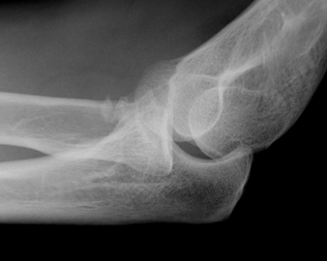
55 YO PVA
What next ?

Slide 4
Describe injury
Classify Coronoid fractures
Approach

Slide 5
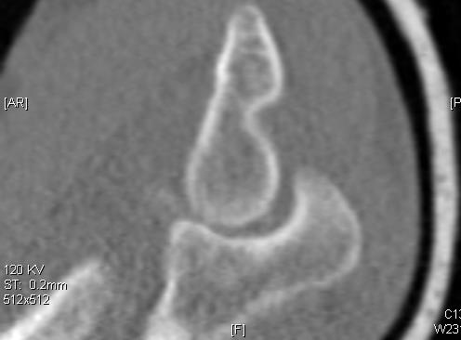
55 YO PVA
Rest of images not much help
What next ?

Slide 6
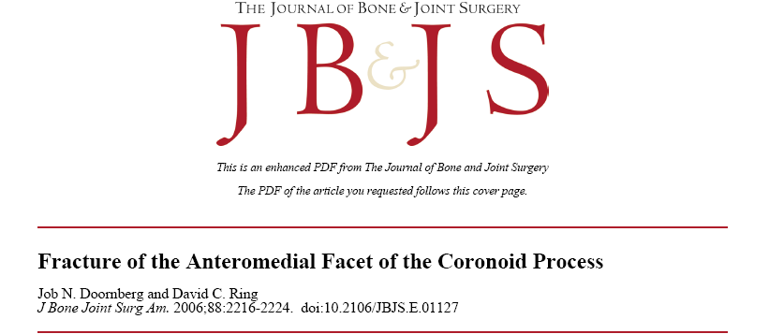
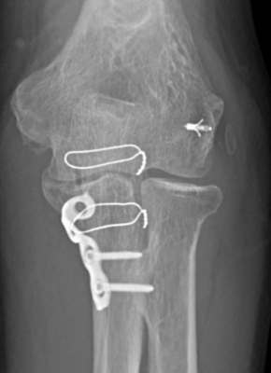
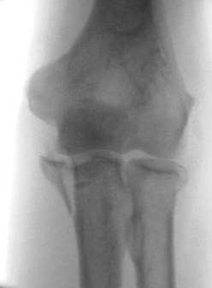
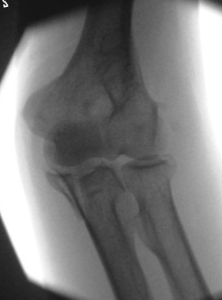
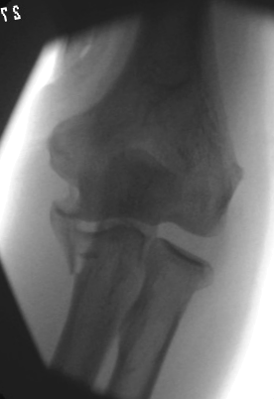
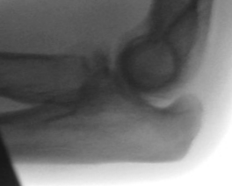
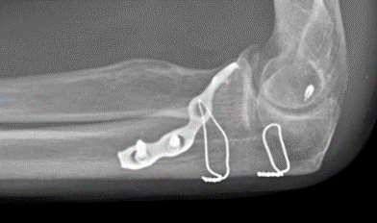
55 YO PVA
Valgus
Varus – What’s diagnosis

Slide 8
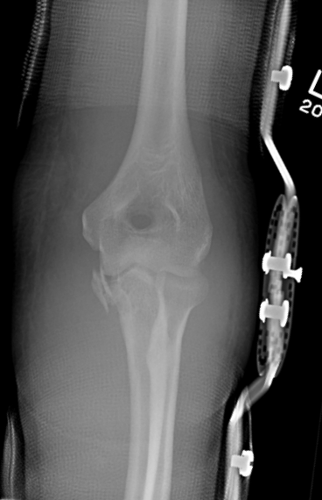
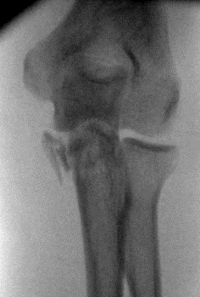
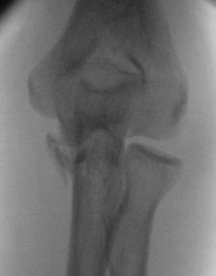
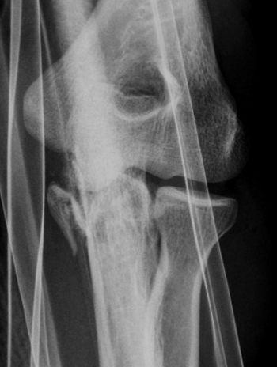
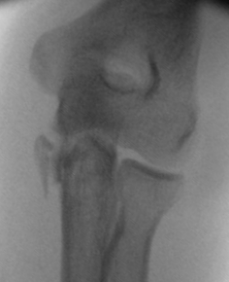
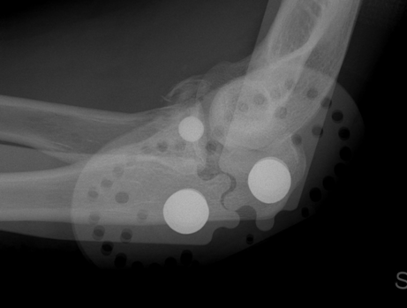
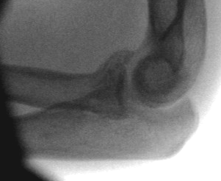
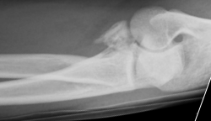
32 YO
Varus
Valgus

Slide 9
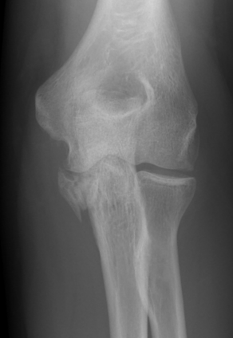
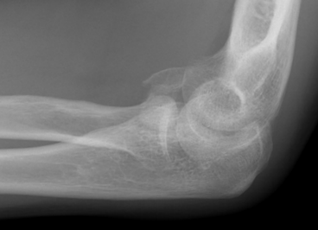
32 YO
6 Months

Slide 10
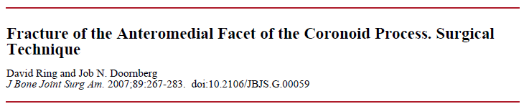
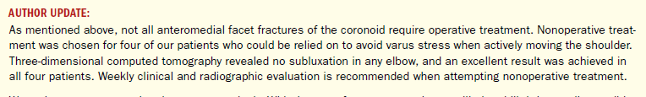
Conclusion
  Operative treatment in most cases
  Non operative only if:
    Very small fracture
    No subluxation of the elbow
    Minimal or no opening of the radiocapitellar joint on varus stress
2007
Doornberg J. N., Ring D. C. J Bone Joint Surg 2006:88:2216-2224

Slide 11
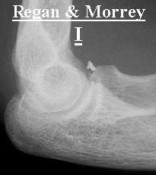
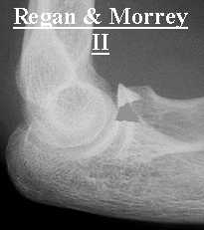
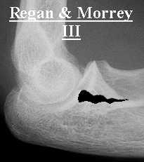
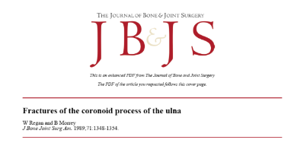
Coronoid
Classification
Regan and Morrey (1989)
    I. Small fleck of bone
    II. 50 % height of coronoid process or less
    III. More than 50 % height of coronoid process

Slide 12
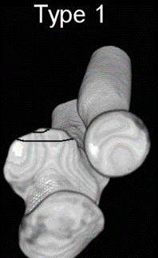
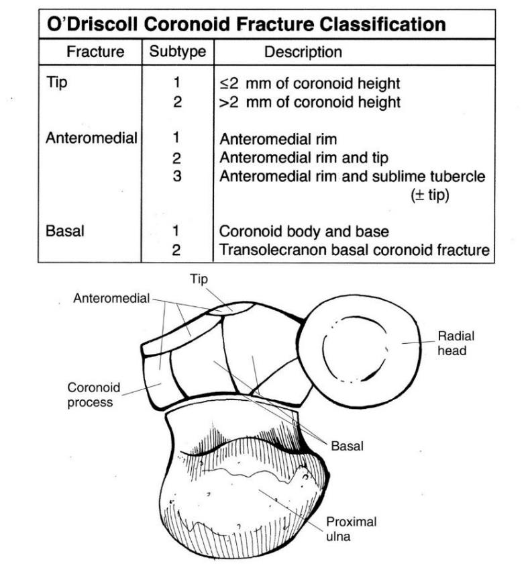
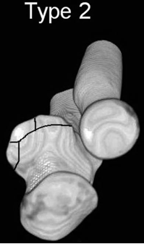
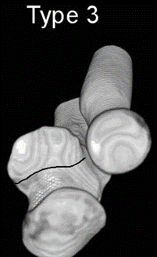
Coronoid classification
O’Driscoll (2003)
    1. Tip
    2. Anteromedial fragment
    3. Base
Subtypes
O’Driscoll et al; Difficult elbow fractures: pearls and pitfalls. Instr Course Lect. 2003;52:113-34.

Slide 13
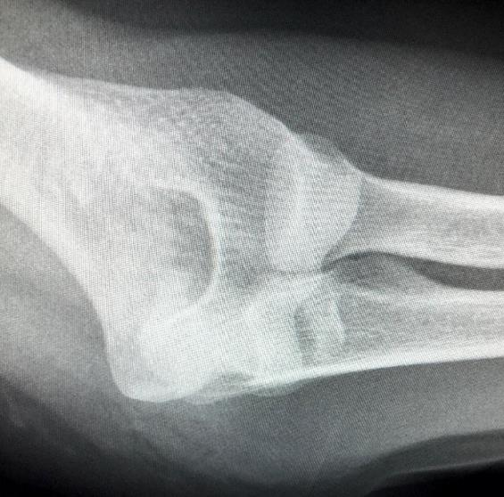
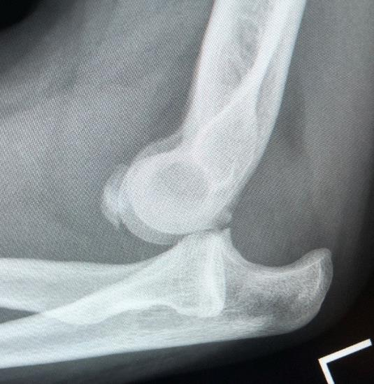
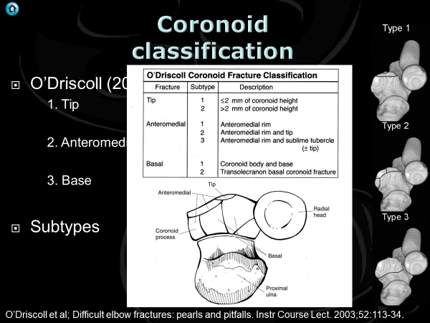
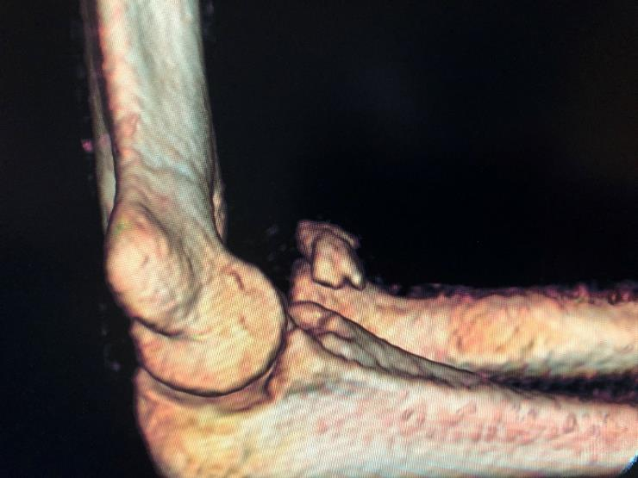
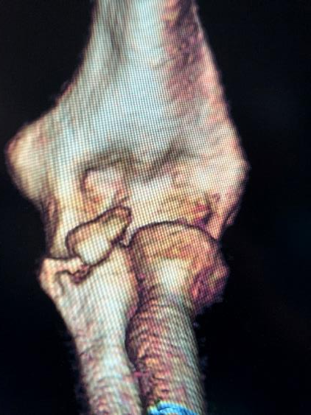

Slide 14

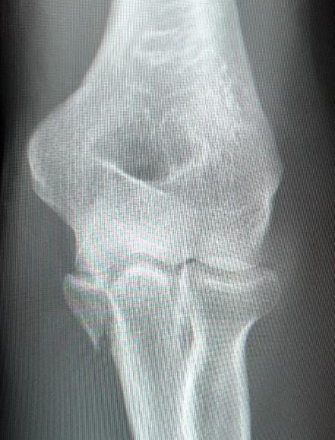
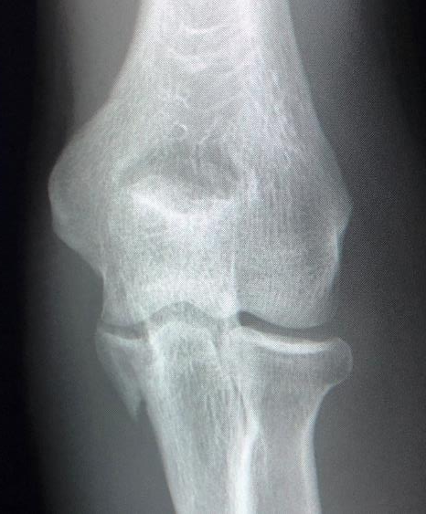
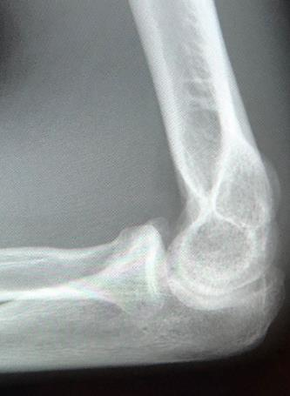
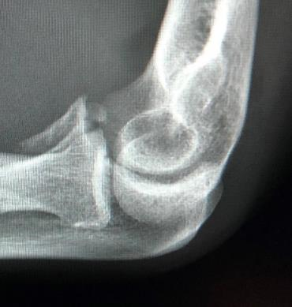
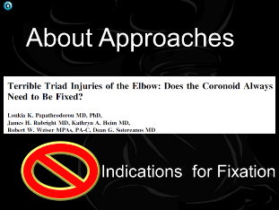
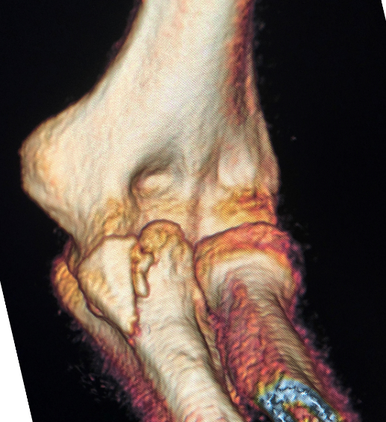
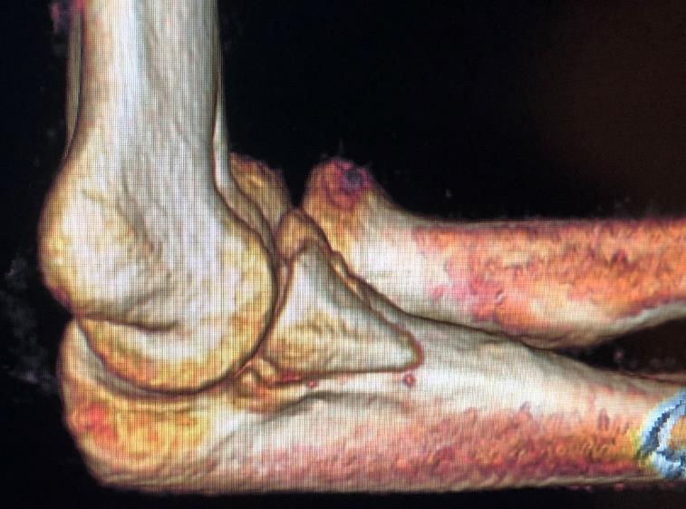
4 months

Slide 15
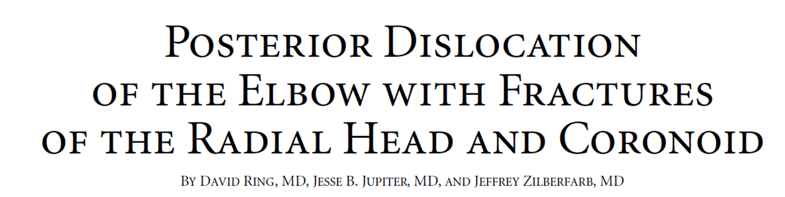
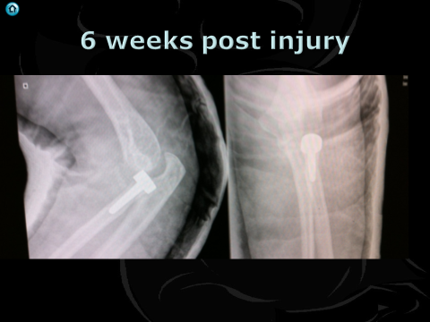
Terrible Triad
JBJS – A VOL84-A · 4 (547-551) APRIL 2002

Slide 16

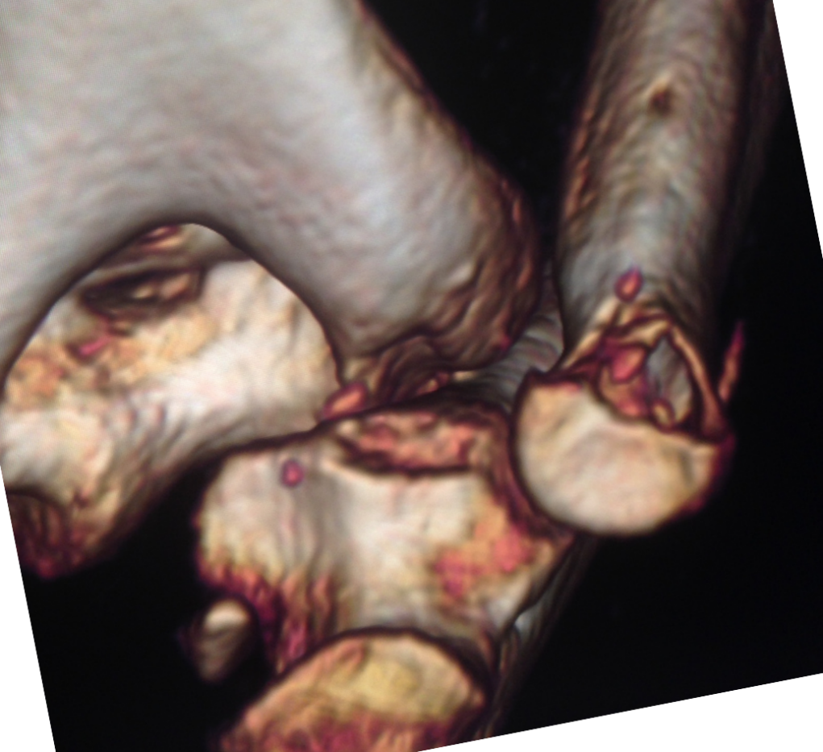
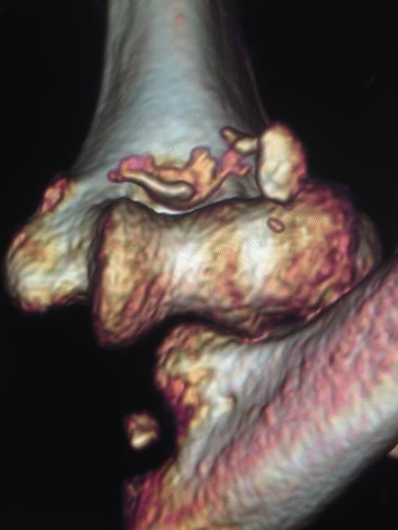

Slide 17
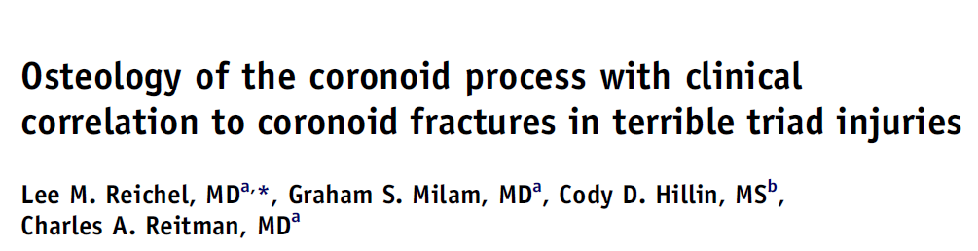
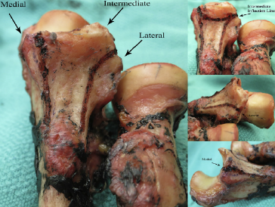
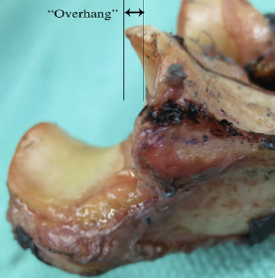
Three ridges
Medial
Intermediate
Lateral
Overhang
Hook ? stopping inferior subluxation
J Shoulder Elbow Surg (2013) 22, 323-328

Slide 18



Slide 19










Slide 20


Slide 21







N = 52
5 patterns, Good kappa
4. AL oblique
7%
Tip
29%
4. AM Oblique
17%
Not Typo
Type 4 Oblique
Anteromedial
Anterolateral
2. Mid Transverse
24%
3. Basal
23%
JSES (2012) 21, 782-788

Slide 22



Taylor Scham
Split FCU
Hotchkiss
“Over Top”
Split Flexor pronator mass
Clin ortho and related research; (370), January 2000, pp 19-33;

Slide 23


Taylor and Scham
Clin ortho and related research; (370), January 2000, pp 19-33;

Slide 24

Split FCU
Clin ortho and related research; (370), January 2000, pp 19-33;

Slide 25

Where is Hotchkiss
Split between anterior border and ulna nerve
Clin ortho and related research; (370), January 2000, pp 19-33;

Slide 26


Favour FCU
Very anterior split of FP mass
Suggested FCU
better
J Orthop Trauma 2013;27:730–734)

Slide 27
Where is Hotchkiss
Split between anterior border and ulna nerve
Clin ortho and related research; (370), January 2000, pp 19-33;

Slide 28


Hotchkiss better
Look where splitting FP
Mass
Not splitting
Between PL and FCU
J Shoulder Elbow Surg (2015) 24, 1074-1080

Slide 29

Problem FCU split
1st motor branch
J Shoulder Elbow Surg (2015) 24, 1074-1080

Slide 30



EMEA

Slide 31

Lateral intervals
Kocher
    between anconeus and ECU
Kaplan
    between ERCB and EDC
EDC Split
Clin ortho and related research; (370), January 2000, pp 19-33

Slide 32



J Bone Joint Surg Am. 2014;96:387-93

Slide 33



EDC split to coronoid
Can get to it
Poor trajectory
Extend proximal and distal
Strip Capsule
J Shoulder Elbow Surg (2016) 25, 1268–1273

Slide 34
J Bone Joint Surg Br September 2006 88-B: 1178-1182

Slide 37








