Slide 1
Tissue vitality and effect of injury
Mr Lee Van Rensburg
Advanced principles of fracture management
Consultant Orthopaedic Surgeon
Cambridge; UK
Cairo July 2019

Slide 2
www.cambridgeses.co.uk

Slide 3

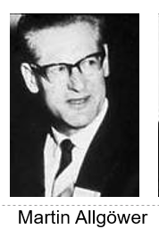
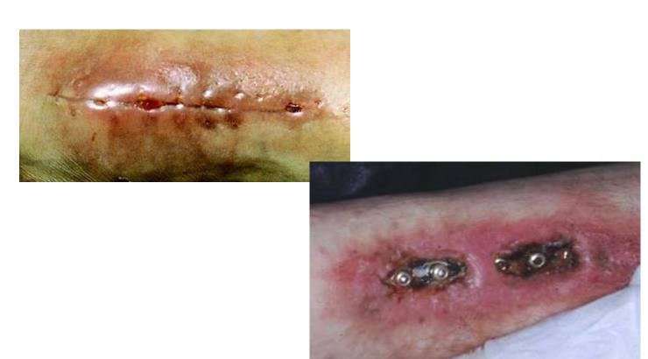

Slide 4
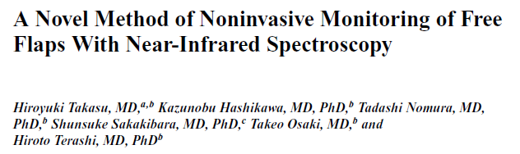
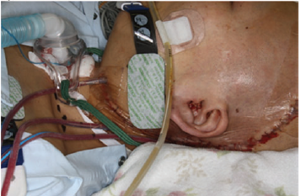
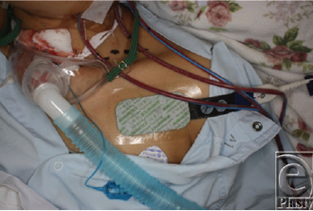
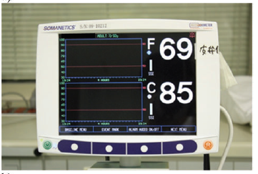
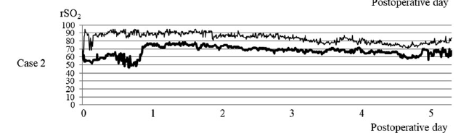
Eplasty. 2017 Dec 15;17:e37. eCollection 2017

Slide 5
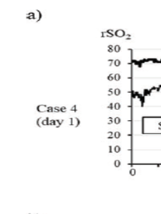
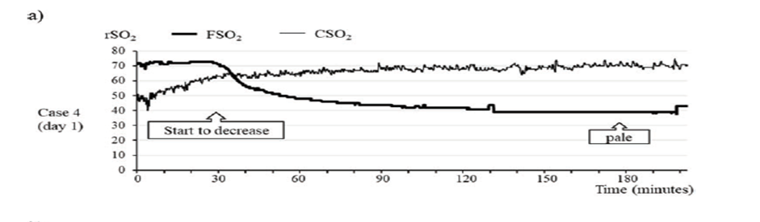
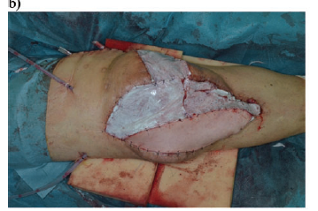
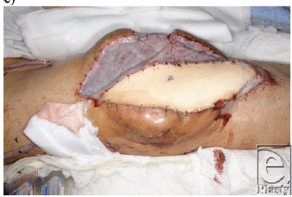
Eplasty. 2017 Dec 15;17:e37. eCollection 2017

Slide 6
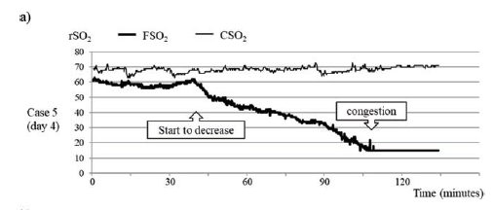
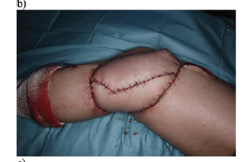
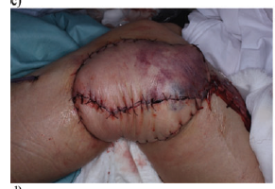
Eplasty. 2017 Dec 15;17:e37. eCollection 2017

Slide 7
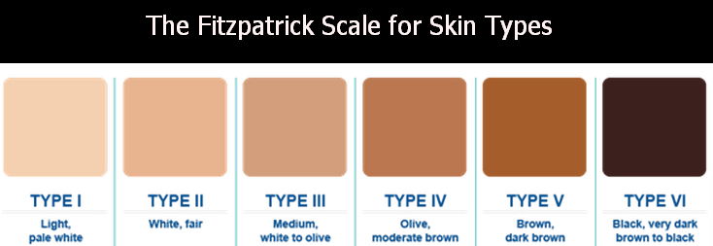
Tourniquet on healthy test subjects
Assessed forearm ischaemia
92% Caucasians
23% African Americans
J Hand Surg Am. 2018 Jan;43(1):24-32

Slide 8
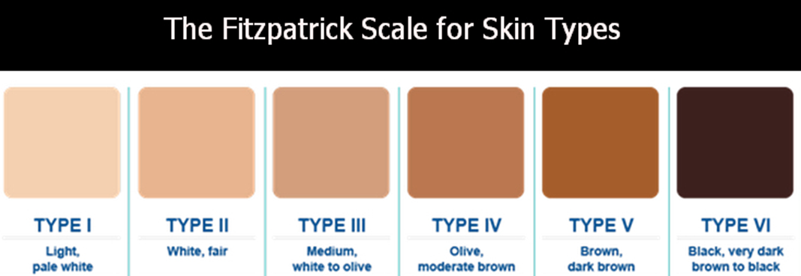
Near Infrared spectroscopy NIRS
  Identified Ischaemia independent of pigmentation
Skin Temperature
  No Value
Plast Reconstr Surg. 2019 Jun 27

Slide 9
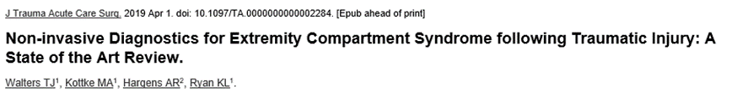

J Trauma Acute Care Surg. 2019 Apr

Slide 10
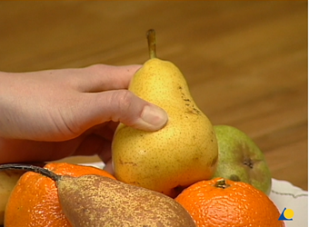
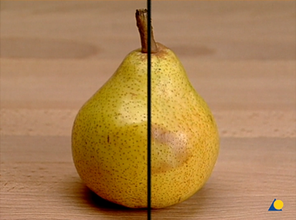
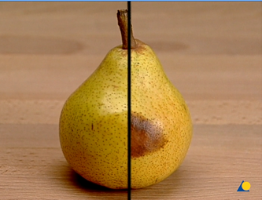
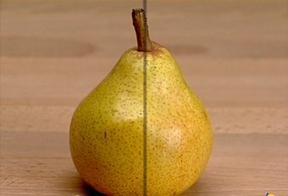

Slide 11
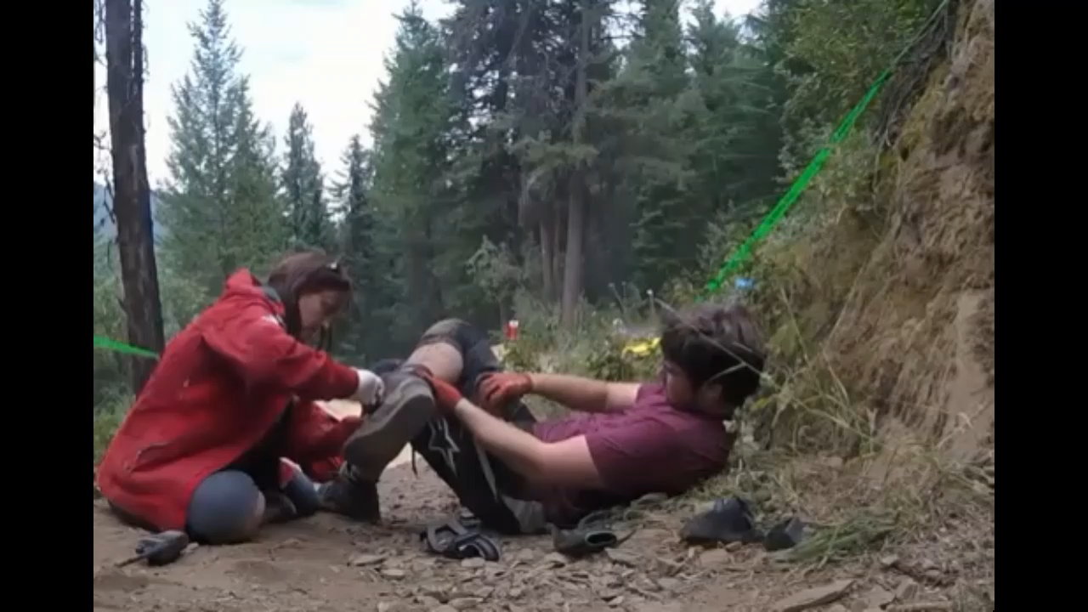

Slide 12
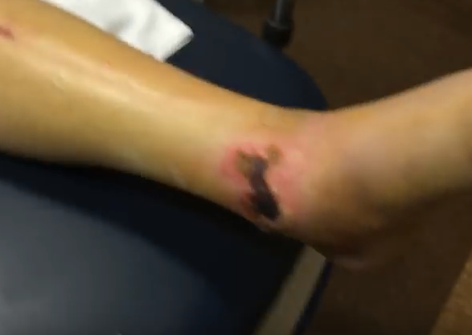
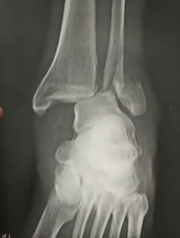
Different case
Delayed presentation
4 days old

Slide 13
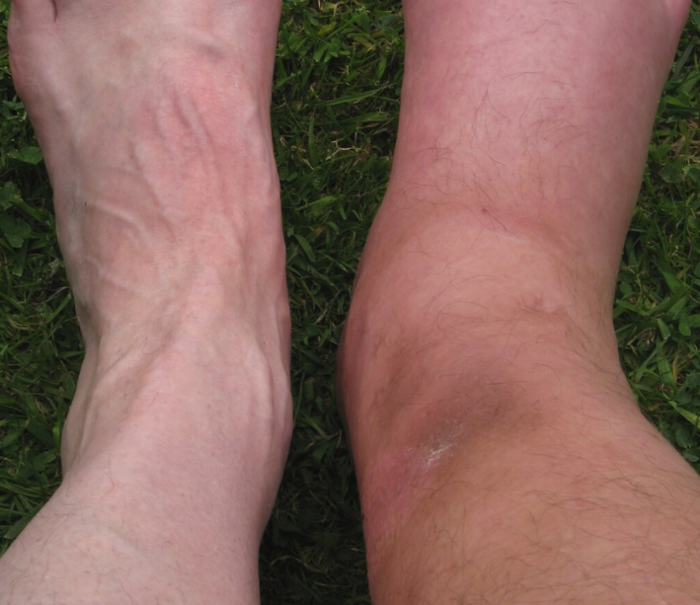


Slide 14

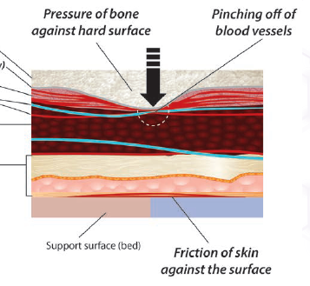

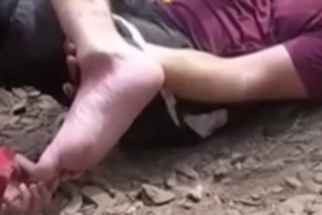
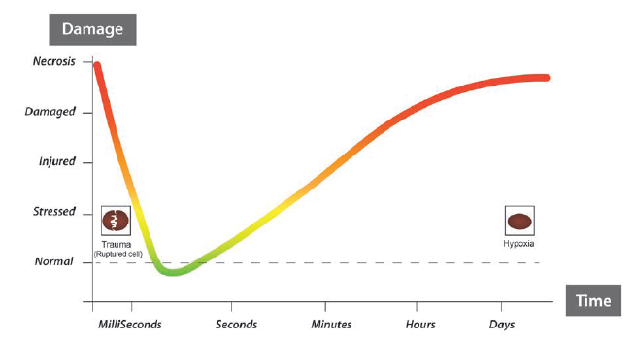

Slide 15
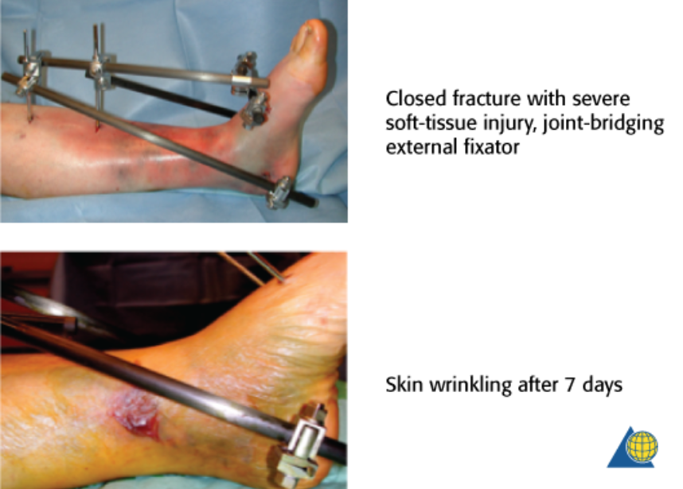

Slide 16
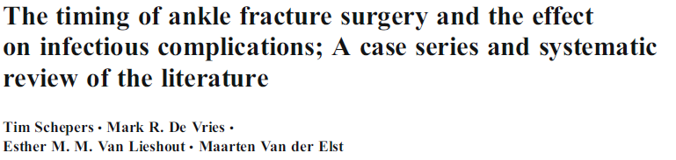
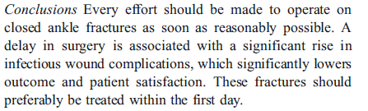
International Orthopaedics (SICOT) (2013) 37:489–494

Slide 17
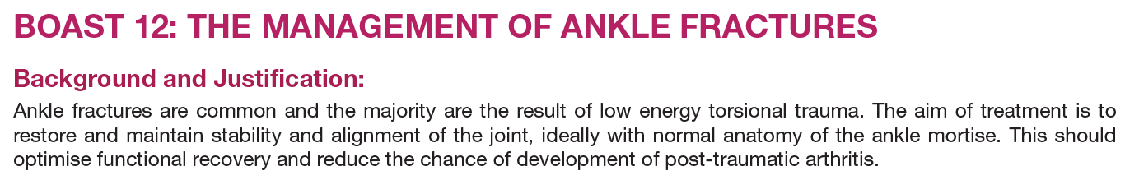



Slide 18
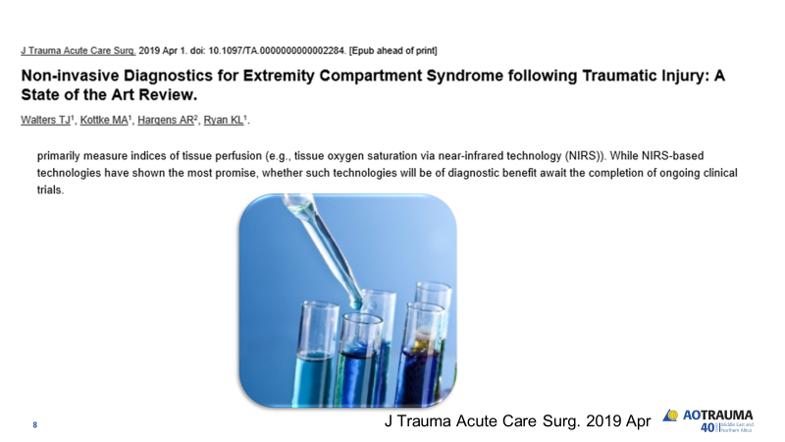
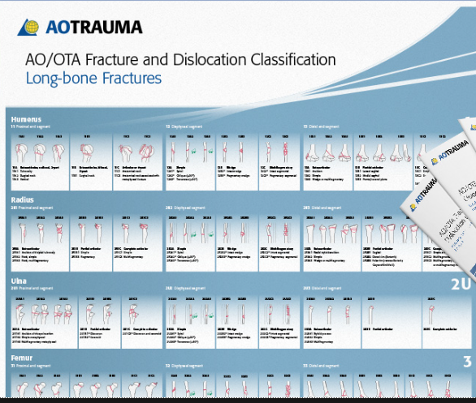
Title and Content

Slide 19
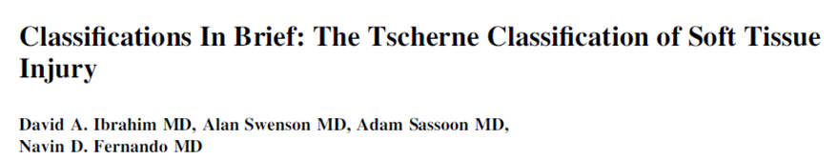
1982 – Hanover
    Harald Tscherne
    Hans-Jo¨rg Oestern
Based on kinetic energy transfer
Physiologic response from soft tissue envelope
Differentiated
  Closed
  Open
Clin Orthop Relat Res (2017) 475:560–564

Slide 20
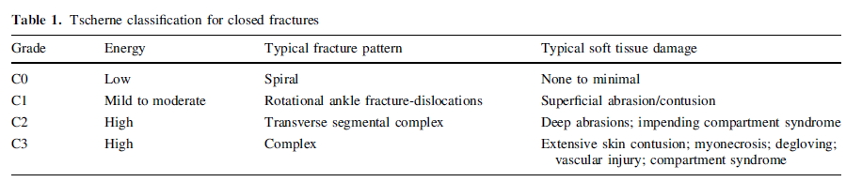
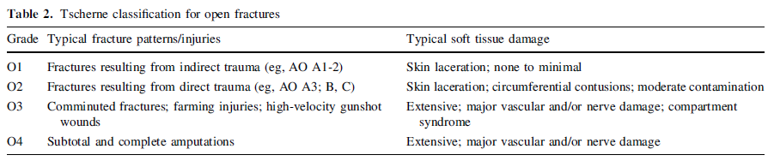
Clin Orthop Relat Res (2017) 475:560–564

Slide 21
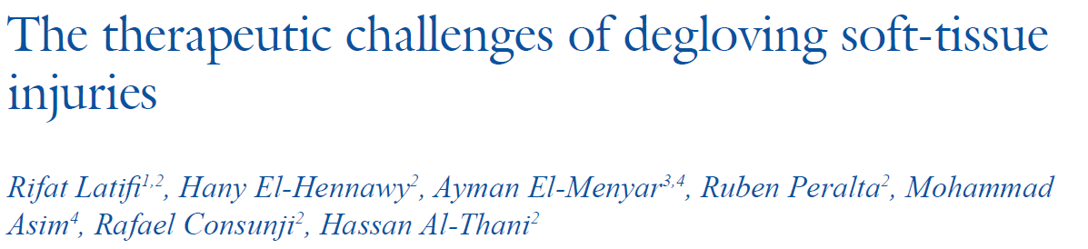
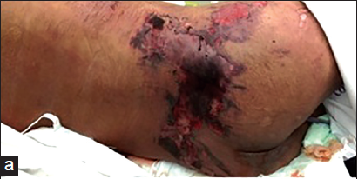
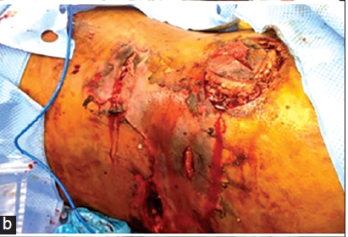
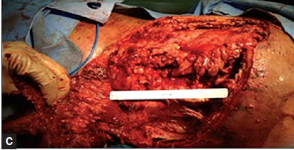
Journal of Emergencies, Trauma, and Shock I 7:3 I Jul - Sept 2014

Slide 22
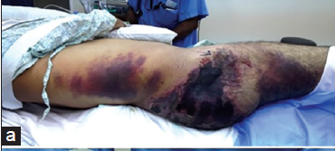
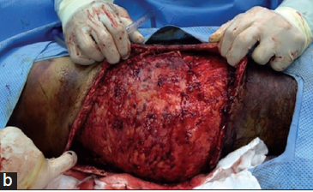
Journal of Emergencies, Trauma, and Shock I 7:3 I Jul - Sept 2014

Slide 23
AO Classification of skin and soft tissue injuries
Skin
  Closed
  Open
Muscle tendons
Nerve and vessel injury

Slide 24
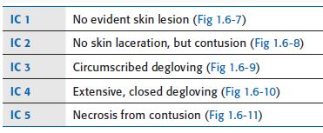
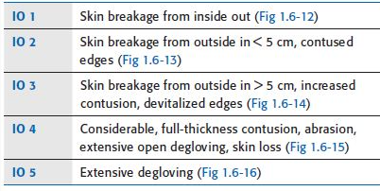
AO Classification of skin and soft tissue injuries
Skin

Slide 25
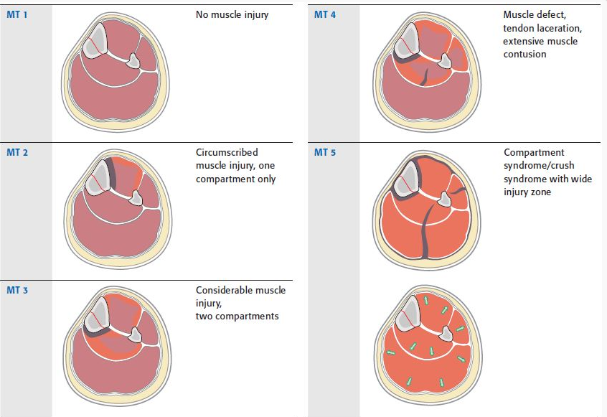
AO Classification of skin and soft tissue injuries
Muscle and tendon

Slide 26
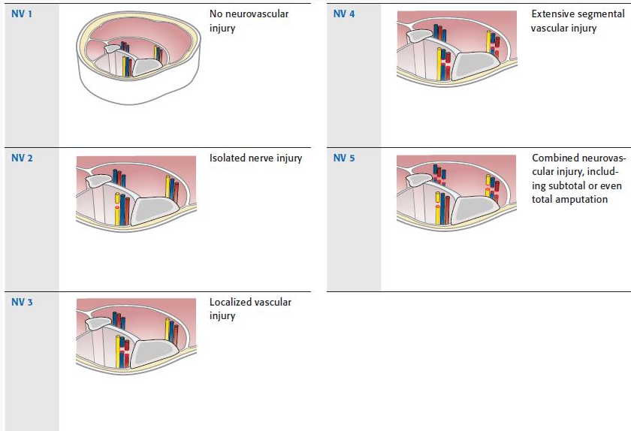
AO Classification of skin and soft tissue injuries
Nerves and vessels

Slide 27


Slide 28
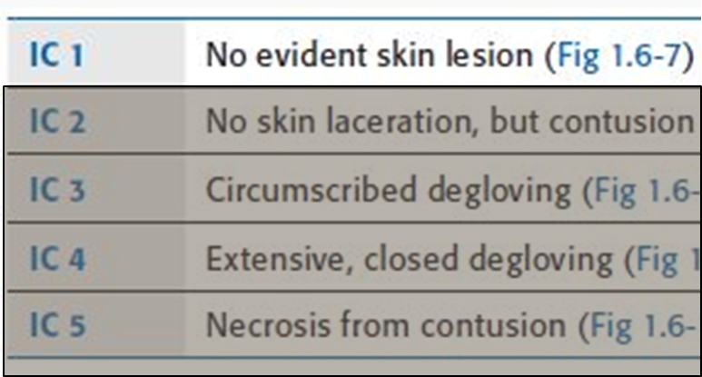
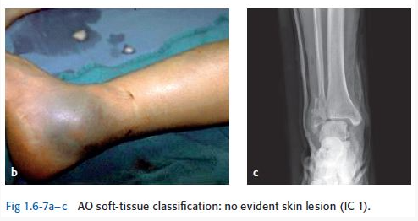

Slide 29
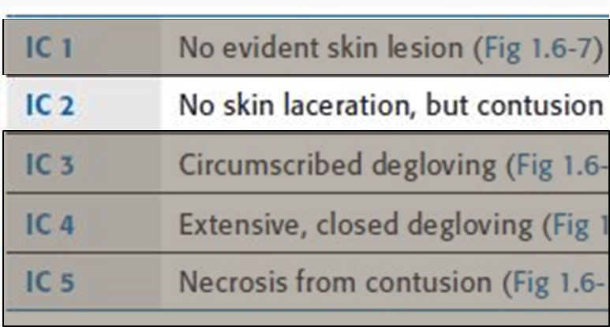




Slide 30




Slide 31


Host

Slide 32


Slide 33












Summary

Slide 34

1976
Open fracture with a wound less than 1 cm long and clean
Open fracture with a laceration greater than 1 cm long without extensive soft tissue damage, flaps, or avulsions
Either
  Open segmental fracture or
Open fracture with extensive soft tissue damage, or a traumatic amputation.
Clin Orthop Relat Res (2012) 470:3270–3274

Slide 35
Either
  Open segmental fracture or
Open fracture with extensive soft tissue damage, or a traumatic amputation.
Special categories in Type III were:
Gunshot injuries
Farm injury
Vascular injury requiring repair
Clin Orthop Relat Res (2012) 470:3270–3274

Slide 36
1984
IIIA. Adequate soft tissue coverage of a fractured bone despite extensive soft tissue laceration or flaps, or high-energy trauma regardless of the size of the wound
IIIB. Extensive soft tissue injury loss with periosteal stripping and bone exposure. This usually is associated with massive contamination
IIIC. Arterial injury requiring repair
Clin Orthop Relat Res (2012) 470:3270–3274

Slide 37
1976
Open fracture with a wound less than 1 cm long and clean
Open fracture with a laceration greater than 1 cm long without extensive soft tissue damage, flaps, or avulsions
Either
  Open segmental fracture or
Open fracture with extensive soft tissue damage, or a traumatic amputation.
Clin Orthop Relat Res (2012) 470:3270–3274

