Slide 1
Distal Humerus
Intra articular fractures and complications
Mr Lee Van Rensburg
Advanced principles of fracture management
Consultant Orthopaedic Surgeon
Cambridge; UK
Cairo July 2019

Slide 2
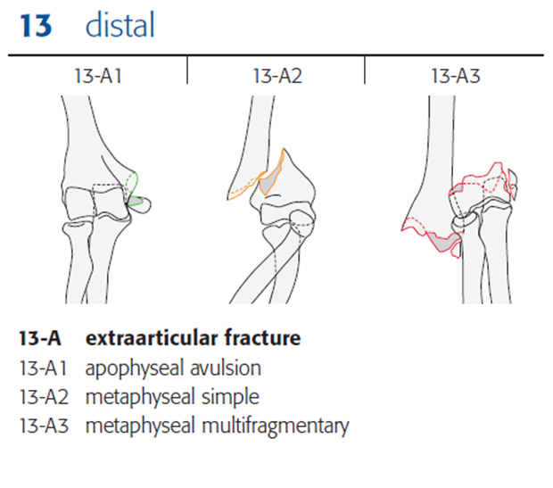
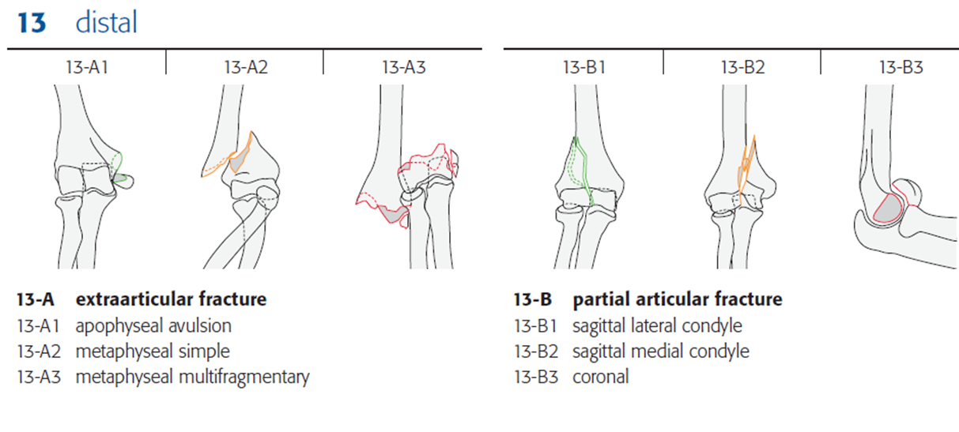
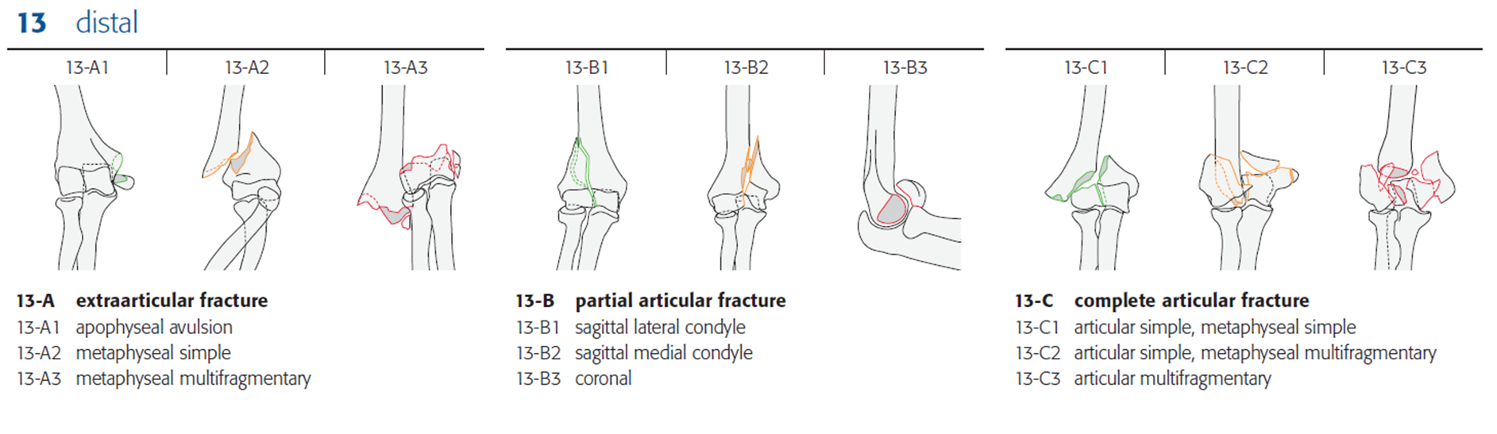
Distal Humerus

Slide 3
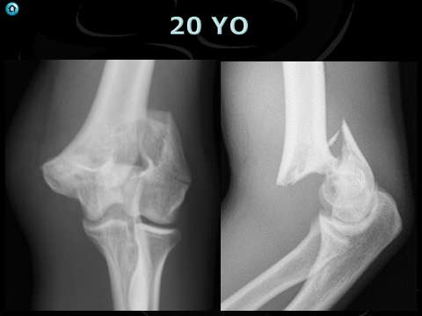
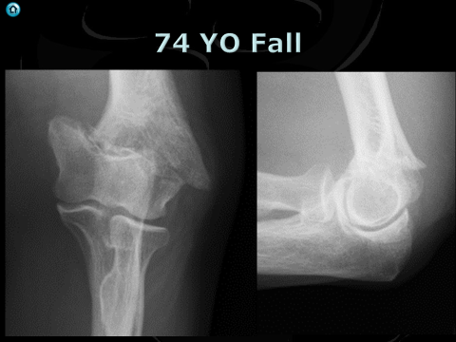
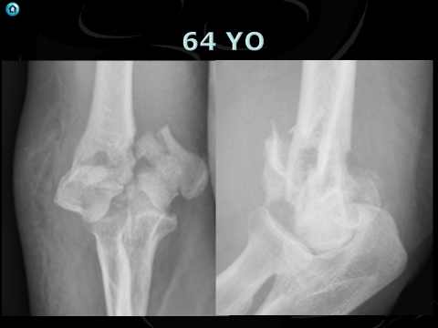
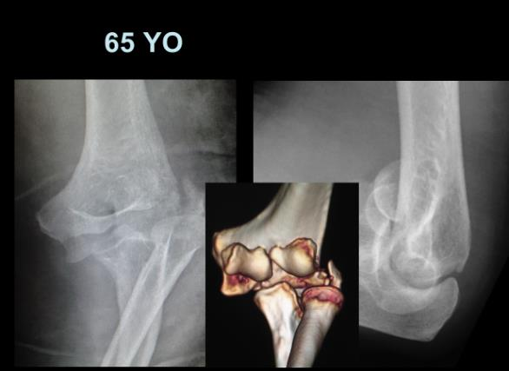
Degrees of badness

Slide 4
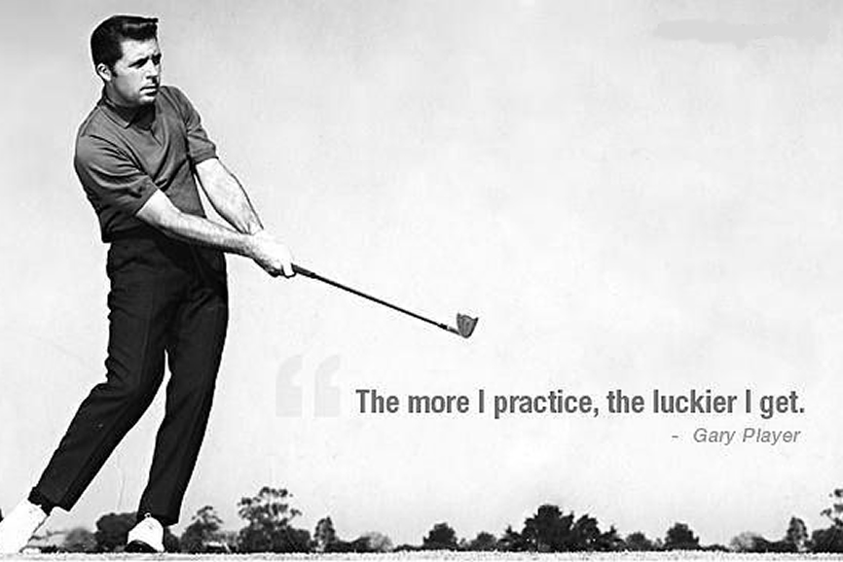

Slide 5
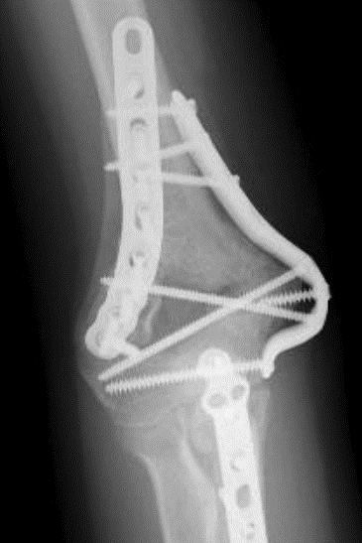
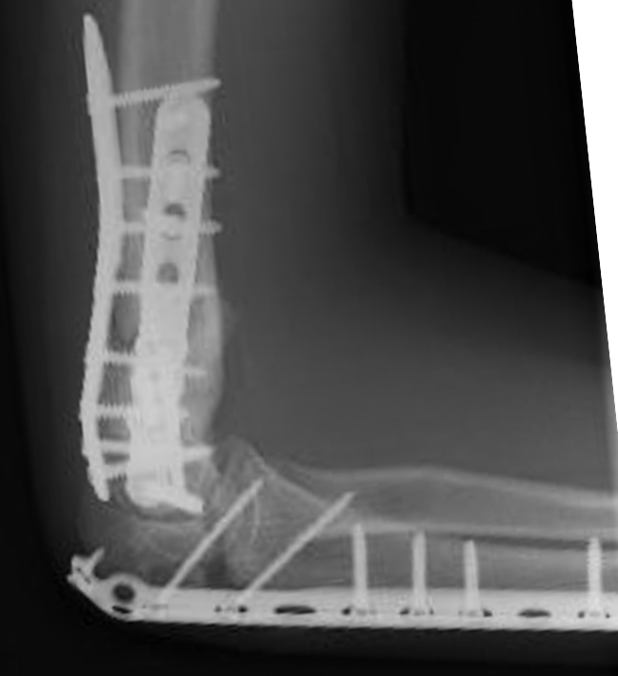
My First case - 2005
17 Y0

Slide 6
My First case - 2005
17 Y0

Slide 7
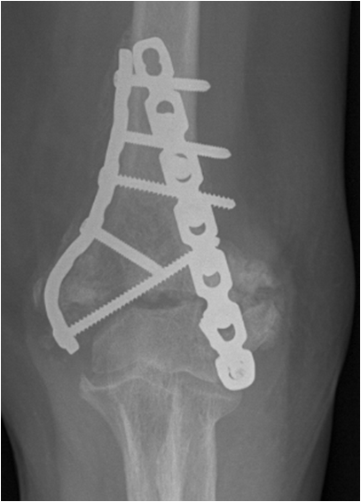
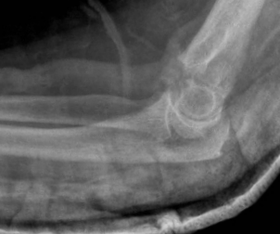
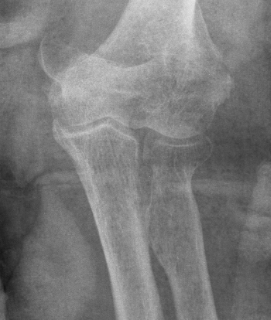
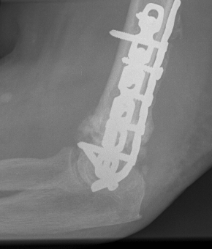
70 YO Fall
What is the problem ?
9 Proximal
At most 2 distal screws

Slide 8
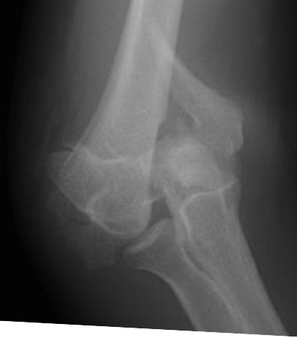
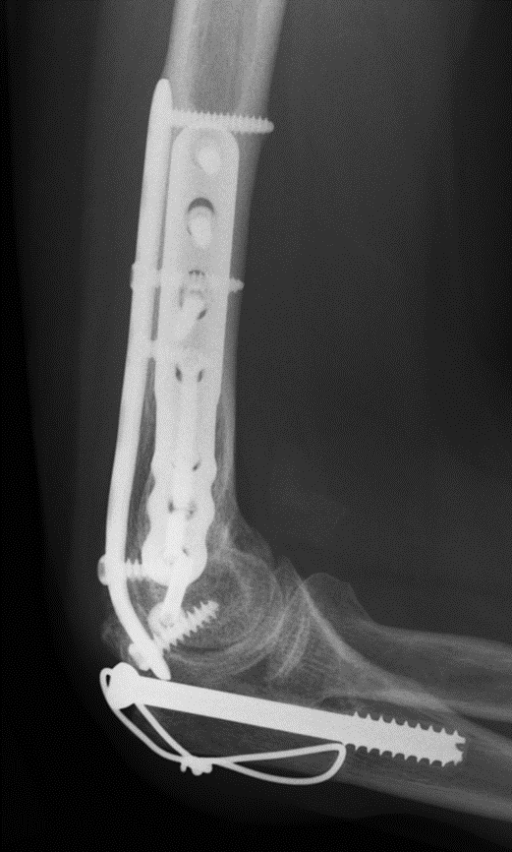
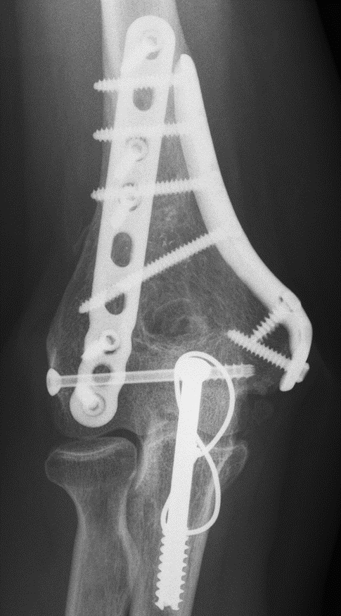
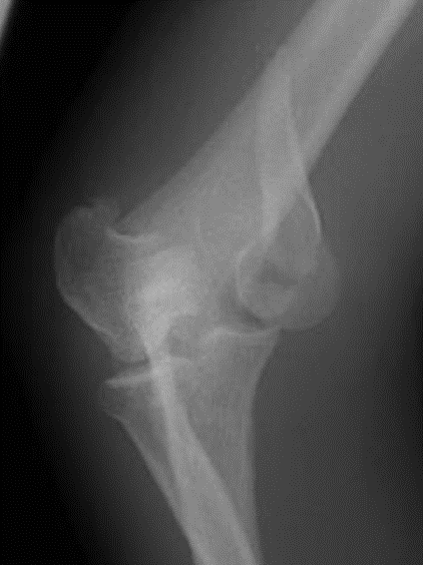
46 YO

Slide 9
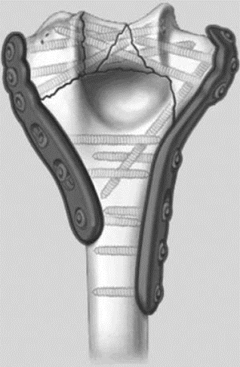
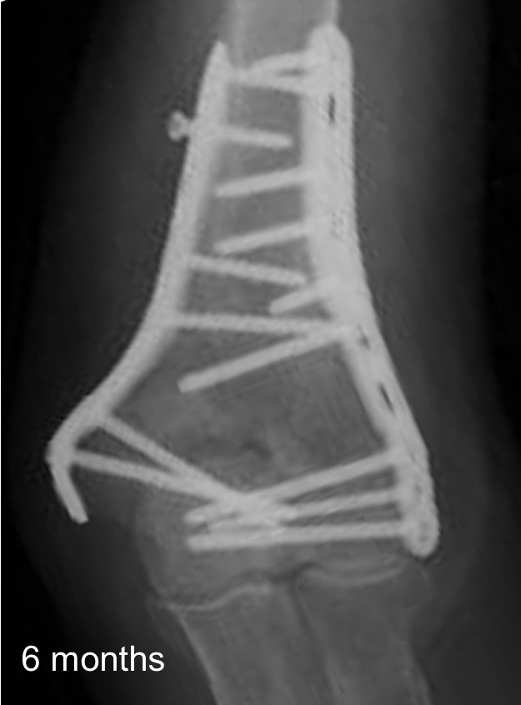
Tip – Hold the distal fragment
4 Good distal screws
Don’t need to be locking
First 2
Great screws
Long
Distal

Slide 10
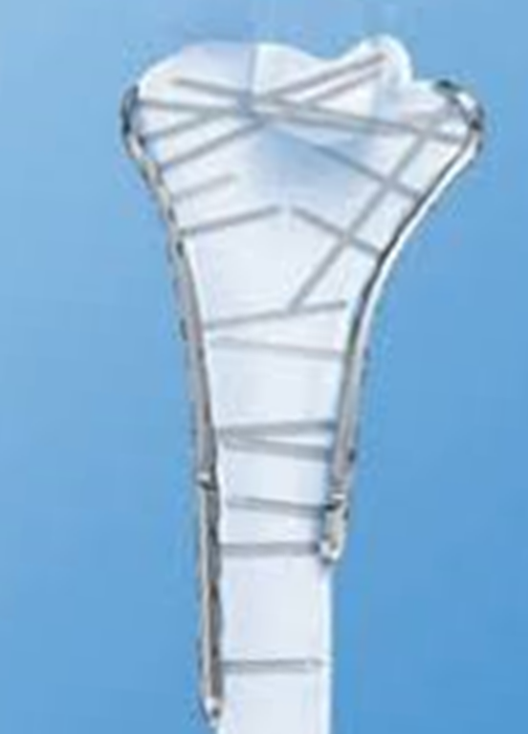
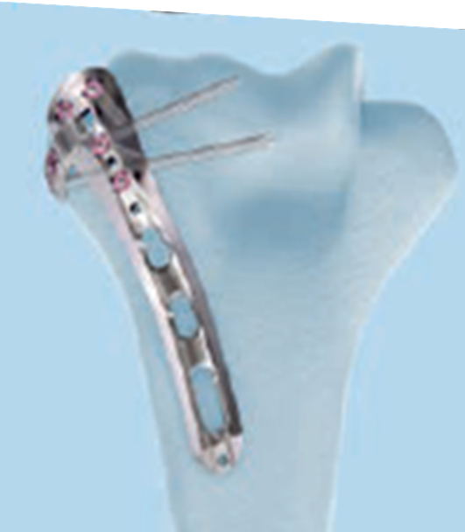
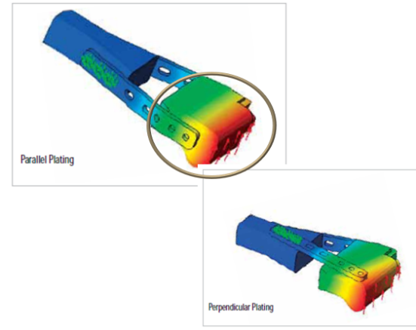
Tip 2
No Home run screw

Slide 11
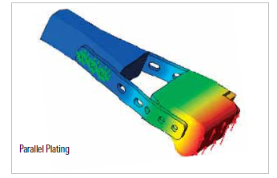
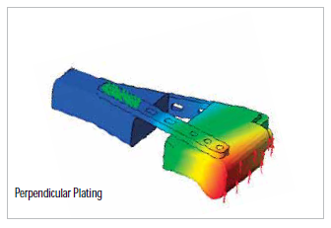

Slide 12
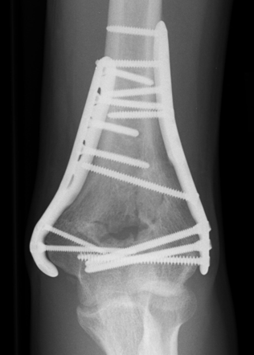
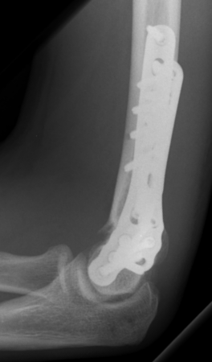
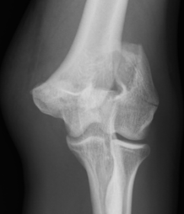
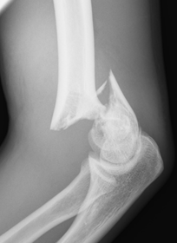
20 YO -2010

Slide 13
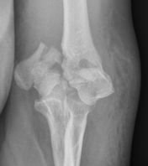
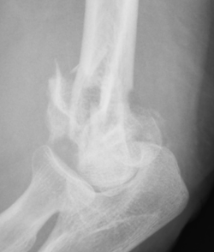
64 YO

Slide 14
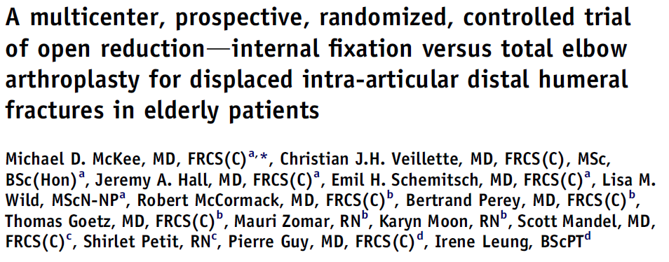

Multicentre
Randomised
comminuted distal humeral fractures in patients aged over 65 years.
TER Vs ORIF
J Shoulder Elbow Surg (2009) 18, 3-12

Slide 15
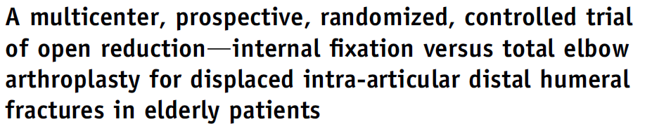
TER superior to ORIF
    surgeon-based (MEPS)
    patient-based (DASH) outcome scores,
Trend toward a reduced reoperation rate and improved range of motion in the TER group
25% of patients randomized to ORIF required intraoperative conversion to TER
J Shoulder Elbow Surg (2009) 18, 3-12

Slide 16
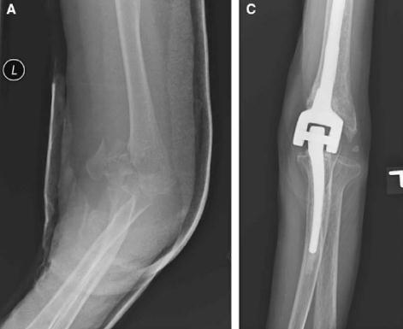
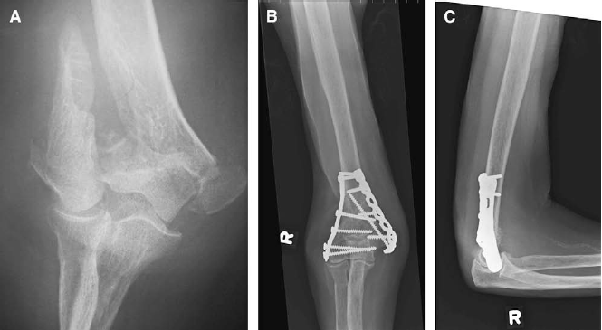
We believe that our study supports the use of primary TER in elderly patients with comminuted, intra-articular distal humeral fractures.
J Shoulder Elbow Surg (2009) 18, 3-12

Slide 18
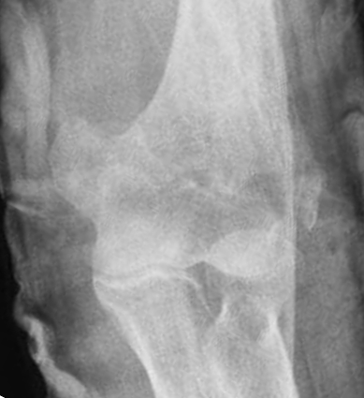
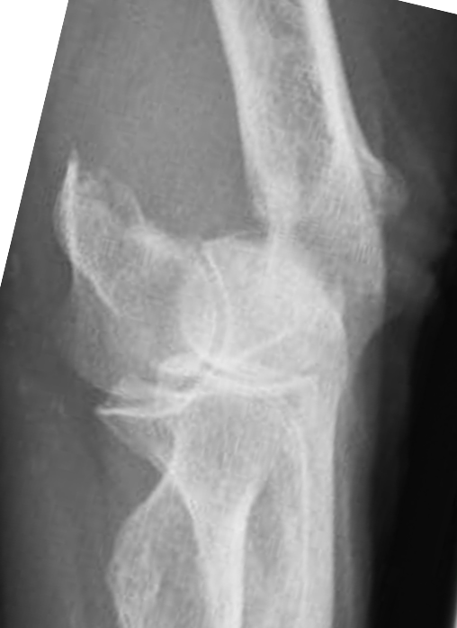
86 YO

Slide 19
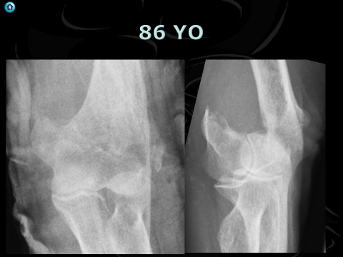
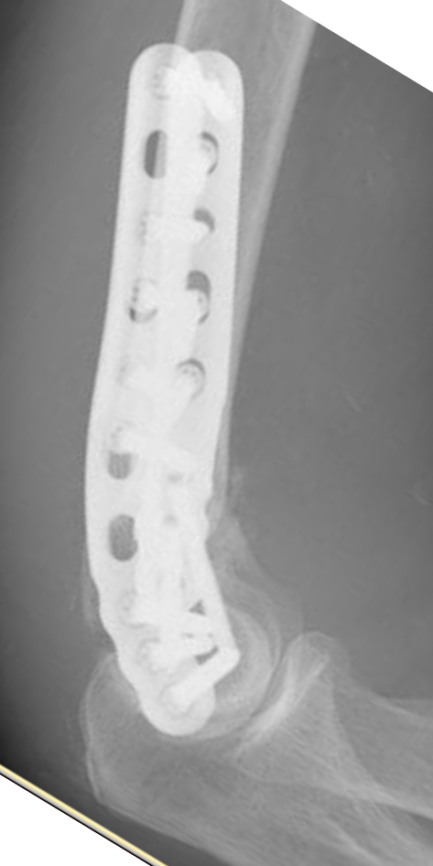
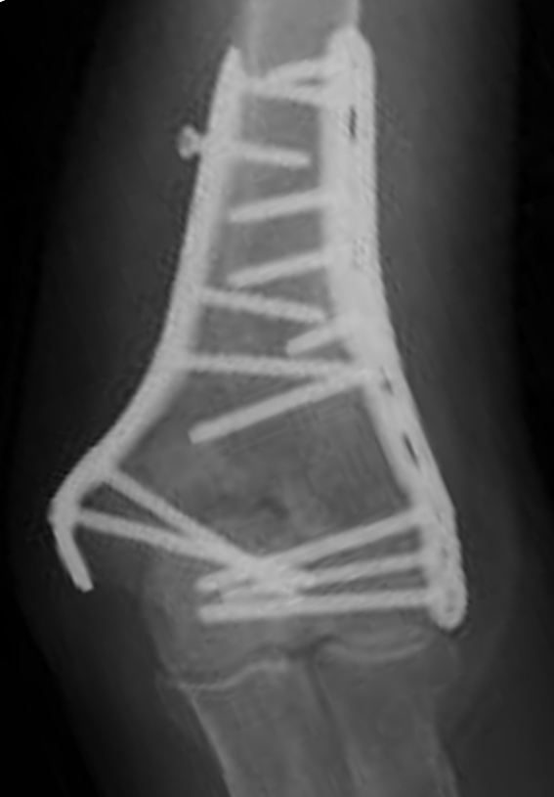
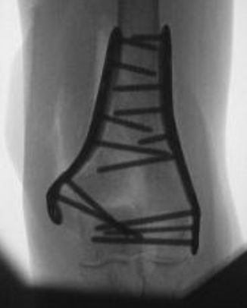
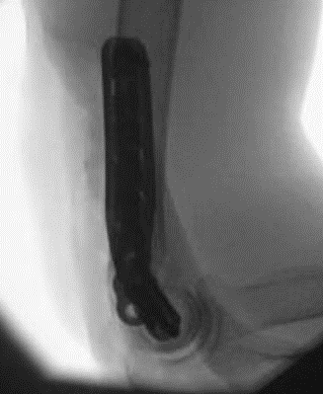
86 YO
6 months

Slide 20
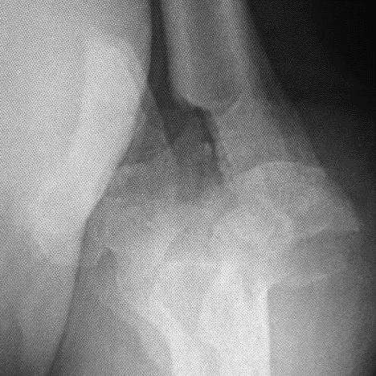
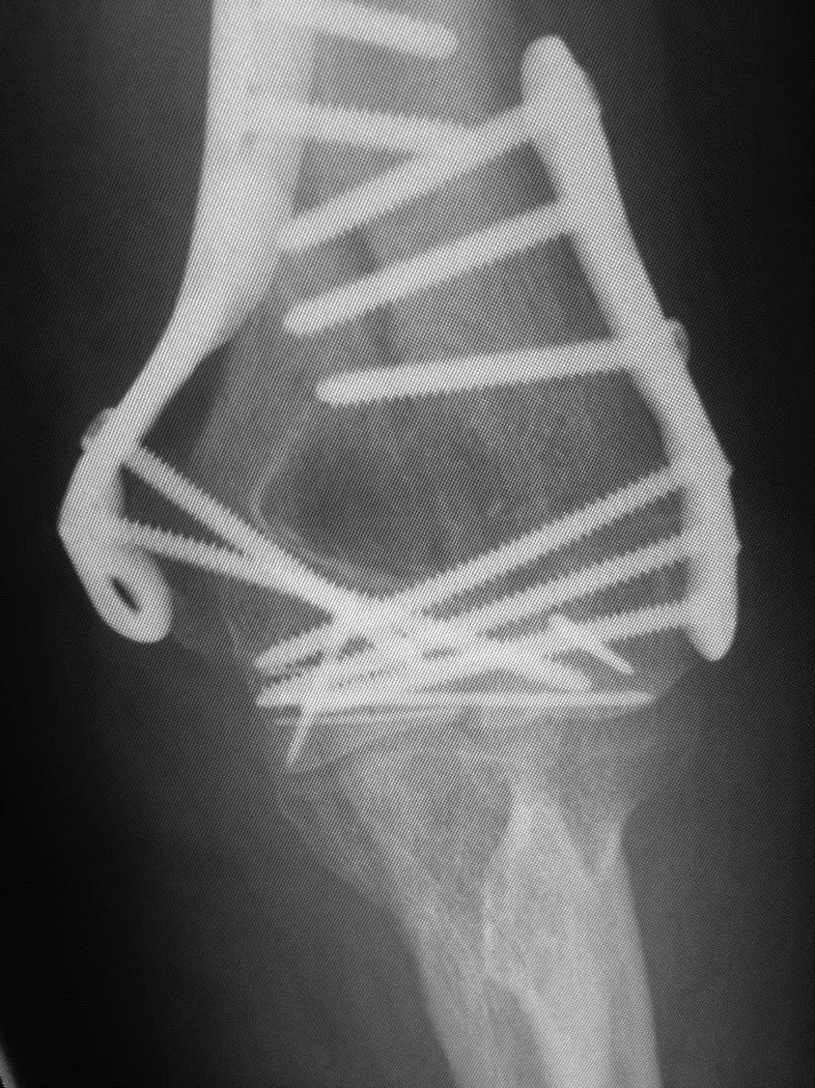
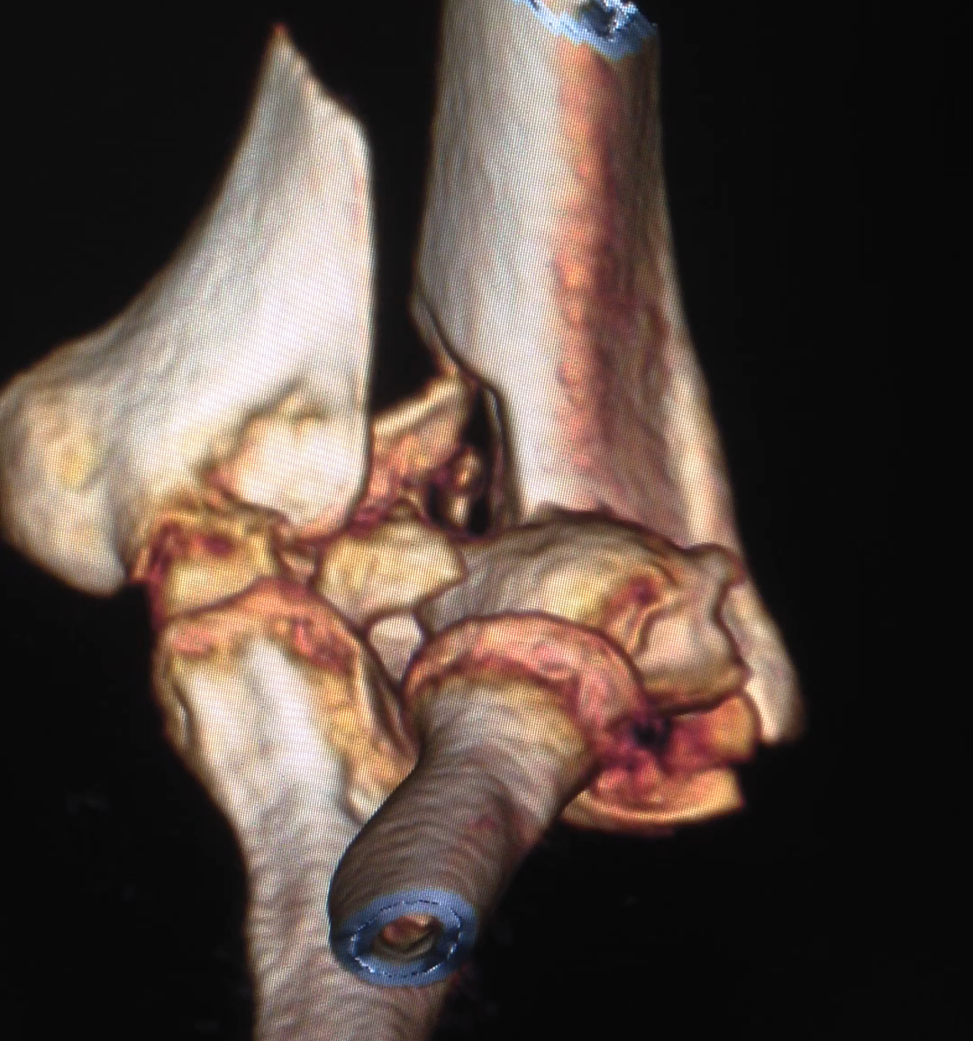
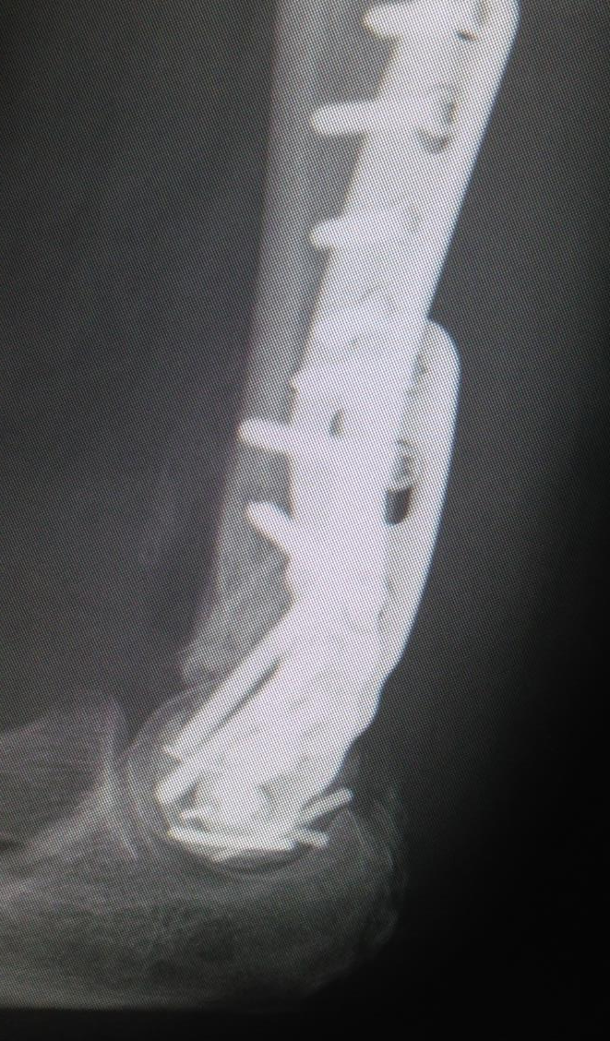
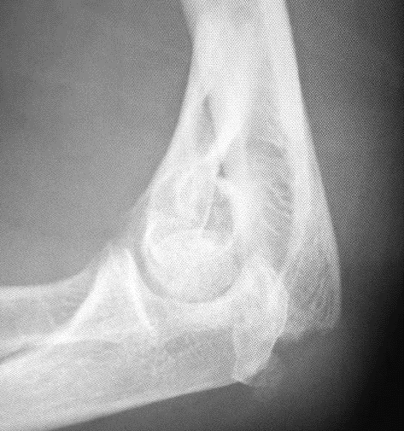

77 YO

Slide 21
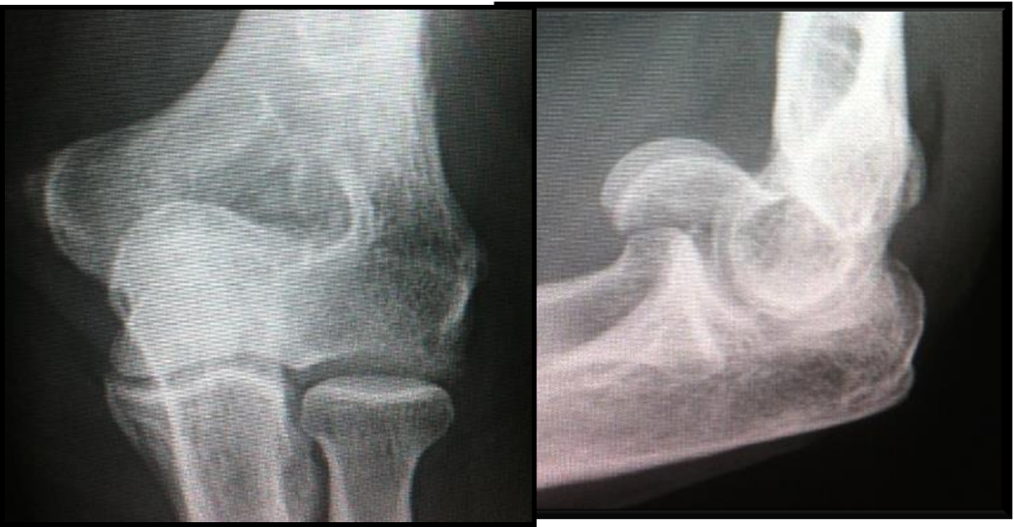
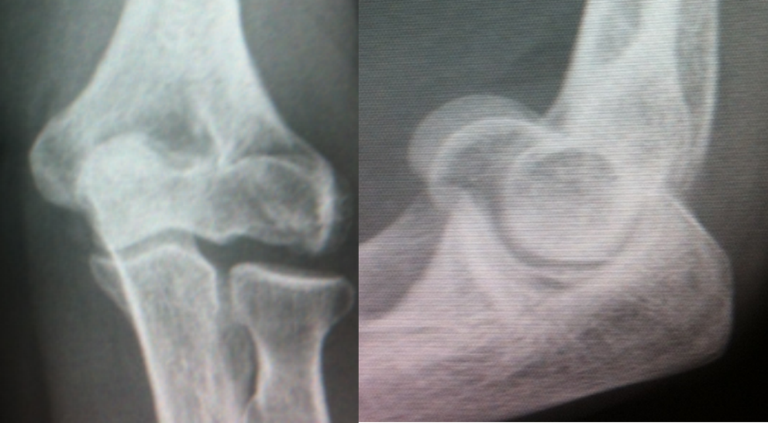
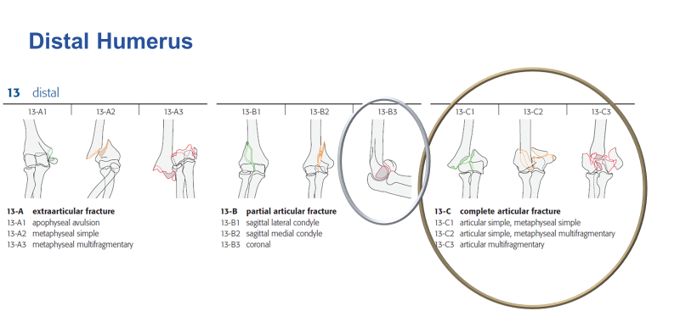

Slide 22









Slide 23









Slide 24





JBJS A VOL 85-A · No. 2 · FEB 2003

Slide 25








Slide 26







55 YO
1 Year

Slide 27









Slide 28


65 YO

Slide 29





65 YO

Slide 30

Ulna nerve
Transpose
Leave in situ
Selective transposition
No Difference

Slide 31

Clin Orthop Relat Res (2008) 466:135–138

Slide 32


2.5 cm proximal to apex
+- 0.4 cm
10 Cadaver
30 Patients
Clin Orthop Relat Res (2011) 469:2638–2644

Slide 33


Olecranon osteotomy

Slide 34

No difference
J Shoulder Elbow Surg (2012) 21, 126-135

Slide 35

110°
1/3rd
J Shoulder Elbow Surg (2012) 21, 126-135

Slide 36






Posterior approaches
Triceps tongue – Van Gorder
Paratricipital
Triceps reflection
  Medial to lateral – Morrey
  Lateral to medial – Deakin and Deshmukh
Olecranon osteotomy
  Intra articular
  Extra articular
Triceps split
TRAP

Slide 37



Paratricipital

Slide 38
Triceps split
  2/3rd radial, 1/3rd ulna
Ulna 1/3rd protects ulna nerve
J Bone Joint Surg [Br] 1999;81-B:1020-2.

Slide 39



Slide 40
J Shoulder Elbow Surg (2010) 19, 399-405

Slide 41


Slide 42
Medial Rolled edge
J Shoulder Elbow Surg (2010) 19, 399-405

Slide 43
Lateral
Para olecranon

Slide 44
Lateral Para-olecranon approach
Boyd HB.
Surgical exposure of the ulna and proximal third of the radius through one incision.Surg Gynaecol Obstet1940;71:87-8.

Slide 45



Lateral para-olecranon

Slide 46
Posterior approach
Van Gorder
Triceps splitting
(Tongue)
Bryan Morrey
Triceps reflecting
Macausland
Transolecranon osteotomy
J Shoulder Elbow Surg 2001;10:380-2.

Slide 47

Lateral para-olecranon
J Shoulder Elbow Surg 2001;10:380-2.

Slide 48

Tip
Extensibility

Slide 49







Summary

Slide 50


76 YO
Fixation 2015
16 Months
No Pain
Lack of extension 20 degrees

Slide 51



Hardly ever do osteotomy

Slide 53





65YO

Slide 54
Medial Rolled edge
J Shoulder Elbow Surg (2010) 19, 399-405

Slide 55
Lateral Para-olecranon approach
Boyd HB.
Surgical exposure of the ulna and proximal third of the radius through one incision.Surg Gynaecol Obstet1940;71:87-8.

Slide 56
Lateral para-olecranon
J Shoulder Elbow Surg 2001;10:380-2.

