Slide 1
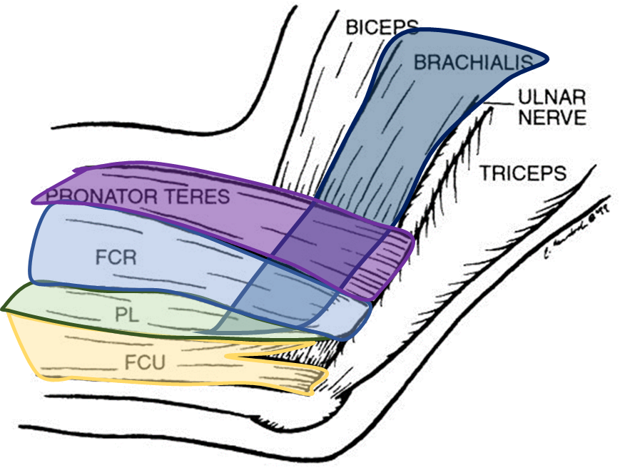
Elbow – Medial approaches
(Coronoid)
Mr Lee Van Rensburg

Slide 2
Anatomy
Muscles/ Tendons
Nerves
Vessels
Ligaments
Bones

Slide 3
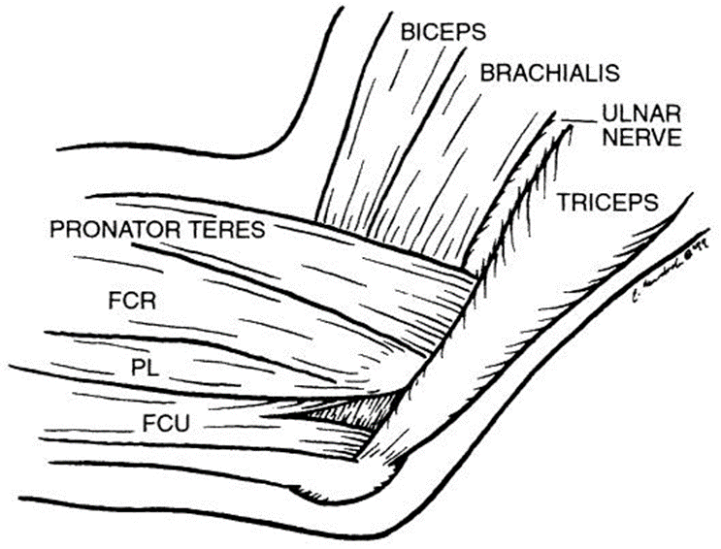
Anatomy
Muscles/ Tendons
  Flexor Carpi Ulnaris
  Palmaris Longus
  Flexor Carpi Radialis
  Pronator Teres
  Brachialis
Nerves
Vessels
Ligaments
Bones
Clin ortho and related research; (370), January 2000, pp 19-33;

Slide 4
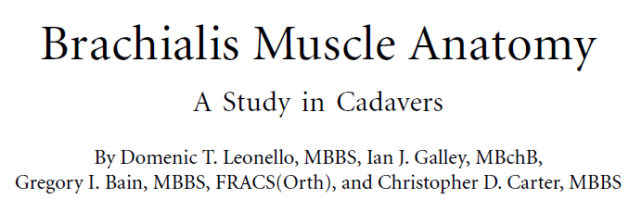
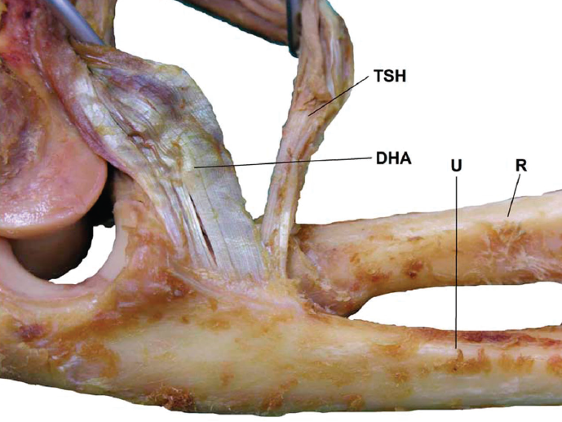
Brachialis
J Bone Joint Surg Am. 2007;89:1293-7

Slide 5
Anatomy
Muscles/ Tendons
Nerves
  Ulna nerve
  Medial antebrachial cutaneous nerve
Vessels
Ligaments
Bones
Clin ortho and related research; (370), January 2000, pp 19-33;

Slide 6
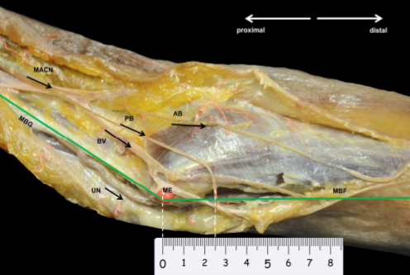
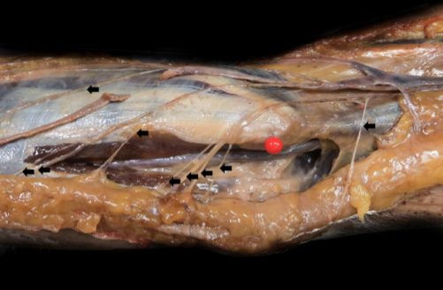
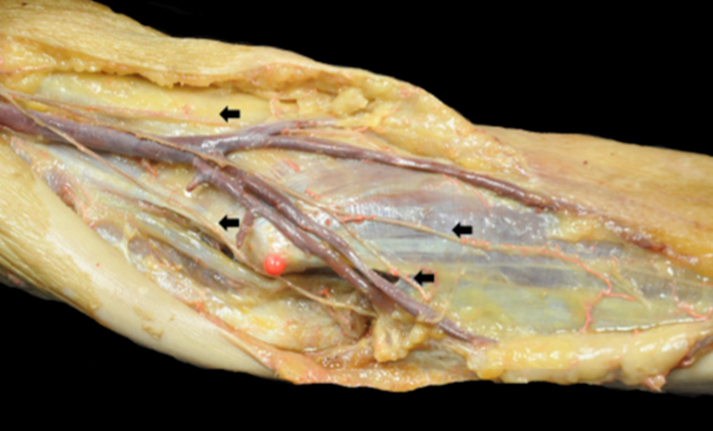
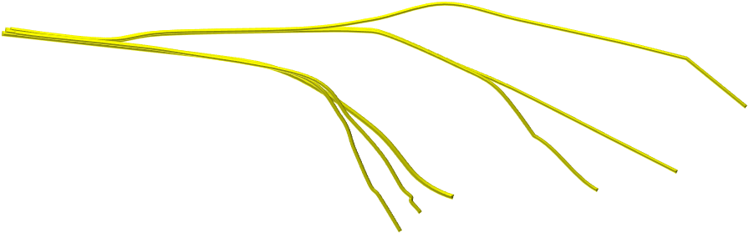
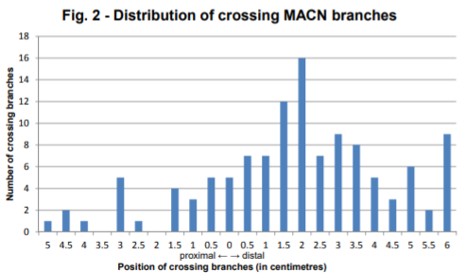
Anatomy
Muscles/ Tendons
Nerves
  Ulna nerve
  Medial antebrachial cutaneous nerve
Vessels
Ligaments
Bones
J Plast Reconstr Aesthet Surg 2017 Nov;70(11):1582-1588

Slide 7
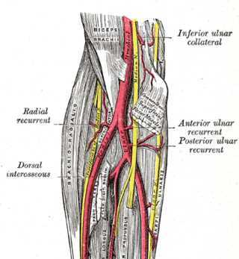
Anatomy
Muscles/ Tendons
Nerves
Vessels
  Anterior ulna recurrent branch
Ligaments
Bones

Slide 8
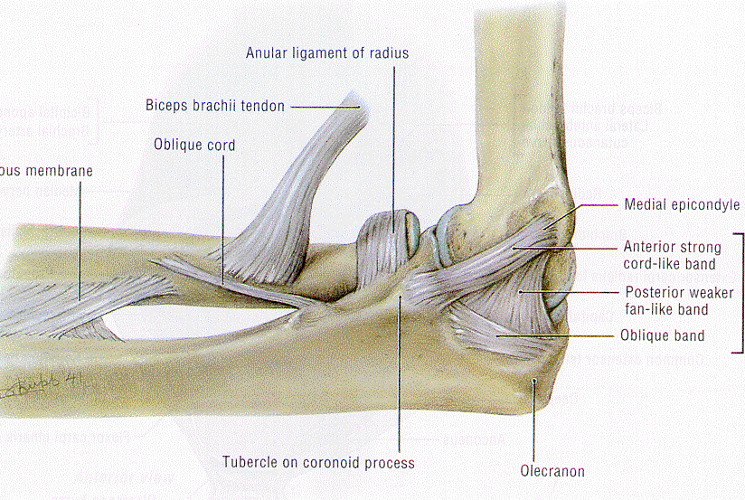
Anatomy
Muscles/ Tendons
Nerves
Vessels
Ligaments
  Anterior band
  Posterior band
  Transverse band
Bones

Slide 9
Medial collateral ligament
Origin anterior bundle MCL
    Antero inferior medial epicondyle
Insertion
    Sublime tubercle
    Long and thin
J Shoulder Elbow Surg 2007;16:657-660

Slide 10
Anatomy
Muscles/ Tendons
Nerves
Vessels
Ligaments
Bones

Slide 11
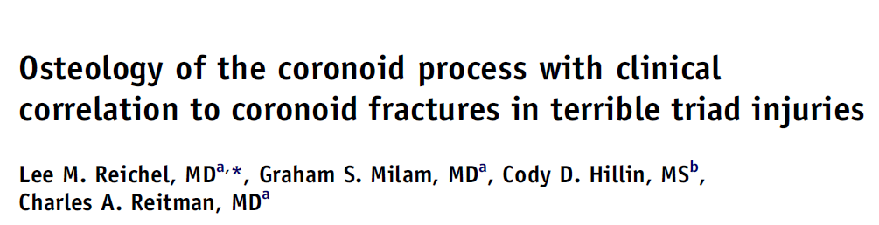
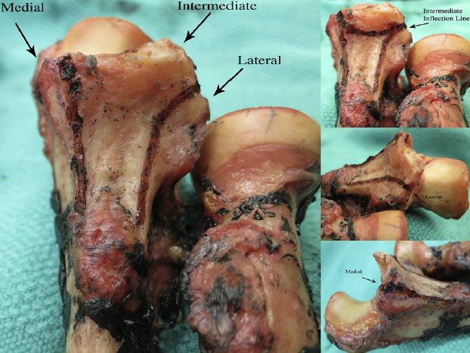
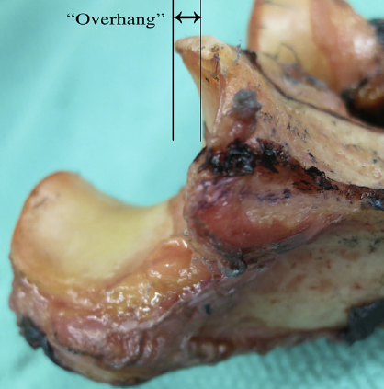
Coronoid
Three ridges
Medial
Intermediate
Lateral
Overhang
Hook stopping inferior subluxation
J Shoulder Elbow Surg (2013) 22, 323-328

Slide 12
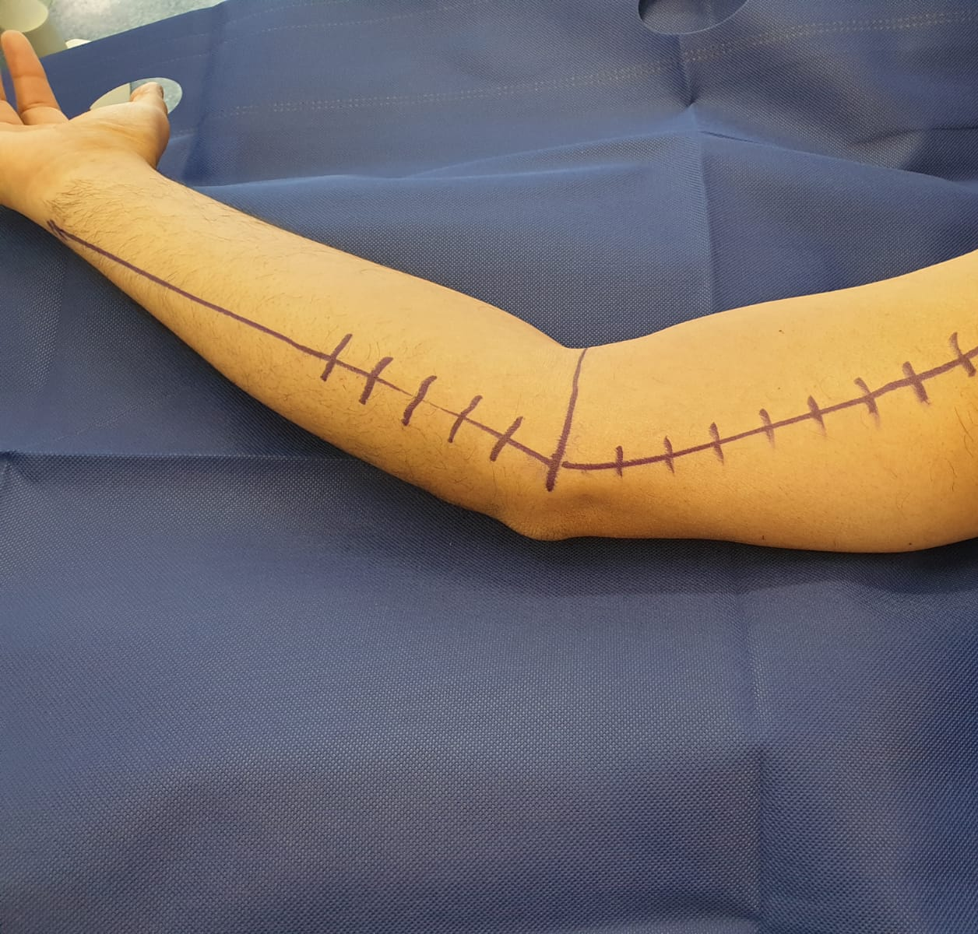
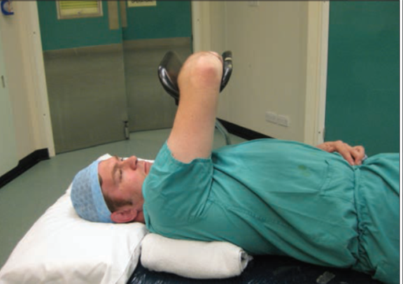
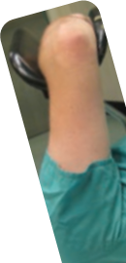

Positioning
Arm board
  More anterior
Supine
  More anterior

Slide 13
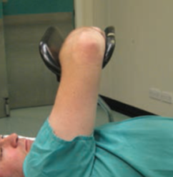
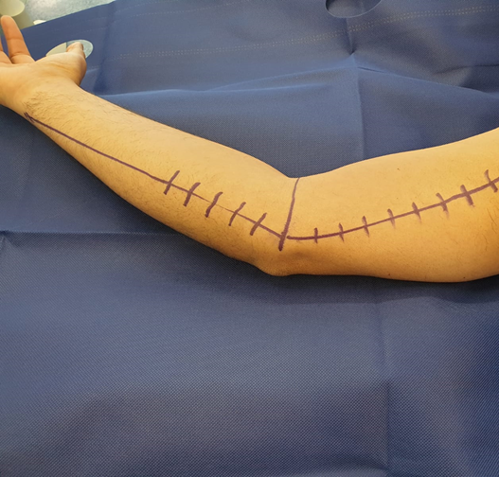
Skin Incision

Slide 14
Superficial Dissection

Slide 15
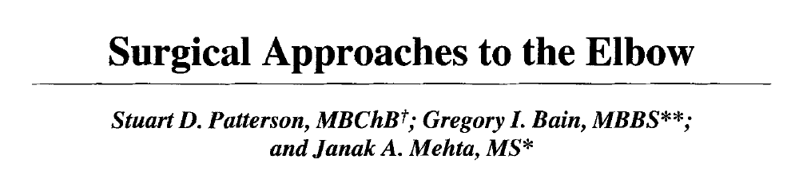

Medial approaches
Taylor Scham
Split FCU
Hotchkiss
“Over Top”
Split Flexor pronator mass
Clin ortho and related research; (370), January 2000, pp 19-33;

Slide 16
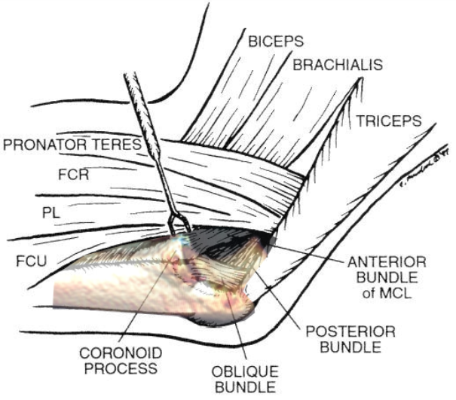
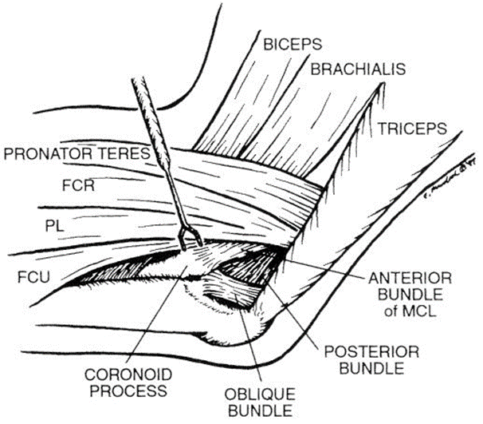
Taylor Scham
Clin ortho and related research; (370), January 2000, pp 19-33;

Slide 17
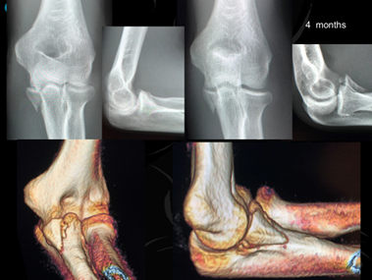
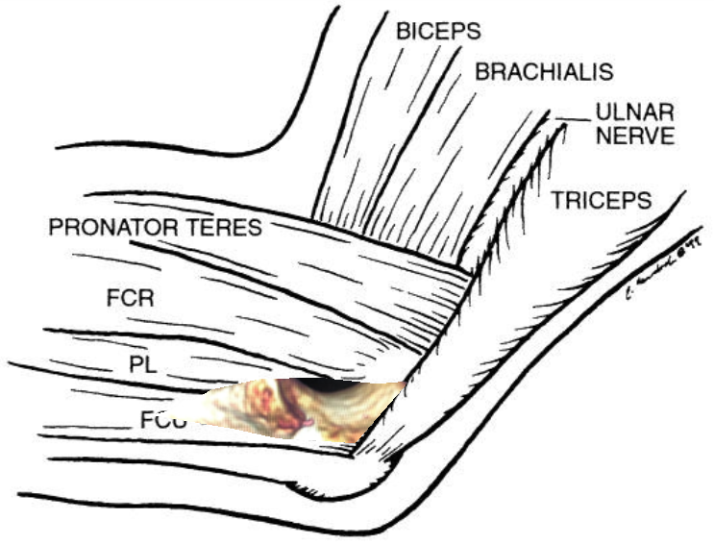
Split FCU
Clin ortho and related research; (370), January 2000, pp 19-33;

Slide 18
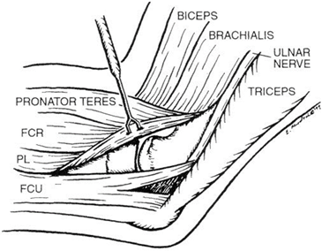
Hotchkiss
Where is Hotchkiss
Clin ortho and related research; (370), January 2000, pp 19-33;

Slide 19
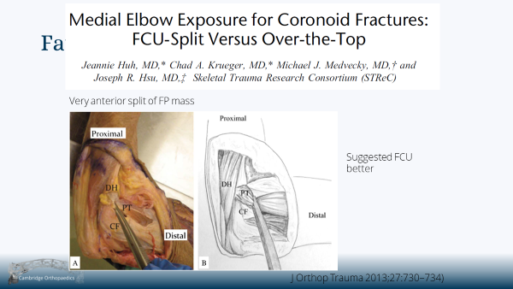
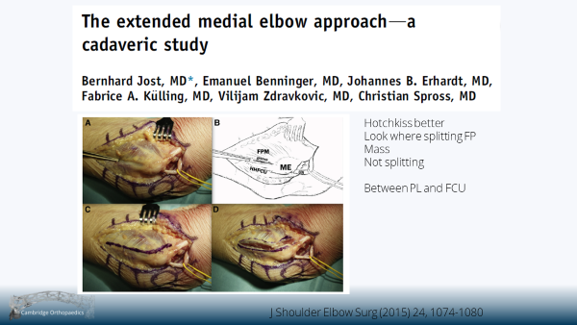
FCU Vs Hotchkiss

Slide 20
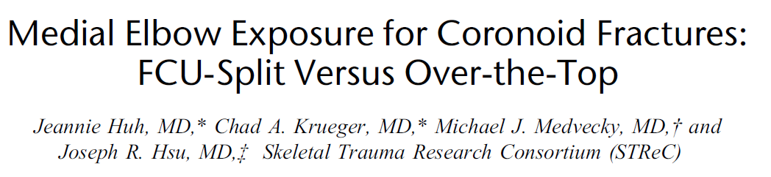
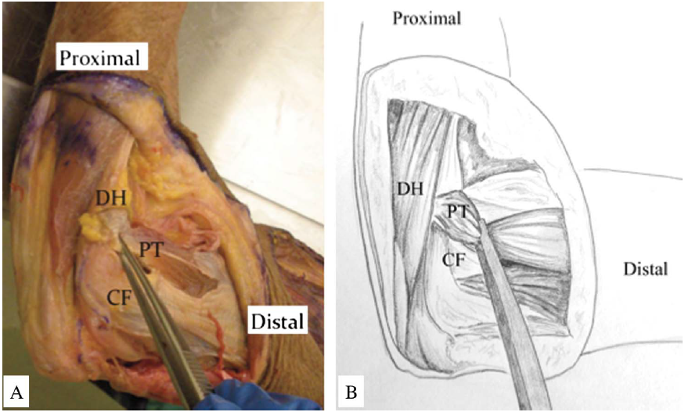
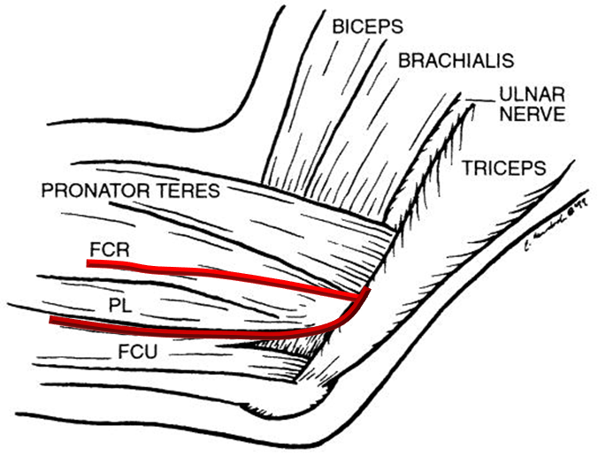

Favour FCU
Very anterior split of FP mass
Suggested FCU
better
J Orthop Trauma 2013;27:730–734)

Slide 21
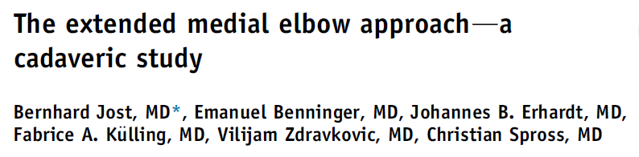
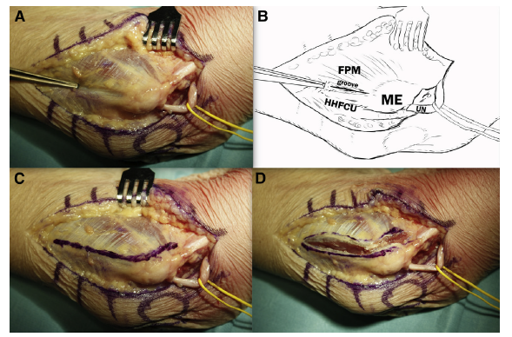
Hotchkiss better
Look where splitting FP
Mass
Not splitting
Between PL and FCU
J Shoulder Elbow Surg (2015) 24, 1074-1080

Slide 22
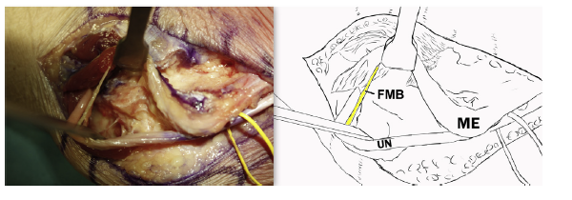
Problem FCU split
1st motor branch
J Shoulder Elbow Surg (2015) 24, 1074-1080

Slide 23
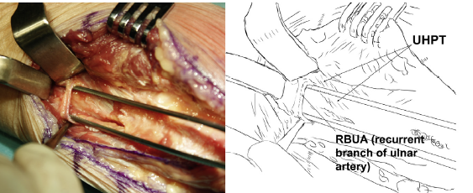
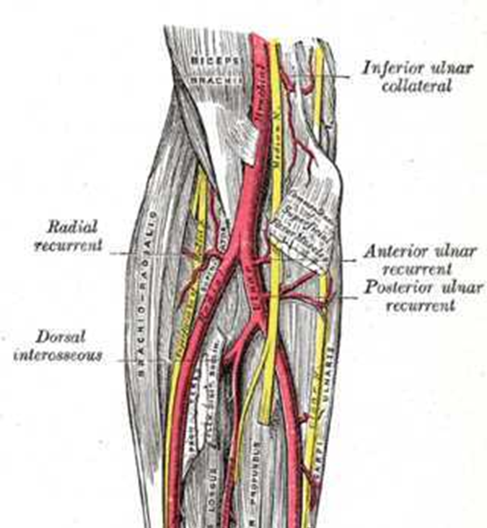
Distal extent of EMEA
Recurrent ulnar artery
J Shoulder Elbow Surg (2015) 24, 1074-1080

Slide 24
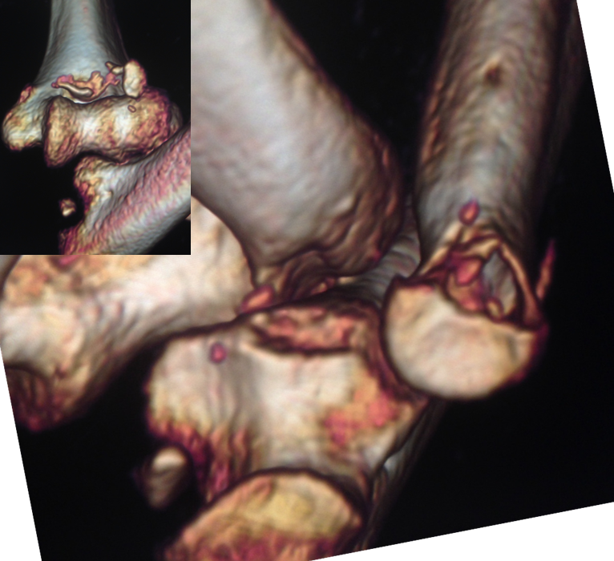
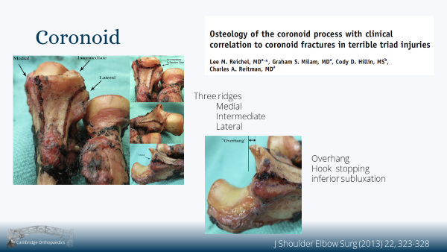
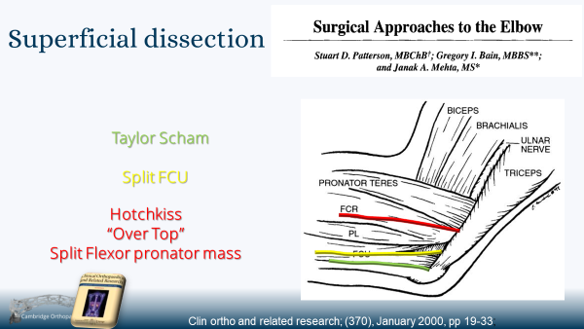

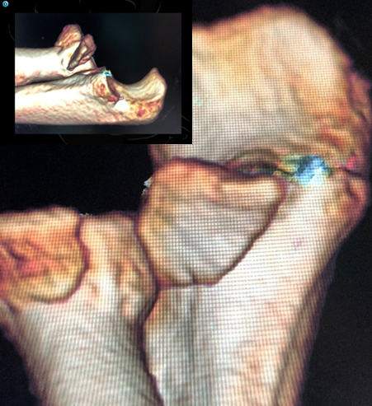
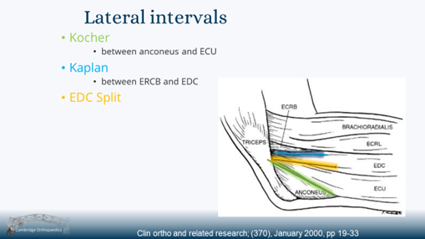
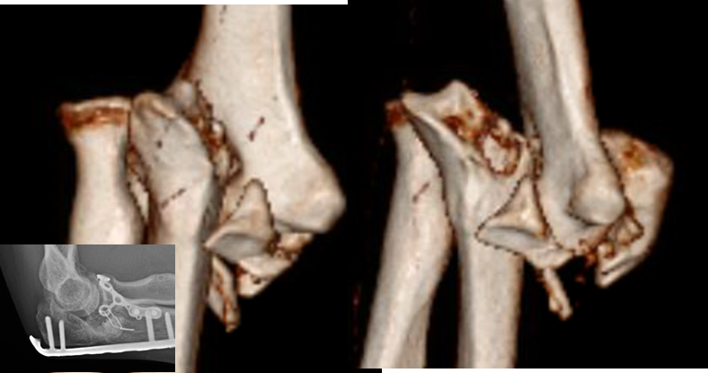
Coronoid

Slide 25
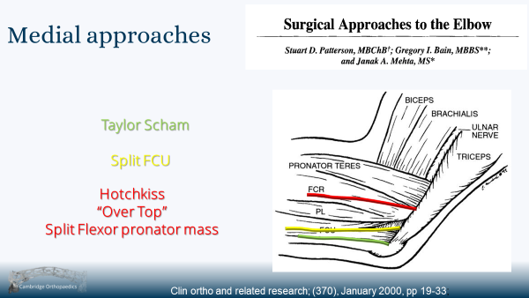
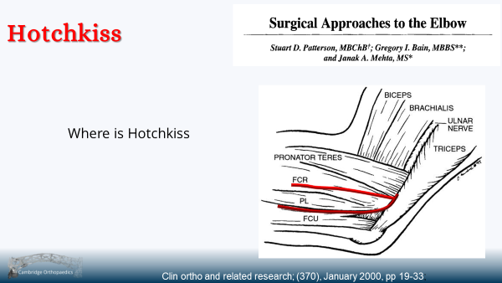
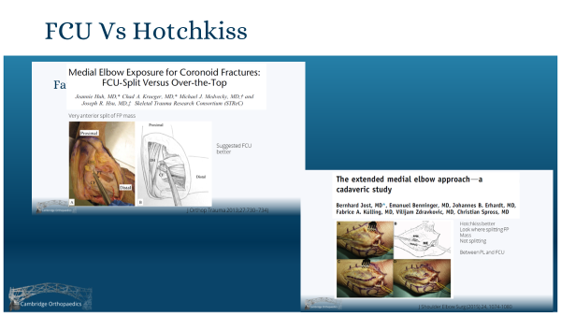
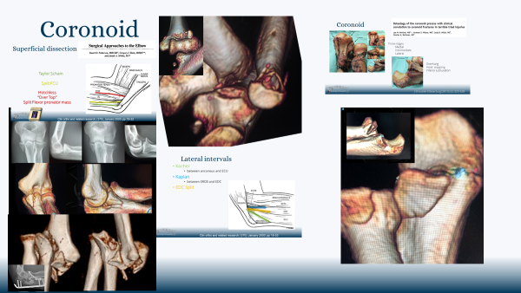
Summary

