Slide 1
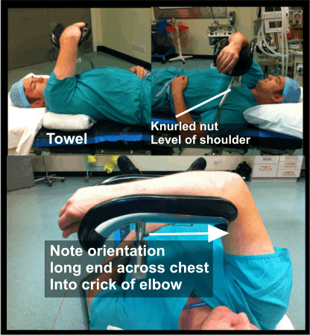
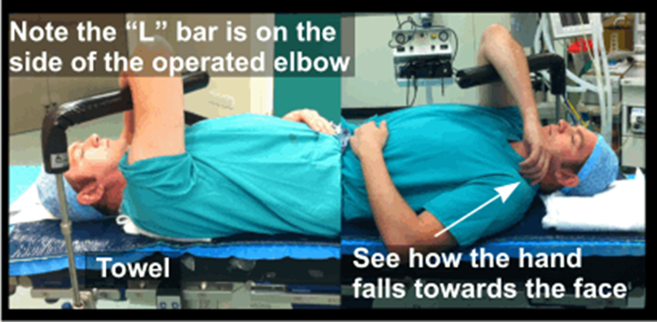

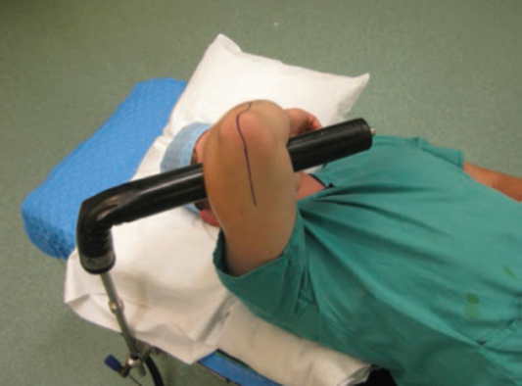
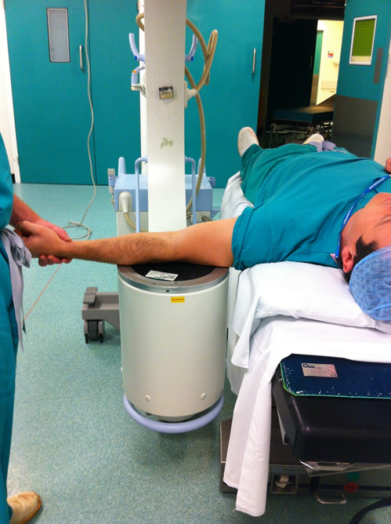
Ann R Coll Surg Engl 2012; 94: 438–448

Slide 2
X-ray
What’s wrong
Pronate forearm
Lock radial head
Avoid PLRI
Varus stress
LCL
Valgus stress
MCL
Flex 30 degrees
Unlock olecranon
Ensure elbow reduced
Bring I/I parallel with bed

