Slide 1
Monteggia variants - Dislocation
Lee Van Rensburg
AO Trauma Online Masters Course—Fractures around the Elbow
Consultant Orthopaedic Surgeon
Madrid, September 2020

Slide 2
Disclosure: Potential or actual conflicts of interest
Faculty: Mr Lee Van Rensburg, Consultant Orthopaedic Surgeon
Relationships with commercial interests:
Acumed
Financial support for courses and paid educational contract
Wright Medical
Financial support for elbow courses
Stryker
Paid educational contract
All potential conflicts of interest have been resolved prior to this event.
Notes:
Declaration options (choose 1, 2 or 3):
I have no financial relationships with commercial entities that produce healthcare related products.
The commercial entities with which I have a financial relationship do not produce healthcare related products or services relevant to the content of my presentation.
I disclose the following financial relationships with commercial entities that produce healthcare related products or services:
Consultant for:
Advisory Board for:
Board member of:
Employee of:
Grant/Research support from:
Honoraria from:
Stockholder in:
Speaker/teacher for:
Royalties from:
Intellectual property rights for:

Slide 3
Learning objectives
#1
  What is a Monteggia variant?
  Where does it fit in elbow instability?
#2
  Describe the anatomical fragments involved
#3
  Have an overview of the surgical approaches and fixation principles and methods
Notes:
Learning objectives should be: Specific, Measurable, Achievable, Relevant, Time-bound (SMART)
DO NOT use the verbs: understand and know (they are not measurable)
USE the sentence: After this learning experience, learner will be able to:
USE these verbs for KNOWLEDGE (mostly for lectures): define, describe, identify, list, outline, recall, reproduce, show, etc.
USE these verbs for SKILLS (mostly for practicals): apply, operate, measure, assemble, construct, design, demonstrate, examine, execute, fix, etc.
USE these verbs for ATTITUDE (mostly for small groups and practicals): accept, appreciate, embrace, relate, resolve, value, etc.
Example lecture: Preoperative planning
Highlight the importance of preoperative planning
Describe various techniques for preoperative planning
Formulate and draw an operative plan
Describe a surgical tactic step by step p (eg, positioning, choice of surgical approach, instruments, reduction technique, implants)
Incorporate patient safety protocols (mark site, time-out check list) in the preoperative plan

Slide 4
#1 What
Nomenclature

Slide 5


Monteggia
Mr Lee Van Rensburg
Fracture of the proximal third of the ulna with dislocation of the proximal head of the radius
Fracture of the ulnar shaft with concomitant dislocation of the radial head
Fracture of Forearm (ulna) with dislocation of Proximal Radioulnar joint

Slide 6

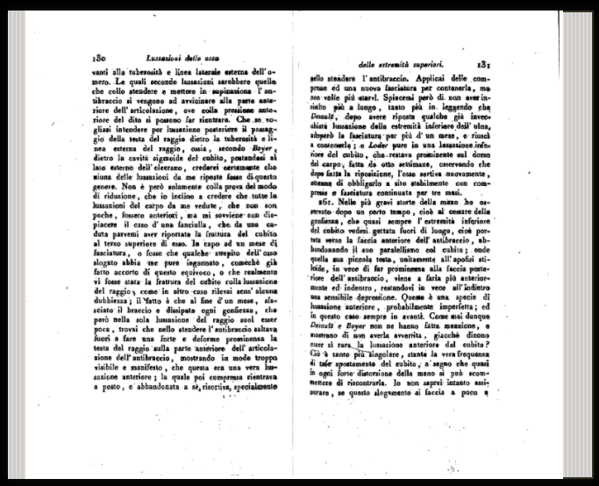
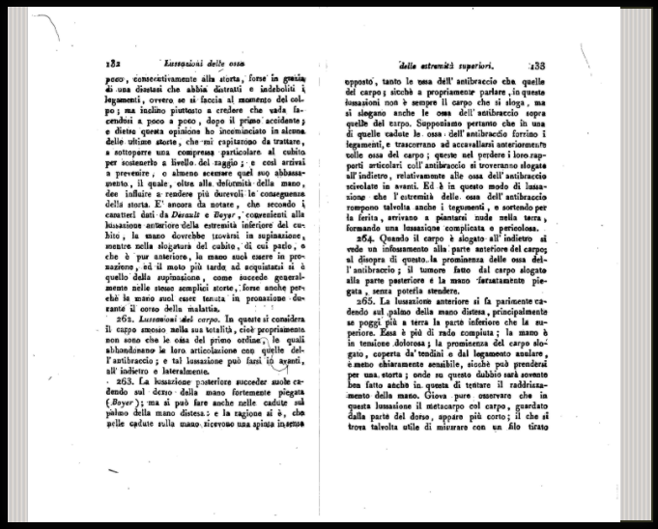

Monteggia - 1814
“…. At the end of the treatment the arm swelling has resolved, but only the dislocation of the radius that was not easy to reduce…. I applied compression and a new bandage again to contain it, but it did not want to stay in place”
Instituzioni Chirurgiches. 2nd. Vol. 5. Maspero; Milan, Italy: 1814. p. 131-133

Slide 7
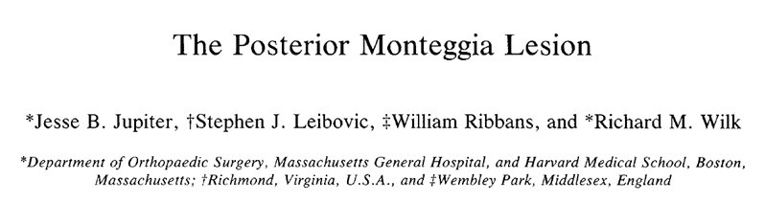
Monteggia - 1814
Bado 1967
Anterior
Posterior
Jupiter
2A
2B
2C
2D
Lateral
Radius and Ulna
Radial head
Radial Head
Radial Head
Radial head
Only 50% satisfied outcome

Slide 8
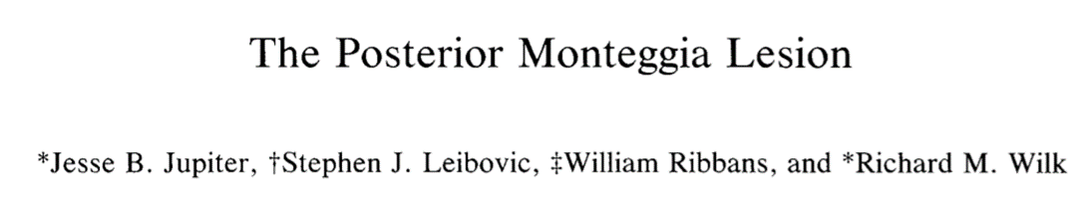
Jupiter - 1991
Type 2A
Type 2B
Metaphyseal diaphyseal junction distal to coronoid
Distal olecranon and coronoid process
Type 2C
Diaphyseal
Type 2D
Complex fracture from olecranon to diaphysis
J Orthop Trauma. 1991; 5(4):395–402.

Slide 9
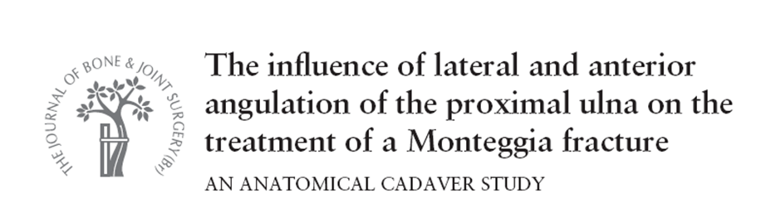
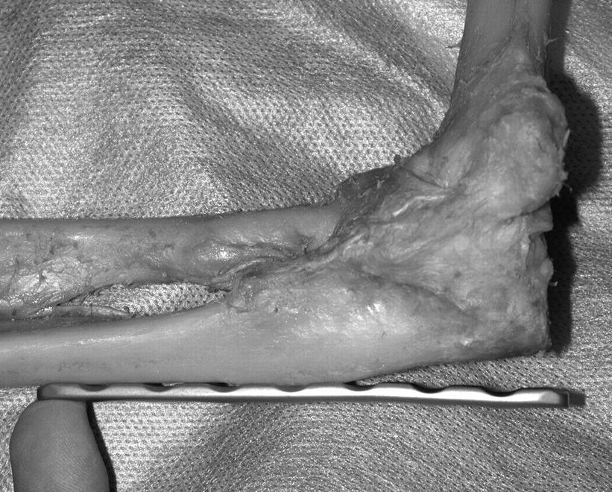
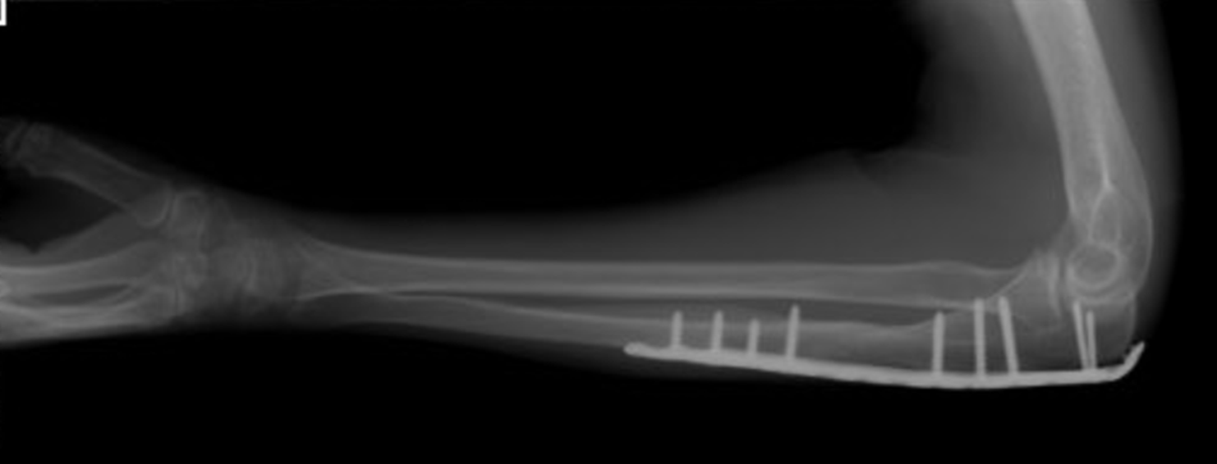
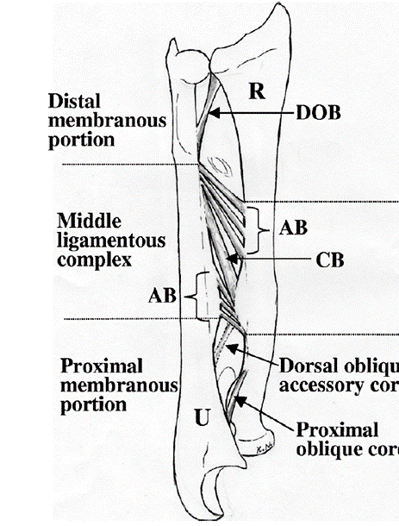
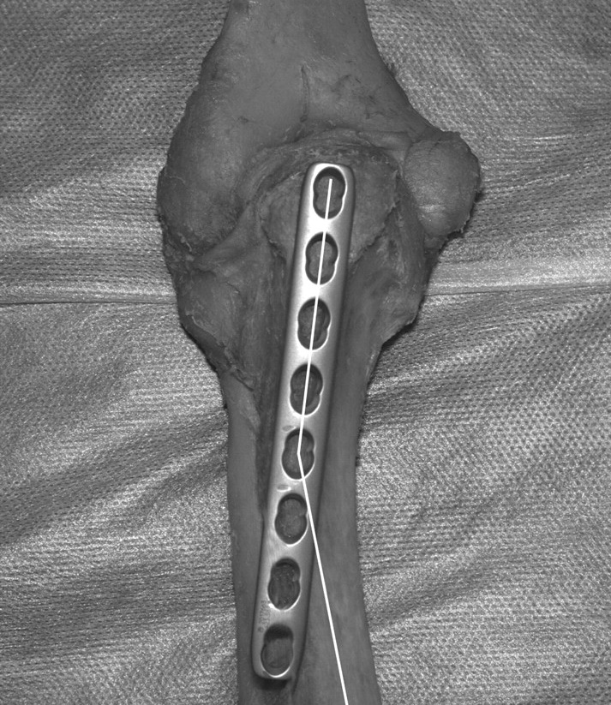
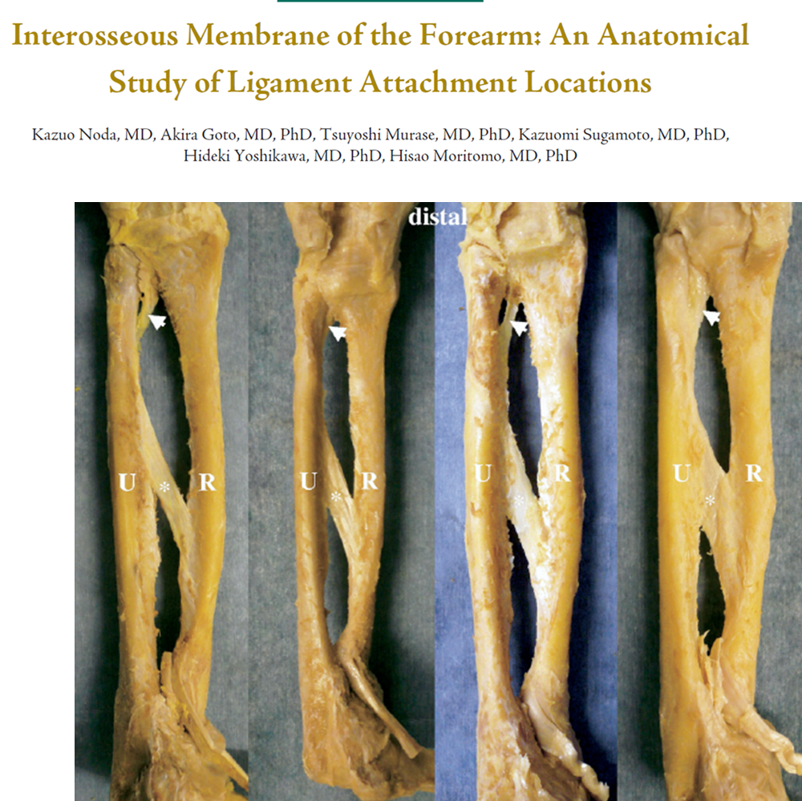
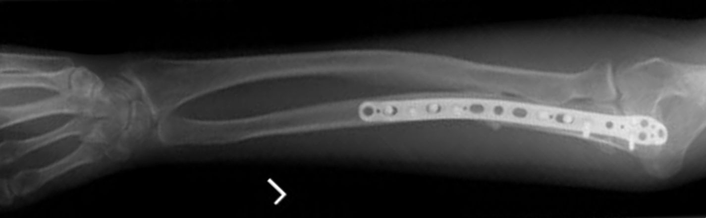
1. Ulna
Anterior mean
4.5° (1° to 14°)
Varus mean
17° (11° to 23°)
5th hole LCDCP
1
2
3
4
4
1
5
Greyhen; VOL. 89-B, No. 6, JUNE 2007

Slide 10
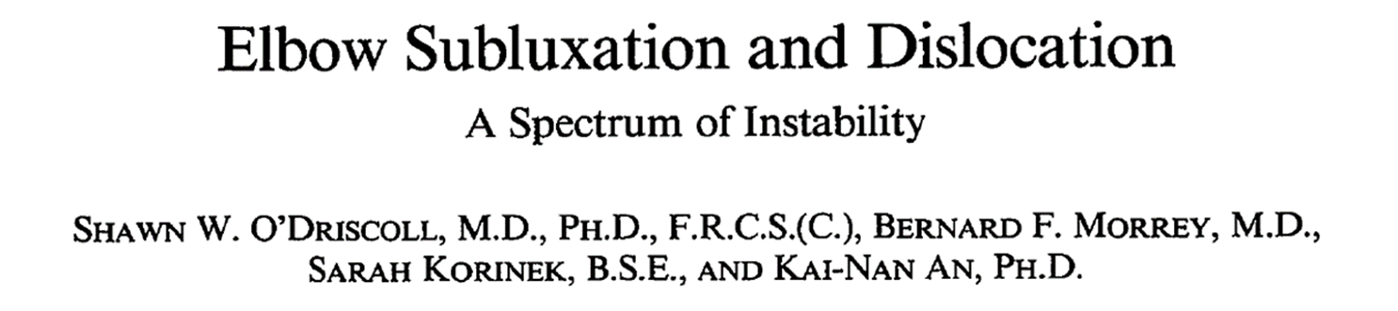

#1 ) Fit In
Clin Orthop Relat Res 1992 Jul;(280):186-97

Slide 11
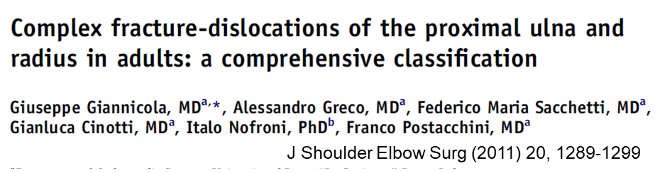
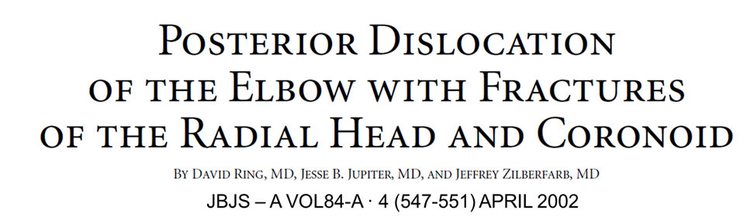
Instability
Simple
Complex
Severe soft tissue
Terrible Triad
PMRI
Proximal ulna fracture dislocations
Trans olecranon fracture dislocations
Monteggia Variants

Slide 12
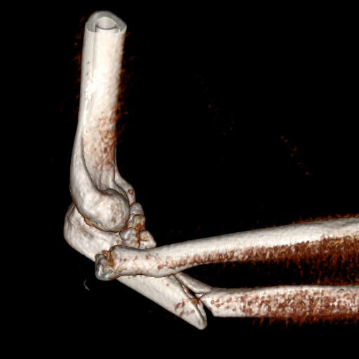
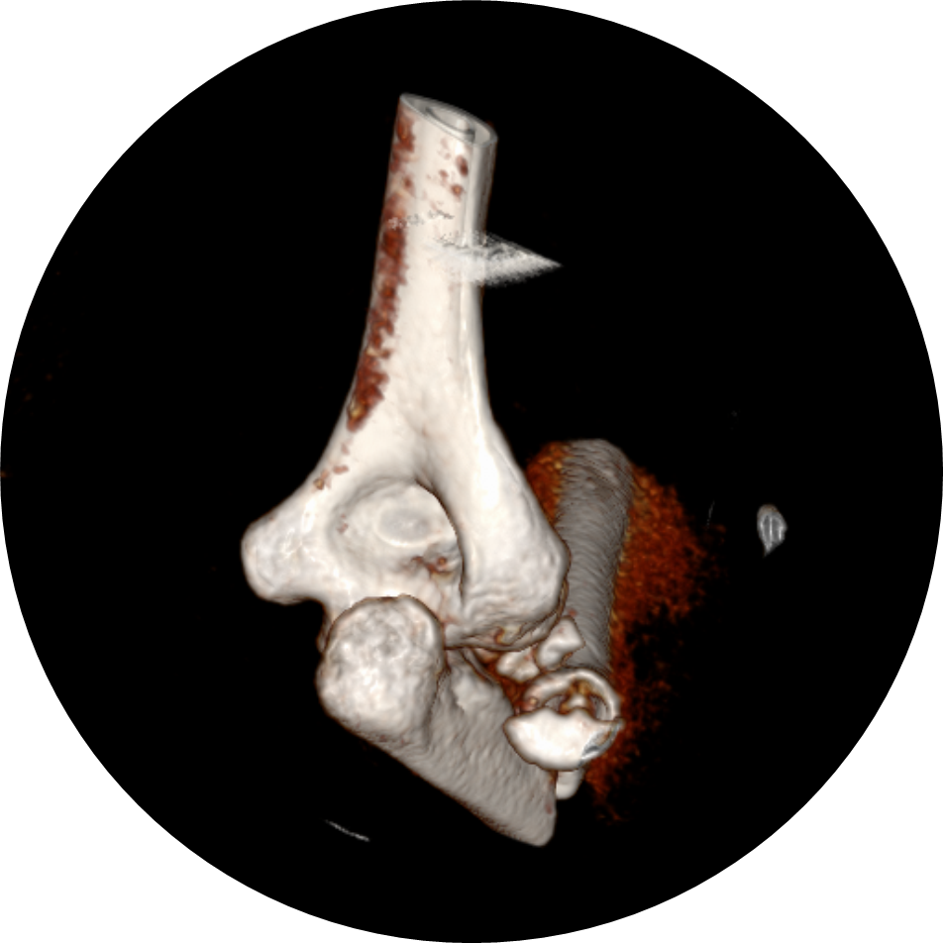
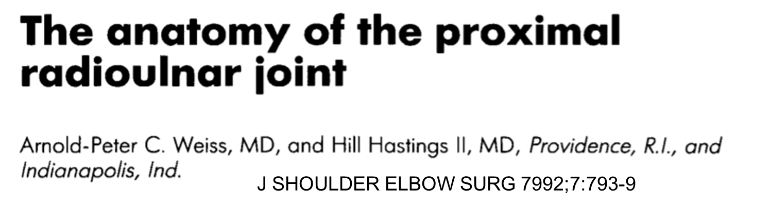


Slide 13

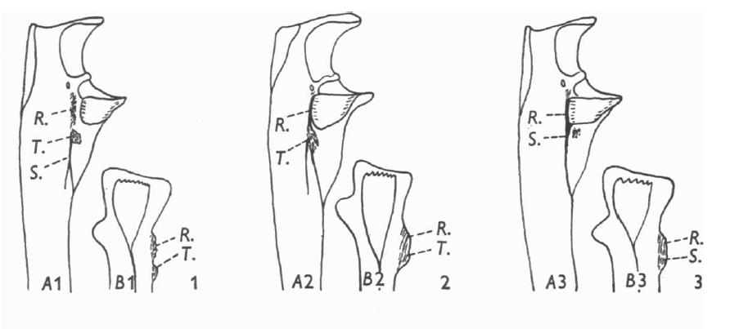
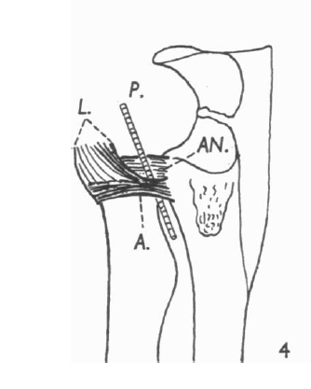
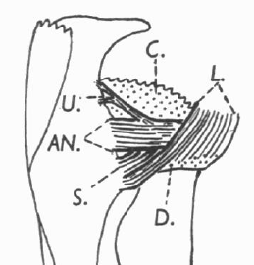
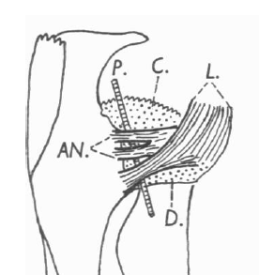
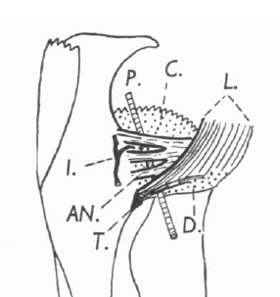
Annular ligament
J Anat. 1958 Jul;92(3):473-82

Slide 14
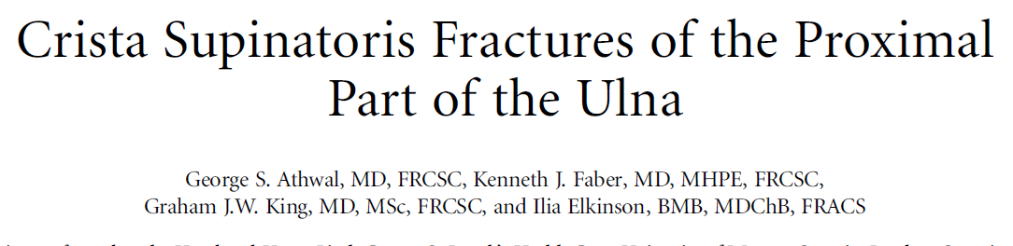
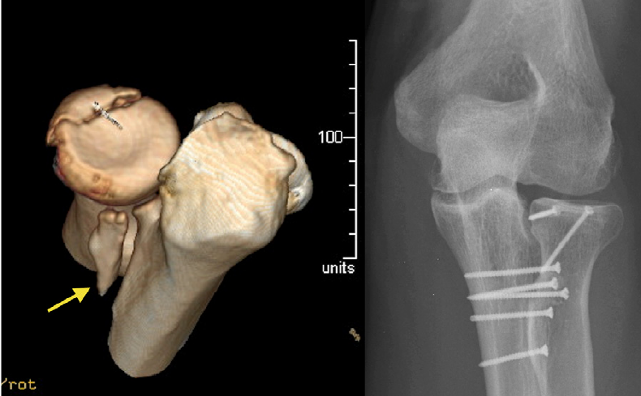
2. Supinator crest
J Bone Joint Surg Am. 2014;96:326-31

Slide 15
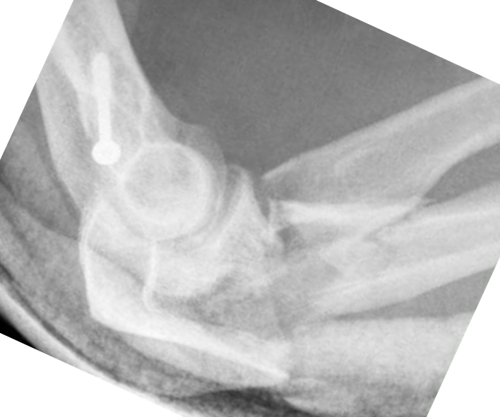
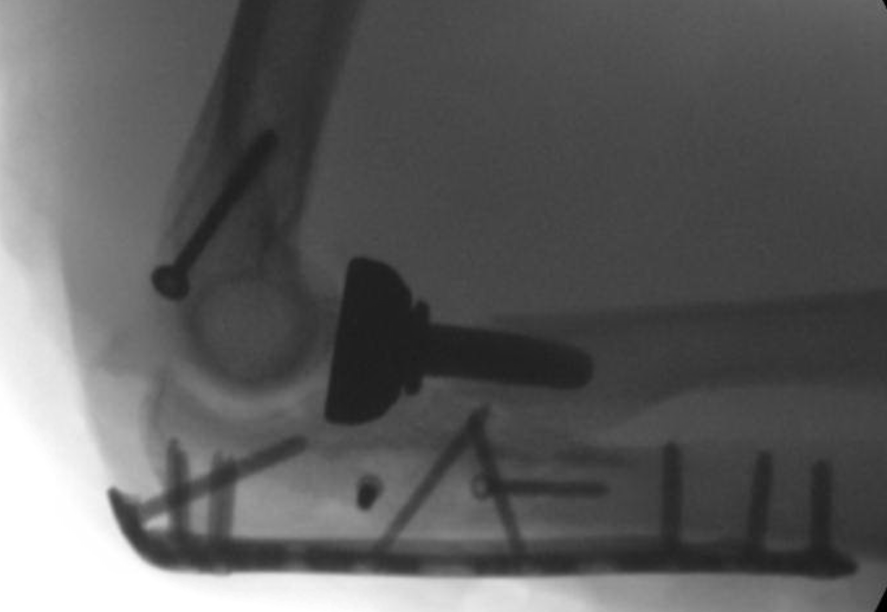
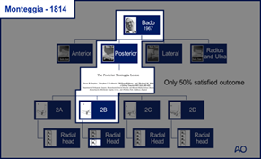
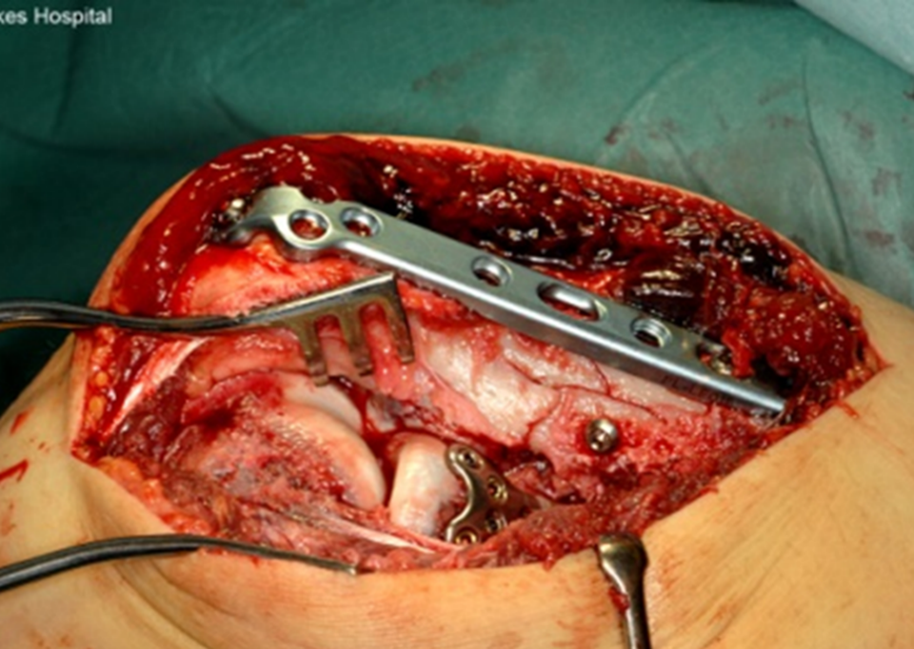
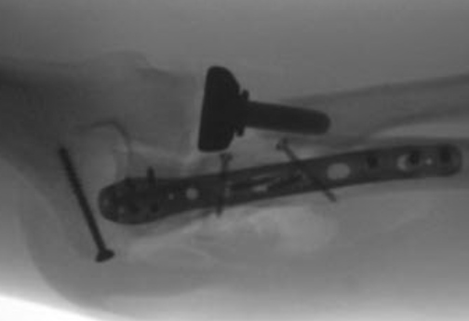
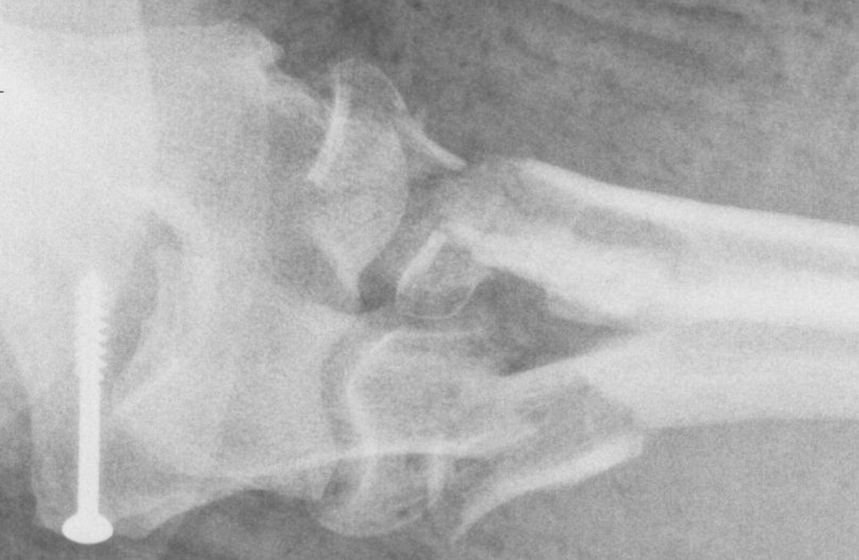
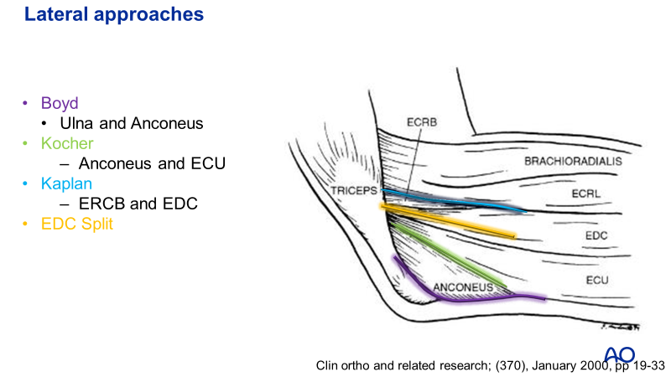
Not same case

Slide 16
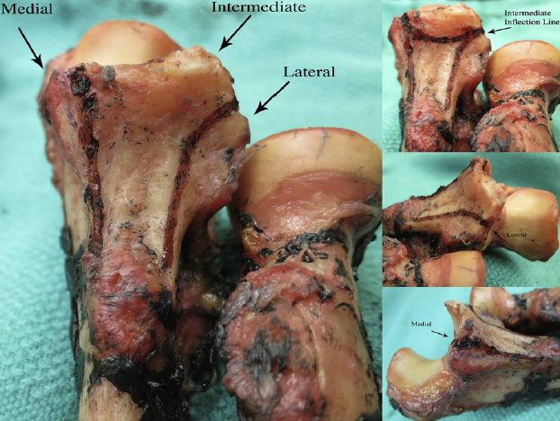
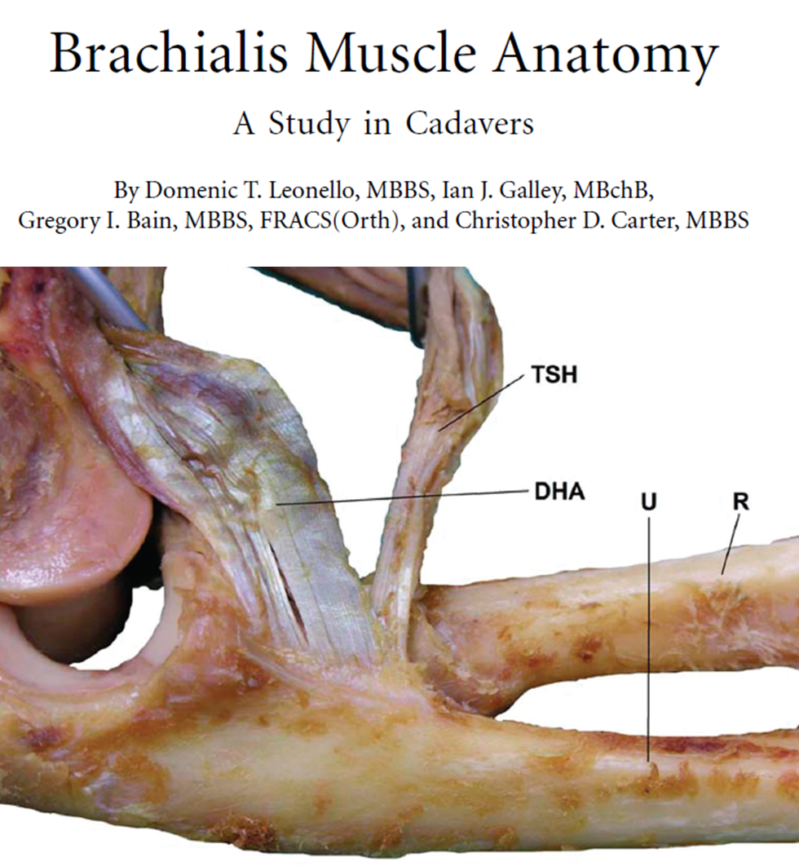
3. Coronoid
J Shoulder Elbow Surg (2013) 22, 323-328

Slide 17
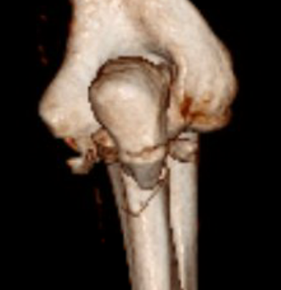
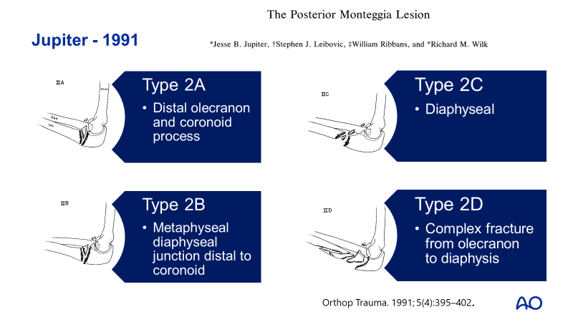
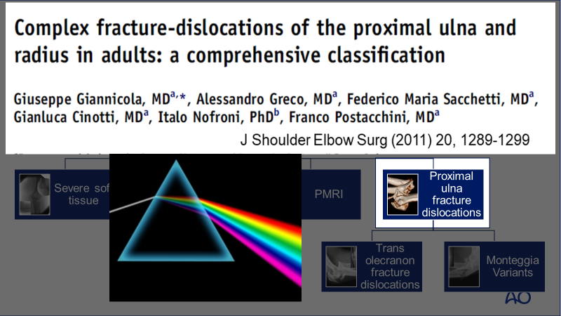
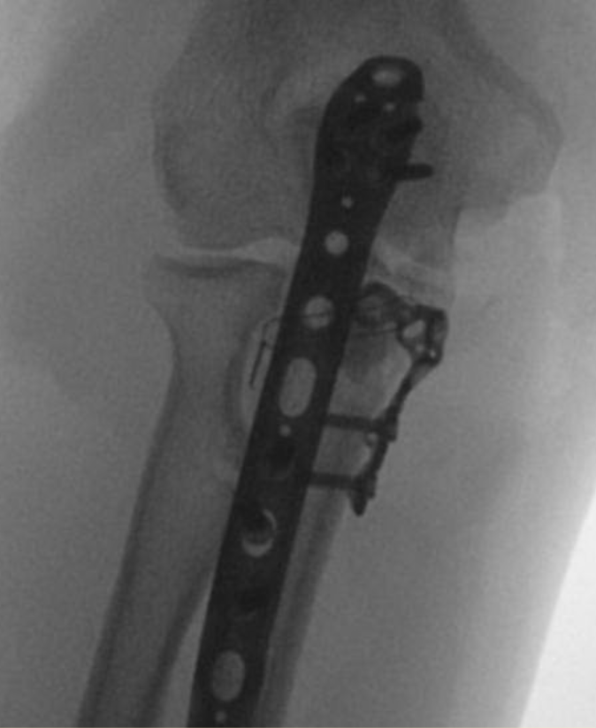
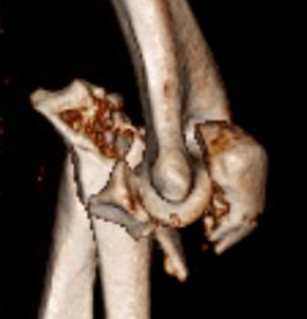
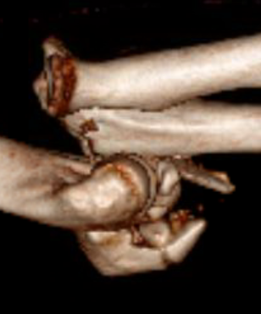
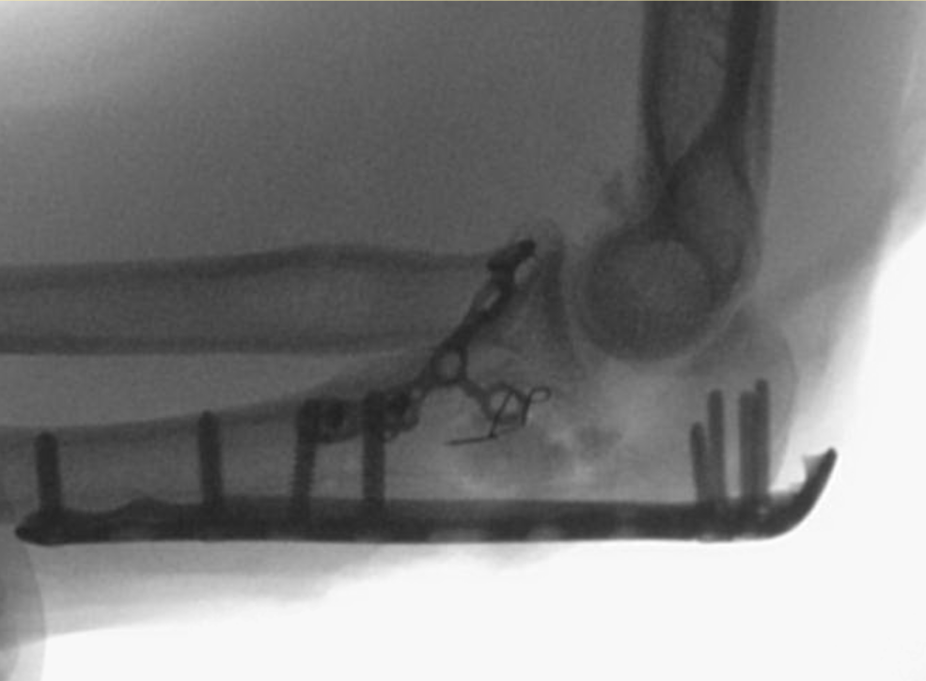
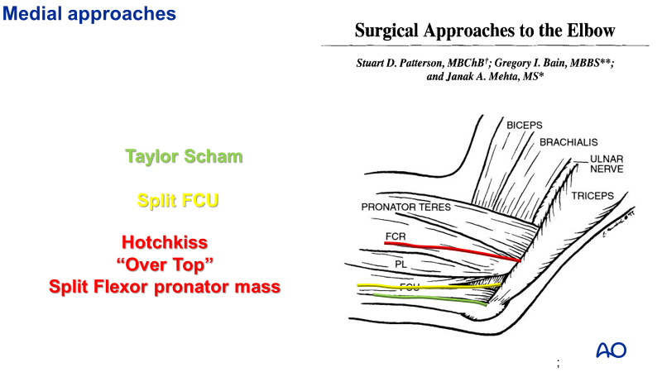
45 YO

Slide 18
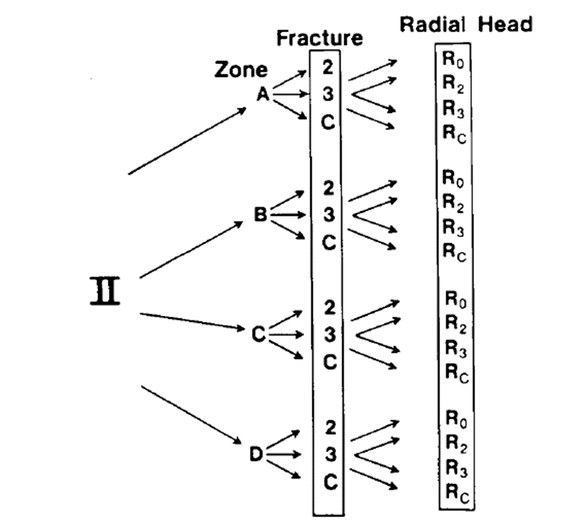

4. Radial head
0 – No Fracture
2 – 2 parts
3 – 3 parts
C - Comminuted

Slide 19

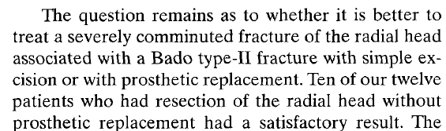
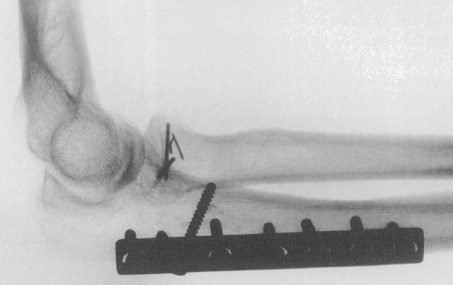
Ring/Jupiter - 1998
7
38
1
2
n=48 1985 -1994
Fracture forearm and dislocation PRUJ
  No transolecranon fracture dislocation
With stable internal fixation
  Overall 83% Satisfactory
  Bado II (posterior with radial head)
    50% satisfied

Slide 20
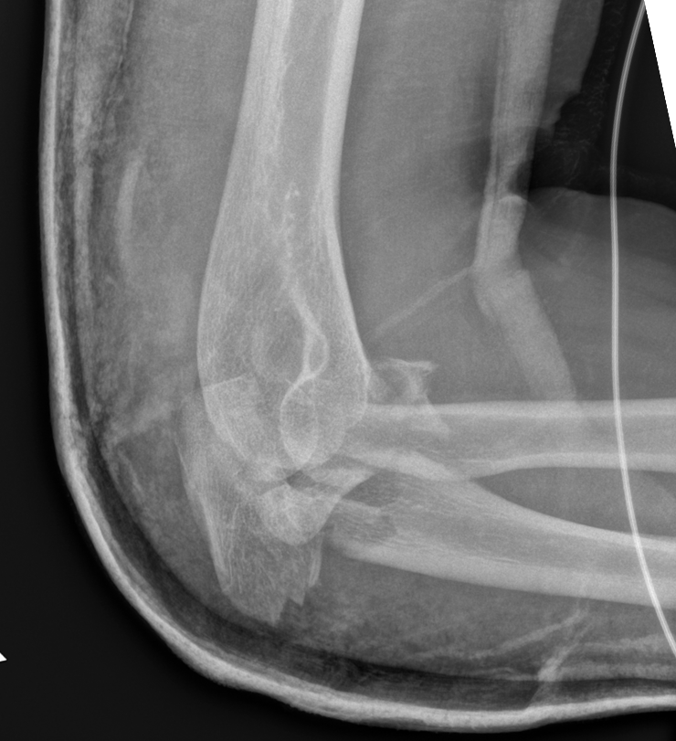
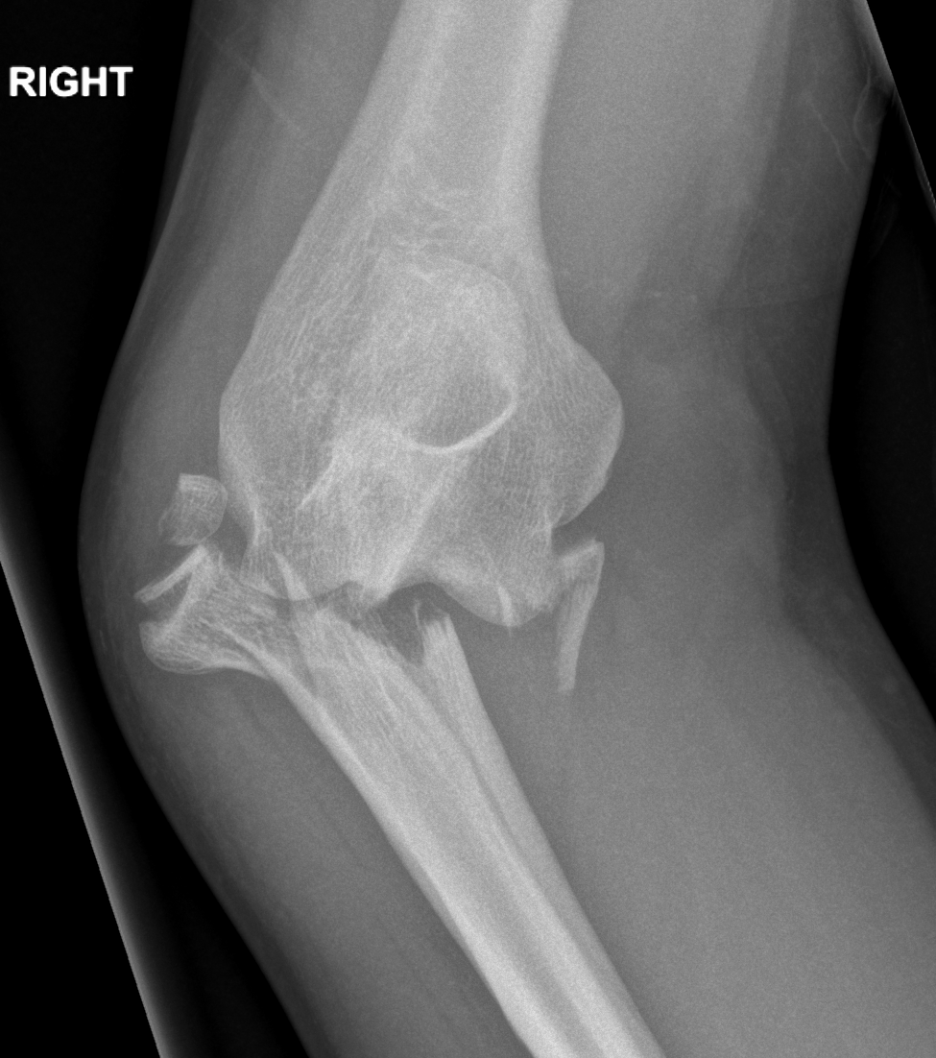
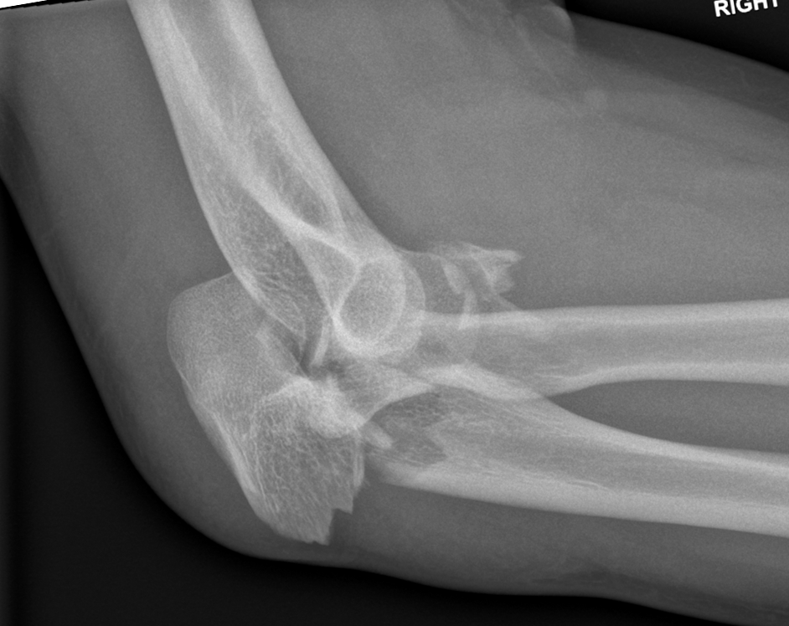
28 YO fall from bicycle Right

Slide 21
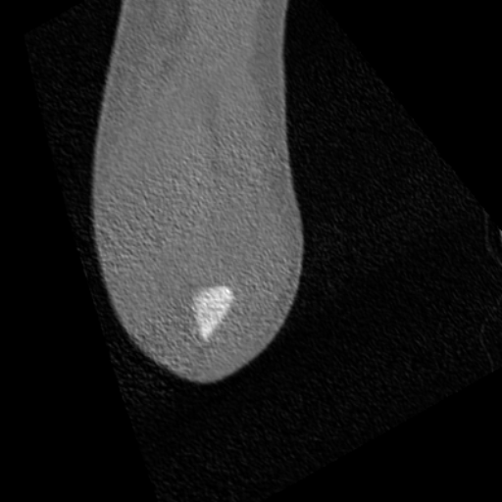
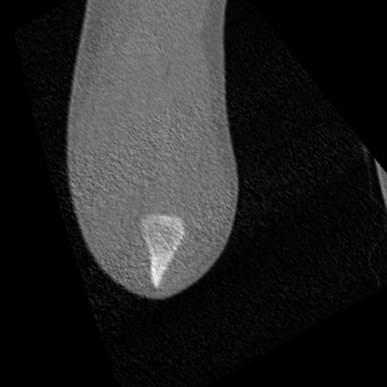
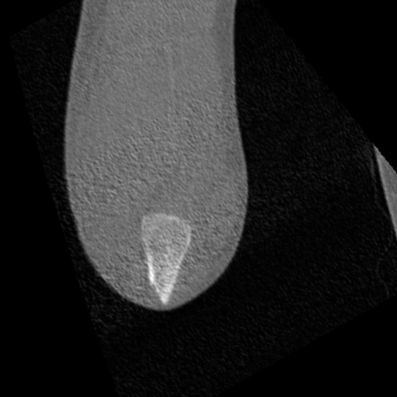
































































Slide 22




















Slide 23



Slide 24




















35 YO fall from bicycle

Slide 25











Slide 26
Summary

Slide 27












Summary
Notes:
Your take-home messages should
Match with your learning objectives
Summarize three to maximum five important points
Be your last slide (this is what your learners will remember and that will stay until the next speaker is up)
Your take-home message can
Be a powerful graphic or picture that is related to the topic
Not be something that has nothing to do with the topic (eg, a picture of your hospital or family or a “thank you” slide)
Example: Preoperative planning
Formulate a preoperative plan
Identify and assess benefits of preoperative planning
Develop a surgical tactic
Describe steps involved

