Slide 1
Distal Humerus
How I fix it
Mr Lee Van Rensburg
BESS 2020

Slide 2
Disclosures
Acumed
  Paid Consultancy work
  Educational contract
  Financial assistance with my courses
Wright medical
  Financial assistance with my Elbow trauma cadaver Course
Stryker
  Educational contract

Slide 3
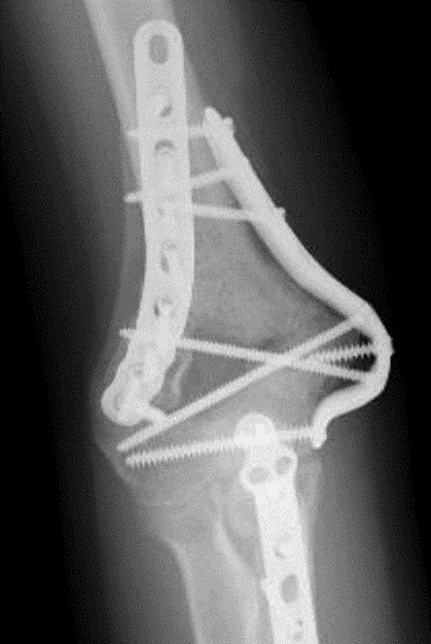
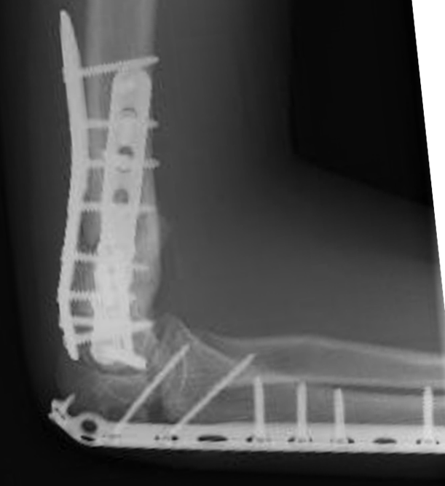
Disclaimer – 1st case 2005

Slide 4
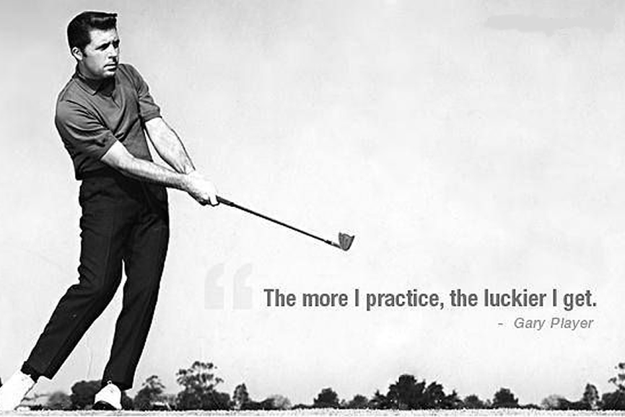

Slide 5
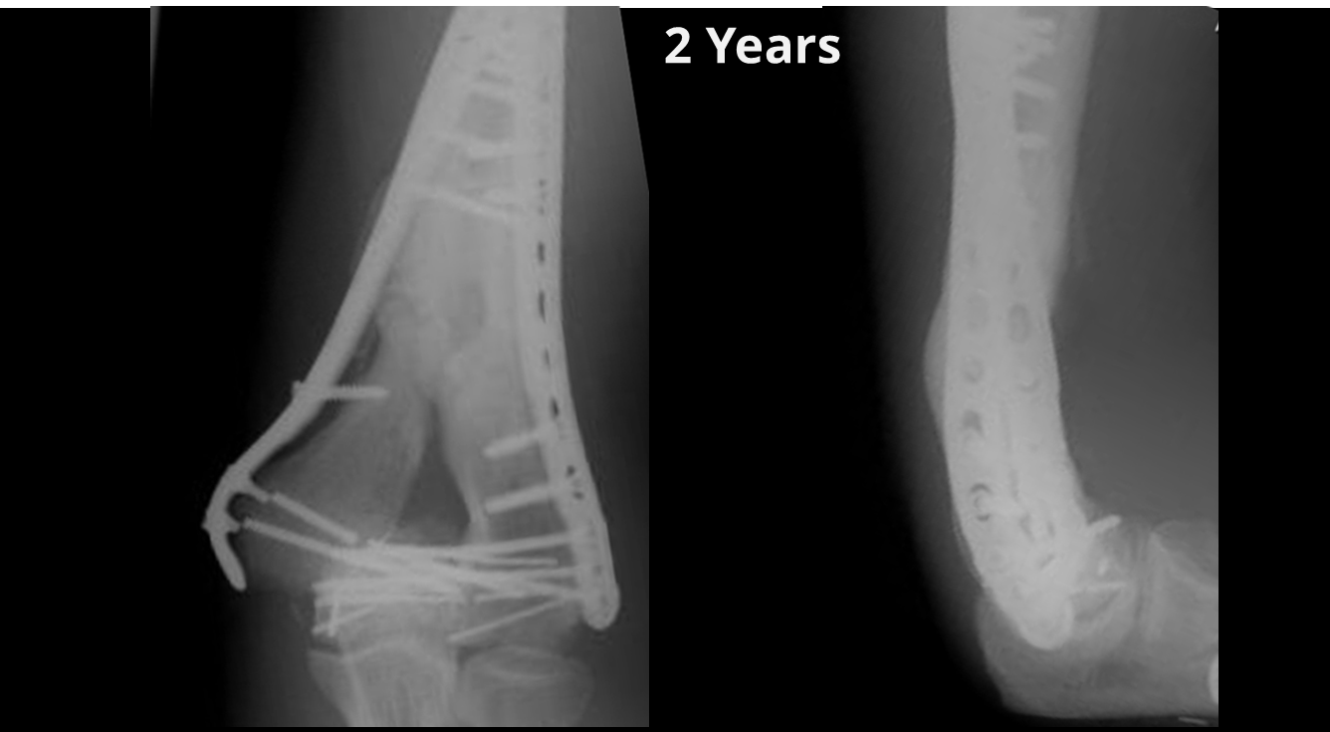
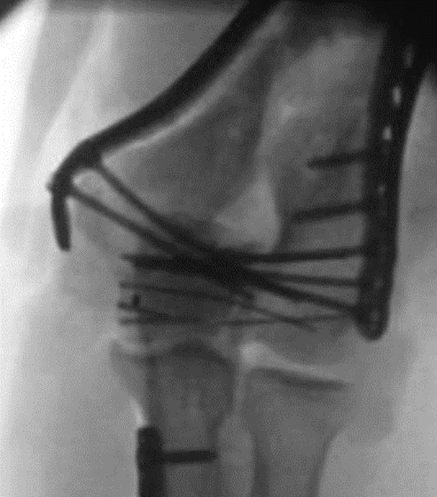
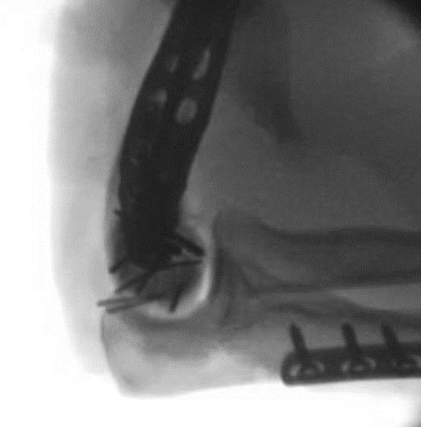
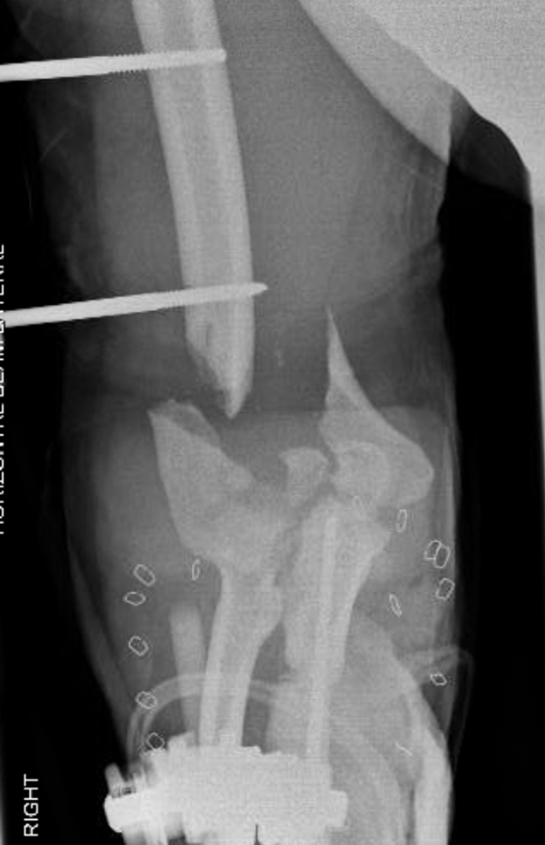
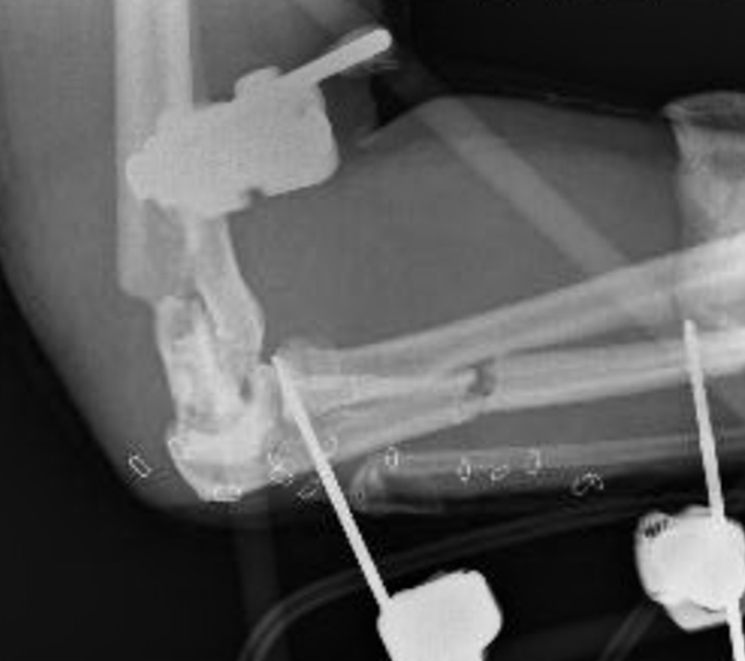
2016– 32 YO Male Open elbow

Slide 6
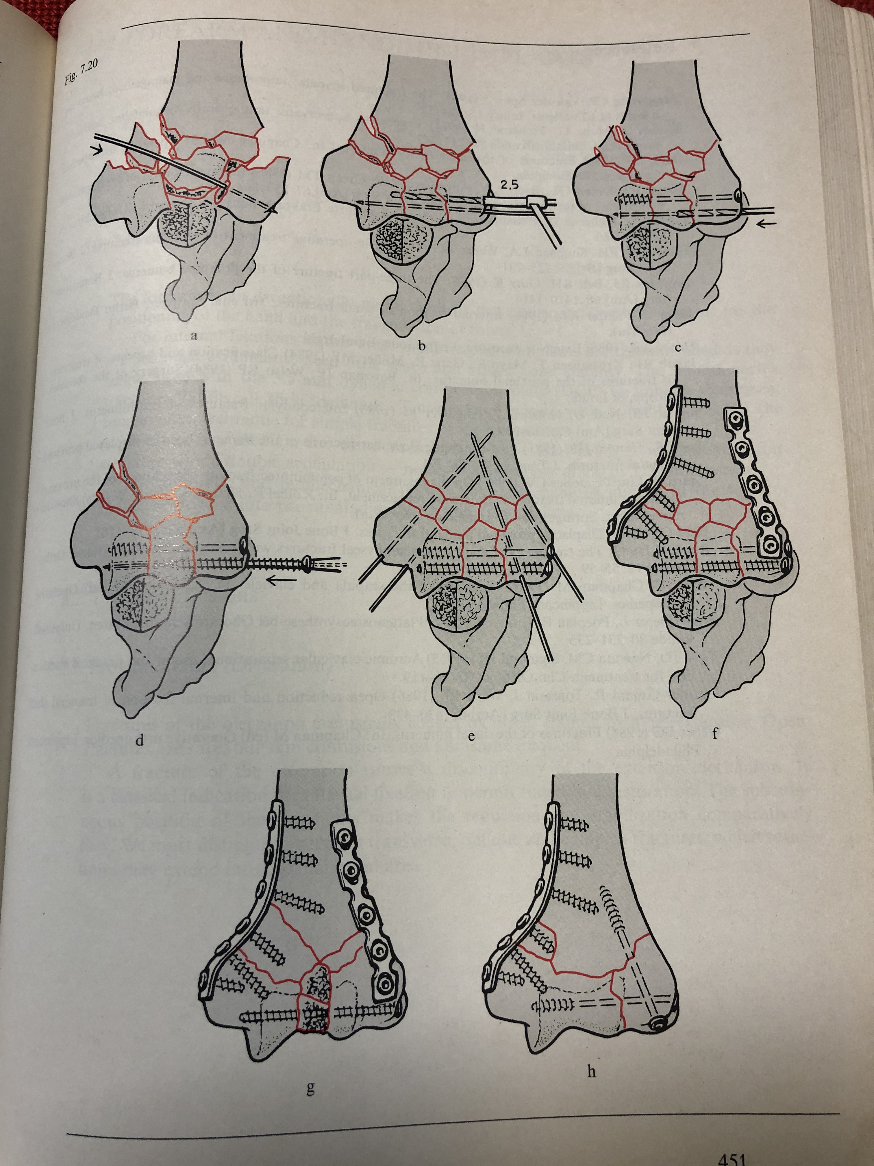
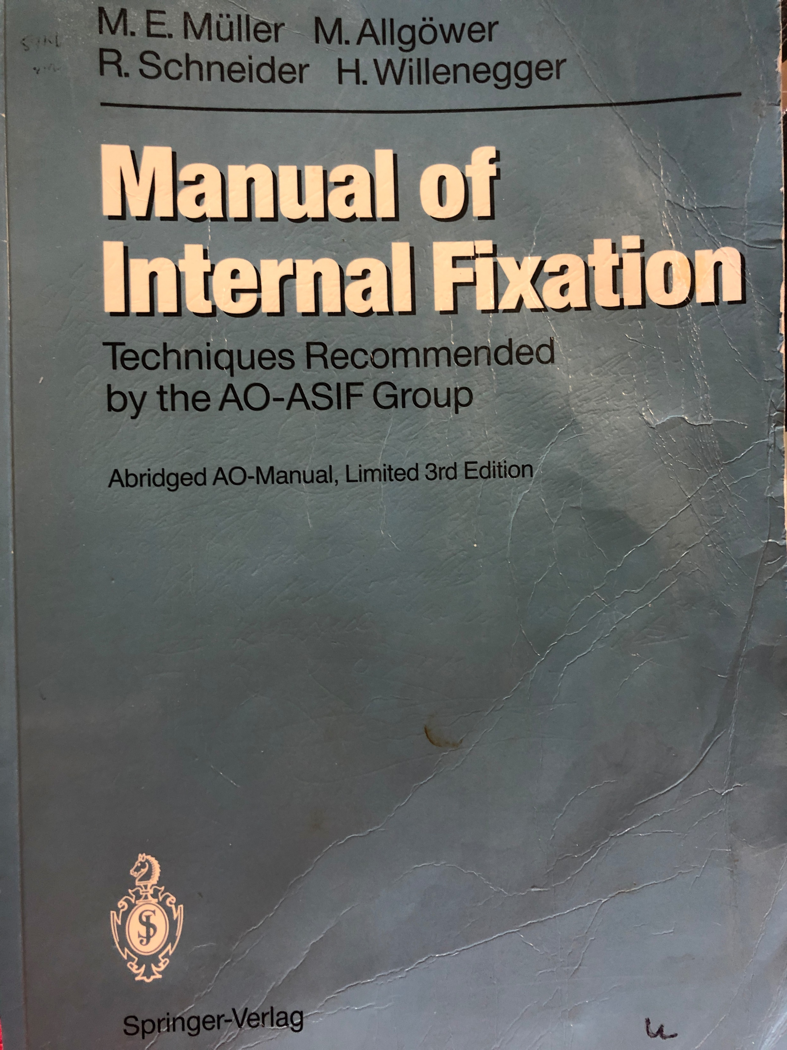
Problem
1992

Slide 7
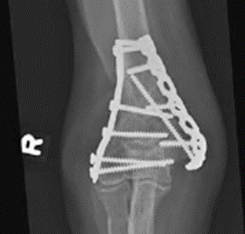

RCT published 2009

Slide 8
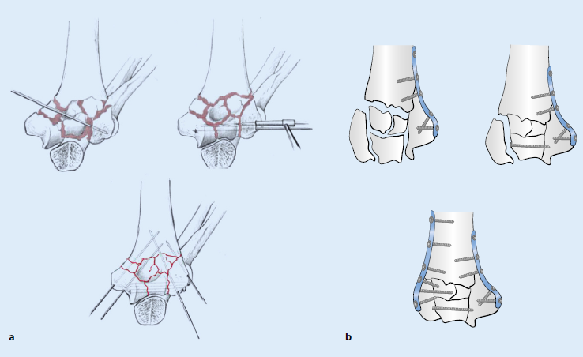
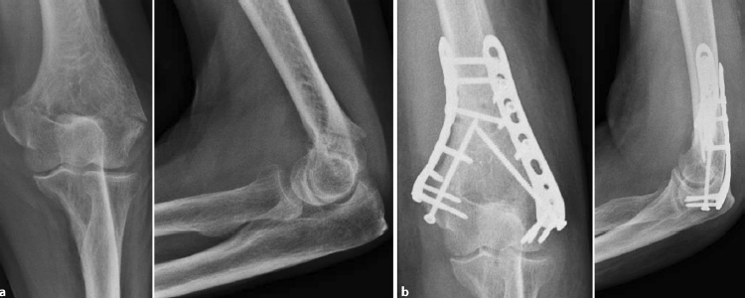
Review article - 2018

Slide 9
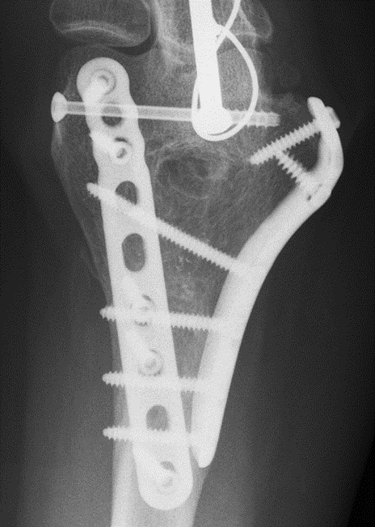
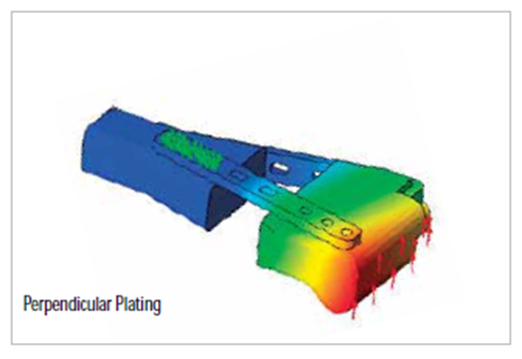
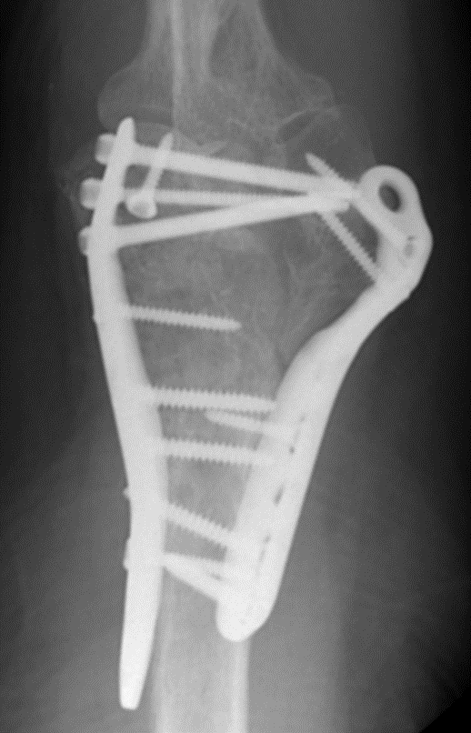
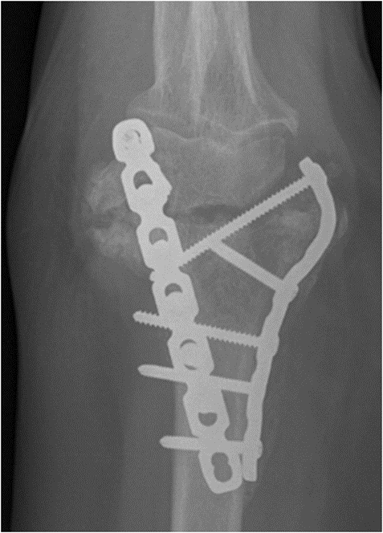
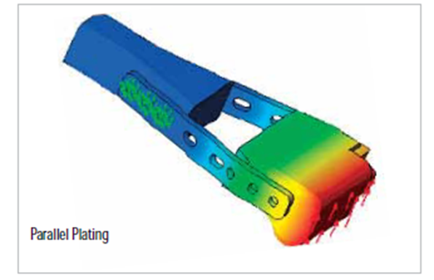
Not competition

Slide 10

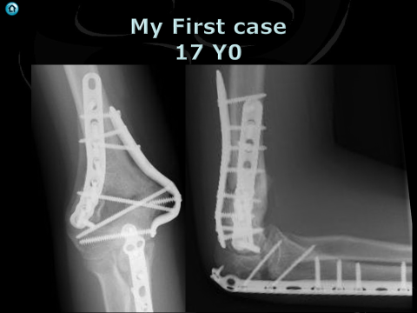
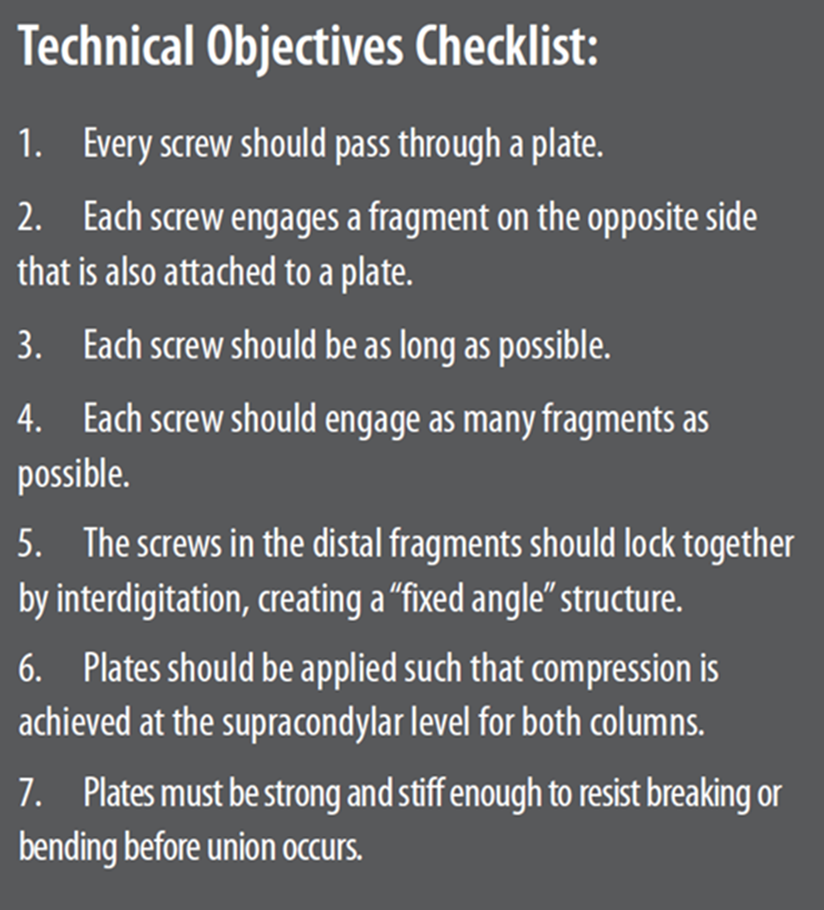

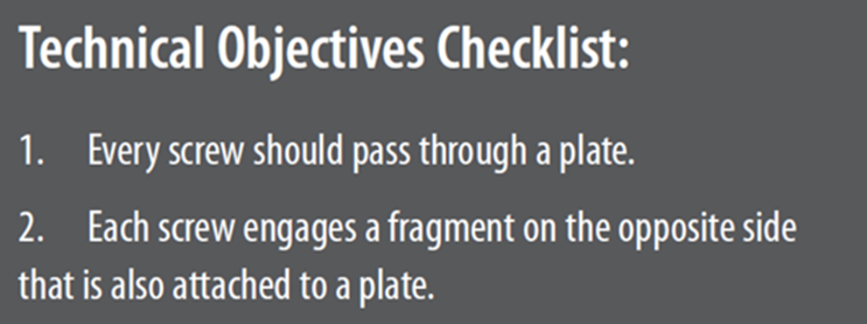
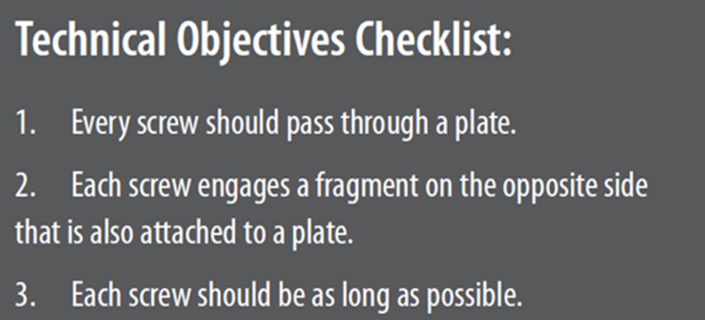
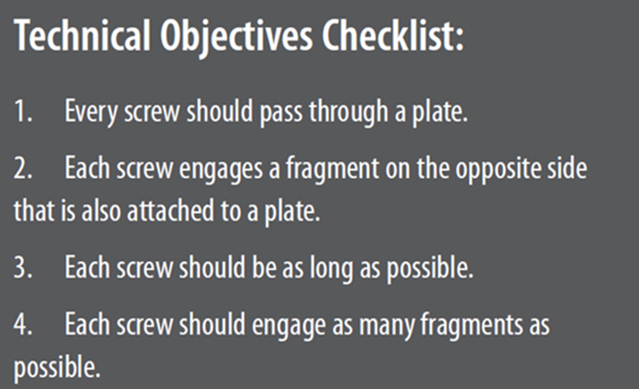
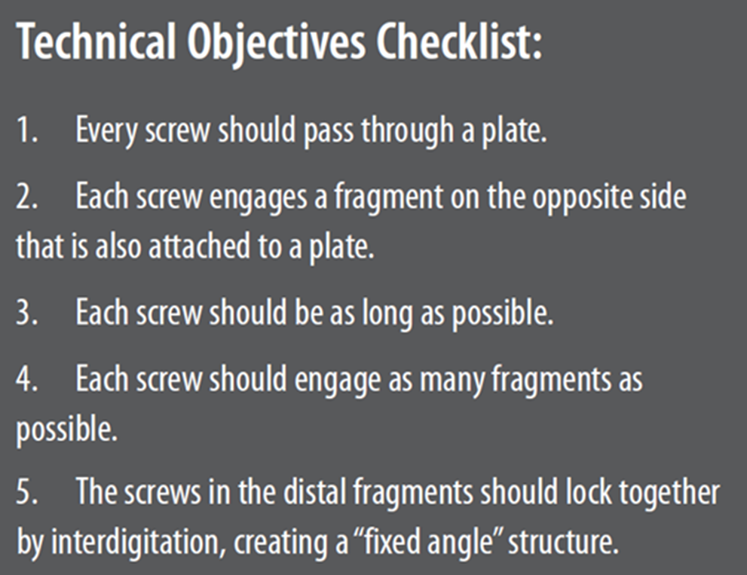
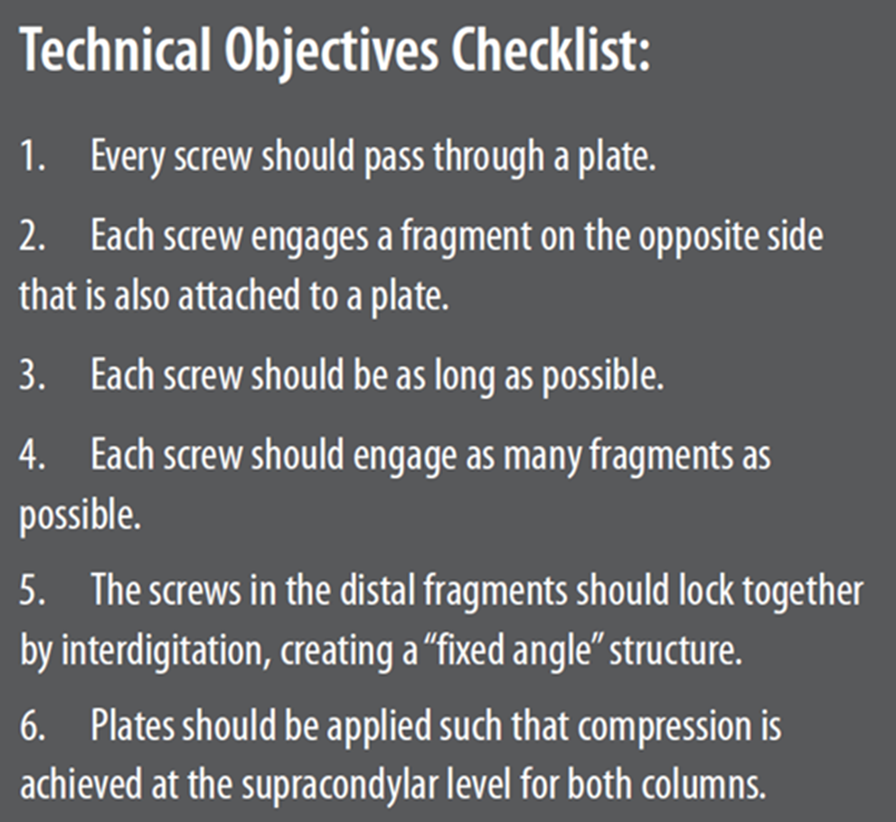
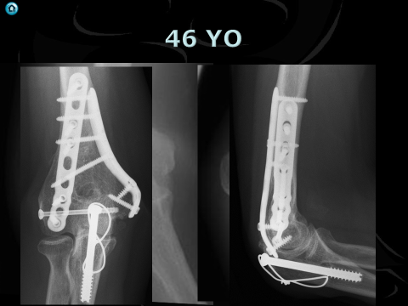
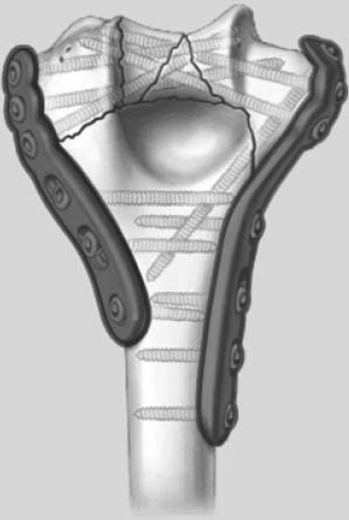
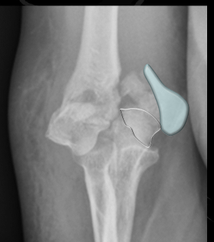
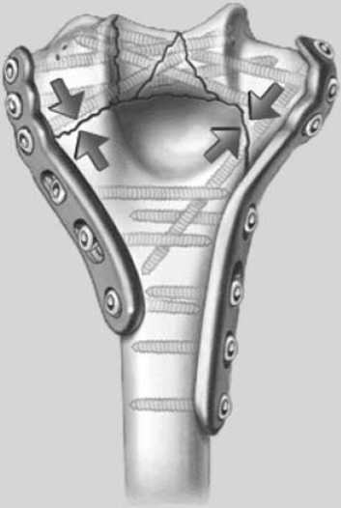
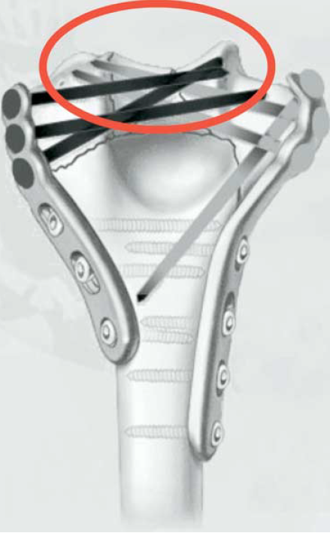
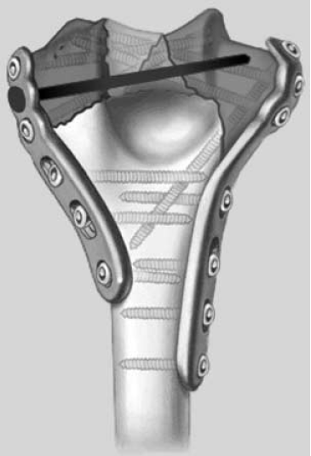
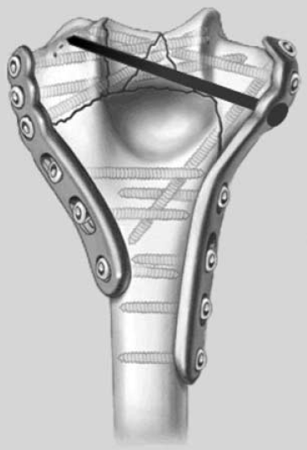
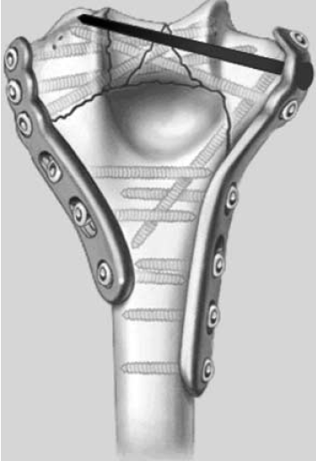
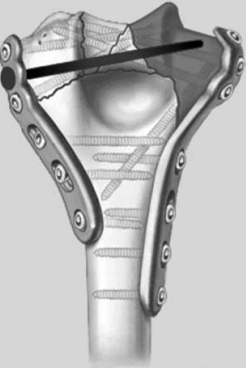

JSES 2005;14:186S-194S

Slide 11
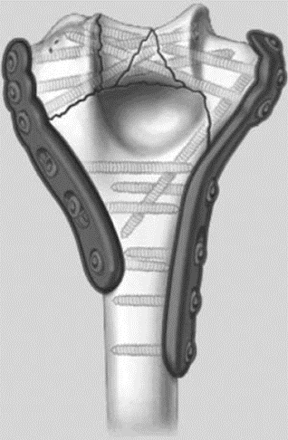
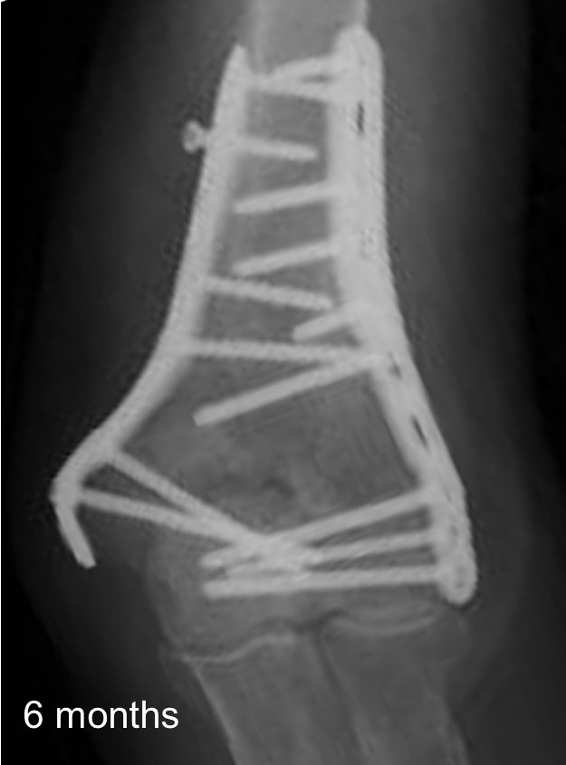
Tip 1
4 Good distal screws
Don’t need to be locking
First 2
Great screws
Long
Distal

Slide 12
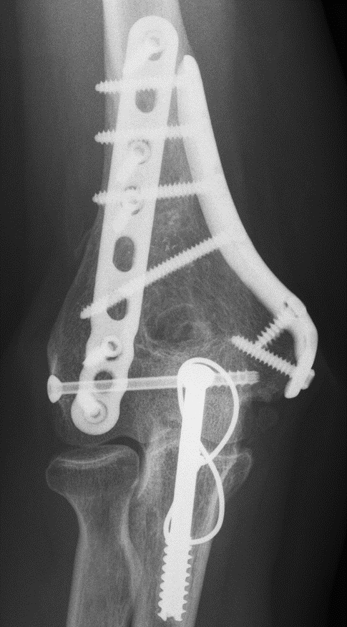
Tip 2
No Home run screw

Slide 13

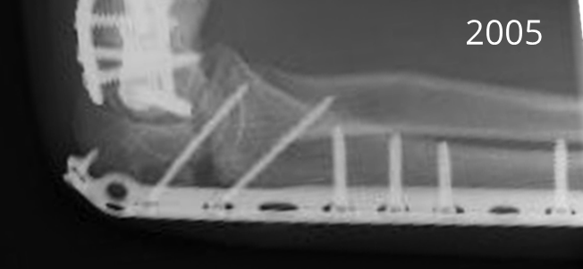


Tip 3
➢
Variable size screws
2016
.
.
.
.

Slide 14
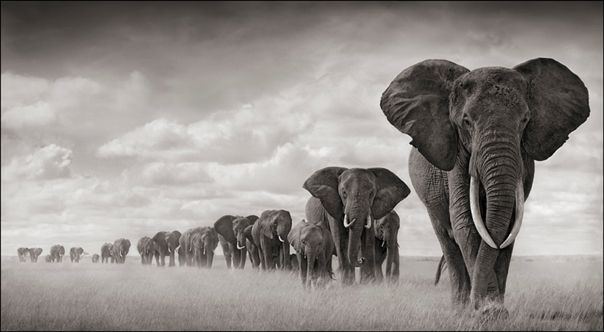

Slide 15

No difference
J Shoulder Elbow Surg (2012) 21, 126-135

Slide 16
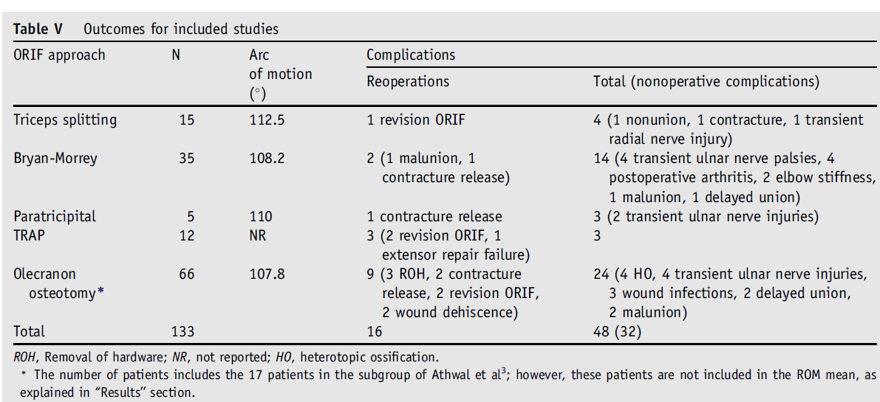
110°
1/3rd
J Shoulder Elbow Surg (2012) 21, 126-135

Slide 17
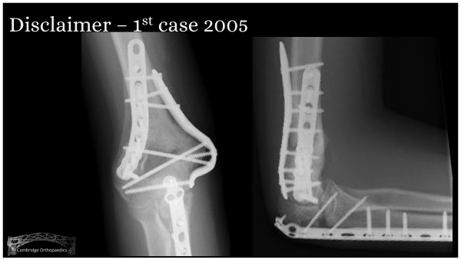
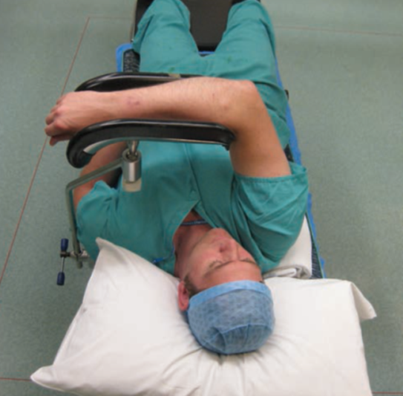
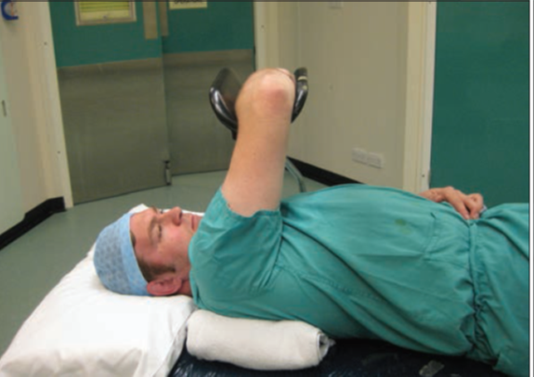
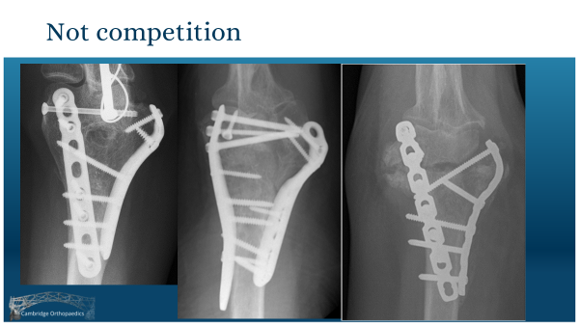
What do I do

Slide 18
Skin Incision

Slide 19
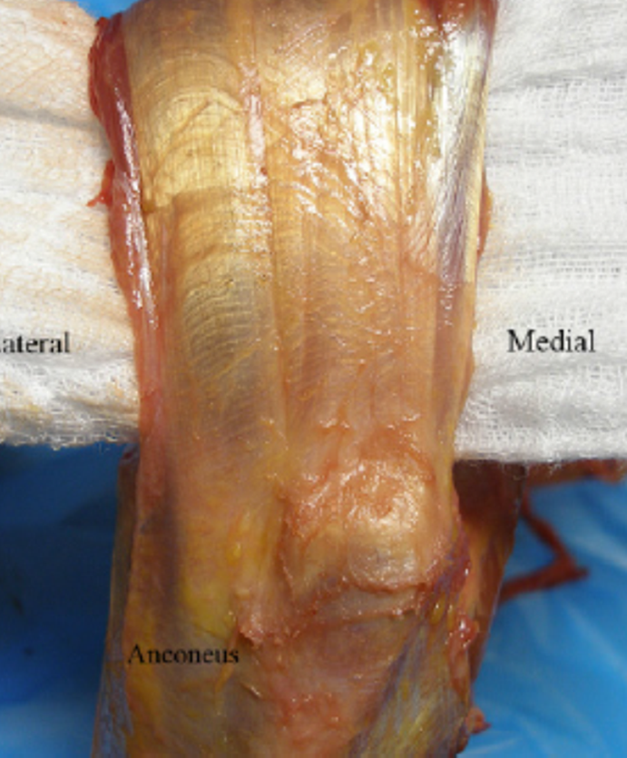

Deep dissection
Lateral Para tricipital
Lateral Para tricipital
TRAP
Medial Paratricipital
Lateral Para Olecranon

Slide 20
Posterior approach
Van Gorder
Triceps splitting
(Tongue)
Bryan Morrey
Triceps reflecting
Macausland
Olecranon osteotomy
J Shoulder Elbow Surg 2001;10:380-2.

Slide 21
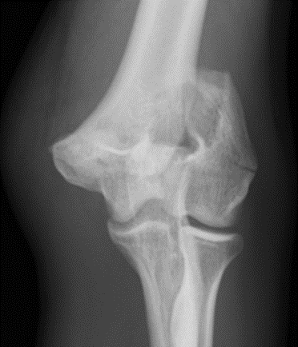

Slide 22
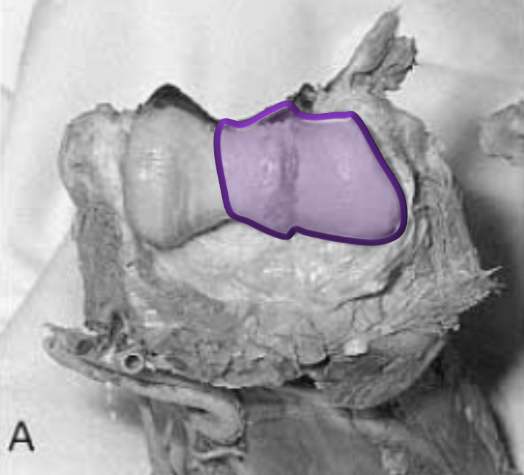
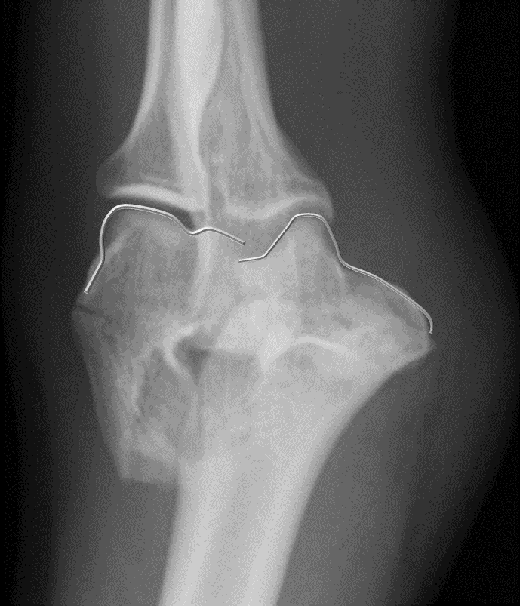
Lateral para-olecranon - 2016
J Shoulder Elbow Surg 2001;10:380-2.

Slide 23
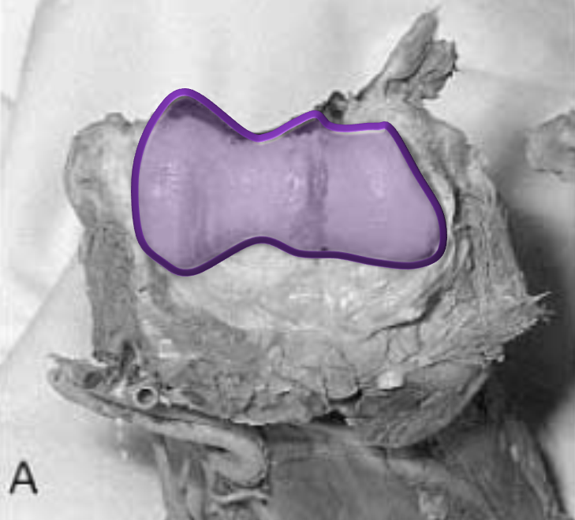
Lateral para-olecranon - 2018
J Shoulder Elbow Surg 2001;10:380-2.

Slide 24
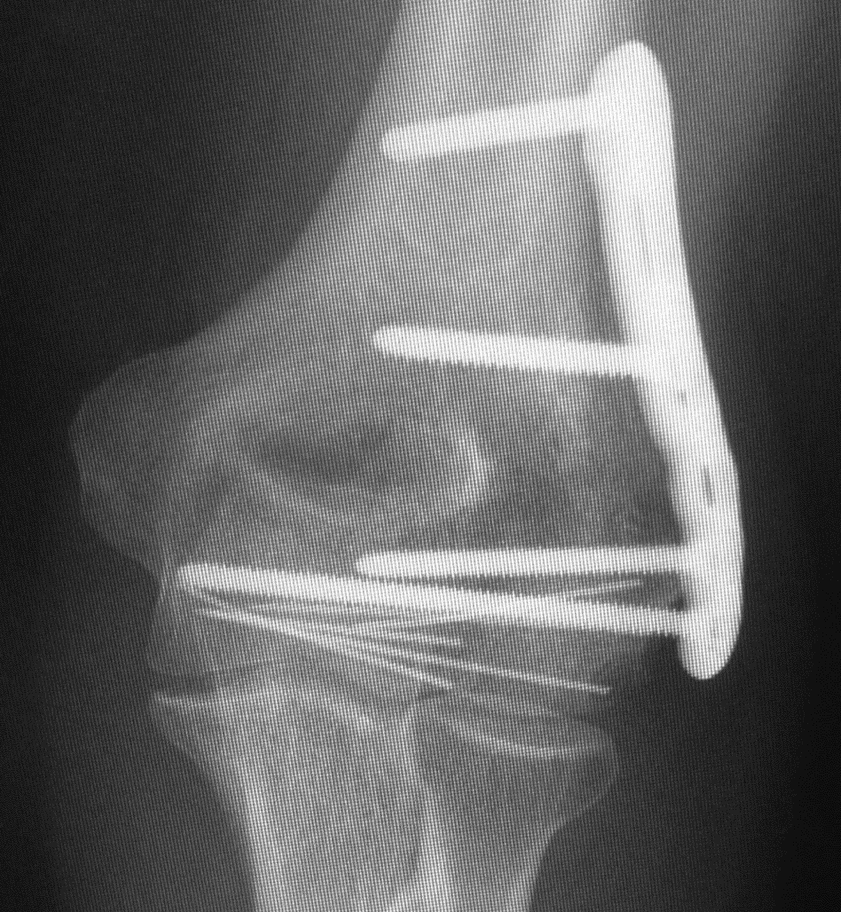





55 YO
1 Year

Slide 25


65 YO

Slide 26





65 YO

Slide 27

Clin Orthop Relat Res (2008) 466:135–138

Slide 28



2.5 cm proximal to apex
+- 0.4 cm
10 Cadaver
30 Patients
Clin Orthop Relat Res (2011) 469:2638–2644

Slide 29

Ulna nerve
2005

Slide 30


Chen 2010
J Orthop Trauma 2010 Jul;24(7):391-4.

Slide 31


Fajolu 2012

Slide 32
Fajolu 2012
Leave in situ
Complete release and move during surgery
  Return at end procedure
Complete release and anterior transposition

Slide 33
Fajolu 2012
Advocate
  Complete release
    8 cm proximal to medial epicondyle into flexor pronator muscle mass
  Leave in Situ
  Transpose
    Touching metal
    Excessive traction or contact with nerve during surgery

Slide 34


Shearin 2018
Hand Clin 2018 Feb;34(1):97-103.

Slide 35




Common scenario

Slide 36


Shin 2017
Clinics in Shoulder and Elbow Vol. 20, No.4, December, 2017

Slide 37



Videos 2010

Slide 38

Videos circa 2019

Slide 39
What I do - Ulnar nerve
Plate
Osbornes fascia
  Cut near Ulna
  Leave cuff of tissue
Arcade of Struthers
  Anterior to Ulna nerve
  Leave ulna nerve attached to triceps
Transpose
  Touching metal
  Wants to sublux

Slide 40








What I do - Ulnar nerve
Plate
Osbornes fascia
  Cut near Ulna
  Leave cuff of tissue
Arcade of Struthers
  Anterior to Ulna nerve
  Leave ulna nerve attached to triceps
Transpose
  Touching metal
  Wants to sublux

Slide 41


What I do - Ulnar nerve
Plate
Osbornes fascia
  Cut near Ulna
  Leave cuff of tissue
Arcade of Struthers
  Anterior to Ulna nerve
  Leave ulna nerve attached to triceps
Transpose
  Touching metal
  Wants to sublux
Hand Clinics, Volume 23, Issue 3, August 2007, Pages 283-289

Slide 42
What I do - Ulnar nerve
Plate
Osbornes fascia
  Cut near Ulna
  Leave cuff of tissue
Arcade of Struthers
  Anterior to Ulna nerve
  Leave ulna nerve attached to triceps
Transpose
  Touching metal
  Wants to sublux
Hand Clinics, Volume 23, Issue 3, August 2007, Pages 283-289

Slide 43



What I do - Ulnar nerve
Plate
Osbornes fascia
  Cut near Ulna
  Leave cuff of tissue
Arcade of Struthers
  Anterior to Ulna nerve
  Leave ulna nerve attached to triceps
Transpose
  Touching metal
  Wants to sublux
Hand Clinics, Volume 23, Issue 3, August 2007, Pages 283-289

Slide 44







Summary

