Slide 1
Deltopectoral approach
Mr Lee Van Rensburg

Slide 2
Anatomy
Muscles/ Tendons
Nerves
Vessels
Ligaments
Bones

Slide 3
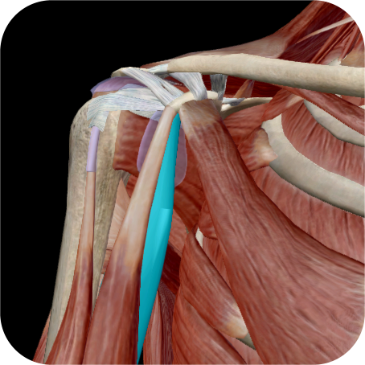
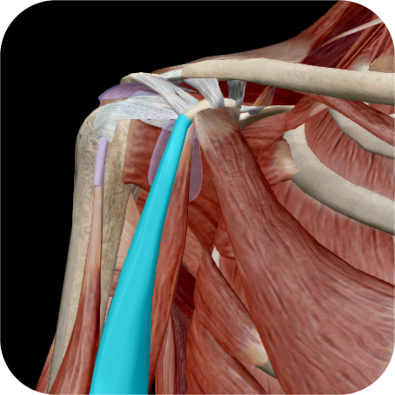
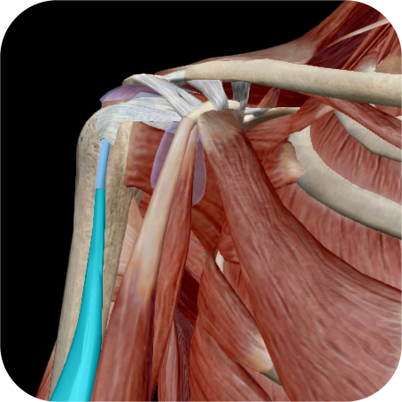
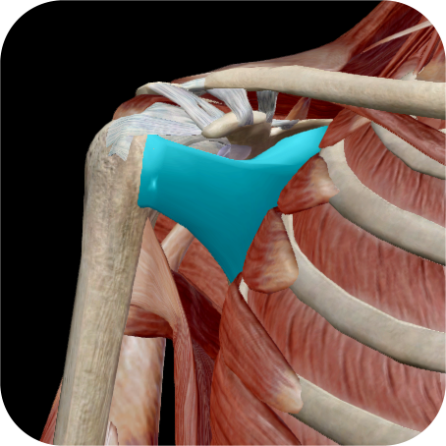
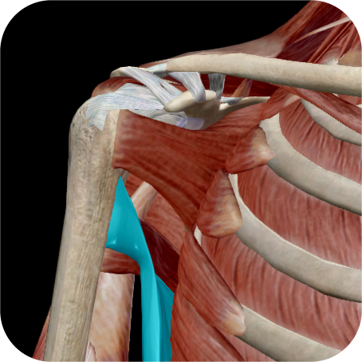
Anatomy
Muscles/ Tendons
Nerves
Vessels
Ligaments
Bones

Slide 4
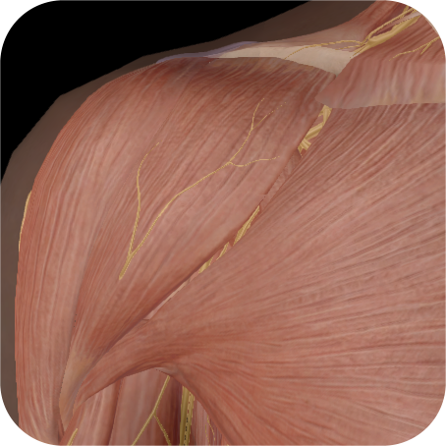
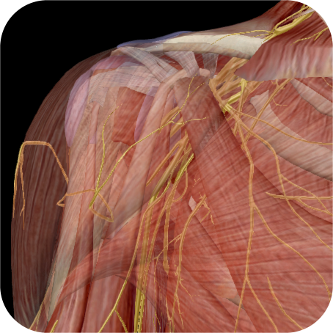
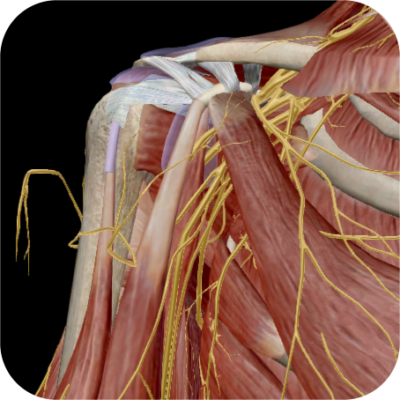
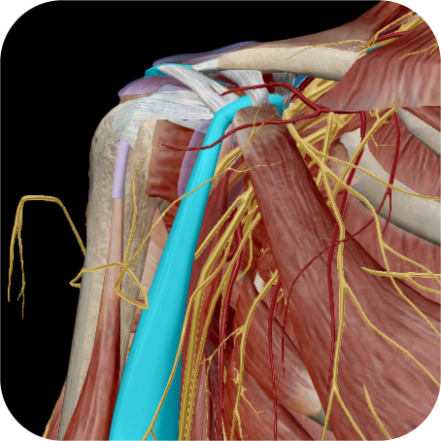
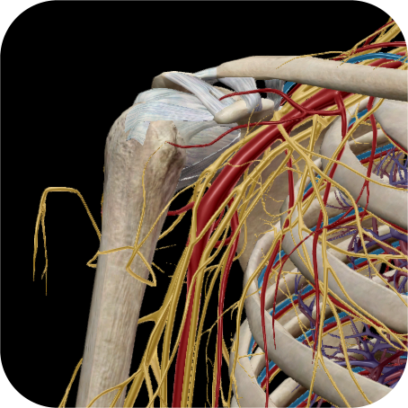
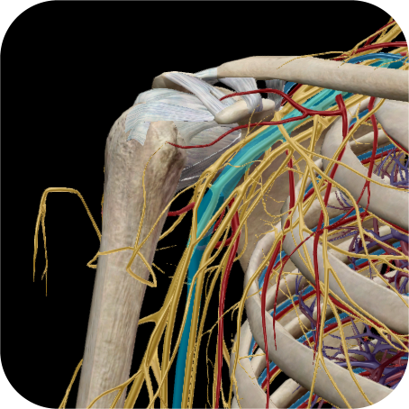
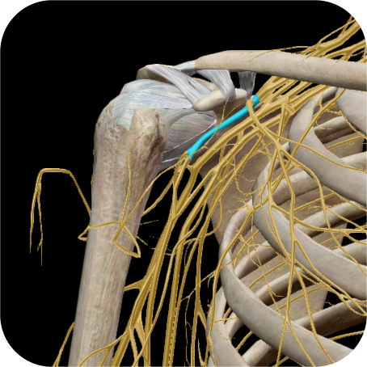


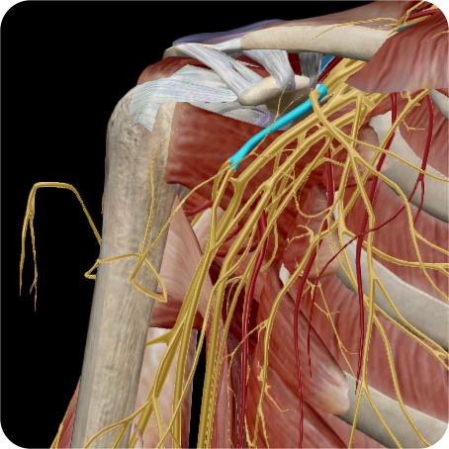
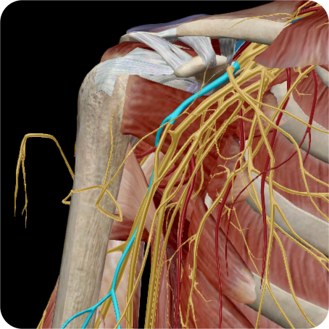




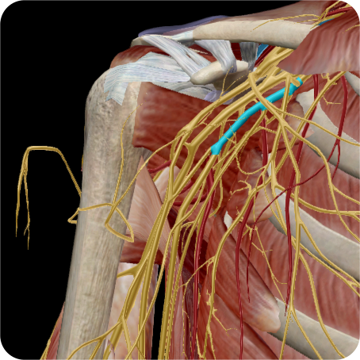






Anatomy
Muscles/ Tendons
Nerves
Vessels
Ligaments
Bones

Slide 5
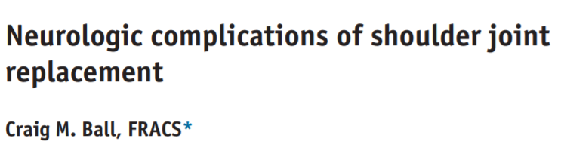
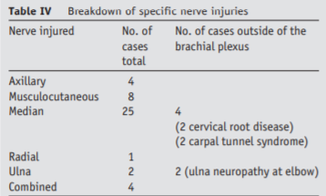
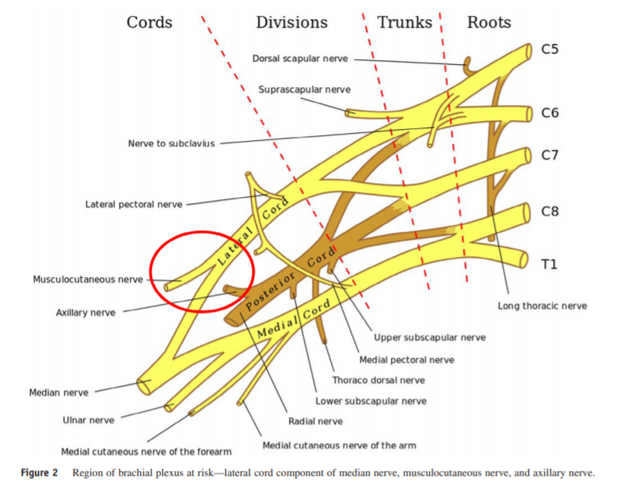
Most common
  Musculocutaneous
  Median
    (lateral cord)
Neuropraxia (most)
  Resolve 3 – 6 months
J Shoulder Elbow Surg (2017) 26, 2125–2132

Slide 6
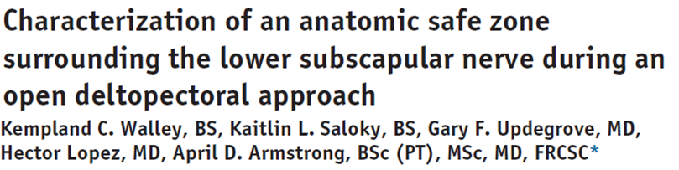
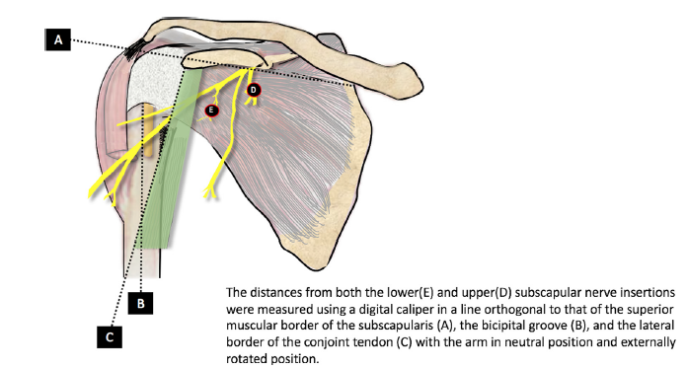
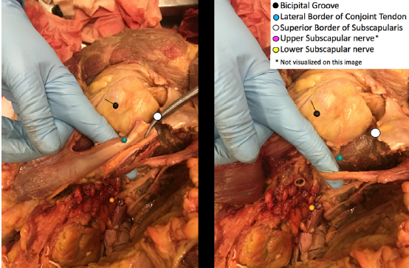
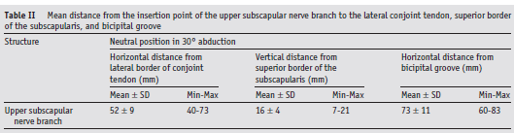
J Shoulder Elbow Surg . 2019 Apr;28(4):671-677

Slide 7
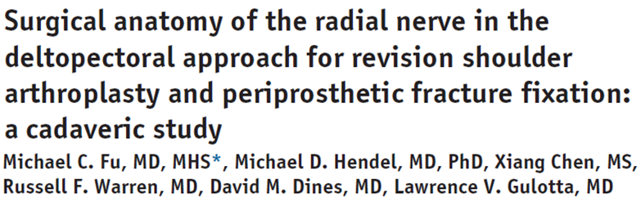

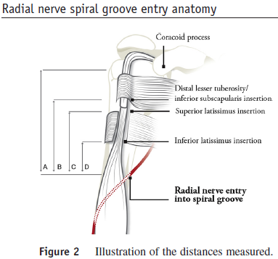
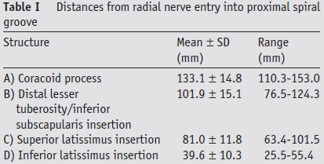
Min 2.5cm
J Shoulder Elbow Surg . 2017 Dec;26(12):2173-2176

Slide 8
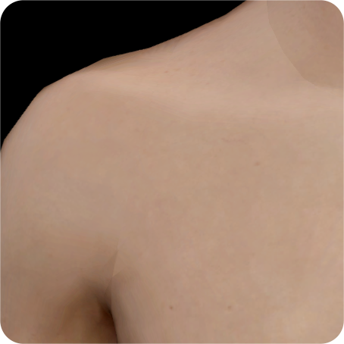
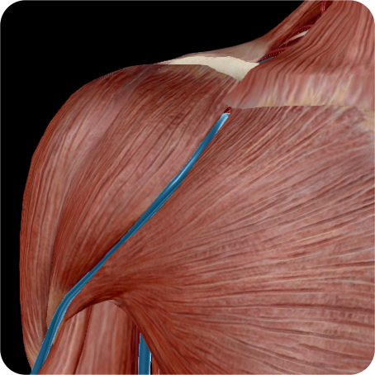
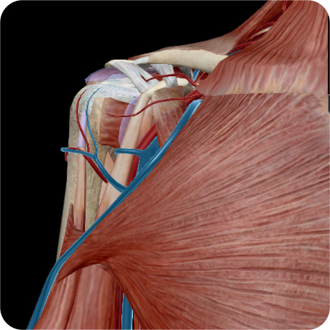
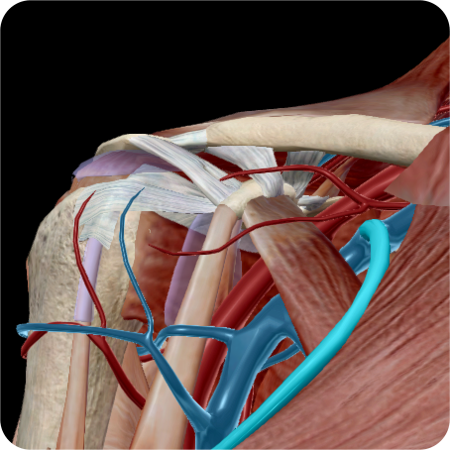
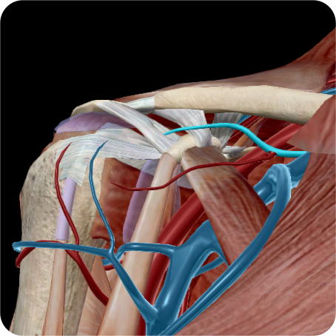
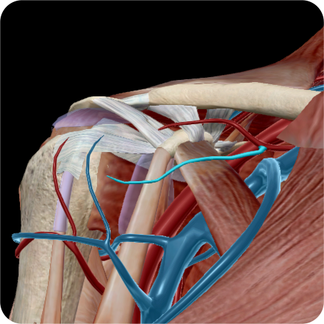

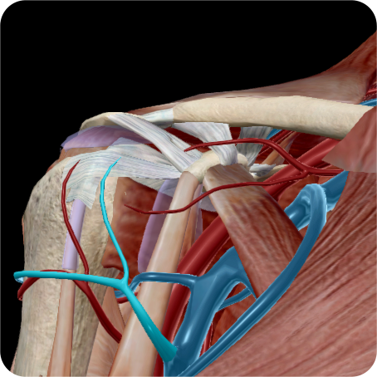

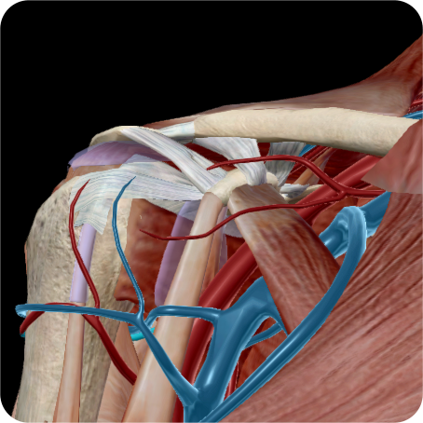
Anatomy
Muscles/ Tendons
Nerves
Vessels
Ligaments
Bones

Slide 9
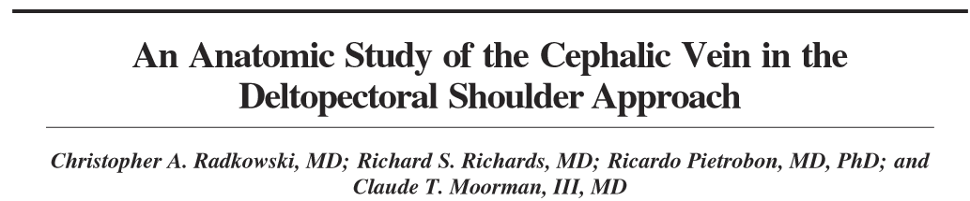
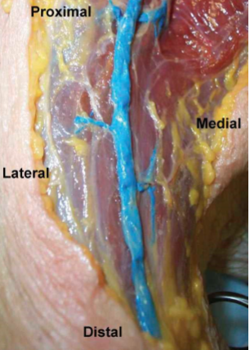
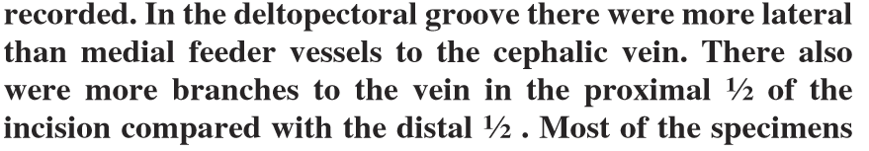
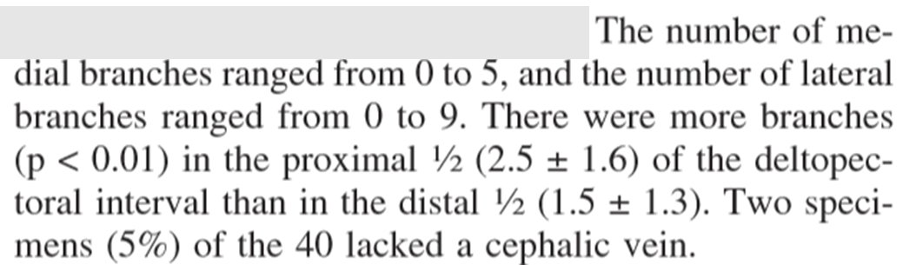
Clin Orthop Relat Res , 2006 Jan;442:139-42

Slide 10
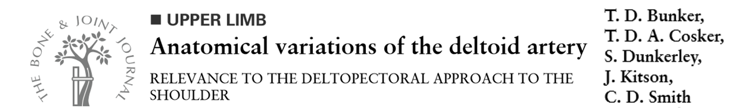
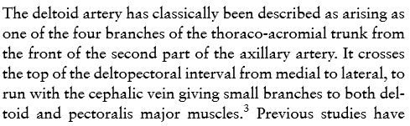
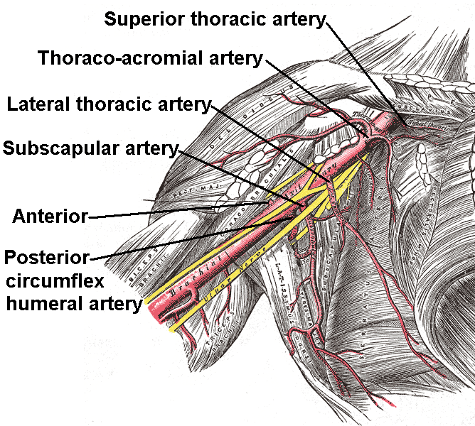
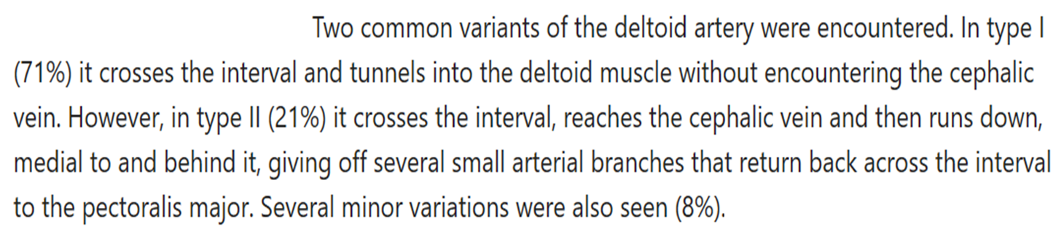
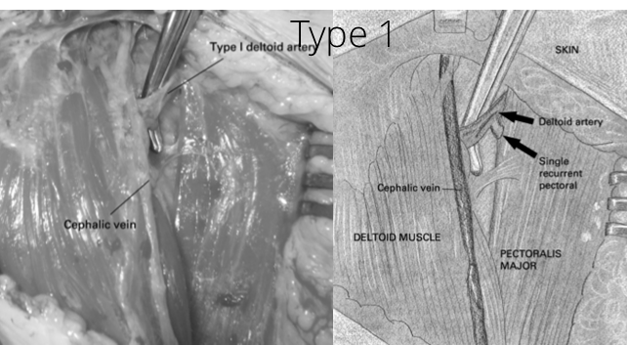
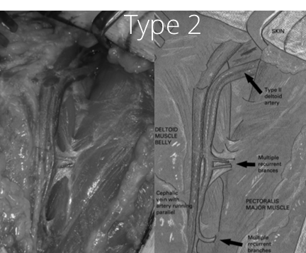
Bone Joint J 2013 May;95-B(5):657-9

Slide 11

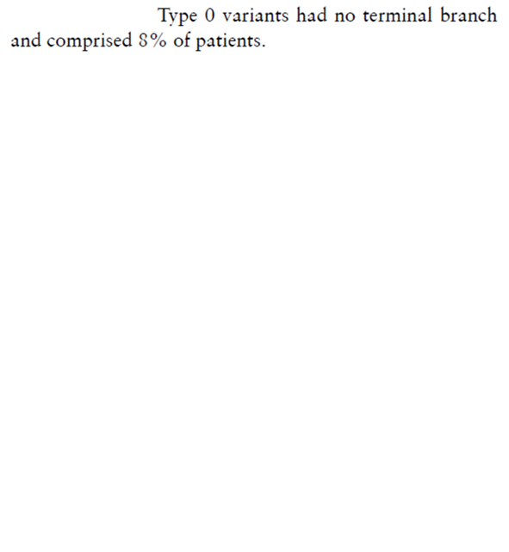
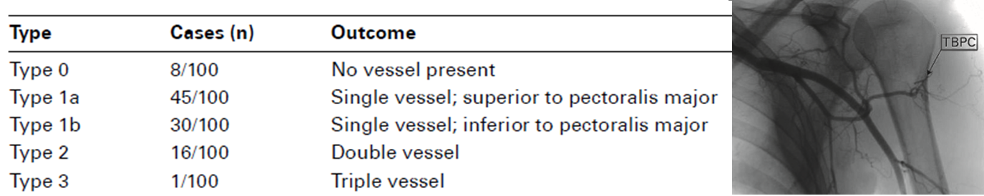
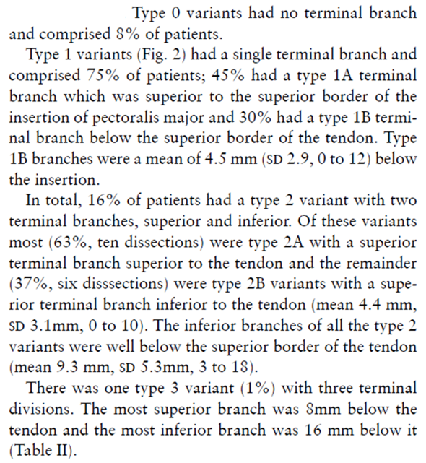

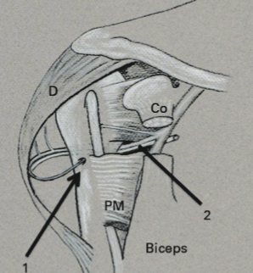
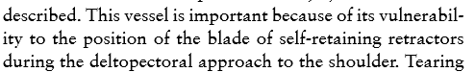

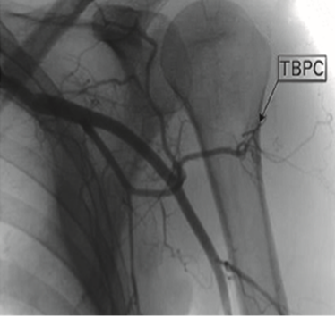
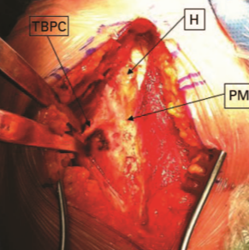

Bone Joint J 2016 Oct;98-B(10):1395-1398
Notes:
Potential source of bleeding when put in retractor

Slide 12
















Anatomy
Muscles/ Tendons
Nerves
Vessels
Ligaments
Bones

Slide 13



Anatomy
Muscles/ Tendons
Nerves
Vessels
Ligaments
Bones

Slide 14

Positioning

Slide 15







Intraoperative imaging

Slide 16




Skin Incision
Humeral shaft
  Fracture
  Arthroplasty

Slide 17
Skin Incision
Glenohumeral
  Instability

Slide 18



Volume rendered CT

Slide 19


Superficial dissection
Cephalic vein
  Absent 5%
  Branches
    Traditional lateral
    Personal Medial

Slide 20



Internervous plane
Deltoid
  Axillary n
Pectoralis major
  Medial and lateral pectoral n’s
Biceps
  Musculocutaneous nerve

Slide 21










Deep dissection
Lateral conjoint tendon
  Clavipectoral fascia
    Coracohumeral ligament
  Subacromial &subdeltoid bursa
  Subcoracoid Bursa
    Lower subscapular n
    Axillary n
  Tendon pectoralis major
  Vessels
    Three sisters
    Thoracoacromial
    Terminal PCHA

Slide 22





Deep dissection
Rotator interval
  Between
    Supraspinatus
    Subscalpularis
Release
  Coracoacromial ligament
Follow
  Upper border subscapularis
  Into biceps tendon sheath
Exposing
  Biceps
    Tenotomy/ tenodesis

Slide 23
Deep dissection
Subscapularis
  Tenotomy
  Peel
  Lesser Tuberosity osteotomy

Slide 24




J Orthop Surg Res 2019 Nov 28;14(1):391

Slide 25
J Shoulder Elbow Surg. 2019 Mar;28(3):407-414

Slide 26









Extension
Deltopectoral
Anterolateral humerus
  Cephalic vein
    Medial
Interval
  Biceps
  Brachialis
  Musculocutaneous n
Split
  Brachialis
  Beware Radial n

Slide 27








Summary

